Slide 1
Toward a Career in CS Research
University of Toronto
Department of Computer Science
Syed Ishtiaque Ahmed

Slide 2
Preparation for a research career
Starts with graduate school!
Check out the grad admission website (https://web.cs.toronto.edu/graduate/prospective)
Prepare your documents
Completion of an appropriate undergraduate degree in computer science or a related discipline, such as engineering, mathematics, or statistics.
If you’re in the audience, you’re probably doing this!
English-language proficiency according to University requirements.
If you’ve done your undergraduate degree at a Canadian university, you’re covered!
A standing that is equivalent to at least B+ (U of T 77-79% or 3.3/4.0) in the final year of study.
The only “official” requirement!

Slide 3
I’m graduating soon, what should I do?
First things first, make sure you meet the official requirements of your target department.
Find out your passion!
Did you enjoy the stats class more than others?
Did HCI classes excite you the most?
…
Pick one (or two) of your major interests, and GOOGLE!
Search for the profs in your target department that work on your subjects of interest.
Shoot them an email (profs love to receive emails from interested people in their field)
Tell them you’re passionate about their subject
Tell them you want to learn more and potentially collaborate with them or their graduate students on a project
Wait for the magic to happen!

Slide 4
I’m graduating soon, what should I do?
Having research experience is a big bonus in graduate applications!
Try reaching out to the professors of the courses that you enjoy the most, if they are in the research stream, ask them about the ways you can engage more in these topics.
PEYs are great!
You can get good reference letters from your supervisors.
You can make great connections.
You’ll gain new perspectives on your goals and passions!
Having good connections with your undergraduate professors is an asset.
They are the ones who end up writing good recommendation letters for you!

Slide 5
The Graduate School Application Process
Example: UofT CompSci MSc Program
Check out the application website ahead of time!
https://web.cs.toronto.edu/graduate/how-to-apply
Required documents:
At least 2 reference letters
(potentially coming from your undergraduate professors!)
Statement of Purpose
(a 2-page personal essay on your research and career goals, your qualifications, and why you want to get into this specific program)
Resume/CV
Official Academic Transcripts
Choosing your research interest
https://web.cs.toronto.edu/graduate/research-interests

Slide 6
Academia or Industry?

Slide 7
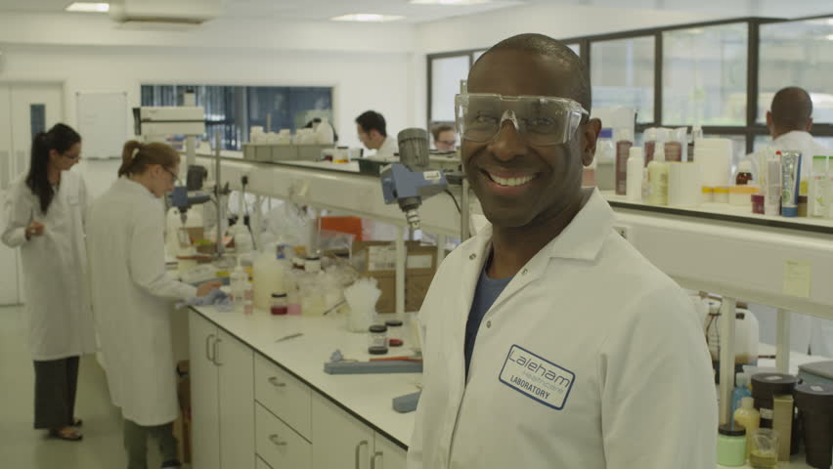
What to consider
Responsibilities
Flexibility
Collaboration
Workspace Culture
Individual Impact
Intellectual Freedom
Salary
Career Advancement

Slide 8
What to consider - Responsibilities
In an academic research career, most professionals have some version of the following broad responsibilities:
Applying for grants
Conducting self-directed research
Publishing papers
Teaching courses
Mentoring students
Performing departmental service
Working in industry can mean many things, as the term encompasses all research work that occurs outside of universities. The scope of work is typically focused on applied research that will have direct, clinical value. Industry work also requires a more business-minded approach. You must be able to develop projects that meet the company goals as you support the business plan of the company.

Slide 9
What to consider - Flexibility
For some, an appealing aspect of working in academia is the freedom to dictate your own schedule, choosing when to teach, conduct research, and publish your work. By not having to answer to anyone about how you allocate your time, however, also means you must be proficient in time management and prioritization.
Time in a business organization’s research lab is more structured and typically revolves around a standard 9-to-5 workday. For some people, this type of structure is preferable to ensure maximum productivity.

Slide 10
What to consider - Collaboration
Academic research is largely collaborative and teamwork oriented. An academic environment creates an extraordinary opportunity for cross-disciplinary thinking and research. You can, however, enjoy a large sense of autonomy, should you choose, with the freedom to choose when, and with whom, you collaborate.
In industry, researchers are working toward a larger, shared goal. Due to the complex nature of drug discovery, there is much collaboration across multiple functional areas and disciplines. Whereas researchers in academia can be highly competitive, in industry, it’s critical for researchers to be able to collaborate and work as a team.

Slide 11
What to consider - Workspace Culture
Academia is highly research and discovery focused, and much research is done for the sake of learning, as opposed to clinical application. In contrast, “industry” work allows researchers to feel a sense of immediate impact on patient lives.
Both workplaces have their own share of pressures and demands, as well. In academia, the researcher’s plight is often “obtain funding and publish, or perish.” Academics are under immense pressure to be self-starters, continually publish their research, and to promote and advocate for their work.
In industry, the pressures are typically more deadline-driven, as teams work to integrate science and business-focused problem solving on tight project timelines in accordance with larger product and business goals. Thus, it’s important for people working in industry to be excellent communicators and have sharp people skills to manage projects.

Slide 12
What to consider - Individual Impact
As an academic, you’ll typically not have quarterly deadlines to meet, monthly reports to file, or a superior that you’re being held directly accountable to. Thus, the ability to make an individual impact and receive recognition for your work can be greater than in industry, where you are a single member working on behalf of an organization.
The flip side, however, is that academics can struggle to have their ideas adopted in practice, whereas the work that that industry researchers do is often directly motivated by business goals. Although this does remove a measure of autonomy, the positive aspect is that research results are often immediately and directly impactful. To work in industry, one must be willing to work on a team and share credit. This teamwork aspect can also take off some of the pressure of having to individually achieve results.

Slide 13
What to consider - Intellectual Freedom
In academia, professionals enjoy intellectual freedom, free from the constraints of short-term deadlines and having to answer to those setting the research priorities. This allows individuals to choose what they would prefer to spend their time researching, and how to pursue it. With this freedom also comes the responsibility of securing funding and resources.
When working in industry, most work is done on a quick timeline and is driven by a product or business goals. This type of clear direction can be very appealing to some researchers, while others may see it as a hindrance to their ability to investigate their own areas of personal interest. A benefit of working in industry is that the funding and more state-of-the-art resources will be supplied by the larger organization.

Slide 14
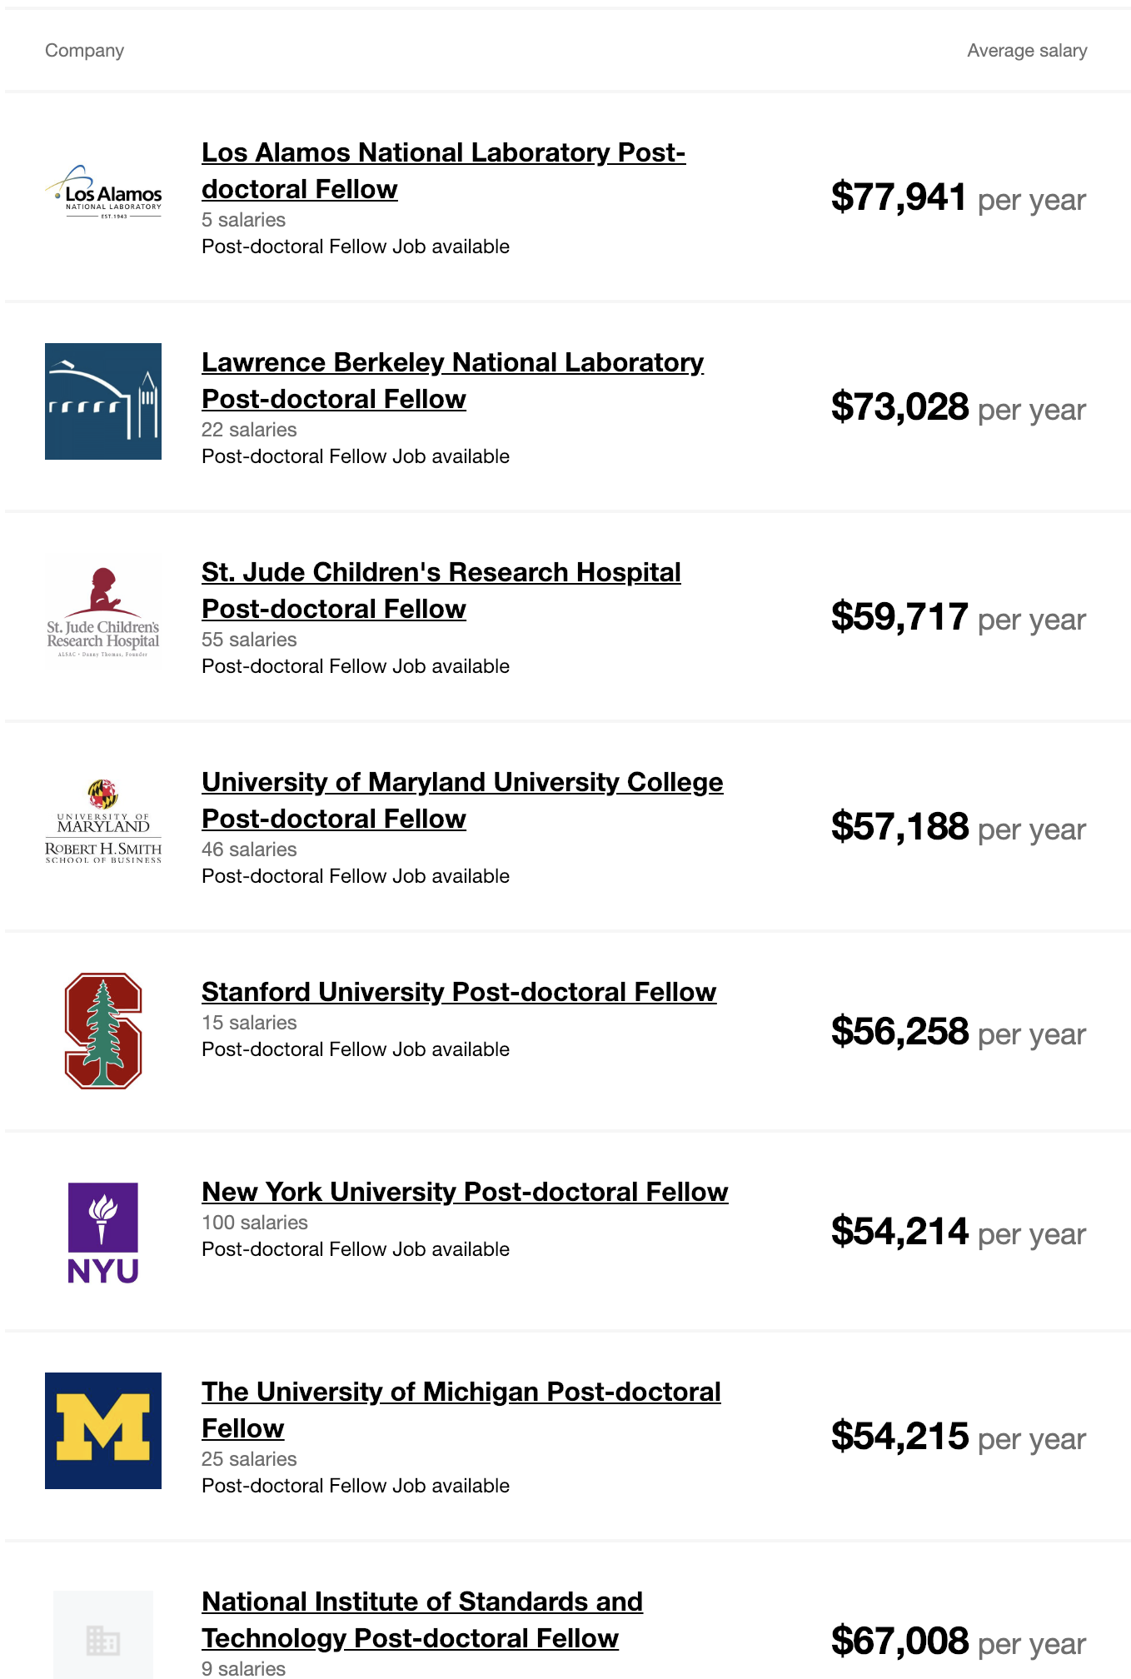
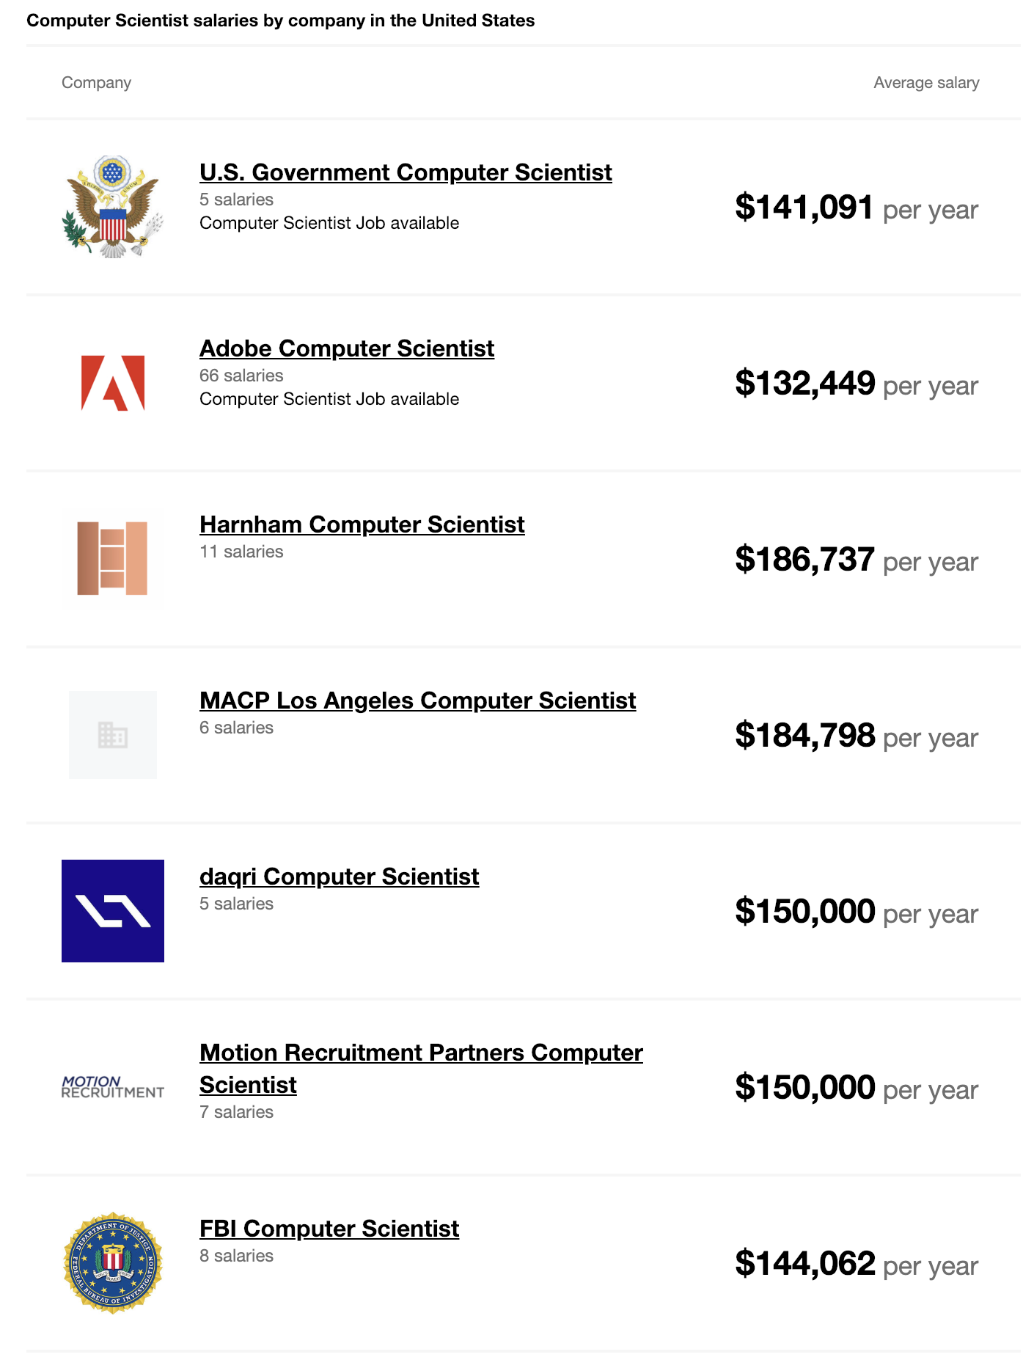
What to consider - Salary
On average, industry scientists typically make more money than academic researchers.
A 2014 Life Sciences Salary Survey found that American, Canadian, and European scientists that worked in industry made about 30 percent more than those in academia. On average, academics, including postdocs, make $88,693 annually, while commercial scientists make $129,507.

Slide 15
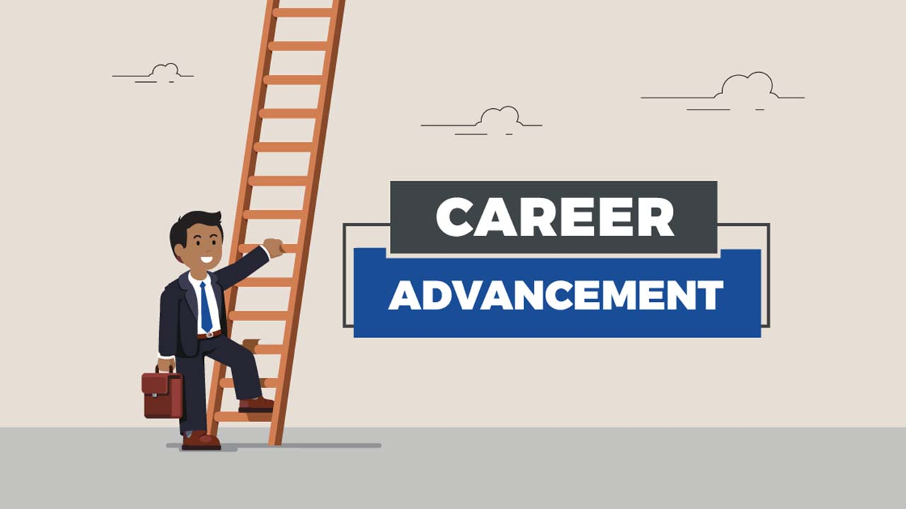
What to consider - Career Advancement
Generally speaking, an academic research scientist’s career moves one of two directions—toward tenure and professorship, or toward work as an academic staff scientist. The career ladder can be difficult if only a handful of universities that may specialize in your discipline, or are actively hiring in a given year. There is great job security, however, if you achieve tenure.
Industry career opportunities are broader, however, and can range from research at the bench to work in product marketing or development. In industry, you also have the opportunity to climb the organizational ladder to manage larger teams and projects.

Slide 16
Tips
Determine your priorities. Consider what matters most to you. Whether you’re most concerned about salary potential, intellectual freedom, or flexibility, it’s important to do some soul-searching to decide what you value most.
Think about how you want to spend your time. Consider how you actually want to spend your time day-to-day. Think about how you feel about teaching, publishing, managing, interacting, traveling, negotiating, collaborating, presenting, reporting, reviewing, fundraising, etc.
Know your strengths. Are you a self-starter who is able to proactively manage your own time? Or do you prefer to work in a more structured, process-oriented environment? Knowing your strengths can help direct you to the path that will increase your chances of success.

Slide 17
Tips
Factor in your personality. Do you prefer to work independently, or do you thrive when working alongside others? Are you comfortable with self-promotion, or would you be more comfortable sharing your successes with a team?
Think long-term, but keep your options open. Where do you see yourself in five years? 10? 20? Think about where you’d like to be long-term, but remember the choice you make is merely for the next step in your career. It doesn’t have to be final. The field is currently more conducive to transitions between the two fields more than ever before.
Be true to yourself. Most of all, be honest with yourself. Stay true to who you are, and consider what you are most passionate about. If you do this, you will find success in whichever path you choose

Slide 18
Thank you for your attention
Notes:
https://www.northeastern.edu/graduate/blog/working-in-industry-vs-academia/

