Slide 1
LoRANN: Low-Rank Matrix Factorization for Approximate Nearest Neighbor Search
Elias Jääsaari, Ville Hyvönen, Teemu Roos
NeurIPS 2024 (poster)
PREPARED BY Jiading Zhu
Notes:
Overall: remember to add bold and red coloring for texts
Overview:
Unlike the previous two papers that are trying to solve the load balancing problem of IVF, LoRANN tries to find a middle ground between IVF and something like PQ that is a lot more efficient but sacrifices recall
In LoRANN, not computing exact distances, but don’t want to do extreme quantization either.

Slide 2
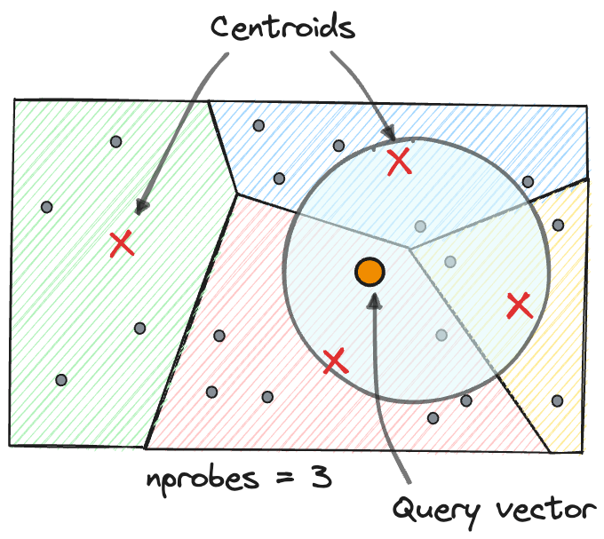
Clustering-based ann Search
Partitions the dataset into clusters before search
During search, find nearest clusters first, then nearest neighbours within clusters
Common method: k-means
Less distance computations between points
Gaps:
Slow clustering
Still requires exact distance computation within clusters
High storage
Notes:
Overview:
Instead of solving the load balance problem of IVF, finding middle ground between IVF and PQ
Not computing exact distances, but don’t want to do extreme quantization to sacrifice recall

Slide 3
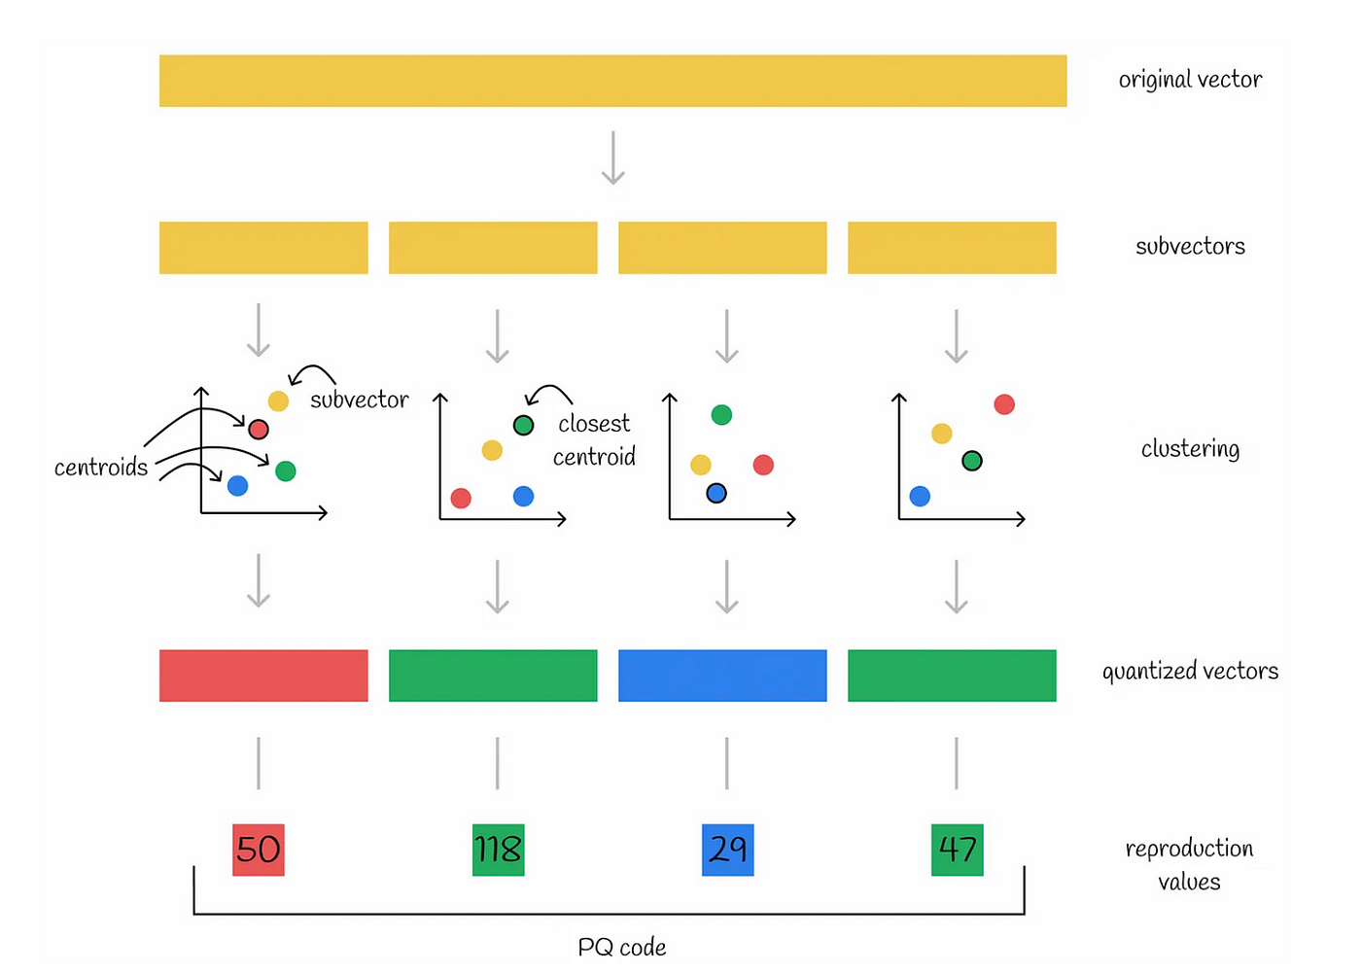
Product Quantization (PQ)
Splits high-dimensional vectors into lower-dimensional sub-vectors and cluster them separately
Use concatenated indices of clusters to represent vectors
Improvements:
Faster clustering
Faster distance computations
Much smaller storage
Gaps:
Low recall

Slide 4
Dissimilarity approximation as a multivariate regression problem
d
corpus point cⱼ
During in-cluster NN search:
Instead of computing exact distances (dissimilarity functions), we can approximate them
Formulate as a multivariate regression problem
Estimate y = xᵀ Cᵀ where
yⱼ = d(x, cⱼ)
(Dissimilarity between query x and corpus point cⱼ)
where d is the (negative) inner product
mₗ
The Cᵀ Matrix
Notes:
Inner product, euclidean distance and

Slide 5
low-rank matrix factorization
The OLS solution Cᵀ gives you the exact inner products
Problems:
Expansive computations
High memory cost
Solution: low-rank matrix factorization
β = A B
where:
A ∈ ℝ^(d×r)
B ∈ ℝ^(r×mₗ)
rank(β) ≤ r < min(d, mₗ)
d
r
r
A
mₗ
B
β = A B
Notes:
Need a visualization shows the shape of the matrices
Focus on how thin r is
Clarify key parameters

Slide 6
Reduced-rank regression (RRR)
The optimal low-rank solution is found by minimizing the training loss:
For a training set of queries, X.
This is the standard reduced-rank regression (RRR) problem
Final prediction:
ŷ = (xᵀ A) B
Solution:
Singular Value Decomposition (SVD) of the C matrix
+ A fast randomized algorithm (Halko et al., 2011)
Notes:
the Frobenius norm.
The training set is either a set of points that follows the distribution of queries, or just the corpus.
Look into the fast randomized algorithm, get a sense of it (might be EM or gradient descent)

Slide 7
8-bit quantization
Further improve query latency and memory consumption: quantization
Convert floating-point values (32-bit) to 8-bit integers: Absmax Quantization
xᵢ⁸ = ⌊(127 / ∥ xᶠ³² ∥∞) ⋅ xᶠ³² ⌉ = ⌊ cₓ xᶠ³² ⌉
Apply quantization to X, A and B
Rotate x before quantization with a random rotation matrix
Spreads the variance among the dimensions of x
Also rotate xᵀ A before re-quantization
Total memory consumption of RRR: of order Ldr + rm bytes
Notes:
Address that this is one of the most basic quantization methods you can do
Normalizing values using max of new space
Why do you need to quantize x?
For computation efficiency
The total memory consumption of RRR is of order Ldr + rm bytes

Slide 8
Dimensionality reduction
Computing ŷ = (xᵀ A) B in RRR is still costly when d is large
Solution: Project query x into a lower-dimensional space s < d
Instead of using query x, use:
x̃ = Wₛᵀ x
where:
Wₛ ∈ ℝ^(d×s)
whose columns are the first s eigenvectors of X_globalᵀ X_global
where X_global ∈ ℝ^(n×d) contains all training points
Notes:
Say that this is basically PCA
Figure out the order of how things are applied (DR -> Q -> RRR)

Slide 9
Quantization Implementation
After reducing x̃ to s-dimensions, apply 8-bit integer quantization
Mixed-Precision Quantization:
Quantize all but the first component of x̃ and first row of A and B
Ensures less precision loss in principal components
Apply random rotation before quantization
x' = R x̃
Uses AVX-512 VNNI instruction set for fast execution
Notes:
- First component not quantized -> good trick
Verify: is only first row of A and B quantized
Why?
Verify: when is rotation applied?

Slide 10
GPU implementation
Batch Processing with Tensor Operations
Represent query Q ∈ ℝ^(|Q|×d) as a |Q| × 1 × 1 × d tensor
Matrices A and B are stored as batched tensors
Balanced k-means for Load Balancing
Ensures clusters have nearly equal points → avoids inefficient memory usage
Mixed Precision: 16-bit Floating Point for GPU Computation
8-bit integer multiplication is inefficient on GPUs
Uses 16-bit floating point instead for better performance
Notes:
Clarify details

Slide 11
Lorann Pipeline
Dimensionality reduction
Quantization
Reduced-rank regression

Slide 12
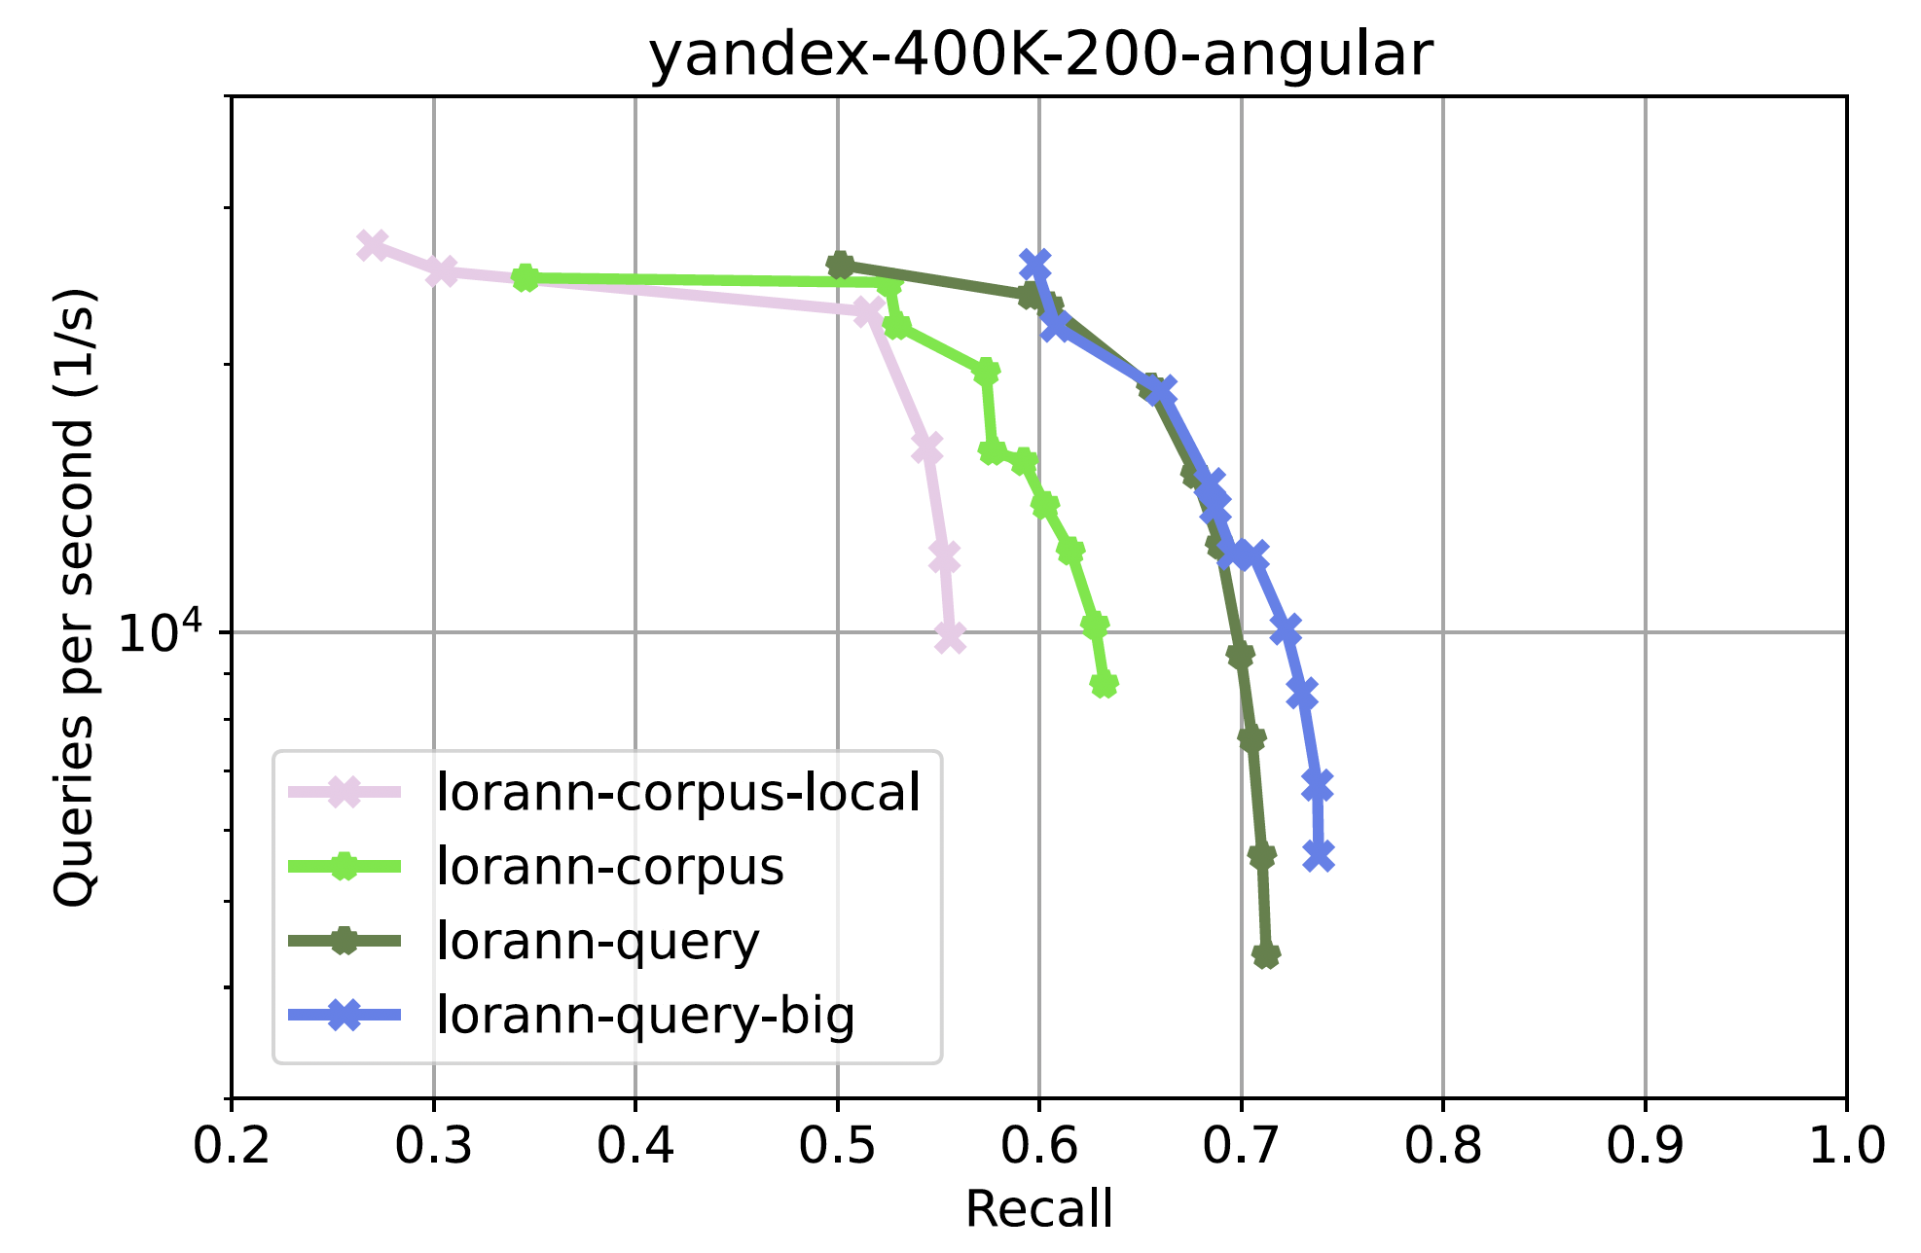
Experiments: Out-of-distribution queries
Key takeaways:
Query-trained models perform better than corpus-trained models
Larger training sets improve performance
Using global training sets across clusters enhances model accuracy
Notes:
LoRANN-query is trained using a sample of 400K points from the query distribution as a training set
LoRANN-query-big uses a sample of 1.2M
points. LoRANN-corpus is trained using the corpus as a training set
LoRANN-corpus-local is trained using the corpus as a training set with only the cluster points as the local training sets of the reduced-rank regression models.
Without the final re-ranking step where they use d dimensional vector, requires everything to be stored in memory, and reduces difference

Slide 13
Experiments
Benchmarking with ANN-benchmarks project (Aumüller et al., 2020)
A set of new high-dimensional datasets in addition
Evaluating LoRANN’s performance using:
Recall (@ k = 100)
Queries per second (QPS)
No query distribution samples available
Only corpus-based training used
r = 32 for all experiments
Test set of separate 1000 queries

Slide 14
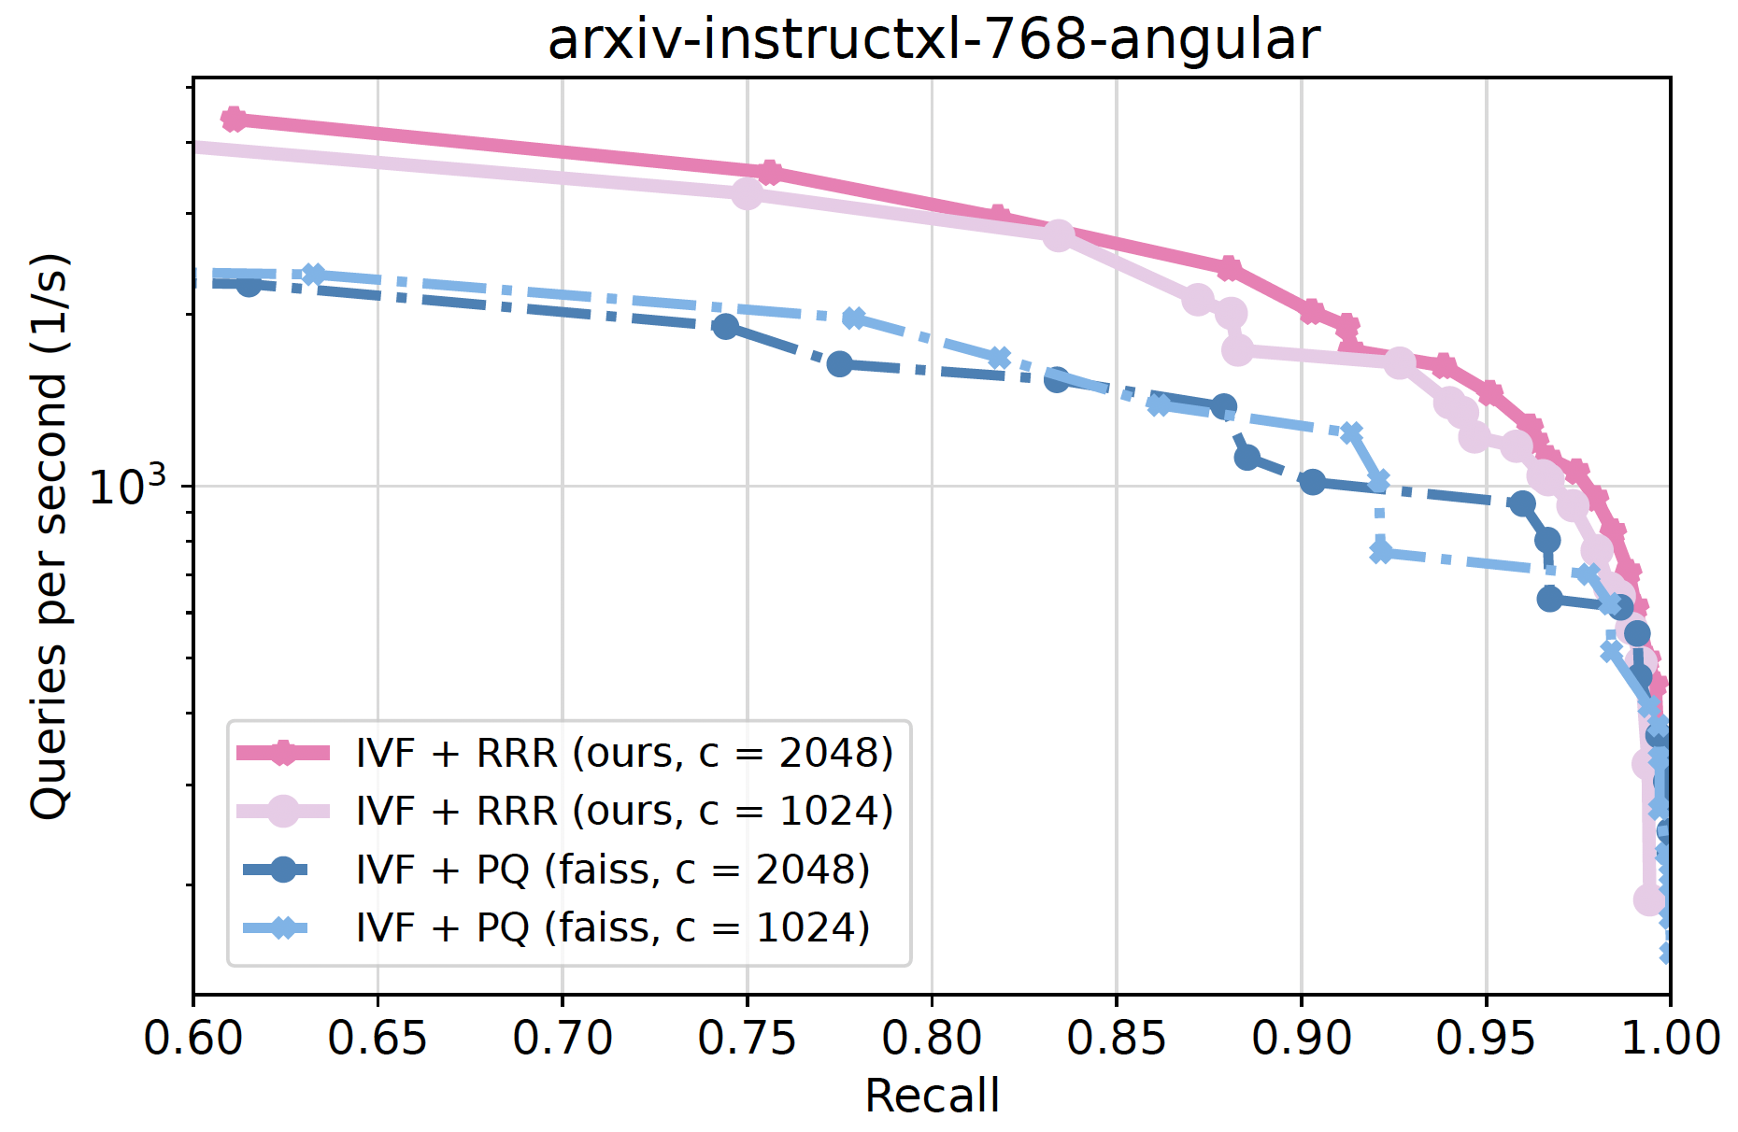
Fixed clustering
Notes:
the IVF index (the partition defined by k-means clustering) is the same for both methods
For RRR, we use r = 32, while for PQ each vector is encoded with d/2 subquantizers for optimal performance

Slide 15
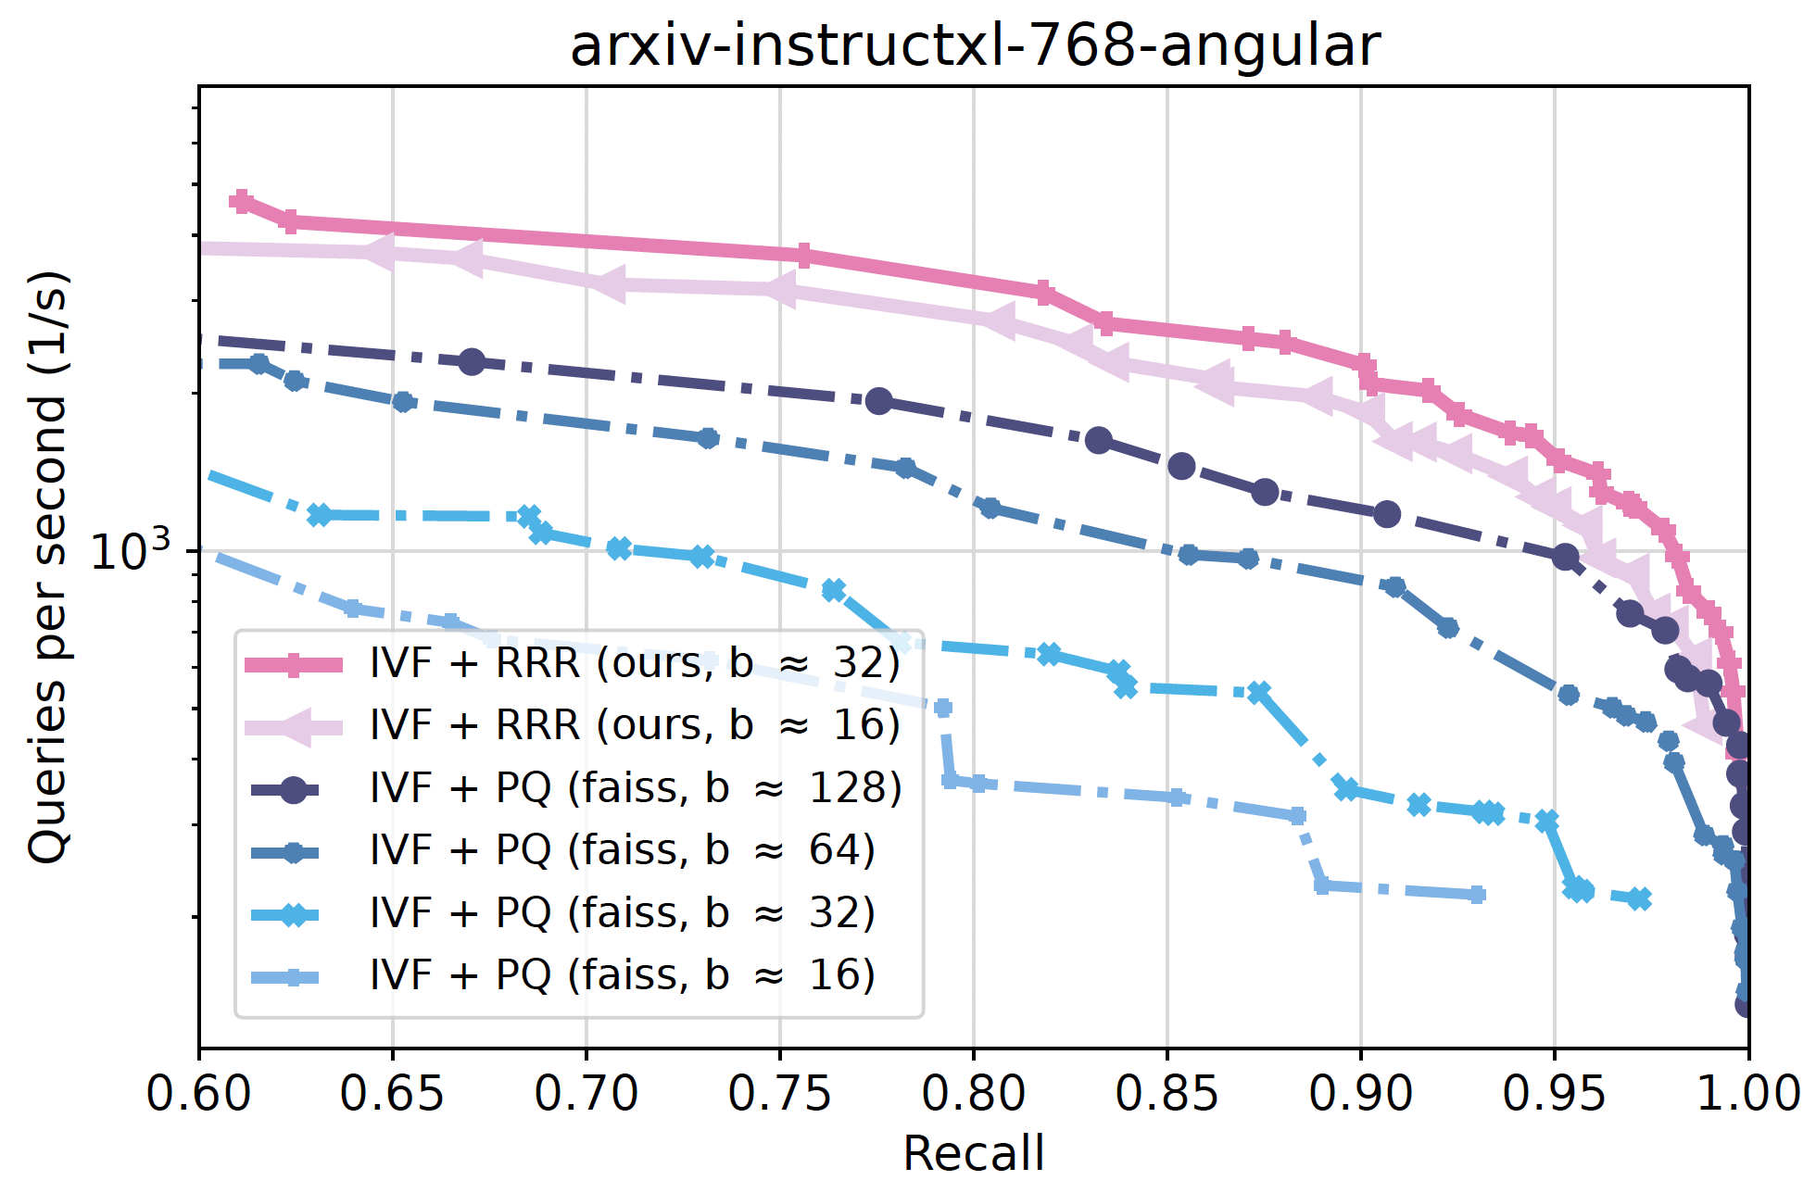
Memory usage
Notes:
Set the stage for this as it is a very important comparison
Different algorithms have different parameters: here fixed to have same bytes per vector in memory

Slide 16
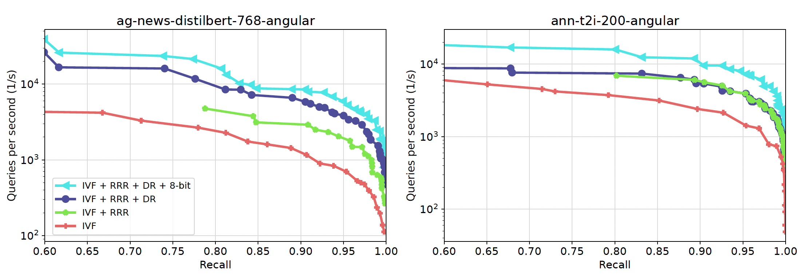
Ablation study
Notes:
- Right figure is a very minor point to make

Slide 17
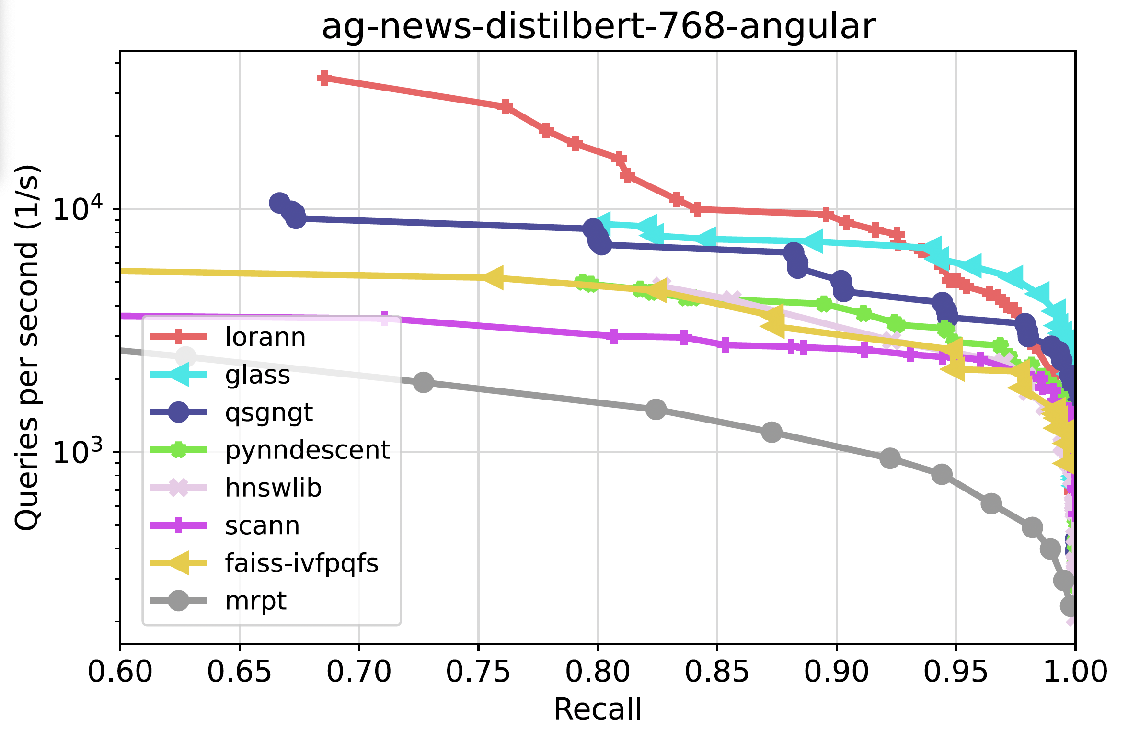
CPU Evaluation
Notes:
Faiss and hnswlib are the two most important ones
High recall: worse than graph-based methods
clustering-based: too many clusters have to be explored to reach the highest recall levels. This performance degradation at the highest recall levels applies also to other SOTA clustering-based methods such as SCANN and IVF-PQ

Slide 18
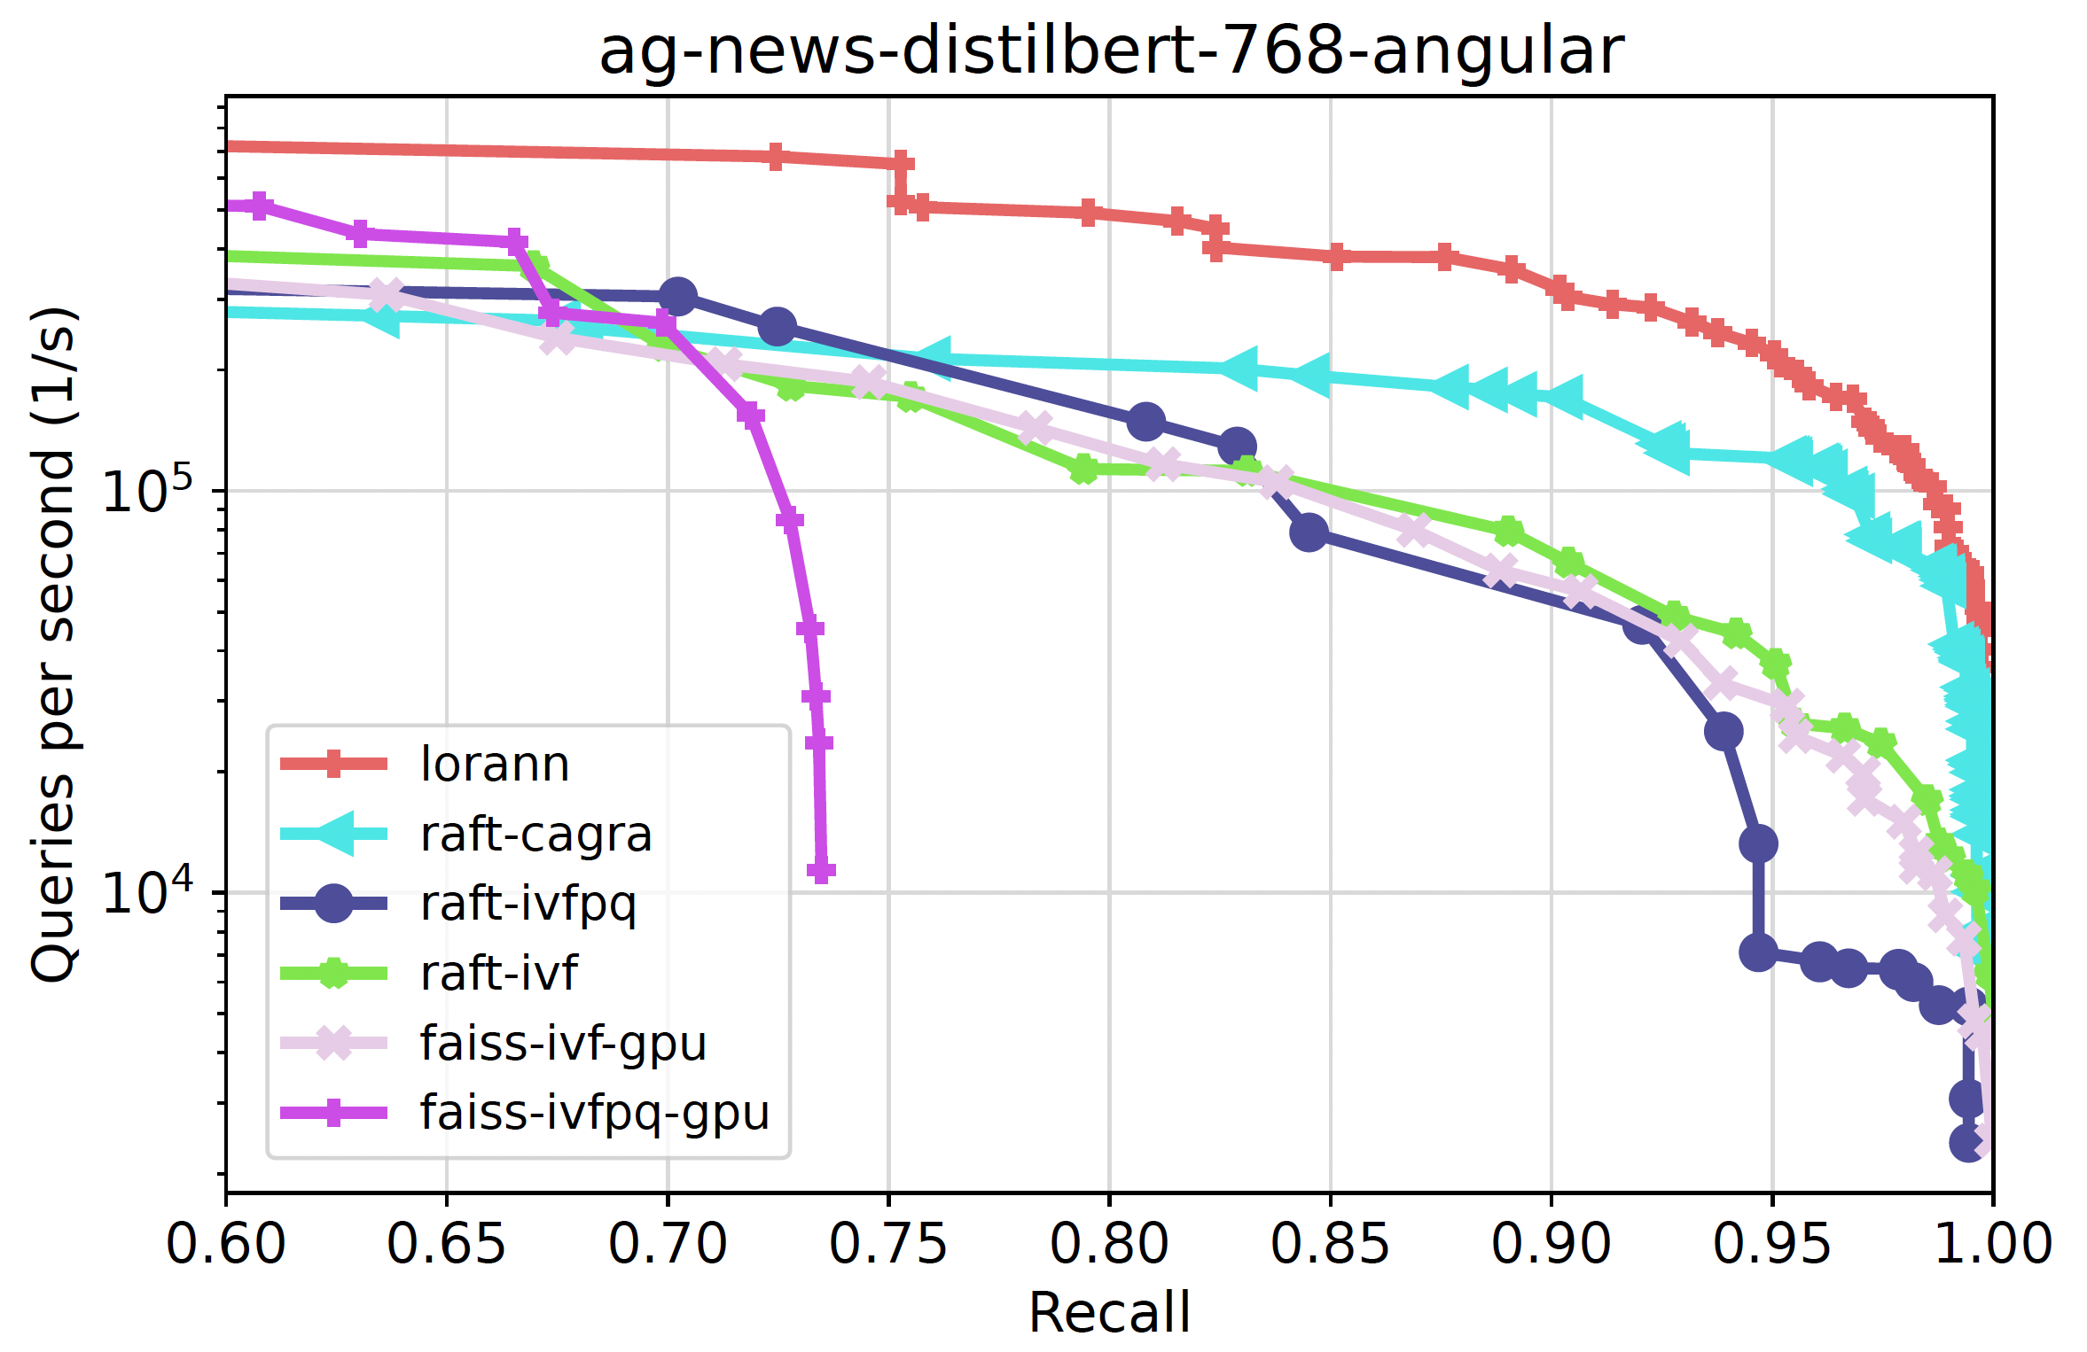
GPU Evaluation
Notes:
This is the slide to skip if there are no time

Slide 19
Discussions & limitations
Key Takeaways:
Reduced-Rank Regression (RRR) is a simple yet powerful alternative to Product Quantization (PQ)
RRR outperforms PQ in memory-limited settings while being easier to implement
LoRANN scales efficiently and can be adapted for large datasets beyond in-memory constraints
Limitations:
No comparison on training time
Not enough exploration on the selection of r (r=32 for all experiments)
Not ideal for low-dimensional data (d < 100) → Requires high r/d ratio for good accuracy
Notes:
Figure out one important thing: how long does the training process take, and how does that compare to PQ?
How does generalize over training data?

Slide 20
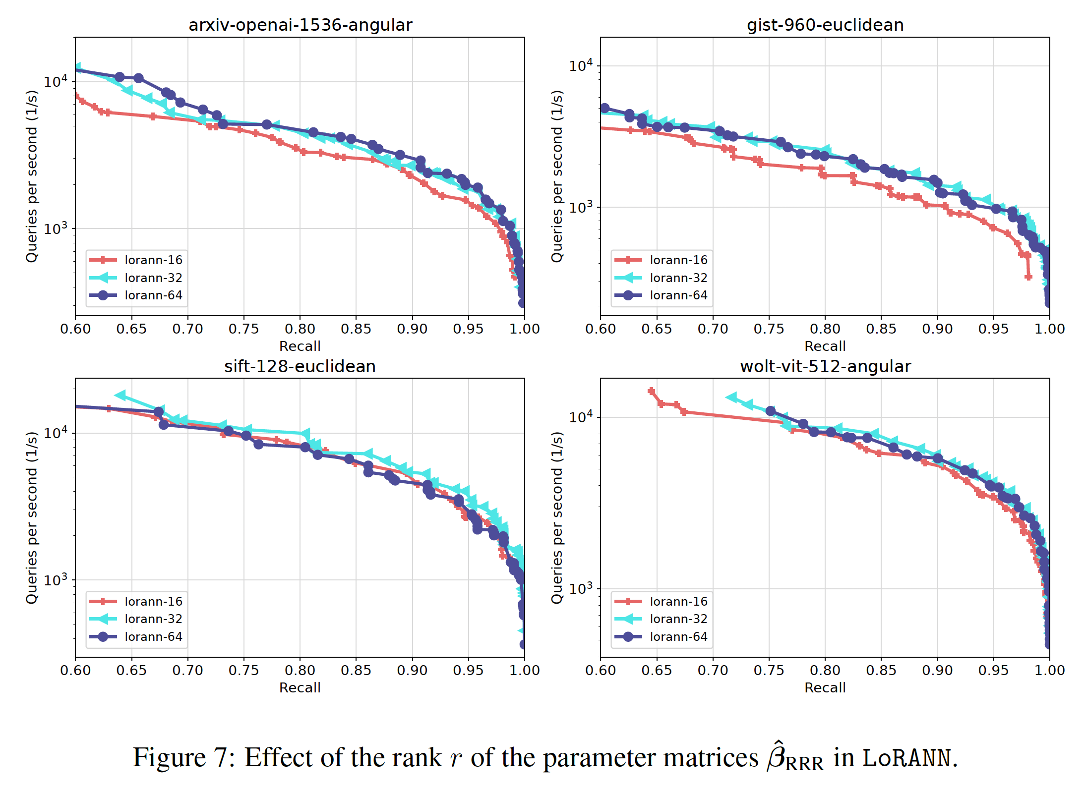
Criticisms
Effect of the rank r is underexplored
Could plot metrics over r by varying r a lot more

Slide 21
Thank you for listening!

