Slide 1
Hardware Architectures for Deep Learning
Andrew Ling, Ph.D. – Engineering Manager Machine Learning Acceleration
OpenCL and the OpenCL logo are trademarks of Apple Inc.

Slide 2
Disclaimer
Performance tests and ratings are measured using specific computer systems and/or components and reflect the approximate performance of Intel products as measured by those tests. Any difference in system hardware or software design or configuration may affect actual performance. Buyers should consult other sources of information to evaluate the performance of systems or components they are considering purchasing. For more information on performance tests and on the performance of Intel products, visit Intel Performance Benchmark Limitations.
Some Results have been simulated and are provided for informational purposes only. Results were derived using simulations run on an architecture simulator. Any difference in system hardware or software design or configuration may affect actual performance.
Intel does not control or audit the design or implementation of third party benchmarks or websites referenced in this document. Intel encourages all of its customers to visit the referenced websites or others where similar performance benchmarks are reported and confirm whether the referenced benchmarks are accurate and reflect performance of systems available for purchase.

Slide 3
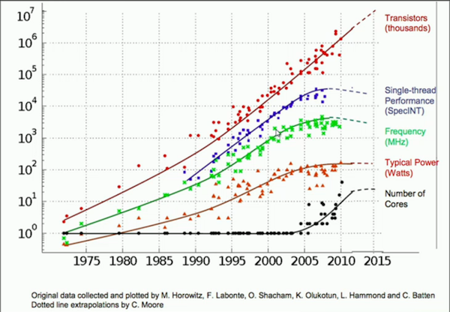
End of Scaling
Additional transistors used for additional computation in space
NVIDIA SC’13 Session

Slide 4
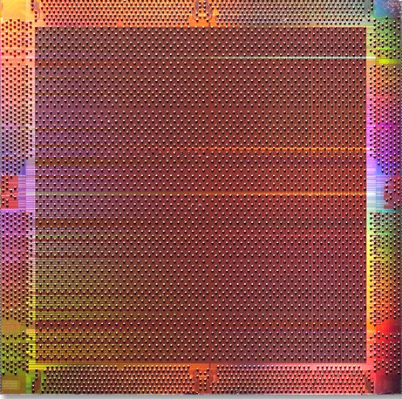
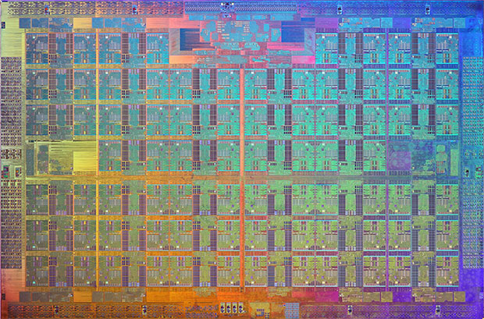
Taking Advantage of Parallelism
Towards more parallelism through spatial computing
Coarse Grain Parallelism
Fine Grain Parallelism
CPUs
Multi-Cores
FPGAs
Intel® Xeon® processor E7 v4 product family: up to 24 Cores
Intel® Xeon® Phi Processor Family: up to 72 Cores
Intel® Stratix 10: up to 280M equivalent logic elements
Notes:
I just highlighted three very distinct trends that effect implementation choice
Increasing development costs of custom & ASSP solution
Market dynamics of shorter time in market & shorter time to market
Product Fragmentation - geographic driven or product feature driven
The solution is programmable!
It is programmable technologies that offer the greatest flexibility in solving our development problems.
I’ve shown here the spectrum of programmable solutions, from fine grain solutions like memories to course grain solutions like DSP & microprocessors.
Although we traditionally think of these devices as being very different they all share the same programming method through a simple digital bit stream.
The biggest difference has been the way in which we design for these technologies Today

Slide 5
Temporal vs Spatial

Slide 6
A simple program
Instruction Level (IR)
OpenCL Code
add: R0 ← Load Mem[100]
R1 ← Load Mem[101]
R2 ← Load #42
R2 ← Mul R1, R2
R0 ← Add R2, R0
Store R0 → Mem[100]
kernel void
add( global int* Mem ) {
...
Mem[100] += 42*Mem[101];
}
How does a program execute on a CPU?

Slide 7
A simple 3-address CPU
LdAddr
LdData
StAddr
PC
Fetch
Load
Store
StData
Instruction
Op
Op
Registers
Aaddr
A
ALU
Val
A
C
Baddr
Caddr
B
CWriteEnable
CData
Op

Slide 8
Load memory value into register
LdAddr
LdData
StAddr
PC
Fetch
Load
Store
StData
Instruction
Op
Op
Registers
Aaddr
A
ALU
Val
A
C
Baddr
Caddr
B
CWriteEnable
CData
R0 ← Load Mem[100]
R1←Load Mem[101]
R2 ← Load #42
R2 ← Mul R1, R2
R0 ← Add R2, R0
Store R0 → Mem[100]
Op

Slide 9
Load immediate value into register
LdAddr
LdData
StAddr
PC
Fetch
Load
Store
StData
Instruction
Op
Op
Registers
Aaddr
A
ALU
Val
A
C
Baddr
Caddr
B
CWriteEnable
CData
R0 ← Load Mem[100]
R1 ← Load Mem[101]
R2 ← Load #42
R2 ← Mul R1, R2
R0 ← Add R2, R0
Store R0 → Mem[100]
Op

Slide 10
Multiply two registers, store result in register
LdAddr
LdData
StAddr
PC
Fetch
Load
Store
StData
Instruction
Op
Op
Registers
Aaddr
A
ALU
Val
A
C
Baddr
Caddr
B
CWriteEnable
CData
R0 ← Load Mem[100]
R1 ← Load Mem[101]
R2 ← Load #42
R2 ← Mul R1, R2
R0 ← Add R2, R0
Store R0 → Mem[100]
Op

Slide 11
Add two registers, store result in register
LdAddr
LdData
StAddr
PC
Fetch
Load
Store
StData
Instruction
Op
Op
Registers
Aaddr
A
ALU
Val
A
C
Baddr
Caddr
B
CWriteEnable
CData
R0 ← Load Mem[100]
R1 ← Load Mem[101]
R2 ← Load #42
R2 ← Mul R1, R2
R0 ← Add R2, R0
Store R0 → Mem[100]
Op

Slide 12
Store register value into memory
LdAddr
LdData
StAddr
PC
Fetch
Load
Store
StData
Instruction
Op
Op
Registers
Aaddr
A
ALU
Val
A
C
Baddr
Caddr
B
CWriteEnable
CData
R0 ← Load Mem[100]
R1 ← Load Mem[101]
R2 ← Load #42
R2 ← Mul R1, R2
R0 ← Add R2, R0
Store R0→Mem[100]
Op

Slide 13
CPU activity, step by step
R0 ← Load Mem[100]
A
Time
R1 ← Load Mem[101]
A
R2 ← Load #42
A
R2 ← Mul R1, R2
A
R0 ← Add R2, R0
A
Store R0 → Mem[100]
A

Slide 14
Fixed Architectures and Flat Memory Systems
Worked well if your clock speed / MIPS increased every 18 months
Extremely easy to program
Power becoming the main limit to performance now – this approach will not scale anymore!

Slide 15
Unroll the CPU hardware…
R0 ← Load Mem[100]
Space
A
R1 ← Load Mem[101]
A
R2 ← Load #42
A
R2 ← Mul R1, R2
A
R0 ← Add R2, R0
A
Store R0 → Mem[100]
A

Slide 16
… and specialize by position
R0 ← Load Mem[100]
A
Instructions are fixed. Remove “Fetch”
R1 ← Load Mem[101]
A
R2 ← Load #42
A
R2 ← Mul R1, R2
A
R0 ← Add R2, R0
A
Store R0 → Mem[100]
A

Slide 17
… and specialize
R0 ← Load Mem[100]
A
Instructions are fixed. Remove “Fetch”
Remove unused ALU ops
R1 ← Load Mem[101]
A
R2 ← Load #42
A
R2 ← Mul R1, R2
A
R0 ← Add R2, R0
A
Store R0 → Mem[100]
A

Slide 18
… and specialize
R0 ← Load Mem[100]
A
Instructions are fixed. Remove “Fetch”
Remove unused ALU ops
Remove unused Load / Store
R1 ← Load Mem[101]
A
R2 ← Load #42
A
R2 ← Mul R1, R2
A
R0 ← Add R2, R0
A
Store R0 → Mem[100]
A

Slide 19
… and specialize
R0 ← Load Mem[100]
Instructions are fixed. Remove “Fetch”
Remove unused ALU ops
Remove unused Load / Store
Wire up registers properly! And propagate state.
R1 ← Load Mem[101]
R2 ← Load #42
R2 ← Mul R1, R2
R0 ← Add R2, R0
Store R0 → Mem[100]

Slide 20
… and specialize
R0 ← Load Mem[100]
Instructions are fixed. Remove “Fetch”
Remove unused ALU ops
Remove unused Load / Store
Wire up registers properly! And propagate state.
Remove dead data.
R1 ← Load Mem[101]
R2 ← Load #42
R2 ← Mul R1, R2
R0 ← Add R2, R0
Store R0 → Mem[100]

Slide 21
… and specialize
R0 ← Load Mem[100]
Instructions are fixed. Remove “Fetch”
Remove unused ALU ops
Remove unused Load / Store
Wire up registers properly! And propagate state.
Remove dead data.
Reschedule!
R1 ← Load Mem[101]
R2 ← Load #42
R2 ← Mul R1, R2
R0 ← Add R2, R0
Store R0 → Mem[100]

Slide 22
Custom Datapath: Your Algorithm, in Space
load
load
42
store

Slide 23
Custom Datapath: Your Algorithm, in Space
Build exactly what you need:
Operations
Data widths
Memory size, configuration
Efficiency:
Throughput / Latency / Power

Slide 24
Rise of Deep learning

Slide 25
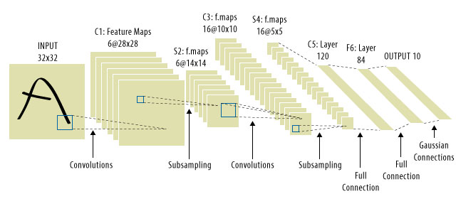
Rise of Convolutional Neural Nets
Convolutions validated as a practical means of tackling deep learning classification problems.
FPGAs are known to be efficient when performing convolutions.

Slide 26
CNN Computation in One Slide
$${\text{I}}_{\text{new}}\left[x\right]\left[y\right]=\sum_{x′=−1}^{1}{\sum_{y′=−1}^{1}{{\text{I}}_{\text{old}}}}\left[x+x′\right]\left[y+y′\right]×\text{F}\left[x′\right]\left[y′\right]$$
-1
-1
-1
-1
9
-1
-1
-1
-1
Input Feature Map
(Set of 2D Images)
Filter
(3D Space)
Output Feature Map
Repeat for Multiple Filters to Create Multiple “Layers” of Output Feature Map
-1
3
-1
1
-1
-1
-1
-1
3
-1
-2
-1
-1
5
-1
4
0
-1
7
-1
-1
-1
1
-1
-1
-1
-1

Slide 27
A Brief Introduction to FPGAs

Slide 28
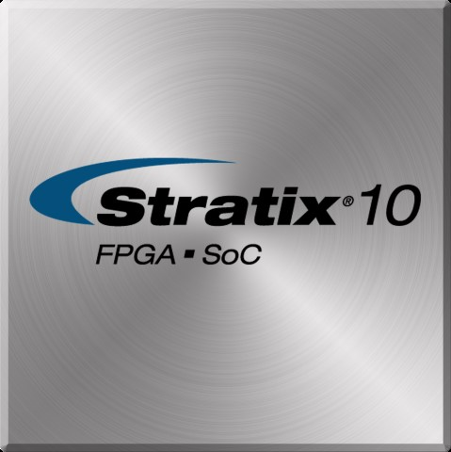
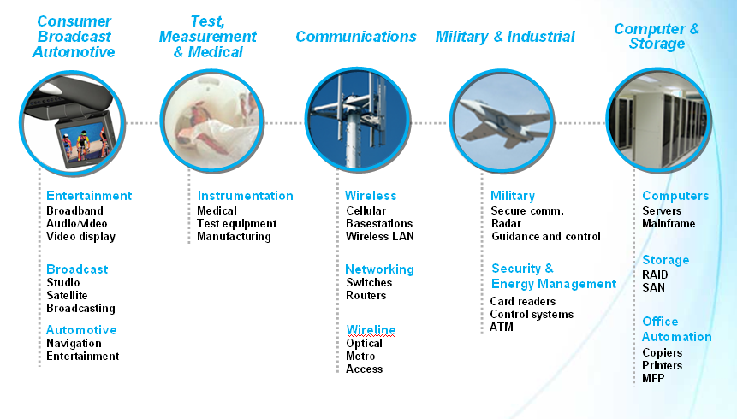
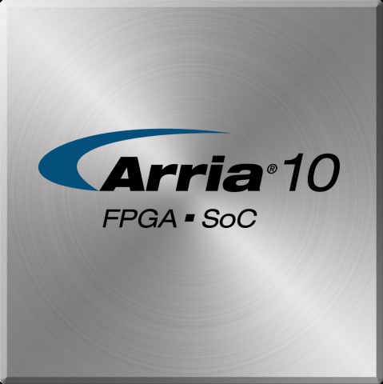
FPGAs and the Traditional FPGA Market
Notes:
Talk about tradeoffs:
Slower and larger than ASIC
Because of programmability
More expensive per unit at high volumes

Slide 29
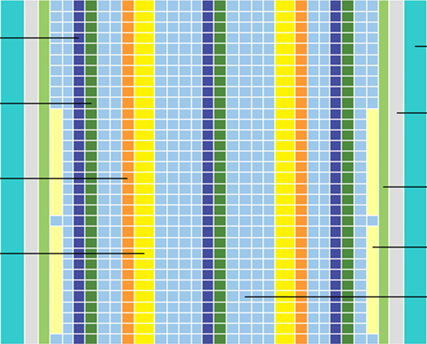
What’s in my FPGA?
Variable Precision DSP Blocks with Hardened Floating Point
Transceiver Channels
M20K Internal Memory Blocks
Hard IP Per Transceiver, 8b/10b PCS, 64b/66b PCS, 10GBase-KR FEC, Interlaken PCS
I/O PLLs
Fractional PLLs
Hard Memory Controllers, General Purpose IO Cells, LVDS
PCI Express Gen3 Hard IP
Core Logic Fabric

Slide 30
What’s in my FPGA?
DSPs
data_in
data_out
Logic Element
1-bit configurable
operation
1-bit register
(store result)
On-chip Memory
Block
addr
data_out
data_in
Logic Elements are surrounded with a flexible interconnect

Slide 31
A Case for FPGA Acceleration: Deep Learning

Slide 32
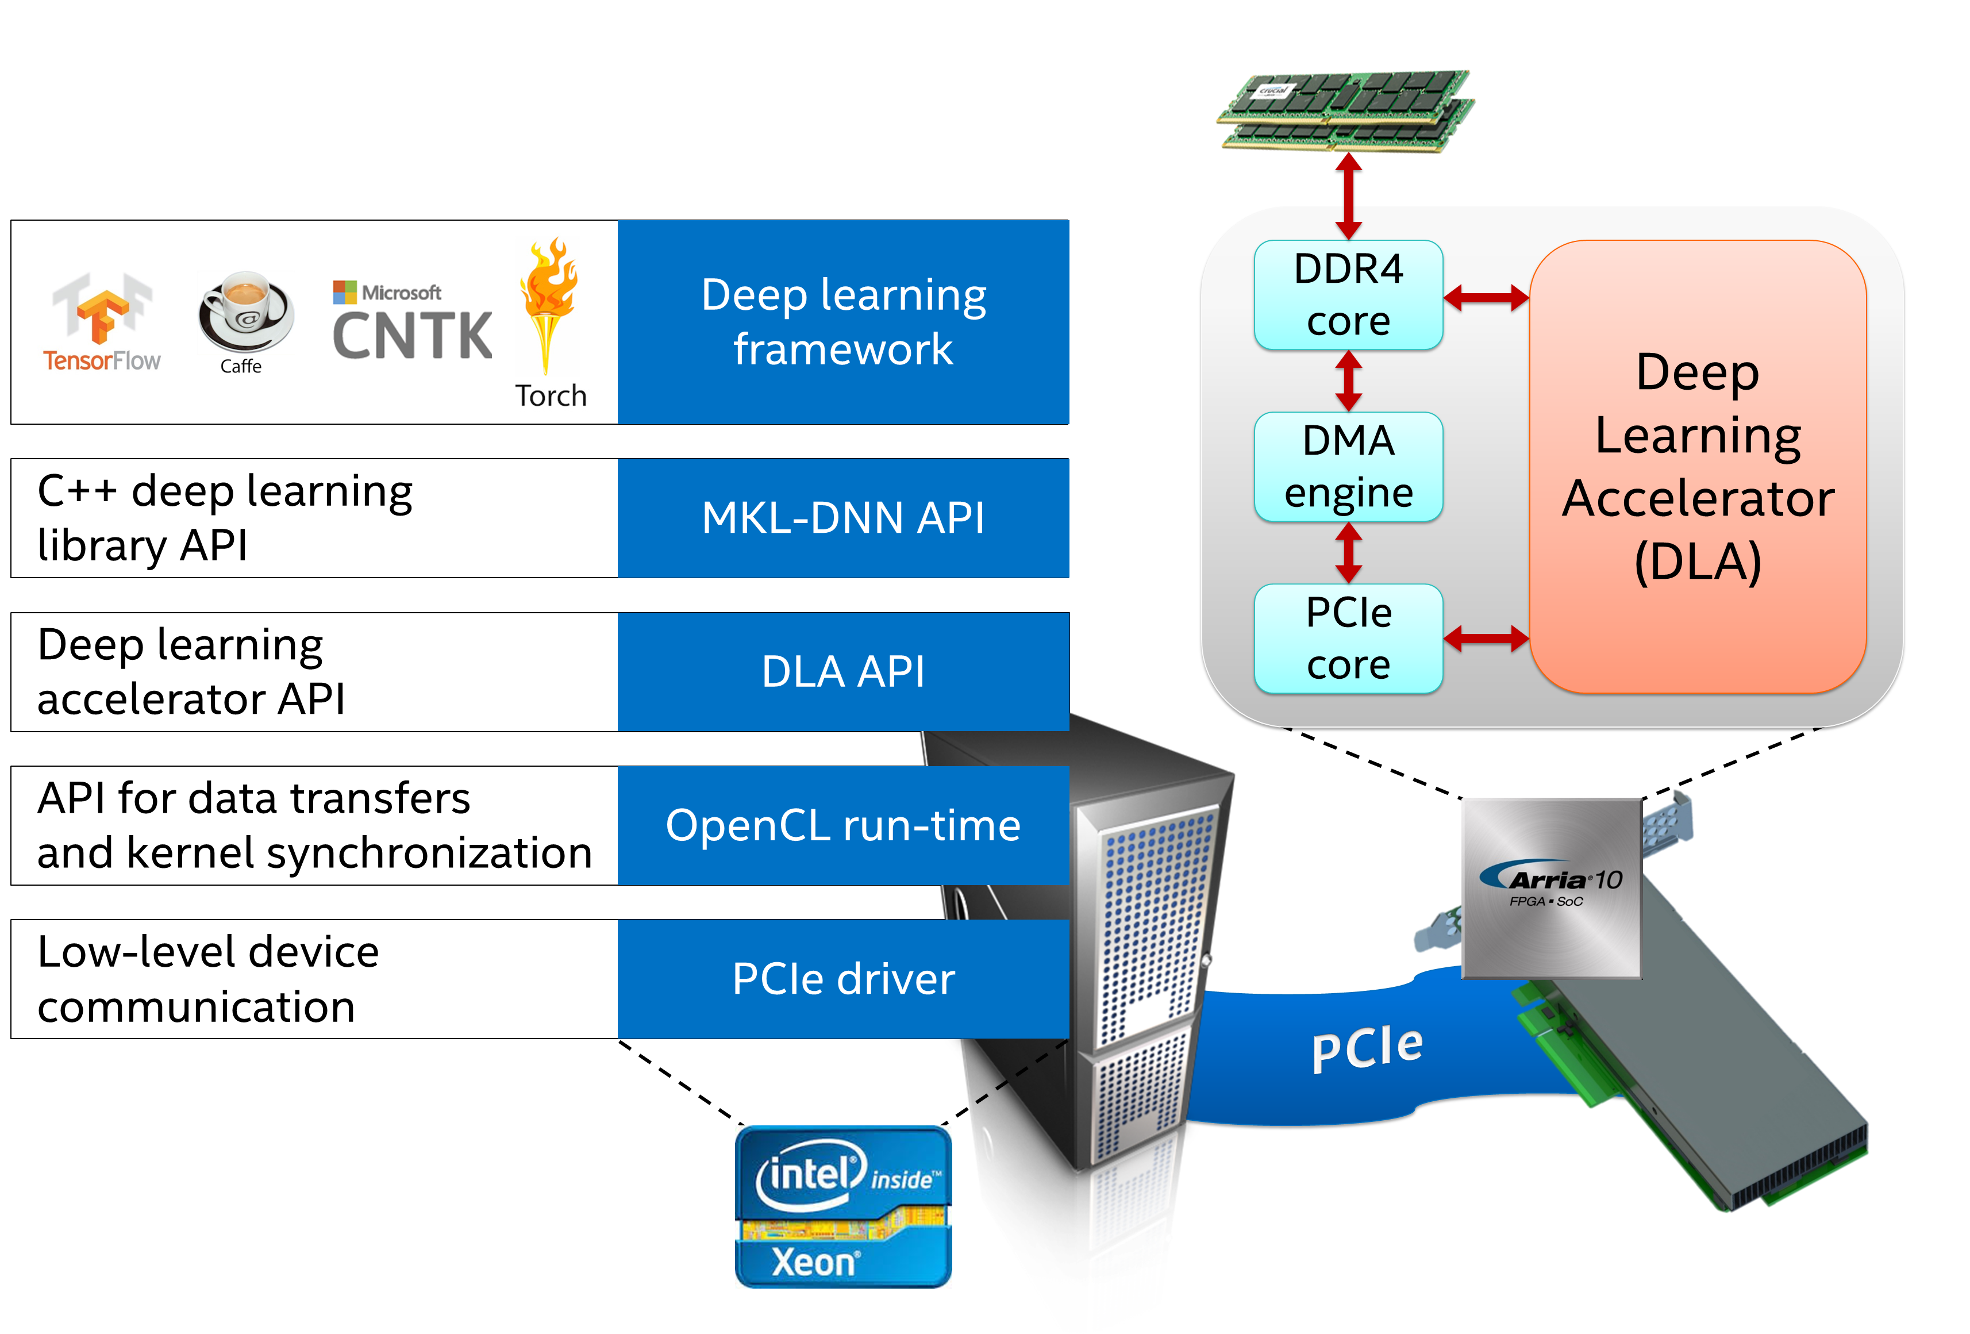
Bringing Intel’s Deep Learning Accelerator (DLA) for Inference to the Masses
Development of Efficient Spatial Architecture for Deep Learning
Leverage Flexibility of FPGA to generate energy efficient architectures
API calls to abstract FPGA use
SW callable accelerator
Support wide array of Deep Learning Frameworks
Model Optimizer & Inference Engine

Slide 33
One Architecture Any Device Any Market
DDR
FPGA
Leverages 3 insights from SGEMM:
Customized Spatial architecture that optimizes data accesses and creates efficient dataflow
Creates large double-buffer to store all feature maps on-die
Creates a systolic PE array to map nicely on 2D Spatial Logic Array on FPGA
Double-Buffer On-Chip RAM
1
2
3
Filters (on-chip RAM)
4
5
6
7
8
9
1
2
3
4
5
6
1
2
3
7
8
9
4
5
6
7
8
9
1
2
3
1
2
3
4
5
6
4
5
6
7
8
9
7
8
9

Slide 34
Keys to DLA efficiency: leveraging the flexibility of the FPGA
1. Flexible compute and memory architecture
Tune the geometry of the PE array, the width of the data path, etc.
Tune number of banks, port widths and the size of the memories
2. Flexible precision: FP32 → FP11 → FP8 → Ternary/Binary
Reduce precision as much as topology allows
3. Flexible platforms
DLA architecture can be implemented on different boards/platforms
4. Flexible graph structure
Map complex and large graphs to DLA → general-purpose DL solution

Slide 35
Keys to DLA efficiency: leveraging the flexibility of the FPGA
1. Flexible compute and memory architecture
Tune the geometry of the PE array, the width of the data path, etc.
Tune number of banks, port widths and the size of the memories
2. Flexible precision: FP32 → FP11 → FP8 → Ternary/Binary
Reduce precision as much as topology allows
3. Flexible platforms
DLA architecture can be implemented on different boards/platforms
4. Flexible graph structure
Map complex and large graphs to DLA → general-purpose DL solution

Slide 36
Flexible levels of parallelism
External DDR
Levels of parallelism:
Filter (output depth)
Input depth
Input width
Input height
Image (batching)
FPGA
Double-Buffer On-Chip RAM
1
2
3
Filters (on-chip RAM)
4
5
6
7
8
9
1
2
3
5
6
Input depth
parallelism
4
8
9
1
2
3
7
2
6
1
Filter parallelism
(output depth)
4
5
9
7
8
PE array geometry can be customized to hyperparameters of given DL topology
Achieve efficient execution of convolutions and inner products
1
2
3
1
2
3
4
5
6
4
5
6
7
8
9
7
8
9
Notes:
* Describe the hardware first

Slide 37
Flexible activation/weight buffering
External DDR
FPGA
Minimize on-chip/off-chip data move:
Stream buffer size
Filter cache size
Pre-fetch mechanisms
On-demand
Pre-load all / partial
Double-Buffer On-Chip RAM
1
2
3
Filters (on-chip RAM)
4
5
6
7
8
9
1
2
3
4
5
6
1
2
3
7
8
9
2
6
1
Filter cache size
4
5
9
Stream buffer size
7
8
Buffers and pre-fetch scheme can be customized to hyperparameters of given DL topology
Achieve efficient execution of convolutions and inner products
1
2
3
1
2
3
4
5
6
4
5
6
7
8
9
7
8
9
Notes:
* Describe the hardware first

Slide 38
Feature Cache (Stream Buffer) and Slicing
Un-Sliced Graph
Sliced Graph
73x73x128
DDR
73x73x128
Feature Cache
73x37x128
73x36x128
720 M20Ks
Feature Cache
Feature Cache
Convolution
Convolution Slice#1
Convolution Slice#2
73x73x32
73x37x32
73x36x32
Feature Cache
180 M20Ks
DDR
73x73x16
Feature Cache Required: 900 M20Ks
Feature Cache Required: 384 M20Ks

Slide 39
Feature Cache (Stream Buffer) and Slicing
Sweet spot varies based on graph dimensions
Small Feature Cache
Big Feature Cache
Performance
Bigger PE array,
but more slicing
Less slicing,
but smaller PE array
Performance Bottleneck = DDR
Performance Bottleneck = PE Compute
Feature Cache Size
PE Array Size

Slide 40
Feature Cache (Stream Buffer) and Slicing
Small Feature Cache
Big Feature Cache
Performance
Bigger PE array,
but more slicing
Less slicing,
but smaller PE array
Performance Bottleneck = DDR
Performance Bottleneck = PE Compute
Slicing and DDR optimizations can improve performance at smaller feature cache sizes, allowing for the PE array to be scaled up
Feature Cache Size
PE Array Size

Slide 41
Hardware / Software convergence

Slide 42
Redefining Software
F. Vahid. It's Time to Stop Calling Circuits "Hardware“, IEEE Computer Magazine, September 2007
“The advent of field-programmable gate arrays requires that we stop calling circuits “hardware” and, more generally, that we broaden our concept of what constitutes “software” ... Developing modern embedded software capable of executing on multiprocessor and FPGA platforms requires expertise not just in temporally oriented modeling (W comes after X) like writing sequential code but also in spatially oriented modeling (Y connects with Z) like creating circuits.”

