Slide 1
Memory Footprint Reduction Techniques for DNN Training: An Overview
Episode III. Weight Placement for EX-Large Models
Bojian Zheng
2022/2/18

Slide 2
Outline
EX-Large Models: Bring us better accuracy but also challenges.
Existing Solutions: Data and Model Parallelism
ZeRO-Infinity: Data-Parallelism-based Solution for EX-Large Training

Slide 3
Recall: A History of Prior Works
2015-2016 | 2016- | 2019-
Weight Pruning for Efficient Inference | Feature Maps Reduction for Efficient Training | Weight Placement for EX-Large Models
[1] T. Chen et al. DianNao: A Small-Footprint High-Throughput Accelerator for Ubiquitous Machine-Learning. ASPLOS 2014 [2] S. Han et al. EIE: Efficient Inference Engine on Compressed Deep Neural Network. ISCA 2015 [3] S. Han et al. Deep Compression: Compressing Deep Neural Networks with Pruning, Trained Quantization and Huffman Coding. ICLR 2015 [4] Y. Chen et al. Eyeriss: A Spatial Architecture for Energy-Efficient Dataflow for Convolutional Neural Networks. ISCA 2016 … | [5] T. Chen et al. Training Deep Nets with Sublinear Memory Cost. arXiv 2016 [6] M. Rhu et al. vDNN: Virtualized Deep Neural Networks for Scalable, Memory-Efficient Neural Network Design. MICRO 2016 [7] A. Jain et al. Gist: Efficient Data Encoding for Deep Neural Network Training. ISCA 2018 [8] B. Zheng et al. Echo: Compiler-based GPU Memory Footprint Reduction for LSTM RNN Training. ISCA 2020 … | [9] S. Rajbhandari et al. ZeRO-Infinity: Breaking the GPU Memory Wall for Extreme Scale Deep Learning. SC 2021 …
Topic for Today!

Slide 4
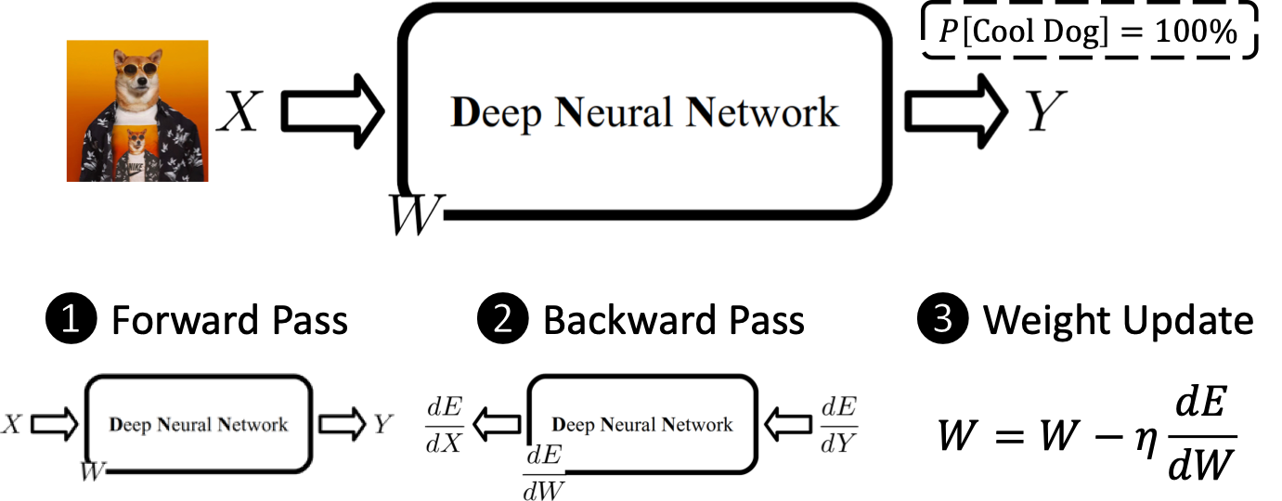

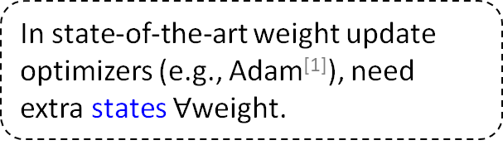
Recall: GPU Memory Allocations in DNN Training
Major GPU memory consumers: Model States & Feature Maps
  Model States: weights (①), gradients (②), optimizer states (③)
①
In state-of-the-art weight update optimizers (e.g., Adam^{[1]}), need extra states $∀$weight.
②
[1] D. Kingma, J. Ba. Adam: A Method for Stochastic Optimization. ICLR 2015

Slide 5

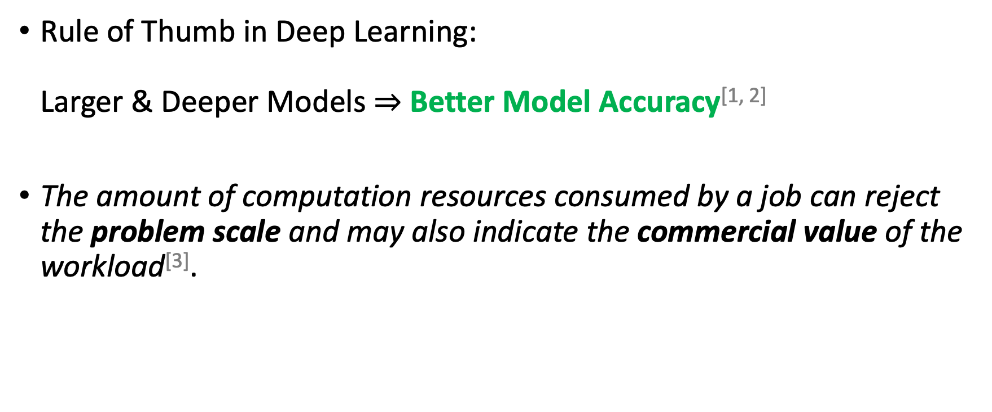
Why EX-Large Models?
Rule of Thumb in Deep Learning:
Larger & Deeper Models $⇒$ Better Model Accuracy^{[1, 2]}
The amount of computation resources consumed by a job can reject the problem scale and may also indicate the commercial value of the workload^{[3]}.
But at what cost?
[1] K. He et al. Deep Residual Learning for Image Recognition. CVPR 2016
[2] T. Brown et al. Language Models are Few-Shot Learners. NeurIPS 2020
[3] M. Wang et al. Characterizing Deep Learning Training Workloads on Alibaba-PAI. IISWC 2019

Slide 6

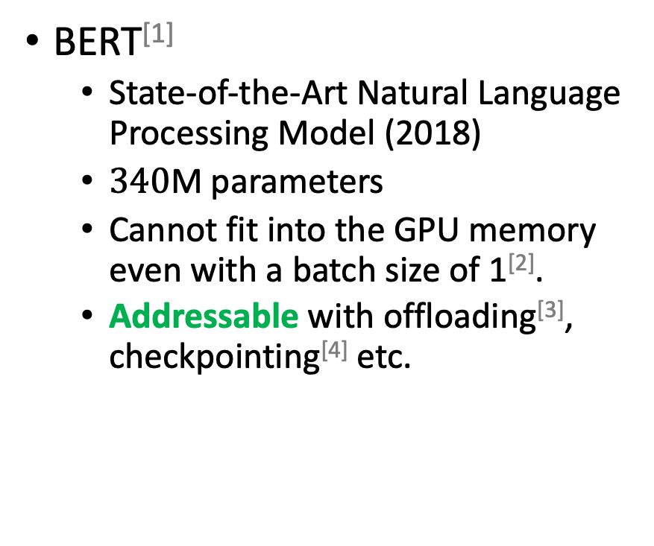
Challenges with Training EX-Large Models
BERT^{[1]}
  State-of-the-Art Natural Language Processing Model (2018)
  $340$M parameters
  Cannot fit into the GPU memory even with a batch size of 1^{[2]}.
  Addressable with offloading^{[3]}, checkpointing^{[4]} etc.
[1] J. Devlin et al. BERT: Pre-training of Deep Bidirectional Transformers for Language Understanding. NAACL 2019
[2] https://github.com/google-research/bert
[3] M. Rhu et al. vDNN: Virtualized Deep Neural Networks for Scalable, Memory-Efficient Neural Network Design. MICRO 2016
[4] T. Chen et al. Training Deep Nets with Sublinear Memory Cost. arXiv 2016

Slide 7

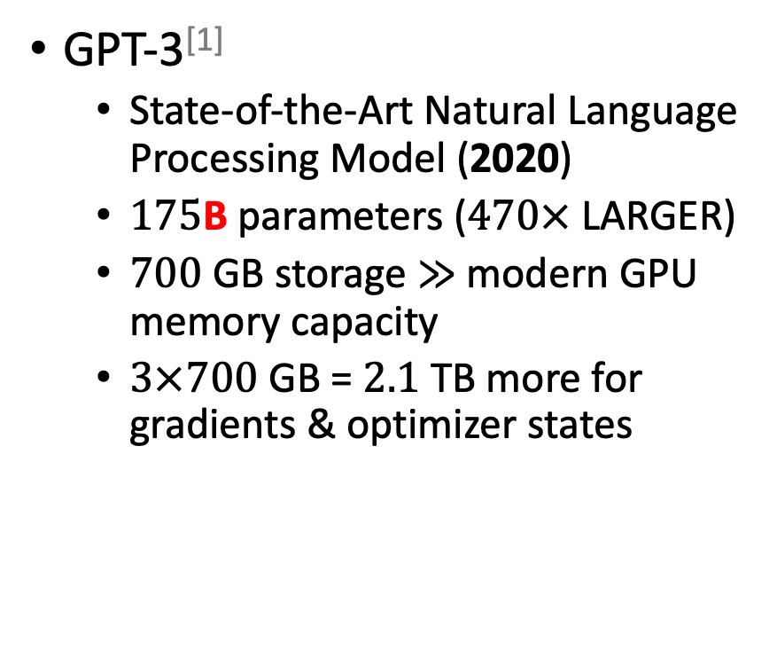
Challenges with Training EX-Large Models
GPT-3^{[1]}
  State-of-the-Art Natural Language Processing Model (2020)
  $175$B parameters ($470×$ LARGER)
  $700$ GB storage $≫$ modern GPU memory capacity
  $3×700$ GB = $2.1$ TB more for gradients & optimizer states
[1] T. Brown et al. Language Models are Few-Shot Learners. NeurIPS 2020

Slide 8

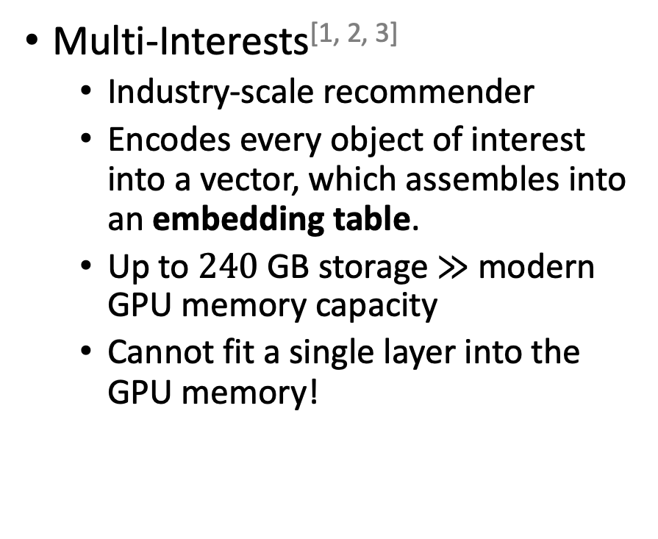
Challenges with Training EX-Large Models
Multi-Interests^{[1, 2, 3]}
  Industry-scale recommender
  Encodes every object of interest into a vector, which assembles into an embedding table.
  Up to $240$ GB storage $≫$ modern GPU memory capacity
  Cannot fit a single layer into the GPU memory!
[1] P. Covington et al. Deep Neural Networks for YouTube Recommendations. RecSys 2016
[2] J. Weston et al. Nonlinear Latent Factorization by Embedding Multiple User Interests. RecSys 2013
[3] M. Wang et al. Characterizing Deep Learning Training Workloads on Alibaba-PAI. IISWC 2019

Slide 9
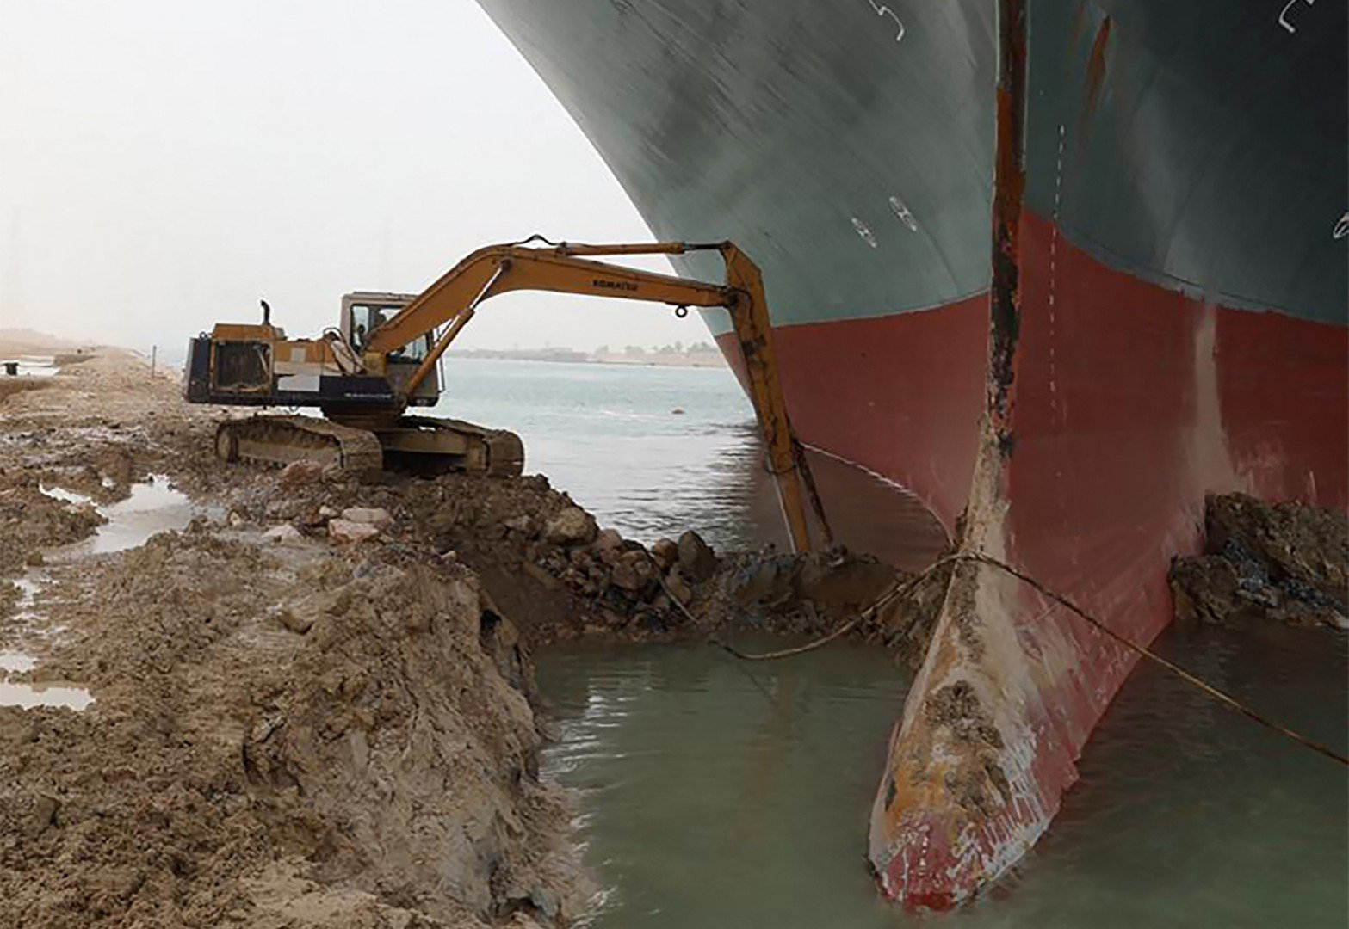
Today’s DNN Training In A Nutshell
DNN Models
GPU Memory
Capacity

Slide 10
Data and Model Parallelism
Partition into multiple devices? E.g., Data and/or Model Parallelism?

Slide 11
Data Parallelism
Partitions the data into multiple devices.

Slide 12
Model Parallelism
Partitions the model into multiple devices.

Slide 13

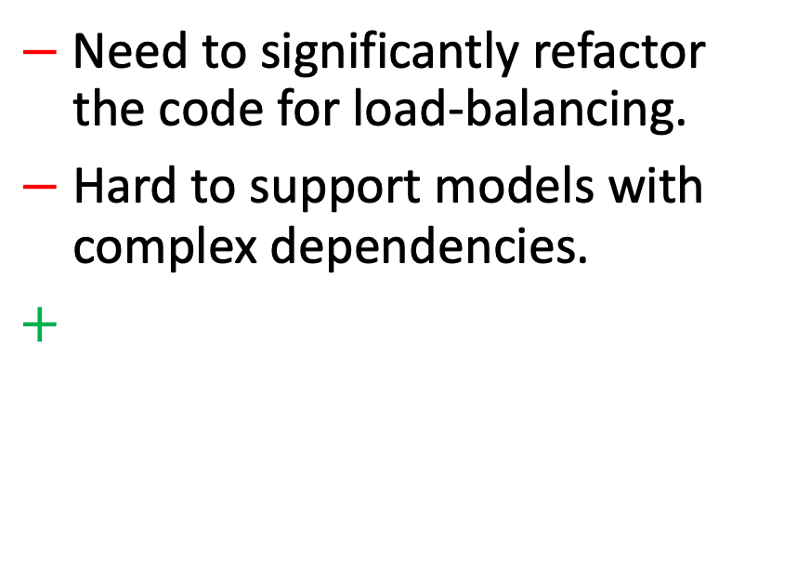
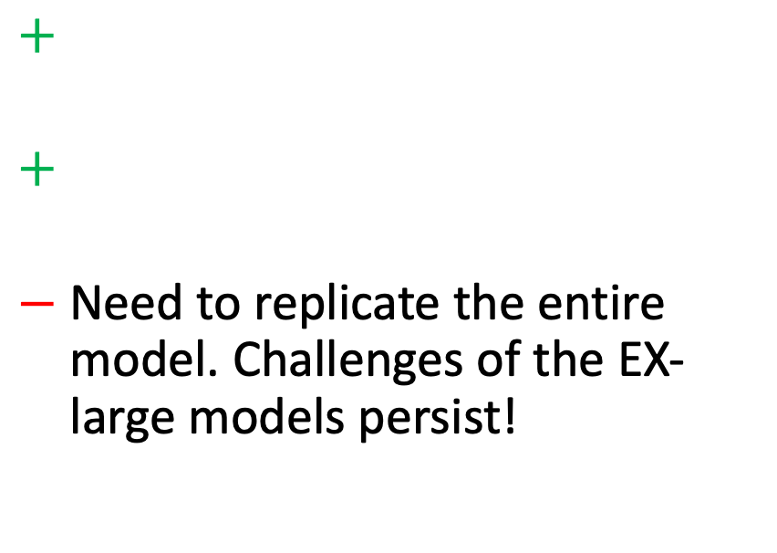
Data vs. Model Parallelism
Data Parallelism
Model Parallelism
$+$
$+$
$−$ Need to replicate the entire model. Challenges of the EX-large models persist!
$−$ Need to significantly refactor the code for load-balancing.
$−$ Hard to support models with complex dependencies.
$+$
Could we have the merits from both?
i.e., generic support for EX-Large models with minor code changes?

Slide 14


ZeRO^{[1]}
A solution that is based on data-parallelism.
Key Idea Partitions model states among devices and use efficient
communication primitives to gather them.
However, hungry DNN models need much more memory!
[1] S. Rajbhandari et al. ZeRO: Memory Optimizations toward Training Trillion Parameter Models. SC 2020

Slide 15
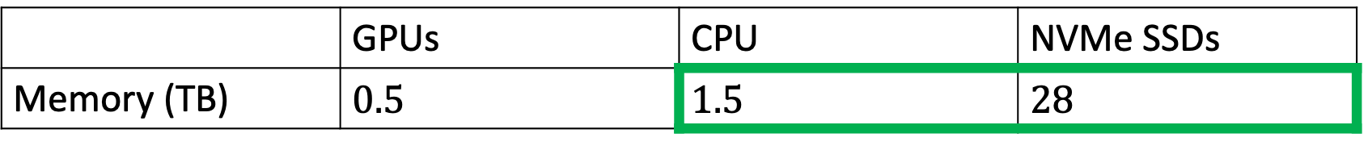
ZeRO-Infinity^{[1]}
ZeRO^{[2]} + Infinity Offload Engine
Observation GPUs are also accompanied with a CPU and NVMe SSDs
Key Idea Partitions model states among (GPUs + CPU + SSD) and
Keeps most of the states to the latter two.
 | GPUs | CPU | NVMe SSDs
Memory (TB) | $0.5$ | $1.5$ | $28$
[1] S. Rajbhandari et al. ZeRO: Memory Optimizations toward Training Trillion Parameter Models. SC 2020

Slide 16
Challenges
Challenge #1 How to efficiently get the weights from CPU/SSDs?
Challenge #2 How to handle cases when the weight of a single layer
cannot fit into the GPU memory?

Slide 17
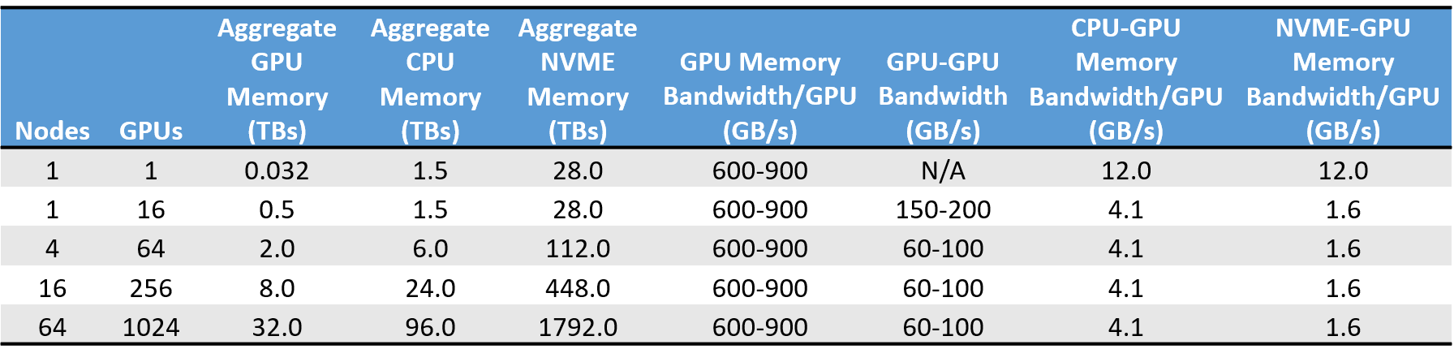

Key Idea #1. Weight Gathering
Challenge #1 How to efficiently get the weights from CPU/SSDs?
Optimization #1 $∀$weight, each GPU worker holds a portion of it and
gathers the rest from others.
  Better utilization than having a single worker broadcast the weight to others.

Slide 18
Key Idea #1. Weight Gathering
Challenge #1 How to efficiently get the weights from CPU/SSDs?
Optimization #1 $∀$weight, each GPU worker holds a portion of it and
gathers the rest from others.
  Better utilization than having a single worker broadcast the weight to others.

Slide 19
Key Idea #1. Weight Gathering
Challenge #1 How to efficiently get the weights from CPU/SSDs?
Optimization #1 $∀$weight, each GPU worker holds a portion of it and
gathers the rest from others.
  Better utilization than having a single worker broadcast the weight to others.

Slide 20
Key Idea #1. Weight Gathering
Challenge #1 How to efficiently get the weights from CPU/SSDs?
Optimization #1 $∀$weight, each GPU worker holds a portion of it and
gathers the rest from others.
  Better utilization than having a single worker broadcast the weight to others.
Same effective bandwidth even if $1024$ GPUs are reading in parallel

Slide 21

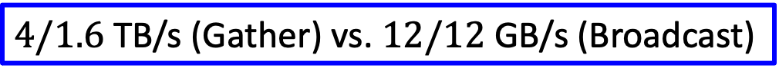
Key Idea #1. Weight Gathering
Challenge #1 How to efficiently get the weights from CPU/SSDs?
Optimization #1 $∀$weight, each GPU worker holds a portion of it and
gathers the rest from others.
  Better utilization than having a single worker broadcast the weight to others.
$4/1.6$ TB/s (Gather) vs. $12/12$ GB/s (Broadcast)

Slide 22
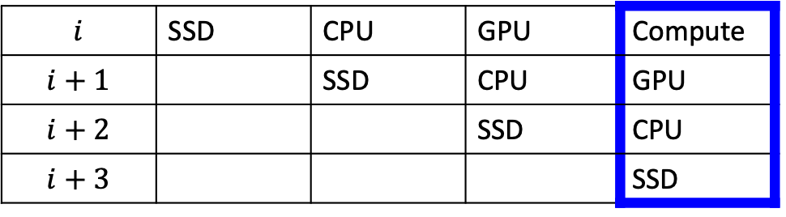
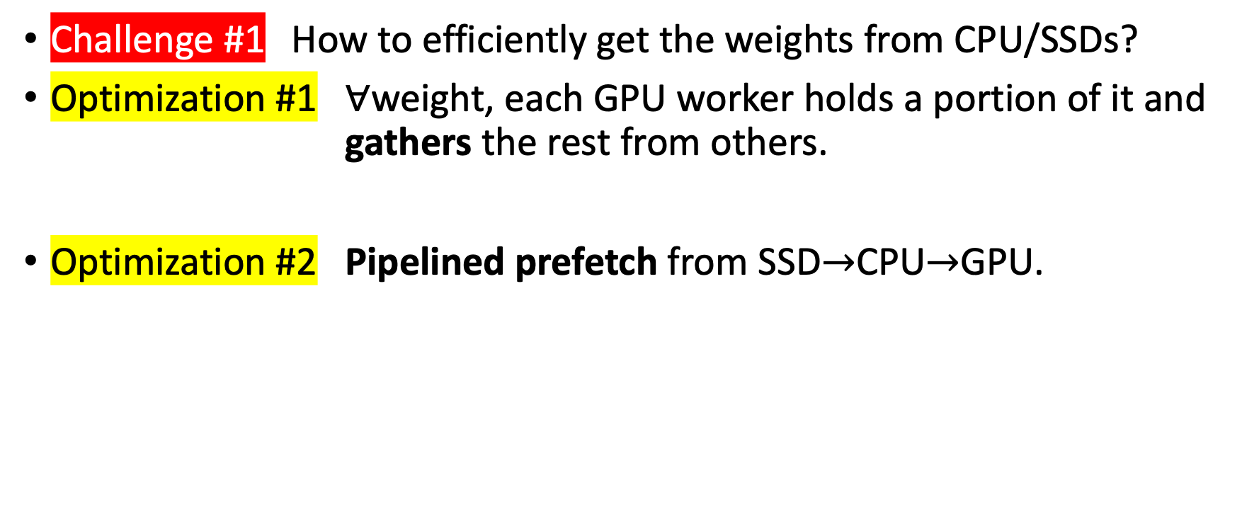
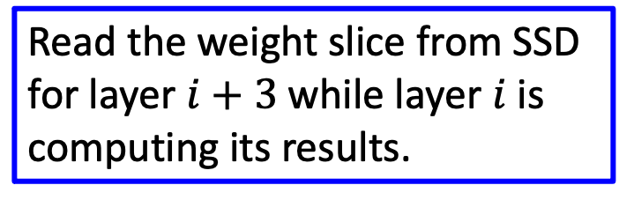
Key Idea #1. Pipelined Prefetch
Challenge #1 How to efficiently get the weights from CPU/SSDs?
Optimization #1 $∀$weight, each GPU worker holds a portion of it and
gathers the rest from others.
Optimization #2 Pipelined prefetch from SSD$→$CPU$→$GPU.
$$i$$ | SSD | CPU | GPU | Compute
$$i+1$$ |  | SSD | CPU | GPU
$$i+2$$ |  |  | SSD | CPU
$$i+3$$ |  |  |  | SSD
Read the weight slice from SSD for layer $i+3$ while layer $i$ is computing its results.

Slide 23
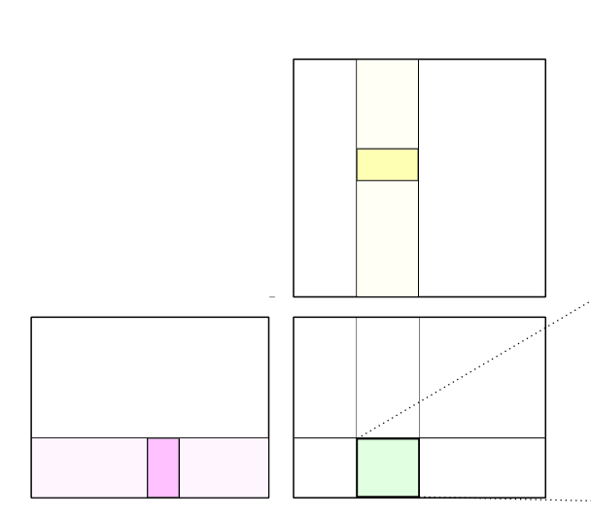




Key Idea #3. Tiled Computation
Challenge #2 How to handle cases when the weight of a single layer
cannot fit into the GPU memory?
Key Idea Some layers can evaluate their results in tiles and some
do not need the whole weight for the full results^{[1]}.
  E.g., Dense Layer $Y=XW^{T}$
$$W$$
$$X$$
$$Y$$
[1] M. Wang et al. Characterizing Deep Learning Training Workloads on Alibaba-PAI. IISWC 2019

Slide 24
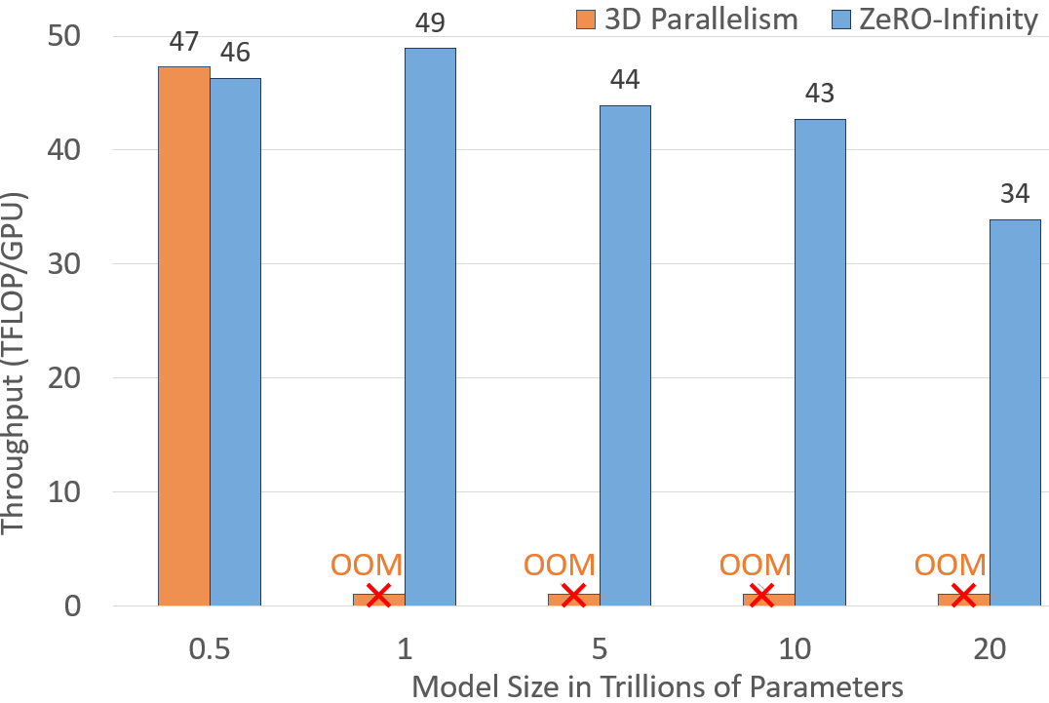
Key Results

Slide 25
Key Results
Baseline with Data + Model Parallelism

Slide 26
Key Results
Offloading to CPU/SSDs cause 2%
performance degradation

Slide 27
Key Results
Support for models that have trillion parameters

Slide 28
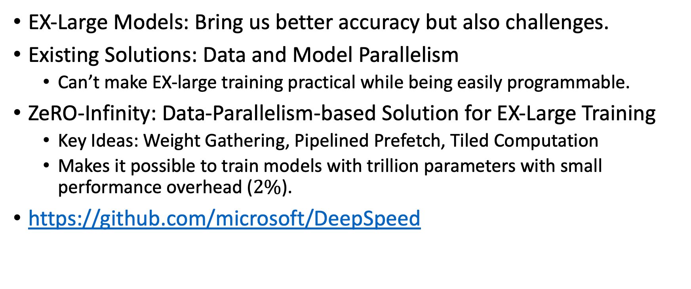
Conclusions
EX-Large Models: Bring us better accuracy but also challenges.
Existing Solutions: Data and Model Parallelism
  Can’t make EX-large training practical while being easily programmable.
ZeRO-Infinity: Data-Parallelism-based Solution for EX-Large Training
  Key Ideas: Weight Gathering, Pipelined Prefetch, Tiled Computation
  Makes it possible to train models with trillion parameters with small performance overhead ($2\%$).
https://github.com/microsoft/DeepSpeed

Slide 29
Memory Footprint Reduction Techniques for DNN Training: An Overview
Episode III. Weight Placement for EX-Large Models
Bojian Zheng
2022/2/18

Slide 30

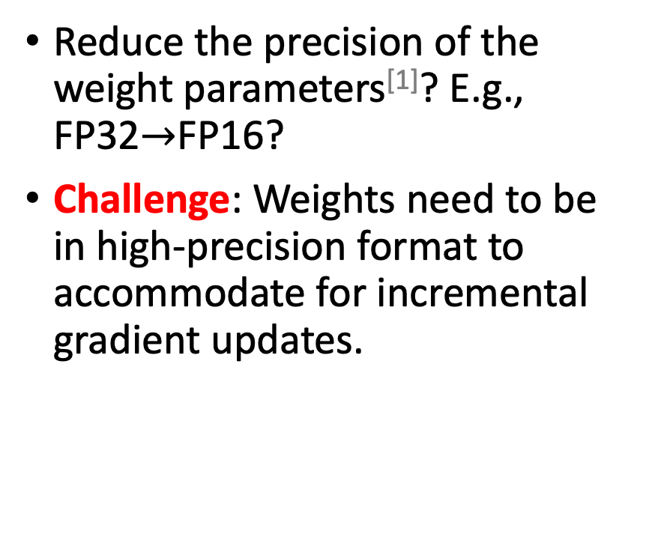
Why Not?
Reduce the precision of the weight parameters^{[1]}? E.g., FP32$→$FP16?
Challenge: Weights need to be in high-precision format to accommodate for incremental gradient updates.
E.g.,

Slide 31



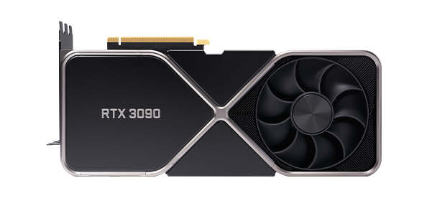
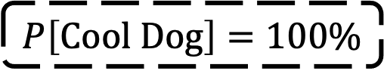
$$P\left[Cool Dog\right]=100\%$$

Slide 32
$$P\left[Cool Dog\right]=100\%$$

Slide 33
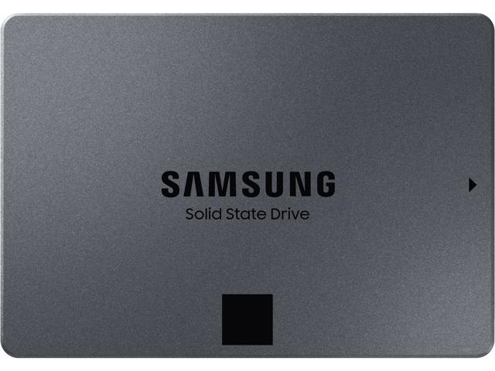
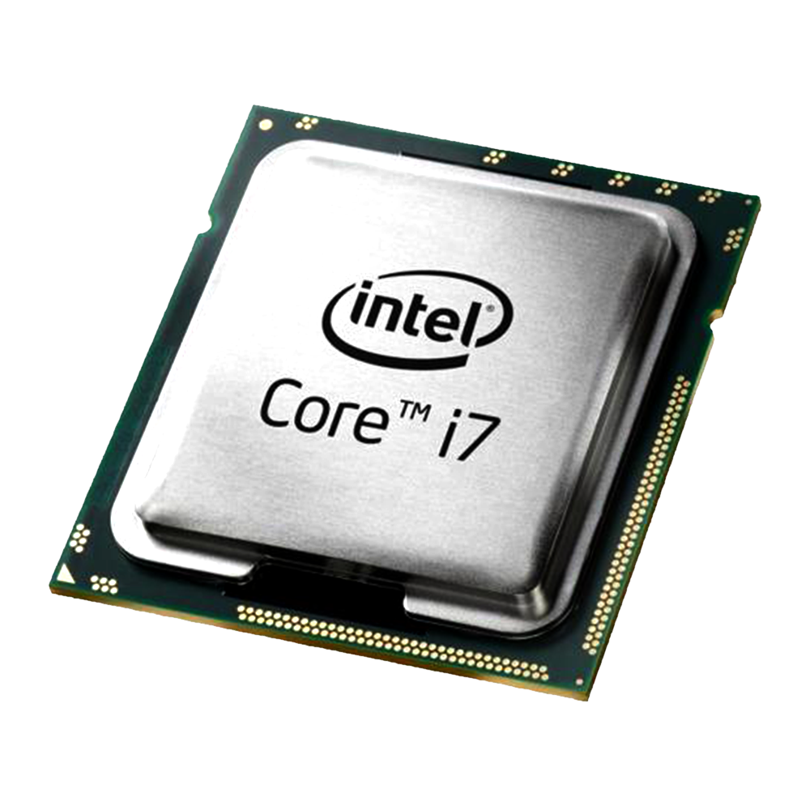
ZeRO-Infinity^{[1]}
ZeRO^{[2]} + Infinity Offload Engine
Observation GPUs are accompanied with large CPU memory and
Key Idea Partitions model states among workers (GPUs + CPU +
NVMe SSD). Offload the states in the latter two
[1] S. Rajbhandari et al. ZeRO: Memory Optimizations toward Training Trillion Parameter Models. SC 2020

Slide 35
