Slide 1
Recent Trend in Machine Learning Compilers: A Survey
Bojian Zheng, Shang Wang, Gennady Pekhimenko
EcoSystem Research Group
Department of Computer Science, University of Toronto
bojian,wangsh46,pekhimenko@cs.toronto.edu

Slide 2
Abstract: Why Machine Learning Compilers?
Machine Learning Frameworks are NOT the end of story!
✖ Performance
✖ Hardware Backend Portability
Machine Learning Compilers create the separation between
what to compute (Algorithms) and how to compute (Schedules).

Slide 3
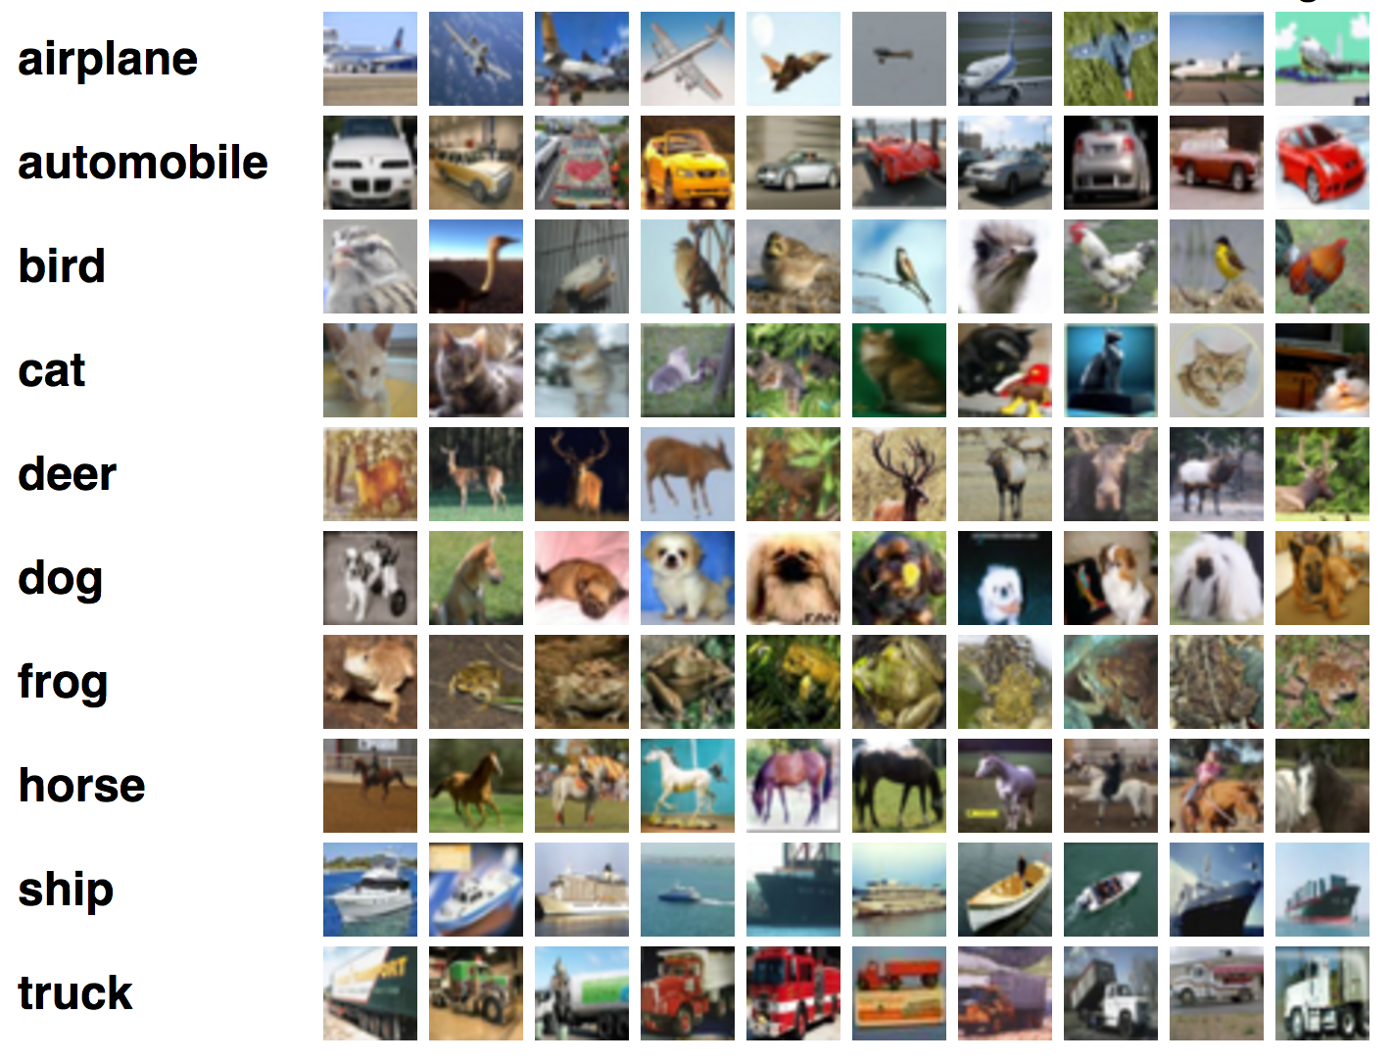
Background: Machine Learning
Machine Learning has applications in many domains.
Image Classification
Speech Recognition
Machine Translation
Notes:
we all know about the importance of machine learning nowadays, which has applications in domains such as ...

Slide 4
Background: Machine Learning Frameworks
Machine Learning Applications are usually developed under Machine Learning Frameworks (Tensorflow, PyTorch, MXNet, CNTK),
which can be viewed as a language wrapper on top of the Operator Pool.
Notes:
machine learning applications nowadays are usually developed using machine learning frameworks,
which serve the purpose as the programming language
the machine learning frameworks behave like a language wrapper on top of the operator pool

Slide 5
Background: Machine Learning Frameworks
The Operator Pool consists of implementations of machine learning operators that are tuned in depth, either by framework developers or vendor libraries.
Notes:
which consists of highly tuned implementations of machine learning operators that are developed either by framework developers,
or directly from the Vendor Libraries

Slide 6
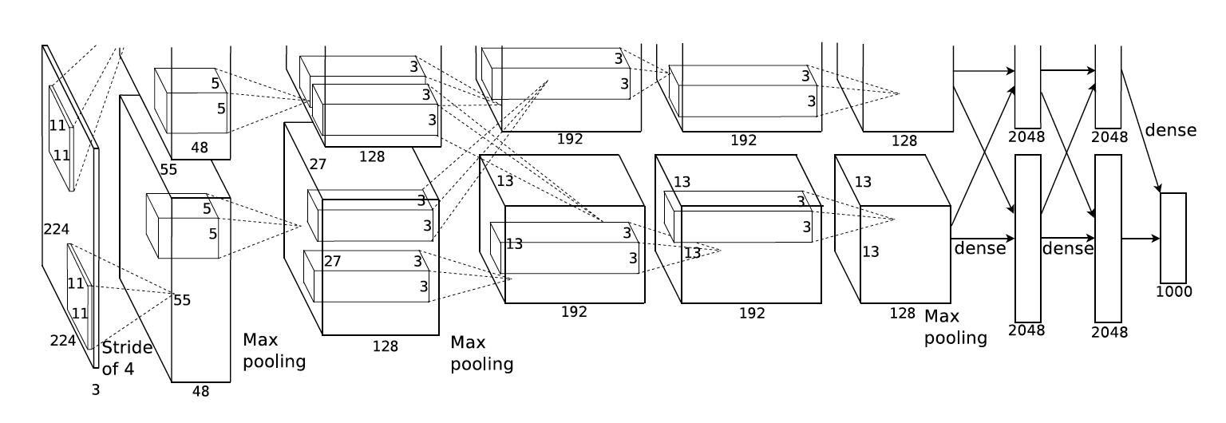
Background: Machine Learning Frameworks
Machine learning practitioners build up Computation Graphs for development.
Each node is an instantiation of the operator with specific parameters.
Krizhevsky, Alex, Ilya Sutskever, and Geoffrey E. Hinton. "Imagenet classification with deep convolutional neural networks." Advances in neural information processing systems. 2012.
Notes:
So how machine learning practitioners benefit from machine learning frameworks?
Well, they instantiate what they need from the operator pool with specific parameter, and build up what they call the computation graph.

Slide 7
Problem Statement
So what are the problems with Machine Learning Frameworks?
✖ Performance
Implementing NEW operators using EXISTING ones are costly.
EXISTING operators CANNOT guarantee
best performance for every input case (dimensions, data types, ...).
✖ Hardware Backend Portability
Many hardwares targeting machine learning workloads.
E.g., CPUs, GPUs, TPU, FPGAs, ASICs …
Different hardwares require different management policy.
Hard for those frameworks to be ported to new hardwares.
Notes:
so what are the problems with machine learning frameworks?
We think there are two major issues:

Slide 8
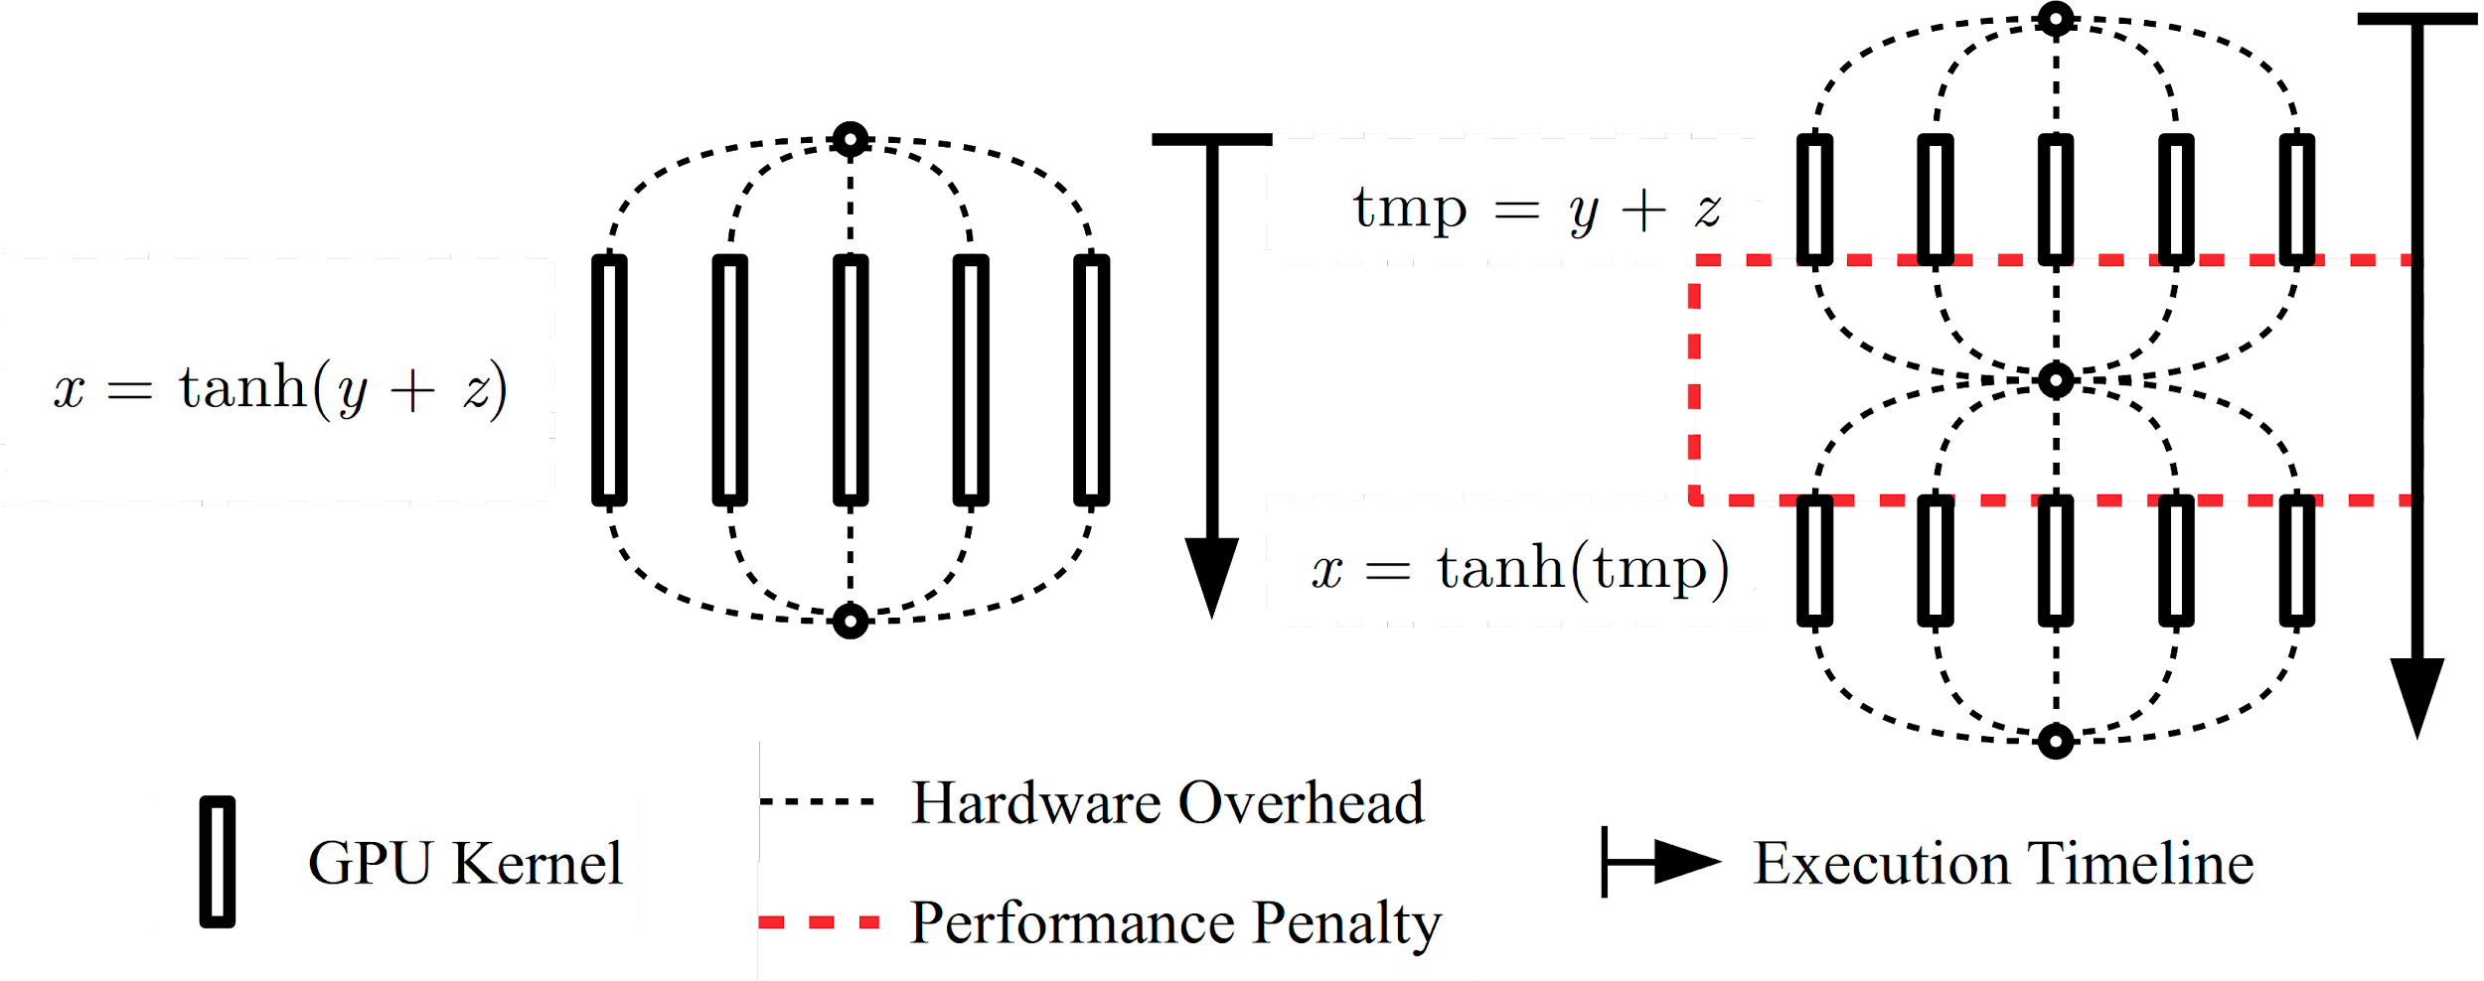
Problem Statement: Performance
“Implementing NEW operators using EXISTING ones are costly.”
Extra Overheads for Splitting/Joining Threads & Reading/Writing tmp
Notes:
please let me elaborate more on the performance issue of machine learning frameworks
suppose that we are hoping to execute
framework, framework, I am hoping to perform computation …
please give me operator

Slide 9
Problem Statement
So what are the problems with Machine Learning Frameworks?
✖ Performance
Implementing NEW operators using EXISTING ones are costly.
EXISTING operators CANNOT guarantee
best performance for every input case (dimensions, data types, ...).
✖ Hardware Backend Portability
Many hardwares targeting machine learning workloads.
E.g., CPUs, GPUs, TPU, FPGAs, ASICs …
Different hardwares require different management policy.
Hard for those frameworks to be ported to new hardwares.

Slide 10
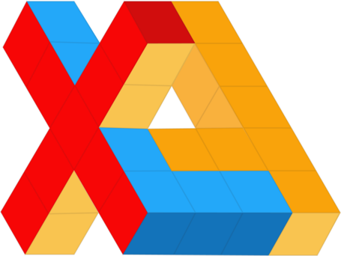
Tensorflow XLA
Tensorflow XLA consists of two separate components:
Ahead-Of-Time Compiler tfcompile:
Major Goal: Reduce size of executables on mobile devices.
Idea: Applications ONLY take subroutines that they need,
rathen than the entire Operator Pool.
Just-In-Time Compiler XLA:
Major Goal: Improve performance and portability.
Idea: Similar Design with LLVM
Currently, Kernel Fusion is the major optimization that XLA does.

Slide 11
TensorComprehensions
TensorComprehensions is mainly focusing on
runtime performance optimization on GPUs.
More specifically, it auto-tunes each individual operator.
This is different from auto-scheduling that
optimizes across multiple different operators.
Two Major Highlights: (1) Code Generation (2) Auto-tuning
Vasilache, Nicolas, et al. "Tensor Comprehensions: Framework-Agnostic High-Performance Machine Learning Abstractions." arXiv preprint arXiv:1802.04730 (2018).

Slide 12
TensorComprehensions: Code Generation
Example: Writing a Matrix Multiply using TensorComprehensions:
# import tc, torch
ee = tc.ExecutionEngine()
# define a new matmul operator
ee.define("""
def mm(float(M, K) A, float(K, N) B) -> (C)
{
C(m, n) +=! A(m, kk) * B(kk, n)
}""")
A = torch.randn(3, 4)
B = torch.randn(4, 5)
C = ee.mm(A, B) # use the newly defined operator

Slide 13
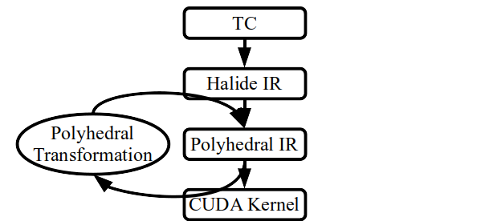
TensorComprehensions: Code Generation
Code Generation of TensorComprehensions relies on PPCG,
the Polyhedral Parallel Code Generator for CUDA.
Features: (1) Polyhedral Scheduling (2) GPU Mapping (3) Memory Promotion

Slide 14
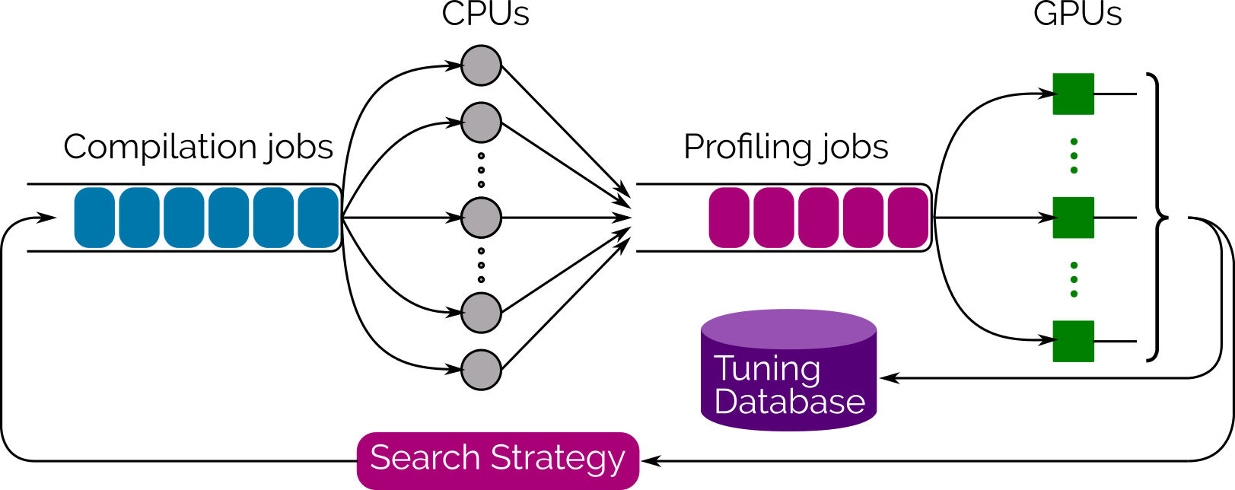
TensorComprehensions: Auto-tuning
Notes:
after the code generation, the CPU compiles the generated kernels and

Slide 15
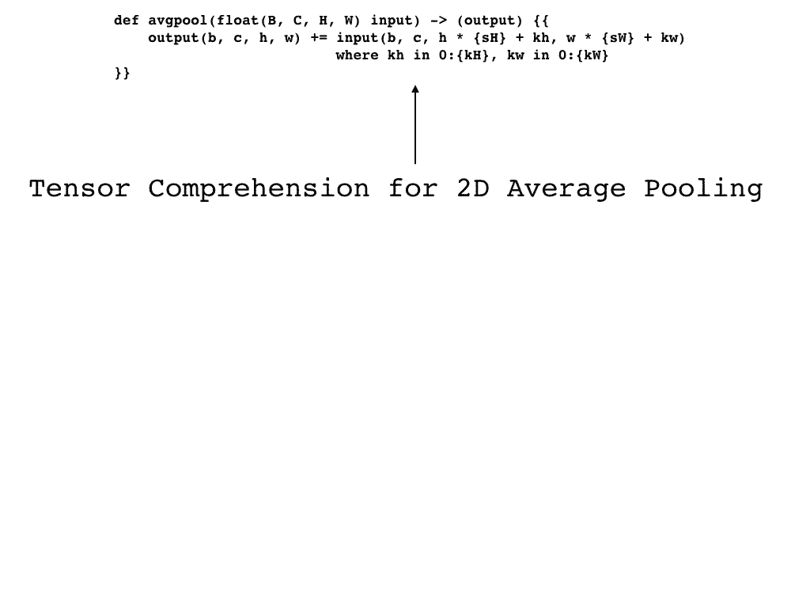
TensorComprehensions: Auto-tuning
Notes:
the anto-tuning of TensorComprehensions adopts the Genetic Search algorithm on the parameters
this is a nice animation that shows how it works

Slide 16
Case Study: Two-stage Blur Filter
Consider a image processing pipeline consisted of a two-stage blur filter:
What are the possible implementations?
blurx(x, y) = in(x-1, y) + in(x, y) + in(x+1, y)
out(x, y) = blurx(x, y-1) + blurx(x, y) + blurx(x, y+1)

Slide 17
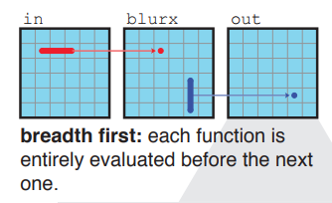
Case Study: Two-stage Blur Filter
Parallelism, Locality, No Redundant Computation

Slide 18
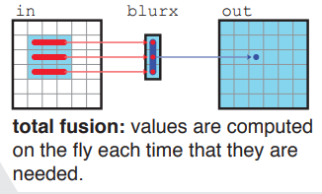
Case Study: Two-stage Blur Filter
Parallelism, Locality, No Redundant Computation

Slide 19
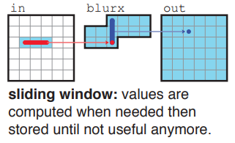
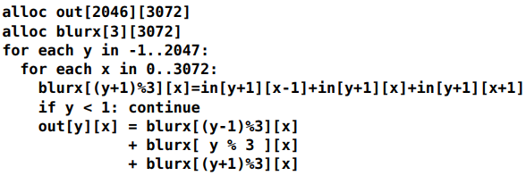
Case Study: Two-stage Blur Filter
Parallelism, Locality, No Redundant Computation

Slide 20
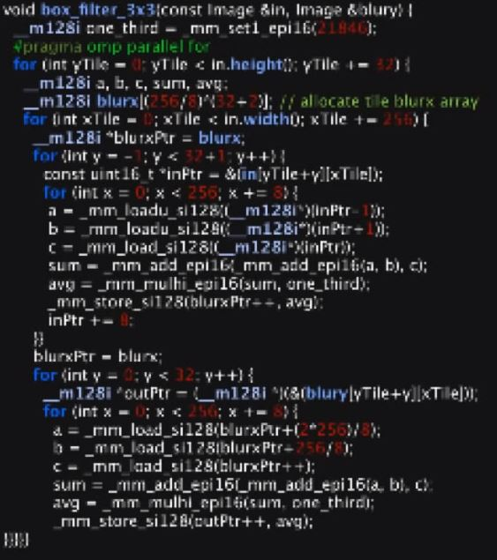
Case Study: Two-stage Blur Filter
Finding optimal kernel by manually trying different combinations.

Slide 21
Halide
Separation between functional correctness and optimization:
Algorithm: What to compute.
Schedule: How to compute.
(Original) Usage: stencil computations and stream programs.
Application: Image processing (graphics).
Motivation: Writing optimized image processing kernels is very hard!
J. Ragan-Kelley, C. Barnes, A. Adams, S. Paris, F. Durand, and S. Amarasinghe, “Halide: a language and compiler for optimizing parallelism, locality, and recomputation in image processing pipelines,” in Proceedings of the 34th ACM SIGPLAN conference on Programming language design and implementation, ser. PLDI ’13. New York, NY, USA: ACM, 2013, pp. 519–530.
Notes:
Domain order: the order in which the required region of each function’s domain should be traversed,
• Each dimension can be traversed sequentially or in parallel.
• Constant-size dimensions can be unrolled or vectorized.
• Dimensions can be reordered (e.g. from column- to row-major).
• Finally, dimensions can be split by a factor, creating two new dimensions: an outer dimension, over the old range divided by the factor, and an inner dimension, which iterates within the factor. After splitting, references to the original index become outer × factor + inner.
Call Schedule:
Each function’s call schedule is defined as the points in the loop nest of its callers where it is stored and computed.

Slide 22
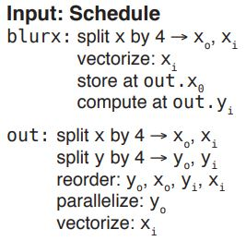
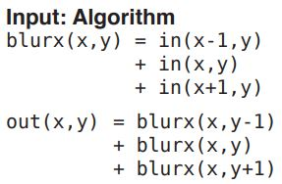
A Halide Program

Slide 23
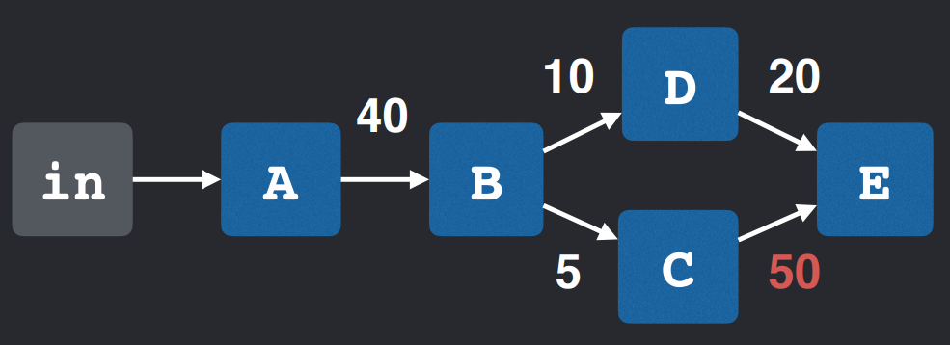
But how to schedule?
Heuristic Cost Model
Greedy Grouping until no positive benefit
A
B
A, B
Cost = (Number of arithmetic operations)
+ (Number of memory accesses) x (LOAD COST)
Benefit(A, B) = Cost(A) + Cost(B) - Cost(A, B)
Ravi Teja Mullapudi, Andrew Adams, Dillon Sharlet, Jonathan Ragan-Kelley, and Kayvon Fatahalian. 2016. Automatically Scheduling Halide Image Processing Pipelines. ACM TOG (2016).

Slide 24
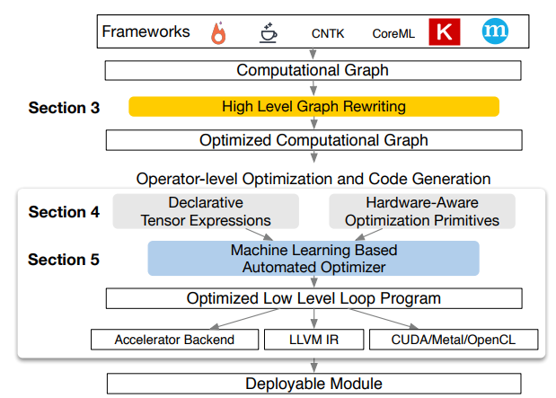
TVM
Like Halide (not exactly), but in machine learning (ML) domain.
ML operators (conv2d, relu, etc.) implemented as Algorithm + Schedule.
Targeted at various hardware backends.
Optimal schedules are different for different hardware backends.
NNVM
TVM
T. Chen et al. TVM: End-to-End Compilation Stack for Deep Learning. In SysML, 2018.

Slide 25
TVM
Graph Level Optimization:
NNVM
Specific Handwritten Rules
Operator Level Optimization:
TVM
More schedule primitives targeted at various hardware backends.

Slide 26
Operator Schedule Auto-tuning
Define a template schedule.
Automatic Schedule Tuning:
Cost Model: Gradient Tree Boosting & TreeRNN
Exploration: Simulated Annealing Algorithm

Slide 27
Operator Schedule Auto-tuning
# Schedule. y, x = s[C].op.axis k = s[C].op.reduce_axis[0] # Get the config object. cfg = autotvm.get_config() # Define search space. cfg.define_knob("tile_y", [1, 2, 4, 8, 16]) cfg.define_knob("tile_x", [1, 2, 4, 8, 16]) # Schedule according to config. yo, yi = s[C].split(y, cfg['tile_y'].val) xo, xi = s[C].split(x, cfg['tile_x'].val) s[C].reorder(yo, xo, k, yi, xi)

Slide 28
Halide v.s. TVM
Halide: Auto-scheduling for the entire pipeline.
TVM:
Break DAG into operators.
Auto-tuning for each operator
Hopefully a bag of optimal operators will yield optimal performance.
Note: “Auto-tuning” does NOT imply “Auto-scheduling”!
In this sense, “auto-tuning” is a simpler problem than “auto-scheduling”.
But both aspects are currently under active research.
The schedule space of TVM is a subset of Halide.
TVM: each operator scheduled at root.

Slide 29
Conclusion
Machine Learning Frameworks are NOT the end of story!
✖ Performance and ✖ Hardware Backend Portability
Machine Learning Compilers come for rescue!
Tensorflow XLA, TensorComprehensions, Halide, TVM
Not covered today: Glow, Tiramisu, Relay, Diesel, R-Stream, etc.
Key Idea: separation between what to compute (Algorithms) and
how to compute (Schedules)
Therefore, this is an interesting research field to pursue!

Slide 30
Thank you!

