Slide 1
Machine Learning Compiler: An Overview
Bojian Zheng
2022/4/1 @Amazon Reading Group

Slide 2
Agenda for Today
Why Machine Learning Compilers?
  State-of-the-Art Machine Learning Frameworks Design, and Flaws:
  Vendor libraries not delivering the optimal performance.
2 Classes of Machine Learning Compilers:
  Halide^{[1]}/TVM^{[2]}: Easier to write high-performance programs.
[1] J. Ragan-Kelley et al. Halide: A Language and Compiler for Optimizing Parallelism, Locality, and Recomputation in Image Processing Pipelines. PLDI 2013
[2] T. Chen et al. TVM: An Automated End-to-End Optimizing Compiler for Deep Learning. OSDI 2018

Slide 3












Why Machine Learning Compilers?
What can go wrong?
State-of-the-Art Machine Learning Frameworks Design:
Python Programming Front-end
define neural networks
C++ Framework Core
optimize graphs; schedule operators;
allocate hardware resources …
Vendor APIs & Libraries
Hardware Architectures

Slide 4
Machine Learning Frameworks
Guaranteed optimal
performance?
State-of-the-Art Machine Learning Frameworks Design:
Python Programming Front-end
define neural networks
C++ Framework Core
optimize graphs; schedule operators;
allocate hardware resources …
Vendor APIs & Libraries
Hardware Architectures

Slide 5
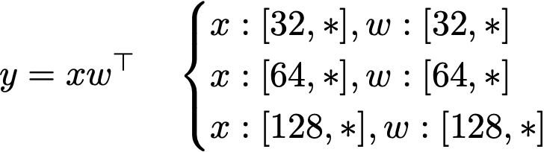
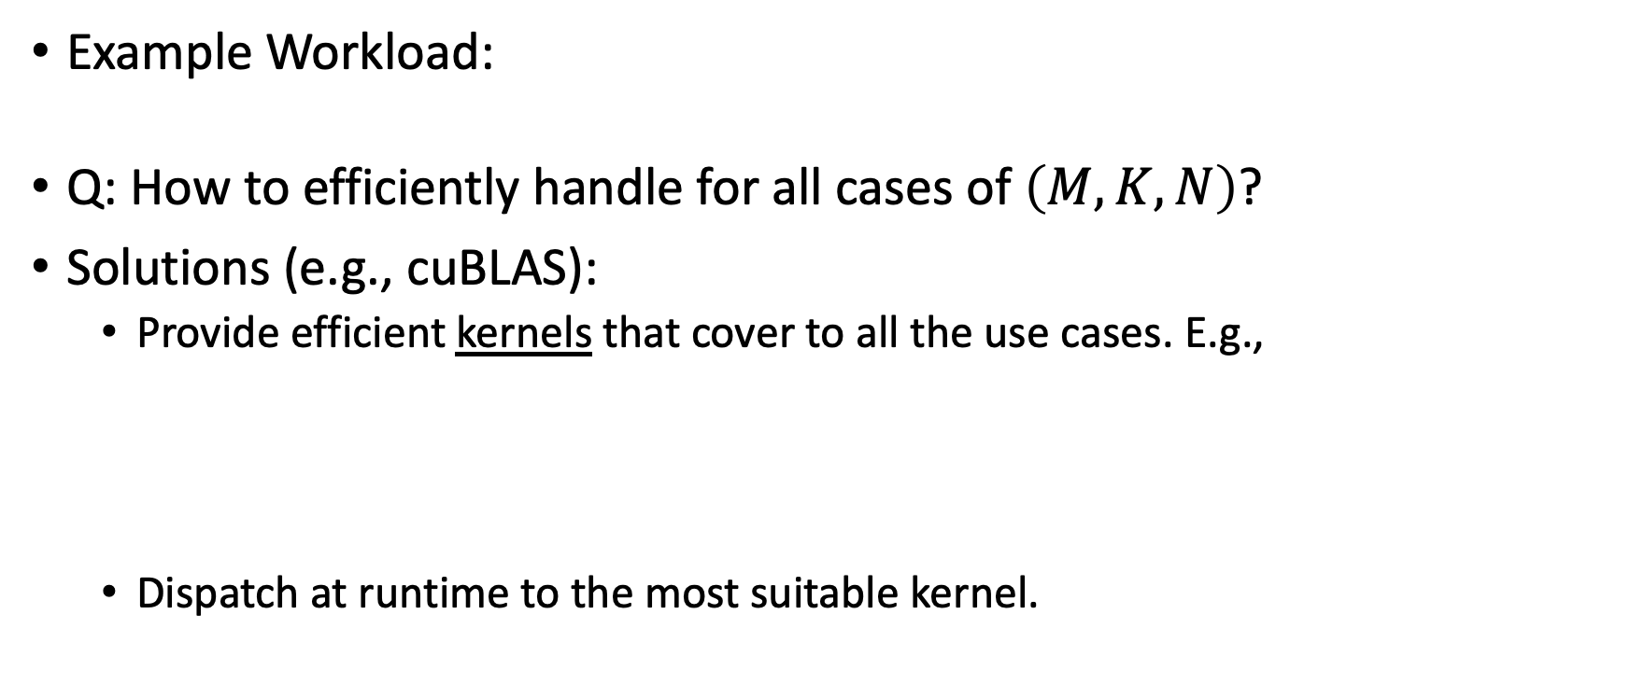
Vendor Libraries
Example Workload:
Q: How to efficiently handle for all cases of $\left(M, K, N\right)$?
Solutions (e.g., cuBLAS):
  Provide efficient kernels that cover to all the use cases. E.g.,
  Dispatch at runtime to the most suitable kernel.

Slide 6
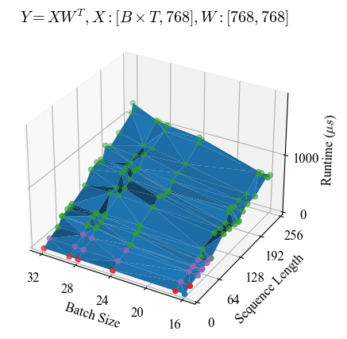

Vendor Libraries
What if the workloads DO NOT
fit into those kernels?
1 Color = 1 Unique CUDA Kernel
Even as the shapes vary, cuBLAS only invokes a handful of kernels.

Slide 7
Vendor Libraries
Example Workload:
Q: How to efficiently handle for all cases of $\left(M, K, N\right)$?
Solutions (e.g., cuBLAS):
  Provide efficient kernels that cover to all the use cases. E.g.,
  Dispatch at runtime to the most suitable kernel.

Slide 8
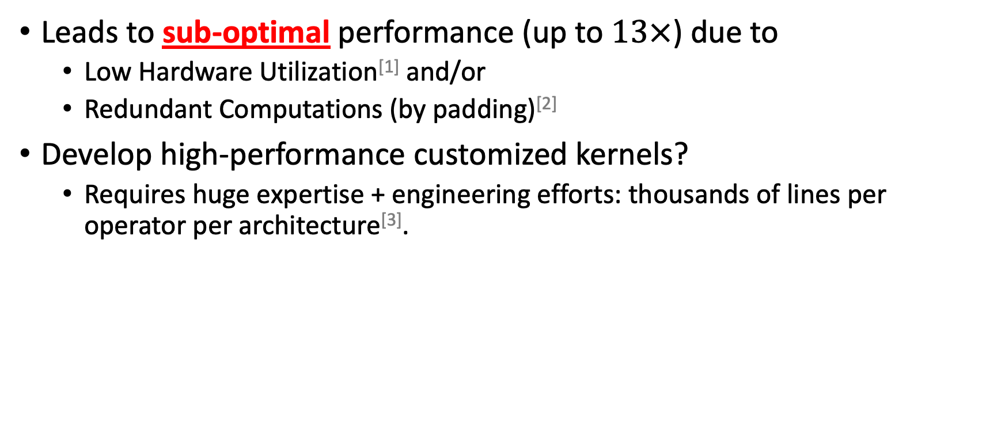
Vendor Libraries
Leads to sub-optimal performance (up to $13×$) due to
  Low Hardware Utilization^{[1]} and/or
  Redundant Computations (by padding)^{[2]}
Develop high-performance customized kernels?
  Requires huge expertise + engineering efforts: thousands of lines per operator per architecture^{[3]}.
[1] F. Yu et al. Towards Latency-aware DNN Optimization with GPU Runtime Analysis and Tail Effect Elimination. arXiv 2020
[2] Alibaba. Bringing TVM into TensorFlow for Optimizing Neural Machine Translation on GPU. 2018
[3] NVIDIA. CUTLASS: CUDA Templates for Linear Algebra Subroutines. https://github.com/NVIDIA/cutlass

Slide 9

Tensor Program Compilers
State-of-the-Arts: Halide^{[1]} & TVM^{[2]}
  Halide: image processing
  TVM: machine learning & better GPU support
Objective: Easier to write high-performance programs.
Key Idea: Abstracts low-level implementations using schedules.
$45$ lines of Python Scheduling Code
s = create_schedule(Y.op)
Y_local = s.cache_write([Y], "local")
i, j, k = tuple(Y_local.op.axis)
i_o_i, i_i = s[Y_local].split(i, factor=8)
i_o_o_i, i_o_i = s[Y_local].split(i_o_i, factor=2)
i_o_o_o, i_o_o_i = s[Y_local].split(i_o_o_i, factor=1)
...
[1] J. Ragan-Kelley et al. Halide: A Language and Compiler for Optimizing Parallelism, Locality, and Recomputation in Image Processing Pipelines. PLDI 2013
[2] T. Chen et al. TVM: An Automated End-to-End Optimizing Compiler for Deep Learning. OSDI 2018

Slide 10
Tensor Program Compilers
State-of-the-Arts: Halide^{[1]} & TVM^{[2]}
  Halide: image processing
  TVM: machine learning & better GPU support
Objective: Easier to write high-performance programs.
Key Idea: Abstracts low-level implementations using schedules.
$45$ lines of Python Scheduling Code
s = create_schedule(Y.op)
Y_local = s.cache_write([Y], "local")
i, j, k = tuple(Y_local.op.axis)
i_o_i, i_i = s[Y_local].split(i, factor=8)
i_o_o_i, i_o_i = s[Y_local].split(i_o_i, factor=2)
i_o_o_o, i_o_o_i = s[Y_local].split(i_o_o_i, factor=1)
...
scheduling primitives
[1] J. Ragan-Kelley et al. Halide: A Language and Compiler for Optimizing Parallelism, Locality, and Recomputation in Image Processing Pipelines. PLDI 2013
[2] T. Chen et al. TVM: An Automated End-to-End Optimizing Compiler for Deep Learning. OSDI 2018

Slide 11


Tensor Program Compilers
State-of-the-Arts: Halide^{[1]} & TVM^{[2]}
  Halide: image processing
  TVM: machine learning & better GPU support
Objective: Easier to write high-performance programs.
Key Idea: Abstracts low-level implementations using schedules.
$45$ lines of Python Scheduling Code
$946$ lines of CUDA Code
s = create_schedule(Y.op)
Y_local = s.cache_write([Y], "local")
i, j, k = tuple(Y_local.op.axis)
i_o_i, i_i = s[Y_local].split(i, factor=8)
i_o_o_i, i_o_i = s[Y_local].split(i_o_i, factor=2)
i_o_o_o, i_o_o_i = s[Y_local].split(i_o_o_i, factor=1)
...
__global__ default_function(...) {
...
float Y_local[128];
__shared__ float X_shared[768];
__shared__ float W_shared[384];
...
}
[1] J. Ragan-Kelley et al. Halide: A Language and Compiler for Optimizing Parallelism, Locality, and Recomputation in Image Processing Pipelines. PLDI 2013
[2] T. Chen et al. TVM: An Automated End-to-End Optimizing Compiler for Deep Learning. OSDI 2018

Slide 12
Tensor Program Compilers
State-of-the-Arts: Halide^{[1]} & TVM^{[2]}
  Halide: image processing
  TVM: machine learning & better GPU support
Objective: Easier to write high-performance programs.
Key Idea: Abstracts low-level implementations using schedules.
$45$ lines of Python Scheduling Code
$946$ lines of CUDA Code
s = create_schedule(Y.op)
Y_local = s.cache_write([Y], "local")
i, j, k = tuple(Y_local.op.axis)
i_o_i, i_i = s[Y_local].split(i, factor=8)
i_o_o_i, i_o_i = s[Y_local].split(i_o_i, factor=2)
i_o_o_o, i_o_o_i = s[Y_local].split(i_o_o_i, factor=1)
...
__global__ default_function(...) {
...
float Y_local[128];
__shared__ float X_shared[768];
__shared__ float W_shared[384];
...
}
automatic inference
[1] J. Ragan-Kelley et al. Halide: A Language and Compiler for Optimizing Parallelism, Locality, and Recomputation in Image Processing Pipelines. PLDI 2013
[2] T. Chen et al. TVM: An Automated End-to-End Optimizing Compiler for Deep Learning. OSDI 2018

Slide 13


Tensor Program Compilers
Pros
Cons
Easily programed, modified and parameterized.
Less flexible
  What if my transformations are NOT supported by primitives?
Not quite “easily” programmed.
$45$ lines of Python Scheduling Code
s = create_schedule(Y.op)
Y_local = s.cache_write([Y], "local")
i, j, k = tuple(Y_local.op.axis)
i_o_i, i_i = s[Y_local].split(i, factor=8)
i_o_o_i, i_o_i = s[Y_local].split(i_o_i, factor=2)
i_o_o_o, i_o_o_i = s[Y_local].split(i_o_o_i, factor=1)
...

Slide 14


Tensor Program Compilers
Pros
Cons
Easily programed, modified and parameterized.
Less flexible
  What if my transformations are NOT supported by primitives?
Not quite “easily” programmed.
Optimal schedules are hardware-specific.
$45$ lines of Python Scheduling Code
s = create_schedule(Y.op)
Y_local = s.cache_write([Y], "local")
i, j, k = tuple(Y_local.op.axis)
i_o_i, i_i = s[Y_local].split(i, factor=8)
i_o_o_i, i_o_i = s[Y_local].split(i_o_i, factor=2)
i_o_o_o, i_o_o_i = s[Y_local].split(i_o_o_i, factor=1)
...
Want to generate high-
performance schedules
automatically.
Why $\left(8, 2, 1\right)$?

Slide 15
Auto-Scheduler
State-of-the-Arts: Halide^{[1]} and TVM^{[2]} Auto-Schedulers
Objective: Given a compute definition, automatically find a high-performance schedule.
[1] A. Adams et al. Learning to Optimize Halide with Tree Search and Random Programs. ACM Transactions on Graphics (TOG) 2019
[2] L. Zheng et al. Ansor: Generating High-Performance Tensor Programs for Deep Learning. OSDI 2020

Slide 16

Auto-Scheduler System Overview
Operator
Specification
Shape
Description
for i in range(2048):
for j in range(2304):
for k in range(768):
Y[i][j] += X[i][k] * W[j][k]
Sketch Generation Rules
for i.o.o.o in range(?):
for i.o.o.i in range(?):
for i.o.i in range(?):
for i.i in range(?):
...

Slide 17

Auto-Scheduler System Overview
Operator
Specification
Shape
Description
Auto-Scheduler
Brute-force permutation
on real hardware?
Search Space
$∞$ plausible schedules
Time-consuming!
for i.o.o.o in range(?):
for i.o.o.i in range(?):
for i.o.i in range(?):
for i.i in range(?):
...
High-Performance
Schedule

Slide 18
Auto-Scheduler System Overview
Operator
Specification
Shape
Description
Auto-Scheduler
Search Space
Predict performance of many
schedules simultaneously
Cost Model
for i.o.o.o in range(?):
for i.o.o.i in range(?):
for i.o.i in range(?):
for i.i in range(?):
...

Slide 19
Auto-Scheduler System Overview
Operator
Specification
Shape
Description
Auto-Scheduler
Search Space
Random Sample
Cost Model
for i.o.o.o in range(?):
for i.o.o.i in range(?):
for i.o.i in range(?):
for i.i in range(?):
...

Slide 20
Auto-Scheduler System Overview
Operator
Specification
Shape
Description
Auto-Scheduler
Search Space
Random Sample
Cost Model
Train
for i.o.o.o in range(128):
for i.o.o.i in range(8):
for i.o.i in range(2):
for i.i in range(1):
...
Measure

Slide 21
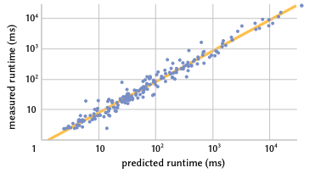
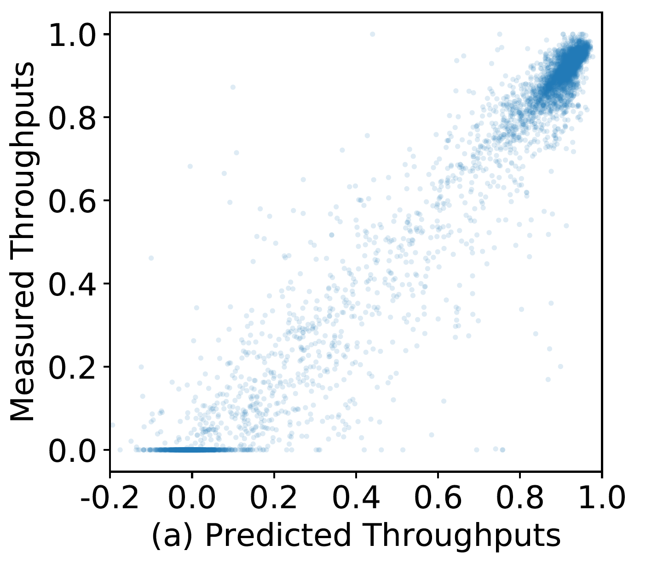
Auto-Scheduler System Overview
Operator
Specification
Shape
Description
Auto-Scheduler
Search Space
[1]
Random Sample
Learned Cost Model
Train
for i.o.o.o in range(128):
for i.o.o.i in range(8):
for i.o.i in range(2):
for i.i in range(1):
...
Measure
[2]
Measured and Predicted are strongly correlated.
[1] A. Adams et al. Learning to Optimize Halide with Tree Search and Random Programs. ACM Transactions on Graphics (TOG) 2019
[2] L. Zheng et al. Ansor: Generating High-Performance Tensor Programs for Deep Learning. OSDI 2020

Slide 22
Auto-Scheduler System Overview
Operator
Specification
Shape
Description
Auto-Scheduler
Search Space
Learned Cost Model
Guide
High-Performance
Schedule

Slide 23
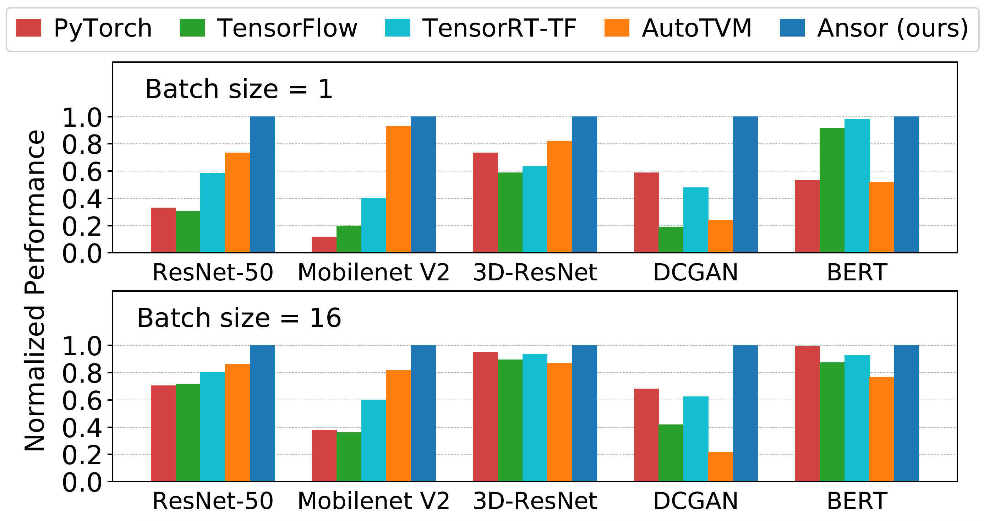
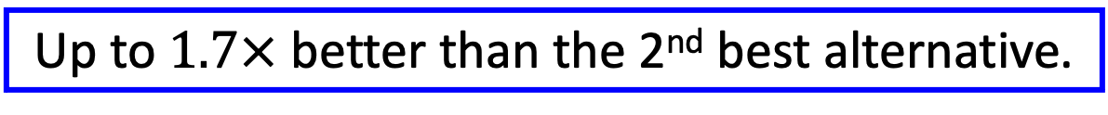
Auto-Scheduler Evaluation
Up to $1.7×$ better than the 2nd best alternative.

Slide 24








DietCode: Automatic Code Generation for Dynamic Tensor Programs
Bojian Zheng^{*1, 2, 3}, Ziheng Jiang^{*4, 5}, Cody Yu², Haichen Shen²,
Josh Fromm⁴, Yizhi Liu², Yida Wang²,
Luis Ceze^{4, 5}, Tianqi Chen^{4, 6}, Gennady Pekhimenko^{1, 2, 3}
* Equal Contribution
1
2
3
4
5
6

Slide 25
Auto-Scheduler System Overview
Operator
Specification
Shape
Description
Auto-Scheduler
Search Space
Learned Cost Model
Guide
High-Performance
Schedule

Slide 26

Auto-Scheduler System Overview
Operator
Specification
Static Shape
Description
Auto-Scheduler
Search Space
An operator has $∞$ possible schedules
Example
Compute:
  for (int i = 0; i < 50; ++i) {
  A[i] = ...
  }

Slide 27


Auto-Scheduler System Overview
Operator
Specification
Static Shape
Description
Auto-Scheduler
Search Space
An operator has $∞$ possible schedules
Example
Schedule:
  for (int io = 0; io < $\left\lceil 50/t\right\rceil$; ++io) {
  for (int ii = 0; ii < $t$; ++ii) {
  if ($io×t+ii<50$) A[$io×t+ii$] = ...
  }
  }
$t∈\left[2, ∞\right)$!

Slide 28



Auto-Scheduler System Overview
Operator
Specification
Static Shape
Description
Auto-Scheduler
Search Space
Limit the candidates to perfect factors
Example
Schedule:
  for (int io = 0; io < $\left\lceil 50/t\right\rceil$; ++io) {
  for (int ii = 0; ii < $t$; ++ii) {
  if ($io×t+ii<50$) A[i] = ...
  }
  }
$$t∈\left\{2, 5, 10, 25\right\}$$

Slide 29
Auto-Scheduler System Overview
Operator
Specification
Static Shape
Description
Auto-Scheduler
Shape-Dependent Search Space
Learned Cost Model
Guide
High-Performance
Schedule

Slide 30



Challenges Faced by the Current System
Challenge #1:
  Hard to share schedules across different shapes of the same operator.
Example
Schedule:
  for (int io = 0; io < $\left\lceil 50/t\right\rceil$; ++io) {
  for (int ii = 0; ii < $t$; ++ii) {
  A[$io×t+ii$] = ...
  }
  }
$$t∈\left\{2, 5, 10, 25\right\}$$

Slide 31



Challenges Faced by the Current System
Challenge #1:
  Hard to share schedules across different shapes of the same operator.
Example
Schedule:
  for (int io = 0; io < $\left\lceil 49/t\right\rceil$; ++io) {
  for (int ii = 0; ii < $t$; ++ii) {
  A[$io×t+ii$] = ...
  }
  }
$$t∈\left\{7\right\}$$
$$⋂\left\{2, 5, 10, 25\right\}=∅$$

Slide 32






Challenges Faced by the Current System
Challenge #1:
  Hard to share schedules across different shapes of the same operator.
Example
Schedule:
  for (int io = 0; io < $\left\lceil 49/t\right\rceil$; ++io) {
  for (int ii = 0; ii < $t$; ++ii) {
  A[$io×t+ii$] = ...
  }
  }
Shape $S_{1}$
auto-schedule
Program $P_{1}$
$$t∈\left\{7\right\}$$
$$⋂\left\{2, 5, 10, 25\right\}=∅$$
Shape $S_{2}$
auto-schedule
Program $P_{2}$
$$⋯$$
$$⋯$$
$$⋯$$
Prohibitably expensive auto-scheduling time for dynamic-shape workloads.

Slide 33



Challenges Faced by the Current System
Challenge #2:
  Can deliver sub-optimal performance for not considering non-perfect candidates.
Example
Schedule:
  for (int io = 0; io < $\left\lceil 49/t\right\rceil$; ++io) {
  for (int ii = 0; ii < $t$; ++ii) {
  if ($io×t+ii<49$) A[$io×t+ii$] = ...
  }
  }
Schedule:
  for (int io = 0; io < $\left\lceil 49/t\right\rceil$; ++io) {
  for (int ii = 0; ii < $t$; ++ii) {
  if ($io×t+ii<49$) A[$io×t+ii$] = ...
  }
  }
Schedule:
  for (int io = 0; io < $\left\lceil 49/t\right\rceil$; ++io) {
  for (int ii = 0; ii < $t$; ++ii) {
  A[$io×t+ii$] = ...
  }
  }
$$t∈\left\{7\right\}$$
$t=2, 3, …$ might be
better candidates
Observation: Performance overhead of if-checks is
negligible with local padding (i.e., pad tensors locally by the size of local and/or shared memory variables).

Slide 34
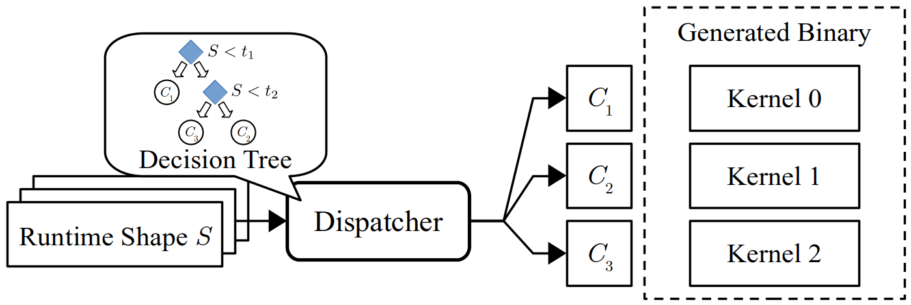
DietCode: A New Auto-Scheduler Framework
Operator
Specification
Shape
Description
DietCode
Shape-Generic Search Space
Micro-Kernel-based
Cost Model
Guide
Notes:
To address those two challenges, we propose DietCode, a new auto-scheduler framework that efficiently supports dynamic-shape workloads.
Due to the time limitation, in this presentation, we mainly focus on two key ideas, or submodules, of DietCode, namely the shape-generic search space and the micro-kernel based cost model.

Slide 35
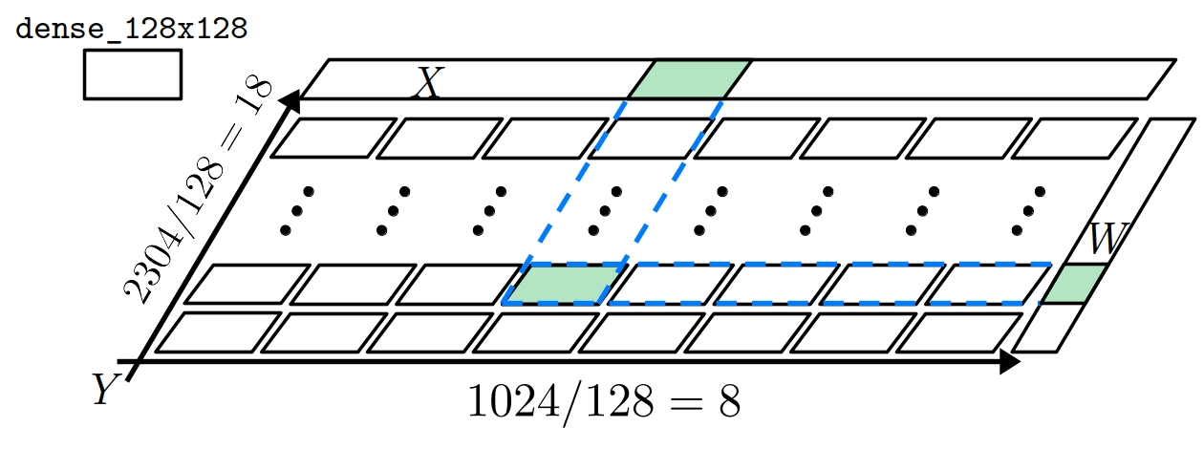

DietCode: Key Ideas
Key Idea #1: Shape-Generic Search Space
  Composed of micro-kernels. Each does a tile of the entire compute.
  A micro-kernel can be ported to all shapes of the same operator.
  Sampled from hardware constraints instead of shape factors (i.e., shape-generic).
Example:
$Y=XW^{T} X: \left[1024, 768\right], W:\left[2304, 768\right]$ with micro-kernel dense_128x128, which evaluates
$Y=XW^{T} X: \left[128, 768\right], W:\left[128, 768\right]$
Notes:
Our first key idea, shape-generic search space, constructs a search space that is composed of micro-kernels.
Each micro-kernel does a tile of the entire compute and can be ported to all shapes of the same operator.
As an example, on the RHS of the slide, we are illustrating how the micro-kernel dense_128x128 can be used to realize the compute 1024x2304 by replicating itself 8x18 times along the spatial dimensions.
The micro-kernels are sampled mostly from the hardware constraints instead of the shape factors. Hence, they form a search space that is shape-generic.

Slide 36
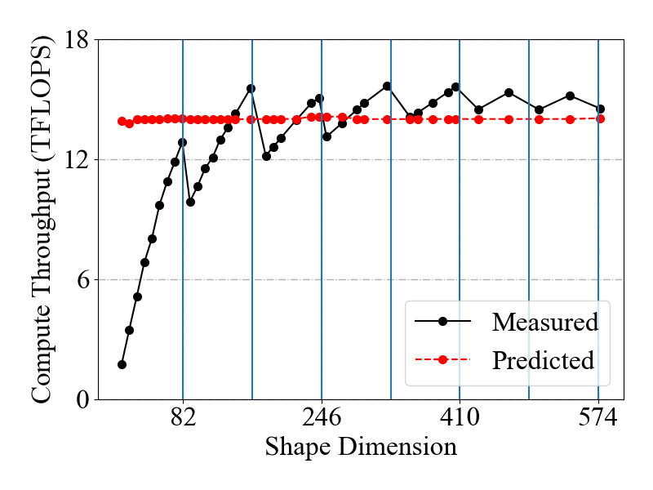
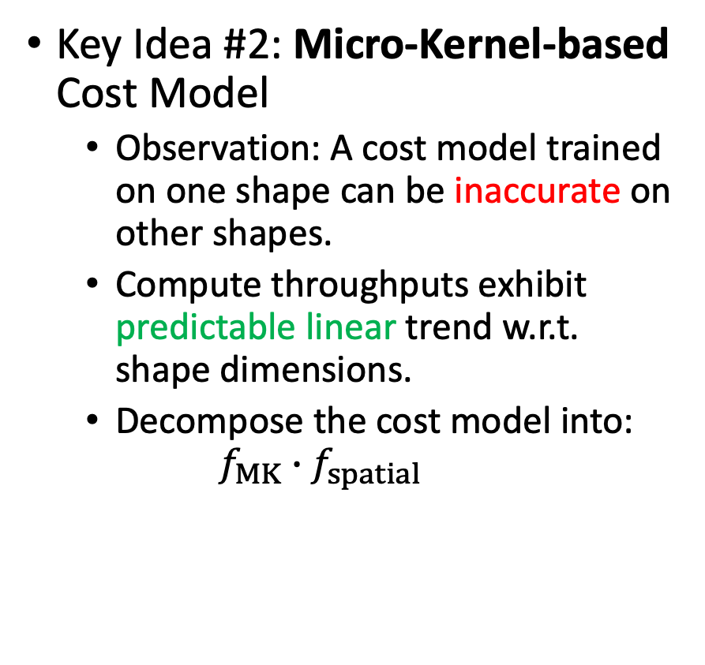
DietCode: Key Ideas
Key Idea #2: Micro-Kernel-based Cost Model
  Observation: A cost model trained on one shape can be inaccurate on other shapes.
  Compute throughputs exhibit predictable linear trend w.r.t. shape dimensions.
  Decompose the cost model into:
  $$f_{MK}∙f_{spatial}$$
Notes:
Our second key idea, micro-kernel based cost model, is from the observation that the existing cost model, if trained on one shape, can be inaccurate on other shapes. As we can see from the RHS of the slide. As we vary the shape of the workload, the existing cost model is unable to capture the change in the compute throughputs.
We further notice, however, that the compute throughputs exhibit predictable linear trend w.r.t. the shape dimensions.
This therefore motivates us to build a new cost model that can be decomposed into two components:

Slide 37
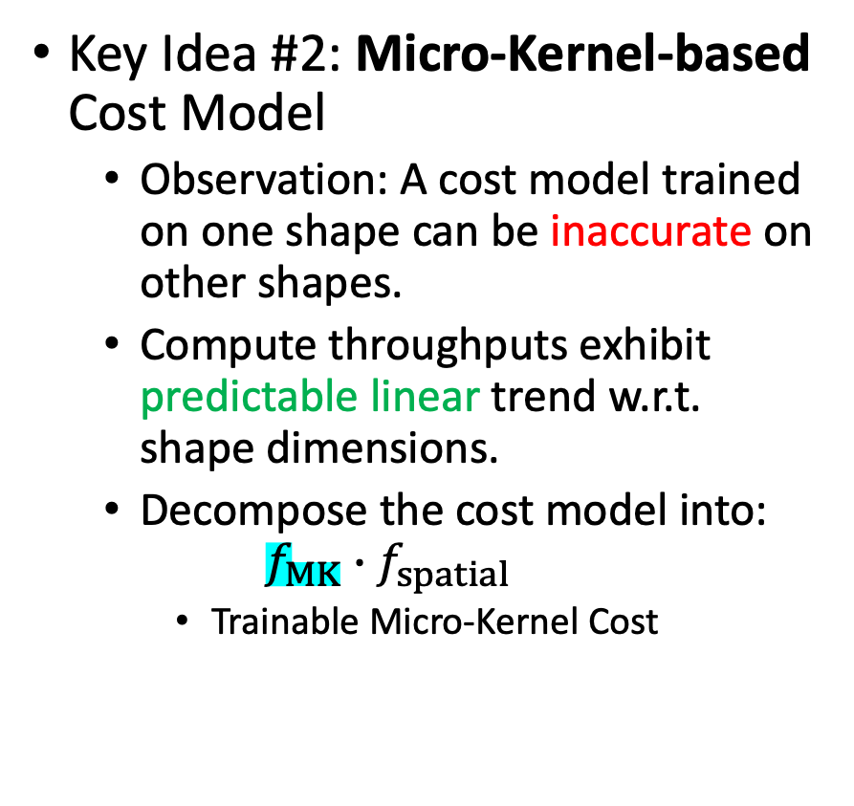
DietCode: Key Ideas
Key Idea #2: Micro-Kernel-based Cost Model
  Observation: A cost model trained on one shape can be inaccurate on other shapes.
  Compute throughputs exhibit predictable linear trend w.r.t. shape dimensions.
  Decompose the cost model into:
  $$f_{MK}∙f_{spatial}$$
    Trainable Micro-Kernel Cost
Notes:
A trainable micro-kernel cost that is modelled using XGBoost.

Slide 38
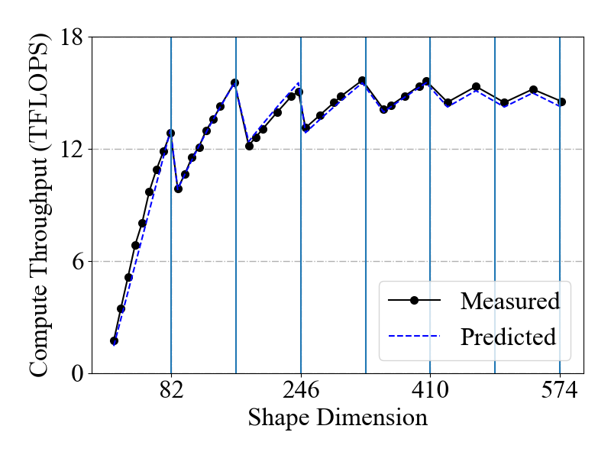
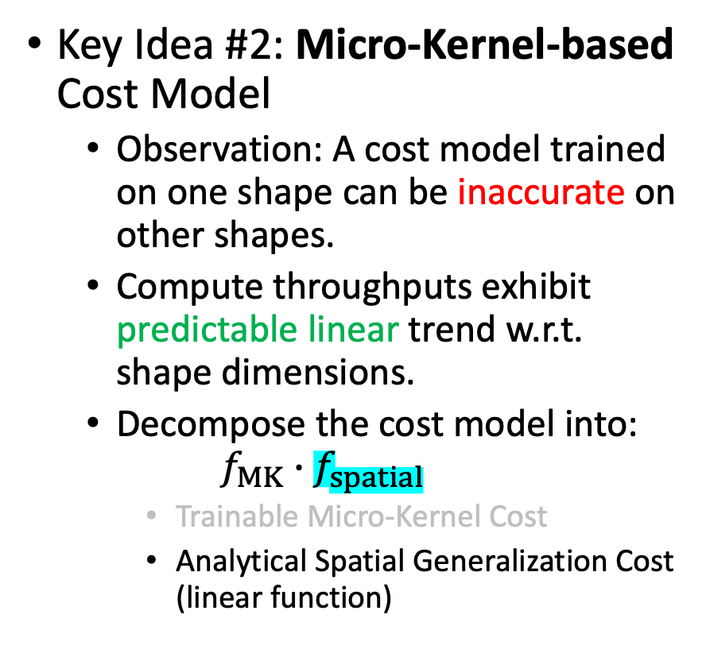
DietCode: Key Ideas
Key Idea #2: Micro-Kernel-based Cost Model
  Observation: A cost model trained on one shape can be inaccurate on other shapes.
  Compute throughputs exhibit predictable linear trend w.r.t. shape dimensions.
  Decompose the cost model into:
  $$f_{MK}∙f_{spatial}$$
    Trainable Micro-Kernel Cost
    Analytical Spatial Generalization Cost (linear function)
Notes:
and an analytical spatial generalization cost that is modelled using a linear function.

Slide 39
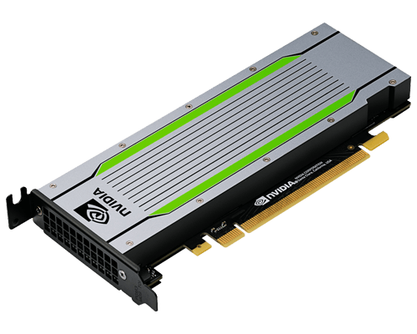

Evaluation
Hardware: NVIDIA Tesla T4 GPU
Software: TVM + CUDA + cuDNN
v0.8.dev0
v11.3
v8.3
Notes:
To test the effectiveness of DietCode, we evaluate on a hardware platform equipped with a modern Tesla T4 GPU, CUDA 11.3 and cuDNN 8.3.

Slide 40
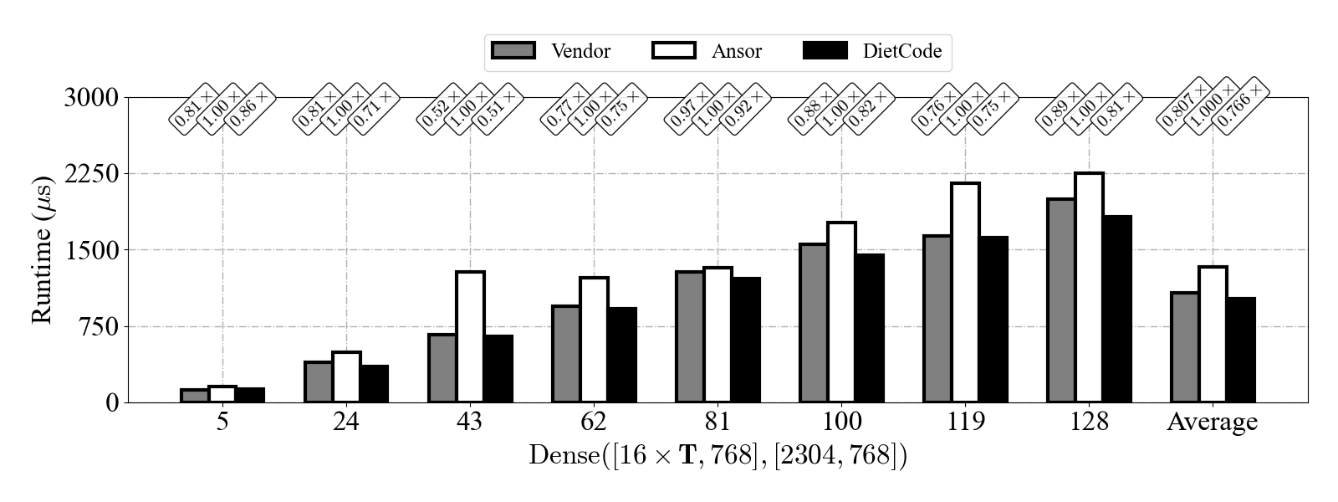
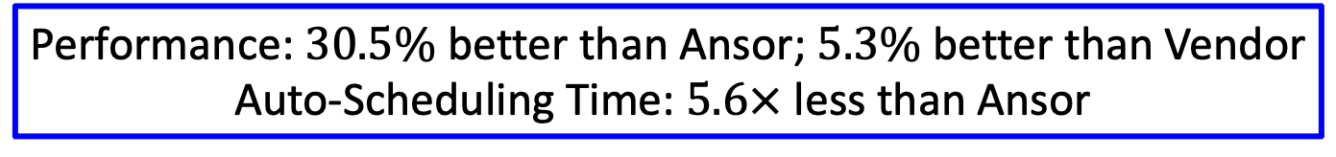
Evaluation
Better
Performance: $30.5\%$ better than Ansor; $5.3\%$ better than Vendor
Auto-Scheduling Time: $5.6×$ less than Ansor
Notes:
We use DietCode to auto-schedule the dense layers extracted from the BERT model, which is a state-of-the-art language modelling application. The sequence length we use is uniformly sampled within the range of [1, 128].
We observe that with those sampled sequence lengths. DietCode delivers on average 30% better than Ansor, the current auto-scheduler design in TVM, in terms of performance, and 5% better than the cuBLAS Vendor library. Furthermore, since DietCode only needs to auto-schedule once and for all shape instances. Its auto-scheduling time is 5.6x less than Ansor.

Slide 41
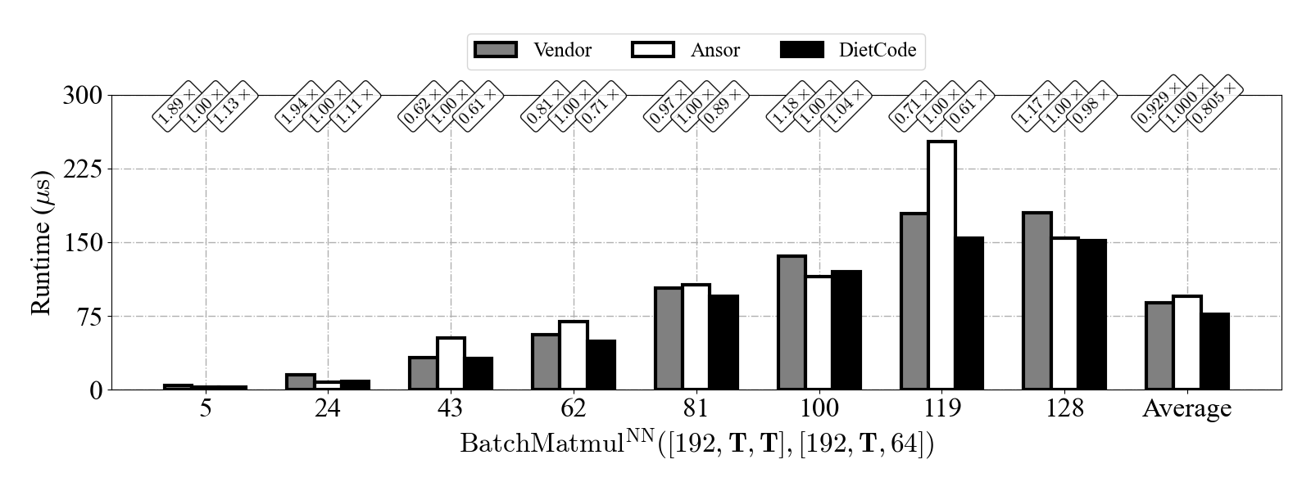
Evaluation
What about multiple dynamic axes?
Better
Performance: $24.2\%$ better than Ansor; $15.4\%$ better than Vendor
Notes:
To make it even more exciting, DietCode also supports workloads with multiple dynamic axes.
We auto-schedule the batched matrix multiply layers extracted from the BERT model, with a spatial axis and a dynamic axis being dynamic.
As we can see from the result, across all the sequence lengths evaluated, DietCode delivers on average 24% better performance than Ansor and 15% better than Vendor. These results indicate that DietCode is a practical auto-scheduler for dynamic-shape workloads.

Slide 42
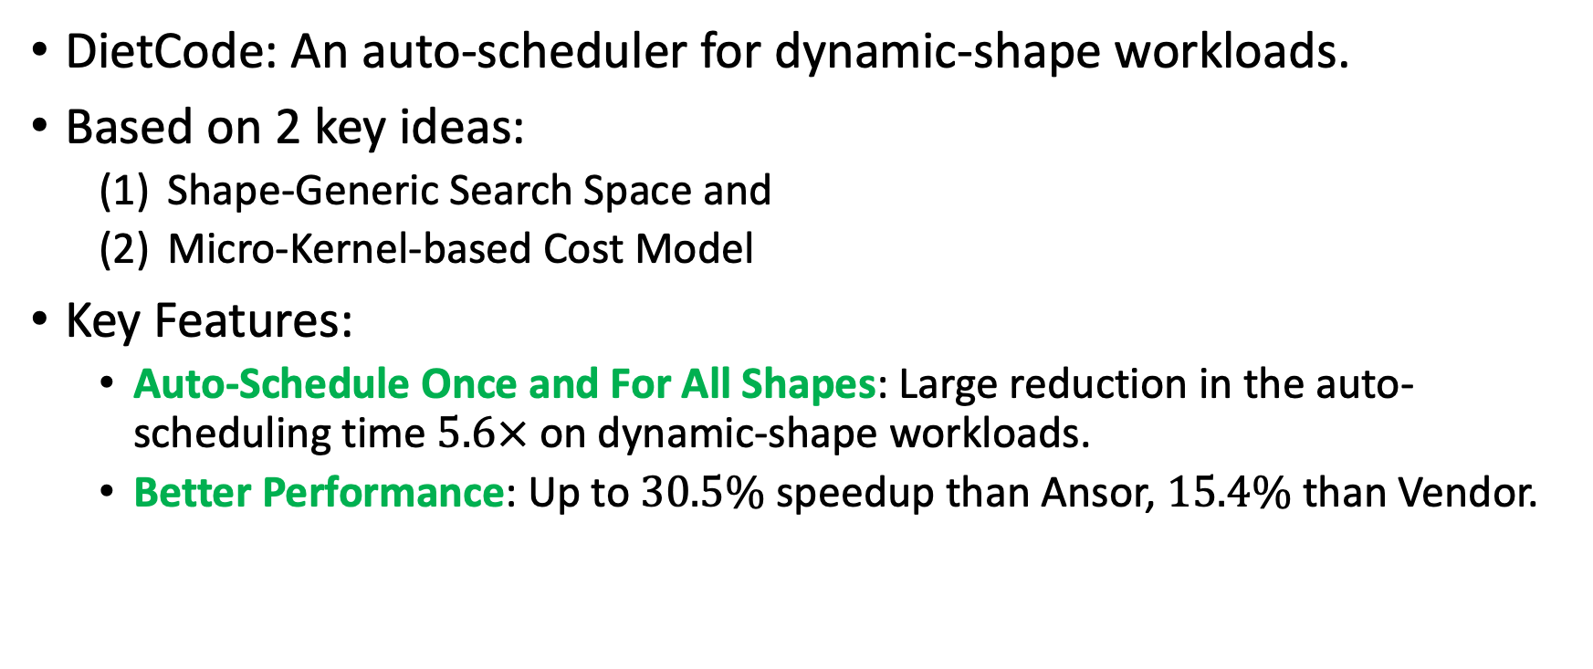
Summary
DietCode: An auto-scheduler for dynamic-shape workloads.
Based on 2 key ideas:
  Shape-Generic Search Space and
  Micro-Kernel-based Cost Model
Key Features:
  Auto-Schedule Once and For All Shapes: Large reduction in the auto-scheduling time $5.6×$ on dynamic-shape workloads.
  Better Performance: Up to $30.5\%$ speedup than Ansor, $15.4\%$ than Vendor.
Notes:
In this presentation, we present DietCode, an auto-scheduler for dynamic-shape workloads.
DietCode is based on two key ideas: Constructing a shape-generic search space that is composed of micro-kernels. Using a micro-kernel-based cost model that consists of a trainable micro-kernel cost and an analytical spatial generalization cost.
Our evaluation of DietCode shows that it only needs to auto-schedule once and for all shapes, leading to large reduction in the auto-scheduling time. Furthermore, it can deliver performance by up to 30% better than Ansor, the current auto-scheduler design in TVM, and 15% better than the vendor library on a modern GPU.
We are currently working on integrating DietCode as part of the TVM main branch.

Slide 43
Last Time
Why Machine Learning Compilers?
  State-of-the-Art Machine Learning Frameworks Design, and Flaws:
  Vendor libraries not delivering the optimal performance.
2 Classes of Machine Learning Compilers:
  Halide^{[1]}/TVM^{[2]}: Easier to write high-performance programs.
[1] J. Ragan-Kelley et al. Halide: A Language and Compiler for Optimizing Parallelism, Locality, and Recomputation in Image Processing Pipelines. PLDI 2013
[2] T. Chen et al. TVM: An Automated End-to-End Optimizing Compiler for Deep Learning. OSDI 2018

Slide 44
Agenda for Today
Why Machine Learning Compilers?
  State-of-the-Art Machine Learning Frameworks Design, and Flaws:
  Vendor libraries not delivering the optimal performance.
  Distinct representations at different system levels.
2 Classes of Machine Learning Compilers:
  Halide^{[1]}/TVM^{[2]}: Easier to write high-performance programs.
  MLIR^{[3]}/TensorIR^{[4]}: Unified compiler infrastructure.
[1] J. Ragan-Kelley et al. Halide: A Language and Compiler for Optimizing Parallelism, Locality, and Recomputation in Image Processing Pipelines. PLDI 2013
[2] T. Chen et al. TVM: An Automated End-to-End Optimizing Compiler for Deep Learning. OSDI 2018
[3] C. Lattner et al. MLIR: Scaling Compiler Infrastructure for Domain Specific Computation. CGO 2021
[4] S. Feng et al. Understanding TensorIR: An Abstraction for Tensorized Program Optimization. TVMCon 2021

Slide 45
Why Unity?
State-of-the-Art Machine Learning Frameworks Design:
Python Programming Front-end
define neural networks
C++ Framework Core
optimize graphs; schedule operators;
allocate hardware resources …
Vendor APIs & Libraries
Hardware Architectures

Slide 46
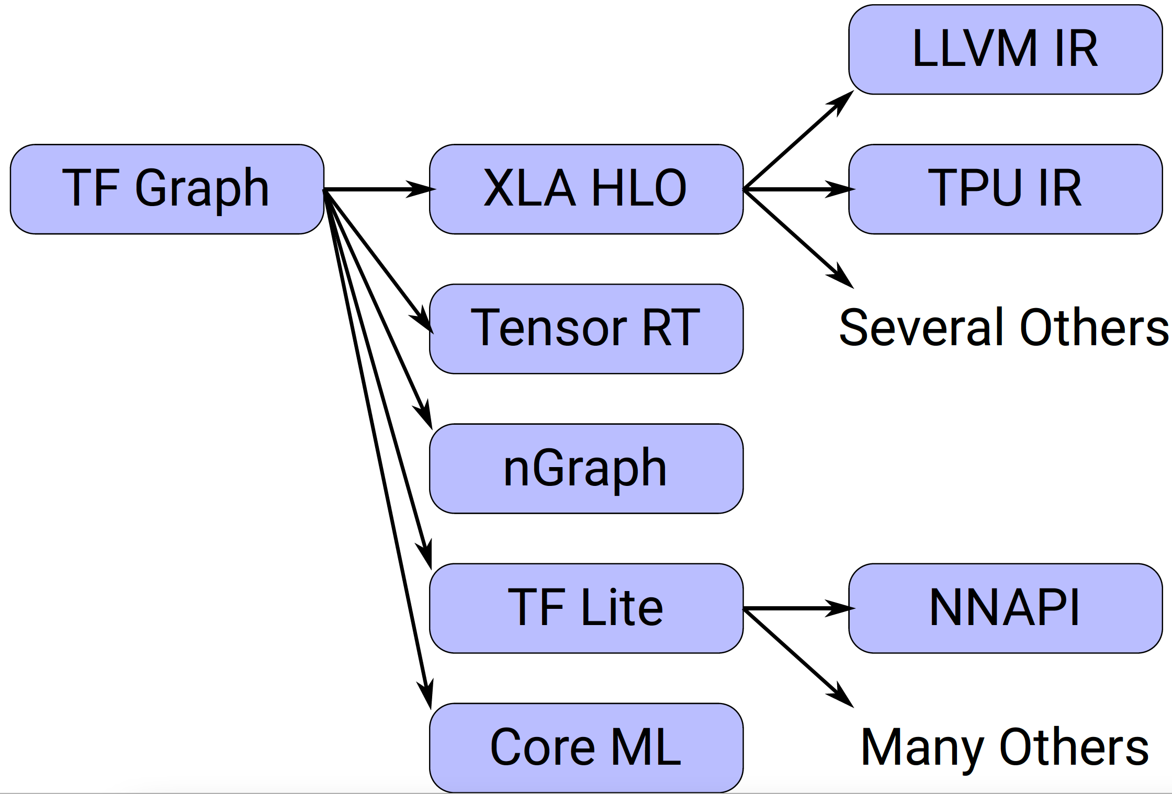
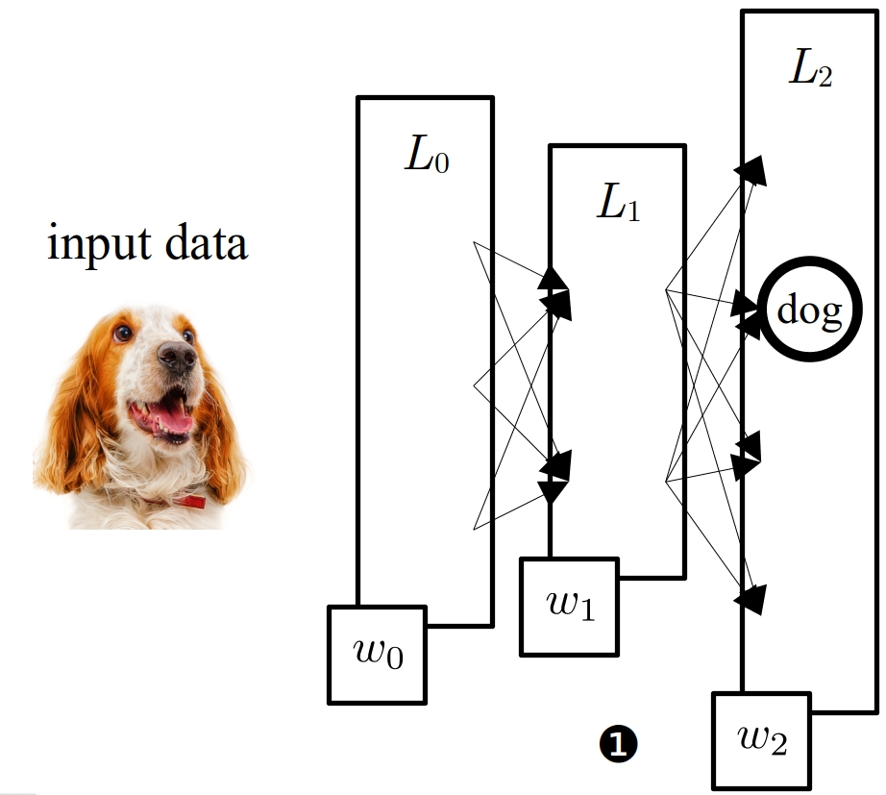
TensorFlow System Overview
Distinct representations at
different system levels

Slide 47
TVM System Overview
Distinct representations at
different system levels
Relay
output = relay.dense(data, weight)
for i in range(...):
for j in range(...):
for k in range(...):
Y[i][j] += X[i][k] * W[j][k]
Schedule Tree
TE
s = create_schedule(Y.op)
Y_local = s.cache_write([Y], "local")
i, j, k = tuple(Y_local.op.axis)
...
primfn(X_1: handle, W_1: handle, Y_1: handle) -> ()
attr [IterVar(blockIdx.x: int32)] "thread_extent" = 144;
allocate(Y.local: Pointer(local float32), [64]);
allocate(X.shared: Pointer(shared float32), [512]);
allocate(W.shared: Pointer(shared float32), [512]);
attr [IterVar(threadIdx.x: int32)] "thread_extent" = 256 {
...
}
TIR
Hard boundary between representations
__global__ void __launch_bounds__(256)
default_function_kernel0(
float* __restrict__ X,
float* __restrict__ W,
float* __restrict__ Y) {
...
}
C++/CUDA etc.

Slide 48
What’s wrong about this design?
Duplicated Infrastructure
  Similar utility classes and functions for each IR.
Premature Lowering
  Need to lower ALL regions at once.
  Unidirectional lowering makes it hard to recover high-level IRs.

Slide 49
Multi-Level Intermediate Representation^{[1]}
abbrev. MLIR
Objective: Unified compiler infrastructure.
Key Idea: Same infrastructure, distinct dialects at different levels.
Each dialect is a set of operators.
IRs | Operators
TensorFlow Graphs
Affine For
LLVM Instructions
[1] C. Lattner. MLIR: A Compiler Infrastructure for the End of Moore's Law. arXiv 2020

Slide 50

TensorIR^{[1]}
Objective: Unified compiler infrastructure.
Key Idea: Remove schedule tree representation.
[1] S. Feng et al. Understanding TensorIR: An Abstraction for Tensorized Program Optimization. TVMCon 2021

Slide 51
TensorIR^{[1]}
Schedule Tree
TensorIR
(-) Not Intuitive
(-) Hard to support even existing hardware primitives.
s = te.create_schedule(Y)
Y_local = s.cache_write([Y], "local")
i, j, k = tuple(Y_local.op.axis)
i_o_i, i_i = s[Y_local].split(i, factor=8)
i_o_o_i, i_o_i = s[Y_local].split(i_o_i, factor=2)
i_o_o_o, i_o_o_i = s[Y_local].split(i_o_o_i, factor=1)
...
def MatMul(x, w, y):
X = tir.match_buffer(x, (1024, 1024), "float32")
W = tir.match_buffer(w, (1024, 1024), "float32")
Y = tir.match_buffer(y, (1024, 1024), "float32")
reducer = tir.comm_reducer(lambda x, y: x + y, tir.float32(0))
with tir.block([1024, 1024, tir.reduce_axis(0, 1024)], "Y") \
as [vi, vj, vk]:
reducer.step(Y[vi, vj], X[vi, vk] * W[vk, vj])

Slide 52
TensorIR^{[1]}
Schedule Tree
TensorIR
(-) Not Intuitive
(-) Hard to support even existing hardware primitives.
s = te.create_schedule(Y)
Y_local = s.cache_write([Y], "local")
i, j, k = tuple(Y_local.op.axis)
i_o_i, i_i = s[Y_local].split(i, factor=8)
i_o_o_i, i_o_i = s[Y_local].split(i_o_i, factor=2)
i_o_o_o, i_o_o_i = s[Y_local].split(i_o_o_i, factor=1)
...
(+) Expressive
(+) Hierarchical Block structure makes it easier to map to hardware primitives.
def MatMul(x, w, y):
X = tir.match_buffer(x, [1024, 1024])
W = tir.match_buffer(w, [1024, 1024])
Y = tir.match_buffer(y, [1024, 1024])
reducer = tir.comm_reducer(lambda a, b: a + b, tir.float32(0))
for i0_outer, i1_outer, i2_outer, i2_inner, \
i0_inner, i1_inner in tir.grid(32, 32, 256, 4, 32, 32):
with tir.block([1024, 1024, tir.reduce_axis(0, 1024)], "C") \
as [vi, vj, vk]:
tir.bind(vi, ((i0_outer*32) + i0_inner))
tir.bind(vj, ((i1_outer*32) + i1_inner))
tir.bind(vk, ((i2_outer*4) + i2_inner))
reducer.step(Y[vi, vj], (X[vi, vk]*W[vk, vj]))

Slide 53
Concluding Remarks
Why Machine Learning Compilers?
  State-of-the-Art Machine Learning Frameworks Design, and Flaws:
  Vendor libraries not delivering the optimal performance.
  Distinct representations at different system levels.
2 Classes of Machine Learning Compilers:
  Halide^{[1]}/TVM^{[2]}: Easier to write high-performance programs.
  MLIR^{[3]}/TensorIR^{[4]}: Unified compiler infrastructure.
[1] J. Ragan-Kelley et al. Halide: A Language and Compiler for Optimizing Parallelism, Locality, and Recomputation in Image Processing Pipelines. PLDI 2013
[2] T. Chen et al. TVM: An Automated End-to-End Optimizing Compiler for Deep Learning. OSDI 2018
[3] C. Lattner et al. MLIR: Scaling Compiler Infrastructure for Domain Specific Computation. CGO 2021
[4] S. Feng et al. Understanding TensorIR: An Abstraction for Tensorized Program Optimization. TVMCon 2021

Slide 54
Python Programming Front-end
define neural networks
C++ Framework Core
optimize graphs; schedule operators;
allocate hardware resources …
Vendor APIs & Libraries
Hardware Architectures

Slide 55
X: [{\color{red}\mathbf{129}}, K], W: [{\color{red}\mathbf{129}}, K]?
y=xw^\top\quad
\begin{cases}
x: [32, *], w: [32, *] \\
x: [64, *], w: [64, *] \\
x: [128, *], w: [128, *]
\end{cases}

Slide 57
Current TensorFlow System
Task #1: Eliminate dead graph nodes.
Task #2: Eliminate dead C++ code.
Really different?

Slide 58
TVM System Overview
Relay
output = relay.dense(data, weight)
for i in range(...):
for j in range(...):
for k in range(...):
Y[i][j] += X[i][k] * W[j][k]
Schedule Tree
TE
s = create_schedule(Y.op)
Y_local = s.cache_write([Y], "local")
i, j, k = tuple(Y_local.op.axis)
...
primfn(X_1: handle, W_1: handle, Y_1: handle) -> ()
attr [IterVar(blockIdx.x: int32)] "thread_extent" = 144;
allocate(Y.local: Pointer(local float32), [64]);
allocate(X.shared: Pointer(shared float32), [512]);
allocate(W.shared: Pointer(shared float32), [512]);
attr [IterVar(threadIdx.x: int32)] "thread_extent" = 256 {
...
}
TIR
__global__ void __launch_bounds__(256)
default_function_kernel0(
float* __restrict__ X,
float* __restrict__ W,
float* __restrict__ Y) {
...
}
C++/CUDA etc.

