Slide 1
DietCode: Automatic Code Generation for Dynamic Tensor Programs
Bojian Zheng^{*1, 2, 3}, Ziheng Jiang^{*4}, Cody Yu², Haichen Shen², Josh Fromm⁵, Yizhi Liu², Yida Wang², Luis Ceze^{5, 6}, Tianqi Chen^{5, 7}, Gennady Pekhimenko^{1, 2, 3}
* Equal Contribution
1
2
3
4
5
6
7
Notes:
Thank you so much for attending this presentation my name is Bojian and I’m here to present our work DietCode which is on automatic code generation for dynamic tensor programs.

Slide 2
Background: Current Auto-Scheduler Design
Notes:
Before diving into the details of DietCode, let us first do a quick review of the current auto scheduler design, which starts with a user supplying an operator specification and static shape description.

Slide 3
Background: Current Auto-Scheduler Design
An operator can have infinitely many possible schedules
Example
Compute:
for (int i = 0; i < 50; ++i) {
A[i] = ...
}
Notes:
Based on the provided information, the auto-scheduler automatically constructs a search space that includes all the schedules under consideration.
However, the key challenge is that an operator can in theory have infinitely many possible schedules.
As an example, consider the compute as is shown on the screen. Imagine that we are about to apply the loop tiling transformation to the loop structure.

Slide 4
Background: Current Auto-Scheduler Design
An operator can have infinitely many possible schedules
Example
Schedule:
for (int io = 0; io < $\left\lceil 50/t\right\rceil$; ++io) {
for (int ii = 0; ii < $t$; ++ii) {
if ($io×t+ii<50$) A[$io×t+ii$] = ...
}
}
$t∈\left[2, ∞\right)$!
Notes:
As you might notice as well, even with such a simple transformation. There can be infinitely many possible tiling candidates as is shown on the slide.

Slide 5
Background: Current Auto-Scheduler Design
Limit the candidates to perfect factors
Example
Schedule:
for (int io = 0; io < $\left\lceil 50/t\right\rceil$; ++io) {
for (int ii = 0; ii < $t$; ++ii) {
if ($io×t+ii<50$) A[$io×t+ii$] = ...
}
}
Schedule:
for (int io = 0; io < $\left\lceil 50/t\right\rceil$; ++io) {
for (int ii = 0; ii < $t$; ++ii) {
if ($io×t+ii<50$) A[$io×t+ii$] = ...
}
}
$$t∈\left\{2, 5, 10, 25\right\}$$
Notes:
To limit the search space, one of the solutions that is commonly adopted is to circumscribe the tiling candidates to those that are perfect factors. Because the perfect factors are dependent on the loop extent, we hence name this approach shape-dependent search space construction.
The additional benefit of this approach is that it also avoids the necessity of introducing out-of-boundary checks in the loop body.

Slide 6
Background: Current Auto-Scheduler Design
Schedule
predicts
Notes:
To efficiently search through the search space, the auto-scheduler introduces a complete program cost model that can accurately predict the performance of each schedule.

Slide 7
Background: Current Auto-Scheduler Design
Notes:
During the learning process, the auto-scheduler uses a cost model that is constantly updated using real hardware measurements to guide the search in the shape-dependent search space.

Slide 8
Background: Current Auto-Scheduler Design
Notes:
and finally deliver a high-performance program.

Slide 9
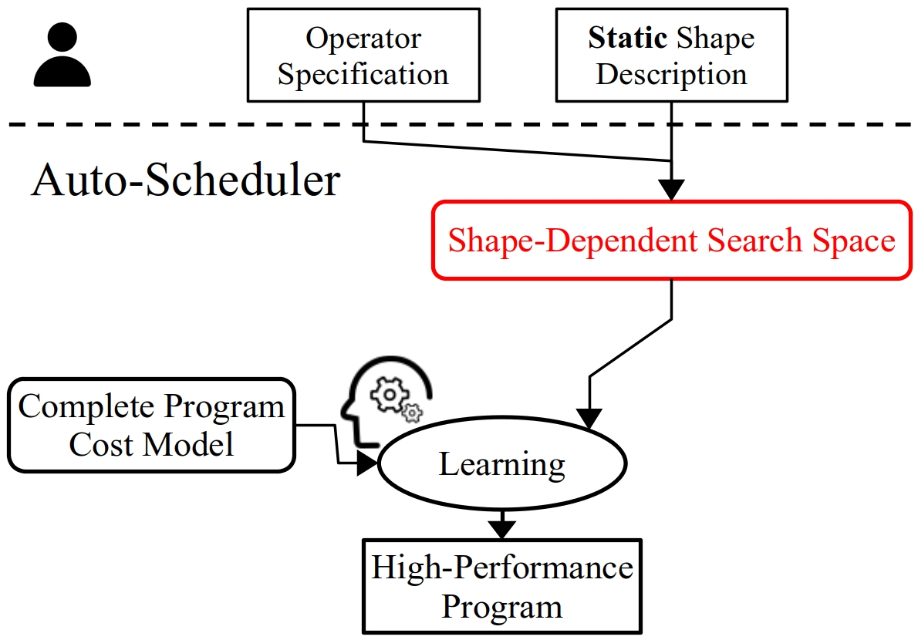
Challenges Faced by the Current Design
Challenge #1:
Hard to share schedules across different shapes of the same operator.
Example
Schedule:
for (int io = 0; io < $\left\lceil 50/t\right\rceil$; ++io) {
for (int ii = 0; ii < $t$; ++ii) {
A[$io×t+ii$] = ...
}
}
$$t∈\left\{2, 5, 10, 25\right\}$$
Notes:
However, we do notice that there are several challenges faced with the current auto-scheduler design, with the first one being that it is hard to share schedules across different shapes of the same operator.
Consider the loop tiling example that we have previously, imagine that the outer loop extent has been changed from 50 to say,
49.

Slide 10
Challenges Faced by the Current Design
Challenge #1:
Hard to share schedules across different shapes of the same operator.
Example
Schedule:
for (int io = 0; io < $\left\lceil 49/t\right\rceil$; ++io) {
for (int ii = 0; ii < $t$; ++ii) {
A[$io×t+ii$] = ...
}
}
$$t∈\left\{7\right\}$$
$$⋂\left\{2, 5, 10, 25\right\}=∅$$
Notes:
With this single change, the tiling candidates have been reduced to a single-element set 7,
which does not have any intersection with the factors of 50.

Slide 11
Challenges Faced by the Current Design
Challenge #1:
Hard to share schedules across different shapes of the same operator.
Example
Schedule:
for (int io = 0; io < $\left\lceil 49/t\right\rceil$; ++io) {
for (int ii = 0; ii < $t$; ++ii) {
A[$io×t+ii$] = ...
}
}
$$t∈\left\{7\right\}$$
$$⋂\left\{2, 5, 10, 25\right\}=∅$$
Prohibitably expensive auto-scheduling time for dynamic-shape workloads.
Notes:
The fact that it is hard to share schedules under the shape-dependent search space construction further implies that it is extremely challenging to auto-schedule dynamic-shape workloads. Assuming that we have a workload whose shapes are dynamic at compile time, in order to auto-schedule for such a workload, we need to search for each shape instance of the workload, as is shown on the RHS of the slide, which is clearly inefficient.

Slide 12
Challenges Faced by the Current Design
Challenge #2:
Can deliver sub-optimal performance for not considering non-perfect candidates.
Example
Schedule:
for (int io = 0; io < $\left\lceil 49/t\right\rceil$; ++io) {
for (int ii = 0; ii < $t$; ++ii) {
if ($io×t+ii<49$) A[$io×t+ii$] = ...
}
}
Schedule:
for (int io = 0; io < $\left\lceil 49/t\right\rceil$; ++io) {
for (int ii = 0; ii < $t$; ++ii) {
if ($io×t+ii<49$) A[$io×t+ii$] = ...
}
}
Schedule:
for (int io = 0; io < $\left\lceil 49/t\right\rceil$; ++io) {
for (int ii = 0; ii < $t$; ++ii) {
A[$io×t+ii$] = ...
}
}
$$t∈\left\{7\right\}$$
$t=2, 3, …$ might be better candidates
Observation: Performance overhead of if-checks is negligible with local padding (i.e., pad tensors locally by the size of local and/or shared memory variables).
Notes:
The second challenge the current auto-scheduler is facing is that it can deliver sub-optimal performance for not considering non-perfect candidates.
Still the same tiling example. Clearly, the current set with a single candidate is too limited, as tiling factors 2, 3, etc. are also viable, and they might deliver better performance compared with 7.
Although it is correct that extra out-of-boundary checks have now to be injected inside the loop body for the program to be correct.
We observe that the performance overhead of those out-of-boundary checks can be negligible with the local padding code generation optimization technique. A technique that pads tensors locally by the size of the local workspace.

Slide 13
DietCode: A New Auto-Scheduler Framework
Notes:
To address those two challenges, we propose DietCode, a new auto-scheduler framework that efficiently supports dynamic-shape workloads.
Due to the time limitation, in this presentation, we mainly focus on two key ideas, or submodules, of DietCode, namely the shape-generic search space and the micro-kernel based cost model.

Slide 14
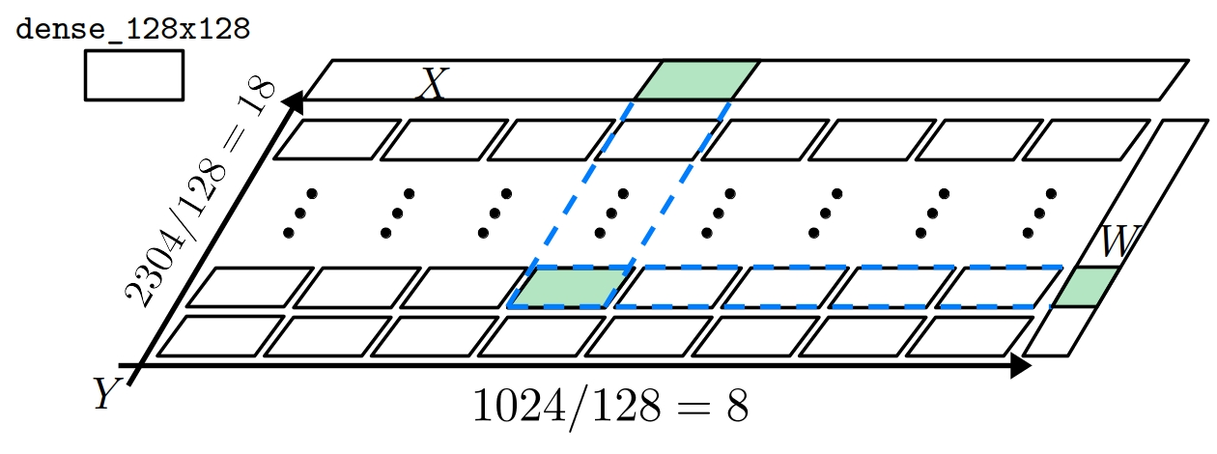
DietCode: Key Ideas
Key Idea #1: Shape-Generic Search Space
Composed of micro-kernels. Each does a tile of the entire compute.
A micro-kernel can be ported to all shapes of the same operator.
Sampled from hardware constraints instead of shape factors (i.e., shape-generic).
Example:
$Y=XW^{T} X: \left[1024, 768\right], W:\left[2304, 768\right]$ with micro-kernel dense_128x128, which evaluates
$Y=XW^{T} X: \left[128, 768\right], W:\left[128, 768\right]$
Notes:
Our first key idea, shape-generic search space, constructs a search space that is composed of micro-kernels.
Each micro-kernel does a tile of the entire compute and can be ported to all shapes of the same operator.
As an example, on the RHS of the slide, we are illustrating how the micro-kernel dense_128x128 can be used to realize the compute 1024x2304 by replicating itself 8x18 times along the spatial dimensions.
The micro-kernels are sampled mostly from the hardware constraints instead of the shape factors. Hence, they form a search space that is shape-generic.

Slide 15
DietCode: Key Ideas
Key Idea #2: Micro-Kernel-based Cost Model
Observation: A cost model trained on one shape can be inaccurate on other shapes.
Compute throughputs exhibit predictable linear trend w.r.t. shape dimensions.
Decompose the cost model into:
$$f_{MK}∙f_{spatial}$$
Notes:
Our second key idea, micro-kernel based cost model, is from the observation that the existing cost model, if trained on one shape, can be inaccurate on other shapes. As we can see from the RHS of the slide. As we vary the shape of the workload, the existing cost model is unable to capture the change in the compute throughputs.
We further notice, however, that the compute throughputs exhibit predictable linear trend w.r.t. the shape dimensions.
This therefore motivates us to build a new cost model that can be decomposed into two components:

Slide 16
DietCode: Key Ideas
Key Idea #2: Micro-Kernel-based Cost Model
Observation: A cost model trained on one shape can be inaccurate on other shapes.
Compute throughputs exhibit predictable linear trend w.r.t. shape dimensions.
Decompose the cost model into:
$$f_{MK}∙f_{spatial}$$
Trainable Micro-Kernel Cost
Notes:
A trainable micro-kernel cost that is modelled using XGBoost.

Slide 17
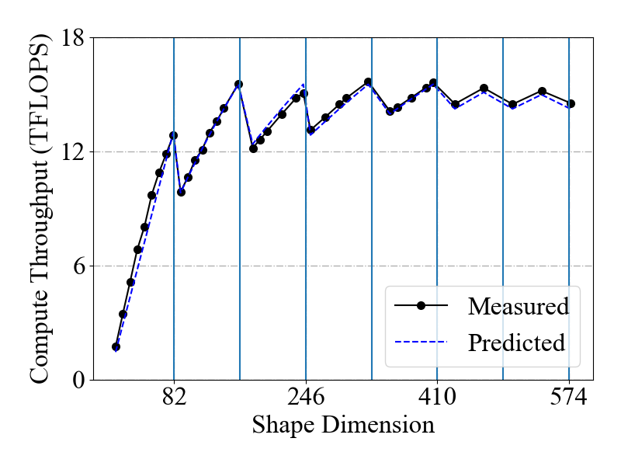
DietCode: Key Ideas
Key Idea #2: Micro-Kernel-based Cost Model
Observation: A cost model trained on one shape can be inaccurate on other shapes.
Compute throughputs exhibit predictable linear trend w.r.t. shape dimensions.
Decompose the cost model into:
$$f_{MK}∙f_{spatial}$$
Trainable Micro-Kernel Cost
Analytical Spatial Generalization Cost (linear function)
Notes:
and an analytical spatial generalization cost that is modelled using a linear function.

Slide 18
DietCode: A New Interface
Supports dynamic-shape workloads with its new interface.
E.g., $Y=XW^{T} X: \left[16×T, 768\right], W:\left[2304, 768\right], T∈\left[1, 128\right]$
T, T_vals = tir.ShapeVar('T’), list(range(1, 128))
task = SearchTask(func=Dense, args=(16*T, 768, 2304),
shape_vars=(T,), wkl_insts=(T_vals,)
wkl_inst_weights=([1. for _ in T_vals],)
)
Notes:
With those two key ideas, we further devise a new interface of DietCode to better support dynamic-shape workloads.

Slide 19
DietCode: A New Interface
Supports dynamic-shape workloads with its new interface.
E.g., $Y=XW^{T} X: \left[16×T, 768\right], W:\left[2304, 768\right], T∈\left[1, 128\right]$
T, T_vals = tir.ShapeVar('T’), list(range(1, 128))
task = SearchTask(func=Dense, args=(16*T, 768, 2304),
shape_vars=(T,), wkl_insts=(T_vals,)
wkl_inst_weights=([1. for _ in T_vals],)
)
Define a dynamic shape variable $T$ and its instances.
Notes:
The new interface allows users to define dynamic-shape variables and their instances.

Slide 20
DietCode: A New Interface
Supports dynamic-shape workloads with its new interface.
E.g., $Y=XW^{T} X: \left[16×T, 768\right], W:\left[2304, 768\right], T∈\left[1, 128\right]$
T, T_vals = tir.ShapeVar('T’), list(range(1, 128))
task = SearchTask(func=Dense, args=(16*T, 768, 2304),
shape_vars=(T,), wkl_insts=(T_vals,)
wkl_inst_weights=([1. for _ in T_vals],)
)
Define a dynamic shape variable $T$ and its instances.
Pass the variable and its instances to the workload function.
Notes:
Pass those variables and instances to the workload function.

Slide 21
DietCode: A New Interface
Supports dynamic-shape workloads with its new interface.
E.g., $Y=XW^{T} X: \left[16×T, 768\right], W:\left[2304, 768\right], T∈\left[1, 128\right]$
T, T_vals = tir.ShapeVar('T’), list(range(1, 128))
task = SearchTask(func=Dense, args=(16*T, 768, 2304),
shape_vars=(T,), wkl_insts=(T_vals,)
wkl_inst_weights=([1. for _ in T_vals],)
)
Define a dynamic shape variable $T$ and its instances.
Pass the variable and its instances to the workload function.
[Optional] Assign weight to each shape instance.
Notes:
and optionally, assign weight to each shape instance.

Slide 22
Evaluation
Hardware: NVIDIA Tesla T4 GPU
Software: TVM + CUDA + cuDNN
v0.8.dev0
v11.3
v8.3
Notes:
To test the effectiveness of DietCode, we evaluate on a hardware platform equipped with a modern Tesla T4 GPU, CUDA 11.3 and cuDNN 8.3.

Slide 23
Evaluation
Better
Performance: $30.5\%$ better than Ansor; $5.3\%$ better than Vendor Auto-Scheduling Time: $5.6×$ less than Ansor
Notes:
We use DietCode to auto-schedule the dense layers extracted from the BERT model, which is a state-of-the-art language modelling application. The sequence length we use is uniformly sampled within the range of [1, 128].
We observe that with those sampled sequence lengths. DietCode delivers on average 30% better than Ansor, the current auto-scheduler design in TVM, in terms of performance, and 5% better than the cuBLAS Vendor library. Furthermore, since DietCode only needs to auto-schedule once and for all shape instances. Its auto-scheduling time is 5.6x less than Ansor.

Slide 24
Evaluation
What about multiple dynamic axes?
Better
$24.2\%$ better than Ansor; $15.4\%$ better than Vendor
Notes:
To make it even more exciting, DietCode also supports workloads with multiple dynamic axes.
We auto-schedule the batched matrix multiply layers extracted from the BERT model, with a spatial axis and a dynamic axis being dynamic.
As we can see from the result, across all the sequence lengths evaluated, DietCode delivers on average 24% better performance than Ansor and 15% better than Vendor. These results indicate that DietCode is a practical auto-scheduler for dynamic-shape workloads.

Slide 25
Summary
DietCode: An auto-scheduler for dynamic-shape workloads.
Based on 2 key ideas:
Shape-Generic Search Space and
Micro-Kernel-based Cost Model
Key Features:
Auto-Schedule Once and For All Shapes
Large reduction in the auto-scheduling time.
Better Performance
Up to $30.5\%$ speedup than Ansor, up to $15.4\%$ than Vendor.
Working on integrating into the TVM main branch …
Notes:
In this presentation, we present DietCode, an auto-scheduler for dynamic-shape workloads.
DietCode is based on two key ideas: Constructing a shape-generic search space that is composed of micro-kernels. Using a micro-kernel-based cost model that consists of a trainable micro-kernel cost and an analytical spatial generalization cost.
Our evaluation of DietCode shows that it only needs to auto-schedule once and for all shapes, leading to large reduction in the auto-scheduling time. Furthermore, it can deliver performance by up to 30% better than Ansor, the current auto-scheduler design in TVM, and 15% better than the vendor library on a modern GPU.
We are currently working on integrating DietCode as part of the TVM main branch.

Slide 26
DietCode: Automatic Code Generation for Dynamic Tensor Programs
Bojian Zheng^{*1, 2, 3}, Ziheng Jiang^{*4}, Cody Yu², Haichen Shen², Josh Fromm⁵, Yizhi Liu², Yida Wang², Luis Ceze^{5, 6}, Tianqi Chen^{5, 7}, Gennady Pekhimenko^{1, 2, 3}
* Equal Contribution
1
2
3
4
5
6
7
Notes:
Thanks again for attending this presentation.

Slide 27
Backup

Slide 28
Scratchpad

Slide 29
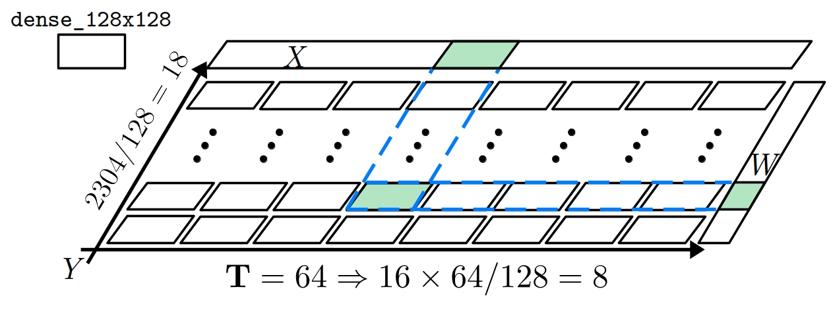
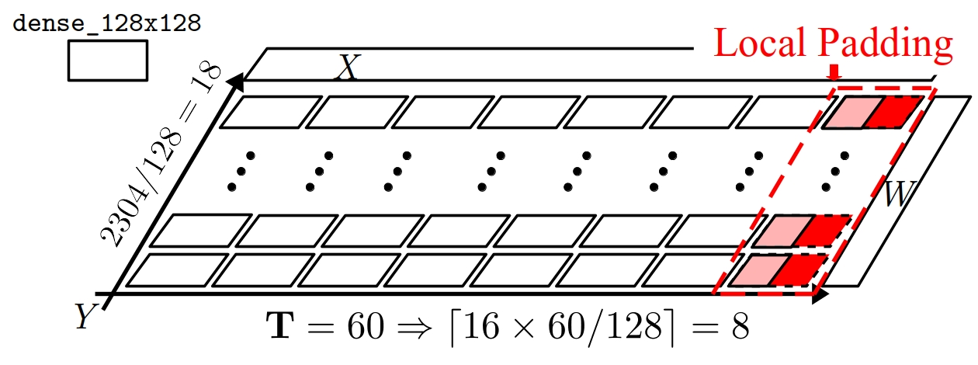
DietCode: Key Ideas
Key Idea #1: Shape-Generic Search Space
Composed of micro-kernels. Each does a tile of the entire compute.
A micro-kernel can be ported to all shapes of the same operator.
Sampled from hardware constraints instead of shape factors (i.e., shape-generic).
Example:
$Y=XW^{T} X: \left[16×T, 768\right], W:\left[2304, 768\right]$ with micro-kernel dense_128x128, which evaluates
$Y=XW^{T} X: \left[128, 768\right], W:\left[128, 768\right]$

Slide 30
Challenges Faced by the Current Design
Challenge #2:
Can deliver sub-optimal performance for not considering non-perfect candidates.
Example
Schedule (Loop Tiling):
for (int io = 0; io < $\left\lceil 49/t\right\rceil$; ++io) {
for (int ii = 0; ii < $t$; ++ii) {
if ($io×t+ii<49$) A[$io×t+ii$] = ...
}
}
$$t∈\left\{7\right\}$$
$t=2, 3, …$ might be better candidates

