Slide 1








DietCode: Automatic Code Generation for Dynamic Tensor Programs
Bojian Zheng^{1, 2, 3 *}, Ziheng Jiang^{4 *}, Cody Yu², Haichen Shen²,
Josh Fromm⁵, Yizhi Liu², Yida Wang²,
Luis Ceze^{5, 6}, Tianqi Chen^{5, 7}, Gennady Pekhimenko^{1, 2, 3}
* Equal Contributions
1
2
3
4
5
6
7

Slide 2
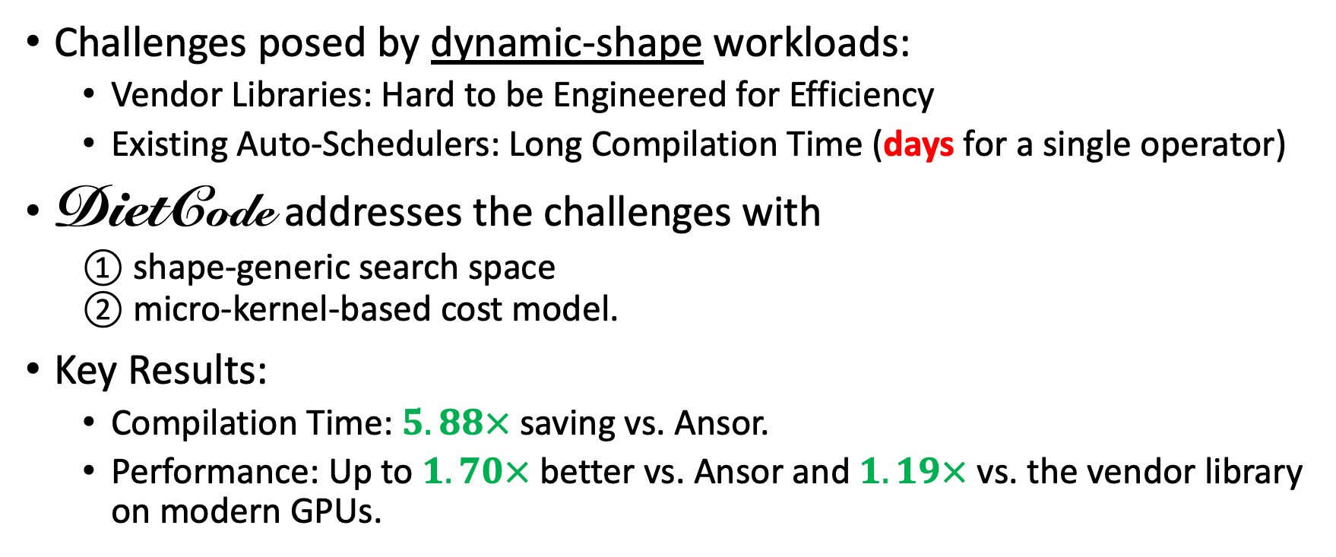
Executive Summary
Challenges posed by dynamic-shape workloads:
  Vendor Libraries: Hard to be Engineered for Efficiency
  Existing Auto-Schedulers: Long Compilation Time (days for a single operator)
DietCode addresses the challenges with
  ① shape-generic search space
  ② micro-kernel-based cost model.
Key Results:
  Compilation Time: $5.88×$ saving vs. Ansor.
  Performance: Up to $1.70×$ better vs. Ansor and $1.19×$ vs. the vendor library on modern GPUs.

Slide 3

Background: ML Framework Stack
[1] J. Guo et al. GluonCV and GluonNLP. JMLR 2020
[2] https://translate.google.com/
[3] https://github.com/NVIDIA/NeMo
[4] M. Abadi et al. TensorFlow. OSDI 2016
[5] A. Paszke et al. PyTorch. NeurIPS 2019
[6] https://github.com/google/jax

Slide 4
Background: ML Framework Stack
Interpretation: Graph of Operators^{[7]}
[4] M. Abadi et al. TensorFlow. OSDI 2016
[5] A. Paszke et al. PyTorch. NeurIPS 2019
[6] https://github.com/google/jax
[7] https://netron.app/

Slide 5

Background: Vendor Libraries
Invoke
Operator
(Matrix Multiply)
Built-in Kernel 2
Dispatcher
Built-in Kernel 1
[1] https://developer.nvidia.com/cublas
[2] https://developer.nvidia.com/cudnn
[3] https://www.nvidia.com/en-us/data-center/tesla-t4/

Slide 6

Background: Vendor Libraries
Invoke
Operator
(Matrix Multiply)
Built-in Kernel 2
Dispatcher
Built-in Kernel 1
[1] https://developer.nvidia.com/cublas
[2] https://developer.nvidia.com/cudnn
[3] https://www.nvidia.com/en-us/data-center/tesla-t4/

Slide 7
Background: Vendor Libraries
Invoke
Operator
(Matrix Multiply)
Built-in Kernel 2
Dispatcher
Built-in Kernel 1
[1] https://developer.nvidia.com/cublas
[2] https://developer.nvidia.com/cudnn
[3] https://www.nvidia.com/en-us/data-center/tesla-t4/

Slide 8
Background: Vendor Libraries
Challenges
  Performance of built-in kernels can be suboptimal on the given shapes or hardware^{[4, 5, 6, 7, 8, 9, …]}.
  Huge engineering efforts and expertise required to tune for specific use cases.
Built-in Kernel 2
Dispatcher
Built-in Kernel 1
[1] https://developer.nvidia.com/cublas
[2] https://developer.nvidia.com/cudnn
[3] https://www.nvidia.com/en-us/data-center/tesla-t4/
[4] T. Chen et al. TVM. OSDI 2018
[5] N. Vasilache et al. Tensor Comprehensions. TACO 2019
[6] L. Zheng et al. Ansor. OSDI 2020
[7] F. Yu et al. Towards Latency-aware DNN Optimization with GPU Runtime Analysis and Tail Effect Elimination. arXiv 2020
[8] S. Feng, B. Hou et al. TensorIR. arXiv 2022
[9] https://tvm.apache.org/2018/03/23/nmt-transformer-optimize

Slide 9
Background: Auto-Scheduler
[1, 2, 3, 4]
Operator
Shape Description
Frontend
Objective:
Auto-Scheduler
Automatically Generate
Hardware
[1] A. Adams et al. Halide Auto-Scheduler. SIGGRAPH 2019
[2] N. Vasilache et al. Tensor Comprehensions. TACO 2019
[3] L. Zheng et al. Ansor. OSDI 2020
[4] S. Feng, B. Hou et al. TensorIR. arXiv 2022

Slide 10
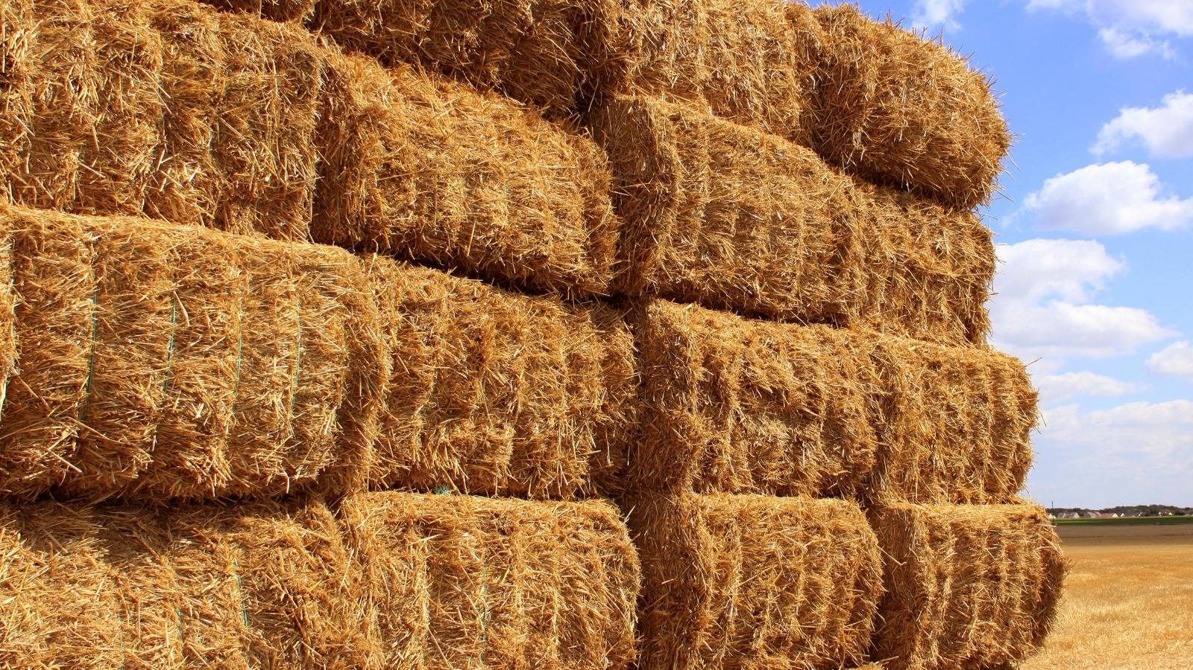

Background: Auto-Scheduler
[1, 2, 3, 4]
Operator
Shape Description
Frontend
Auto-Scheduler
Search Space
High-Performance Schedule
Hardware
[1] A. Adams et al. Halide Auto-Scheduler. SIGGRAPH 2019
[2] N. Vasilache et al. Tensor Comprehensions. TACO 2019
[3] L. Zheng et al. Ansor. OSDI 2020
[4] S. Feng, B. Hou et al. TensorIR. arXiv 2022

Slide 11
Background: Auto-Scheduler
[1, 2, 3, 4]
Operator
Shape Description
Frontend
E.g.,
Auto-Scheduler
Hardware
[1] A. Adams et al. Halide Auto-Scheduler. SIGGRAPH 2019
[2] N. Vasilache et al. Tensor Comprehensions. TACO 2019
[3] L. Zheng et al. Ansor. OSDI 2020
[4] S. Feng, B. Hou et al. TensorIR. arXiv 2022

Slide 12


Background: Auto-Scheduler
[1, 2, 3, 4]
Operator
Shape Description
Frontend
E.g.,
Auto-Scheduler
Search Candidate: tile size $t$
Hardware
[1] A. Adams et al. Halide Auto-Scheduler. SIGGRAPH 2019
[2] N. Vasilache et al. Tensor Comprehensions. TACO 2019
[3] L. Zheng et al. Ansor. OSDI 2020
[4] S. Feng, B. Hou et al. TensorIR. arXiv 2022

Slide 13



Background: Auto-Scheduler
[1, 2, 3, 4]
Operator
Shape Description
Frontend
E.g.,
Auto-Scheduler
Search Techniques:
Shape-Dependent Search Space
Complete Program Cost Model
Search Candidate: tile size $t∈\left[2, ∞\right)$
Search Candidate: tile size $t$
Hardware
[1] A. Adams et al. Halide Auto-Scheduler. SIGGRAPH 2019
[2] N. Vasilache et al. Tensor Comprehensions. TACO 2019
[3] L. Zheng et al. Ansor. OSDI 2020
[4] S. Feng, B. Hou et al. TensorIR. arXiv 2022

Slide 14
1. Shape-Dependent Search Space
Operator
Shape Description
Frontend
Auto-Scheduler
Shape-Dependent Search Space
Search Candidate: tile size $t∈\left[2, ∞\right)$
Hardware

Slide 15

1. Shape-Dependent Search Space
Operator
Shape Description
Frontend
Auto-Scheduler
Shape-Dependent Search Space
Circumscribes
Search Candidate: tile size $t∈\left[2, ∞\right)$
Hardware

Slide 16
1. Shape-Dependent Search Space
Operator
Shape Description
Frontend
Auto-Scheduler
Shape-Dependent Search Space
Circumscribes
Search Candidate: tile size $t$
Search Candidate: tile size $t∈\left[2, ∞\right)$
Search Candidate: tile size $t∈\left[2, ∞\right)$ $\left\{2, 5, 10, 25\right\}$
Hardware

Slide 17

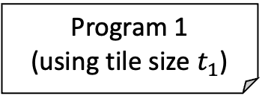
2. Complete Program Cost Model
Operator
Shape Description
Frontend
Auto-Scheduler
Shape-Dependent Search Space
Sample
Search Candidate: tile size $t$
Program 2
$$Performance=\operatorname{Predictor}\left(Complete Program P\left(tile size t\right)\right)$$
Program 1
(using tile size $t_{1}$)
Complete-Program
Cost Model
Measure
Train
Hardware

Slide 18
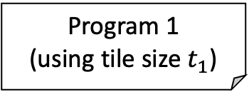
Challenges from Dynamic-Shape Workloads
Operator
Shape Description
Frontend
Auto-Scheduler
Shape-Dependent Search Space
Sample
Program 2
Program 1
(using tile size $t_{1}$)
Program 1
Complete-Program
Cost Model
Measure
Train
Hardware

Slide 19
Challenges from Dynamic-Shape Workloads
Cannot efficiently handle dynamic-shape operators, common in
Operator
Shape Description
Frontend
Auto-Scheduler
Shape-Dependent Search Space
Sample
Program 2
Program 1
Complete-Program
Cost Model
Measure
Train
Hardware

Slide 20
Challenges from Dynamic-Shape Workloads
Cannot efficiently handle dynamic-shape operators, common in
whose input sentences/audios have dynamic lengths.
Operator
Shape Description
Frontend
Auto-Scheduler
Shape-Dependent Search Space
Sample
Program 2
Program 1
Complete-Program
Cost Model
Measure
Train
Hardware
[1] https://translate.google.com/
[2] https://github.com/NVIDIA/NeMo
[3] J. Devlin et al. BERT. NAACL-HTL 2019
[4] A. Radford et al. GPT-2. 2019

Slide 21
Challenges from Dynamic-Shape Workloads
Cannot efficiently handle dynamic-shape operators,
due to
  Humongous Search Space
  Inaccurate Performance Prediction
DietCode’s Key Ideas:
  Shape-Generic Search Space
  Micro-Kernel-based
  Cost Model
Operator
Shape Description
Frontend
Auto-Scheduler
Shape-Dependent Search Space
Sample
Program 2
Program 1
Complete-Program
Cost Model
Measure
Train
Hardware

Slide 22
Challenge #1. Humongous Search Space
Hard to share search
space between operators
of different shapes.
Operator
Shape Description
Frontend
Auto-Scheduler
Shape-Dependent Search Space
Sample
Program 2
Program 1
Complete-Program
Cost Model
Measure
Train
Hardware

Slide 23

Challenge #1. Humongous Search Space
Shape Description 1
Shape Description 1
Frontend
Hard to share search
space between operators
of different shapes.
  $\bigcap{search space}$: Tiny
  $\bigcup{search space}$: Humongous
Operator
Shape Description 1
Auto-Scheduler
Shape 1’s Search Space
Shape 1’s Search Space
Shape 1’s Search Space
Sample
Program 2
Program 1
Complete-Program
Cost Model
Measure
Train
Hardware

Slide 24
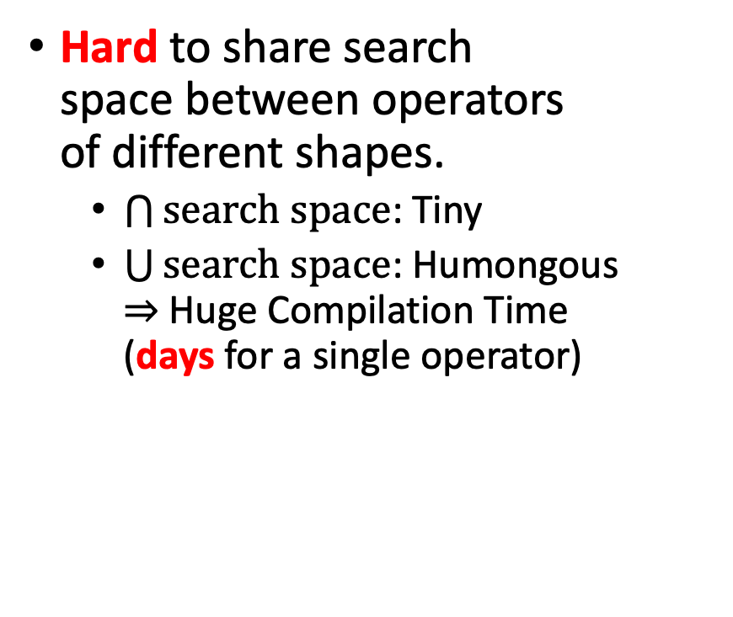
Challenge #1. Humongous Search Space
Shape Description 1
Shape Description 1
Frontend
Hard to share search
space between operators
of different shapes.
  $\bigcap{search space}$: Tiny
  $\bigcup{search space}$: Humongous
  $⇒$ Huge Compilation Time
  (days for a single operator)
Operator
Shape Description 1
Auto-Scheduler
Shape 1’s Search Space
Shape 1’s Search Space
Shape 1’s Search Space
Sample
Program 2
Program 1
Complete-Program
Cost Model
Measure
Train
Hardware

Slide 25
Key Idea #1. Shape-Generic Search Space
Shape Description 1
Shape Description 1
Frontend
Composed of micro-
kernels, each
  Does a tile of the entire compute.
  Sampled uniformly from maximum shapes and constrained by hardware parameters.
  Can be ported to all shapes of
  the same operator.
Operator
Shape Description 1
Auto-Scheduler
Shape-Generic Search Space
Sample
Micro-Kernel 2
Micro-Kernel 1
Complete-Program
Cost Model
Measure
Train
Hardware

Slide 26
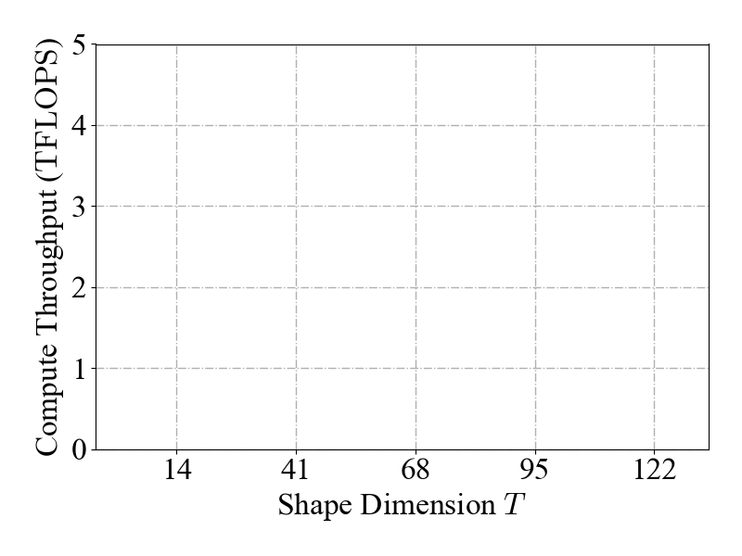
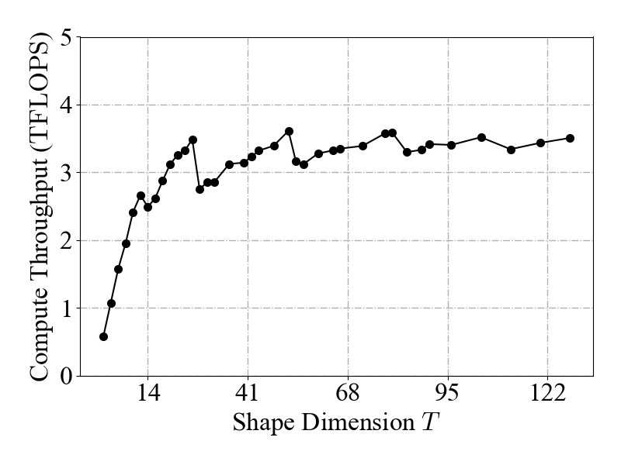

Challenge #2. Inaccurate Performance Prediction
Cost model trained on
one shape can be
inaccurate on others.
  E.g., Performance of $Y=XW^{T}$
  $X:\left[16×T, 768\right], W:\left[2304, 768\right]$ w.r.t. $T$ on a NVIDIA Tesla T4 GPU^{[1]}, all sharing the same micro-kernel.
Operator
Shape Description
Frontend
Auto-Scheduler
Shape-Dependent Search Space
Sample
Program 2
Program 1
Complete-Program
Cost Model
Measure
Train
Hardware
[1] https://www.nvidia.com/en-us/data-center/tesla-t4/

Slide 27
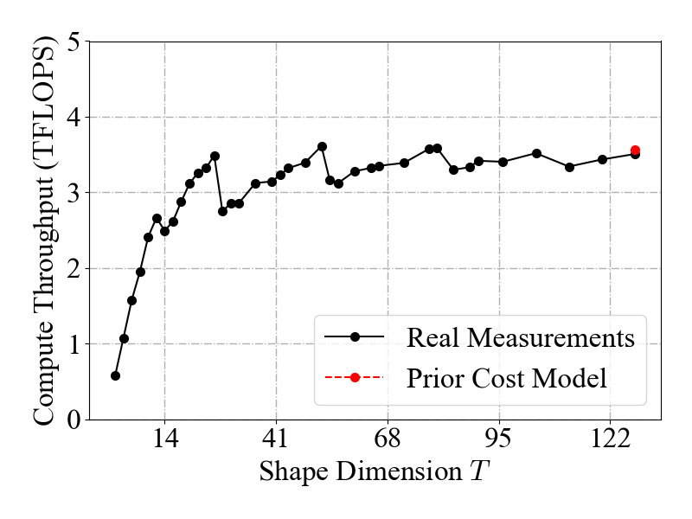
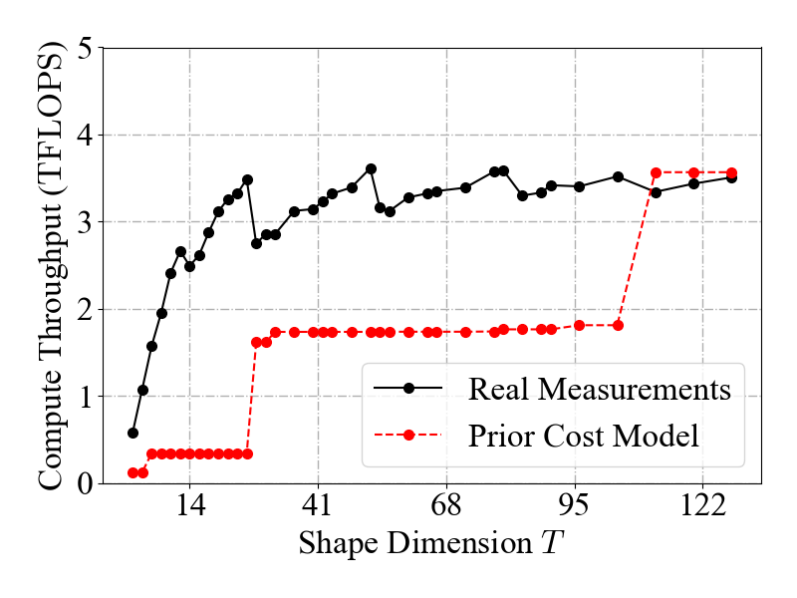
Challenge #2. Inaccurate Performance Prediction
Cost model trained on
one shape can be
inaccurate on others.
  E.g., Performance of $Y=XW^{T}$
  $X:\left[16×T, 768\right], W:\left[2304, 768\right]$ w.r.t. $T$ on a NVIDIA Tesla T4 GPU^{[1]}, all sharing the same micro-kernel.
Operator
Shape Description
Frontend
Auto-Scheduler
Shape-Dependent Search Space
Sample
Program 2
Program 1
Complete-Program
Cost Model
Measure
Cost model trained here
Train
Hardware
🙁 Predictions are inaccurate on other shapes.
[2]
[1] https://www.nvidia.com/en-us/data-center/tesla-t4/
[2] L. Zheng et al. Ansor. OSDI 2020

Slide 28
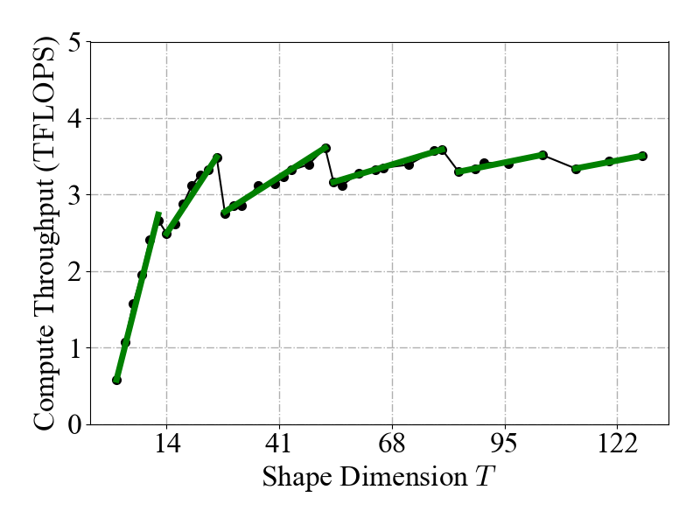

Key Idea #2. Micro-Kernel-based Cost Model
Key Observation:
Performance scales proportionally with hardware core occupancy.
$$f_{MicroKernel}∙f_{Penalty}$$
Operator
Shape Description
Frontend
Auto-Scheduler
Shape-Dependent Search Space
Sample
Program 2
Program 1
Micro-Kernel-based
Cost Model
Measure
Train
Hardware

Slide 29

Key Idea #2. Micro-Kernel-based Cost Model
Key Observation:
Performance scales proportionally with hardware core occupancy.
$$f_{MicroKernel}∙f_{Penalty}$$
Operator
Shape Description
Frontend
Auto-Scheduler
Shape-Dependent Search Space
Sample
Program 2
Trainable function for
peak prediction
Program 1
Micro-Kernel-based
Cost Model
Measure
Train
Hardware

Slide 30
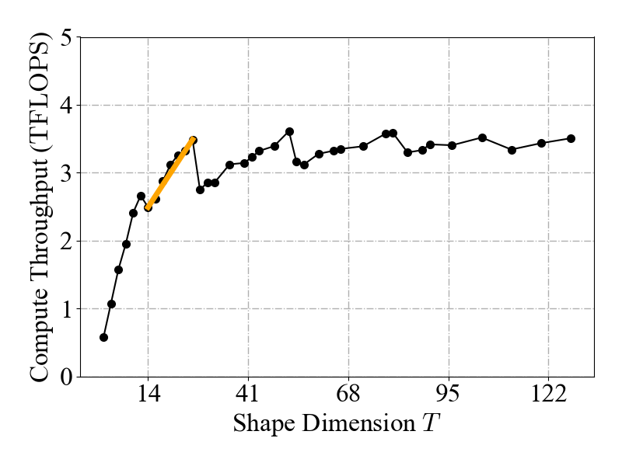


Key Idea #2. Micro-Kernel-based Cost Model
Key Observation:
Performance scales proportionally with hardware core occupancy.
$$f_{MicroKernel}∙f_{Penalty}$$
Operator
Shape Description
Frontend
Auto-Scheduler
Shape-Dependent Search Space
Sample
Program 2
Analytical linear function
of the core occupancy
Program 1
Micro-Kernel-based
Cost Model
Measure
Train
Hardware

Slide 31

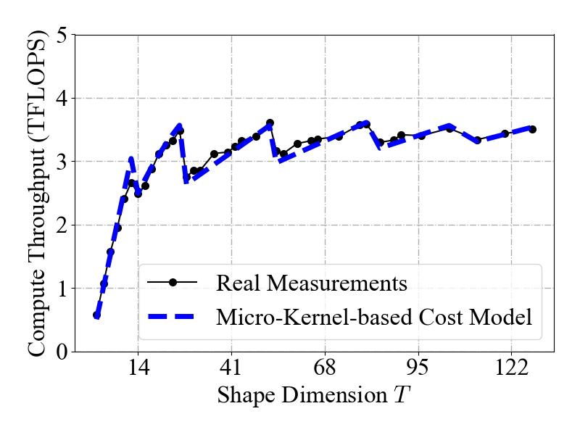

Key Idea #2. Micro-Kernel-based Cost Model
Key Observation:
Performance scales proportionally with hardware core occupancy.
$$f_{MicroKernel}∙f_{Penalty}$$
More Accurate Predictions
Operator
Shape Description
Frontend
Auto-Scheduler
Shape-Dependent Search Space
Sample
Program 2
Program 1
Micro-Kernel-based
Cost Model
Measure
Train
Hardware

Slide 32

DietCode System Overview
Shape Description 1
Shape Description 1
Frontend
Operator
Shape Description 1
DietCode
Shape-Generic Search Space
How is DietCode performing on real workloads?
Sample
Micro-Kernel 2
Program 1
(using tile size $t_{1}$)
Micro-Kernel 1
Micro-Kernel-based
Cost Model
Measure
Train
Hardware

Slide 33
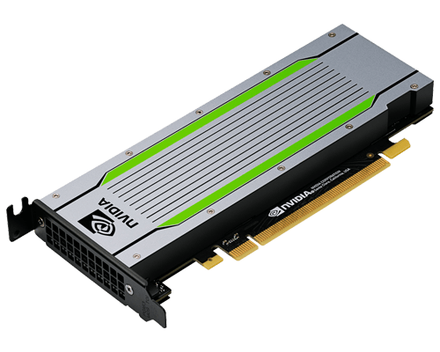
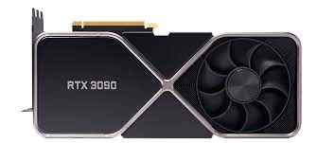
Evaluation
[1] https://www.nvidia.com/en-us/data-center/tesla-t4/
[2] https://www.nvidia.com/en-us/geforce/graphics-cards/30-series/rtx-3090-3090ti/
Hardware
NVIDIA Tesla T4 GPU^{[1]}
NVIDIA RTX 3090 GPU^{[2]}

Slide 34


Evaluation
[1] https://www.nvidia.com/en-us/data-center/tesla-t4/
[2] https://www.nvidia.com/en-us/geforce/graphics-cards/30-series/rtx-3090-3090ti/
Hardware
Software
NVIDIA Tesla T4 GPU^{[1]}
NVIDIA RTX 3090 GPU^{[2]}
[4]
[5]
TVM^{[3]} v0.8.dev0
v11.3
v8.3
[3] T. Chen et al. TVM. OSDI 2018
[4] https://docs.nvidia.com/cuda/archive/11.3.0/
[5] https://docs.nvidia.com/deeplearning/cudnn/developer-guide/index.html

Slide 35

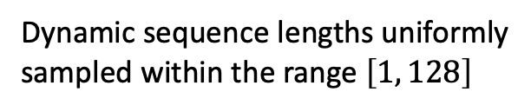
Evaluation
[1] https://www.nvidia.com/en-us/data-center/tesla-t4/
[2] https://www.nvidia.com/en-us/geforce/graphics-cards/30-series/rtx-3090-3090ti/
Hardware
Software
Application
NVIDIA Tesla T4 GPU^{[1]}
NVIDIA RTX 3090 GPU^{[2]}
[4]
[5]
TVM^{[3]} v0.8.dev0
v11.3
v8.3
Dynamic sequence lengths uniformly
sampled within the range $\left[1, 128\right]$
[6]
[3] T. Chen et al. TVM. OSDI 2018
[4] https://docs.nvidia.com/cuda/archive/11.3.0/
[5] https://docs.nvidia.com/deeplearning/cudnn/developer-guide/index.html
[6] J. Devlin et al. BERT. NAACL-HTL 2019

Slide 36

Evaluation
[1] https://www.nvidia.com/en-us/data-center/tesla-t4/
[2] https://www.nvidia.com/en-us/geforce/graphics-cards/30-series/rtx-3090-3090ti/
Hardware
Software
Application
Baselines
NVIDIA Tesla T4 GPU^{[1]}
NVIDIA RTX 3090 GPU^{[2]}
[4]
[5]
TVM^{[3]} v0.8.dev0
v11.3
v8.3
Dynamic sequence lengths uniformly
sampled within the range $\left[1, 128\right]$
[6]
[7]
with the Vendor Library
’s Auto-Scheduler Ansor^{[8]}
[3] T. Chen et al. TVM. OSDI 2018
[4] https://docs.nvidia.com/cuda/archive/11.3.0/
[5] https://docs.nvidia.com/deeplearning/cudnn/developer-guide/index.html
[6] J. Devlin et al. BERT. NAACL-HTL 2019
[7] A. Paszke et al. PyTorch. NeurIPS 2019
[8] L. Zheng et al. Ansor. OSDI 2020

Slide 37
Evaluation
[1] https://www.nvidia.com/en-us/data-center/tesla-t4/
[2] https://www.nvidia.com/en-us/geforce/graphics-cards/30-series/rtx-3090-3090ti/
Hardware
Software
Application
Baselines
NVIDIA Tesla T4 GPU^{[1]}
NVIDIA RTX 3090 GPU^{[2]}
[4]
[5]
TVM^{[3]} v0.8.dev0
v11.3
v8.3
Dynamic sequence lengths uniformly
sampled within the range $\left[1, 128\right]$
[6]
[7]
with the Vendor Library
’s Auto-Scheduler Ansor^{[8]}
[3] T. Chen et al. TVM. OSDI 2018
[4] https://docs.nvidia.com/cuda/archive/11.3.0/
[5] https://docs.nvidia.com/deeplearning/cudnn/developer-guide/index.html
[6] J. Devlin et al. BERT. NAACL-HTL 2019
[7] A. Paszke et al. PyTorch. NeurIPS 2019
[8] L. Zheng et al. Ansor. OSDI 2020

Slide 38
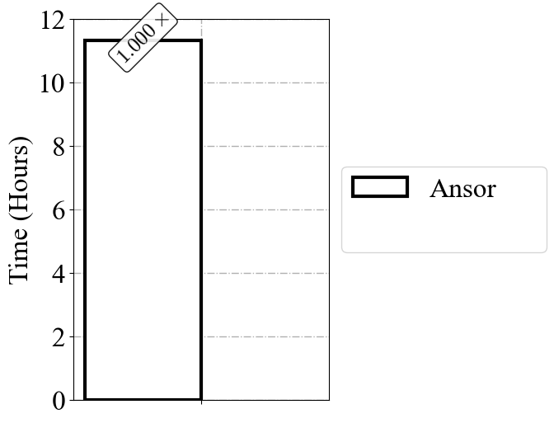
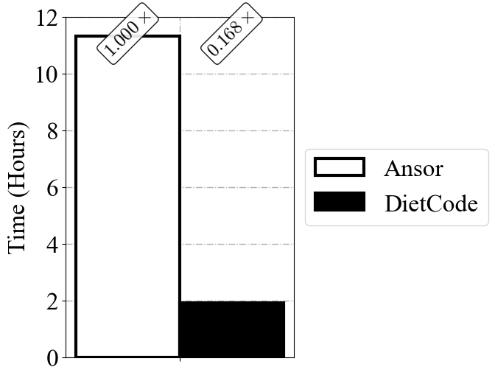
Compilation Time vs. Ansor
Better
DietCode

Slide 39

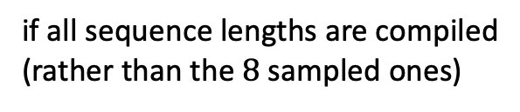
Compilation Time
Ansor: Time estimated to be more than 1 week for only key operators.
$$16×$$
if all sequence lengths are compiled
(rather than the $8$ sampled ones)
Better
(Projected)

Slide 40
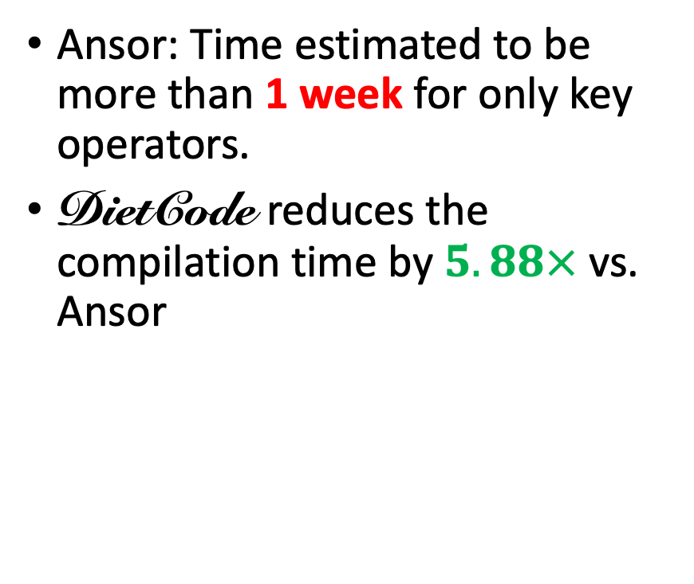
Compilation Time vs. Ansor
Ansor: Time estimated to be more than 1 week for only key operators.
DietCode reduces the compilation time by $5.88×$ vs. Ansor
Better
DietCode

Slide 41
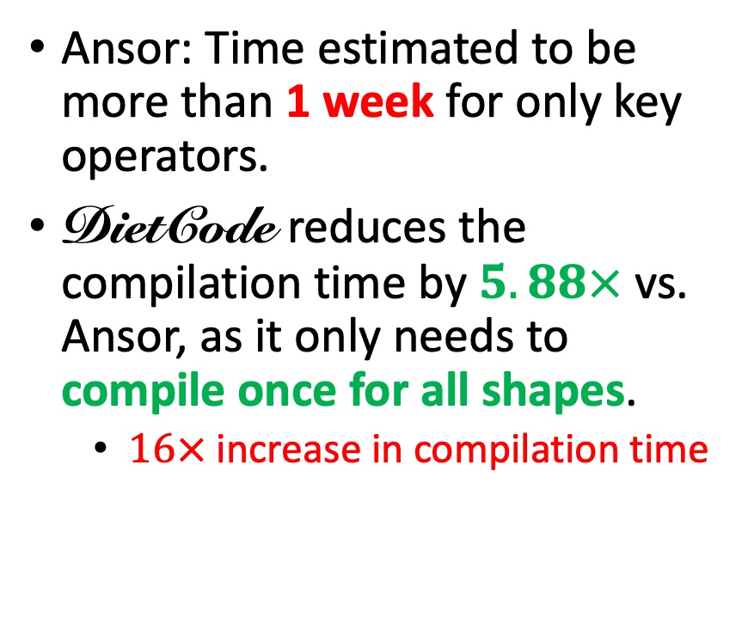
Compilation Time vs. Ansor
Ansor: Time estimated to be more than 1 week for only key operators.
DietCode reduces the compilation time by $5.88×$ vs. Ansor, as it only needs to compile once for all shapes.
  $16×$ increase in compilation time
Better
DietCode

Slide 42

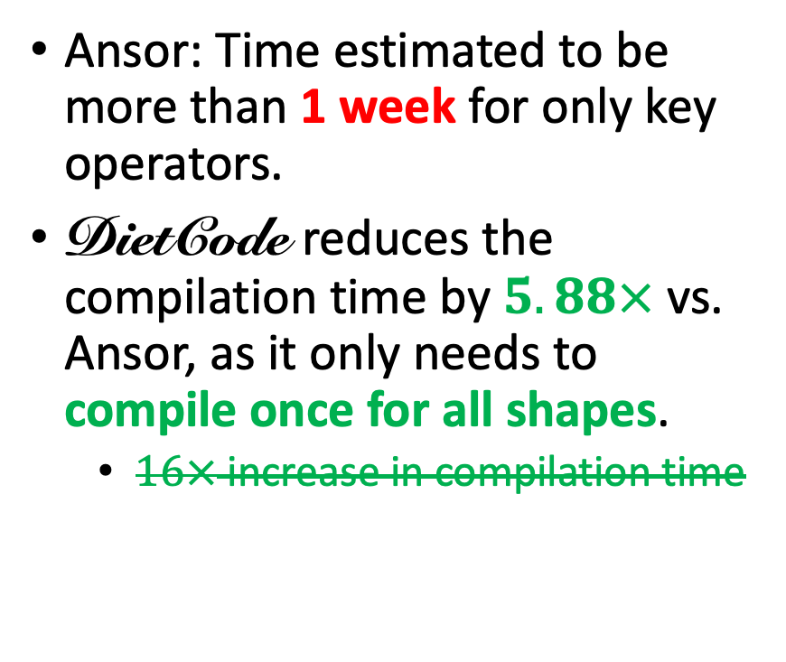
Compilation Time vs. Ansor
Ansor: Time estimated to be more than 1 week for only key operators.
DietCode reduces the compilation time by $5.88×$ vs. Ansor, as it only needs to compile once for all shapes.
  $16×$ increase in compilation time
Better
DietCode

Slide 43
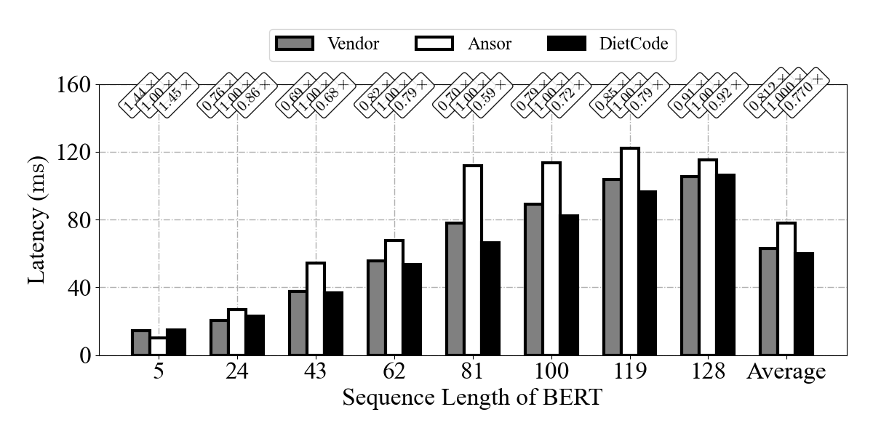
Latency vs. Vendor/Ansor
DietCode

Slide 44
Latency vs. Vendor/Ansor
DietCode
Better
Uniformly sampled and includes composite and prime numbers.

Slide 45
Latency vs. Vendor/Ansor
DietCode
Better
$√$ Up to $1.70×$/$1.19×$ better than Ansor/Vendor.

Slide 46
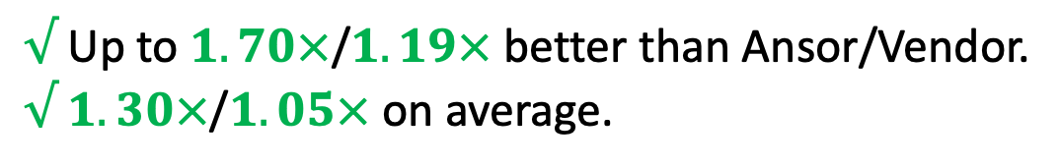
Latency vs. Vendor/Ansor
DietCode
Better
$√$ Up to $1.70×$/$1.19×$ better than Ansor/Vendor.
$√$ $1.30×$/$1.05×$ on average.

Slide 47

Latency vs. Vendor/Ansor
DietCode
Better
Contributed by
$√$ Up to $1.70×$/$1.19×$ better than Ansor/Vendor.
$√$ $1.30×$/$1.05×$ on average.

Slide 48
Latency vs. Vendor/Ansor
DietCode
Better
Contributed by
$√$ Up to $1.70×$/$1.19×$ better than Ansor/Vendor.
$√$ $1.30×$/$1.05×$ on average.

Slide 49


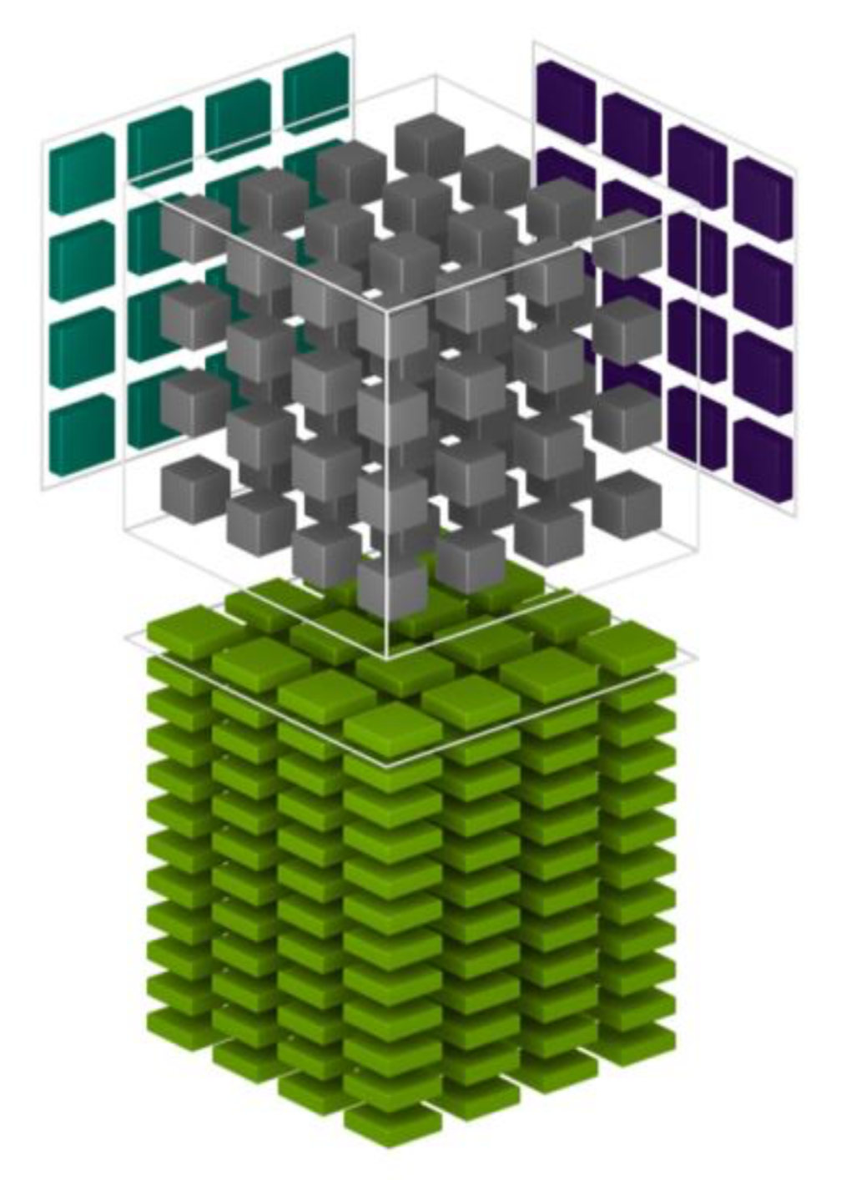
Future Directions
We are working on upstreaming DietCode to the TVM main branch:
https://github.com/apache/tvm-rfcs/pull/72, together with improvement of the tuning algorithms.
Many thanks to the community!
Evaluations on more hardware platforms (CPUs and NVIDIA GPUs using tensor core operations)
[1] https://www.nvidia.com/en-us/data-center/tensor-cores/
[1]

Slide 50
Future Directions
We are working on upstreaming DietCode to the TVM main branch:
https://github.com/apache/tvm-rfcs/pull/72, together with improvement of the tuning algorithms.
Many thanks to the community!
Evaluations on more hardware platforms (CPUs and NVIDIA GPUs using tensor core operations) and workloads.
[1] https://www.nvidia.com/en-us/data-center/tensor-cores/
[2] https://github.com/NVIDIA/NeMo
[3] K. He et al. Mask R-CNN. ICCV 2017
[1]

Slide 51
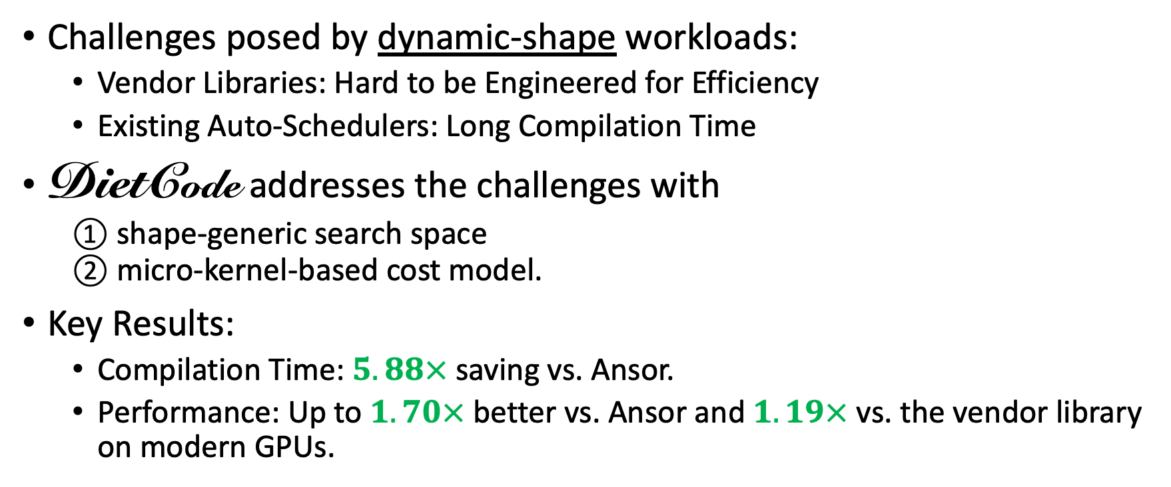
Conclusion
Challenges posed by dynamic-shape workloads:
  Vendor Libraries: Hard to be Engineered for Efficiency
  Existing Auto-Schedulers: Long Compilation Time
DietCode addresses the challenges with
  ① shape-generic search space
  ② micro-kernel-based cost model.
Key Results:
  Compilation Time: $5.88×$ saving vs. Ansor.
  Performance: Up to $1.70×$ better vs. Ansor and $1.19×$ vs. the vendor library on modern GPUs.

Slide 52
DietCode: Automatic Code Generation for Dynamic Tensor Programs
Bojian Zheng^{1, 2, 3 *}, Ziheng Jiang^{4 *}, Cody Yu², Haichen Shen²,
Josh Fromm⁵, Yizhi Liu², Yida Wang²,
Luis Ceze^{5, 6}, Tianqi Chen^{5, 7}, Gennady Pekhimenko^{1, 2, 3}
* Equal Contributions
1
2
3
4
5
6
7

Slide 53
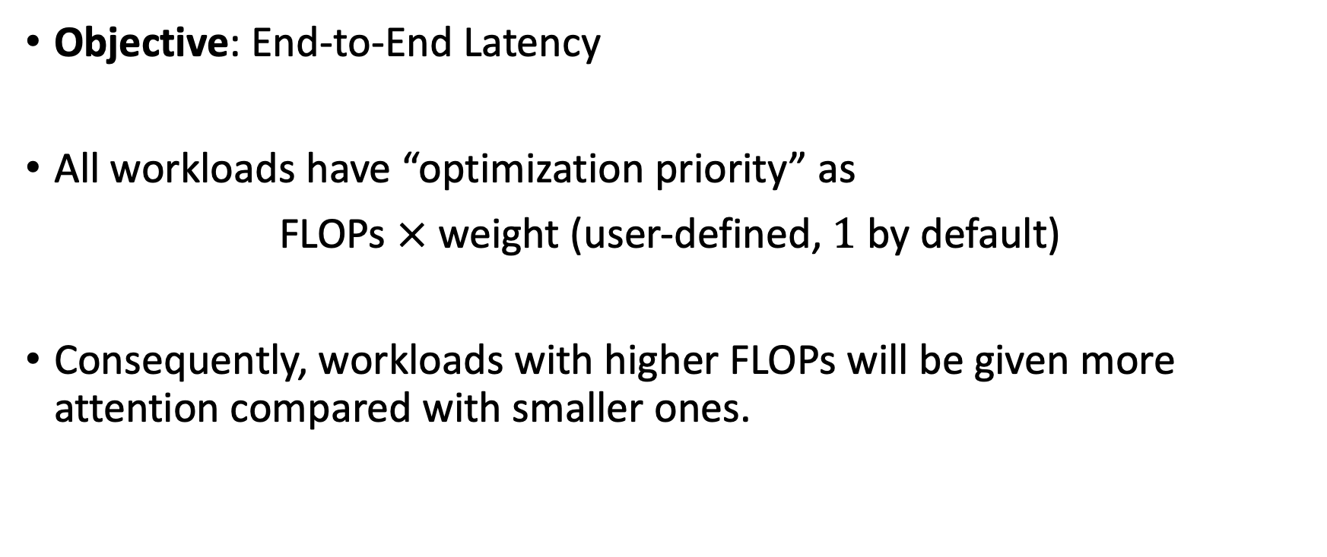
Optimization Strategy
Objective: End-to-End Latency
All workloads have “optimization priority” as
FLOPs $×$ weight (user-defined, $1$ by default)
Consequently, workloads with higher FLOPs will be given more attention compared with smaller ones.

Slide 54
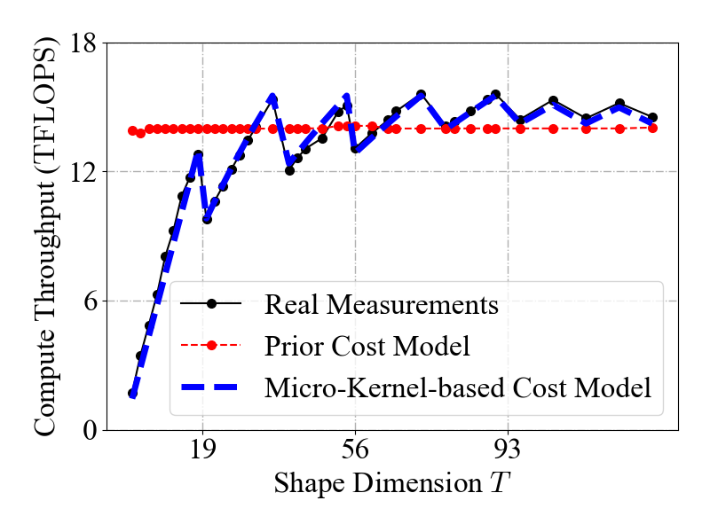
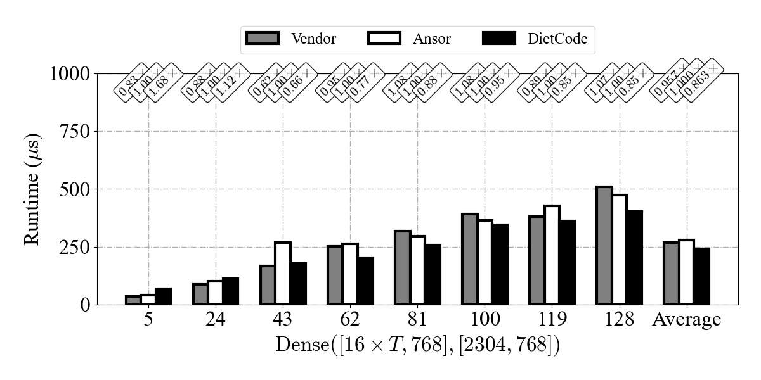

NVIDIA RTX 3090^{[1]} Preliminary Results
Micro-Kernel-based Cost Model
Performance
DietCode
Better
[2]
Up to $1.52×$/$1.26×$ better than Ansor/Vendor
($1.16×$/$1.11×$ on average).
[1] https://www.nvidia.com/en-us/geforce/graphics-cards/30-series/rtx-3090-3090ti/
[2] L. Zheng et al. Ansor. OSDI 2020

Slide 55
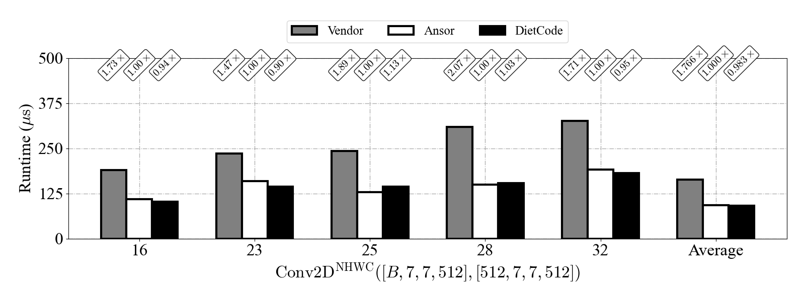
Conv2D
NCHW is usually implemented using the Winograd algorithm, which is in essence batched matrix multiplies.
NHWC:
DietCode
Better
Up to $1.11×$/$2.01×$ better than Ansor/Vendor ($1.02×$/$1.80×$ on average).

Slide 56
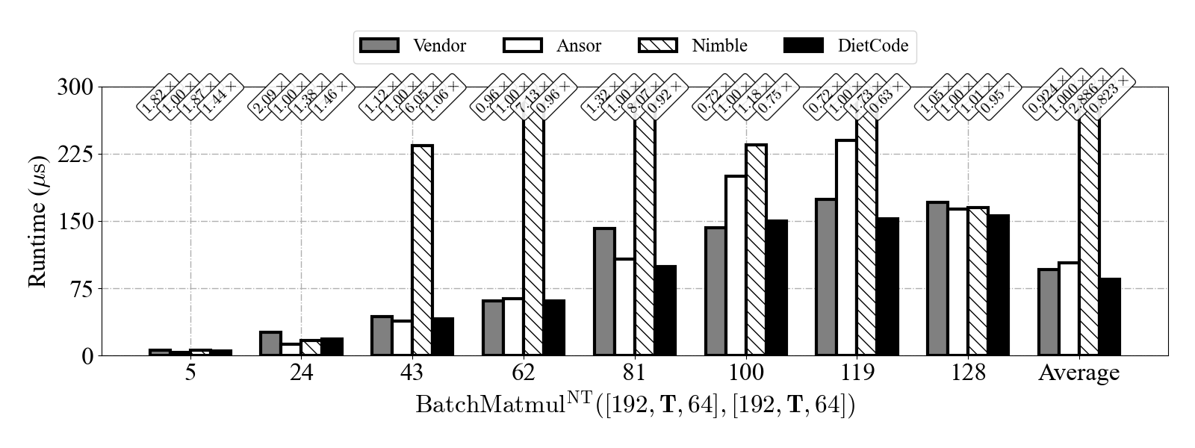
vs. Nimble
[1]
Focuses on the runtime system for dynamic-shape workloads, with one section (i.e., Section 3.5) discussing about the code generation.
Better
Nimble cannot cover all shapes efficiently.
[1] H. Shen, J. Roesch et al. Nimble. MLSys 2021

Slide 57
Local Padding vs. Loop Partitioning
Common:
  Key Observation: Out-of-boundary checks in the compute stage are what negatively affect performance the most.
  Performance difference is usually less than 5%.

Slide 58
Local Padding vs. Loop Partitioning
Local Padding
Loop Partitioning
Key Idea: Pads tensors by the size of the local workspace when loading from the off-chip device memory.
(-) Redundant computations
Key Idea: Partition the regions that have predicates and regions that do not.
(-) Cannot remove overheads in some pathological cases.
(-) Cannot support compute intrinsics such as the tensor core operations.

