Slide 1
SQL Injections with sqlmap
Veerpal and Anusha

Slide 2
Note for Future Reference
Some of our notes are in the “Presenter Notes” part at the bottom of each slide
Some of these include sources
Further insight
What we said that may not be on the slides
The demo code is on the slides for future reference with explanations for the options used

Slide 3
What Are SQL Injections?
They are code injection attacks that target SQL (Structured Query Language) databases through an entry field from client to the application
Any platform, but usually through web page input
Affects the execution of predefined SQL commands
Occur when you do not verify user input in a database query
Notes:
Entry field: when you ask users for input

Slide 4
Brief History
1998: The first public discussions of the attack began
2007: Rated in the top 10 web application vulnerabilities by the Open Web Application Security Project (OWASP)
2010: Again rated in the top 10 web app vulnerabilities by OWASP
2013: Number 1 attack in the OWASP top 10
Nov. 2017 - Mar. 2019: SQL injection attacks accounted for 65% of web based attack vectors

Slide 5
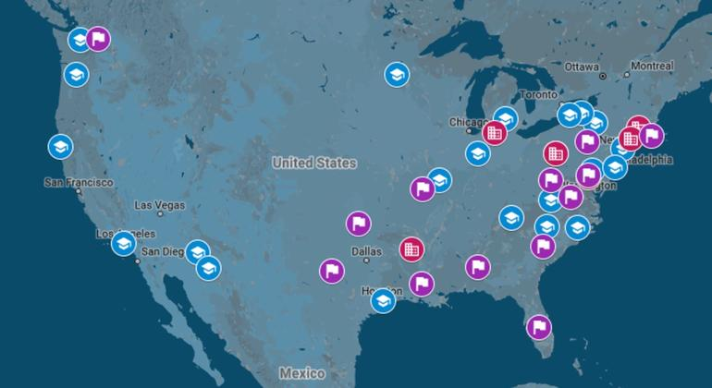
Recent SQL Injection Attack
In 2017, Rasputin, a hacker who is believed to be Russian, breached 60+ universities and government agencies using SQLi.
Included universities from the US and UK:
24 US universities (Virginia Tech, Purdue University)
10 UK universities (Cambridge, Oxford)
US Government agencies at the city, state, and federal level
Sells data from the databases for profit

Slide 6
Capabilities of SQL Injections
SQL injections can allow attackers to:
Read database information
Tamper with database information (Insert, Update, or Delete)
Identity spoofing
Gain administrator privileges of the database server
Delete a table
Send commands to the operating system

Slide 7
Impacts of SQL Injections
Confidentiality: data can be read from databases
Integrity: data can be changed or deleted
Availability: data can be deleted and made unavailable
Authentication: Can connect to the system without knowing the password
Authorization: data can be changed

Slide 8
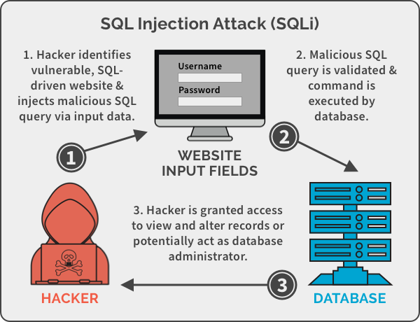
Steps to Perform an SQL Injection
Find an injection point
Test if it is vulnerable to SQL injections by using different techniques such as inputting ‘ (a single quote)
Fingerprint the database using different requests
Perform the attack
Relies on the attacker’s knowledge.
Notes:
Url’s, form fields, POST/GET requests, anything you think will later be used for a db query.
Use ‘ to check for possible injection, try to guess table names or table data to enumerate information

Slide 9
Types of SQL Injections
There are three main types of SQL Injections:
Blind (Inferential): the web application does not send data back
Observe server behavior to learn about its structure
In-band (Classic): the attacker uses the same communication channel to conduct the attack and gather results
Easiest and most commonly used
Out-of-band: a different channel is used to retrieve output, such as HTTP requests or DNS resolution
Attacker needs to control that channel
Application shows the same response regardless of input or server error
Notes:
https://www.imperva.com/learn/application-security/sql-injection-sqli/
https://pentest-tools.com/blog/sql-injection-attacks/#blind-sqli
https://www.acunetix.com/websitesecurity/sql-injection2/

Slide 10
Introduction to sqlmap
Open source penetration testing tool
Automates detection and exploitation of SQL injection vulnerabilities
Uses a trial and error approach that uses different techniques to retrieve information from the database
Good default settings for beginners without sql knowledge but also highly customizable for advanced users
Notes:
Response is changing with value changed (e.g. id=2)
Artificial delay -> will check avg response time and some that are meant to be longer and do some gaussian math on it to detect liekly hood of delay

Slide 11
sqlmap History
First developed in 2006 by Daniele Bellucci and later Bernardo Damele
Has had steady releases ever since and currently on version 1.4
Developed in python 2 and now supports python 3
Used by pentesters to look for vulnerabilities

Slide 12
sqlmap Usage
View the full list of options at
https://github.com/sqlmapproject/sqlmap/wiki/Usage
python sqlmap.py [options]
Useful options:
--batch
Use default behavior rather than asking for user input
-h, --help / -hh
Basic / advanced help message and exit
-u URL, --url=URL
Target URL (e.g. "http://www.site.com/vuln.php?id=1")
Notes:
Need to explain what some important options do

Slide 13
How sqlmap Works
Performs SQL injections into GET and POST requests
sqlmap uses a mix of injection heuristics to discover vulnerabilities that are injectable
Based on heuristics uses trial and error to determine payload that can extract information from the database
Supports 5 different techniques of sql injection vulnerabilities
Not just checking if injection if possible but determine if you can inject a query that gives you information about the database

Slide 14
sqlmap SQLi Techniques
Blind (Inferential):
Boolean-Based Blind
Time-Based Blind
In-band (Classic):
Error based
Union Query Based
Stacked Queries

Slide 15
Boolean-Based Blind
Confirm if the database is vulnerable to Blind SQL Injection by evaluating the results of various queries which return either TRUE or FALSE
Can use true / false queries to determine information about the db
Notes:
Determine info about db by checking if certain queries are true or false
Have a true query and a false query and ensure that the results are different
http://localhost:81/sqli/Less-8/?id=1' AND (ascii(substr((select table_name from information_schema.tables where table_schema=database() limit 3,1) ,1,1))) = 117 --+
https://www.hackingarticles.in/beginner-guide-sql-injection-boolean-based-part-2/

Slide 16
Boolean Based Blind

Slide 17
Boolean Based - Enumerate Table Names
http://example.com?id=1' AND (ascii(substr((select table_name from information_schema.tables where table_schema=database() limit 3,1) ,1,1))) = 117 --
Information_schema has details about db tables and columns
Is first ascii character of table name == 117 ie ‘u’ ?
Once you have table name you can enumerate users!
Notes:
Mysql server has an information schema view that contains table and column information, you can check if the first character is ‘a’, ‘b’, etc and determine the table name (why not get name directly, because you need true vs false)

Slide 18
Time Based Blind
When you don’t have visible page content changes you can use a time based approach
Create a conditional query such that in one case, you add a time delay
By observing response time you can determine if query evaluated to true or false
SELECT * FROM products WHERE id=1-IF(MID(VERSION(),1,1) = '5', SLEEP(15), 0)
Databases also use different time delays which can be used to determine which database is used in the backend
Notes:
https://www.sqlinjection.net/time-based/
https://owasp.org/www-community/attacks/Blind_SQL_Injection

Slide 19
Error Based
Use error messages to extract information about the database
Also use the error message to show data
Search HTTP response headers and body for database error messages
Web application needs to show error message to user for this to work
Notes:
https://hydrasky.com/network-security/error-based-sql-injection-attack/
concat(DESIRED_DATA,floor(rand()*2)) gives one random number between 0 and 1 for every row of output. group by will fail, because the group_key which was expected to be unique (it's the ID of the temporary result table) will be duplicate, and cause the database to err. Now, Mysql likes to tell you what exactly is the duplicate value in that query, so it shows you the duplicate key, which will be the DESIRED_DATA concatenated by 1 or 0
parses the HTTP response headers and body in search of DBMS error messages containing the injected pre-defined chain of characters and the subquery statement output within. This technique works only when the web application has been configured to disclose back-end database management system error messages
https://security.stackexchange.com/questions/92137/can-anybody-explain-error-based-sql-injection-attacks

Slide 20
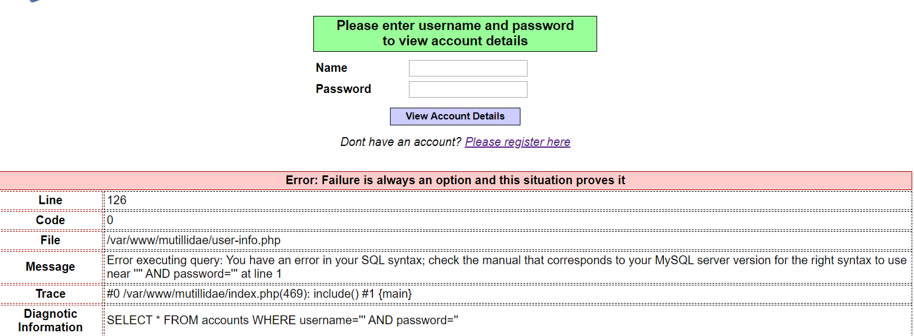
Error Based

Slide 21
Error Based
SELECT COUNT(*), CONCAT((SELECT @@version),FLOOR(RAND(0)*2)) x FROM information_schema.tables GROUP BY x
group by will fail, because the group_key which was expected to be unique will be duplicate, and cause the database to err.
Error tells you the duplicate value in that query
Notes:
Information schema contains info about the db tables
concat(DESIRED_DATA,floor(rand()*2)) gives one random number between 0 and 1 for every row of output.
group by will fail, because the group_key which was expected to be unique will be duplicate, and cause the database to err.
Mysql likes to tell you what exactly is the duplicate value in that query

Slide 22
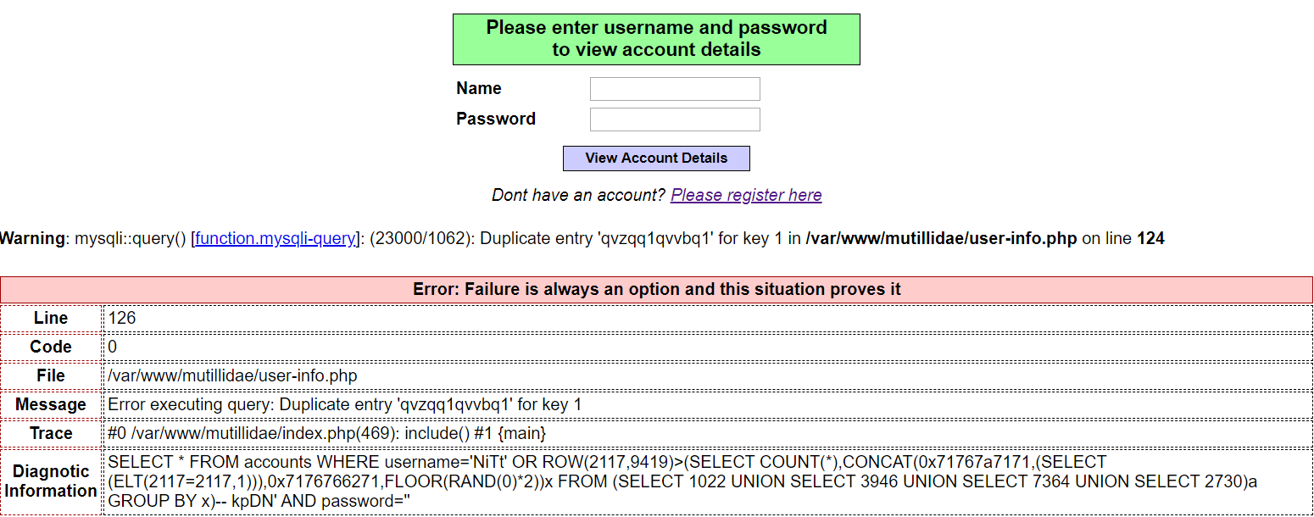
Error Based

Slide 23
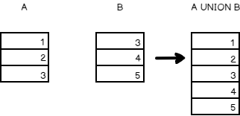
Union Query Based
Use UNION keyword to extract data from other tables
For a UNION query to work, two key requirements must be met:
The individual queries must return the same number of columns.
The data types in each column must be compatible between
the individual queries
Notes:
https://portswigger.net/web-security/sql-injection/union-attacks
Union allows you to combine data from two different tables into a single table

Slide 24
Union Query Based
Submitting a series of UNION SELECT queries specifying a different number of null values:
' UNION SELECT NULL--
' UNION SELECT NULL,NULL--
If the number of nulls does not match the number of columns, the database returns an error. If no error, you found the correct number of columns.
Notes:
Using Null allows you to build dummy columns in your union for when they don’t match. So you want the correct number of NULLS

Slide 25
Union Query Based
Probe each column to test whether it can hold string data:
' UNION SELECT 'a',NULL,NULL,NULL-- (test is first column is type string)
' UNION SELECT NULL,'a',NULL,NULL-- (test is second column is type string)
Notes:
The ‘a’ will just let you concat ‘a’ to the original query, and so you can use this to check the datatypes.

Slide 26
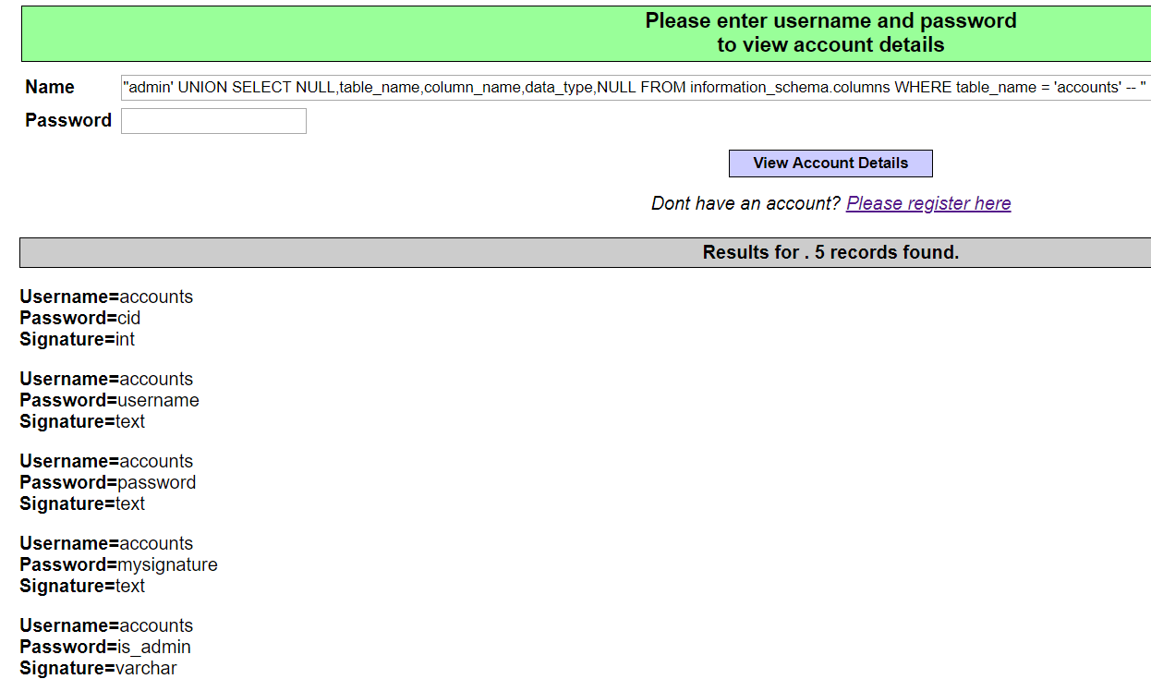
Notes:
"admin' UNION SELECT NULL,table_name,column_name,data_type,NULL FROM information_schema.columns WHERE table_name = 'accounts' -- "

Slide 27
Stacked Queries
Instead of injecting into a query, use multiple queries separated by “;”
http://www.example.com/index.php?id=1; INSERT INTO users(username, password, admin) VALUES("admin", "admn_password", 1); --
Try to insert user with admin permission in table users.
Not supported by all databases
Notes:
https://hydrasky.com/network-security/sql-injection-exploit-techniques/

Slide 28
Why Use sqlmap?
Do not need to remember different SQL queries for each attack
Automatically identifies the vulnerable parameters
Automatically identifies which SQL injection technique can be used
Allows you to use different SQL injection techniques easily
Level of attack does not depend on user knowledge
Notes:
In image: show that sqlmap identified vulnerable parameter username and shows types of techniques it is vulnerable to.

Slide 29
Demo

Slide 30
Demo
python sqlmap.py -u http://localhost:8000/ --forms --dump --risk=3 --technique=B
--forms : sqlmap will search url form forms to inject into (default looks for vulnerability in URL)
-- dump: tells sqlmap to dump entire db contents
--risk=3: sets the risk level (risk 3 added OR based queries)
--technique=B : use boolean based blind (default is all techniques)

Slide 31
Other features
Tamper scripts
In certain cases you can use injection to send a command to the OS or read files off the system
Set cookies to be send with each request
Detect CSRF-token and use them in requests
Try to inject HTTP headers such as User-Agent, Host, Referrer
Find SQL injection vulnerabilities in Google Results

Slide 32
Mitigation - Development Phase
Input sanitization (on the front end and the backend!)
Blacklisting: Remove special chars: quote, SELECT, DROP TABLE, etc
Not recommended, have to predict SQLi attacks
Whitelisting: Only allow approved characters, disallow all others
Prepared statements (but check for vulnerabilities)
SQL query templates: user input is not part of SQL query
Send SQL query with placeholder for user input, then send user input as a different command
User input and SQL query compiled separately
Highly effective, SQLi not interpreted as a command

Slide 33
Mitigation - Development Phase
Database permission limitations
Principle of least privilege: Limit the applicative user’s permissions to only what is needed
Limit the damage SQLi can do
Keep your software up-to-date
SQLi is prevalent with PHP and ASP applications because they commonly use old functional interfaces

Slide 34
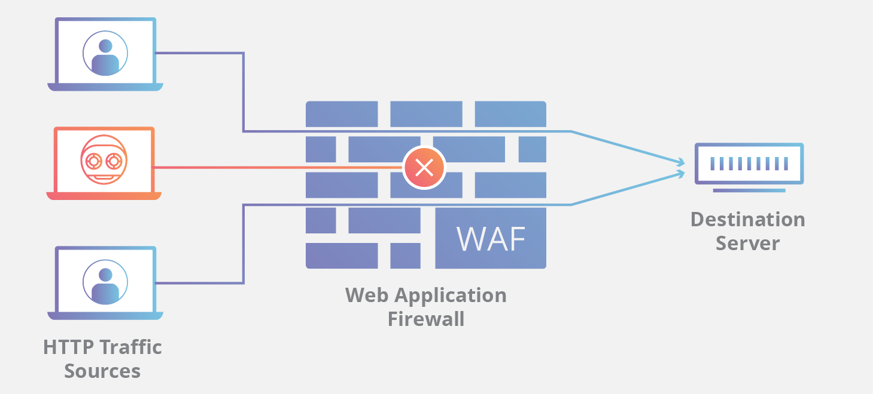
Mitigation - Post-Development
Penetration testing
Use tools such as sqlmap or Metasploit to ensure your database is safe against SQL injection attacks
Web Application Firewall (WAF)
Inspect traffic at application level
Can detect and block attacks
Signatures need to be updated, or attackers can bypass WAF

Slide 35
Why Are They Still Prevalent?
SQLi Mitigation techniques are well-understood, but
Expensive:
Need to improve old systems
Can affect usability:
Two-factor authentication may help, but may be inconvenient
Constantly evolving:
New platforms
Attackers find the data valuable

Slide 36
Thank you for listening!

