Slide 1
Snort
The Hog IPS/IDS

Slide 2
Agenda
What is Snort
What is IPS/IDS
Detection Methods
Pros and Cons
Modes
Rules and Actions

Slide 3
What is Snort
01
an open-source, rule-based, network intrusion detection and prevention system.
02
combines the benefits of signature-, protocol-, and anomaly-based inspection methods to deliver flexible protection from malware attacks or malicious activities.
03
capable of performing real-time traffic analysis and packet logging on IP networks.
04
cross-platform.

Slide 4
What is an IPS (Intrusion Prevention System)
01
an IPS is an active system that sits on the network and intercepts network traffic, analyze and stops anything deemed malicious.
02
IPS that is installed is able to actively block any intrusions that are detected.

Slide 5
What is IDS (Intrusion Detection System)
01
IDS is a passive system, it doesn’t stop network traffic, but sets alerts and sends message if something happen.
02
Snort use rule set to inspect packet. When the packet match rule in ruleset, Snort may take some actions.

Slide 6
Detection Methods (Signature-based)
Detection of attacks by looking for specific patterns.
relies on a database of traffic signatures that are common network attacks or other malicious activity
Although signature-based IDS can easily detect known attacks, it is difficult to detect new attacks, for which no pattern is available.
On-time updating of the IDS with the signature is a key aspect

Slide 7
Detection Methods (Protocol-based)
Identifies deviations of protocol states by comparing observed events with "pre-determined profiles of generally accepted definitions of benign activity"
Notes:
A typical use for a PIDS would be at the front end of a web server monitoring the HTTP (or HTTPS) stream.however this greater protection comes at the cost of increased computing on the web server.

Slide 8
Detection Methods (Anomaly-based)
Use machine learning to create a model of trustworthy activity, and then compare new behavior against this model.
Used to detect unknown attacks.
may suffer from false positives
Notes:
detecting both network and computer intrusions and misuse by monitoring system activity and classifying it as either normal or anomalous.

Slide 9
Pros and Cons -- you can’t have your cake and eat it, too...
Snort detects threats at incredibly high speeds;
Provides rapid response, offering greater accuracy, and being an adaptable system;
Easy to install and set up;
Rules are powerful, flexible and relatively easy to write.
New rules to detect the latest malware are often written by the Snort community within hours of an outbreak.
But, requires a lot of processing power.
But, may produce a lot of false positives.

Slide 10
Modes
03
Packet Sniffer
IPS/inline
Intercepts data flowing in a network.
uses rulesets to inspect IP packets.
Packet Logger
01
02
When an IP packet matches the characteristics of a given rule, Snort may take one or more actions.
Makes copies of the packets transmitted in a network

Slide 11
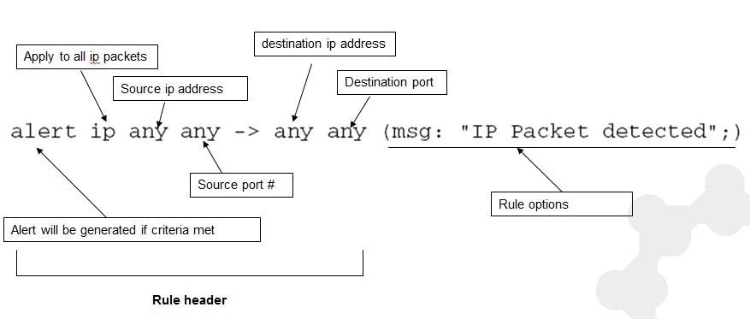
Rules and Actions

Slide 12
Rule Types
Alert: generate an alert using the selected alert method, and then log the packet.
Log: log the packet.
Pass: ignore the packet.
Drop: block and log the packet.
Reject: block the packet, log it, and then send a TCP reset if the protocol is TCP or an ICMP port unreachable message if the protocol is UDP.
Sdrop: block the packet but do not log it.
Customize: you can define your own rule types

Slide 13
Rule Options
General
These options provide information about the rule but do not have any affect during detection
Payload
These options all look for data inside the packet payload and can be inter-related
Non-payload
These options look for non-payload data
Post-detection
These options are rule specific triggers that happen after a rule has “fired.”

Slide 14
Example rule

Slide 15
In the Lab

