Slide 1
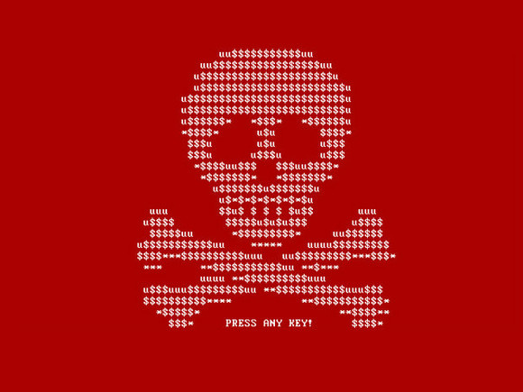
Ransomware & Phishing
By Leah Furyk and Nitharsan Kopu

Slide 2
Recent Exploits
In October 2019, Three Ontario hospitals’ computer systems crippled by Ryuk
Resulting in:
Email systems were taken offline
Longer wait times for patients
Trouble accessing patient’s records
Notes:
Ryuk can stay dormant for weeks or months
It attacks computer networks
No reported injuries or deaths associated
Likely other canadian hospitals were infected but don’t know it yet
No data left the hospital, stopped by a firewall
Healthcare was particularly vulnerable because they rely on specialized software that isn’t updated frequently

Slide 3
Ransomware
Ransomware is malicious software that blocks access to a user’s files and systems
According to the US Department of Justice, Ransomware is a “New model of cybercrime with a potential to cause impacts on a global scale”
It encrypts the data with cryptographic algorithms
The public key is generated on the victim’s computer while the perpetrator has the private key
Notes:
It’s simply scareware
Relies on 2 age old vices: deception and taking advantage of another’s fear

Slide 4
Types of Ransomware
Encryption Ransomware
Lock Screen Ransomware
Ransomware Encrypting Web Servers
Mobile Device Ransomware
Master Boot Record (MBR) Ransomware
Notes:
Encryption Ransomware: encrypt all files on the computer
Example: CryptoLocker
Lock Screen: locked out of your OS
Example: FBI Ukash MoneyPak ransomware
Ransomware encrypting Web Servers: blocks access to critical information stored on servers
Example: LiLocked
Mobile Device ransomware: locks you out of your phone
It steals sensitive information
Example: Android Ransomware, ScarePakage
MBR: is a small program that executes every time the computer boots, even before OS loads

Slide 5
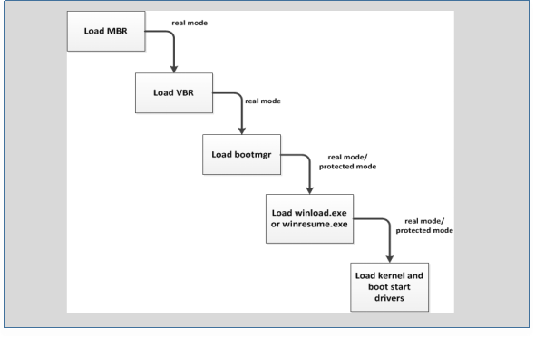
Master Boot Record
Used for start-up processes
MBR Ransomware
Prevents the OS from loading
Notes:
OS is not loaded, so anti-virus & anti-ransomware tools tools don’t work
MBR loads every time the computer is turned on
Locks the user completely out from their computer
Loading in safe mode doesn’t help
Example: Mamba

Slide 6
Ransomware Statistics
In 2018, there were 204 million ransomware attacks
97% of U.S companies refused to pay the ransom
50% of surveyed cyber security professionals believe their organization is not prepared for a ransomware attack
96% of U.S. organizations are not very confident in their ability to stop ransomware
Notes:
2016 State of Ransomware report
surveyed 540 CIOs, CISOs, and IT directors in four countries
Globally, more than 40% of victims paid the ransom demands
Current enterprise security measures are weak against ransomware. Almost half of ransomware incidents in the U.S. occurred on a desktop within the enterprise security environment.
https://www.malwarebytes.com/pdf/infographics/global-impact-of-ransomware-on-business.pdf

Slide 7
Impact of Ransomware
On Businesses
Reputation Damage
Productivity Loss and Business Disruption
On Individuals
Financial Loss
Temporary or permanent loss of information
Notes:
According to the Second Annual State of Ransomware Report
1/5th of companies infected by ransomware had to completely stop operations completely
Ransomware downtime is costing organizations more that $64,000 on average
More than 60% of attacks took more than 9 hours to remediate
About 1% of attacks asked for over $150,000 with 20% of attacks asking for over $10000
Ransomware is costing businesses more than 75 billion a year

Slide 8
Who is targeted by Ransomware?
81% of ransomware is targeted at enterprises
29% of ransomware detections occurred in the United States
Industries
32% Construction and Manufacturing
31% Professional Services
23% Healthcare
20% Finance/Insurance

Slide 9
History of Ransomware
First ransomware, PC Cyborg or AIDs, created in 1980s
A biologist, Joseph L. Popp, released 20,000 compromised diskettes to attendees of an internal World Health Organization AIDS conference
$189 ransom
In 2006, started using asymmetric RSA encryption
The first version of CryptoLocker was released in September 2013
After 2012, ransomware started spreading worldwide
Notes:
The program would count the number of times the computer was booted, once it reached 90 it would hide directories and encrypt the files
It was a simple symmetric cryptographic algorithm, easily beaten
Ransomware cyber crime was uncommon until 2006
Starting to become in 2006

Slide 10
Evolution of Ransomware
- CryptoLocker - TorrentLocker
- Locker Ransomware - BitCryptor and CoinVault
- CryptoWall - TeslaCrypt
- CTB-Locker - Locky
Notes:
CryptoLocker: a trojan horse that infects the computer and searches for files to encrypt
One of oldest forms of ransomware
Locker Ransomware: locks user files using AES copy of CryptoLocker
CryptoWall: is a Trojan horse that infects the computer
Advanced form of CryptoLocker
Came into existence in 2014 after fall of CryptoLocker - uses tor for the registry key
CTB-Locker: outsource infection process to partners in exchange for profits
Proven strategy for spreading malware infections
Ransomware as a service
TorrentLocker: spread through spam email campaigns
AES encryption algorithm
captures email addresses from address book
Bitcryptor and CoinVault: same ransomware with different interfaces
Deletes shadow volume copies - backup copies or snapshots of computer files or volumes, even when they are in use.
BitCryptor released after CoinVault
TeslaCrypt: variant of TorrentLocker
Distributed through a popular angler exploit kit
scan your system for vulnerabilities
exploit the vulnerabilities
execute malicious code
Usually installs itself in Microsoft temp folder
Locky: spread through email address disguised as an invoice
Similar to other types of ransomware
AES encryption

Slide 11
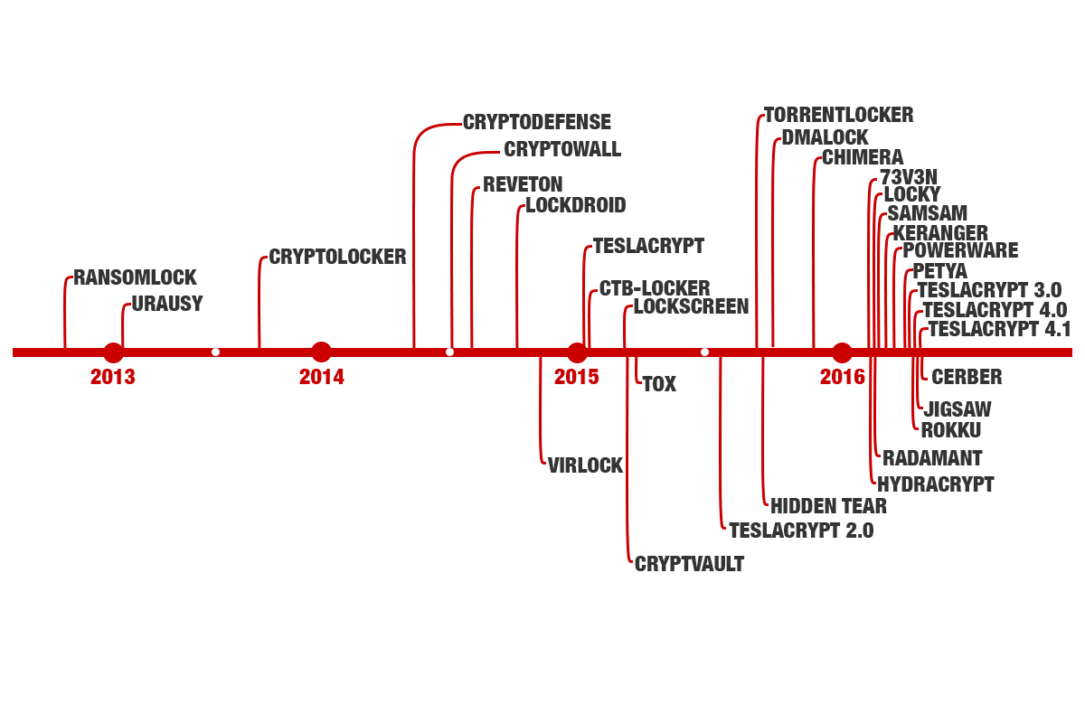
Notes:
Timeline of ransomware

Slide 12
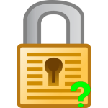
Detecting and Identifying Ransomware
Renamed Files
Encrypted Files
Locked Screen/Locked Browser
Look at the name of the ransom note
Examine the extension of the encrypted files
Look at the pattern of the extension pattern
Use a tool to identify the ransomware
ID Ransomware
Notes:
Detecting ransomware when it is not active, is very difficult
Ransomware will stay on an infected device and gather information on their owner(s)
Ransomware note names are typically unique to the ransomware program
Example: Ryuk Ransomware, RyukReadMe.txt
The extension of the encrypted files will give a clue
Example: Locky ransomware, extension is .locky
There are tools available such as ID Ransomware

Slide 13
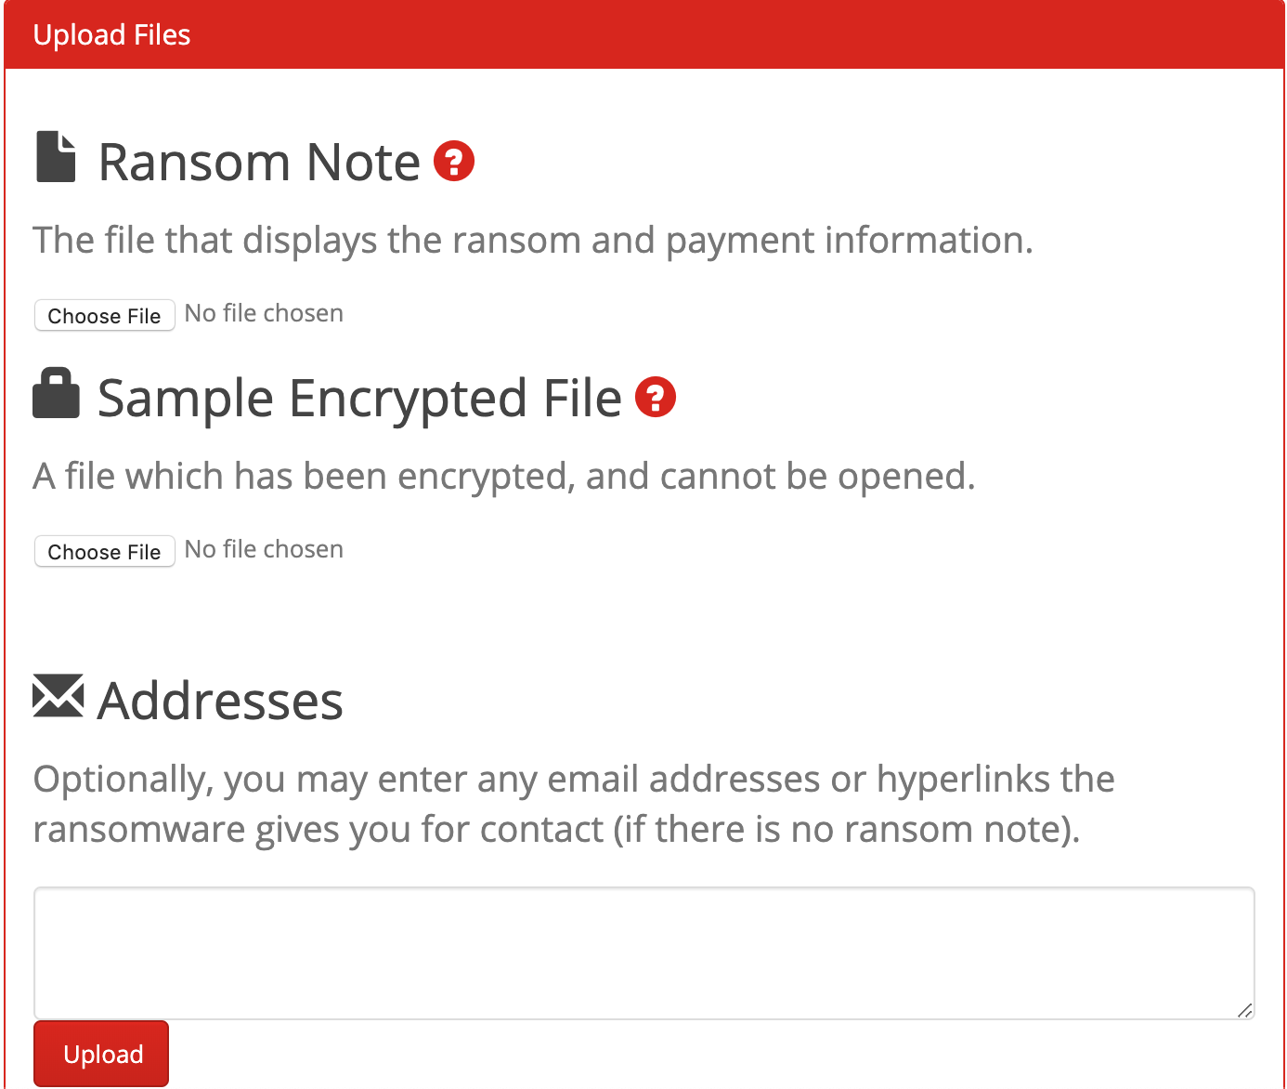
Notes:
It currently detects 803 ransomware types
Only works for certain ransomware types

Slide 14
Responding to Ransomware
Never Pay the Ransom
Unplug from the network
Notify the authorities
Update all security systems
Notes:
Paying ransom encourages the attackers to continue with ransomware
It does not guarantee access to your data

Slide 15
A Typical Ransomware Attack DEMO
Notes:
Demo of Encryption Ransomware

Slide 16
Protecting Against Ransomware
Backup your computer and store backups separately
Verify email addresses and open email attachments with caution
Patch and update vulnerable applications
Notes:
Backups ensures that you have access to the data

Slide 17
OWASP Anti-Ransomware Guide
OWASP recommends perimeter protections:
Firewalls
Proxy Server/Web Filter
Network Defences
DNS Sinkhole
Network Segmentation
Endpoint Protections
No Administrative Rights
Notes:
Perimeter Protections: first line of defence
Firewall, need both ingress and egress entries
Network Defences: deployed on LAN to help detect and mitigate malware outbreaks
DNS sinkhole or black hole DNS is used to spoof DNS servers to prevent resolving host names of specified URLs.
Network segmentation can help to ensure that a malware infection, or other security issue, stays isolated to just the network segment the infected endpoint is on and does not spread through the entirety of the organization
Endpoint Protections
Protections that exist on desktop PCs and other systems that users interface with.
No administrative Rights: will prevent users from installing malware from being installed (because they won’t have permission to install)

Slide 18
Ransomware Removal
There is an implementation error in the encryption
The key to the ransomware is made available (Law Enforcement releases the keys or the malware authors release)
Notes:
Difficult to remove ransomware
Sometimes the authors of ransomware will release the key
Regret their actions
HildaCrypt, was created for fun
Released master key
No More Ransomware
National High Tech Crime Unit of the Netherlands’ police, Europol’s European Cybercrime Centre, Kaspersky Lab and McAfee with the goal to help victims of ransomware retrieve their encrypted data without having to pay the criminals

Slide 19
Data Recovery after Ransomware
In cases, where only part of the data is encrypted, then there is possible data recovery
To do so
Find the end of the file and carve the ransom ware’s addition
Determine the size of the damaged header
Establish the location and size of encrypted fragments in the file
Notes:
Partial encryption happens when there is a large volume of files with limited time period
Practical Case
Encrypted the beginning of the file
Small size in the body of the file
Added some technical info. to the end of the file
Using a hex editor
File carving is the process of reconstructing files by scanning the raw bytes of the disk and reassembling them

Slide 20
Why Ransomware is so Effective
Authors of Ransomware instill fear and panic into their victims
Ransomware is easily scalable
Ransomware is less risky, easier and faster compared to other attacks
Bitcoin has helped the expansion of ransomware attacks
Notes:
Typically there is a threat associated with a period of time
Ransomware-as-a-service
Bitcoin keeps the identity of the perpetrator’s identity a secret

Slide 21
Future of Ransomware
64% predict ransomware will target IoT devices
63% predict ransomware will target social media accounts
62% predict ransomware will bankrupt whole companies
Notes:
Of MSPs
Managed Service Provider
Manages a company’s IT infrastructure &/or end-user systems

Slide 22
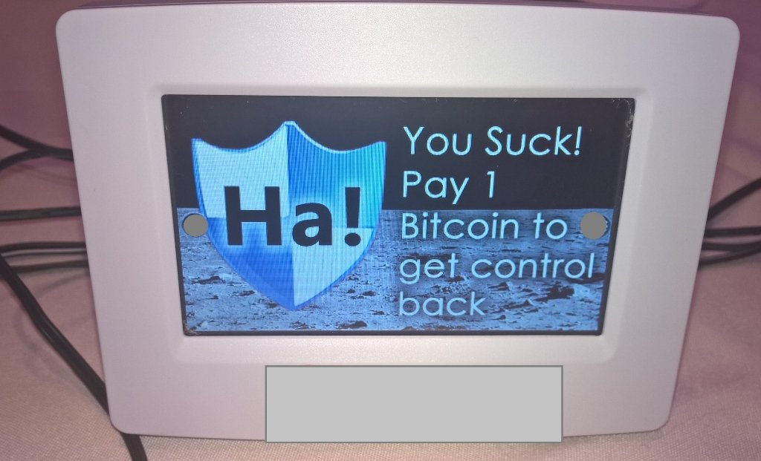
Ransomware and IoT Devices
In 2016, 2 security researchers released a proof of concept for malware that locks a smart thermostat
IoT devices are unsecure
Notes:
Not being paid attention too enough
IoT data is stored on the cloud
Locking device instead preventing access to data (the classic model)
More challenge for hackers
Each IoT device is different
IoT ransomware hinges on being timely and critical

Slide 23
The Next Ransomware Target
Cars are increasingly computerized
Fiat Chrysler recalled certain Jeep models after a vulnerability was discovered in the infotainment system
Enabled researchers to take control of steering and acceleration
The risk will be in the deployment of autonomous vehicles

Slide 24
Phishing
-Phishing is the fraudulent attempt to obtain sensitive information such as usernames, passwords and credit card details by disguising oneself as a trustworthy entity in an electronic communication.
- Usually done through email spoofing, instant messaging , and fake websites

Slide 25
The Connection Between Ransomware and Phishing
In 2019, Almost all ransomware was sent via spam/phishing emails usually through Inline Phishing Links
Email Attachments
Fake Attachments
Multiphase links
- 93% of phishing emails are now ransomware
Notes:
Inline Phishing links:
Phishing links are placed in email attachments to avoid detection by spam filters
Fake Attachments: the attachment is a phishing link
Multiphase links: starts as a phishing link and evolves to a spear phishing attack

Slide 26
Types of Phishing
Algorithm-Based Phishing(1990s)
Email Phishing (2000s)
Domain Spoofing(2000s)
Phishing via HTTPS (2018)
Notes:
Algorithm-based phishing: America Online (AOL) flagged the concept of phishing in the early 1990s.
During that time, the first phishers created an algorithm to generate random credit card numbers in order to get an original card’s match from the AOL accounts. Once matched, the phishers accessed this data to manipulate it.
By the time AOL caught up to the scam – after 1995 – phishers had already moved to newer technologies.
Phishing via HTTPS: falsely saying secure if its using https opposed to http, False certificates that was being sent as “secure”

Slide 27
Phishing categories
Vishing (voice phishing)
Smishing (SMS phishing)
Search Engine Phishing (Fake domain phishing)
Spear Phishing ( targeted phishing)
Whaling (high profile targets CEO’s COOs etc.)

Slide 28
Phishing Tactics used in Ransomware
HTML Character Encoding
Content Encryption
Inspection Blocking
Phishing URLs in Attachments
Content Injection
Notes:
HTML Character Encoding – Allows an email’s HTML code to display properly in Web browsers but hides certain trigger words that most email security systems flag.
Content Encryption – The content of the email is encrypted along with the attachments, preventing them from being seen by security solutions.
Inspection Blocking – Uses block list to prevent connections from specific IP addresses and hosts that are associated with certain security providers.
Phishing URLs in Attachments – By hiding the phishing URLs in attachments instead of the email itself, detection becomes more difficult. Weaponized documents have also become the phishing scheme of choice for nation states that target rival embassies, governmental offices, and agencies.
Content Injection – Phishing threat actors include links to legitimate but vulnerable webpages or apps which redirect users to phishing sites.

Slide 29
Phishing Kits
These kits are usually along the lines of a fake login (Gmail, Facebook etc.)
Huge abundance on the dark web with some reports stating over 5000 free accessible kits online

Slide 30
Protecting Against Phishing
Carefully checking a link or email before clicking, can significantly decrease the likelihood of a phishing attack
If still unsure if a link or email is not authentic, it is advisable to go through known secure ways of accessing that information
Go directly to the known website and continue from there
Find the official phone number of a legitimate organization/website

Slide 31
Why is Phishing so effective?
Huge amount of services are now online each primarily with its own website and affiliated emails
Large amount of internet users are unaware of the associated risks
Usually only one erroneous mistake can cause significant damage

Slide 32
Key Takeaways
Never pay the ransom
Ransomware and Phishing are extremely effective in our society
Small lapses in judgement can have significant impact ( financially or otherwise)
Ransomware and Phishing are constantly evolving
Contact authorities and notify IT or relevant personnel to possibly update systems
Back-up your data

Slide 33
Resources
https://www.us-cert.gov/ncas/tips/ST19-001
https://digitalguardian.com/blog/history-ransomware-attacks-biggest-and-worst-ransomware-attacks-all-time
https://www.malwarebytes.com/ransomware/
https://medium.com/@cloudyforensics/ransomware-incident-response-and-forensics-bbe74fb4cd98
https://www.influencive.com/how-ransomware-impacts-businesses/
https://www.nomoreransom.org/en/ransomware-qa.html
https://www.statista.com/topics/4136/ransomware/

Slide 34
Resources
https://www.statista.com/statistics/695988/leading-ransomware-infected-countries/
https://www.statista.com/statistics/700965/leading-cause-of-ransomware-infection/
https://docs.google.com/presentation/d/1lJHa_6HN9UeQ-Uzxib9NFbA0rd-WcU5YgV_ttRtaWU0/edit#slide=id.g7c38796109_1_95
https://www.microsoft.com/security/blog/2016/05/18/the-5ws-and-1h-of-ransomware/?source=mmpc
https://www.comparitech.com/antivirus/ransomware-statistics/
https://www.gdatasoftware.com/blog/2019/06/31666-ransomware-identification-for-the-judicious-analyst
https://resources.infosecinstitute.com/file-carving/#gref

Slide 35
Resources
https://www.f-secure.com/documents/996508/1030743/cyber-security-report-2017
https://blog.radware.com/security/2018/10/origin-of-ransomware/
https://phoenixnap.com/blog/ransomware-statistics-facts
https://www.digitalforensics.com/blog/data-recovery-after-ransomware-that-encrypts-files/
https://www.digitalforensics.com/blog/data-recovery-after-ransomware-that-encrypts-files/
https://www.cio.com/article/3284383/how-to-respond-to-a-ransomware-attack.html
https://www.knowbe4.com/aids-trojan

Slide 36
Resources
https://security.berkeley.edu/faq/ransomware/why-ransomware-so-effective
https://d3security.com/blog/why-are-ransomware-attacks-so-successful/
https://www.cyber.nj.gov/threat-profiles/ransomware#LIST-OF-KNOWN-RANSOMWARE
https://seclab.ccs.neu.edu/static/publications/dimva2015ransomware.pdf
https://www.govtech.com/analysis/The-Five-Phishing-Tactics-Used-in-Ransomware-Contributed.html
https://blog.syscloud.com/types-of-phishing/
https://www.csoonline.com/article/3077434/93-of-phishing-emails-are-now-ransomware.html
https://en.wikipedia.org/wiki/Phishing
https://www.csoonline.com/article/3077434/93-of-phishing-emails-are-now-ransomware.html

Slide 37
Resources
https://www.endgame.com/blog/technical-blog/your-package-has-been-successfully-encrypted-teslacrypt-41a-and-malware-attack
https://www.vice.com/en_us/article/aekj9j/internet-of-things-ransomware-smart-thermostat
https://enterprise.comodo.com/lock-screen-ransomware.php
https://blogs.quickheal.com/breed-mbr-infecting-ransomware-analysis-quick-heal-security-labs/
https://www.cnet.com/news/malwarebytes-state-of-ransomware-shutting-down-1-in-5-affected-small-businesses/
https://www.comparitech.com/antivirus/ransomware-statistics/
https://www.knowbe4.com/locker-ransomware

Slide 38
Resources
https://usa.kaspersky.com/resource-center/definitions/cryptolocker
https://enterprise.comodo.com/different-types-of-ransomware.php
https://enterprise.comodo.com/different-types-of-ransomware.php
https://www.datto.com/blog/common-types-of-ransomware
https://www.bleepingcomputer.com/forums/t/575991/bitcryptor-ransomware-in-the-wild-from-the-same-creators-as-coinvault/
https://resources.infosecinstitute.com/dns-sinkhole/#gref
https://searchitchannel.techtarget.com/definition/managed-service-provider

Slide 39
Resources
https://www.nomoreransom.org/en/about-the-project.html
https://www.iotsecurityfoundation.org/the-iot-ransomware-threat-is-more-serious-than-you-think/
https://www.bleepingcomputer.com/news/security/hildacrypt-ransomware-developer-releases-decryption-keys/
https://www.netfort.com/blog/methods-for-detecting-ransomware-activity/
https://hackernoon.com/ransomware-is-a-dangerous-reality-edb9a597a42d
https://www.information-management.com/opinion/cloud-based-apps-are-highly-vulnerable-to-ransomware-attacks
https://www.enisa.europa.eu/topics/csirts-in-europe/glossary/dns-sinkhole
https://resources.infosecinstitute.com/dns-sinkhole/#gref

Slide 40
Resources
https://www.consumerreports.org/hacking/your-car-could-be-the-next-ransomware-target/
https://www.fbi.gov/file-repository/ransomware-prevention-and-response-for-cisos.pdf/view
https://morphuslabs.com/mamba-the-new-full-disk-encryption-ransomware-family-member-7b2fd3d0b89c
https://blog.knowbe4.com/evolution-of-mobile-ransomware
https://securityintelligence.com/news/lilocked-ransomware-infects-thousands-of-linux-servers-to-encrypt-files/
https://www.trendmicro.com/vinfo/us/security/news/cybercrime-and-digital-threats/ransom-notes-know-what-ransomware-hit-you
https://www.cyber.nj.gov/threat-profiles/ransomware-variants/ryuk

