Slide 1
Networking + NMAP
The Network Mapper

Slide 2
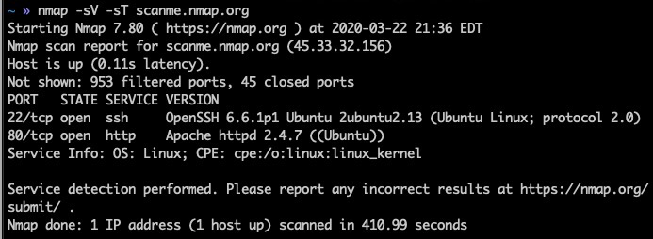
What is NMAP?
Free and Open Source network scanner
Uses raw IP Packets for scans
Uses in C, C++, Python, Lua
Released 12 December 1998: Nmap 2.0
Supports Windows, Linux, macOS

Slide 3
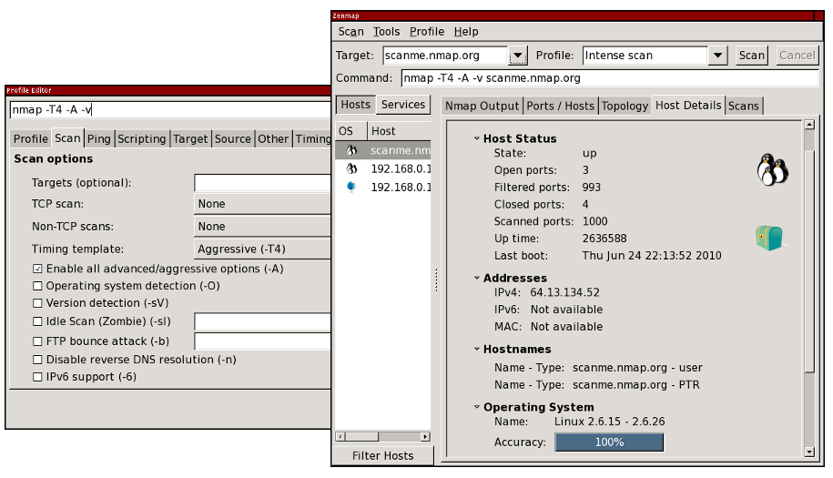
Nmap GUI: Zenmap

Slide 4
Features & Uses
Host Discovery
Port Scanning
Version Detection
OS Detection
Scriptable interaction with target
Identifying open ports on a target host
Exploiting and Detecting network vulnerabilities
Network mapping, maintenance and asset management
Notes:
Host discovery – Identifying hosts on a network. For example, listing the hosts that respond to TCP and/or ICMP requests or have a particular port open.
Port Scanning – Enumerating the open ports on target hosts.
Version detection – Interrogating network services on remote devices to determine application name and version number.^{[9]}
OS Detection – Determining the OS and hardware characteristics of network devices.
Scriptable interaction with the target – using Nmap Scripting Engine^{[10]} (NSE) and Lua programming language.

Slide 5
Networking

Slide 6
Network Ports
Communication endpoint
If a mall is an IP address, ports represent stores
Services use ports as communication endpoints
Common ports: 22 - SSH, 80 - HTTP, 443 - HTTPS

Slide 7
TCP
Transmission Control Protocol
TCP is a connection-oriented protocol residing in the transport layer of the network stack
Ensures reliability via retransmission
A connection is established using the TCP handshake
Examples of TCP services:
HTTPS (port 443)
HTTP (port 80)
SMTP (port 25)
SSH (port 22)

Slide 8
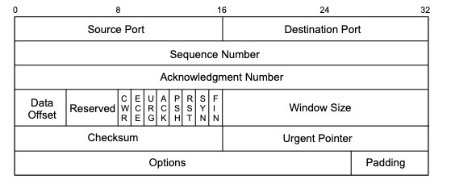
TCP Packet

Slide 9
SYN Packet
Synchronize Packet
TCP Packet with SYN Flag set used to initiate connection with server
Used to initialize the sequence numbers between the client and the server
Used to keep ensure data is being transmitted reliably

Slide 10
ACK Packet
RST Packet
FIN Packet
Acknowledgement packet
Used to indicate successful transmission
SYN/ACK sent during connection initialization
FIN/ACK sent during connection termination
Reset the connection
Marks last packet from sender

Slide 11
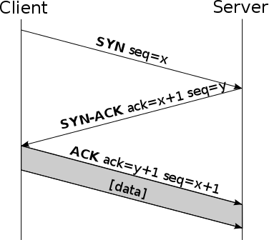
TCP Handshake
3 Way handshake
Client sends a SYN packet to the server
Server sends a SYN/ACK packet to the client
Client sends ACK packet to server, allowing data transfer to begin

Slide 12
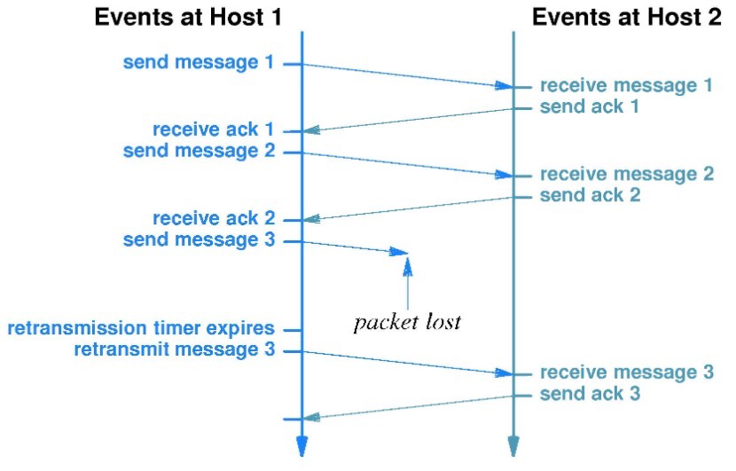
TCP Reliability
Synchronization Number
Timer
If packet is dropped → timer runs out; resend packet with corresponding sync number

Slide 13
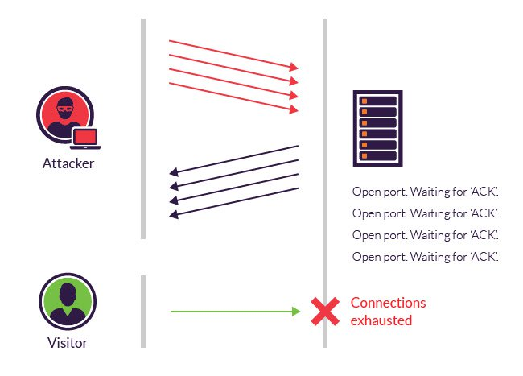
SYN Flood
Denial-of-service attack
Exploits TCP reliability
Succession of SYN requests to target system
Mitigation: Filtering requests, firewall rules, shorten wait timer for ACK

Slide 14
UDP
User Datagram Protocol
Also resides in the transport layer
Connectionless
No handshake process
No retransmission of lost packets (unreliable)
Examples:
DNS (port 53)
DHCP (port 67)
NTP (port 123)

Slide 15
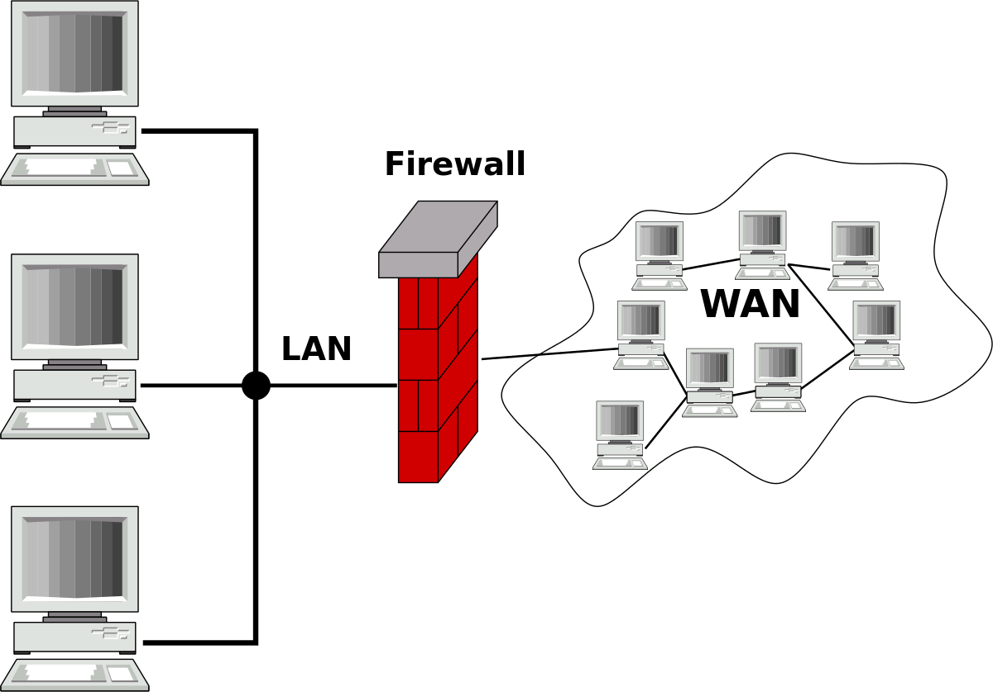
Firewall
Network security device
Hardware appliance or software
Monitors traffic
Can block ports, packet types, IP addresses
Respond to blocked packets or Ignore blocked packets

Slide 16
ICMP
Internet Control Message Protocol
Error reporting protocol
Type & Code to describe errors
Types:
3 - Destination Unreachable
Codes - For type 3
1 - Destination host unreachable
2 - Destination protocol unreachable
3 - Destination port unreachable
10 - Host administratively prohibited

Slide 17
NMAP

Slide 18
Port Discovery Scans
TCP SYN -sS
TCP connect() -sT
TCP ACK -sA
UDP -sU

Slide 19
TCP SYN scan -sS
Most common scan option
Does not establish connection, 2 steps instead of the 3 step handshake
Performed quickly
Unobstructive and stealthy since it never establishes a full TCP connection
Clear & reliable differentiation between states

Slide 20
TCP SYN scan (open)
We send a SYN packet to port 22 on the server
Server sends a SYN/ACK indicating an open port
We send a RST packet to terminate the connection, otherwise server will re-send SYN/ACK

Slide 21
TCP SYN scan (closed)
We send SYN packet to port 113
Server sends RST to us, meaning the port is closed

Slide 22
TCP SYN scan (filtered)
We send SYN to port 139
If we get an ICMP response packet, Nmap will mark it filtered
If we don't get a response, Nmap resends SYN
After a few retries, Nmap stops
This means that there’s probably a firewall dropping our packets before it reaches the server

Slide 23
TCP connect() scan -sT
Uses the OS-provided connect() system call to initiate a TCP connection to the target IP and port
Useful when user does not have raw packet privileges
Less efficient than SYN scan since the connection has to be completed vs. being left half open
More likely to be logged

Slide 24
TCP ACK scan -sA
Map out firewall rulesets, determine whether firewall is stateful and if ports are filtered
Only has ACK flag set
Probe Response | Assigned State
TCP RST response | unfiltered
No response received (even after retransmissions) | filtered
ICMP unreachable error (type 3, code 1, 2, 3, 9, 10, or 13) | filtered

Slide 25
UDP scan -sU
Can be combined with TCP scans
Scans all ports; use -F to scan 100 most common UDP ports
Empty probe packet to all but common UDP ports
Open ports rarely respond to empty probes
Probe Response | Assigned State
Any UDP Response | open
No Response (Even after Multiple Attempts) | open | filtered
ICMP Port unreachable error (Type 3; Code 3) | closed
Other ICMP Port unreachable errors (Type 3; Code 1, 2, 9, 10 or 13) | filtered

Slide 26
Host Discovery Scans
Time consuming, depending on the target IPs
Use different pinging techniques to discover hosts
-PS <port list>; TCP SYN ping
-PA <port list>; TCP ACK ping
Traceroute path to host --traceroute
sudo nmap --traceroute -Pn -sn google.com
-Pn to avoid host discovery; -sn to bypass initial port scan

Slide 27
Other features
OS Detection (-O)
Version Detection (-sV)
Verbose (-v)
Aggressive scanning (-A)
Warning, can get you in trouble
Nmap Scripting Engine (NSE)
Useful for detecting application vulnerabilities
Use common scripts
Create your own
Lua programming language

Slide 28
Cultural References

Slide 29
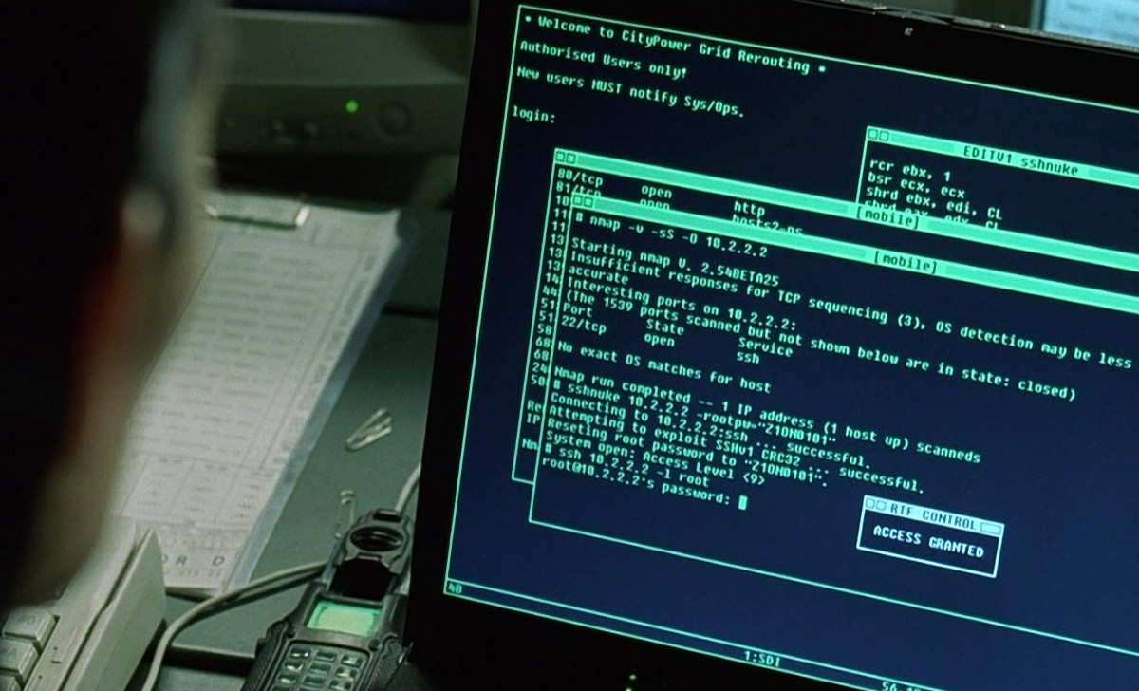
Trinity using Nmap in The Matrix Reloaded, source

Slide 30
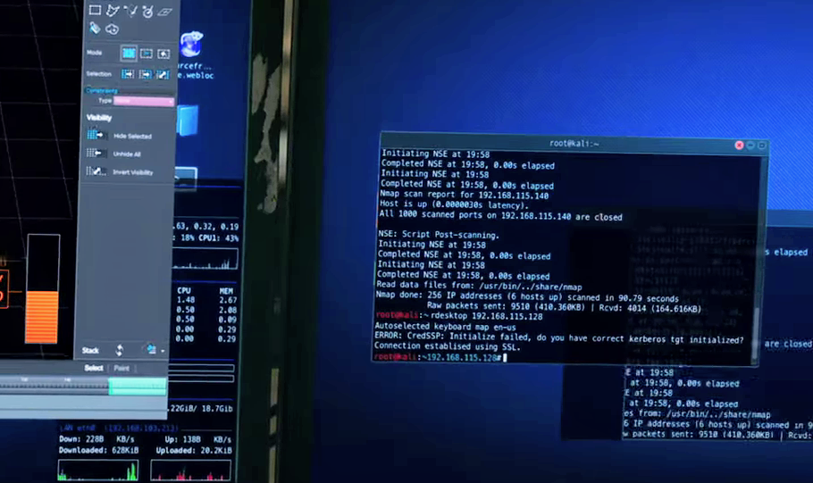
Nine Ball and crew use Nmap in Ocean’s 8, edited from source

