Slide 1
Burp Suite
A unified platform for testing the security of your web applications
Shabaz Badshah and Waleed Muhammad
Tuesday March 17, 2020
CSC427 - Information Security
University of Toronto Mississauga

Slide 2
Join the sli.do event for lecture+tutorial Q&A
Slido Code
https://www.sli.do/
# X126

Slide 3
Create a “vulnerabilities.txt” file
Write as many general vulnerabilities that you can use to break a web application (e.g. specific injections, types of misconfigurations, etc.)
2 minutes

Slide 4
Agenda
Web security context
How the web works
Burp software suite
Brute Forcing DVWA with Burp
Demo
Summary

Slide 5
Web Security Context

Slide 6
WebSec Context
Web isn’t just about websites anymore
Progressive web apps (PWAs)
APIs Backends (e.g. REST API accessed via Android app)
~3.2 billion smartphones users worldwide → 42% of the world ¹
Notable breaches:
Equifax (2017): up to 143 million victims, caused through sending malicious code through the content-type HTTP header ²
Capital One (2019): ~100 million victims, used server side request forgery to gain access to AWS meta resources ³
Notes:
Web apps are complex
Libraries are vulnerable

Slide 7
Web Security Context - OWASP Top 10
Injection
Broken Authentication
Sensitive Data Exposure
XML External Entities
Broken Access Control
Security Misconfiguration
Cross Site Scripting
Insecure Deserialization
Using Components with Known Vulnerabilities
Insufficient Logging and Monitoring
Notes:
Open Web Application Security Project

Slide 8
How the Web Works

Slide 9
Web 101 - What is HTTP
A protocol are rules that allow for the exchange of data
The web is built on the HTTP protocol
Client (your browser) requests a resource through a URL from a server
Server (HTTP server) responds with resource to client
URL - The address of something you want
HTTP is stateless
Does not remember who you are
Terminates connection once transaction is complete
Cookies are a mechanism for state management

Slide 10
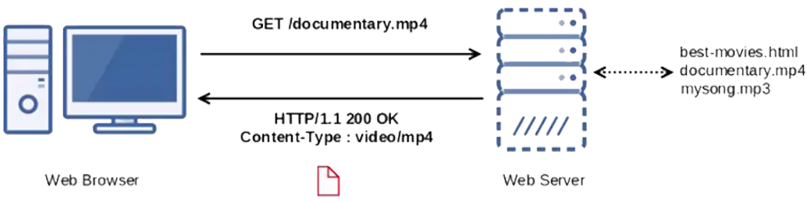
Web 101 - What is HTTP
An HTTP transaction where the client requests a video called documentary.mp4, from the server. The server then responds to the client with the video.
https://medium.com/@me.sanjeev3d/https-medium-com-me-sanjeev3d-nginx-webserver-215b636afcc5

Slide 11
Web 101 - HTTP Request and Response
How a server and client understand each other
Request Type
Resource
HTTP Version
HTTP Headers
An example of an HTTP request

Slide 12
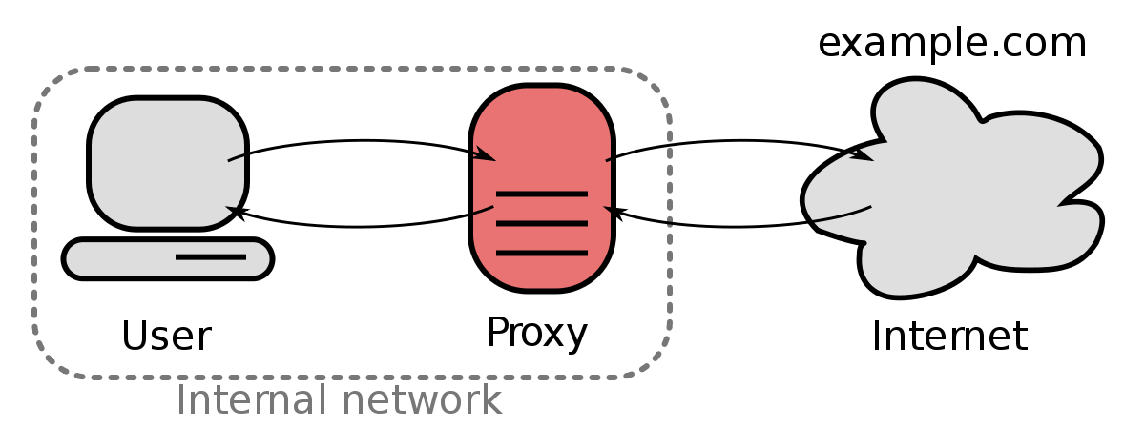
Web 101 - Proxies
An intermediate program/computer that intercepts requests
Act at the application layer in the OSI stack
A “middleman”
Proxies can:
Modify requests
Forward requests
Block requests
An example of a proxy sitting between a user and the internet
https://upload.wikimedia.org/wikipedia/commons/thumb/1/19/Forward_proxy_h2g2bob.svg/1200px-Forward_proxy_h2g2bob.svg.png

Slide 13
Burp Software Suite

Slide 14
“Burp Suite is a leading range of cybersecurity tools, brought to you by PortSwigger. We believe in giving our users a competitive advantage through superior research”
- definitely some marketing person

Slide 16
“A tool that consolidates web application security testing (e.g. injections, XSS, etc.) under a single application
- probably a CSC427 student

Slide 17
What is Burp Suite
Created and maintained by PortSwigger
Targeted towards Enterprise clients
Java based web penetration testing framework
An Interception Proxy
Pause, manipulate, and replay individual HTTP request
Identify and analyse vulnerabilities
Verify attack vectors

Slide 18
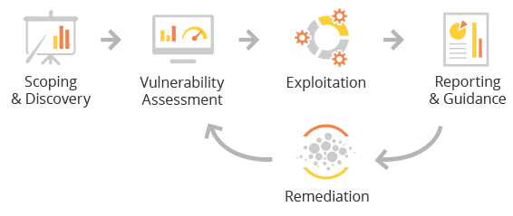
Penetration Testing Framework
Burp works across all stages
Stages of penetration testing
https://www.cloneguard.com/images/OnDemand-Penetration-Testing/OnDemand-Penetration-Testing-Overview.png

Slide 19
Burp Suite Use-cases
Exploit or detect vulnerabilities in web apps
Manually
Automation through CI integration or REST APIs
Unified solution for red-teaming
Accessible tool for QA teams to enhance overall app security
Post-scan Reports
Targeted towards Enterprise
Training and Support
Notes:
How does it actually do the exploits (can you write your own)?
Autotests?
What can burp do to help?
purpose

Slide 20
Burp Suite Architecture
Burp Agent (REST, CI, manual) hits target
Agent saves report/configurations into database
Extension implemented in Java or Python
Run exploits directly on target
Extension
Extension
Extension
Burp Agent
Database
Target
Notes:
How does it actually do the exploits (can you write your own)?
Autotests?
What can burp do to help?
purpose

Slide 21
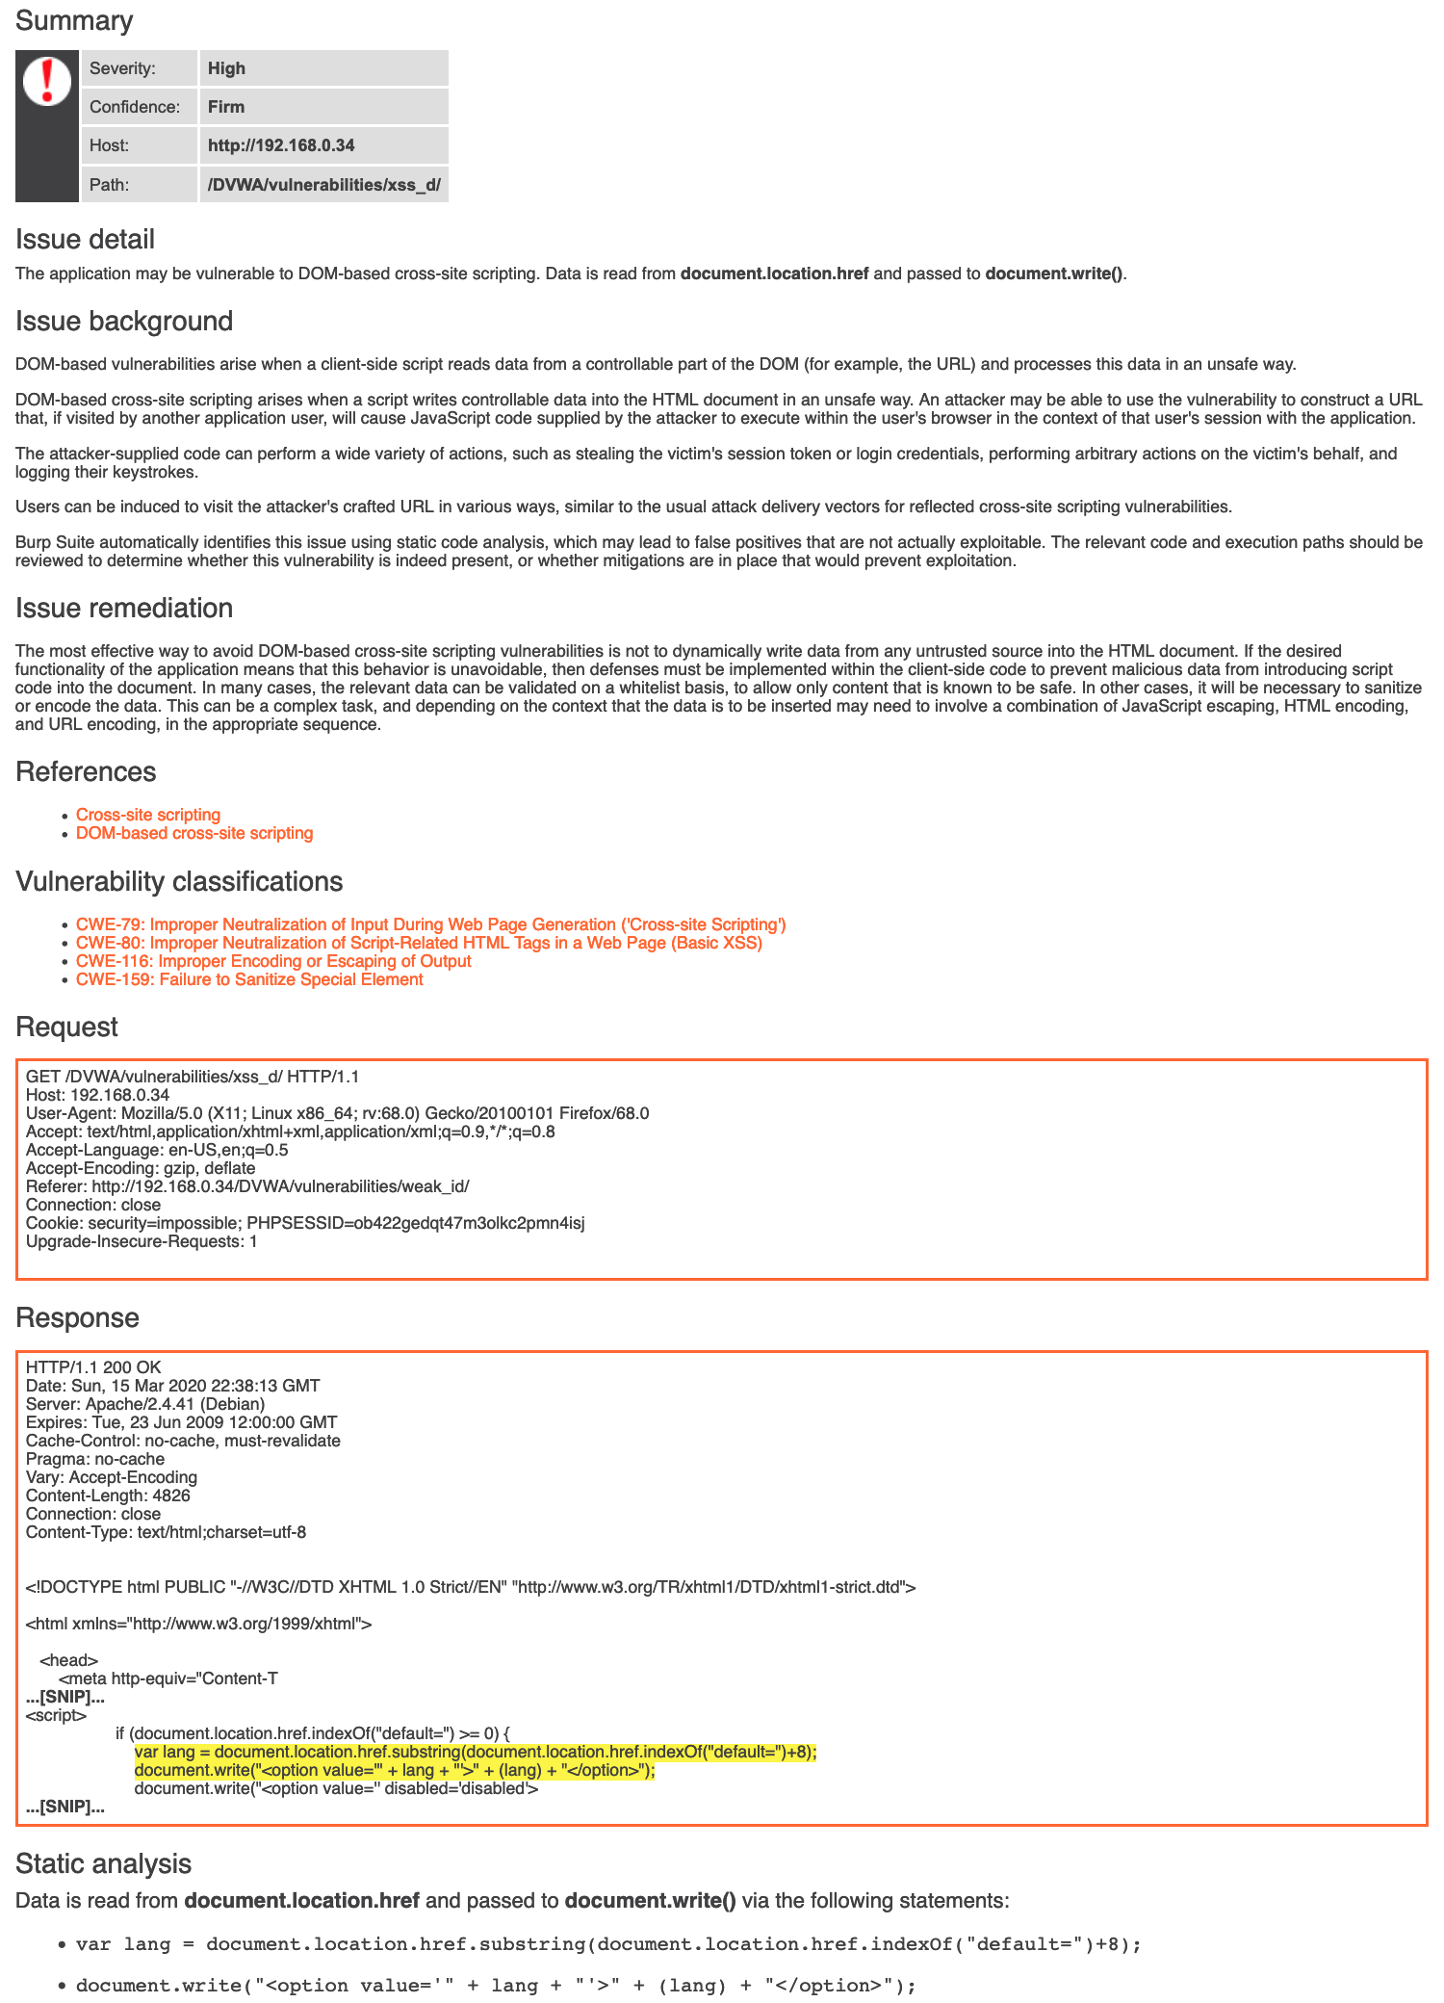
Burp Scanner Report
Live scan can provide vulnerabilities for common user flows
Static scan generates vulnerability report
Can add custom vulnerability definitions to scanner. Base DB here
Report generated provides:
Vulnerability descriptions
Mitigation techniques
Static analysis of code, etc.
Example of a single vulnerability in a repo

Slide 22
The Burp Toolset
Target - Specify domain that Burp Proxy will attach to
Proxy - Setup Burp Proxy to intercept requests to/from target
Intruder - Inject values into request
Can be used for Brute Forcing attacks
Repeater - Send a request multiple times
Sequencer - Analyze quality of randomness in data items
Decoder - Decode any text into HTML/URL/Base64
Comparer - Compare different requests/responses
Extender - Allows use of Burp plugins
Scan - Crawl and audit all possible vulnerabilities in your web app

Slide 23
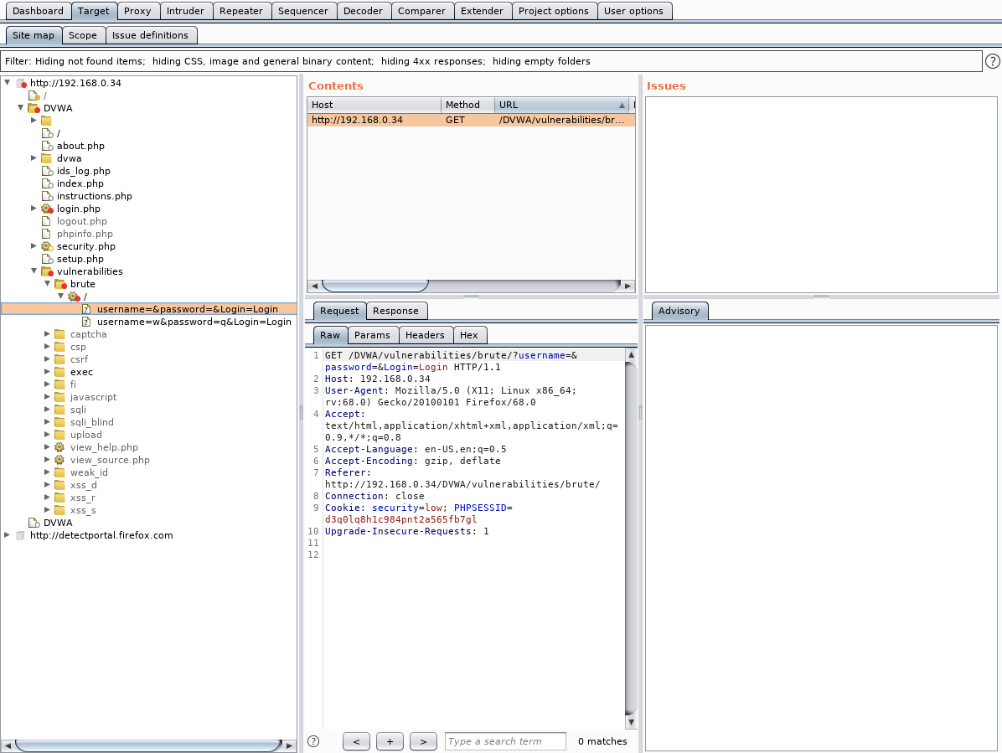
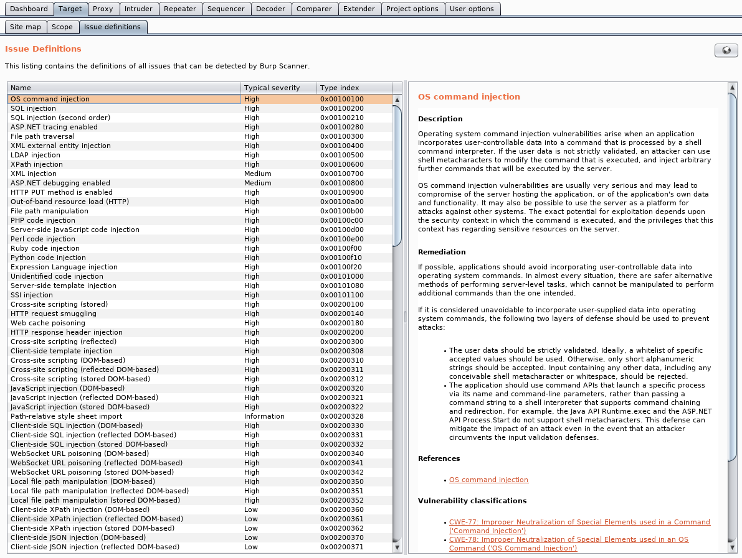
Target

Slide 24
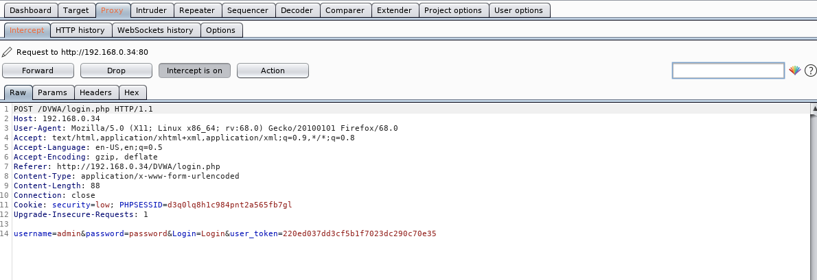
Proxy and Intruder
All requests show up here →
← Important for tutorial

Slide 25
Let’s Use Burp
Burp Suite Community is free to use
Comes pre-installed in Kali Linux
We need to allow Burp to read our HTTP traffic (i.e. Proxy)
Begin intercepting
Profit??
Notes:
Mention the scan

Slide 26
Brute Forcing DVWA with Burp
Notes:
sql injection
scanning
tutorial - brute forcing

Slide 27
Brute Forcing using Penetration Testing Framework
Assuming Burp proxy is setup (see tutorial),
Assessment: How do you normally attempt to brute force a password?
Determine insecure fields via request/response analysis
Attempt some common passwords
Compare request/response to determine passwords
Assessment: What tools would you use to accomplish this?
Discovery/Assessment: Proxy - to intercept a request
Exploit: Intruder - to modify a request and specify parameters to brute force
Exploit: Comparer - to analyze intruder results and determine credentials
Notes:
=

Slide 28
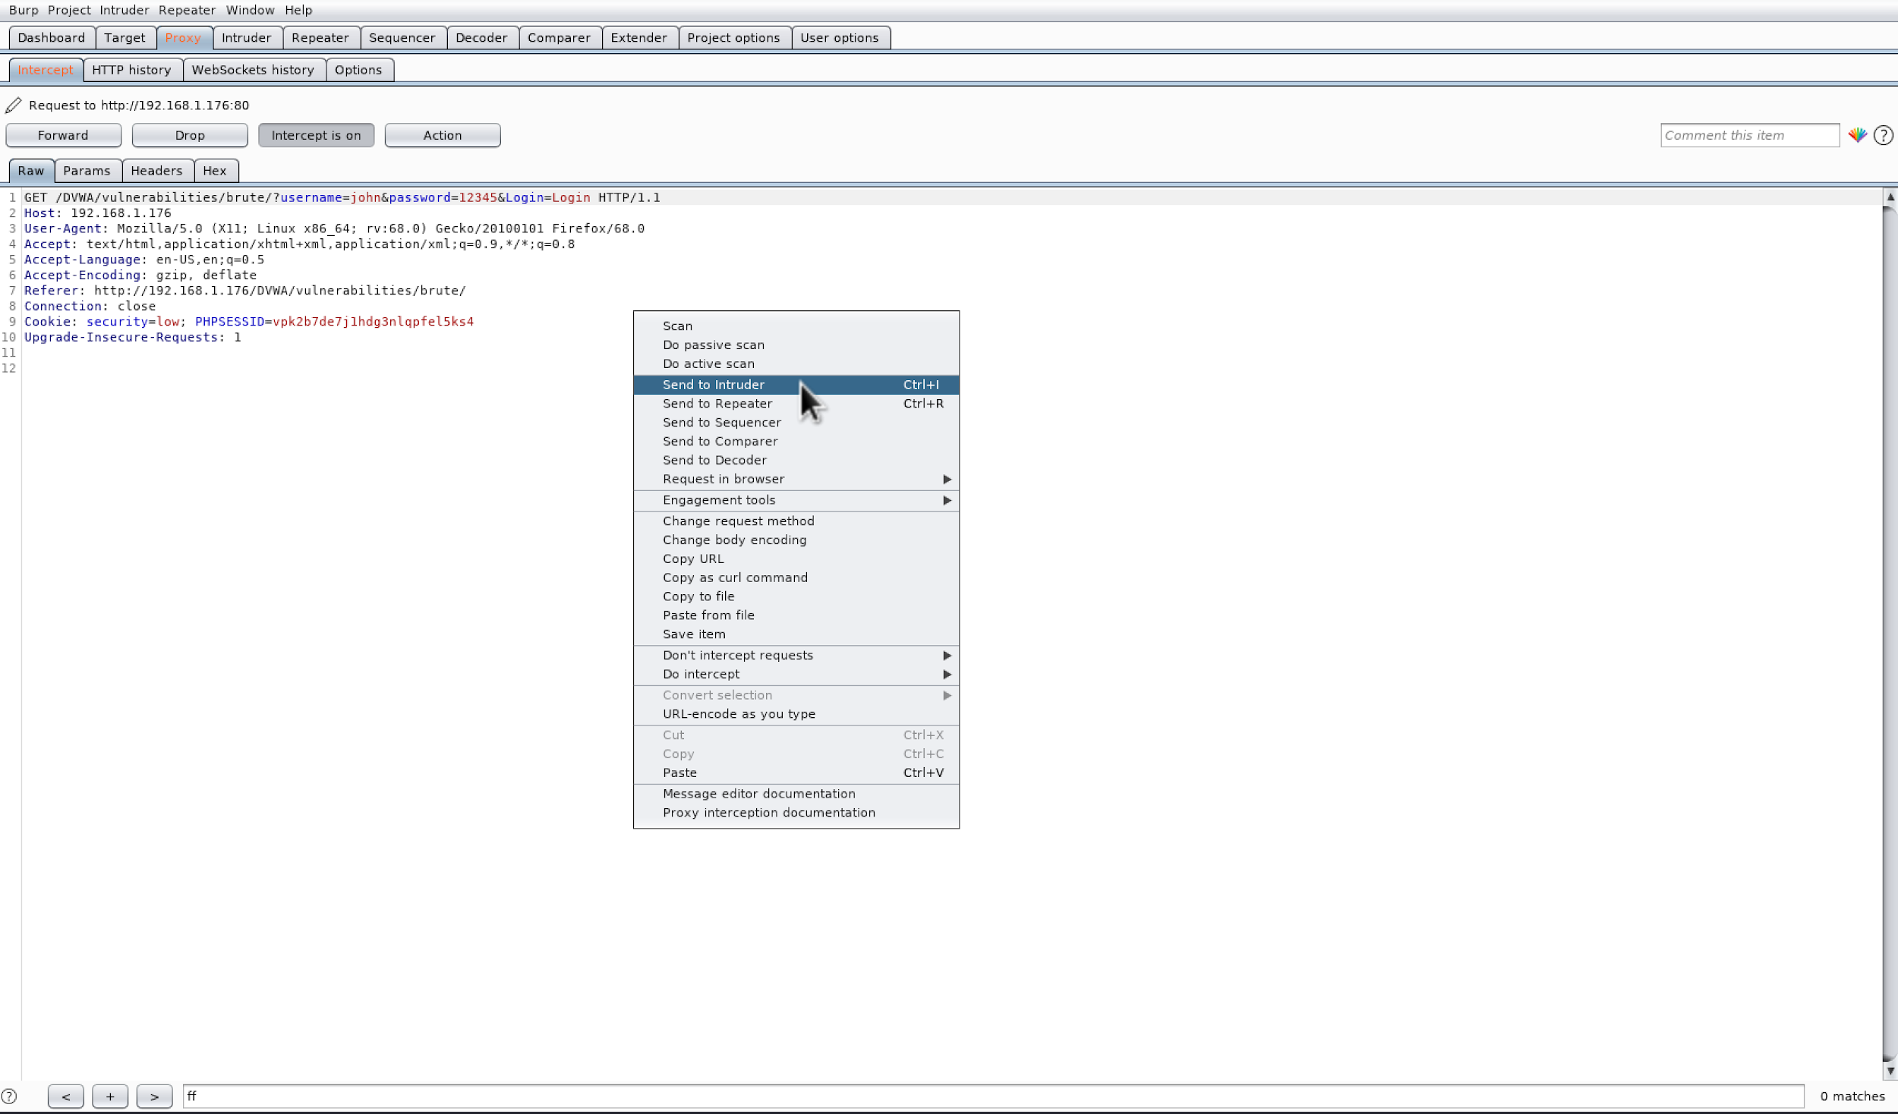
Using the Proxy
Reads all traffic between a client and target
See individual request/responses
Analyze traffic by sending to different tool
Modify request prior to sending to target
Proxy documentation
An interception of a request that is being sent to the Intruder to be modified (via right-click)
Notes:
=

Slide 29
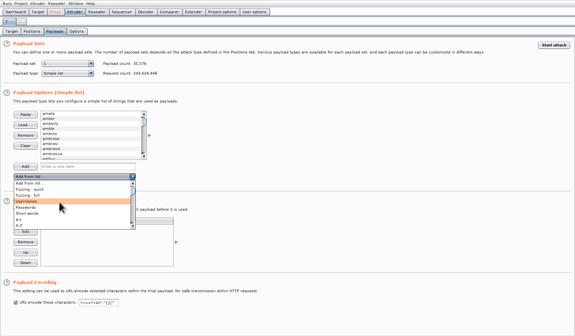
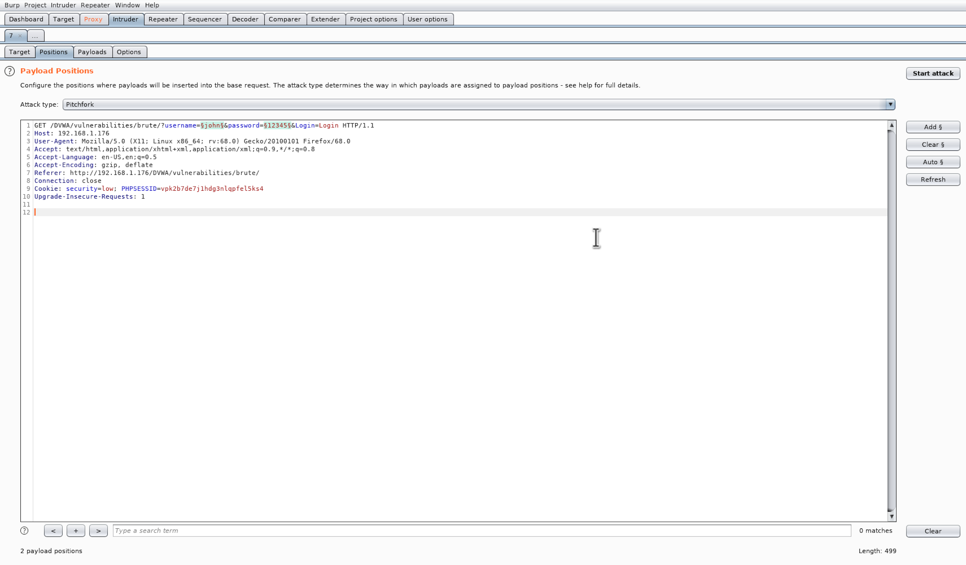
Using the Intruder
Modify request parameters
Save responses
Specify attack type
Encode payload
Specify parameter values manually or via files
Intruder documentation
Top: Specifying the values that will be tested within each field
Bottom: Specifying parameters to modify and the attack type that will be ran (i.e. pitchfork, sniper, sniper, etc.)
Notes:
=

Slide 30
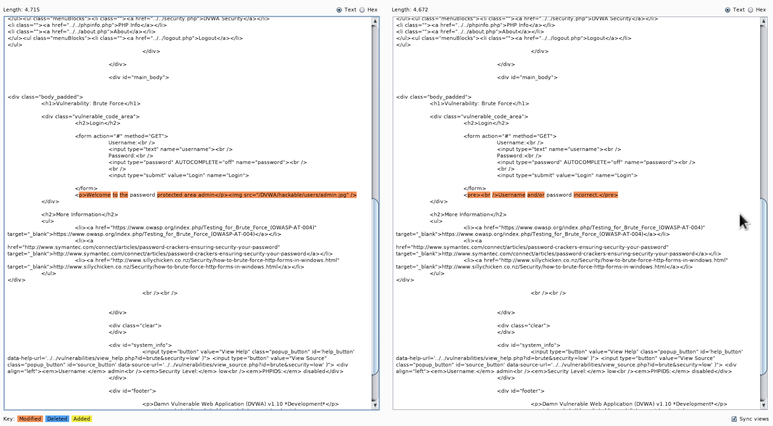
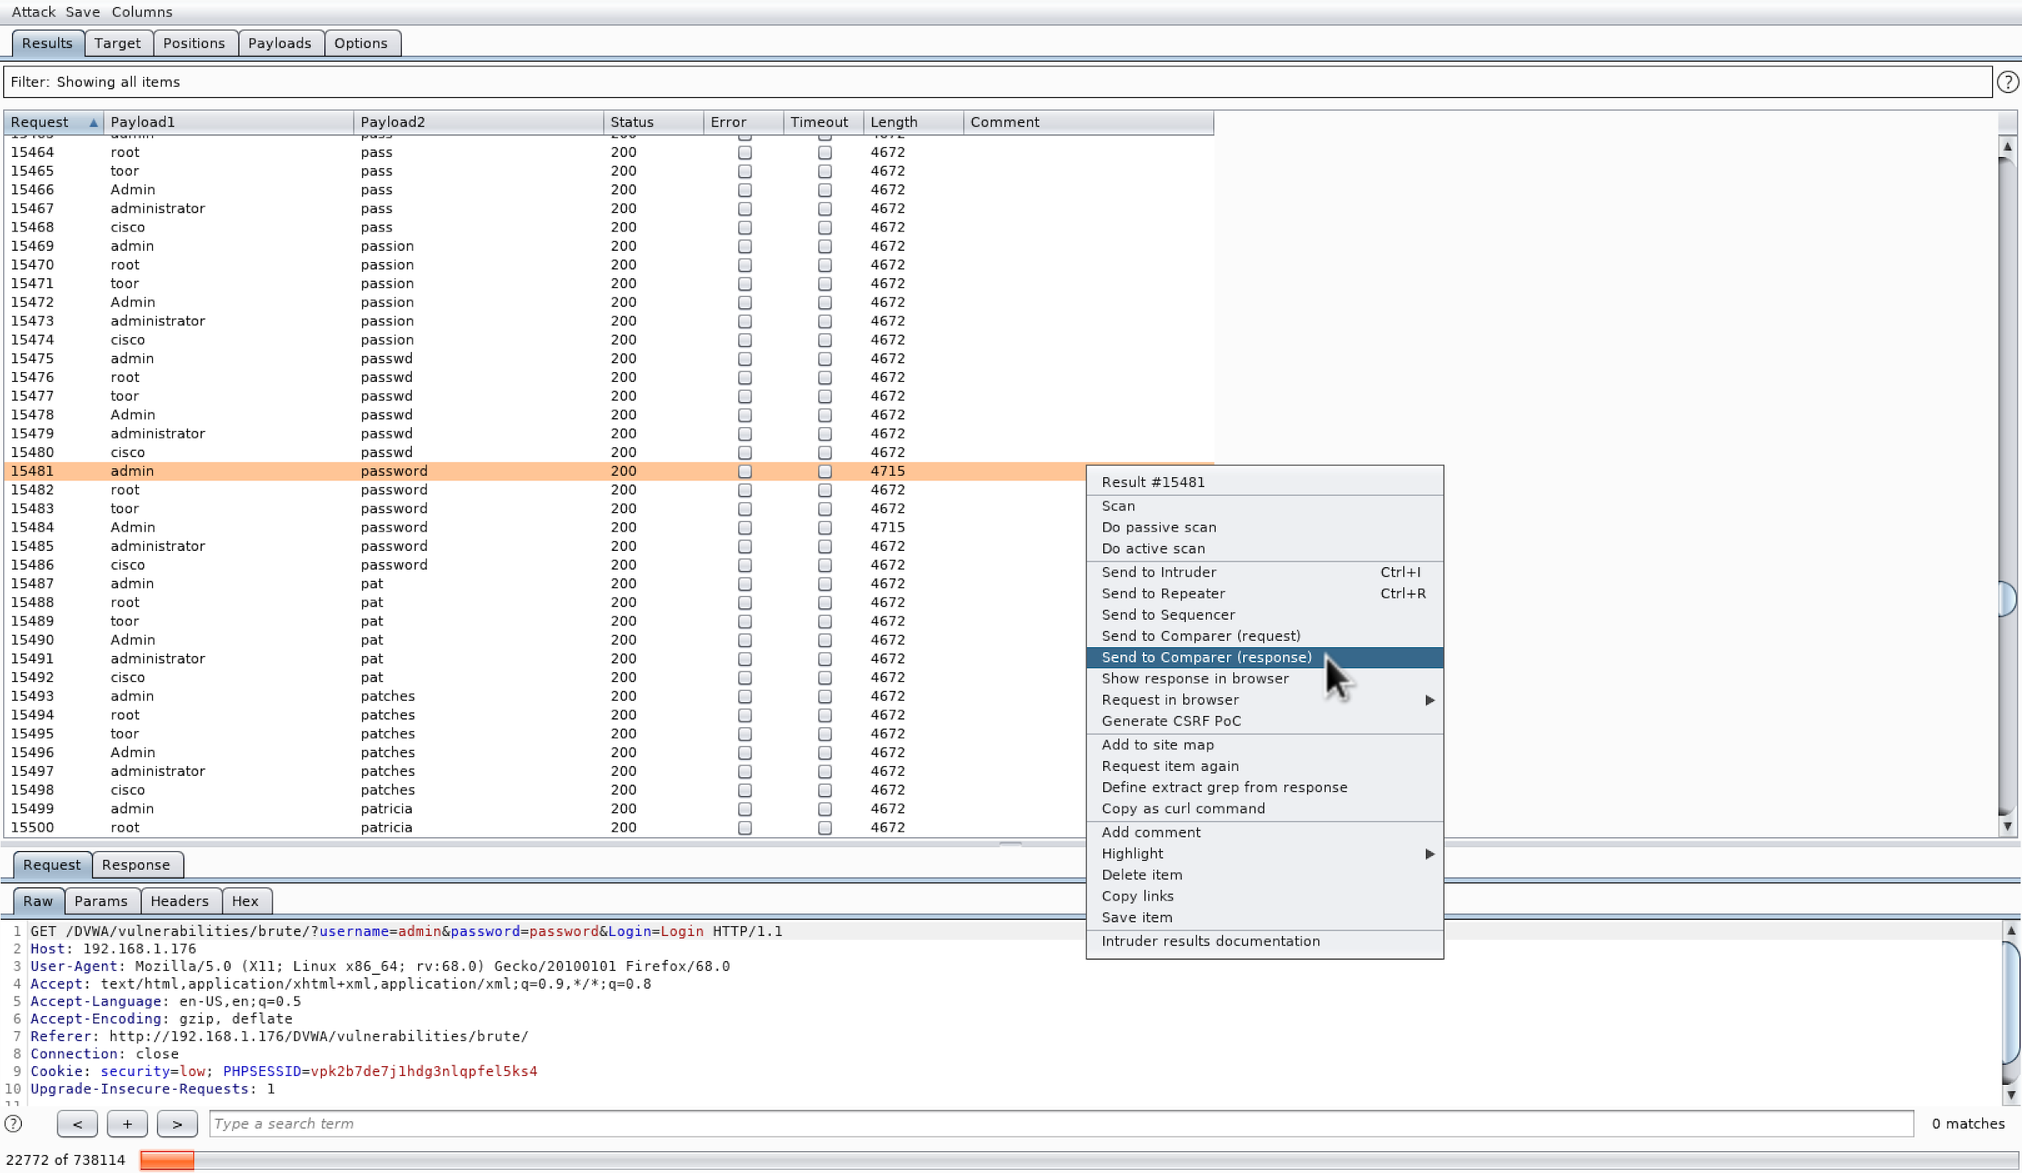
Using the Comparer
Compare two requests/responses
Used to determine successful attack
Compare content-length headers
Manual vs automated testing
Intruder automated, human analyzes results
Comparer documentation
Top: Comparing two requests from intruder
Bottom: Selecting request from brute force attack to analyze
Notes:
=

Slide 31
Demo
Notes:
sql injection
scanning
tutorial - brute forcing

Slide 32
Summary
Web is complicated and difficult to secure
Burp is a proxy
Provides consolidated toolset to test web security
Toolset assists through entire penetration testing framework
Allows for manual and automated testing
Some Key Tools:
Intruder
Comparer
Decoder
Scanner
Scan and report site vulnerabilities
Improve overall team productivity and app security due to testing consolidation

Slide 33
Thank You
Notes:
sql injection
scanning
tutorial - brute forcing

Slide 34
Resources and References
Number of smartphone users in the world: https://www.statista.com/statistics/330695/number-of-smartphone-users-worldwide/
Equifax Breach: https://www.csoonline.com/article/3444488/equifax-data-breach-faq-what-happened-who-was-affected-what-was-the-impact.html
Capital One Breach: https://krebsonsecurity.com/tag/capital-one-breach/
HTTP Overview: https://developer.mozilla.org/en-US/docs/Web/HTTP/Overview
Basic Burp Overview: https://www.youtube.com/watch?v=YCCrVtvAu2I
OWASP Top 10 List: https://owasp.org/www-project-top-ten/
Brute forcing with Burp: https://www.hackingarticles.in/brute-force-website-login-page-using-burpsuite/
XSS scripting with Burp: https://www.youtube.com/watch?v=Gg88JUav18E ← may be useful for the assignment 😉
Burp Tools Documentation: https://portswigger.net/burp/documentation/desktop/tools ← may be useful for the assignment 😉

