Slide 1
The Onion Router
Jacob Steele

Slide 2
What is Tor?
Allows users to improve their privacy and security while on the internet
Tor network is a group of volunteer-operated servers
Users connect through a series of virtual tunnels
An effective censorship circumvention tool
Hides users among other users
Notes:
-Allows users to improve their privacy and security while on the internet
-Tor network is a group of volunteer-operated servers
-Users connect through a series of virtual tunnels rather than making a direct connection, thus allowing organizations and individuals to share information over public networks without compromising their privacy
-An effective censorship circumvention tool, allowing its users to reach otherwise blocked destinations or content
-Hides users among other users on the network, so the more populous and diverse the user base for Tor is, the more anonymity you’re granted

Slide 3
Who uses Tor?
Individuals
Journalists and NGOs can use Tor for privacy
Private groups and organizations recommend Tor for online security and privacy
Indymedia
Electronic Frontier Foundation
Corporations
U.S. Navy uses it for intelligence gathering
Law enforcement
Notes:
-Individuals
-Individuals can use Tor to keep websites from tracking them and their family members, connect to new sites, instant messaging services, or the like when they are blocked by internet providers
-Journalists and NGOs can use Tor for privacy
-Journalists use Tor to communicate safely with whistleblowers and dissidents
-NGOs (Non-governmental organizations) use Tor to allow their workers to connect to their home website while they’re in a foreign country, without notifying everybody nearby that they’re working for that organization
-Private groups and organizations recommend Tor for online security and privacy
-Electronic Frontier Foundation: recommend Tor as a mechanism for maintaining civil liberties online
-Corporations: use Tor as a safe way to conduct competitive analysis, and to protect sensitive procurement patterns from eavesdroppers
-Also use it to replace traditional VPNs, which reveal the exact amount and timing of communication
I.e: Which locations have employees working late? Which locations have employees consulting job-hunting websites?
-U.S. Navy uses it for intelligence gathering, and one of its teams used Tor while deployed in the Middle East
-Law enforcement uses Tor for visiting or surveilling websites without leaving government IP addresses in their web logs, and for security during sting operations
-These are just some of the people that use Tor, but the more variety of people who use Tor, the more secure it becomes.

Slide 4
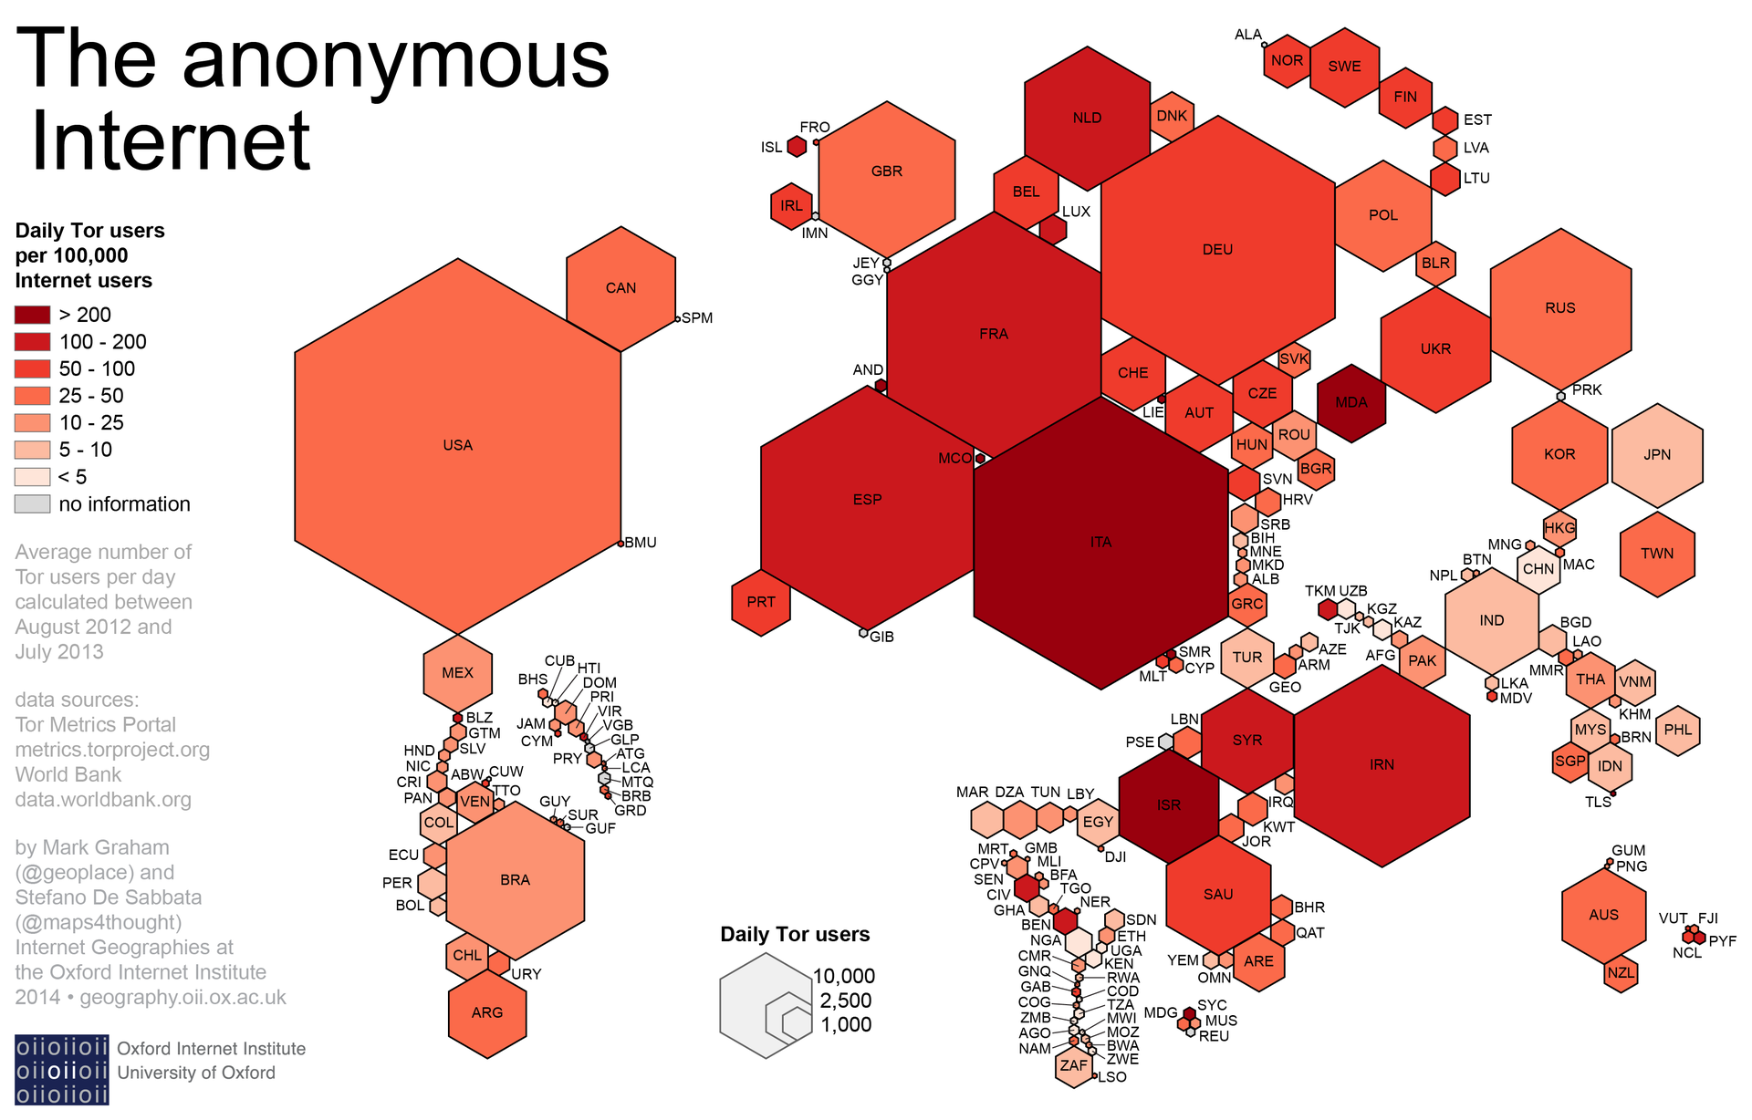

Slide 5
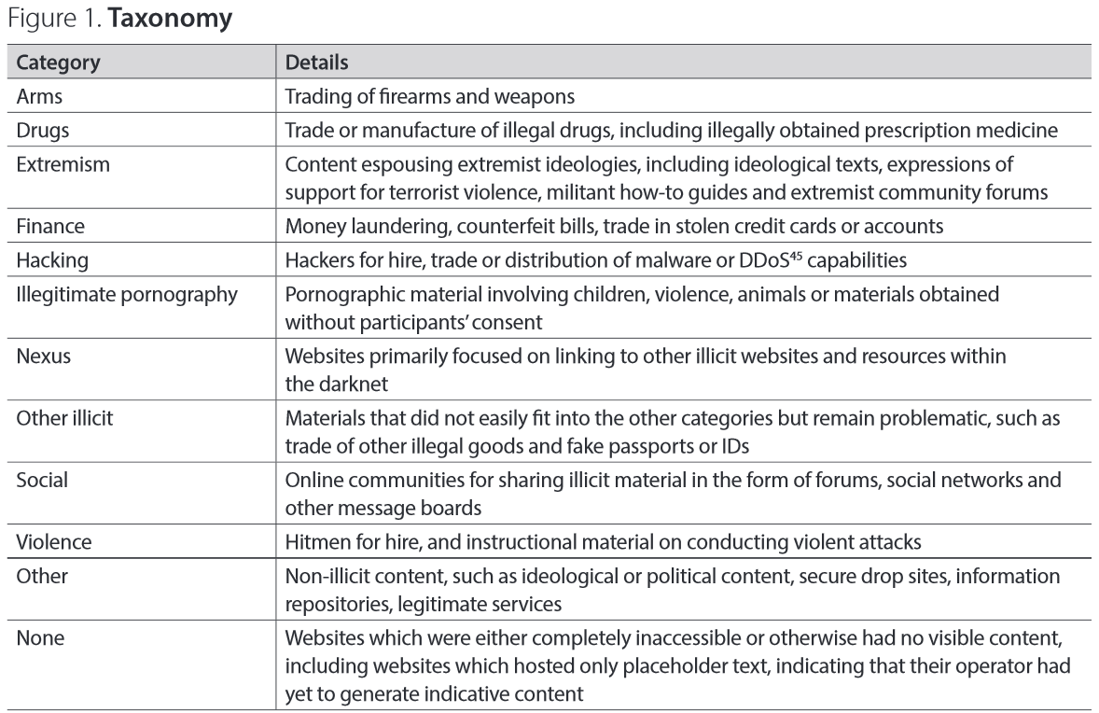
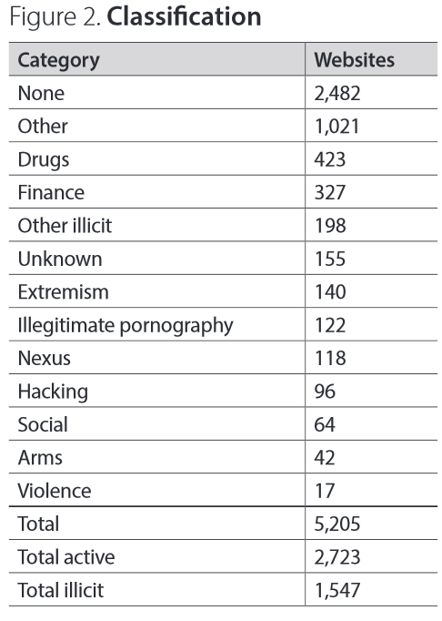

Slide 6
Why do we Need Tor?
Using Tor protects you against traffic analysis
Traffic analysis works by analyzing internet packets
Packets have two parts, the payload and header
Can be used to infer who is talking to whom over public networks
Knowing the source and destination of internet traffic allows others to track you
Can reveal who and where you are
Used to protect against more sophisticated attacks
Notes:
-Using Tor protects you against a common form of internet surveillance which is traffic analysis
-Traffic analysis works by analyzing internet packets
-Packets have two parts, the data payload and header used for routing
-Even if you encrypt the data payload, traffic analysis can still reveal what you’re doing, and possibly what you’re saying
-Mainly because traffic analysis focuses on the header, which discloses source, destination, size, timing, etc
-Can be used to infer who is talking to whom over public networks
-Knowing the source and destination of internet traffic allows others to track you, specifically your behaviour and interests
-An example of this is an e-commerce website which uses price discrimination based on your country or institution of origin
-Can reveal who and where you are
-For example, if you’re travelling abroad and connect to your employer’s computers to check or send mail, you can inadvertently reveal your national origin and professional affiliation to anyone observing the network, even if the connection is encrypted
-A basic problem for people worried about privacy, is that the recipient or your messages can see that you sent it by looking at headers. This means authorized intermediaries, like ISPs, can read the headers
-Used to protect against more sophisticated attacks, attackers can spy on multiple parts of the internet and use statistical techniques to track communication patters of people and organizations. Encryption does not help against these attacks.

Slide 7
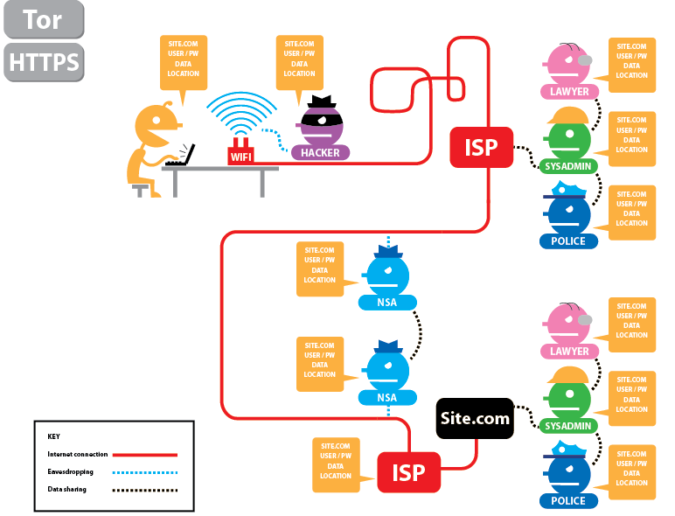

Slide 8
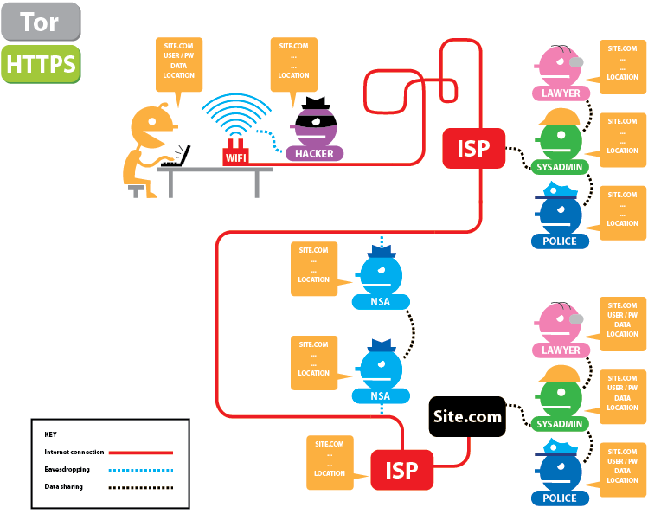

Slide 9
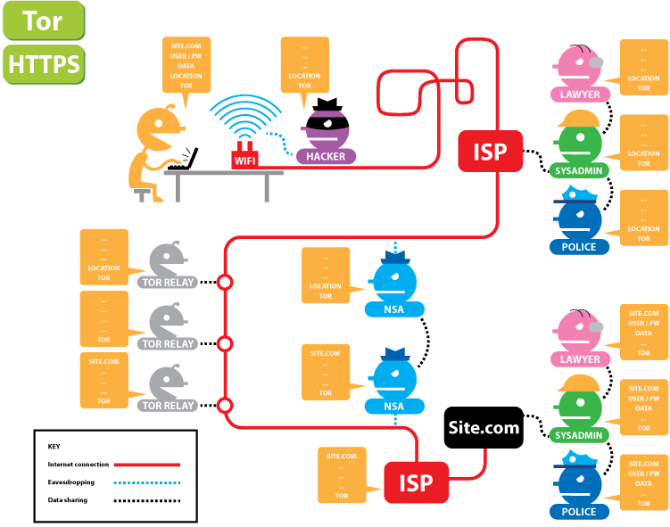

Slide 10
How Tor Works?
Tor distributes your transactions over several places on the internet
Idea is to take a hard-to-follow route
Instead of taking a direct route, data packets take a random pathway
Notes:
-Tor helps reduce the risks of simple and sophisticated traffic analysis by distributing your transactions over several places on the internet, so no single point can link you to your destination.
-Idea is to take a hard-to-follow route in order to throw off somebody who is tailing you, and then periodically erase your footprints
-Instead of taking a direct route, from source to destination, data packets take a random pathway on the Tor network, through several relays that cover your tracks so no observer at any single point can tell where the data came from or where its going

Slide 11
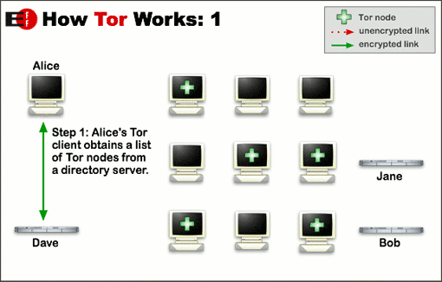

Slide 12
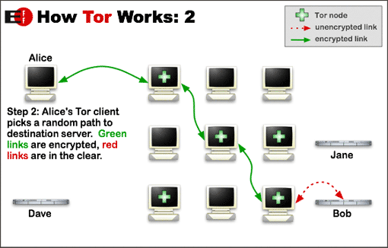
Notes:
-To create a private network pathway with Tor, the user’s software of client incrementally builds a circuit of encrypted connections through relays on the network. The circuit extends one hop at a time, and each relay along the way knows only which relay gave it data and which relay It is giving data to. No individual relay ever knows the complete path that a data packet has taken. The client negotiates a separate set of encryption keys for each hop along the circuit to ensure that each hop can’t trace these connects as they pass through

Slide 13
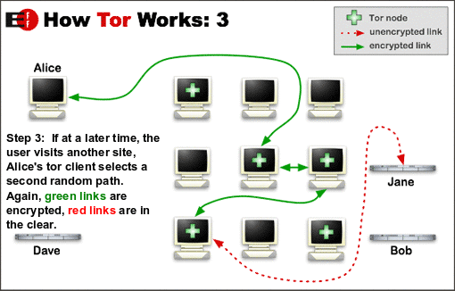
Notes:
Once a circuit has been established, many kinds of data can be exchanged and several different sorts of software applications can be deployed over the Tor network.
Because each relay sees no more than one hop in the circuit, neither an eavesdropper nor a compromised relay can use traffic analysis to link the connection’s source and destination.
As well, for efficiency, Tor software uses the same circuit for connections that happen within the same ten minutes or so. Later requests are given a new circuit, to keep people from linking your earlier actions to new ones

Slide 14
Hidden Services
Servers configured to receive inbound connections only through Tor are called hidden services
Uses onion addresses instead of IP addresses
No direct readable list of hidden services
Notes:
-Servers configured to receive inbound connections only through Tor are called hidden services
-Uses onion addresses instead of IP addresses -Rather than revealing a server’s IP addresses (and thus the network location), a hidden service is accessed through its onion address
-Tor network understands these addresses and can route data to and from hidden services, even those behind firewalls, or NATs, while persevering anonymity of both parties
-Since Tor is decentralized by design, there is no direct readable list of hidden services, although there are some number of hidden service catalogues

Slide 15
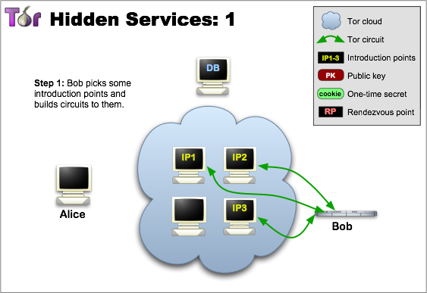
Notes:
A hidden service needs to advertise its existence in the Tor network before clients will be able to contact it. Therefore, the service randomly picks some relays, builds circuits to them, and asks them to act as introduction points by telling them its public key.
Remember the green links are circuits rather than direct connections

Slide 16
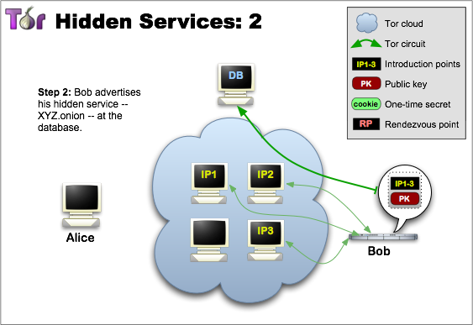
Notes:
The hidden service (bob) assembles a hidden service descriptor, containing its public key and a summary of each introduction point, and signs this descriptor with its private key. It uploads that descriptor to a distributed hash table. The descriptor will be found by clients requesting XYZ.onion, where XYZ is a 16 character name derived from the service’s public key.

Slide 17
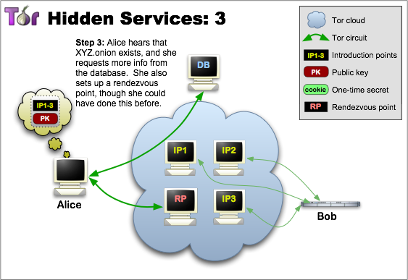
Notes:
A client (Alice) wants to contact a hidden service needs to learn about its onion address first. After that, the client can initiate connection establishment by downloading the descriptor from the distributed hash table. If there is a descriptor for XYZ.onion, the client now knows the set of introduction points and the right public key to use. At this time, the client also creates a circuit to another randomly picked relay and asks it to act as a rendezvous point by telling it a one time secret.

Slide 18
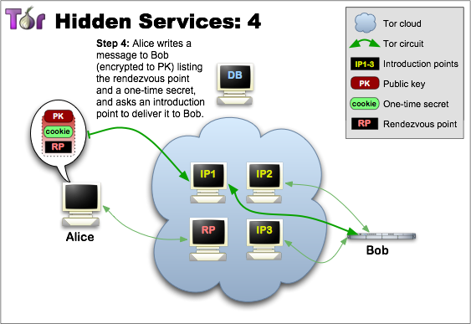
Notes:
When the descriptor is present and the rendezvous point is ready, the client assembles an introduce message (which is encrypted to the hidden service’s public key) including the address of the rendezvous point and the one-time secret. The client sends this message to one of the introduction points, requesting it be delivered to the hidden service. Again, communication takes place in a circuit, and is not direct communication

Slide 19
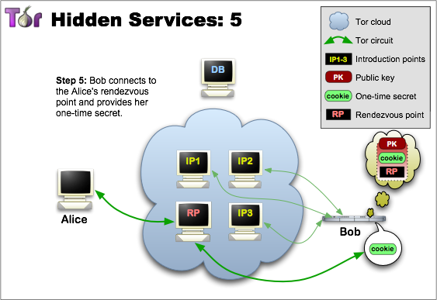
Notes:
The hidden service decrypts the client’s introduce message and finds the address of the rendezvous point and the one-time secret in it. The service creates a circuit to the rendezvous point and sends a one-time secret to it in a rendezvous message.

Slide 20
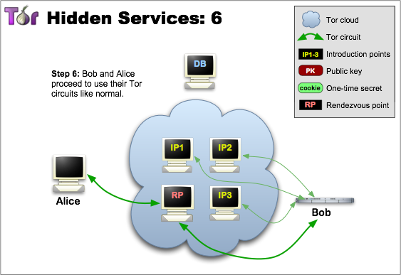
Notes:
The rendezvous point notifies the client about successful connection establishment. After that, both client and hidden service can use their circuits to the rendezvous point for communicating with each other. The rendezvous point simple relays (end-to=end encrypted) messages from client to service.
One of the reasons for not using the introduction circuit for actual communication is that no single relay should appear to be responsible for a given hidden service. This is why the rendezvous point never learns about the hidden service’s identity.
In general, the complete connection between client and hidden service consists of 6 relays: 3 picked by the client with the third being the rendezvous point, and 3 being picked by the hidden service

Slide 21
Staying Anonymous on Tor
Tor cannot solve all anonymity problems
Focuses on protecting transport of data
You need to also be smart
Notes:
-Tor cannot solve all anonymity problems
-It focuses on only protecting the transport of data.
-You need to use protocol-specific support software if you don’t want sites seeing your identifying information
-For example, you can use the Tor Browser while browsing the web to withhold info about you
-You need to also be smart
-Don’t provide your name or any other revealing information on web forms
-Tor also doesn’t protect against end-to-end timing attacks
-If your attacker can watch the traffic coming out of your computer, and also the traffic arriving at your destination, they can use statistical analysis to discover that they are part of the same circuit

Slide 22
Sources
https://www.torproject.org/
https://www.eff.org/pages/tor-and-https
Moore, Daniel. "Cryptopolitik and the Darknet". Survival: Global Politics and Strategy. Retrieved 20 March 2016.

