Slide 1
Cain and Abel
Minsoo Jin & Alex Kornilenko

Slide 2
Overview
Notes:
Only works on Windows. Supported by a team of two. Used for attacking and checking your defense. Antivirus software tags Cain as : malware, virus or just a dangerous application

Slide 3
LSA Secret - Local Security Authority
-stores important data like windows local login passwords
-stored in registry at HKEY_LOCAL_MACHINE/Security/Policy/Secrets
-need system privilege
-windows local login passwords use LM/NTLM hash (and stored)
LM/NTLM Hash
-Microsoft security protocol (Microsoft’s hash functions basically)
-stored in c:\windows\system32\config\SAM
-file is encrypted and locked when Windows is running, but Cain can bypass the lock and decrypt the SAM file to get LM/NTLM hashes

Slide 4
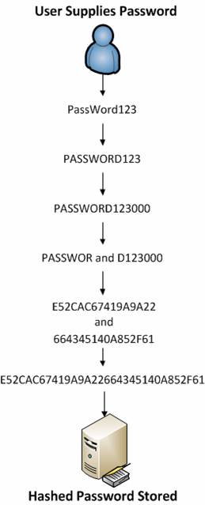
LM Hash (Win98, 2000, XP)
-based on DES
-only supports up to 14 characters
-passwords longer than 7 characters are divided and hashed separately
-password is converted into all uppercase letters in the first process of hash

Slide 5
NTLM Hash (Win7, Vista, 8+)
-based on MD4
no maximum length limit
more secure than LM hash
but Windows does not use salting
vulnerable to rainbow table attacks

Slide 6
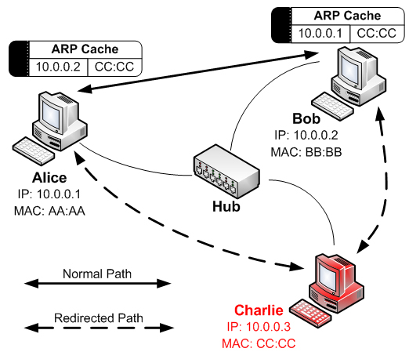
ARP Cache Poisoning/DNS Spoofing
Router
ATTACKER

Slide 7
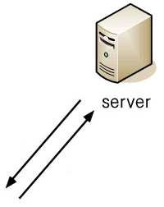
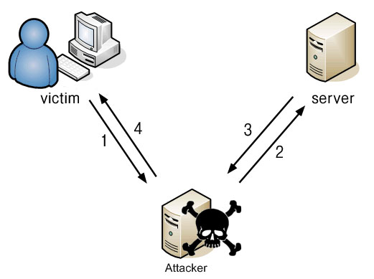
DNS Server
Gateway Router
VM

Slide 8
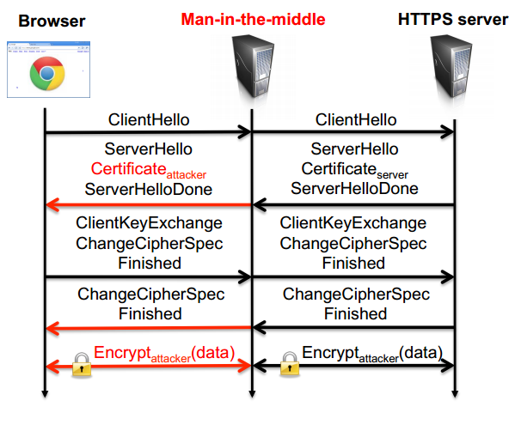
Bypassing HTTPS

