Slide 1
IP SEC
CSC 427 | Presentation | Hassan Tahir

Slide 2
Outline
IP Architecture Overview
IP SEC Overview
Tunnel vs Transport modes
IP SEC Components
AH
ESP
IKE
Demo

Slide 3
OSI Model
Application Layer
Application
Presentation Layer
PGP, Kerberos,
SSH, etc.
HTTP
SMTP
FTP
DNS
FTP
SNMP
NFS
Session Layer
Transport Layer
TCP, UDP
Transport Layer Security (TLS)
Network Layer
IP
IP Security
Logical Link Layer
Device Driver
Hardware encryption
Physical Layer
Network Adapter

Slide 4
IP
History
  IP protocol was designed in the late 70s to early 80s
  Part of DARPA Internet Project
  Very small network
  All hosts are known!
  So are the users!
  Therefore, security was not an issue
Problem & Solution
  Communications can be altered, examined and exploited.
  There is a growing need to protect private information crossing the public networks that make up the Internet infrastructure.
  IPSec is a set of protocols and methodologies to create secure IP connections.

Slide 5
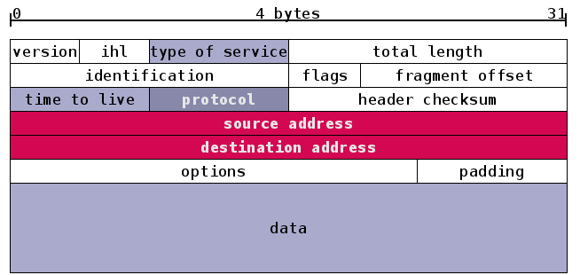
IP Packet

Slide 6
OSI Model - IP in Action
Application Layer
Original
Message
Transport Layer
(TCP, UDP)
Header 3
Data 3
Network Layer
(IP)
Header 2
Data 2
Data Link
Layer
Header 1
Data 1

Slide 7
Securing a Network
Secure
Insecure

Slide 8
IP SEC
IPSec provides data confidentiality (encryption), integrity (hash), authentication (signature/certificates) of IP packets while maintaining the ability to route them through existing IP networks
IPSec is not a single protocol, but rather a framework, and set of algorithms that provide IP layer security services
  Authentication
  Confidentiality
  Key Management
Implemented between transport and IP layers
  All packets going out are encrypted
  All packets coming in are authenticated and decrypted
  Can be implemented in routers, and also in client software
Benefits
  Transparent to applications: good for security-ignorant apps
  Routers can authenticate requests and other routers

Slide 9
Set of Protocols
A collection of protocols (RFC 2401)
  Authentication Header (AH)
    RFC 2402
  Encapsulating Security Payload (ESP)
    RFC 2406
  Internet Key Exchange (IKE)
    RFC 2409
  IP Payload Compression (IPcomp)
    RFC 3137

Slide 10
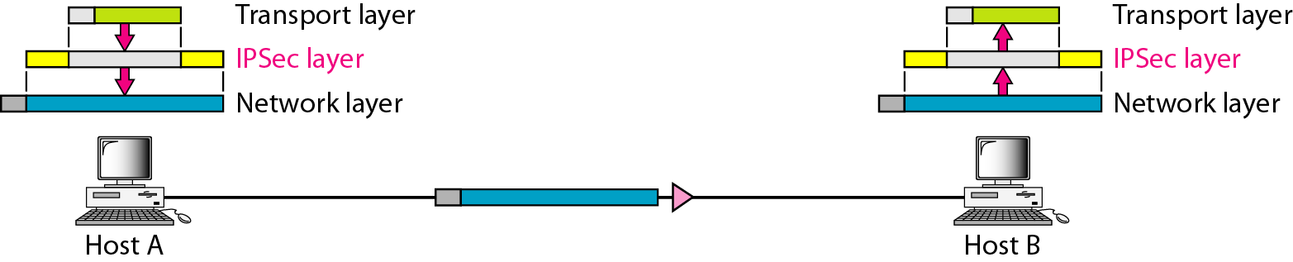
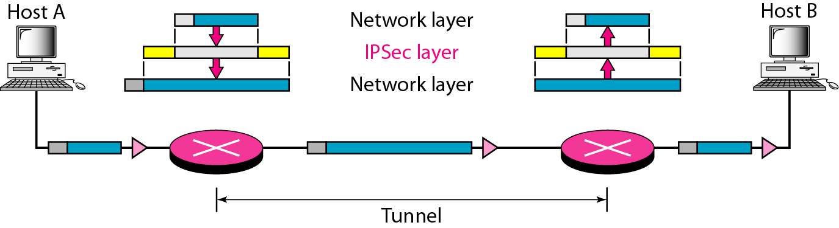
Transport vs Tunnel
Transport Mode
Tunnel Mode

Slide 11
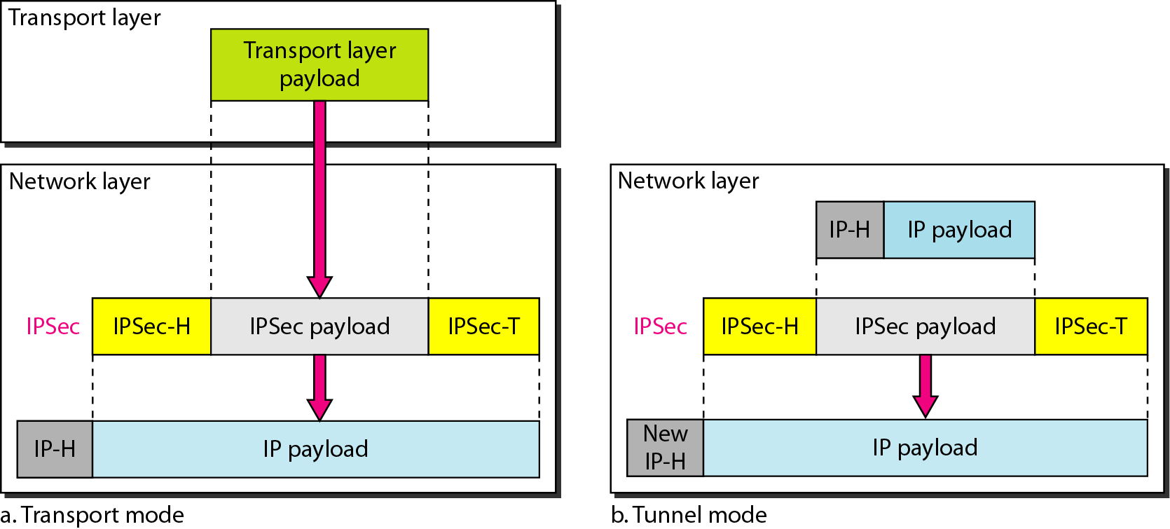
Transport vs Tunnel mode

Slide 12
IP SEC – Components
ESP
AH
Encapsulating Security
Payload
Authentication Header
IPSec
IKE
The Internet Key Exchange

Slide 13
IP SEC – Components
Key distribution and management
  Establishes a Security Association (SA) for a session
  SA is used to provide authentication/confidentiality for that session
  SA is referenced via an Security Parameter Index (SPI)
Authentication Header (AH)
  defines the authentication protocol
  no encryption
Encapsulating Security Payload (ESP)
  provides encryption
  optionally authentication

Slide 14
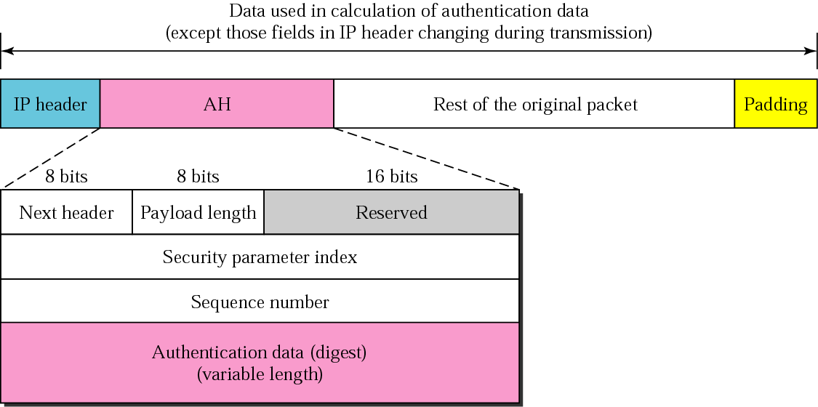
AH

Slide 15
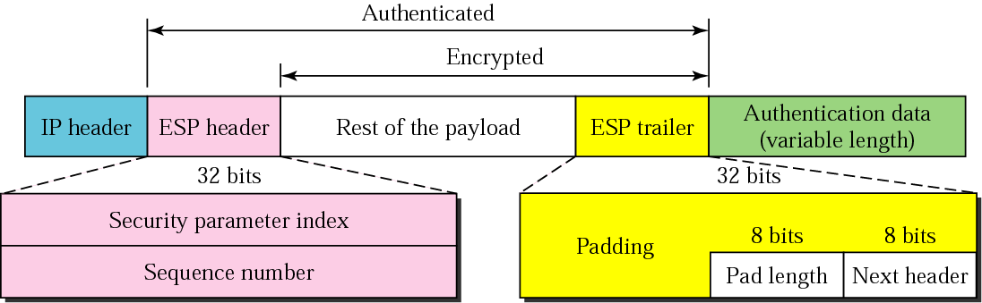
ESP

Slide 16
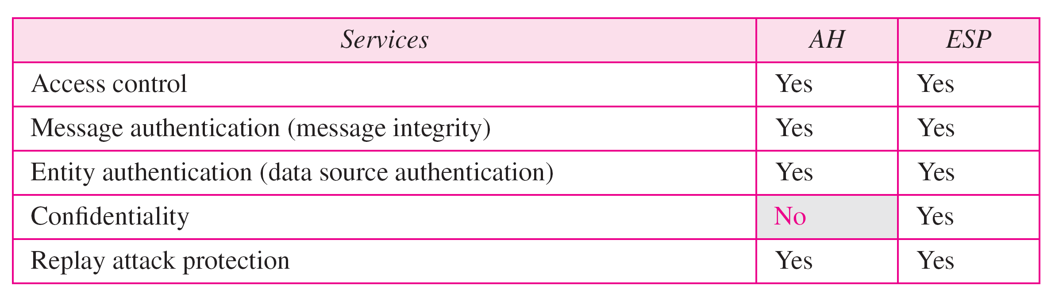
Difference between AH & ESP

Slide 17
Security Association
a one-way relationship between sender & receiver
  specifies IPSec related parameters
Identified by 3 parameters:
  Security Parameters Index (SPI)
    locally unique value
  Destination IP Address
  Security Protocol: AH or ESP (not both!)
There are several other parameters associated with an SA
  stored in Security Association Database (SAD)

Slide 18
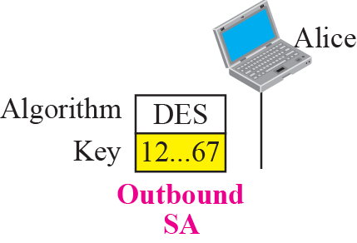
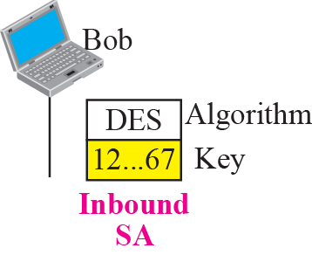
Simple SA

Slide 19
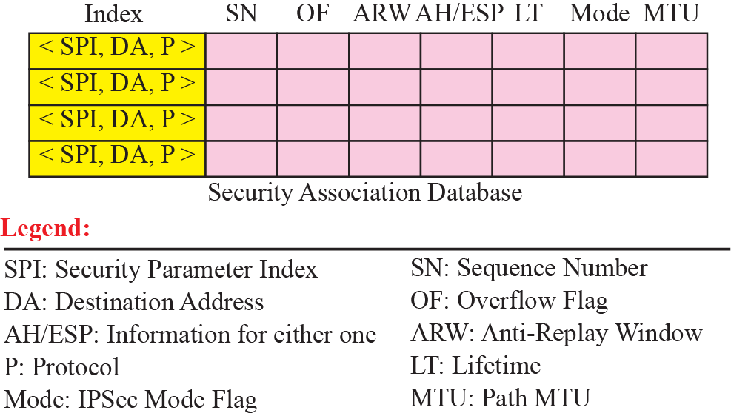
Security Association Database

Slide 20
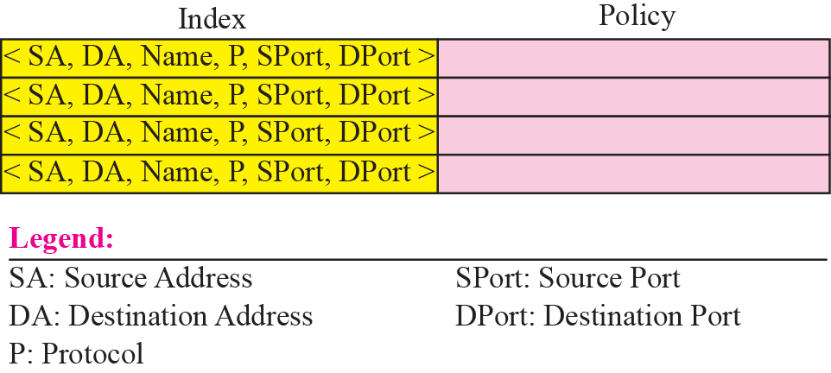
Security Policy Database

Slide 21
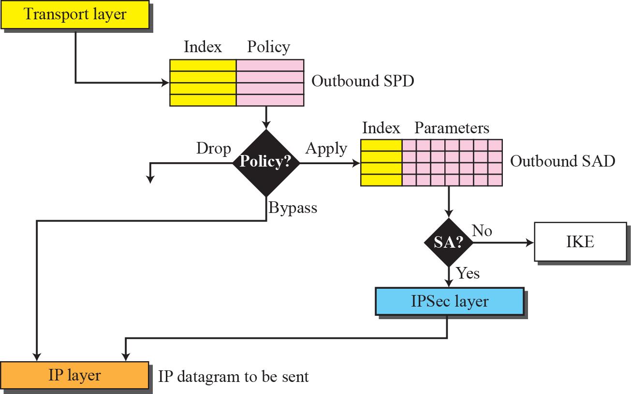
Outbound processing

Slide 22
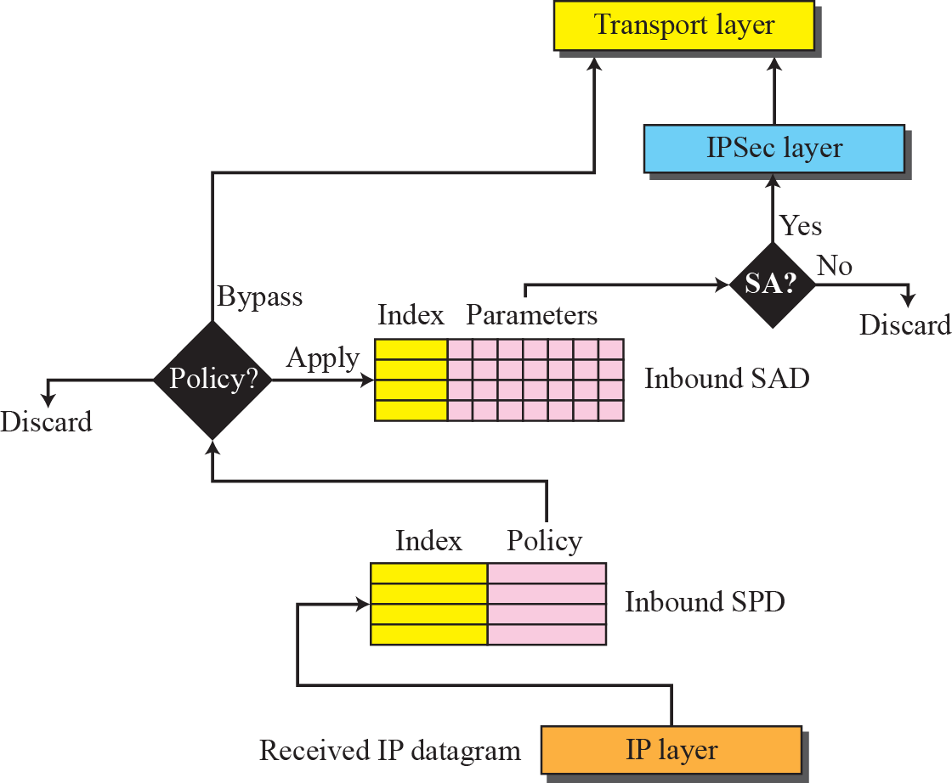
Inbound processing

Slide 23
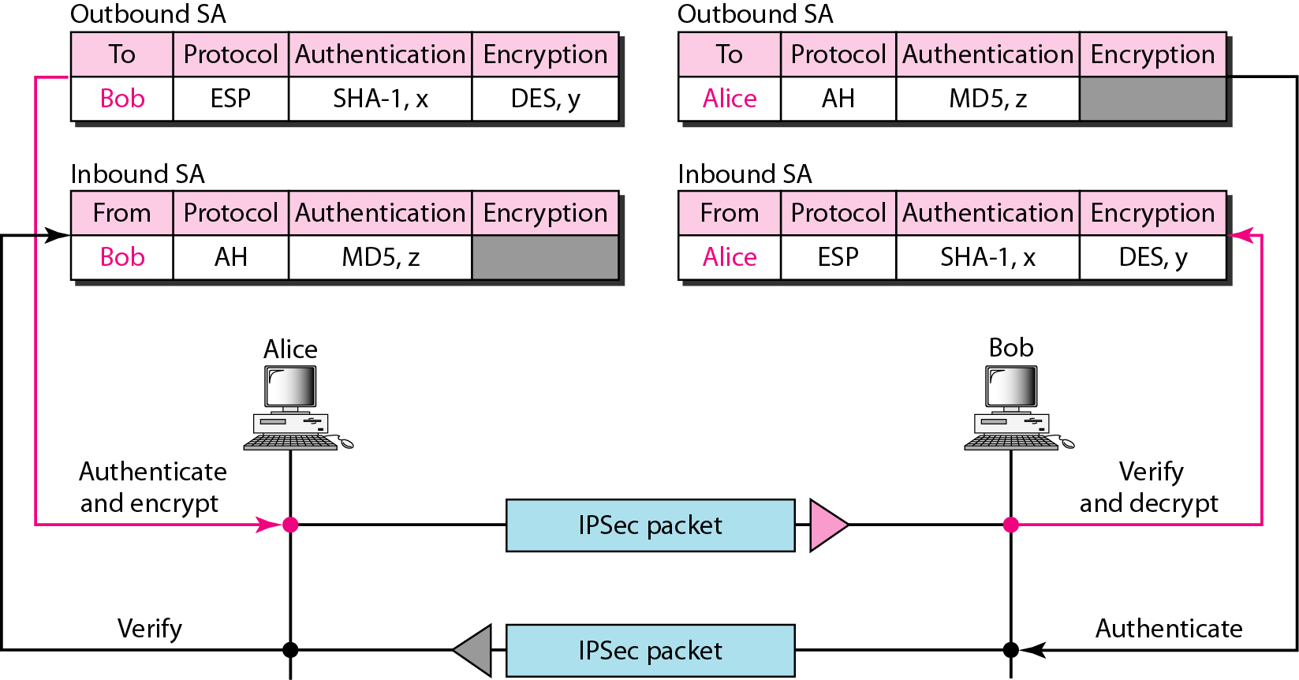
Simple Inbound & Outbound SAs

Slide 24
Key Management
IPSec assumes availability of symmetric keys
Option 1: Manual configuration
    Primarily for link communication
Option 2: Internet Key Exchange (IKE) automated on-demand creation of keys
  ISAKMP – default SA and key management protocol
    Does not mandate a specific key exchange protocol
    Implements at least Oakley, but can also use RSA for instance
  Oakley – default key determination protocol, based on a hardened Diffie-Hellman protocol

Slide 25
ISAKMP
Internet Security Association and Key Management Protocol
defines procedures and message formats to establish, negotiate, modify and delete SAs
  SA-centric, so some calls it only a SA management protocol
    but we have keys in SAs
ISAKMP is NOT key exchange protocol
independent of key exchange protocol, encryption algorithm and authentication method
IKE combines everything

Slide 26
Oakley
A refinement of Diffie-Hellman
DH weaknesses
  Clogging attack: attacker forces Alice to exponentiate endlessly
  Man-in-the-middle attack: attacker impersonates Alice to Bob and impersonates Bob to Alice
Oakley hardening (IKEv2)
  Precedes the DH phase with exchange of a pseudorandom number (“cookie”) which is specific to each party (based on IPs of parties)
  This number is first acknowledged as belonging to other party, and only then DH is performed. Hence attacker can only clog with acknowledge requests
  Authenticates DH exchange to prevent impersonation

Slide 27
Exchange
Can operate in two modes:
  Main mode
  Six messages in three round trips
  More options
Quick mode
  Four messages in two round trips
  Less options
Ways to authenticate (either mode)
  Digital signature
  public key encryption
  Pre-shared key

Slide 28
Main Mode
Initiator
Responder
[Header, SA₁]
[Header, SA₁]
[Header, KE, Ni {, Cert_req}]
[Header, KE, Ni {, Cert_req}]
[Header, IDi, {CERT} sig]
[Header, IDr, {CERT} sig]

Slide 29
Aggressive Mode
Initiator
Responder
[Header, SA₁, KE, Ni, IDi]
[Header, SA₂, KE, Nr,
IDr, [Cert]sig]
[Header, [Cert]sig]

Slide 30
IPSEC Benefits
Provides a level of security for all applications.
Allows deployment of new/emerging applications that may not have their own security.
Transparent to transport layer
Transparent to end-users
No need for training, key issue, key revocation, etc.
Can be provided to individual users where needed (e.g. off-site workers)
Extensible to new, stronger, cryptographic methods as these become available

Slide 31
IPSEC Drawbacks
Processing performance overhead
  Protection is applied to all traffic, though only a small portion may be security-sensitive
Blocks access to non-IPsec hosts
Hosts must have security association
  Not great for short-lived connections
Not practical for broadcast

Slide 32
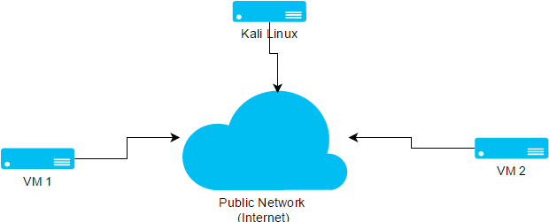
DEMO

Slide 33
Questions

