Slide 1
Password Hashing & Rainbow Tables
David Fu

Slide 2
What is a Hash Function?
Function used to map data of arbitrary size to data of fixed size
Input = message
Output = hash value
A cryptographic hash function is a hash function which is considered infeasible to invert
Four main properties
Relatively quick to compute hashes for a given message
Infeasible to generate a message from its hash
Infeasible to modify a message without changing the hash
Infeasible to find two different messages with the same hash
Notes:
A hash function is any function that can be used to map data of arbitrary size to data of fixed size. The input data is often called the message, and the output the hash value (the hash) is often called the message digest or simply the digest.
A cryptographic hash function is a hash function which is considered infeasible to invert (in cryptography terms this means that it is practically impossible to do so conveniently or efficiently, though this tends to become more feasible with time).
The ideal cryptographic hash function has four main properties:
- It is quick to compute the hash value for any given message
- It is infeasible to generate a message from its hash value
- It is infeasible to modify a message without changing the hash value (this property allows things such as md5 checksums to be useful for verifying file integrity)
- It is infeasible to find two different messages with the same hash value

Slide 3
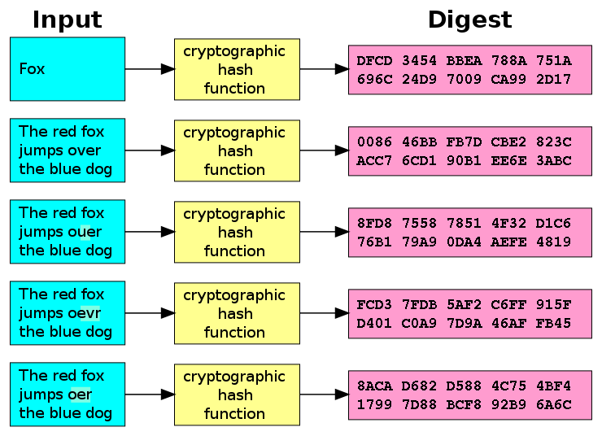
Example: SHA-1 Hash Function
Arbitrary input length
Fixed output length
Avalanche effect
Notes:
Here is an example of the commonly used SHA-1 hash function. There are two important things to note:
First, you can see that regardless of the input length, the length of the output hash remains fixed. In the case of SHA-1, the output length is fixed at 40 hexadecimal digits long, or 160 bits in size.
Second, notice that even small changes in the source input (which you can see here in the word “over”) drastically change the resulting output, to the point where the last 4 output hashes are practically indistinguishable from one another, despite having almost identical inputs. This is known as the avalanche effect, a crucial element of what makes hash functions practically impossible to invert. It is caused by hash functions designed to allow small changes to propagate rapidly through iterations of the algorithm, such that every bit of the output depends on every bit of the input (typically caused by a combination of product ciphers and large data blocks).

Slide 4
Why Hash Passwords?
Nowadays considered standard practice for authentication security
Without hashing, plaintext passwords can be easily stolen
Attacker gains access to user accounts of the compromised application and possibly the accounts of other services as well
Because we generally do not use unique passwords
Hashing makes it infeasible for an attacker to determine the original plaintext password
However, hashing technically does not make an application more secure
Notes:
Hashing passwords is nowadays considered to be a standard practice for ensuring authentication security of user accounts.
Without hashing, all plaintext passwords that are stored in an application's database can be stolen if the database is compromised. This allows an attacker to not only gain access to all user accounts of the compromised application, but also gives the attacker the passwords that those same users most likely use for other services. This is because despite knowing the risks, most users generally do not use unique passwords.
By applying a hashing algorithm to users’ passwords before storing them in the database, it becomes infeasible for any attacker to determine the original passwords, despite being able to gain unauthorized access to the database. The goal here is to make it as difficult as possible for the attacker to retrieve plaintext passwords from the compromised hashes. Though you’ll see that over time as hackers get better at cracking hashes, methods for hashing passwords need to become increasingly more complex.
It is important to note that hashing passwords technically does not make an application more secure, since it does not prevent attackers from getting in in the first place. However it does provide data security in the event of a breach, which adds a different layer of security. It can be seen as a form of damage containment so to speak.

Slide 5
The Problem
Although it takes a significant amount of time to brute-force attack a single hash, it only needs to be cracked once
Multiple users with the same password requires cracking a single hash
Precomputed hash tables store password combinations alongside their precomputed hashes
Attacker must simply search through the indexed hashes to generate the plaintext of a given hash
Time-memory tradeoff
Trades increased storage space for less processing time
Retrieving data from memory is often faster than performing relatively expensive computations
Notes:
Although it takes a significant amount of time to conduct a brute-force attack on a single hash to obtain its original password, it only needs to be cracked once.
For example if multiple users use the same password, all of them will end up generating the same identical hash, allowing an attacker who has cracked the single hash to gain access to multiple accounts.
This creates the problem of precomputed hash tables, where millions of password combinations are stored alongside their precomputed hashes, allowing an attacker to simply run a search through the indexed hashes in order to generate the original plaintext password for a given hash.
This introduces the concept of a time-memory tradeoff, where the precomputed hash table trades increased storage space for less processing time. Since the original inputs of each possible hash have been cracked and stored ahead of time, an attacker is able to reduce the computing time required for each hash, with the only limit being the amount of memory available to store the entire hash table. This allows for significant savings in processing time since retrieving a value from memory is often faster than performing relatively expensive computations for each hash.

Slide 6
Rainbow Tables
Storing every precomputed hash requires too much space
Also takes longer to search through the large amount of hashes
1 billion passwords, 8 characters, 32 byte hash = 40 GB
Rainbow tables compromise between less processing time and low memory usage
Strikes a balance between brute-force attacks and precomputed hash chains
Uses precomputed hash chains
Notes:
The problem with storing every single precomputed hash in a table is that at a certain point the table becomes too large and takes up too much space. This also introduces the problem of diminishing returns as it takes increasingly longer to search through the large amount of indexed hashes. For example, a hash table of 1 billion passwords with an average length of 8 characters and a 32 byte hash would take up around 40GB of storage space on its own.
Rainbow tables try to solve this problem by finding a compromise between less processing time and low memory usage. If brute-force attacks offer one extreme by using the most processing time and the least amount of memory, while hash tables offer the least processing time with the most amount of memory usage, rainbow tables offer a balance between the two. This is achieved primarily through the use of precomputed hash chains.

Slide 7
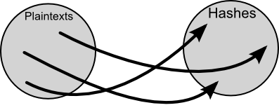
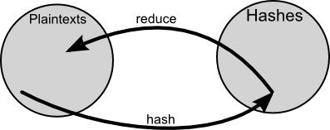
Reduction Function
Hash Function
Reduction Function
Notes:
The circle on the left represents the set of all possible plaintext passwords, while the circle on the right represents the set of all possible password hashes.
While a hash function works by mapping plaintexts to hashes, a reduction function works by doing the complete opposite: it maps hashes to plaintexts. It is important to note that although a reduction function maps hashes to plaintexts, it is by no means an inverse hash function (remember that hash functions are designed such that it is infeasible to find their inverses). A reduction function simply maps a given hash to a different plaintext, with its only requirement being able to return a plaintext of a specific size. For example, a simple reduction function might just return the last 6 characters in the hash.

Slide 8
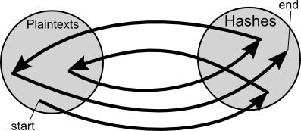
Precomputed Hash Chains
Look for the hash in the list of final hashes, if it is there break out of the loop.
If it isn't there reduce the hash into another plaintext, and hash the new plaintext.
Go to the start.
If the hash matches one of the final hashes, the chain for which the hash matches the final hash contains the original hash.
Notes:
Hash chains are constructed by alternating between hash and reduction functions for a certain fixed length, beginning on a certain plaintext and ending at a certain hash. These are called the starting point and the endpoint of the hash chain. These are the only 2 values stored on the hash table. It is in this way that hash tables can store long hash chains while minimizing memory usage. The time-memory tradeoff here is that some processing time is required to iterate through a given hash chain from its starting plaintext to end hash.
These are the steps required to utilize a hash table with precomputed hash chains.
A major problem for hash chains is the existence of collisions. This occurs if at any point two chains collide and produce the same value, despite coming from different starting points. This also opens up the possibility of loops, when a hash is reduced to a plaintext that was already hashed at a previous point in the chain. These waste valuable computation time, and cause the table to cover less passwords in total.

Slide 9
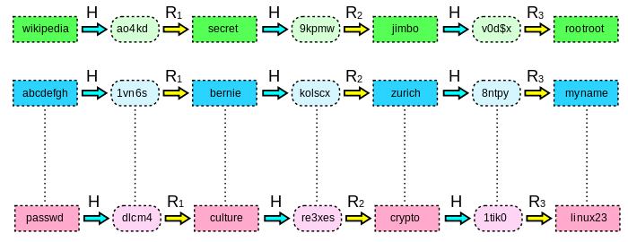
Rainbow Table Example
Notes:
Rainbow tables attempt to effectively solve the problem of chain collisions by using multiple reduction functions instead of just 1. Each link in a given hash chain is computed using a different reduction function, so that the chances of collisions become much smaller, since they would have to occur on the same iteration between two chains.
The reason they’re called rainbow tables is because of the different reduction functions used. If each reduction function were to represent a different color, then the sequence of different reduction functions might appear like a rainbow.

Slide 10
Rainbow Table Demo

Slide 11
Hacked Examples
PlayStation Network Outage (2011)
LinkedIn Hack (2012)
Evernote Security Breach (2013)
Ubuntu Forums (2013)
Notes:
The 2011 PlayStation Network outage was the result of an "external intrusion" on Sony's PlayStation Network and Qriocity services, in which personal details from approximately 77 million accounts were compromised and prevented users of PlayStation 3 and PlayStation Portable consoles from playing online through the service. Credit card data was encrypted, but Sony admitted that other user information was not encrypted at the time of the intrusion.
The social networking website LinkedIn was hacked on 5 June 2012, and passwords for nearly 6.5 million user accounts were stolen by Russian cybercriminals. The passwords were easy to unscramble because of LinkedIn's failure to use a salt when hashing them, which is considered an insecure practice because it allows attackers to quickly reverse the scrambling process using existing standard rainbow tables, pre-made lists of matching scrambled and unscrambled passwords.
On March 2, 2013, Evernote revealed that hackers had gained access to their network and been able to access user information, including usernames, email addresses, and hashed passwords. All users were asked to reset their passwords.[62][63] Following the password reset, Evernote accelerated plans to implement an optional two-factor authentication option for all users.
On July 20, 2013 the site was compromised, with attacker(s) both defacing the site and gaining access to "all user email addresses and hashed passwords. The attacker posted an announcement and then sent private messages to three Forum administrators (also members of the Ubuntu community) claiming that there was a server error on the announcement page and asking the Forum administrators to take a look. The passwords were cryptographically scrambled using the MD5 hashing algorithm, along with a per-user cryptographic salt. Password experts consider MD5 with or without salt to be an inadequate means of protecting stored passwords.

Slide 12
Defense against Rainbow Tables
Using large salts
Older Unix passwords with 12-bit salts = 4096 tables
SHA2-crypt and bcrypt use 128-bit salts
Key stretching
Multiple iteration loops to increase required computation time
Key strengthening
Securely delete the salt after generating the hash
Notes:
The salt value is not secret and may be generated at random and stored with the password hash. A large salt value prevents precomputation attacks, including rainbow tables, by ensuring that each user's password is hashed uniquely. This means that two users with the same password will have different password hashes (assuming different salts are used). In order to succeed, an attacker needs to precompute tables for each possible salt value. The salt must be large enough, otherwise an attacker can make a table for each salt value. For older Unix passwords which used a 12-bit salt this would require 4096 tables, a significant increase in cost for the attacker, but not impractical with terabyte hard drives. The SHA2-crypt and bcrypt methods—used in Linux, BSD Unixes, and Solaris—have salts of 128 bits.
Another technique that helps prevent precomputation attacks is key stretching. When stretching is used, the salt, password, and a number of intermediate hash values are run through the hash function multiple times to increase the computation time required to hash each password. For instance, MD5-Crypt uses a 1000 iteration loop that repeatedly feeds the salt, password, and current intermediate hash value back into the MD5 hash function. The user's password hash is the concatenation of the salt value (which is not secret) and the final hash. The extra time is not noticeable to users because they have to wait only a fraction of a second each time they log in. On the other hand, stretching reduces the effectiveness of a brute-force attacks in proportion to the number of iterations. This principle is applied in MD5-Crypt and in bcrypt. It also greatly increases the time needed to build a precomputed table, but in the absence of salt, this needs only be done once.
An alternative approach, called key strengthening, extends the key with a random salt, but then (unlike in key stretching) securely deletes the salt. This forces both the attacker and legitimate users to perform a brute-force search for the salt value.

Slide 13
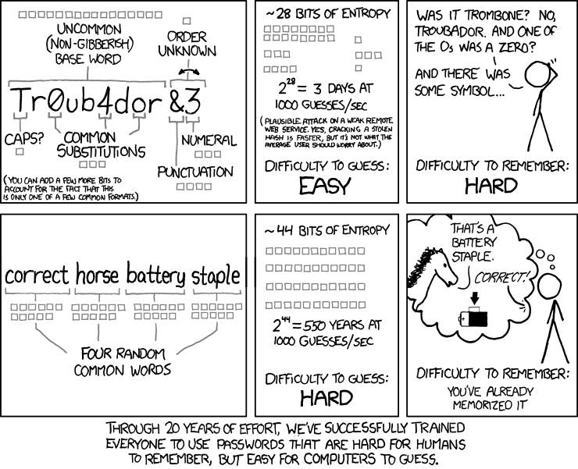
Password Entropy
Notes:
Password entropy is a measurement of how unpredictable a password is.
Password entropy is based on the character set used (which is expansible by using lowercase, uppercase, numbers as well as symbols) as well as password length. Password entropy predicts how difficult a given password would be to crack through guessing, brute force cracking, dictionary attacks or other common methods.
-Length
-Variety of character types
-Randomness
-Uniqueness
Of course password entropy can't be the only thing considered or passwords would be too long, complex and unmemorable. Best practices involve employing something memorable to the user but not easily guessed by anyone else. Because password length is one of the most important factors affecting password entropy and overall strength, a longer password can be simpler than a shorter one and still be effective.

Slide 14
Takeaways
Always hash passwords for safety measure
Common hashing algorithms (md5,sha1,sha2) alone are NOT safe
Always add randomized long salts
Complex hashing won’t help against weak passwords
Use longer passwords and avoid commonly used ones
Expect hashing methods to become increasingly more complex

