Slide 1
IPv6
Minsoo Jin & Alex Kornilenko
Notes:
Introduction >^_^<

Slide 2
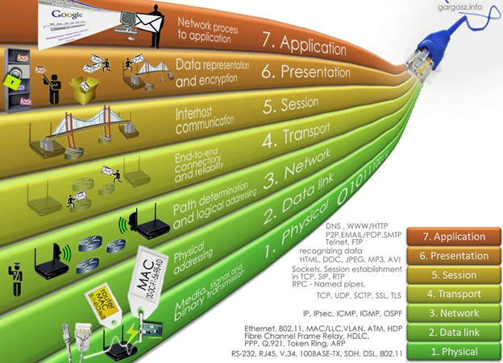
Notes:
Here on this slide we have the image representation of the 7 layer O S I model, which stands for “Open Systems Interconnection Model”. This is the standard for architecture of network systems. There is also a 5 layer Model called T C P Model. Both of these models agree that there are:
Physical Layer
Data Link Layer
Network Layer
Transport Layer
But in the 5 Layer model the “Session”, “Presentation” and “Application” are compressed into a single layer called “Process and Application”. You can learn more about these models if you take a networking class. For today, we will be looking at the “Network Layer”.
If you look at the bottom right corner you will see the common protocols used in each layer. The first protocol mentioned for the network layer is IP. That’s our subject today.

Slide 3
IP Main Jobs
Addressing Hosts
Routing
Notes:
I P has two main jobs.
Job one is, it dictates the header format of the packet and the way the payload is nested within. Real life example would be sending a mail. The return address has to be in the top left corner, the destination should be in the middle and the mail should be inside the envelope.
Job two is, finding the best path from the sender to the recipient. This is done by the routers as the packet is being delivered. The real life example of this is to deliver a mail from Toronto to Vancouver without the mail taking a trip to China, Germany and Australia unnecessary.

Slide 4
IPv4
Current : RFC-791 (1981)
Prev: RFC-760 (1980)
Range: 0.0.0.0 : 255.255.255.255
Supports: 2^32 || 4.3 * 10 ^ 9
Notes:
So currently this job is done by IPv4. IPv4 current implementation was formally described in RFC791 in 1981. The earlier version was RFC760 from 1980. So this protocol has been around for a very long time, with no major revisions. IPv4 ranges from 0.0.0.0 to 255.255.255.255 which is 2 to the power of 32 combinations or approximately 4.3 billion addresses. Now this is not a small number but… Can someone tell me what could be a problem with having 4.3 billion addresses?
Yes we are running out! Last 16 million top-level IPv4 addresses were allocated by IANA in 2011. These addresses are given to 5 “Internet Network information centers” around the world. Each information center, more or less covers a continent. North America, Europe, etc
In 2015, only one “Information Centre”’ is using a normal IPv4 distributing protocol. The other 4 are getting smaller blocks.
Distribution and buying of IP’s
While we are on the subject of numbers, doing some quick math… how come 4.3 billion IPv4 is enough currently? Well that's where NAT comes in

Slide 5
NAT (Network Address Translation)
Full Cone NAT
Restricted Cone NAT
Port Restricted Cone NAT
Symmetric NAT
Notes:
NAT or “Network address translation” allows to transform from local to global IP addresses. NAT allows computer on different local network to have same IP, without information being delivered to the wrong computer.
There are different types of NAT:
Full Cone NAT : or one-to-one nat. allows the mapping of external address ports to the corresponding internal addresses ports
Restricted Cone NAT : allows the local IP address and port number to be mapped to a particular external IP address and port number respectively.
Port restricted cone NAT : restricts the port numbers that are used for communication purposes over the Internet. All the external communication is directed to particular communication port except if there is a continuous communication with an application over a specific communications port.
Symmetric NAT : maps outgoing communication to a unique external IP address with a port number
In practice a combination of these would be used to get desired network configuration.
NAT Good:
Extra IP addresses
Network Control
Inherent Firewall
Bad:
NAT does not allow for true end-to-end connectivity. For example for real-time applications, proxy servers tend to complicate and slow down the communications process.
Adds an expensive overhead that was tolerated because of IPv4 low address problem
So at the very least what we need are more addresses. So let's take a look at IPv6..

Slide 6
IPv6
Formally: RFC-2460 (1998)
Range: 0000:0000:0000:0000:0000:0000:0000:0000
FFFF:FFFF:FFFF:FFFF:FFFF:FFFF:FFFF:FFFF
Supports: 2^128 || 3.4 * 10 ^ 38
Visual IPv4: 4,300,000,000
Visual IPv6: 340,000,000,000,000,000,000,000,000,000,000,000,000
Notes:
So IPv6 has been first formally described in 1998. In RFC-2460.
As you can see the IPv6 address looks different. It has 8 fields and they are described in hex. Range has been increased. Instead of being 2^32 it is now 2^128… but powers are hard to visualize… So we have added two numbers at the bottom of the screen to show the difference… But the number doesn't really help here either… Image all the known universe, each star in an observable universe can have 340 million billions ip addresses.

Slide 7
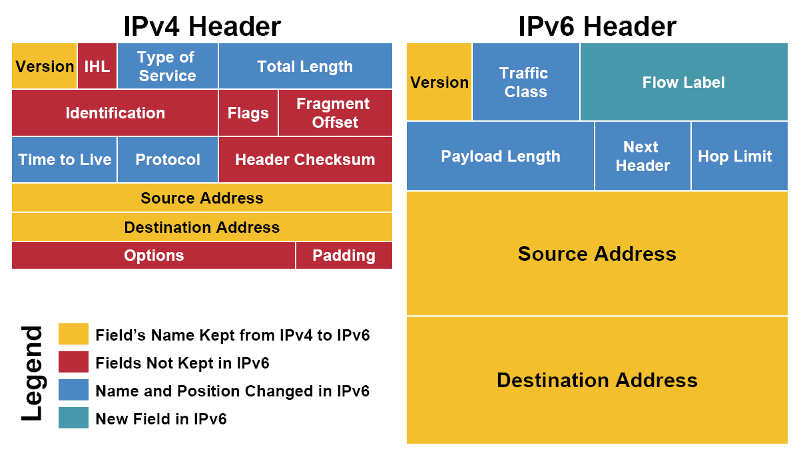
IPv4 Vs IPv6 Headers
Notes:
Source : https://343networks.wordpress.com/2010/06/02/ipv4-vs-ipv6-header/
The IPv6 header size is 40 bytes or 320 bits, which is double the size of IPv4 header.
In IPv6 the packet headers are larger but allot of unnecessary stuff has been removed.
Version is only 4-bits… It's only a number 4 or 6, depending on the IP version.
8 bits - Traffic Class provides differentiation of services and priority. Priority is here to indicate high congestion and reduce number of dropped packets.
20 bits - Flow allows telling routers that all packets that are part of the same flow will be handled in the same fashion.
16bits - payload size
8 bits- header type of the payload
8bits - 0 discard and if more then propagate
Source and Destination are self explanatory. 128bits vs 32 bits
No Header Checksum, idea is that transmission failures these days are low. And even if there is an error it will be delivered to the wrong destination, and it will be disregarded there.

Slide 8
Stateless Address autoconfiguration
Described in RFC2462
Eliminates the need for DHCP
Allows hot plugging of network devices
Smaller overhead
Notes:
The autoconfiguration and renumbering features are defined in RFC2462.
Stateless Address autoconfiguration eliminates the need of Dynamic Host Configuration Protocol (DHCP). A DHCP server holds a pool of IP addresses that are dynamically assigned for a specified amount of time to the requesting node in a Local Area Network (LAN).
Network Devices will be autoconfigured removing the need to manually configure the devices.
This feature also helps by removing the intermediary proxy and DHCP servers allowing for a smaller overhead and faster connections

Slide 9
Stateless Address autoconfiguration - Steps
Link-Local Address Generation
Link-Local : ‘1111111010’ + 50 * ‘0’ + 64 bit interface identifier
Link-Local Address Uniqueness Test
Link-Local Address Assignment
Router Contact
Router Direction
Global Address Configuration
Notes:
In this step, the networked device ensures that the link-local address generated by it is not already used by any other device i.e. the address is tested for its uniqueness.
Once the uniqueness test is cleared, the IP interface is assigned the link local address. The address becomes usable on the local network but not over the Internet.
The networked device makes contact with a local router to determine its next course of action in the auto configuration process.
The node receives specific directions from the router on its next course of action in the auto configuration process.
The host configures itself with its globally unique Internet address. The address comprises of a network prefix provided by the router together with the device identifier.

Slide 10
IPv6 Interface Identifiers
RFC 2373: Identifier is derived from (EUI)-64 address
RFC 3041: Randomly-generated
Notes:
Interface Identifier is the last 64 bits of an address that is unique to the 64-bit prefix.
The way the identifier is determined was described in RFC-2373 and 3041

Slide 11
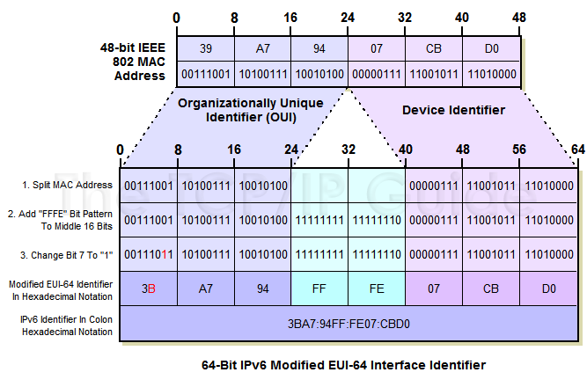

Slide 12
Stateless Address autoconfiguration - Steps (Continue)
Link-Local Address Generation
Link-Local address : ‘1111111010’ + 50 * ‘0’ + 64 bit interface identifier
Link-Local Address Uniqueness Test
Link-Local Address Assignment
Router Contact
Router Direction
Global Address Configuration
Global Unique Address
Notes:
In this step, the networked device ensures that the link-local address generated by it is not already used by any other device i.e. the address is tested for its uniqueness.
Once the uniqueness test is cleared, the IP interface is assigned the link local address. The address becomes usable on the local network but not over the Internet.
The networked device makes contact with a local router to determine its next course of action in the auto configuration process.
The node receives specific directions from the router on its next course of action in the auto configuration process.
The host configures itself with its globally unique Internet address. The address comprises of a network prefix provided by the router together with the device identifier.
Whats Link-Local and Global Unique Address?

Slide 13
Unicast, Multicast and Anycast Addresses
Unicast : One to One
Multicast : One/Many to Many
Anycast : Many to Few
Notes:
1) Unicast addresses A Unicast address acts as an identifier for a single interface. An IPv6 packet sent to a Unicast address is delivered to the interface identified by that address.
2) Multicast addresses A Multicast address acts as an identifier for a group/set of interfaces that may belong to the different nodes. An IPv6 packet delivered to a Multicast address is delivered to the multiple interfaces.
3) Anycast addresses Anycast addresses act as identifiers for a set of interfaces that may belong to the different nodes. An IPv6 packet destined for an Anycast address is delivered to one of the interfaces identified by the address.

Slide 14
Global Unicast, Link-Local and Unique-Local Address
Notes:
Global Unicast address is world-routable, so anyone anywhere in the world can see that IP address
link-local address is just for your local area network. Consider it the equivalent of a 192.168.0.1 or 10.1.1.1 address.
Unique local addresses are available for use in private networks, e.g. inside a single site or organization or spanning a limited number of sites or organizations. They are not routable in the global IPv6 Internet.
SOurce: https://technet.microsoft.com/en-us/library/bb726995.aspx

Slide 15
IPv6 Address Types
https://www.ripe.net/participate/member-support/new-lir/ipv6_reference_card.pdf
Notes:
https://www.ripe.net/participate/member-support/new-lir/ipv6_reference_card.pd
If we have time to show these

Slide 16
IPv4 and IPv6 Direct Communication
No direct Communication :(
Notes:
There is no direct communication between IPv4 and IPv6
http://www.cisco.com/c/en/us/products/collateral/ios-nx-os-software/enterprise-ipv6-solution/white_paper_c11-676278.html
some tools can be used

Slide 17
IPv6 Consumer Switch
In order to use ipv6, 3 things must be true:
-your machine must support ipv6
-your home network must support ipv6 (your router)
-your isp provider must support ipv6
Notes:
Most if not all computers and cellphones are now capable of using IPv6.

Slide 18
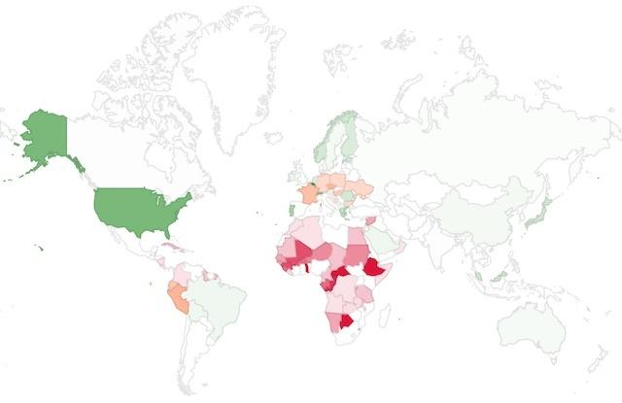
IPv6 ISP Switch
Per-Country IPv6 adoption in July 2015
Source: Google
Notes:
The issue is not with the consumers
ISP are holding back the change
IPv6 or dual stack gear is expensive (isp providers are deploying dual stack gear to new customers to transition)
no benefit to average customer
ISP want NAT to have control of traffic and visibility
We can mention the net neutrality
-----
(green)Regions where IPv6 is more widely deployed (the darker the green, the greater the deployment) and users experience infrequent issues connecting to IPv6-enabled websites.
(orange)Regions where IPv6 is more widely deployed but users still experience significant reliability or latency issues connecting to IPv6-enabled websites.
(red)Regions where IPv6 is not widely deployed and users experience significant reliability or latency issues connecting to IPv6-enabled websites.
Notice Canada did not participate in ipv6 switch actively: http://www.itworldcanada.com/article/world-ipv6-day-starts-without-bell/44285
http://www.secure.techvibes.com/blog/how-slow-canadian-adoption-from-ipv4-to-ipv6-could-affect-the-ambitions-of-innovators-and-the-internet-of-things-2011-08-04

Slide 19
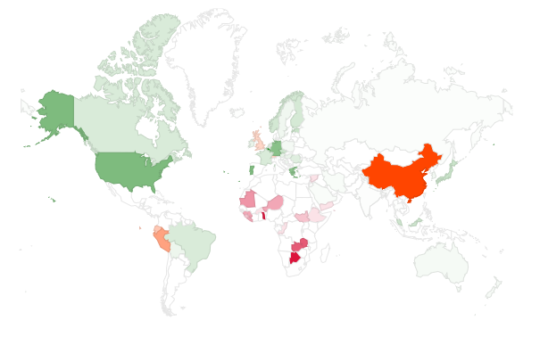
Per-Country IPv6 adoption
in Jan 2016
Source: Google

Slide 20
Top 25 internet service providers for IPv6 in Canada (Nov 2015) (IPv6 tests count)
1.Hurricane Electric (1,159)
2.Peer 1 Network (USA) Inc. (597)
3.gogo6 Inc. (573)
4.TELUS Communications Inc. (539)
5.Canada Web Hosting (521)
6.TekSavvy Solutions (383)
7.Rogers Cable Communications Inc. (298)
8.Le Groupe Videotron Ltee (228)
9.Start Communications (168)
10.Amanah Tech Inc. (86)
11.OVH Hosting (58)
12.COGECO Cable Canada Inc. (53)
13.Bell Mobility Inc. (50)
14.Cogeco Cable Inc. (44)
15.Rogers Communications Partnership (33)
16.TekSavvy Solutions Inc. (32)
17.Futureway Communications Inc. (31)
18.Team Cymru Inc. (26)
19.Electronic Box (18)
20.University of Waterloo (16)
source: http://ipv6-test.com/stats/country/CA
21.Bell Canada (16)
22.American Registry Internet Numbers (16)
23.Shaw Communications Inc. (13)
24.Canarie Inc (13)
25.Cogent Communications (13)
Notes:
The ipv6 count for bell and rogers are still low (considering they are the biggest isp for canada)
You can call your ISP to get an ipv6 address (may cost you extra)

Slide 21
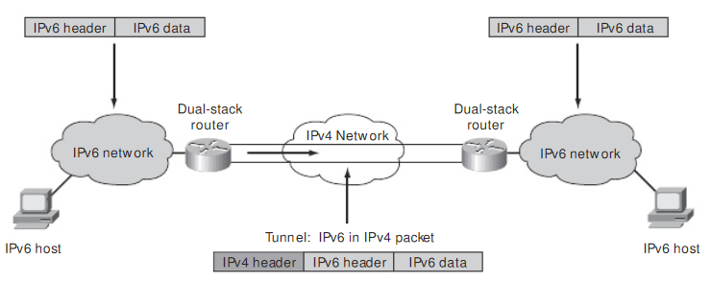
Setting up IPv6 (Tunneling)
Notes:
Tunneling is a way to set up ipv6 over ipv4 if you are unable to obtain an ipv6 address through your isp provider.
As mentioned previously, your home network is NATed if you are on ipv4 (we already ran out of new ip addresses in 2015 http://arstechnica.com/information-technology/2015/07/us-exhausts-new-ipv4-addresses-waitlist-begins/)
There are many tunneling methods:
4in6, 6in4, 6over4, 6to4, ISATAP, Teredo, etc
we will look at 6in4 and teredo.
The diagram shows the idea of how tunneling works (6in4) - for the hurricane electric demo
https://josephmlod.wordpress.com/network/ipv6/deploying-ipv6-over-ipv4-tunnels/
For the demo, only difference is my home network is IPv4, so the diagram would look like IPv4/IPv6 host inside IPv4 network with IPv4 router.
The host creates the IPv6 encapsulated in IPv4 packet, sends to the IPv4 router which then goes across the tunnel to the dual stack router.
One way to set up tunneling is using a tunneling provider like: Hurricane Electric: https://tunnelbroker.net/
Another way is to use Teredo (insecure)

Slide 22
Teredo (Shipworm) Service
provides IPv6 connectivity to nodes located behind one or more IPv4 NATs
tunnels IPv6 packets over the User Datagram Protocol (UDP) through NAT devices
Teredo tunnels use Teredo servers and Teredo relays
The Teredo servers are stateless, and manage a small fraction of the traffic between Teredo clients, while the Teredo relays act as IPv6 routers between the Teredo service and the native IPv6 Internet
Notes:
teredo servers: take care of ping requests; mostly for checking connectivity
relays: actually forward your packets to ipv6 world
anyone can sign up to be a teredo relay.
microsoft used to run teredo servers and relays but the service is now discontinued.
This is bad because:
1. Public Teredo relays are under management of unaccountable third parties which provide unpredictable performance
2. The "nearest" Teredo relay to the IPv6 host would be used and you have no control over which one would be used. (could be across the world)
3. Effectively a man in the middle attack. Can you trust these third party gateways? Anyone can inject a Teredo gateway into the global IPv6 table
4. Firewall bypass. Like all tunnels, Teredo bypasses any network level firewalls and policy protection setup

Slide 23
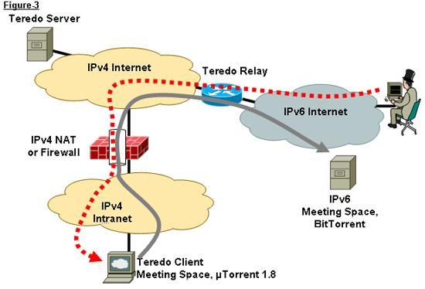
Teredo (Shipworm) Service
Notes:
send packet that encapsulates IPv6 inside UDP IPv4 packet.
to IPv4 only hosts/routers these are just UDP packets.
once packets reach teredo relay, the IPv6 is extracted and sent over the IPv6 internet.
teredo client can bypass firewalls if the firewall is IPv4 only or does not filter IPv6 over IPv4 packets.
this is also how gogo6 (demo) works. only difference is that relays and servers are checked by gogo6 (certified).

Slide 24
IPv6 using Tunnel Brokers (demo)
Hurricane Electric
gogo6

