Slide 1
Lecture 1: Attacks
CSC2412 Algorithms for Private Data Analysis
Sasho Nikolov
University of Toronto

Slide 2
The Problem
How do we analyze sensitive and private data about people?
Approach I: Don’t collect sensitive data. May forfeit benefits for
  Science
  Policy decisions
Approach II: Remove personally identifying information (PII):
  What is PII?
  Numerous failures: Netflix challenge, AOL search logs, MA governor health records

Slide 3
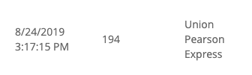
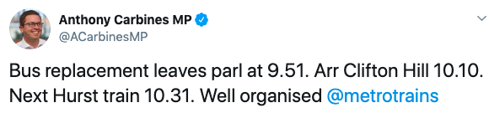
Remove PII?
Example attack: Myki public transport dataset [Culnane Rubinstein Teague 19]
Data: tap on/off events for a Presto-like card
  No names or real card IDs included
Step 1: Identify my own card
  I know my travel history
Step 2a: Identify card of a co-worker or friend
  Based on a few trips we took together
  Now I know every trip they have taken
Step 2b: Correlate with Twitter activity

Slide 4
Lessons
Everything can be personally identifiable
  Surprisingly few pieces of information make us unique
The “attacker” may already know a lot about you.
  Access to auxiliary information
Datasets can be linked to make it easier to break privacy
  Even more will be released about you in the future

Slide 5
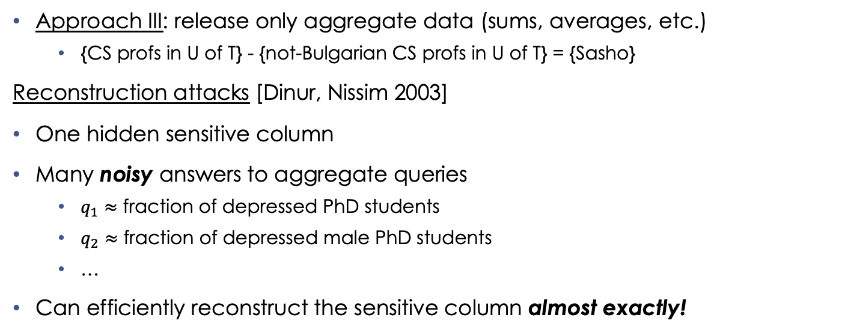
Aggregate ≠ Private
Approach III: release only aggregate data (sums, averages, etc.)
  {CS profs in U of T} - {not-Bulgarian CS profs in U of T} = {Sasho}
Reconstruction attacks [Dinur, Nissim 2003]
One hidden sensitive column
Many noisy answers to aggregate queries
  $q_{1}≈$ fraction of depressed PhD students
  $q_{2}≈$ fraction of depressed male PhD students
  …
Can efficiently reconstruct the sensitive column almost exactly!
Gender | Education | … | Clinical Depression?
M | BSc | … | Yes
F | PhD | … | Yes
F | MSc | … | No
M | PhD | … | No
M | MSc | … | No
M | BSc | … | Yes

Slide 6
Aggregate ≠ Private
Tracing attacks [Homer et al. 08]
DNA data from a medical study (genetic factors for depression)
  Frequencies of alleles for individuals in the study
Data of one individual
Frequencies of alleles in the population at large
Can determine if the individual was in the study or not
1 | 0 | 1 | 1 | 1 | 0 | 1 | 1 | 1 | 1
0 | 1 | 1 | 1 | 0 | 0 | 0 | 1 | 1 | 1
0 | 1 | 1 | 0 | 0 | 0 | 1 | 1 | 0 | 1
.33 | 0.66 | 1 | 0.66 | 0.33 | 0 | 0.66 | 1 | 0.66 | 1
Published
Public
1 | 0 | 1 | 1 | 1 | 0 | 1 | 1 | 1 | 1
.20 | .84 | .63 | .43 | .40 | .01 | .71 | .92 | .53 | .78

Slide 7
Fundamental Law of Information Recovery:
Too accurate answers to too many aggregate questions destroy privacy.

Slide 8

Details of the Attacks
Now we move to the “board”

