Slide 1
TSS: Trivia Night
15 December 2021

Slide 2
Code
Matching
Fruit
Word
Complexity
Problem 1
Problem 1
Problem 1
Problem 1
Problem 1
Problem 2
Problem 2
Problem 2
Problem 2
Problem 2
Problem 3
Problem 3
Problem 3
Problem 3
Art
Problem 4
Problem 1
Problem 4
Problem 5
Problem 6

Slide 3
Back

Slide 4
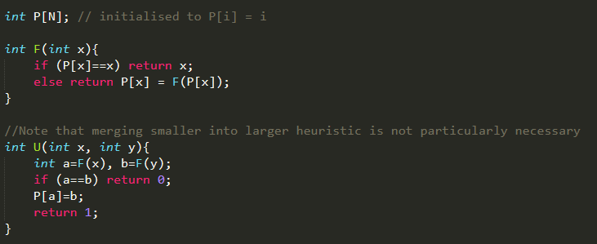
Back

Slide 5
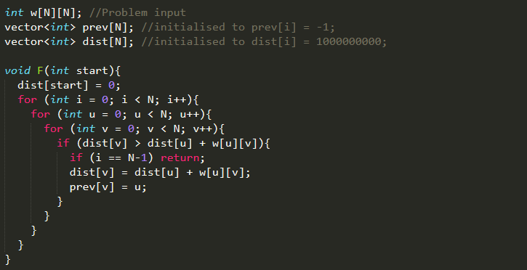
Back

Slide 6
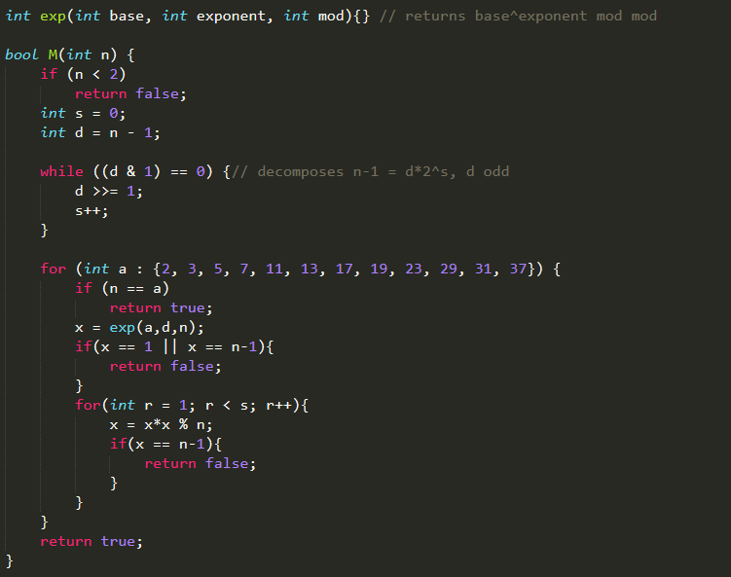
Back

Slide 7
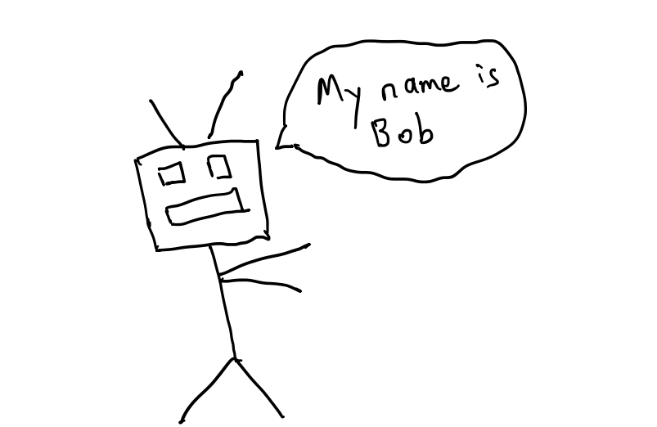

Slide 8
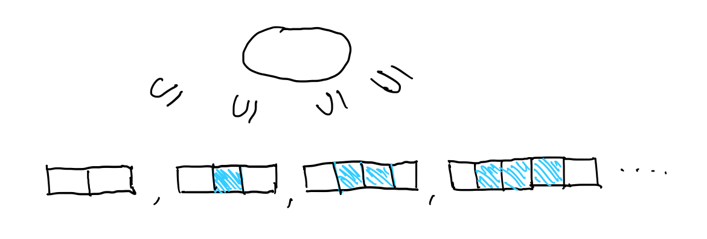

Slide 9
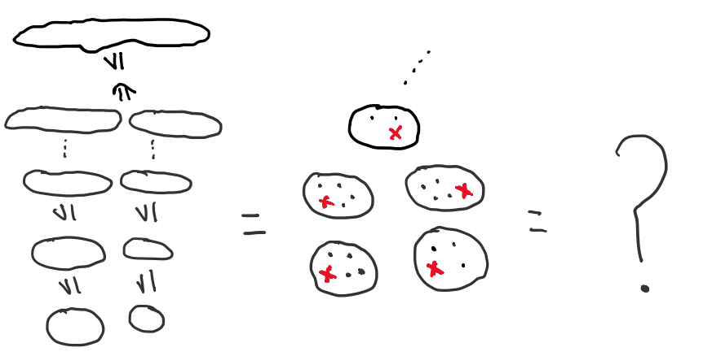

Slide 10
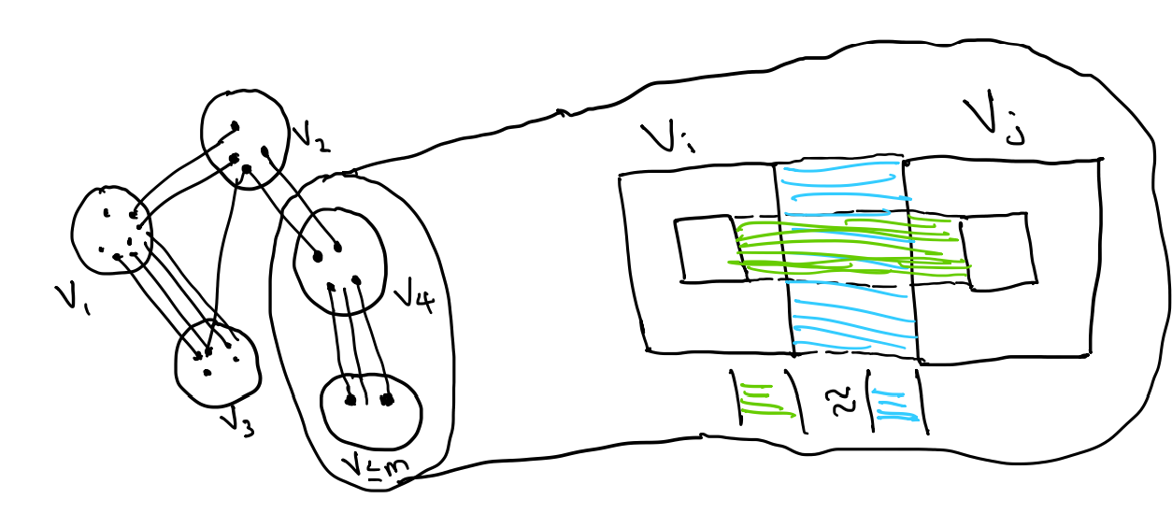

Slide 11
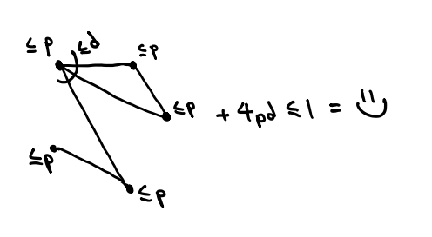

Slide 12
A*
Bernstein-Vazirani
Bron-Kerbosch
Cole-Vishkin
Dinic’s
Hungarian
Lehmer’s
Lenstra’s
Morris++
Simmons-Su
Approximate stream counting
Distributed tree colouring
Envy-free division
Elliptic curve factorization
Max flow
Min-cost perfect matching
Number of maximal cliques
Pseudorandom number generator
Secret string learning
Shortest path algorithm
Back
Notes:
1J, 2I, 3G, 4B, 5E, 6F, 7H, 8D, 9A, 10C

Slide 13
$Ax≤b$ is unsatisfiable iff there exists $y≥0$ such that $y^{T}A=0$ and $y^{T}b=−1$
BWBP = nonuniform NC¹
Every finite perfect information alternating two person has a winner
Every graph property has a threshold
If NP $⊆$ P/poly, then PH = $Σ_{2}$
If P $≠$ NP, then NPI is non empty
NL = coNL
PH $⊆$ P^{#P}
S(A,B,C) + S(B) $≤$ S(A,B) + S(B,C)
Barrington’s
Bollobas Thomason
Farkas’
Immerman-Szelepcsenyi’
Karp-Lipton
Ladner’s
Lieb’s
Toda’s
Zermelo’s
Back
Notes:
1B, 2D, 3A, 4G, 5E, 6F, 7I, 8H, 9C

Slide 14
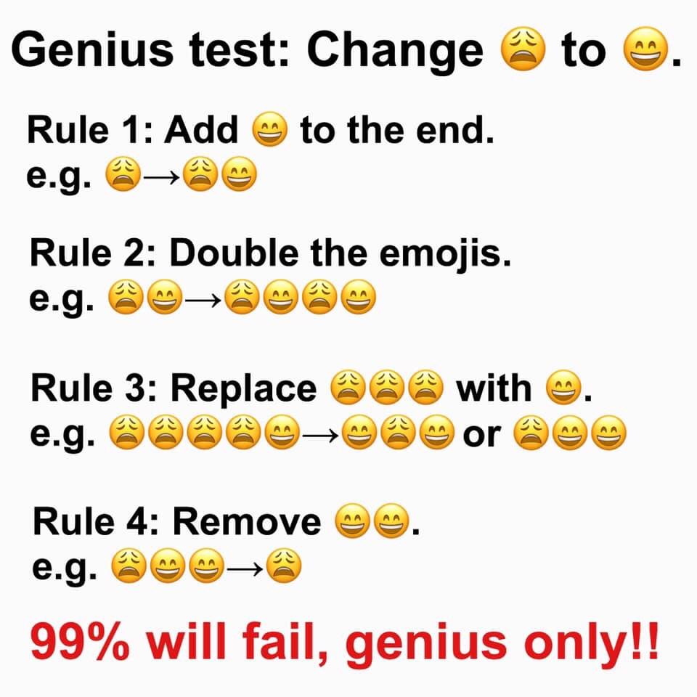
Back
Credit: Reddit

Slide 15
🍇 + 🍈 + 🍉+ 🍌 + 🍌 + 🍌 = 0
🍇 + 🍈 + 🍉+ 🍉 + 🍉 + 🍌 = 0
🍇 + 🍈 + 🍍+ 🍍 + 🍌 + 🍌 = 0
🍇 + 🍈 + 🍉+ 🍌 + 🍌 + 🍌 = 0
🍇 + 🍈 + 🍉+ 🍎 + 🍌 = 0
🍑 + 🍑 + 🍑+ 🍇 + 🍈 + 🍉+ 🍌 + 🍌 = 0
99% of people can’t tell if this system has any non trivial solutions 😆
Back

Slide 16
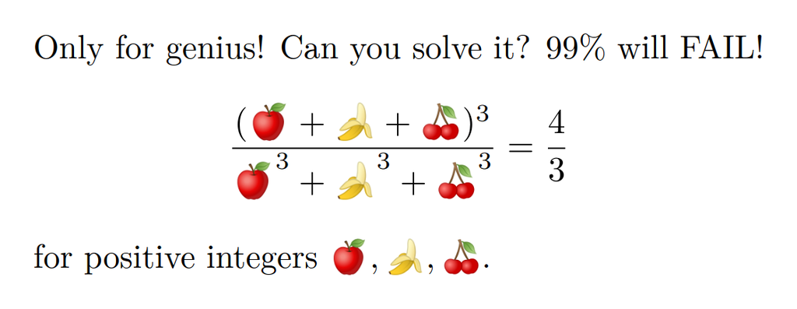
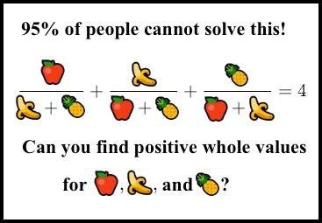
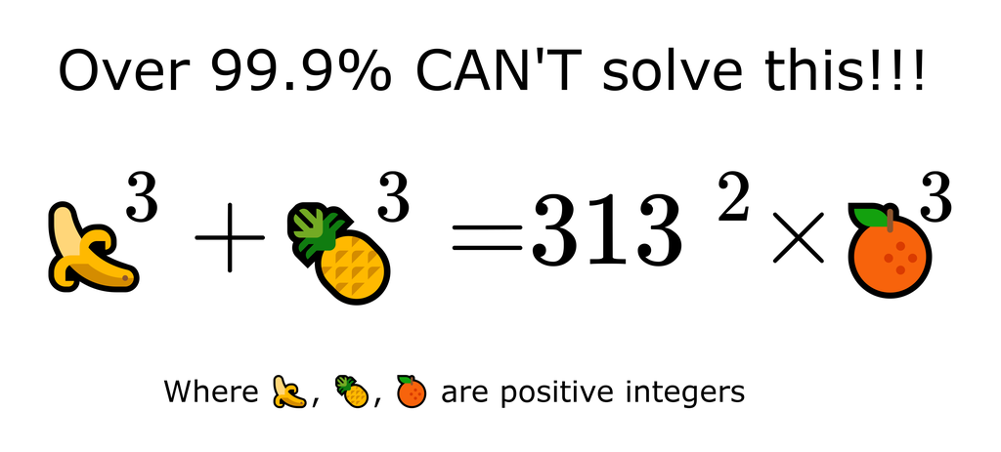
Alice is tired of seeing people post math memes on Facebook, and wants to know is an algorithm to decide if a polynomial $F($🍇, 🍈, 🍉, 🍌…) with integer coefficients has a positive integer solution. Can you help her?
Back

Slide 17
We have two loaded dice (not identical) with numbers 1, . . . , 6 coming up with various probabilities when each one is rolled. Is it possible that when we roll them both, the sums 2, . . . , 12, all come up with equal probability 1/11?
Back
Credit: Harry

Slide 18
Twenty-four ants are placed randomly on a circular hoop, 1 meter in radius. Each ant is facing clockwise or counterclockwise with equal probability. At a signal, they proceed to march forward at 1 cm/sec; whenever two ants collide, they reverse directions. After 100 seconds, the ants stop where they are. One of the ants, Ant Alice, is of particular interest to us. What is the probability that Ant Alice ends up exactly where she began?
What if it were 1 meter in diameter?
Back
Credit: Lily

Slide 19
Alice the cook wants to construct a menu consisting of $n$ dishes. A meal is defined to be a set of dishes (no repetition), and a menu is defined to be a set of meals.
Fix $n=15.$Alice decides that a menu is legal if for any two meals, the intersection is also a meal. Can she construct a menu with exactly 2021 meals?
Alice now decides that a menu is legal if no meal is contained in another. What is the largest menu possible?
Alice now decides that a menu is legal if every two meals share a dish. What is the largest menu possible?
Alice now decides that a menu is legal if no meal can be obtained from another meal by removing or adding a single dish. What is the largest menu possible?
Let $f(n)$ be the answer to the previous problem. If there were $f\left(n\right)+1$ meals, how many violations is the worst meal involved in?
Back

Slide 20
At the start of the 2019 season, WNBA star Missy Overshoot's lifetime free-throw percentage was below 80%, but by the end of the season, she was above 80%. Must there have been a moment in the season when her free-throw percentage was exactly 80%?
For what probabilities is the answer “Yes”?
Back
Credit: Lily

Slide 21
Let $X$ be a random variable with mean $0$ and variance $1$. What is the maximum possible value of the median? Is it bounded or unbounded?
Construct a distribution matching the bound.
Back

Slide 22
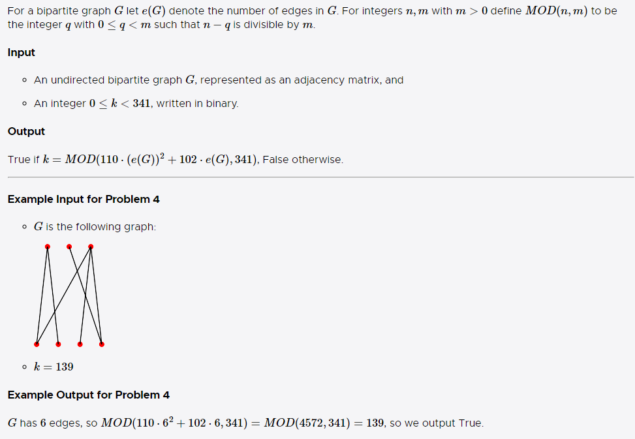
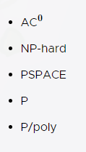
Back
Credit: MIT MH 2020
Notes:
PSPACE, P, P/poly = Yes
NP-hard = ?
AC0 = No

Slide 23
Back
Credit: MIT MH 2020
Notes:
NP-hard, PSPACE = Yes
P, P/Poly = ?
AC0 = No

Slide 24
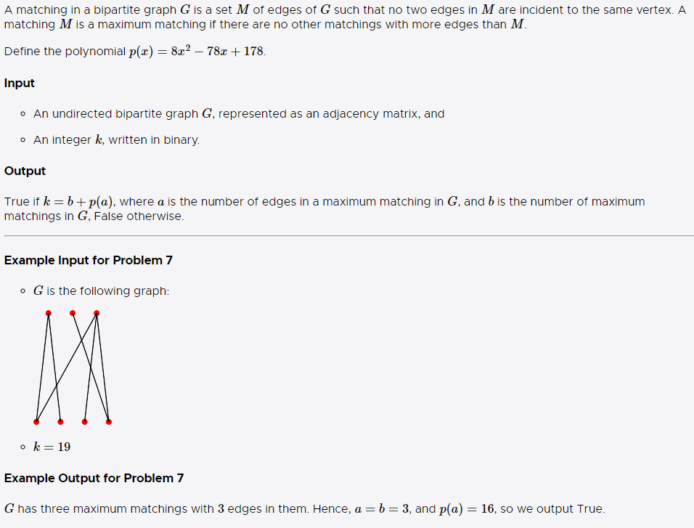
Back
Credit: MIT MH 2020
Notes:
NP-hard, PSPACE = Yes
P, P/Poly = ?
AC0 = No

Slide 25
bit.ly/TSSTrivia
Back

Slide 26
Number of sacks |  | Weight Choice |  | Solution Type |  | Penalties |  | Reward
Multiple | 0 | 0-1 Knapsack | 0 | Exact | 0 | Unbounded | 0 | Unbounded | 0
One | 3 | Unbounded Knapsack | 2 | 0.01-approximation | 3 | Bounded | 2 | Bounded | 1
 |  | Fractional Knapsack | 4 |  |  | Unit | 3 | Unit | 3
What is the minimum size Knapsack required for the above Knapsack problem to have a poly time solution?
Back

