Slide 1
Embedded Ethics: Privacy and Contact Tracing (Module 2)
Notes:
Script by any educator:
Instructor introduces everyone and speaks about the module’s objectives.
Thank you for joining again for this second module in Embedded Ethics. <Introduce Embedded Ethics team>
How did you find the last module? Did we manage to challenge you a little bit? Use the annotations and let me know how it was. <Respond to feedback>
This time we are going to learn about an alternative approach to the Module 1 contact tracing scenario. We will discuss how to build a contact tracing app with privacy in mind, so that the purpose of contact tracing is achieved and privacy is protected. As we’ll see, this will involve some tradeoffs, and different stakeholders will have different preferences for what tradeoffs we make. This will lead us right into Benjamin’s presentation about tradeoffs and justification, and these concepts will help you to tackle software development with consideration for ethical implications.
Photo by Vitaly Vlasov from Pexels (https://www.pexels.com/photo/person-pointing-numeric-print-1342460/)
Photo by Charl Durand from Pexels (https://www.pexels.com/photo/the-thinker-statue-in-rodin-museum-france-6486112/)
These slides are licensed by the XXXXXXXXXX under the Attribution-NonCommercial-ShareAlike 4.0 International license. To view a copy of this license, visit https://creativecommons.org/licenses/by-nc-sa/4.0/.
Licensed by the University of Toronto Embedded Ethics Education Initiative under the Attribution-NonCommercial-ShareAlike 4.0 International license. To view a copy of this license, visit https://creativecommons.org/licenses/by-nc-sa/4.0/.

Slide 2
Name | Location | Start Time | End Time
Mike | A | Feb 14th, 9:12 PM | Feb 15th, 1:35 AM
Parsa | A | Feb 14th, 9:37 PM | Feb 15th, 1:15 AM
Tiana | A | Feb 14th, 10:06 PM | Feb 15th, 1:35 AM
Ahmed | A | Feb 14th, 6:08 PM | Feb 15th, 8:30 AM
Mike | B | Feb 15th, 1:57 AM | Feb 15th, 7:30 AM
Tiana | B | Feb 15th, 1:57 AM | Feb 15th, 9:30 AM
Mike | C | Feb 15th, 8:00 AM | Feb 15th, 4:00 PM
Yien | C | Feb 15th, 8:30 AM | Feb 15th, 4:30 PM
Marc
Ahmed
Ali
Tiana
Mike
Jialun
Mario
Yien
Parsa
Kevin
Bhuvana
Mengsha
Hazel
Confirmed case
2
Close contact
Notes:
Script by the CS educator:
Last time We discussed that by collecting individuals' name, location and the amount of time that they were in that location, we can create a graph and use it to identify individuals who were exposed to a confirmed case and must be notified. The graph helped us to support contact tracing.

Slide 3
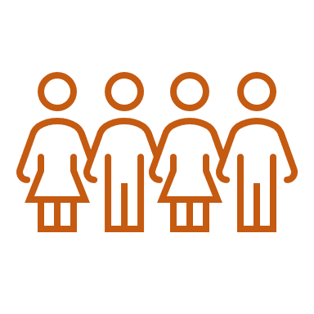
They were doing the weekly prep
Either he works too much or parties too much
Mike is probably into Tiana
Mike has a day time job
Mike and his friends are irresponsible
Mike is social, he meets other people a lot
Ahmed throws some good parties
Notes:
Script by the CS educator:
<This slide might need updating depending on students’ responses in the first module.>
However, we also inferred additional, private information about individuals by examining this small subset of data.
You decided that Mike and friends were irresponsible because they got together during the lockdown. You easily found out that Mike had a day job, and that he is probably Tiana’s partner. You discovered his home and work locations and many more…
We learned that the more data we have, the more powerful our system can become. However, we also learned that privacy is very important and must be protected. This requires us to implement a privacy-preserving design.

Slide 4
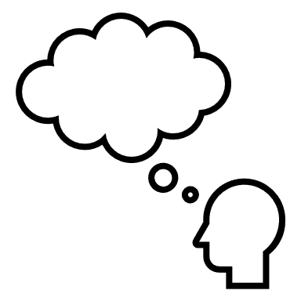
Addressing the ethical issues
Could we have collected less or different information and still accomplished the task of contact tracing?
How could we have changed what information we collect to minimize the potential for inference of further information?
Notes:
Script by the CS educator:
We left you with these two questions. <questions are read from the slide>
Today we are going to explore the ways in which we preserve privacy and fulfill contact tracing goals at the same time.

Slide 5
Applying PIPEDA’s Limited Collection
We collected:
Demographic information
Location
arrival and departure times
Purpose: Notify individuals who have been in a proximity to a confirmed case during the past two weeks.
Therefore we need:
Proximity records for the last 14 days
A way to notify
Notes:
Script by the CS educator:
From the pre-class video, we learned that one of the privacy principles in PIPEDA, which is a Canadian privacy protection act, is limited collection, which means that information should only be collected if it is needed. In our system we collected name, location, as well as the arrival and departure times at that location.
Now let’s see which of the collected data we could have done without, and what data do we REALLY need?
Let's go back for a second and review our purpose: We want to notify individuals who have been in a proximity to a confirmed case during the past two weeks.
Based on our purpose, we only need to determine whether people were in proximity within the last 14 days or not. Therefore, capturing the location, arrival, and departure times is not necessary to achieve the contact tracing goal. Also, we don’t require individuals’ names, only a way to notify them if they become close contacts.

Slide 6
Exposure notification system
Key | Contact info
K001 | 647.888.1111
K284 | 647.222.3333
K112 | 647.111.4563
K390 | 647.555.6666
K222 | 647.222.4444
K831 | 647.333.9999
K426 | 647.999.8888
K444 | 647.000.6666
Key
K001
K284
K112
K390
K222
Key | Time
K001 | t1
K284 | t2
K112 | t3
K390 | t4
Key | Time
K831 | T6
K426 | T1
K444 | t5
K222 | t5
K222
K444
Notes:
Script by the CS educator:
<This slide contains animation that must be synced with the talk. See the sample lecture video>
Now let’s see how we can capture only the information that we really need. By using Bluetooth technology, we can capture whether individuals were in close proximity to one another. When two devices come near each other, the distance between them is calculated depending on the signal’s strength. If the distance is within two meters, in COVID’s case for example, a unique Bluetooth beacon key is exchanged between the two devices and is stored locally on the device.
If a person becomes a confirmed case, they report this fact along with their 14 days worth of keys from other devices they’ve been near. The central system looks up all those keys, finds out the contact information, and messages them.
Notice that the contact information are not available to the devices and the central system does not have access to the details of when contacts occurred.

Slide 7
Applying PIPEDA’s Retention
Principle 5 – Limiting Use, Disclosure, and Retention
“… Personal information shall be retained only if necessary, for the fulfillment of those purposes.”
Key | Time
K001 | t1
K284 | t2
K112 | t3
K390 | t4
K222 | t5
Old
Notes:
Script by the CS educator:
Also from the pre-class video, Principle 5 in PIPEDA indicates that data can be retained only as long as necessary.
To support PIPEDA’s retention principle in our contact tracing system, any data collected more than 14 days ago must be removed from devices.

Slide 8
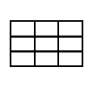
Exposure notification system
Limited collection compliance
Retention compliance
Decentralized approach
User data remains anonymous
User data cannot be passed to a third party
Prevent the possible abuse of data
Notes:
Script by the CS educator:
This design only collects information that is needed for notifying close contacts. In addition, the expired data are removed from devices. So, it complies with both PIPEDA Limited collection and retention principles.
Also, there is a bonus: The data is not stored in a centralized database, it is stored locally on individual’s devices. In that way, the risk for mining additional information from the whole system is minimized.
Reference:
https://logsentinel.com/blog/centralized-vs-decentralized-approaches-to-protecting-user-data

Slide 9
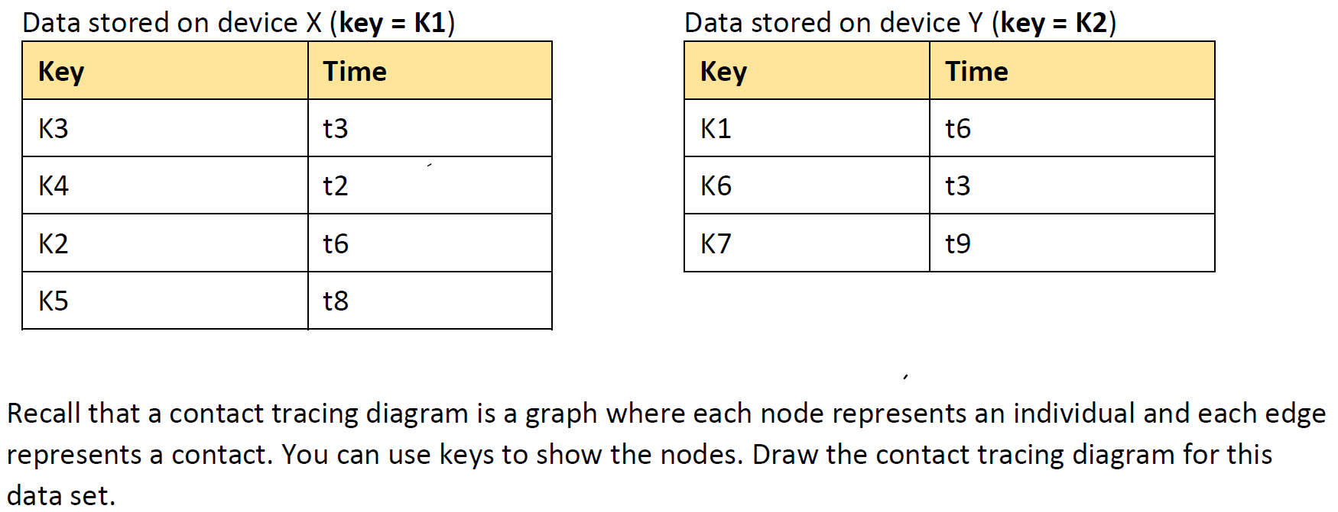
Breakout room activity
K4
K3
K1
K2
K5
Notes:
Script by the CS educator:
Now let’s do an activity. As before, I will send you to the breakout rooms. You will need your CS worksheet that is available on <provide the place>. Your worksheet contains these two sets of data from two devices X and Y. Your job is to draw a contact tracing graph and answer the questions.
The best way is to start with one of the tables. So here I add K1 which is the key for device X, then I add these nodes to represent all the keys that are stored on this device and I connect each of them to my K1.
You will have 8 minutes. Work as a team. Share your screen right away and use the annotations.
We will check on you in the breakout rooms, so let us know if you need help.

Slide 10
Key | Time
K3 | t3
K4 | t2
K2 | t6
K5 | t8
Key | Time
K1 | t6
K6 | t3
K7 | t9
Additional information could not be extracted
Could find people who should be notified
K4
K6
K3
K1
K2
K7
K5
Notes:
Script by the CS educator:
Welcome back everyone. I hope you had fun. Let’s go over the answers. Here is the graph. As you see if device X’s owner which is identified by K1 indicates that they are a confirmed case, K2, K3, K4 and K5 are identified as closed contacts. Could anyone infer information about the individuals who own the devices? Can you tell me what did you find?
<Possible in-class discussions>

Slide 11
Gain
Privacy protection
Support for contact tracing
Loss
Extensive research
Identification of infected area
Identification of gatherings that violate congregation or social distancing rules
Trade-off
Notes:
Script by the CS educator:
We learned that if only data that is required is collected, it cannot be used to infer much about the owners of the device: not their location, not their name, not their health records. On the other hand, this system supports neither extensive research nor additional features such as prioritization.
This is a trade-off of extra features for privacy. Now we continue to tell you more about trade-offs and justification.

Slide 12
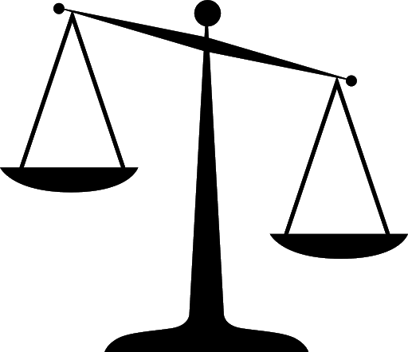
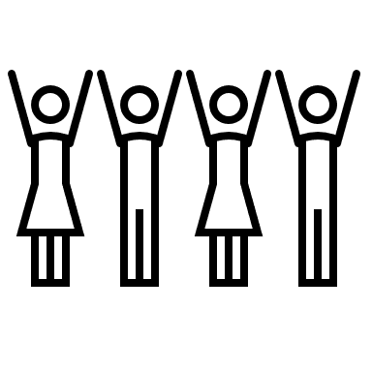
Notes:
Script by the Philosophy educator:
So, we've seen that there’s a lot of different designs we could choose for a contact tracing system. We've looked at two designs and saw that they end up embodying different kinds of trade-offs between the two values we talked about last class: Public health and privacy. But remember from last class that we're concerned about the effect on all the different stakeholders, if they are affected by the by the app we’re designing. Also, stakeholders are going to have different preferences over which value they'd rather see us prioritize, so it looks like the app design we looked at in the first module is going to be liked by those people who wanted to prioritize public health over privacy, whereas this second app is going to be preferred by people who wanted more privacy, even at the expense of some public health. So, we've got some disagreement now. What is the right way to resolve or to build a system and which values to prioritize? Then we have to decide how we're going to resolve this disagreement. We have to decide what trade-offs we're going to make. Considering, whatever we choose, some people will end up being unhappy with that choice, how do we make that decision?

Slide 13
You could use your own assessment of the best trade-off
But that seems unfair to all the other stakeholders with different views on the best trade-off
Notes:
Script by the Philosophy educator:
There's a couple of approaches we could take: One is you could just use your own assessment of the best trade-off and use your own judgment; but in the case where so many other people are affected, and they all have their own sort of very reasonable concerns, it seems unfair to these other stakeholders with different views on the best trade-off to just insist on using your own. It's treating yourself as if you were some sort of king who had the authority to impose your view of the good on other people; so that's unappealing.
Image Source; Photo by Rebrand Cities from Pexels (https://www.pexels.com/photo/group-of-people-sitting-in-front-of-table-1367275/)

Slide 14
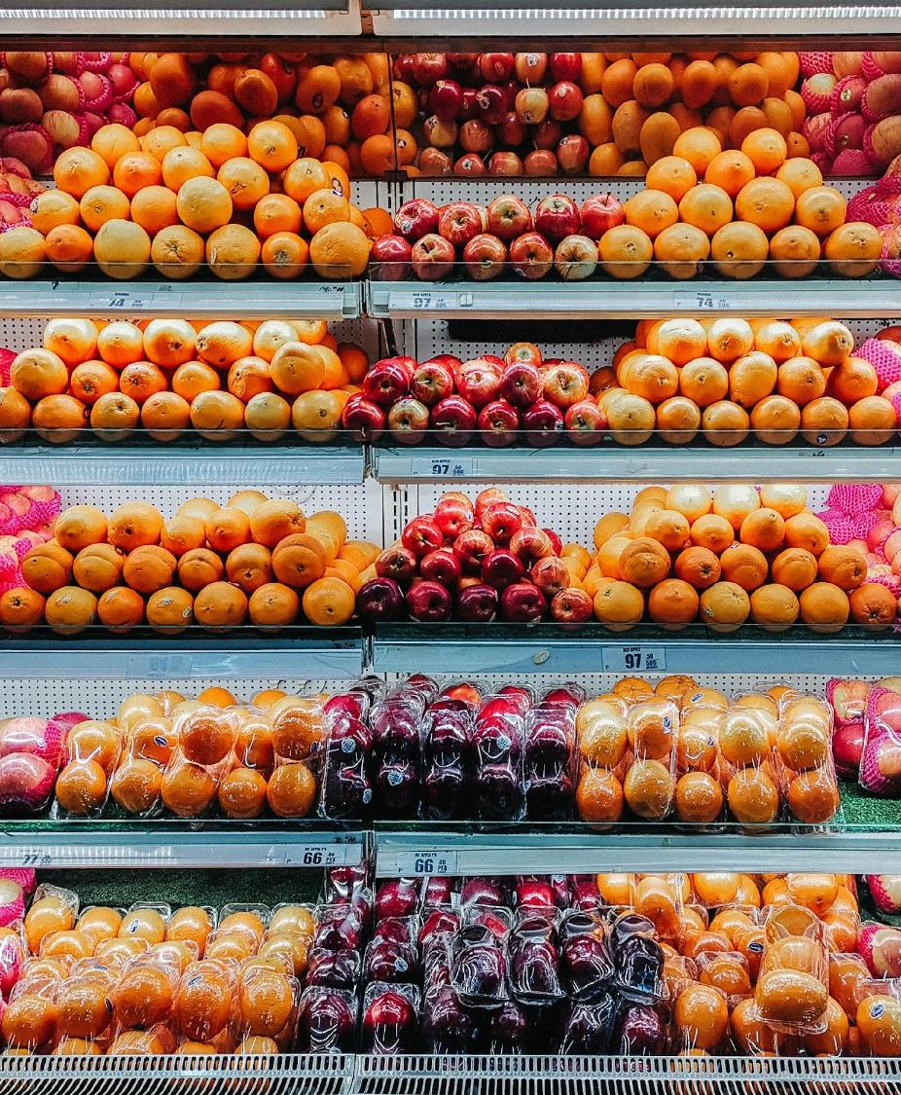
We could try to avoid making any kind of value judgment—just stick to programming
But every programming decision ends up making trade-offs between values
Notes:
Script by the Philosophy educator:
Now, a lot of people say: “Well, I don't want to impose my own assessment of my own ethics on other the people. I'll just avoid making value judgments. I'm just going to avoid this all together by sticking to the program right where that doesn't need to make any moral decisions.” The problem is, we've seen from what you just did in the activity earlier, that there's no way to do that. There's no neutral decision, because whatever decisions you make about how to build your program, even very basic decisions like what data to collect and things like that, you're going to end up making judgment calls and end up encoding different preferences, different prioritizations of the values. Every program decision is making trade-offs between values, so even if you sort of try not to think about the ethical decisions you're making, nonetheless, the product will end up embodying certain sorts of ethical views and trade-offs. So, in light of that, what should we do? How do we make a decision between these conflicting values?
Image Source: Photo by Carlo Martin Alcordo from Pexels (https://www.pexels.com/photo/fruits-on-glass-top-display-counter-2449665/)

Slide 15
A better approach: choose an option you can justify to all of the stakeholders (even those who disagree with the choice)
Notes:
Script by the Philosophy educator:
Well, here's a better approach: It is not the only approach by the way, this is just what we're going to talk about today. In the philosophy literature, there's lots of approaches to these sorts of problems. But today we choose an option so you can justify to all of the stakeholders, even those who disagree with the choice. So, the thought here is we can reduce the worry that we're imposing their view on other people if in making the decision, we make sure to think about all the different stakeholders, and what we might say to them if they challenged us on why we chose the design we did. So, let's talk a little more about this idea: What does it mean to justify a decision to the stakeholders?
Image Source: Photo by Christina Morillo from Pexels (https://www.pexels.com/photo/grayscale-photo-of-group-of-people-laughing-1181399/)

Slide 16
What does it mean to justify a decision to someone?
It can’t mean getting everyone to agree—few decisions will ever manage to do that
Notes:
Script by the Philosophy educator:
Well, one thing it can't mean is getting everyone to agree! Very few decisions will ever manage to get everyone to silence all disagreement. When we’re talking about a decision with as many stakeholders as the COVID-19 contact tracing app would have, it becomes vanishingly unlikely they would get universal agreement. Philosophers since Plato have been searching for an argument so compelling that, no matter what, everyone who heard it would be forced to agree, but we certainly haven't found one in the few 1000 years since then, and I wouldn't hold my breath. So, it can't mean universal agreement. We have to be able to just successfully justify decision to someone, even while they remain unconvinced by our justification.
Image Source: Photo by fauxels from Pexels (https://www.pexels.com/photo/photo-of-people-near-wooden-table-3184418/)

Slide 17
It is not just a justification, but a justification to someone
“Because I will make lots of money” might well be a justification, but it won’t justify a decision to someone who was harmed as a result
Notes:
Script by the Philosophy educator:
Another important thing is that it's not just a justification, it's a justification to someone, to an individual. And that makes a difference. “I'll make lots of money”, that's a perfectly fine justification for some decisions. If I said “I went into philosophy because I'll make lots of money”, then I'm making a factual error. But in terms of being a justification, seems perfectly alright. That could indeed justify my decision, if it were true. But notice in the case of something like a COVID app, it won't justify the decision. Someone who's harmed as a result, someone whose privacy was violated or who wanted more public health, and instead more people got COVID. Well “because I made lots of money off of it” is not going to be a satisfactory justification to that person. So in justifying it to someone we need to take account of their perspective, their goals, their values, and that's the key.
Image Source: Photo by Alexander Mils from Pexels (https://www.pexels.com/photo/person-holding-100-us-dollar-banknotes-2068975/)

Slide 18
To justify a decision to someone, we need to show them that their unique perspective was taken into account
Six
Nine
9
Notes:
Script by the Philosophy educator:
To Justify a decision to someone, we have to show that their unique perspective was taken into account; even though of course some of the time we won't be able to make everyone happy. We can show that we considered their point of view, and as far as possible, try to accommodate the things they valued into our design.
So, that's been at a fairly abstract level…

Slide 19
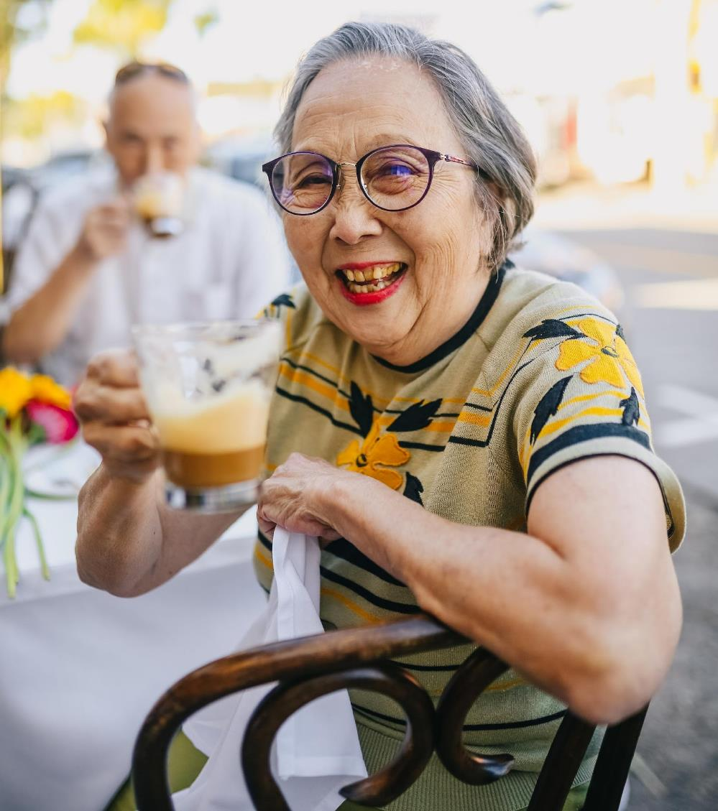
Jingyi: A resident of a long-term care home
Jingyi is the resident of a long-term care home. She has a phone, but only uses it to talk to her family on zoom. She has been isolated by the pandemic and hopes it will end quickly so that she can see her grandchildren again.
Notes:
Script by the Philosophy educator:
… Let's bring it back down to Earth with an example. This is an example you've seen before when we talk about Jingyi, a resident of a long-term care home. So, she has a phone; but only uses it to talk to her family on zoom. She's been isolated by the pandemic and hopes it will end quickly so she can see her grandchildren again. Now, in the homework, people actually had lots of really great different views on whether Jingyi would prioritize public health or privacy. For the for the sake of argument for now, we're going to assume that we've talked to her, and she tells us what she really wants is to prioritize public health, so, she can see her grandchildren again and so that her own health is protected, and that she's willing to sacrifice privacy for that.
Image Source: Photo by RODNAE Productions from Pexels (https://www.pexels.com/photo/smiling-elderly-woman-while-drinking-chocolate-5637712/)

Slide 20
Jingyi: A resident of a long-term care home
Consider an app that prioritizes privacy over health
How might we justify such an app to Jingyi?
Notes:
Script by the Philosophy educator:
Now consider an app that instead prioritizes privacy over health. So, it doesn't give her what she wants. It makes the opposite trade-off to the one we should prefer. How might we justify such an app to Jingyi? There's a couple of things we might be tempted to say. We can imagine saying: <Next slide>
Image Source: Photo by RODNAE Productions from Pexels (https://www.pexels.com/photo/smiling-elderly-woman-while-drinking-chocolate-5637712/)

Slide 21
Jingyi: A resident of a long-term care home
Surveys said this design was more popular
We needed the app to be widely downloaded, and protecting privacy helps
We wanted to make the app as effective as possible, but a more invasive app would violate people’s rights
Notes:
Script by the Philosophy educator:
One, we could say “well, the surveys said this design was more popular”. Secondly, we could try saying, “well, we needed the app be widely downloaded, protecting privacy”, and with third, we could say “we wanted to make the app as effective as possible, but a more invasive app would violate people's rights.”
<Discussion between educators>
So what do you think about these three justifications? Which do you think would be the best at justifying the choice to Jingyi?
I think the one that talks about the survey isn’t going to be a good choice.
Yeah, I agree. Why should she care what's most popular? That doesn't tell her anything about what we should do. It just says other people like it.
Yeah, it almost risks sort of swerving into this “tyranny of the majority” idea, where we can ignore people's values and their preferences, as long as they're in the minority of people, fewer people have those preferences or values. So that doesn't seem very compelling. What about number two? Is that feeling any better?
No, I don't think that one would be appealing to her, because why would she care about the app being downloaded?
I think you're right, it's probably is not that compelling as stated, but maybe we could add to it and extend it a little bit. Because I think what she wants is an effective app, right? Well that that has a lot of public health impact. Of course, an app that isn't widely downloaded won't have that impact, so maybe if we added, we had to protect privacy in order for the app to be effective at its goal of tracing COVID-19. Now we've linked the decisions we made back to something she cares about, so that might be a better way.
Yeah, I like that if we could revise two and make it about public health, and it definitely has to do with what she cares about.
I think number 3 might be the best for me. Because they wanted to make the app as effective as possible, but they couldn't make it so effective that it violated other people's rights, and I think Jingyi just has to recognize that this is also an important thing, even if she cares more about public health herself, she has to admit that other people's rights are also important.
Right, because she wants her own rights to be respected even if other people want things that might infringe on her rights.
So, this is an example of how we can think about discussing and reasoning through what might work as an effective justification to an individual based on what they prefer, based on their background.
Image Source: Photo by RODNAE Productions from Pexels (https://www.pexels.com/photo/smiling-elderly-woman-while-drinking-chocolate-5637712/)

Slide 22
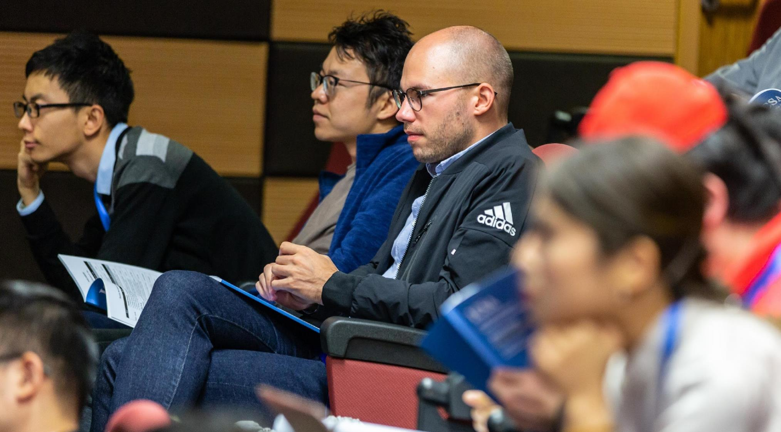
For each stakeholder discuss with your group how to justify your chosen app design to them, making sure to:
1. Highlight how your chosen version of the app accomplishes some of what the stakeholder wanted.
2. Explain why your chosen app doesn’t make exactly the tradeoff that the stakeholder was hoping for.
Notes:
Script by the Philosophy educator:
So just like last class, we're now going to go into breakout rooms and practice the same activity. You can go to the Google form and that will have the information you need to do the activity, and enter your answers right there. Again, if someone could share their screen that will make it easier to all follow along and discuss the same questions at the same time. But you can all enter your answers individually. You don't necessarily have to come to a consensus. For each stakeholder you're going to discuss with your group how to justify your chosen app design. We're going to stay with two possible designs of the app, basically corresponding to the one that we introduced today, and the one that we discussed in the last module. You choose one of them to defend, and don't take too long on this. If you can't decide, you can just randomly determine which one you want to defend. And then for each of the two stakeholders that we present, we want to highlight how your chosen version of the app accomplishes some of what they want and try and explain why your chosen app doesn't make exactly the trade-off they were hoping for. This will be your way of building up a justification to them for the app that you want to defend. We will circulate around. If you have any problems.
<Sample discussion for after activity. Show and use the result from the google form>
OK, welcome back. Let's have a quick look at the responses we've come up with. I start with App A, which is more privacy invasive. This is not what Isaac wants. He wants one that protects his privacy because he's worried about getting fewer shifts. We might say that there's a risk of privacy violation here, but for the greater good, it's encouraged to share more privacy to combat this unprecedented pandemic. That seems like something we could say. Like privacy is important, it's valuable, but this current situation is unprecedented, and there's a major contribution to the public good. Those are the sorts of things we'd expect Isaac to care about. Even if he's not convinced, we've at least appealed to things that he will recognize as important.
What about for Sahar? Why did you choose App B even though it doesn't make the exact trade-off, Sahar was hoping for? App B is the one that protects privacy more, which ends up making it harder to track new variants or do research, which is something Sahar values. Some people just said it'll help more people download the app and control the virus. It says in the bio that she recognizes that privacy is important to incentivize people to participate, so we can use that to make the case to her in a way that will be compelling. Other people said that it's recording too much information. Maybe it’s in terms of just the value of privacy. The fact that this is more information than is reasonable to ask people to disclose, even though we won't be able to do some of the things we wanted to do, like gather travel information or store location, that's something we're going to have to accept in order to make sure that we're not violating people's privacy. OK, so I think you guys have a lot of interesting things to say here.
Image Source: Photo by ICSA from Pexels (https://www.pexels.com/photo/man-wearing-black-adidas-jacket-sitting-on-chair-near-another-man-wearing-blue-jacket-1708988/)

Slide 23
Homework
Note on groupwork: You’re welcome to talk about this assignment with other people, but make sure to write your answers separately.
For this assignment, you’ll be answering the same questions that you talked about in the breakout room, but for different stakeholders.
Write your answers in two separate paragraphs--one paragraph about each stakeholder.
Notes:
Script by the Philosophy educator:
We're going to switch back to the PowerPoint now. So, you're going to have a homework assignment again, and the homework assignment is going to be very similar to the exercise you just did. For this assignment, you'll be answering the same question you talked about in the breakout room but with different stakeholders. So, it'll be the same structure. We’ll ask you to write your answer in two separate paragraphs, one paragraph for each stakeholder, and discuss for each stakeholder. Again, choose a version of the app and justify it to each other. Quick note: You're welcome to talk about this assignment with each other, just like you did in the breakout rooms, but make sure you write your answers separately. You don't want to be repeating exactly what other people are saying or anything like that. You want to be putting it in your own words. So that brings us to the end of this module.

Slide 24
Going Forward
Main takeaway: Good design involves thinking about stakeholders and ethical impact on them
We learned how to:
Identify stakeholders and reason about their values and preferences
Recognize the trade-offs between different values that emerge in design
Justify a decision to the stakeholders to guide design in the presence of disagreement
Notes:
Script by the any educator:
I want to take the opportunity to talk a little about both modules as a whole and what we hope you've taken away, the goals we’re seeking, and some resources you can look at going forward. If there's one main takeaway, we hope you walk away from these two modules with, it's that good design involves thinking about stakeholders and the ethical impact on them. Notice good design here is meant to be not just ethical design, but within the design process itself, ethics is a component of good design, just as efficiency or cost are elements of good design. We want you to see ethical design is not something alien or external that comes in at the end of the process to placate people who might be worried about ethics but it is something you're thinking of all the way through, thinking about stakeholders and how they might be affected by your decisions.
We've also tried to give you some tools to be able to do this effectively. We've learned how to identify stakeholders and reason about their values and preferences. We can't figure out what ethical issues our design might raise unless we can identify who is affected and think about what they are going to want and how our product might interact with that. We learned to recognize the trade-offs between different values that emerge in design. So, we often won't be able to get everything, and there's no neutral design in those cases. When our decisions are going to impact other people's values, or have large impacts on them, then we're not going to be able to just sort of retreat to a neutral conception of design. We're going to have to recognize these trade-offs and confront them. And then we looked at a way to do, by thinking about justifying a decision to the stakeholders as a guide to design in the presence of this kind of disagreement.
So, that's sort of the big picture of what we hope you've taken out of these modules. But of course, there's no way that in two one-hour modules we can cover all of ethics or anything close to that. So, we also hope that this is something you'll keep thinking about and maybe look for more resources in the future.
[this is a standard Microsoft image]

Slide 25
Other Resources
Institution-specific resources can be added here

Slide 26
References
[1] https://logsentinel.com/blog/centralized-vs-decentralized-approaches-to-protecting-user-data/?cookie-state-change=1616899129752
[2] https://www.ncbi.nlm.nih.gov/pmc/articles/PMC6450795/pdf/cmajo.20180105.pdf
[3] https://arstechnica.com/tech-policy/2009/09/your-secrets-live-online-in-databases-of-ruin/
[4] https://www.bostonmagazine.com/news/2016/08/21/bill-weld/
[5] https://www.newswire.ca/news-releases/majority-of-canadians-would-sacrifice-personal-privacy-if-it-helped-stop-covid-19-finds-kpmg-in-canada-survey-891920008.html

