Slide 1



Daydream: Accurately Estimating the Efficacy of Optimizations for DNN Training
Hongyu Zhu_{1,2}, Amar Phanishayee₃, Gennady Pekhimenko_{1,2}
1
2
3
Notes:
Hi everyone, today I am going to tell you about a technique to accurately estimate how existing optimizations or improvements in hardware capabilities affect the performance of DNN training.
This is joint work with my advisor at U of Toronto, and my mentor at MSR.

Slide 2
Executive Summary
Motivation: Benefits of many DNN optimizations are not easy to exploit because
  Efficacy varies for different HW/SW deployments
  It is onerous to implement optimizations
Goal: Need to quickly find the effective optimizations for a given deployment
  No need to FULLY implement the optimizations
Our proposal: a system called Daydream, that can estimate runtime improvement of various DNN optimizations, using dependency graph analysis:
  Tracking dependencies at the abstraction of GPU kernels (graph size is large)
  Correlating low-level traces with layer organization of DNN models
  Ability to model a diverse set of optimizations
Evaluation: Low estimation error (8% average) on 5 optimizations, 5 DNN models
  Accurately estimating distributed training runtime based on single-GPU profile
Notes:
First, a brief summary of my presentation today. Our project is motivated by that DNN training is highly time-consuming, but the benefits of many proposed DNN optimizations are not easy to exploit for the following reasons
First, the efficacy of a DNN optimization varies when applied to different hardware/software deployments
Second, it is onerous for programmers to implement and debug DNN optimizations
This raises a demand for a solution that can quickly identify the effective optimization for any given deployment, so that there is no need to try each optimization.
For this purpose, we propose a system called Daydream, which allows users to quickly estimate the runtime improvement of common ML optimizations based on their own deployments. Our system is based on the dependency graph analysis, and we identify three unique key requirements of using dependency graph analysis in the ML context.
First, it needs track dependencies at the abstraction of GPU kernels, and properly constructs a graph with thousands of nodes.
Second, it needs to correlate the low-level kernel traces, with high-level layers of DNN models.
Third, it should enable ML programmers to easily model a very diverse set of DNN optimizations.
We extensively evaluated our Daydream system, with five different optimizations over 5 DNN models, achieving low estimation error.
And we also show that using Daydream we can accurately estimate the distributed training runtime, based only on a single-GPU profile.
Now let’s look at the details.

Slide 3
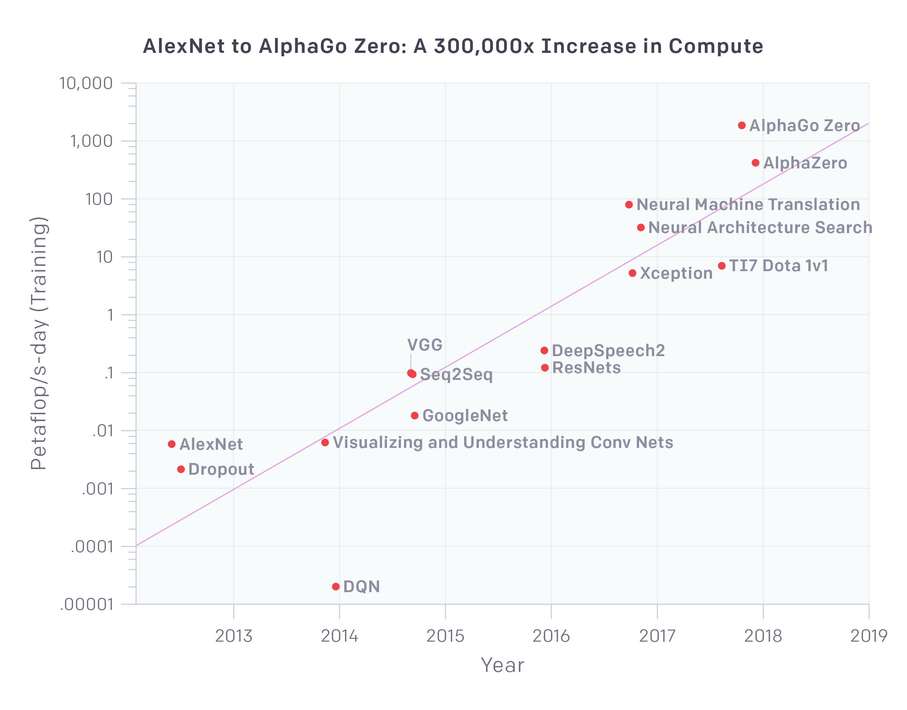
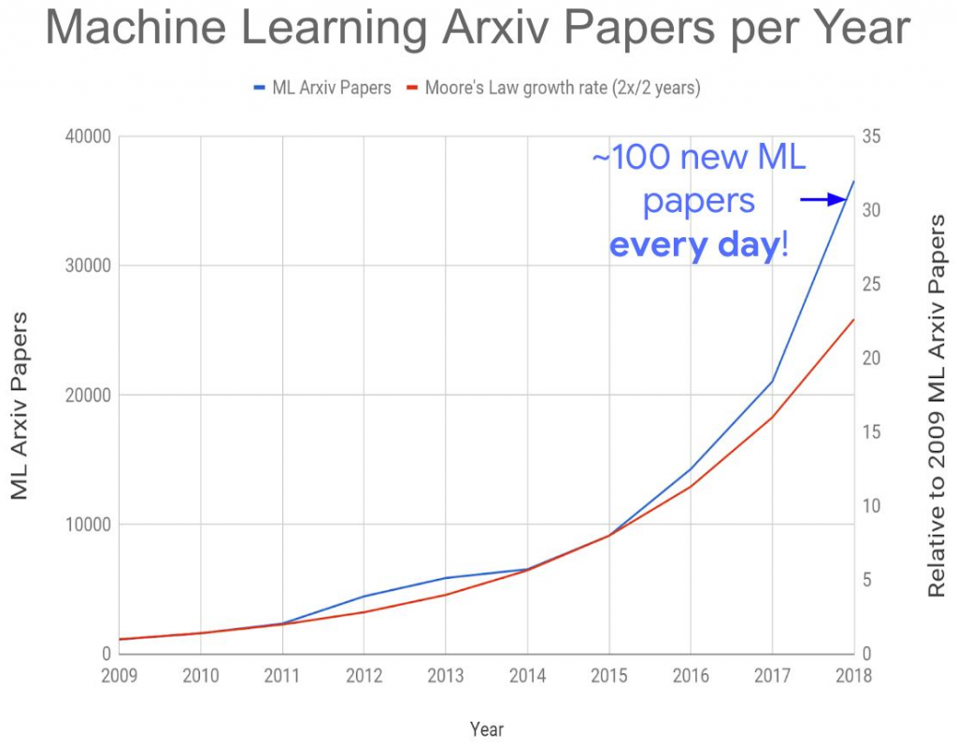
Advances in ML Full Stack Research
Hard for a ML programmer to identify the efficacy of
new algorithms, optimizations, and hardware improvements
in their deployments.
DNN compute requirements are growing exponentially
Rapid advances in algorithms, systems optimizations & hardware architectures
https://openai.com/blog/ai-and-compute/
https://ieeexplore.ieee.org/stamp/stamp.jsp?arnumber=8259424&tag=1
Notes:
Over the past few years, ML researchers have proposed many DNN models. The y-axis in this figure shows the every-day amount of compute used to train these selected models, and this line suggests that the demand for DNN compute has always been growing exponentially.
This demand is unsustainable, today we need not just the hardware, but also other ways to improve the training performance.
Therefore, researchers are proposing many new advances in algorithms, optimization & hw architectures every year.
However, despite these advances, it is not easy for a ML programmer to identify the efficacy of these proposals in their own deployments.

Slide 4
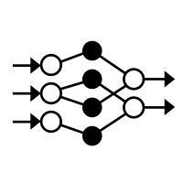


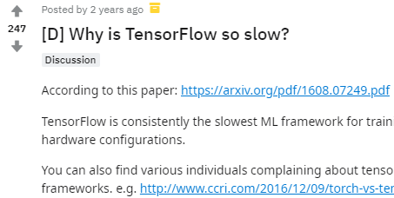
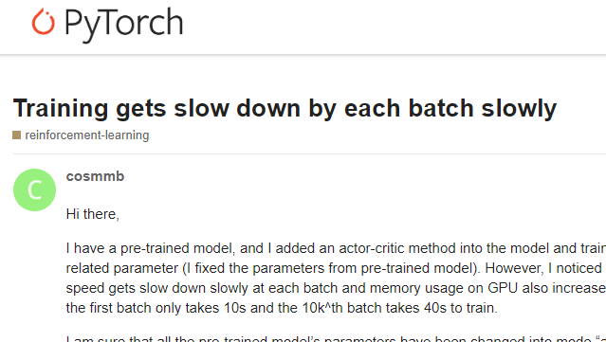


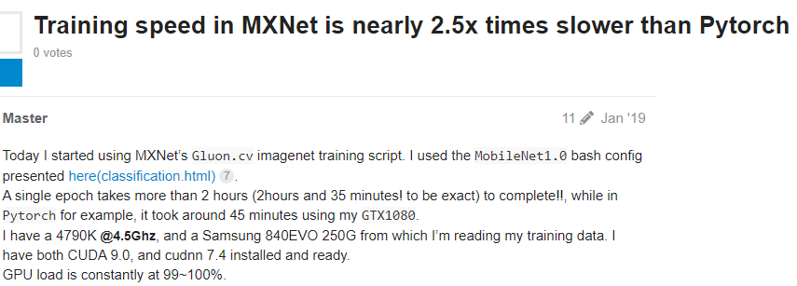
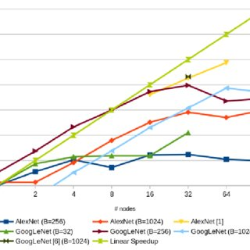

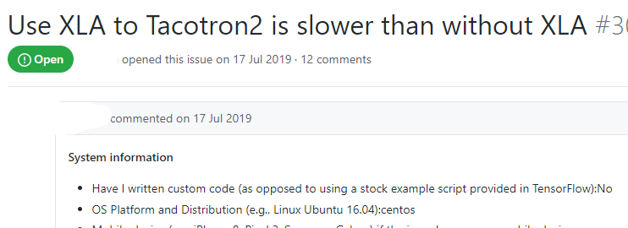
What-if Questions
Why is my DNN training workload running slow? What is the bottleneck?
+
Will optimization X improve the performance of my model?
What if I get the latest GPU and my compute is 2x faster?
How will my workload scale with the number of GPUs?
ML Programmer
Will upgrading to a faster network (for example, 10Gbps to 40Gbps) improve training throughput?
Notes:
So imagine a machine learning programmer, who just developed a DNN model on his or her machine. Since the training could take days or weeks, it is very common for him or her to ask what-if questions like:
Answering these questions is not easy, because you often have to spend time on implementing and debugging certain optimizations, or you need to pay for extra compute power.
(who is a ML programmer?)

Slide 5
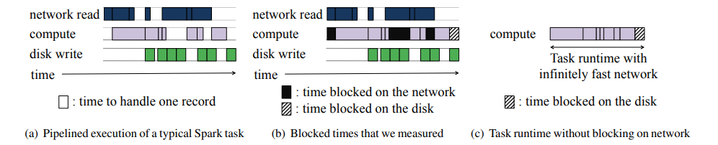
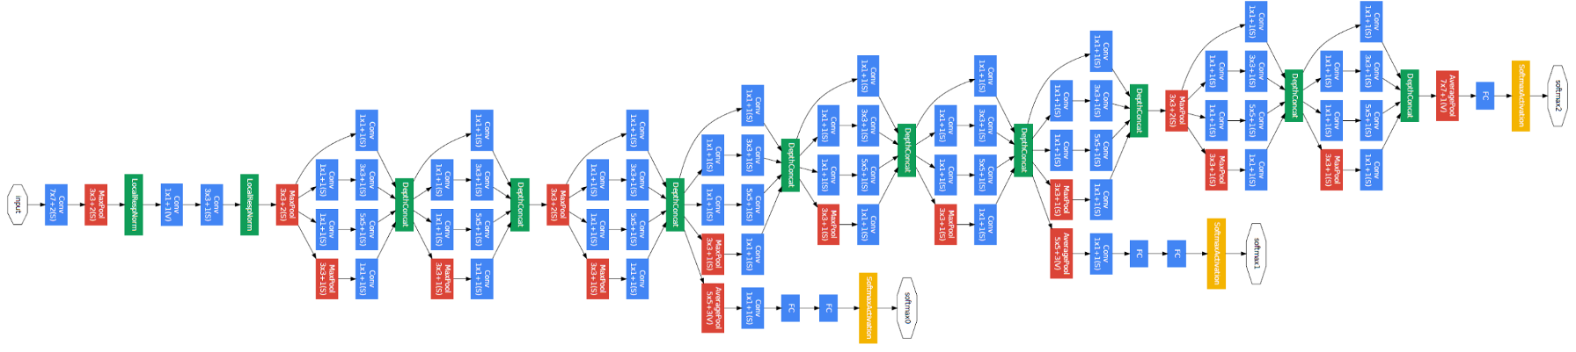
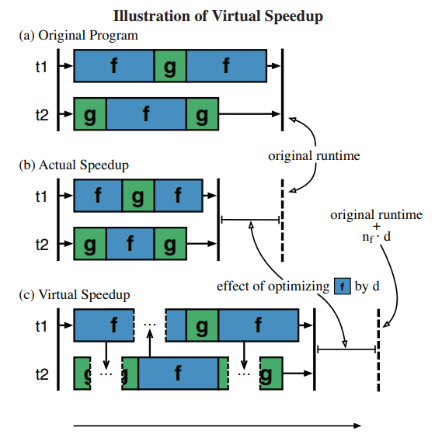
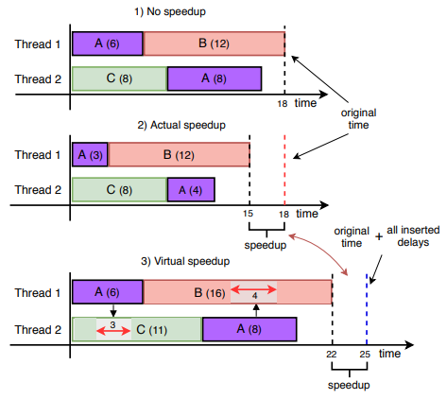
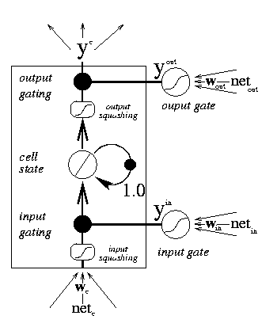
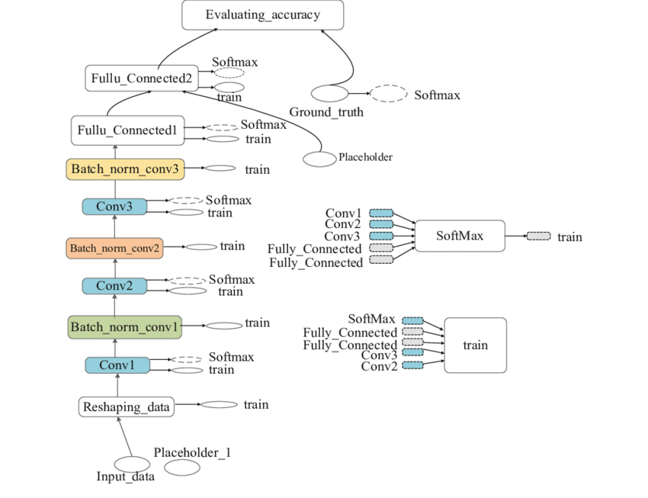
Why Dependency Analysis
Making Sense of Performance in Data Analytics Frameworks (Ousterhout et al., NSDI 15)
Inception (2014)
COZ: Finding Code that Counts with Causal Profiling (Curtsinger et al., SOSP 15)
What-If Analysis of Page Load Time in Web Browsers Using Causal Profiling (Pourghassemi et al., SIGMETRICS 19)
TensorFlow’s computational graph (2016)
LSTM (2014)
Answering what-if questions in non-ML contexts
DNN Computational Graph
Similarities between the graph structures, unique challenges and opportunities for the ML context
Notes:
Luckily, exploring what-if questions is not an entirely new problem. System researchers have been using the dependency graph analysis approach, to answer performance-related what-if questions in some non-ML contexts, like big data processing systems.
On the other hand, dependency graph structures are also common in the ML context. For example, many DNN models are specified using dependency graphs, and mainstream ML frameworks also performance DNN computation based on dependency graph structures.
The similarities of graph structures, suggest that we can use the idea of dependency graph analysis for our system. However, we identify several unique challenges when using this approach in the ML context.

Slide 6
Challenges for Dependency Graph Analysis in the ML context
Challenge #1: Thousands of tasks, and dependency needs to be tracked across CPU threads, GPU streams, and interconnects.
CPU Thread #1
launch
cudaMalloc
cudaFree
CPU Thread #2
cudaDeviceSynchronize
cudaMemcpy
CPU Thread #3
launch
launch
launch
launch
GPU Stream #1
volta_scudnn_128x64_relu_...
GPU Stream #2
void cudnn::detail::wgrad_alg0_enging<float, …
void cudnn…
GPU Stream #3
MemCpy (DtoH)
MemCpy (DtoH)
Communication
nccl::all_reduce(…
Notes:
The first challenge is that we need to build the graph with nodes at the abstraction of GPU kernels.
Here is an example showing what the low-level execution timeline might look like. Each box corresponds to one GPU kernel or CUDA API, and will have a corresponding node in the dependency graph.
There are usually thousands of CUDA APIs and GPU kernels in just one training iteration, meaning that the graph will be huge, and dependency needs to be tracked across all these traces, different threads and streams.

Slide 7
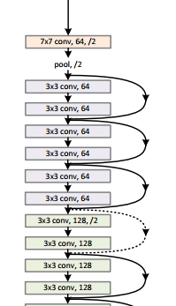
Challenges for Dependency Graph Analysis in the ML context
Challenge #2: Modeling DNN optimizations requiring correlation between kernel and layer abstractions.
CPU Thread
GPU Stream #1
volta_scudnn_128x128…
cudnn::detail::wgrad…
GPU Stream #2
_ZN2at6native18ele…
kernelPointwise…
volta_sgemm_...
What if I improve CONV layers?
Which kernels belong to these layers?
Notes:
The second challenge is that some optimizations operate kernel-level granularity, yet still requiring the knowledge of DNN layers. Machine learning people are familiar with the DNN model graph, however Daydream’s dependency graph is at kernel-level.
So say a programmer wants to know what if he or she can speed up CONV layers by 2x. It is hard to model this, because there is no profiler that can tell us which kernels belong to which layers.
Hence the system should find a way to correlate these two different granularities.

Slide 8

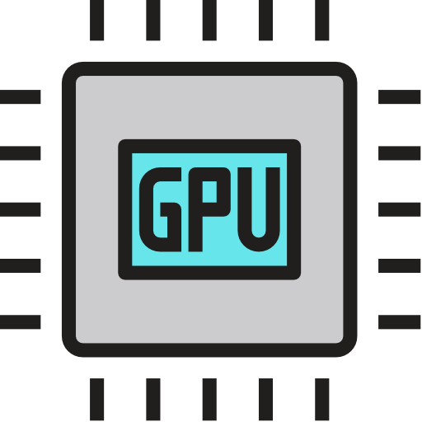

Challenges for Dependency Graph Analysis in the ML context
Challenge #3: Ability to easily model diverse DNN optimizations.
Optimizations
How to make it easy to model of all potential ?
Notes:
The third challenge is that there are various DNN optimizations. Suppose we train a DNN using multiple machines with multiple GPUs. A DNN optimization may try to optimize the algorithm, the CPU/GPU, or the intra and interconnects, and with the same optimization goal, there are often multiple techniques. This diversity of the DNN optimizations, raises the challenge that the system should allow users to easily model the common potential optimizations.

Slide 9



Daydream Overview
Input: an DNN training implementation X, an optimization Y
Output: the estimation of runtime when applying Y to X
Kernel-level Traces
Daydream Transformation Primitives
Training Implementation X
Daydream’s Dependency Graph
Optimization Y
Daydream Profiler
Layer Graph
Layer L₀
Post-Optimization Graph
Simulation
Layer L₁
Layer L₂
Notes:
So before we show how Daydream addresses these challenges, let’s first go through the Daydream’s workflow.
Daydream system takes two inputs. The first one is a …, the second one is an …. And it outputs the estimation …
So given a training implementation, Daydream will first run a profiler on top of it, collecting profiling data and generate both the kernel-level traces and layer-level traces.
Then, Daydream combine these traces, generating Daydream’s dependency graph.
The users will use Daydream’s transformation primitives to depict the given optimization. The primitives will alter the dependency graph, and finally Daydream simulate the post-optimization graph to output a final estimation.

Slide 10
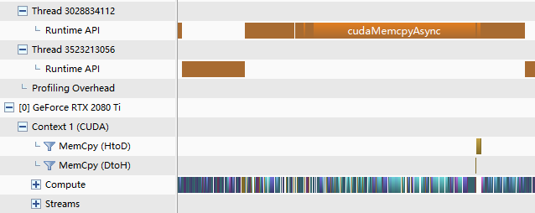
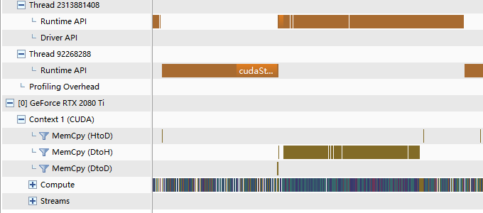
Challenge 1: Tracking Dependencies
CUDA APIs
GPU kernels
NVProf profile of one ResNet50 iteration
NVProf profile of one BERT_{LARGE} iteration
Observation: GPU kernels are highly serialized for most DNN training workloads
Notes:
Now let’s look at each challenge in details.
The first challenge is that Daydream has to track dependencies among thousands of low-level traces, and across different hardware.
Here are two figures showing the kernel-level traces of training a resnet50 and BERT_LARGE. There are thousands of GPU kernels and CUDA APIs invoked in just one iteration. Hence Daydream needs to construct a graph that is potentially extremely complicated.
But, we notice that the GPU kernels in a DNN training workload are usually highly serialized.
Such serialization property is due to that the GPU kernels are mostly compute-intense, hence they are carefully crafted to fully utilize the GPU resources, and leaving very limited space for concurrent kernels.
This greatly simplifies our construction of the dependency graph.

Slide 11
Daydream’s Graph Construction
We identify the six types of dependencies:
CPU Thread
Launch K0
cudaMemcpyAsync
cudaDeviceSynchronize
Launch K1
GPU Stream
K0
CUDAMemcpy
(1) Sequential CPU-CPU: two consecutive CPU calls on the same CPU thread
(2) Sequential GPU-GPU: two consecutive GPU kernels on the same stream
(3) CPU-GPU launching: A CPU call launching a GPU kernel/CUDA memory copies
(4) GPU-CPU sync: A CPU synchronization call waiting for GPU kernel to finish
Notes:
Based on this observation, we identify six types dependencies that we need to track, so that Daydream can accurately replay the execution.
First, any two consecutive CUDA APIs on the same CPU thread, will have a dependency between them.
Second and similarly, two consecutive GPU kernels or CUDA memory copies on the same GPU stream, will have a dependency between them.
Third, each GPU kernel or a CUDA memory copy is invoked by a corresponding CUDA API, therefore there should be a dependency from a launching API to its GPU kernel.
Forth, when calling a synchronization call on a CPU thread, the thread will wait for GPU kernels to complete, creating a dependency from a GPU kernel to a CPU call.

Slide 12
Daydream’s Graph Construction (cont.)
(5) CPU-Communication
Parameter Server Architecture:
Collapsed Compute
CONV_BP
POOL_BP
RELU_BP
……
POOL_FF
CONV_FF
Communication
Push
Pull
(6) CPU-CPU (e.g. thread spawn, join, lock, …)
Server
Accumulate_Grad
MPI-like Architecture:
Collapsed Compute
FC_BP
CONV_BP
……
CONV_FF
FC_FF
Communication
AllReduce Grad
AllReduce Grad
Notes:
Then we have dependencies from CPU tasks to communication calls because we aim to estimate distributed training runtime. When estimating the distributed runtime, we first collapse the CPU calls and GPU kernels into layer-wise forward and backward tasks, then we add dependencies between compute and communication tasks. If we model a parameter server architecture, we need to add push/pull operations, and if it is a decentralized architecture, we need to add all reduce operations.
And finally for completeness, we have CPU to CPU dependencies, representing the thread spawn, join, lock etc.
Once we properly construct all the six types of dependencies, Daydream is able to accurately replay and estimate the runtime.

Slide 13
Challenge 2: Trace-Layer Correlation
Optimizations requiring correlation between low-level traces and DNN layers:
  E.g., Fusing CONV and RELU layers
  Low-level traces have NO domain knowledge
Naïve approach: adding synchronization
Get timestamps
CPU Timeline
sync
Launch K₀
Launch K₁
Launch K₂
😕
GPU Timeline
K₀
K₁
K₂
Notes:
The second challenge we need to address is the correlation between low-level traces and DNN layers.
This is required because DNN optimizations might operate at the kernel level, yet requiring the knowledge of DNN topology at the same time.
For example, one way to improve the training of a convolutional network, is to fuse a convolutional layer with the activation layer. Unfortunately, the kernel-level traces have no domain knowledge, therefore we have no idea which traces belong to which layer.
Naively, people solve this problem by adding synchronizations, suppose we have a timeline that looks like this. When inserting a synchronization, we can measure the time of GPU kernels on CPU side, and then compare the timestamps with the time-span of GPU kernels.
This approach is simple, but as we can see, it creates an additional dependency. This is not good because it alters the dependency graph.

Slide 14
Daydream’s Kernel-Layer Mapping
❶ Get L₀’s Timestamps
K₀, K₁ belong to L₀
t₀
t₁
❷ Get L₀’s CPU tasks
CPU Timeline
Launch K₀
Launch K₁
Launch K₂
GPU Timeline
K₀
K₁
K₂
❸ Map K₀, K₁ to L₀ according to dependencies
Little overhead (only need to instrument frameworks for per-layer timestamps)
No alternation to the dependency graph (synchronization-free)
Notes:
Daydream addresses this challenge using a synchronization free mapping. Let’s use this timeline for example, suppose that K0 and K1 belong to L0
We first time the start and stop timestamps of layer 0, and get all the CPU tasks that belong to L0. Then, using the dependency information, we can find all the GPU kernels launched by L0, and map them to L0 as well.
This approach introduces little overhead, because we only instrument per-layer timestamps to the frameworks, and there is no alternation to the dependency graph, because we don’t inject any synchronizations.

Slide 15
Challenge 3: Optimization Diversity
Optimization Goals
Strategy
Technique Examples
Improving Hardware
Increasing Mini
-
batch Size by
vDNN
(MICRO16),
Gist
(ISCA18), Echo (ISCA20)
Utilization in Single
-
Reducing Memory Footprints
Worker Environment
Reducing Precision
Automatic Mixed
Precision
(arxiv17)
Kernel/Layer Fusion
FusedAdam
,
MetaFlow
(MLSys19), TASO
(SOSP19)
Improving Kernel
Restructuring
Batchnorm
(MLSys19), TVM
Implementation
(OSDI18),
Tensor
Comprehensions (arxiv18)
Lowering Communication
Reducing Communication
Deep Gradient
Compression
(ICLR18), QSGD
Overhead in Distributed
Workloads
(NeurIPS17),
AdaComm
(MLSys19), Parallax
Training
(EuroSys19),
TernGrad
(NeurIPS17)
Improving Communication
Wait
-
free
Backprop
(ATC17)
,
P3
(MLSys19)
,
Efficiency/Overlap
BlueConnect
(MLSys19)
,
TicTac
(MLSys19)
,
BytePS
(SOSP19), Blink
(MLSys19)
We evaluate “some optimizations”, and show that we can conveniently model “others” using Daydream
Notes:
The third challenge is that there are various DNN optimizations, targeting different performance bottlenecks in different ways.
Some optimizations for example, aim at improving hardware utilization in a single-worker environment, while some others try to reduce the communication overhead in distributed training.
These optimizations use different strategies to achieve their goals. For example, to improve hardware utilization, one can either reduce the precision, or fuse kernels or layers. There are multiple techniques that implement each of these strategies.
Similarly, there are many optimization techniques that either try to reduce communication workloads, or improving communication/computation overlap.
In our paper, we show that using Daydream we can easily model the ones highlighted in bold italic, and accurately estimate the efficacy of the optimizations shown in green.

Slide 16
Daydream’s Transformation Primitives
Most DNN optimizations can be described as a combination of the following primitives:
(1) Select(expr): return tasks of interests for further process
(2) Shrinking/Scaling the task duration
CPU Timeline
Launch K0
Launch K1
Launch K2
Synchronize
Launch K3
GPU Timeline
K0 (POOL)
K1 (CONV)
K2 (POOL)
K3 (CONV)
Select(taskPtr(isOnGPU()))
Select(taskPtr(isCONV()))
Shrink CONV layers by 2x
CPU Timeline
Launch K0
Launch K1
Launch K2
sync
Launch K3
GPU Timeline
K0 (POOL)
K1 (CONV)
K2 (POOL)
K3 (CONV)
Notes:
To address the challenge of the DNN optimization diversity, we propose a set of simple transformation primitives. Based on our previous design, we found that most DNN optimization can be described a combination of simple transformation primitives.
The first one is the selection primitive. A DNN optimization could affect lots of nodes in the dependency graph. Users can use this primitive to get all the tasks of interests for further process. For example, when estimating the performance of reducing precision, users can find affected tasks by selecting all GPU tasks. Or if a technique improves convolutional layers, we can select all GPU kernels that belong to convolutional layers.
The second one is shrinking/scaling the task duration. So say that we shrink the duration of CONV layers by 2x, the timeline will look like this.

Slide 17
Daydream’s Transformation Primitives (cont.)
(3) Insert(s, task, t): Insert a task between s and t
(4) Remove(task): Remove a task from the graph
insert
CPU Thread
remove
CPU Thread
insert
GPU Stream
remove
Notes:
We then have the primitives allowing users to manipulate the dependency graph topology, by inserting or removing nodes. Suppose we have a simple timeline that looks like this, inserting a CPU task between them is just like inserting a node to a linked list. A removal is just a reverse of the insertion.
When inserting a GPU task, it is a bit different because a GPU kernel has a corresponding CUDA launch API invoked on CPU. Hence when inserting a GPU task, we need to insert also a CPU task to the right position, representing the CUDA launch call. And again, removal is the reverse of insertion.

Slide 18
Daydream’s Transformation Primitives (cont.)
(5) Schedule(Q: a queue of tasks that are ready to execute): --> task
Decide which task to execute when multiple tasks are ready
Compute
L2_BP
L1_BP
L0_BP
L0_FF
L1_FF
L2_FF
Communication
Grad_L2
Grad_L1
Grad_L0
Reschedule Grad_L1 and Grad_L0
Compute
L2_BP
L1_BP
L0_BP
L0_FF
L1_FF
L2_FF
Communication
Grad_L2
Grad_L0
Grad_L1
Notes:
The last primitive allows users to reschedule the execution of the graph tasks to achieve better overlap. For example, for a timeline shown below, one can switch the order of the gradient exchange of L1 and L0, leading to a timeline that looks like this.
Since both timelines are based on the same dependency graph, to achieve this rescheduling, users need to override this Schedule function. The Schedule function returns one task from a queue of tasks that are ready to execute. This function is invoked by the simulation process, and users can override it, and implement any custom scheduling policy.

Slide 19
Example – Automatic Mixed Precision
Using Daydream to estimate the efficacy of AMP (Micikevicius et al., arxiv 2017)
Low-level traces
Per-layer timestamps
def estimate_AMP(cupti_file, timestamps_file):
graph = Graph(cupti_file)
graph.mapping(timestamps_file)
GPUNodes = [node for node in graph.nodes() if node.kind == “KERNEL”]
for node in GPUNodes:
if “wgrad” in node.name or “sgemm” in node.name:
node.dur /= 3
else:
node.dur /= 2
return graph.simulate()
Constructing kernel-level dependency graph
Map low-level traces to DNN layers using per-layer timestamps
Select all GPU tasks from the graph
If we expect this task to use TensorCore
Otherwise, use half-precision cores
Simulate the timeline, return the elapsed execution time
10 optimization examples, each around 20 lines of code (refer to our paper)
Notes:
So far we have introduced Daydream’s transformation primitives, which might look very simple, but actually very powerful.
We show one simple example of using Daydream to model the optimization of Automatic Mixed Precision.
The modeling process takes two inputs from Daydream’s profiler, one is the low-level traces collected by using CUPTI, the other is the per-layer timestamps collected by instrumenting the ML frameworks.
We then construct Daydream’s dependency graph based on the low-level traces, and map the low-level traces to the DNN layers. Then, we can select all GPU tasks from the graph, and check how AMP affects the duration of each GPU kernel. We shrink the duration of a GPU task by 3x if we expect a task to use TensorCore, and 2x otherwise for using half-precision cores.
Finally, we simulate the altered graph for a runtime prediction.
The code is written in Python, showing our prototype implementation of Daydream user programs.
This is a very simple example. In the paper we show 9 other examples, each of them takes around only 20 to 30 lines of code.

Slide 20
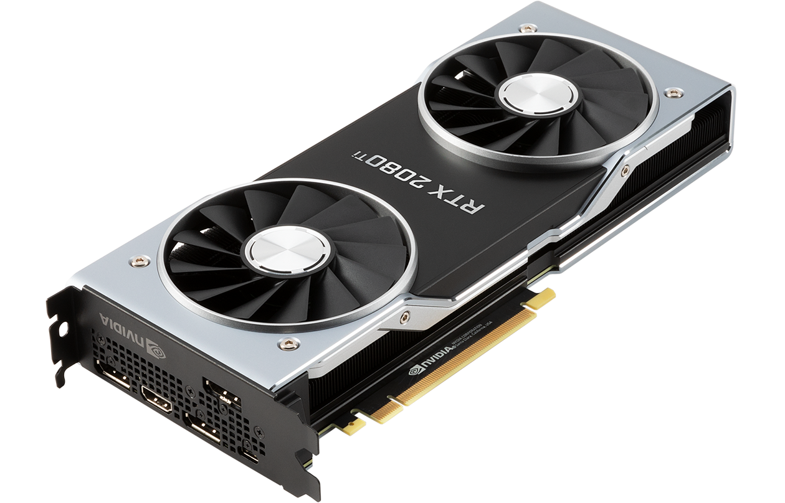


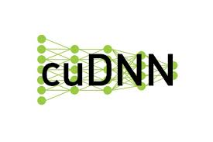
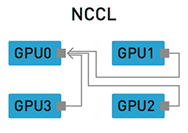
Methodology
Woakloads:
Setup:
Application | Model | Dataset
Image Classification | VGG-19 | Imagenet
 | DenseNet-121
 | ResNet-50
Machine Translation | GNMT (Seq2Seq) | WMT
Language Modeling | BERT | SQuAD
RTX 2080 Ti
Quadro P4000
v10.0
v7.4.2
v2.4.2
Optimizations:
v1.0
v1.1
v1.0
Improving hardware utilization:
Automatic Mixed Precision (AMP), FusedAdam, Reconstructing Batchnorm
Distributed training:
Data-parallel distributed training, Priority-based parameter propagation (P3)
Notes:
For the last part of my presentation, I will show the evaluation of Daydream’s estimation accuracy. We evaluate Daydream using 5 DNN training workloads.
We use 2080Ti and P4000 GPUs, and we add the Daydream instrumentation to PyTorch, MXNet, and Caffe.
We evaluate these five optimizations, three of them aim at improving hardware utilization, including AMP, FusedAdam, and Reconstructing Batchnorm.
The FusedAdam optimizer is from Nvidia’s opensource package, which fuses all kernels in the Adam optimizer. Reconstructing Batchnorm is an approach to overlap GPU compute latency with GPU memory latency through kernel fission and fusion.
We also evaluate the data-parallel distributed training, and Priority-based parameter propagation, also called P3, which is a technique to improving the computation/communication overlap.

Slide 21
Methodology (cont.)
Given a and a , we evaluate:
Baseline:
Ground Truth:
+
Prediction:
Notes:
For each optimization and a DNN training workload, we evaluate the followings:
First, the baseline, showing the iteration time of just running the workload
Second, the ground truth, showing the iteration time after applying the optimization to the workload
Third, the prediction, showing Daydream’s estimation of the optimization

Slide 22
Runtime Estimation Accuracy
Estimating Automatic Mixed Precision (AMP), FusedAdam, and Restructuring Batchnorm (RB)
1.54x
1.63x
3.9%
6.1%
1.9%
12.5%
5.5%
4.5%
15.3%
12.6%
Daydream achieves 8% estimation error on average (15% maximum)
Notes:
We first show the evaluation of 3 optimization techniques, which are automatic mixed precision, the FusedAdam optimizer, and reconstructing batchnorm.
The X axis shows different combinations of optimizations and training workloads, and the Y axis shows the iteration time.
When using AMP on the BERT base model, we achieve 1.54x speedup, and using Daydream, we predict the speedup to be 1.63x. The difference is only 5.5%. We did the same analysis for using AMP on other three DNN models, and achieve prediction error around 15% at maximum.
We also evaluate the FusedAdam, and reconstructing batchnorm optimizations, achieving low estimation error. In general, Daydream achieves 8% estimation error on average, and 15% maximum.

Slide 23
Estimating Distributed Training
Estimating data-parallel distributed training of BERT_{LARGE}
Daydream can accurately estimate the distributed performance for various system configurations
Notes:
We then show Daydream’s prediction of distributed training runtime. The baseline is running on a single machine with a single GPU. We vary the system configuration in multiple dimensions, including the number of machines, the number of GPUs per machine, and the interconnect bandwidth.
The green bars show the measured ground truth runtime of BERT large, and the red bars show the runtime prediction. The estimation error (shown in y axis) is generally much lower than 10%, showing that Daydream can accurately estimate the distributed training performance for various system configurations.

Slide 24
Estimating Distributed Training
ResNet-50
GNMT
BERT_{BASE}
BERT_{LARGE}
Daydream can accurately estimate the distributed performance for a variety of DNN models
Notes:
We evaluate three other DNN training workloads. As we can see, the estimation errors are still generally less than 10%, showing that Daydream can accurately estimate the distributed training performance for multiple DNN models.

Slide 25
Estimating Efficacy of P3
Prediction accuracy for Priority-Based Parameter Propagation (P3)
(we use 4 machines and 1 P400 GPU on each machine)
Runtime Prediction for ResNet-50
Runtime Prediction for VGG-19
Using Daydream, we can successfully estimate whether P3 would provide significant or subtle improvement
Notes:
Finally we show the evaluation of P3. We use 4 machines and 1 GPU on each machine.
Here is the figure showing how Daydream’s estimation of using P3 on ResNet-50 and multiple network bandwidths. The improvement of using P3 is subtle, and the prediction curve almost overlaps with the ground truth curve.
It is same for VGG-19, that the prediction curve is very close to the ground truth curve, but the improvement of using P3 is significant. This suggests that using Daydream, we can successfully estimate whether P3 would provide significant or subtle improvement.

Slide 26
Conclusion
Benefits of DNN optimizations are not easy to exploit:
  Efficacy various across different hw/sw deployments
  Often onerous to implement and debug
Basic Idea: Dependency graph analysis
Our Solution: The Daydream system allowing users to quickly estimate the performance of various DNN optimizations:
  Tracking dependencies at the kernel-level granularity
  Sync-free trace-to-layer mapping
  Simple graph transformation primitives
Key Results: Estimation error of 8% on average (15% maximum)
Modeling a wide range of optimizations (only 20 lines of code each)
Notes:
To conclude my presentation, our project is motivated by that
Based on the idea of using dependency graph analysis, we build a system called Daydream, allowing ..
Daydream’s design features three key ideas.

Slide 27
Daydream: Accurately Estimating the Efficacy of Optimizations for DNN Training
Hongyu Zhu_{1,2}, Amar Phanishayee₃, Gennady Pekhimenko_{1,2}
Thank you!
1
2
3
serailhydra@cs.toronto.edu
Notes:
Thank you everyone for watching this video, I am happy to take any questions through emails.

