Slide 1
TerseCades: Efficient Data Compression in Stream Processing
Gennady Pekhimenko
Chuanxiong Guo, Myeongjae Jeon, Peng Huang, Lidong Zhou

Slide 2
IoT
Clouds
Big Data
Huge volumes of streaming data with real-time processing requirements Enormous pressure on the capacity and bandwidth of servers’ main memory

Slide 3
Is Data Compression Useful for Streaming?
Intuitively, streaming with simple operators should be bandwidth-bottlenecked: either network or memory bandwidth
Simple single node experiment with the state-of-the-art streaming engine, Trill, with the Where query over large one column 8-byte field:
E.g., Where (e => e.errorCode != 0)
Expectation: observe memory bandwidth as a major bottleneck
Notes:
Hence compression can be useful in reducing bandwidth consumption

Slide 4
Compressibility ≠> Performance Gain
Only 10%-15% performance improvement with 8X compression
Notes:
Trill engineers intuition – Where query should be bandwidth bottlenecked
Not that much with Trill!

Slide 5
What Went Wrong?
Memory allocation overhead:
just-in-time copy of payloads to create a streameable event
Memory copying and reallocation:
enables flexible column-oriented data batches
Inefficient bit-wise manipulation
Hash tables manipulations
Notes:
2/3 for memory related overheads
46% - bitwise manipulation

Slide 6
Compressibility => Performance Gain
8X Compression with Add benchmark from STREAM suite
Up to 6.1X speedup with realistic compression algorithm:
Base-Delta Encoding
If no artificial bottlenecks: performance improvement is close to
compression ratio (7.6X speedup with 8X compression)
Notes:
Long – 64-bit uint; Char – 8-bit char type (mimics 8X compression with no overhead;
CharCompr. – compressing 64-bit values to 8-bit using Base-Delta encoding

Slide 7
Prerequisites for Efficient Data Streaming
Fixed Memory Allocation
Efficient HashMap Primitives
Efficient Filtering Operations (bit-wise manipulations)

Slide 8
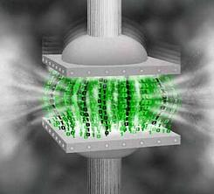
Key Observations
Memory bandwidth becomes the major bottleneck if streaming is properly optimized
Dominant part of the data is synthetic in nature and hence has a lot of redundancy
Can be exploited through efficient data compression

Slide 9
TerseCades: Baseline System Overview
Event
Stream
Compressor
Decompressor
Decompressor
Op₁
Op_{n}
Compressed
Data Store
Operator Op₁ on compressed data
Operator Op_{n} on compressed data

Slide 10
Key Design Choices and Optimizations
Lossless Compression
Arithmetic vs. Dictionary-based Compression
Decompression is on the critical path
Lossy Compression without Output Quality Loss
Integers and floating points
Reducing Compression/Decompression Cost
Hardware-based acceleration: vectorization, GPU, FPGA
Direct Execution on Compressed Data

Slide 11
Lossless Compression: Base-Delta Encoding
✓ Fast Decompression:
vector addition
✓ Simple SW/HW Implementations:
arithmetic and comparison
✓ Effective: good compression ratio

Slide 12
Lossy Compression Without Output Quality Loss
Base-Delta Encoding modification
Truncate deltas when full precision not required
ZFP floating point compression engine
Equivalent of BD in floating point domain with controlled precision

Slide 13
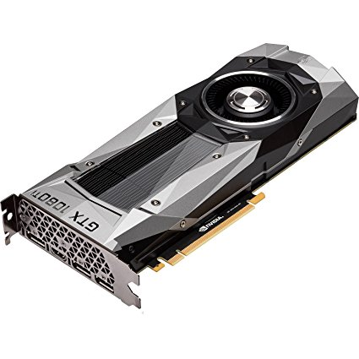
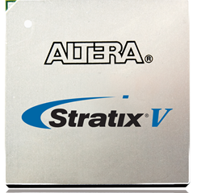
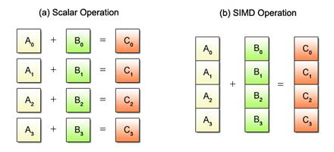
Reducing Compression Overhead
SIMD/Vectorization
GPU
FPGA
Intel Xeon with 256-bit SIMD
NVIDIA 1080Ti
Altera Stratix V
Notes:
Turns out in most cases SIMD is good enough with B+D, although GPU/FPGA can be useful for more complicated algorithms

Slide 14
Execution on Compressed Data
Decompress
Memory
Processor
Compress
Compressed
Incurs decompression and compression latency
High energy overhead
Can we leverage data being in a condensed form?

Slide 15
Execution on Compressed Data
Key 1
Value 1
Key 2
Value 2
Key 3
Value 3
Key N
Value N
Memory
Value 1
Value 2
Value 3
Value N
8B
8B
8B
8B

Slide 16
Execution on Compressed Data
Value
N 8-byte Comparisons
Value 1
Value 2
Value 3
Value N
8B
8B
8B
8B
Value
1 or N/8 Comparisons
Metadata
Value 1
Value 2
Value 3
Value N
1B
1B
1B
1B
Low Latency
Single Comparison
Narrower Operations

Slide 17
Evaluation: Methodology
CPU: 24-core system based on Intel Xeon CPU E5-2673, 2.40GHz with SMT-enabled, and 128GB of memory
GPU: NVIDIA GeForce GTX 1080 Ti with 11GB of GDDR5X memory
FPGA: Altera Stratix V FPGA, 200MHz

Slide 18
STREAM Benchmark Results
Add benchmark from STREAM suite
Vectorization further reduces compression/decompression overhead, especially for smaller number of threads

Slide 19
STREAM Benchmark Results (2)
Search benchmark
When direct execution is applicable, it can significantly improve performance as it reduces the total computation

Slide 20
Monitoring and Troubleshooting: PingMesh
C2cProbeCount = Stream
.HopWindow(windowSize, period)
.Where(e => e.errorCode != 0
&& e.rtt >= 100)
.GroupApply((e.srcCluster,
e.dstCluster))
.Aggregate(c => c.Count())
TimeStamp (8, BD) | ErrorCode (4, EN+BD) | SrcCluster (4, HS+BD)
DstCluster (4, HS+BD) | RoundTripTime (4, BD)
BD – Base+Delta encoding
HS – String hashing
EN – Enumeration
Number in parenthesis – number of bytes
before compression
T2tProbeCount = Stream
.HopWindow(windowSize, period)
.Where(e => e.errorCode != 0
&& e.rtt >= 100)
.Join(m, e => e.srcIp, m => m.ipAddr,
(e,m) => {e, srcTor=m.torId})
.Join(m, e => e.dstIp, m => m.ipAddr,
(e,m)=> {e, dstTor=m.torId})
.GroupApply((srcTor, dstTor))
.Aggregate(c => c.Count())

Slide 21
PingMesh C2cProbeCount Results
Total of more that 15X improvement in throughput due to data compression with efficient optimizations

Slide 22
Performance of Individual Operators
The highest performance benefits are for operators where direct execution is applicable (e.g., Where)

Slide 23
IaaS VM Performance Counters
TimeStamp (8, BD) | Cluster (11, HS) | VmID (36, HS) | SampleCount (4, BD) | MinValue (8, ZFP)
MaxValue (8, ZFP) | CounterName (15, EN) | NodeId (10, HS) | Datacenter (3, HS) | AverageValue (8, ZFP)
BD – Base+Delta encoding; HS – String hashing; EN – Enumeration;
ZFP – efficient floating point compression (lossy with controlled accuracy)
Number in parenthesis – number of bytes before compression
Upto 6X compression with ZFP lossy compression algorithm

Slide 24
IoT Datasets
Geolocation data (GPS coordinates from GeoLife project):
4.5X average compression ratio
Less than 10⁻⁶ loss in accuracy
Weather data (Hurricane Katrina in 2005)
3X-4X compression ratios for 18 metrics used in the data set
TimeStamp (8, BD) | Latitude (8, ZFP)
Longtitude (8, ZFP) | Altitude (4, BD)

Slide 25
Comparison to Prior Work
Compression in databases
Succinct, NSDI’15: execution on compressed textual data, complete redesign of data storage in memory
Abadi, SIGMOD’06: compression in column-oriented data stores; uses conventional compression algorithms not applicable to streaming
Generic memory compression
Execution on compressed data is not supported
Lower compression ratios due to generality of algorithms chosen

Slide 26
Summary
Q: Can data compression be effective in stream processing?
A: Yes, our TerseCades design is the proof-of-concept
Properly optimize the baseline system
Use light-weight data compression algorithms + HW acceleration
Directly execute on compressed data
Results on troubleshooting workload used in production allowed to replace 16 servers with just one!

Slide 27
TerseCades: Efficient Data Compression in Stream Processing
Gennady Pekhimenko
Chuanxiong Guo, Myeongjae Jeon, Peng Huang, Lidong Zhou

