Slide 1






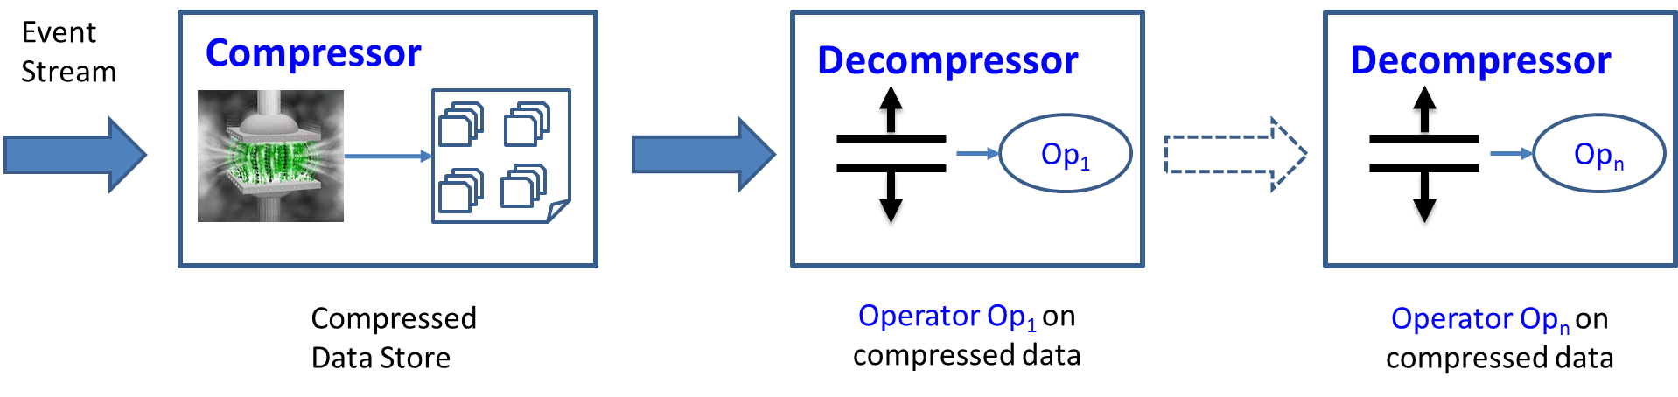
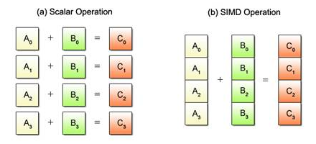


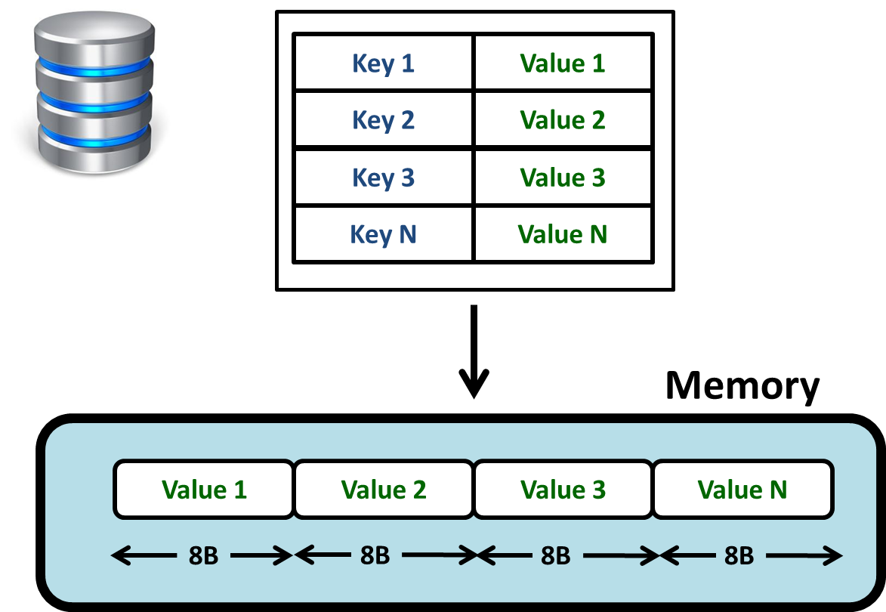
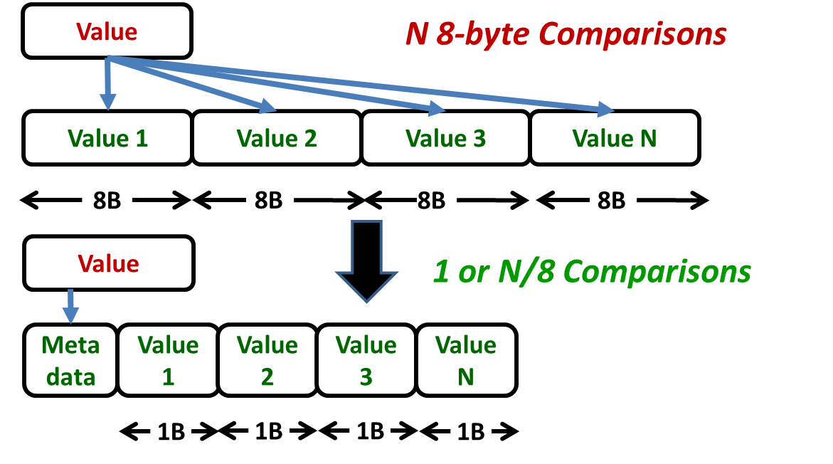
TerseCades: Efficient Data Compression in Stream Processing
Gennady Pekhimenko, Chuanxiong Guo, Myeongjae Jeon, Peng Huang, Lidong Zhou
Stream Processing
Is Data Compression Useful for Streaming?
Intuitively, streaming with simple operators should be bandwidth-bottlenecked: either network or memory bandwidth
Simple single node experiment with the state-of-the-art streaming engine, Trill: Where query over large one column field: Where (e => e.errorCode != 0)
Expectation: observe memory bandwidth as a major bottleneck
IoT
Clouds
Big Data
Huge volumes of streaming data with real-time processing requirements Enormous pressure on the capacity and bandwidth of servers’ main memory
Compressibility ≠> Performance
Compressibility => Performance
8X Compression with Add benchmark from STREAM suite
Only 10%-15% performance improvement with 8X compression
“Ideal” performance improvement is close to compression ratio
(7.6X speedup with 8X compression)
Up to 6.1X speedup with realistic compression algorithm: Base-Delta Encoding
Prerequisites and Key Observations
TerseCades: System Overview
Fixed Memory Allocation
Efficient HashMap Primitives
Efficient Filtering Operations
(bit-wise manipulations)
Memory bandwidth becomes major bottleneck
Synthetic data has a lot of redundancy -> exploitable with simple compression algorithms
Lossless & Lossy Compression
Reducing Compression Overhead
Base-Delta Encoding,
PACT’12
  ✓ Fast Decompression:
  vector addition
  ✓ Simple SW/HW Implementations:
  arithmetic and comparison
  ✓ Effective:
  good compression ratio
SIMD/Vectorization
GPU
FPGA
Intel Xeon with 256-bit SIMD
NVIDIA 1080Ti
Altera Stratix V
Direct Execution on Compressed Data
STREAM Suite Results
Add benchmark from STREAM suite
Vectorization further reduces compression/decompression overhead, especially for smaller number of threads
Monitoring and Troubleshooting: Pingmesh
C2cProbeCount = Stream
.HopWindow(windowSize, period)
.Where(e => e.errorCode != 0
&& e.rtt >= 100)
.GroupApply((e.srcCluster,
e.dstCluster))
.Aggregate(c => c.Count())
TimeStamp (8, BD) | ErrorCode (4, EN+BD) | SrcCluster (4, HS+BD)
DstCluster (4, HS+BD) | RoundTripTime (4, BD)
Total of more that 14X improvement in throughput due to data compression with efficient optimizations
The highest performance benefits are for operators where direct execution is applicable (e.g., Where)

