Slide 1
Non-Interactive Secure Computation with Constant Communication Overhead
Yuval Ishai, Ziyang Jin, Naty Peter, Akshayaram Srinivasan
Theory Seminar
University of Toronto
March 27, 2026

Slide 2
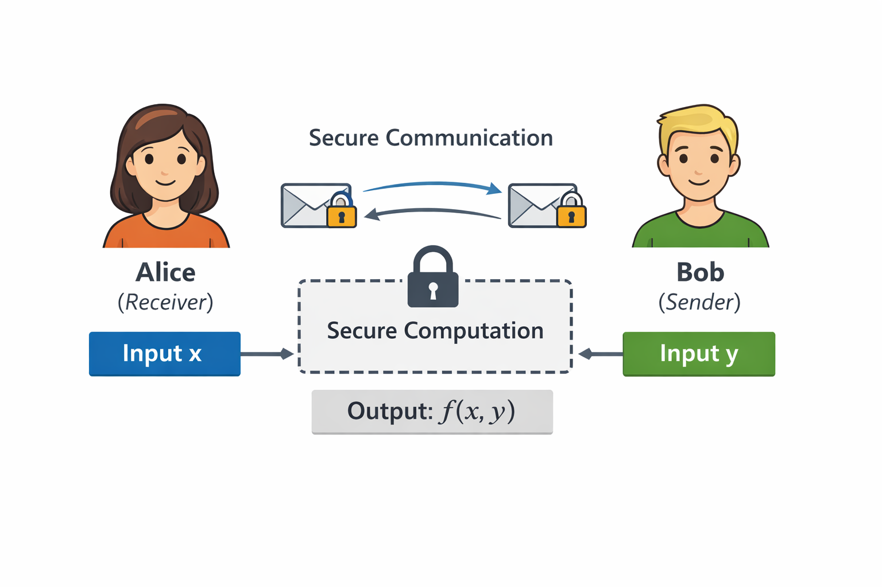

Secure Two-Party Computation
Alice learns nothing beyond x, f(x,y)
Bob learns nothing beyond y
In our case:
only Alice learns the output.

Slide 3
Semi-honest Adversary
Follows the protocol but tries to learn additional information from its view
Maybe I can extract info from Bob’s msg?

Slide 4


Malicious Adversary
Follow the protocol? Nah!
Can deviate arbitrarily from the protocol
Probabilistic
Polynomial Time
Algorithm

Slide 5
Do we need to pay extra to achieve malicious security?

Slide 6


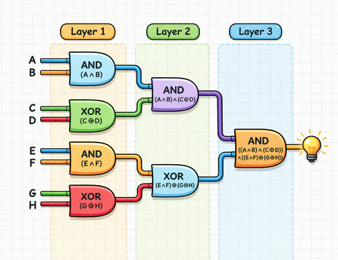

Garbled Circuits [Yao 86]
Boolean Circuit C
Garbled Circuit C
Input & gate outputs are exposed!
x₁
key for x₁
Only C(x,y) is learnt!
x₂
key for x₂
x₃
key for x₃
C(x,y)
key for y₁
C(x,y)
y₁
key for y₂
y₂
key for y₃
y₃
I generate the garbled circuit + all the keys
How do I get my keys without letting him know x?
For each wire i in the circuit,
Bob generates (key_{i,0} , key_{i,1})
Garbler:
Evaluator:

Slide 7
Oblivious Transfer (OT)
For Alice’s i-th input bit x_{i}, set b = x_{i}
Receiver has a selection bit b
Sender has two strings (s₀, s₁)
(s₀, s₁) = (key_{i,0}, key_{i,1})
Receiver obtains s_{b};
does not know s_{1-b}
Obtains key_{i,xi}
Sender does not know about b

Slide 8
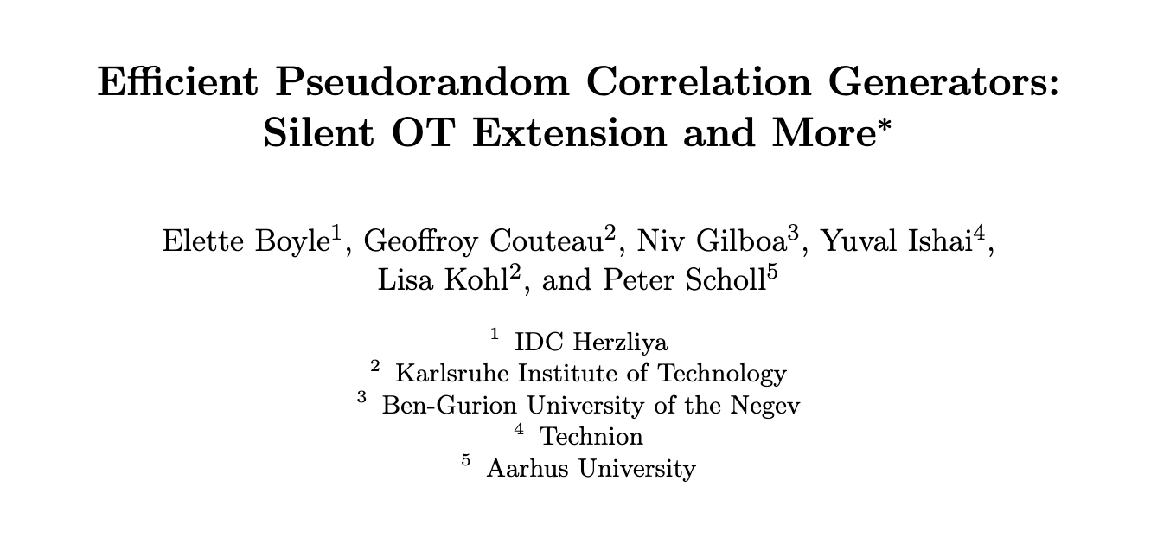
OT Correlations
OT correlations are preprocessed random OT pairs ((b,r_{b}), (r₀,r₁)), where receiver holds (b,r_{b}), and sender holds (r₀,r₁).
Can be used to realize any two-round OT protocol.
Can be efficiently generated offline using Pseudorandom Correlation Generators [BCG+ 19].

Slide 9

Garbled Circuits
First-round OT msg to obtain keys for Alice’s input
OT response (Alice’s keys)
Generates the garbled circuit + all the keys
Evaluates
the garbled circuit to obtain C(x,y)
key for Bob’s input

Slide 10
Summary
λ: computational security parameter
Yao’s garbled circuit
  Semi-honest secure
  Two rounds (a.k.a. non-interactive secure computation)
  Communication: O(|C|λ)
  Assumptions: one-way function and oblivious transfer
optimal
Inherent even in the random oracle model
OT correlations
Can we achieve malicious security with the same round-complexity, same communication, and same assumptions?

Slide 11
Generic Transformation [GMW 87]
Using a non-interactive zero-knowledge proof, we can upgrade semi-honest security to malicious security.
  Can be constructed in the random oracle model.
  It makes a non-blackbox use of one-way function (i.e. the construction needs to access the code of one-way function).
Can we achieve malicious security with only black-box use of underlying crypto primitives?

Slide 12
Black-Box Protocol Compilers [IKSS 22]
Maliciously secure
Two rounds
Assumptions: Random Oracle and OT correlations (black-box)
Communication: O(|C|) · poly(λ)
Due to verifiable secret sharing
Can we achieve malicious security with black-box use of crypto and constant communication overhead to semi-honest protocol?

Slide 13
Our Contribution
We construct a malicious-secure 2PC
Two-rounds (i.e. NISC)
Communication: O(|C|λ)
Assumptions: Random Oracle and OT correlations
Black-box use of crypto primitives.

Slide 14
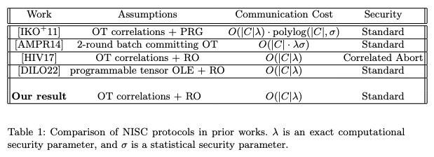
Comparison

Slide 15
Our Construction: A Step-by-Step Approach

Slide 16



Attempt to Achieve Malicious Security
Consider Alice and Bob execute m instances of a semi-honest 2PC protocol in parallel
Bob reveals his input and randomness to selected instances
x
y
x
y
Oh no!
Alice selects a random subset of instances
x
y
If Bob cheats in these instances, he gets caught

Slide 17
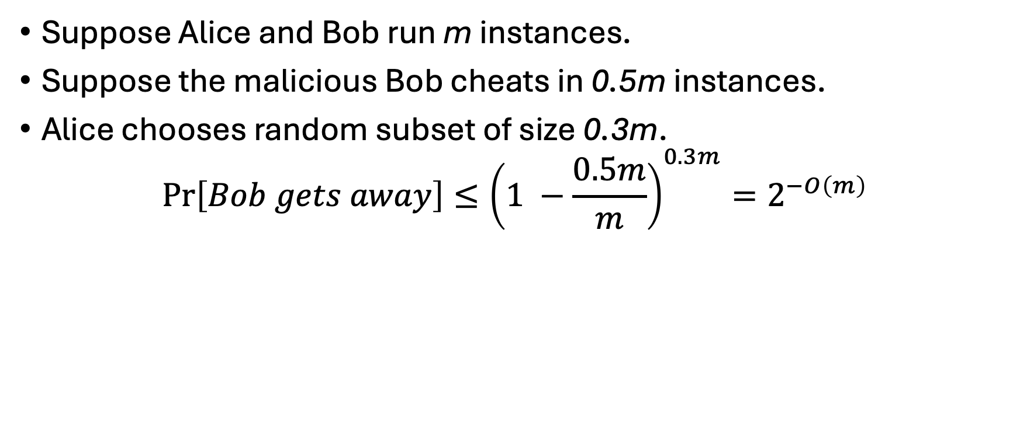
Simple Calculation
Cut & Choose!
Suppose Alice and Bob run m instances.
Suppose the malicious Bob cheats in 0.5m instances.
Alice chooses random subset of size 0.3m.
$$\operatorname{Pr}\left[Bob gets away\right]≤{\left(1 −\frac{0.5m}{m}\right)}^{0.3m}=2^{−O\left(m\right)}$$
I should only cheat in a small fraction of instances!
The majority of the instances should be correct!

Slide 18
Attempt to Achieve Malicious Security
What about communication?
m-fold
Take majority vote
How about privacy?
Alice may learn Bobs input

Slide 19
How to Fix This?
How to deal with privacy?
  Reveal a small subset of instances tells nothing about the input
  Shamir secret sharing [Shamir 79]
How to reduce communication cost?
  Make each instance do more work
  “Packing” more information into each instance
How to have privacy and low communication cost at the same time?
Packed Shamir Secret Sharing [Franklin-Yung 92]

Slide 20

Packed Shamir Secret Sharing [FY 92]
Encoding secrets in a polynomial
Over finite field $𝔽$
Packing size: l
Secrets: x = (x₁, x₂, …, x_{l}) shared to m parties
Fix m distinct points: α₁, …, α_{m}
generate shares
x_{l}
Fix l distinct points: β₁, …, β_{l}
hide secrets
x₃
<= t parties can be corrupted
x₁
x₂
Share(x) algorithm:
1. Sample a random polynomial p of degree k conditioned on p(β₁) = x₁, p(β₂) = x₂ , …, p(β_{l}) = x_{l}
2. Distribute the shares by giving p(α_{i}) to party i
α₁
α₂
β₁
α₃
α₄
β₂
β₃
α_{m}
β_{l}
If we set degree k = t + l, then any t parties cannot deduce any information about the secrets, and any t + l + 1 parties can reconstruct all the secrets (via interpolation).

Slide 21
Multiplication under Packed Secret Sharing
(p(α₁), …, p(α_{m})) is a sharing of vector x = (x₁, x₂, …, x_{l}).
(q(α₁), …, q(α_{m})) is a sharing of vector y = (y₁, y₂, …, y_{l}).
Then (p(α₁)·q(α₁), …, p(α_{m})·q(α_{m})) is a sharing of?
(x₁y₁, …, x_{l}y_{l})
y_{l}
y₃
q
Multiplying the shares gives you multiplication of secrets!
y₂
x_{l}
y₁
p
x₃
x₁
x₂
o
α₁
α₂
β₁
α₃
α₄
β₂
β₃
α_{m}
β_{l}

Slide 22
Making It Work with Packed Secret Sharing

Slide 23

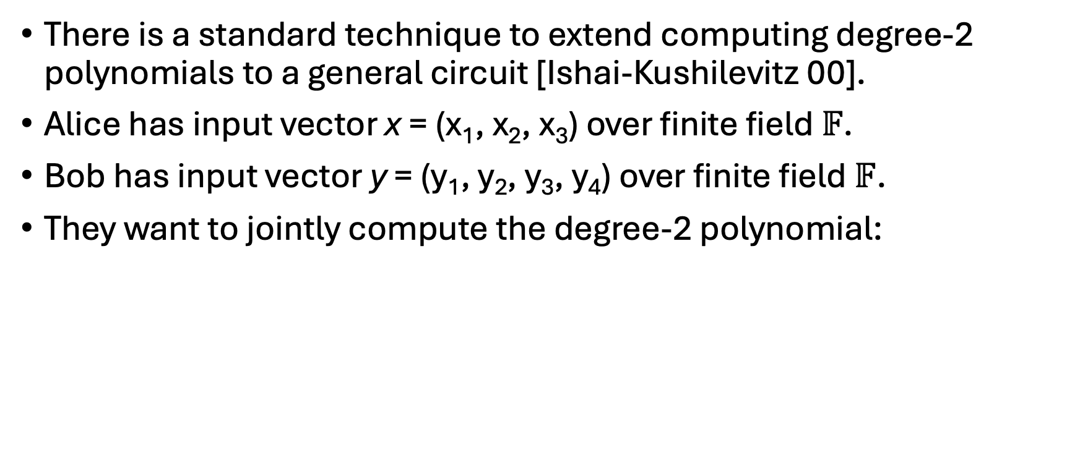
A Simplified Task: Computing Degree-2 Polynomials
There is a standard technique to extend computing degree-2 polynomials to a general circuit [Ishai-Kushilevitz 00].
Alice has input vector x = (x₁, x₂, x₃) over finite field $𝔽$.
Bob has input vector y = (y₁, y₂, y₃, y₄) over finite field $𝔽$.
They want to jointly compute the degree-2 polynomial:
$$\left|𝔽\right|=2^{λ}$$
p(x,y) = 1 + y₁ + x₁y₃ + x₂² + x₃y₂ + y₃y₄

Slide 24
Polynomial Decomposition
x = (x₁,x₂,x₃)
y = (y₁,y₂,y_{3,}y₄)
p(x,y) = 1 + y₁ + x₁y₃ + x₂² + x₃y₂ + y₃y₄
Put monomials into a vector p:
1
y₁
x₁y₃
x₂²
x₃y₂
y₃y₄
Receiver’s component p^{x}:
1
1
x₁
x₂²
x₃
1
Sender’s component p^{y}:
1
y₁
y₃
1
y₂
y₃y₄

Slide 25
2PC Protocol (Attempt)
multiply the shares
p^{x}(α₁)
p^{y}(α₁)
Receiver’s input p^{x}:
Sender’s input p^{y}:
p^{x}(α₂)
p^{y}(α₂)
1
1
x₁
x₂²
x₃
1
1
y₁
y₃
1
y₂
y₃ y₄
Packed secret share
Packed secret share
Packing size l = 6
p^{x}(α_{m})
p^{y}(α_{m})
1
1
x₁
x₂²
x₃
1
Use a degree-(t+l) polynomial to share the vector

Slide 26
2PC Protocol (Attempt)
If m >= 4t+2l+1, can tolerate t corruptions [Berlekamp-Welch 86]
p^{x}(α₁)
p^{y}(α₁)
Receiver’s input p^{x}:
Sender’s input p^{y}:
p^{x}(α₁) · p^{y}(α₁)
p^{y}(α₂)
p^{x}(α₂) · p^{y}(α₂)
If m >= 2(t+l)+1,
Alice can reconstruct
p = p^{x} · p^{y}
p^{x}(α_{m})
Is this semi-honest secure?
p^{y}(α_{m})
p^{x}(α_{m}) · p^{y}(α_{m})
No!
1
y₁
x₁y₃
x₂²
x₃y₂
y₃ y₄
Summing yields p(x,y)

Slide 27
2PC Protocol (Fix)
p^{x}(α_{i}) · p^{y}(α_{i}) + p^{z}(α_{i})
p^{x}(α₁)
p^{y}(α₁), p^{z}(α₁)
Sample a random vector p^{z}:
z₁
z₂
z₃
z₄
z₅
z₆
p^{x}(α₁) · p^{y}(α₁) + p^{z}(α₁)
where z₁ + … +z₆ = 0.
p^{y}(α₂), p^{z}(α₂)
p^{x}(α₂) · p^{y}(α₂) + p^{z}(α₂)
Also packed secret share p^{z} via a degree 2(t+l) polynomial
1
y₁
x₁y₃
x₂²
x₃y₂
y₃ y₄
p^{x}(α_{m})
p^{y}(α_{m}), p^{z}(α_{m})
masked by
The semi-honest protocol that performs p^{x}(α_{i}) · p^{y}(α_{i}) + p^{z}(α_{i})
is called an Oblivious Linear Evaluation (OLE)
z₁
z₂
z₃
z₄
z₅
z₆
p^{x}(α_{m}) · p^{y}(α_{m}) + p^{z}(α_{m})
But the sum is still p(x,y)

Slide 28
Summary of Our Protocol
Is this malicious secure?
To compute: p(x,y) = 1 + y₁ + x₁y₃ + x₂² + x₃y₂ + y₃y₄
Alice obtains p^{x} and Bob obtains p^{y} following the decomposition
Alice and Bob run m instances of a semi-honest protocol
  Alice packed secret shares p^{x}
  Bob packed secret shares p^{y} and a masking vector p^{z}
  The semi-honest protocol (OLE) computes p = p^{x} · p^{y} + p^{z} and return to Alice
Alice and Bob perform cut & choose to each other.
Alice reconstructs vector p and sum up the monomials to obtain p(x,y)
Can cheat!
Can cheat!
Prevented by cut & choose and error correction!

Slide 29
Problems to Solve
A malicious adversary may not perform the packed secret sharing honestly!
A malicious adversary may not follow the decomposition rule!
We use specialized zero-knowledge arguments to enforce the adversary’s behavior!

Slide 30
Proving Correctness of Packed Secret Sharing
How to prove the packed secret sharing is honest?
A sharing is evaluations of polynomial p(α₁), …, p(α_{m})
Suppose Bob needs to share k vectors p^{y}₁, p^{y}₂, … , p^{y}_{k}
Let’s put the shares in a matrix:
Reed-Solomon Code
RS codeword
p^{y}₁(α₁)
p^{y}₁(α₂)
p^{y}₁(α₃)
p^{y}₁(α₄)
…
p^{y}₁(α_{m})
RS codeword
p^{y}₂(α₁)
p^{y}₂(α₂)
p^{y}₂(α₃)
p^{y}₂(α₄)
…
p^{y}₂(α_{m})
Want to Prove:
The matrix has very few corrupted columns.
.
.
.
.
.
.
.
.
.
.
.
.
.
.
.
RS codeword
p^{y}_{k}(α₁)
p^{y}_{k}(α₂)
p^{y}_{k}(α₃)
p^{y}_{k}(α₄)
…
p^{y}_{k}(α_{m})
Even if one share is incorrect, the semi-honest instance will compute a wrong result

Slide 31

Ligero Proofs [AHIV 17]
r₁
p^{x}₁(α₁)
p^{x}₁(α₂)
p^{x}₁(α₃)
…
p^{x}₁(α_{m})
Random coefficients
r₂
p^{x}₂(α₁)
p^{x}₂(α₂)
p^{x}₂(α₃)
…
p^{x}₂(α_{m})
.
.
.
.
.
.
.
.
.
.
.
.
r_{k}
p^{x}_{k}(α₁)
p^{x}_{k}(α₂)
p^{x}_{k}(α₃)
…
p^{x}_{k}(α_{m})
u₁
u₂
u₃
…
u_{m}
A random linear combination of RS codewords
Prover computes u_{i} = r₁ · p^{x}₁ (α_{i}) + r₂ · p^{x}₂ (α_{i}) + … + r_{k} · p^{x}_{k} (α_{i}) for i in [m]
Prover reveals a random subset of columns
Verifier checks:
if (u₁ …, u_{m}) is a valid RS codeword
if the opened columns follows the computation
accepts
Very few corrupted columns

Slide 32
Key Lemma (Intuition)
Intuition: a random linear combination of RS codewords is a RS codeword; a random linear combination of non-RS codewords is unlikely to be a RS codeword.
Formalization: Proximity Gap Theorem
The proof in Ligero paper works under definition for the max number of corruptions in a row, but we need to prove for number of corrupted columns.
Theorem (Informal) [BCIKS 20, BCHKS 26]
  If there are more than t corrupted columns, then probability that the resulting codeword (u₁, …, u_{m}) has fewer than t corruptions is negligible.
!

Slide 33
Problems to Solve
A malicious adversary may not perform the packed secret sharing honestly!
Ligero Proofs for Reed-Solomon Proximity!
A malicious adversary may not follow the decomposition rule!
We use specialized zero-knowledge arguments to enforce the adversary’s behavior!

Slide 34
Summary of Our Protocol
To compute: p(x,y) = 1 + y₁ + x₁y₃ + x₂² + x₃y₂ + y₃y₄
Alice obtains p^{x} and Bob obtains p^{y} following the decomposition
Alice and Bob run m instances of a semi-honest protocol
  Alice packed secret shares p^{x}
  Bob packed secret shares p^{y} and a masking vector p^{z}
  The semi-honest protocol (OLE) computes p = p^{x} · p^{y} + p^{z} and return to Alice
Alice and Bob do cut & choose + Ligero proof to each other.
Alice reconstructs vector p and sum up the monomials to obtain p(x,y)
Can cheat!
Ligero Proofs for RS proximity!
Prevented by cut & choose and error correction!
Is this secure?
No!

Slide 35
Protect Decomposition
p(x,y) = 1 + y₁ + x₁y₃ + x₂² + x₃y₂ + y₃y₄
1
y₁
x₁y₃
x₂²
x₃y₂
y₃y₄
Receiver’s component p^{x}:
1
1
x₁
x₂²
x₃
1
Can use an arbitrary
vector
Sender’s component p^{y}:
1
y₁
y₃
1
y₂
y₃y₄

Slide 36
Further Decompose
Further decompose until each monomial is linear
Sender’s component p^{y}:
1
y₁
y₃
1
y₂
y₃y₄
Sender’s component p^{y}₁:
1
y₁
y₃
1
y₂
y₃
Sender’s component p^{y}₂:
1
1
1
1
1
y₄
Can write linear equations:
p^{y}₁[3] - p^{y}₁[6] = 0
p^{y}₁[1] = 1, p^{y}₁[4] = 1
p^{y}₂[1] = 1, …, p^{y}₂[5] = 1
Correctness of decomposition = linear constraints are satisfied
Ligero Proofs for linear constraints

Slide 37
Problems to Solve
A malicious adversary may not perform the packed secret sharing honestly!
Ligero Proofs for Reed-Solomon Proximity!
A malicious adversary may not follow the decomposition rule!
Ligero Proofs for Linear Constraints!
We use specialized zero-knowledge arguments to enforce the adversary’s behavior!

Slide 38

Summary of Our Protocol
Ligero Proofs for Linear Constraints!
To compute: p(x,y) = 1 + y₁ + x₁y₃ + x₂² + x₃y₂ + y₃y₄
Alice obtains p^{x} and Bob obtains p^{y} following the decomposition
Alice and Bob run m instances of a semi-honest protocol
  Alice packed secret shares p^{x}₁ , p^{x}₂
  Bob packed secret shares p^{y}₁ , p^{y}₂ and a masking vector p^{z}
  The semi-honest protocol computes p^{x} = p^{x}₁ · p^{x}₂ and p^{y} = p^{y}₁ · p^{y}₂ , then p = p^{x} · p^{y} + p^{z} and return to Alice
Alice and Bob do cut & choose + Ligero proofs to each other.
Alice reconstructs vector p and sum up the monomials to obtain p(x,y)
Ligero Proofs for RS proximity!
Cut & choose and error correction!
This is malicious-secure!

Slide 39
Let’s Check Communication Cost, Assumptions, and Round Complexity.

Slide 40
Communication Complexity
A single instance of semi-honest 2PC has communication cost O(|C|λ).
We have m instances.
If we set packing size l to be a constant fraction of m, say l = 0.1m.
The communication cost is m · O(|C|λ / l) = O(|C|λ).
The Ligero proofs: O(|C|λ).
The cut & choose: O(|C|λ).
Total communication cost O(|C|λ).
Match Yao’s protocol up to constant factors!

Slide 41
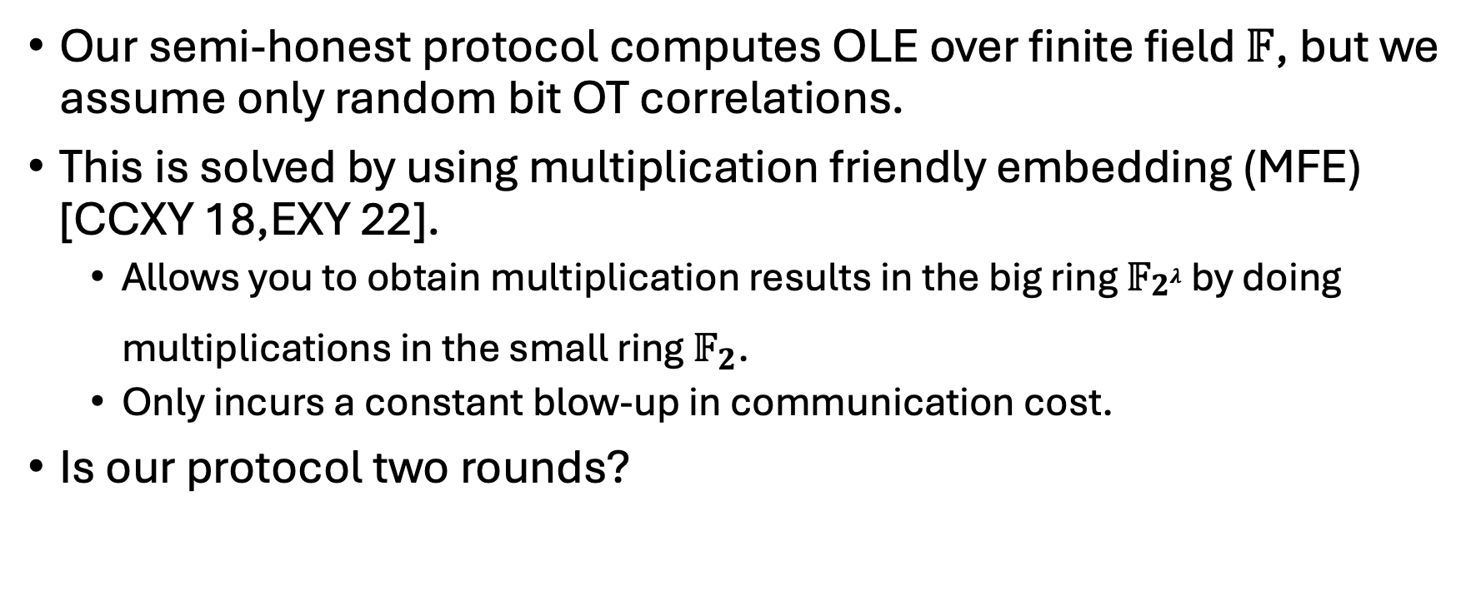
Assumptions and Round Complexity
Our semi-honest protocol computes OLE over finite field $𝔽$, but we assume only random bit OT correlations.
This is solved by using multiplication friendly embedding (MFE) [CCXY 18,EXY 22].
  Allows you to obtain multiplication results in the big ring $𝔽_{\begin{aligned}2λ \\ \end{aligned}}$ by doing multiplications in the small ring $𝔽_{2}$.
  Only incurs a constant blow-up in communication cost.
Is our protocol two rounds?
OT
Use the random oracle to apply Fiat-Shamir transformation
to select random subsets on behalf of the other party.

Slide 42
Our Result
Theorem 1
Assume random OT correlations and a random oracle. There is a (malicious-secure, two-party) NISC protocol for any Boolean circuit C with a communication cost of O(|C|λ) bits, where λ is an exact computational security parameter.

Slide 43
Future Work
Extend the 2PC protocol to multiple parties. Under the same assumptions, can we have a two-round malicious-secure MPC with low communication cost?
If the communication channel is bi-directional, can we make both parties output in two rounds?
Can we make the protocol more practical for real-world applications?

Slide 44

Questions

Slide 45
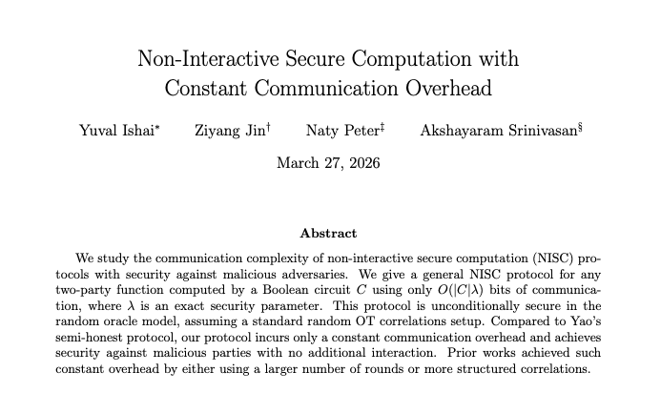
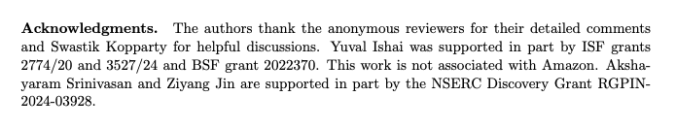
Thank you!

