Slide 1
Non-Interactive Secure Computation with Constant Communication Overhead
EUROCRYPT 2026
Yuval Ishai¹, Ziyang Jin², Naty Peter, Akshayaram Srinivasan²
¹ Technion and AWS, ² University of Toronto
May 14, 2026

Slide 2
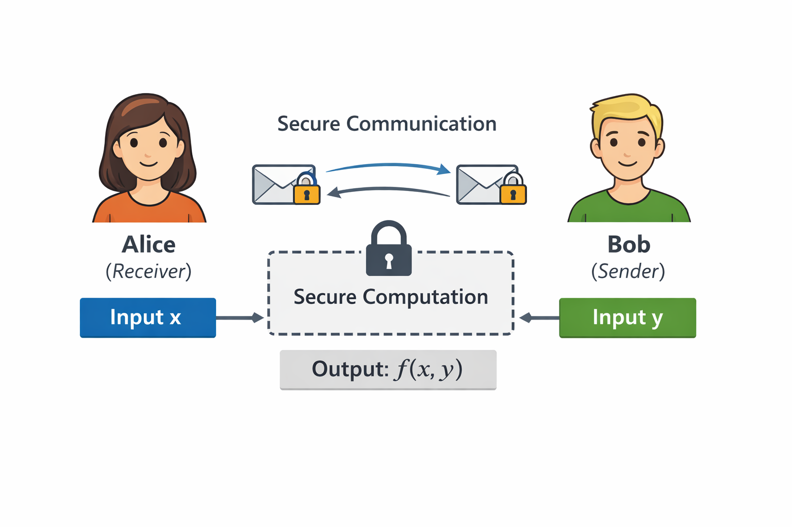

Secure Two-Party Computation
Alice learns nothing beyond x, f(x,y)
Bob learns nothing beyond y
In our case:
only Alice learns the output.

Slide 3
Semi-honest Adversary
Maybe I can extract info from Alice’s msg?
Follows the protocol but tries to learn additional information from its view

Slide 4


Malicious Adversary
Follow the protocol? Nah!
Can deviate arbitrarily from the protocol

Slide 5

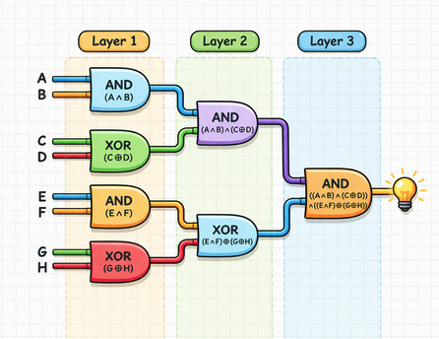

Garbled Circuits [Yao 86]
λ: computational security parameter
First-round OT msg to obtain keys for Alice’s input
OT response
Generates the garbled circuit + all the keys
Evaluates
the garbled circuit to obtain C(x,y)
keys for Bob’s input
Semi-Honest
Two rounds (NISC)
Communication: O(|C|λ)
Assume two-round OT

Slide 6
Can malicious NISC protocols match the communication complexity of the semi-honest Yao’s garbled circuits?

Slide 7
Generic Transformation [GMW 87]
Using a generic non-interactive zero-knowledge proof, we can upgrade semi-honest security to malicious security.
Can be constructed in the random oracle model.
However, it makes a non-black-box use of one-way functions (i.e. the construction works on the circuit of the one-way function).
less efficient, less modular
Can we achieve malicious security with only black-box use of cryptographic primitives?

Slide 8
Black-Box Compilers [IPS 08, IKSS 22]
Malicious security
Two rounds
Assumptions: Random Oracle and OT correlations
Communication: O(|C|) · poly(λ)
Consistency checks for Verifiable Secret Sharing incur a bottleneck in communication cost

Slide 9
Can we construct a two-round, malicious NISC protocol with constant communication overhead O(|C|λ)?
Yes, assuming a random oracle and OT correlations.

Slide 10
Our Result
Main Theorem
Assume a random oracle and random bit OT correlations. There is a malicious-secure, two-party NISC protocol for any Boolean circuit C with a communication cost of O(|C|λ) bits.
Black-box use of underlying cryptographic primitives
Compatible with FreeXOR optimization

Slide 11
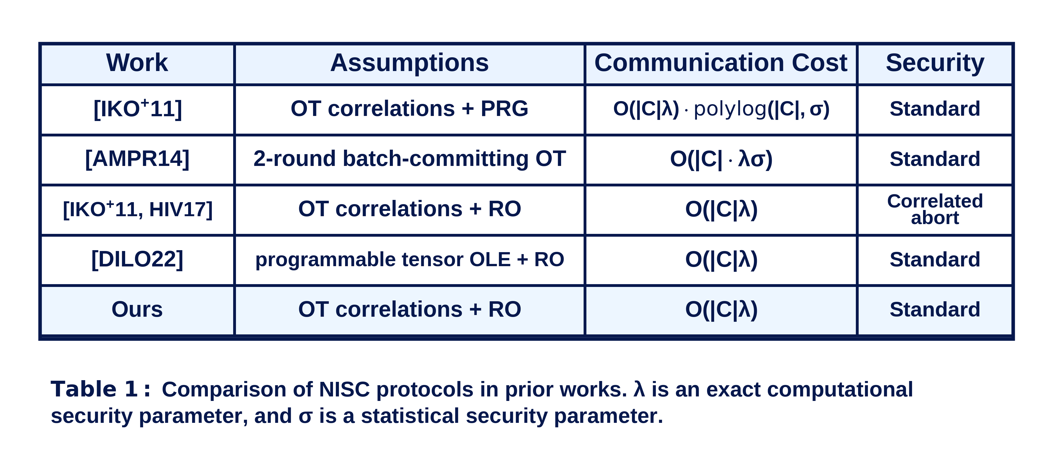
Comparison

Slide 12
Our Compiler:
A novel combination of
IPS Compiler + Packed SS + Ligero Proofs

Slide 13

Packed Shamir Secret Sharing [FY 92]
Over finite field $𝔽$
Encoding secrets in a polynomial
Packing size: l
Secrets: x = (x₁, x₂, …, x_{l}) shared to m parties
Fix m distinct points: α₁, …, α_{m}
generate shares
x_{l}
Fix l distinct points: β₁, …, β_{l}
hide secrets
x₃
≤ t parties can be corrupted
x₁
x₂
Share(x) algorithm:
1. Sample a random polynomial p of degree k conditioned on p(β₁) = x₁, p(β₂) = x₂, …, p(β_{l}) = x_{l}
2. Distribute the shares by giving p(α_{i}) to party i
α₁
α₂
β₁
α₃
α₄
β₂
β₃
α_{m}
β_{l}
[x] := (p(α₁), …, p(α_{m})) is called a sharing of x.
Multiplying two sharings gives
a sharing of (entry-wise) product of the secrets!
[x]_{(t+l)} · [y]_{(t+l)} = [xy]_{2(t+l)}

Slide 14
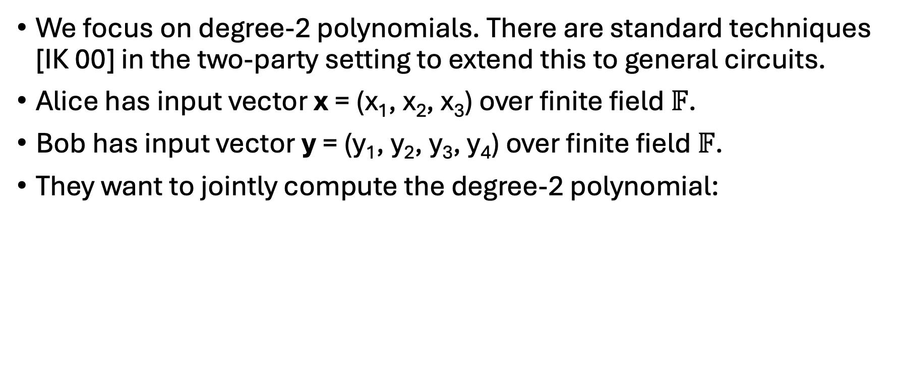
Degree-2 Polynomials
We focus on degree-2 polynomials. There are standard techniques [IK 00] in the two-party setting to extend this to general circuits.
Alice has input vector x = (x₁, x₂, x₃) over finite field $𝔽$.
Bob has input vector y = (y₁, y₂, y₃, y₄) over finite field $𝔽$.
They want to jointly compute the degree-2 polynomial:
p(x,y) = 1 + y₁ + x₁y₃ + x₂² + x₃y₂ + y₃y₄

Slide 15


Decomposition
p(x,y) = 1 + y₁ + x₁y₃ + x₂² + x₃y₂ + y₃y₄
Vector of monomials p:
1
y₁
x₁y₃
x₂²
x₃y₂
y₃y₄
x = (x₁,x₂,x₃)
Alice’s component p^{x}:
1
1
x₁
x₂²
x₃
1
Assign values
Bob’s component p^{y}:
1
y₁
y₃
1
y₂
y₃y₄
y = (y₁,y₂,y_{3,}y₄)

Slide 16

2PC Protocol
multiply the shares
p^{x}(α₁)
p^{y}(α₁)
Sender’s input p^{y}:
Receiver’s input p^{x}:
Cut & Choose!
1
y₁
y₃
1
y₂
y₃ y₄
p^{x}(α₂)
p^{y}(α₂)
1
1
x₁
x₂²
x₃
1
Packed secret share
Packed secret share
Reconstruct
p^{x}(α_{m})
p^{y}(α_{m})
1
y₁
x₁y₃
x₂²
x₃y₂
y₃ y₄
The monomials may reveal information!
m instances of semi-honest protocol

Slide 17
2PC Protocol
MFE
Oblivious Linear Evaluation (OLE)
OT
p^{x}(α_{i}) · p^{y}(α_{i}) + p^{z}(α_{i})
Sample a random vector p^{z}:
z₁
z₂
z₃
z₄
z₅
z₆
p^{x}(α₁)
where z₁ + … + z₆ = 0.
p^{y}(α₁), p^{z}(α₁)
p^{x}(α₁) · p^{y}(α₁) + p^{z}(α₁)
p^{y}(α₂), p^{z}(α₂)
1
y₁
y₃
1
y₂
y₃ y₄
1
1
x₁
x₂²
x₃
1
p^{x}(α₂) · p^{y}(α₂) + p^{z}(α₂)
Packed secret share p^{x}
Packed secret share p^{y}, p^{z}
Reconstruct
1
y₁
x₁y₃
x₂²
x₃y₂
y₃ y₄
p^{x}(α_{m})
p^{y}(α_{m}), p^{z}(α_{m})
masked by
z₁
z₂
z₃
z₄
z₅
z₆
p^{x}(α_{m}) · p^{y}(α_{m}) + p^{z}(α_{m})
But the sum is still p(x,y)

Slide 18
Follow the protocol? Nah!
However, decomposition could be incorrect and packed secret sharing can be invalid.
Specialized zero-knowledge proofs to
enforce the behavior of malicious adversaries

Slide 19
Correctness of Packed Secret Sharing
Shares are evaluations of p(α₁), …, p(α_{m})
Reed-Solomon Code
Not too many corrupted shares
Proximity of RS codewords
Suppose Bob shares k vectors p^{y}₁, p^{y}₂, … , p^{y}_{k} .
Let’s put their packed Shamir sharings row-by-row into a matrix:
RS codeword
p^{y}₁(α₁)
p^{y}₁(α₂)
p^{y}₁(α₃)
p^{y}₁(α₄)
…
p^{y}₁(α_{m})
RS codeword
p^{y}₂(α₁)
p^{y}₂(α₂)
p^{y}₂(α₃)
p^{y}₂(α₄)
…
p^{y}₂(α_{m})
Want to prove:
There is only a small fraction of corrupted columns.
.
.
.
.
.
.
.
.
.
.
.
.
.
.
.
RS codeword
p^{y}_{k}(α₁)
p^{y}_{k}(α₂)
p^{y}_{k}(α₃)
p^{y}_{k}(α₄)
…
p^{y}_{k}(α_{m})
Even if one share is incorrect, the semi-honest instance will compute a wrong result

Slide 20


Ligero Proofs [AHIV 17]
$$\left|𝔽\right|=2^{λ}$$
r₁
p^{y}₁(α₁)
p^{y}₁(α₂)
p^{y}₁(α₃)
…
p^{y}₁(α_{m})
Random coefficients
r₂
p^{y}₂(α₁)
p^{y}₂(α₂)
p^{y}₂(α₃)
…
p^{y}₂(α_{m})
Use RO for commitment and Fiat-Shamir
.
.
.
.
.
.
.
.
.
.
.
.
r_{k}
p^{y}_{k}(α₁)
p^{y}_{k}(α₂)
p^{y}_{k}(α₃)
…
p^{y}_{k}(α_{m})
compute:
u₁
u₂
u₃
…
u_{m}
Prover:
commits the matrix column-wise
computes (u₁, …, u_{m}) = r₁ · p^{x}₁ + r₂ · p^{x}₂ + … + r_{k} · p^{x}_{k}
opens a random subset of columns
A linear combination of RS codewords
Verifier checks:
whether (u₁, …, u_{m}) is a valid RS codeword
whether the opened columns follow the computation
accepts
Very few corrupted columns
Proximity Gap Theorem [BCIKS 20]

Slide 21
Specialized ZK Proofs
A malicious adversary may not perform the packed secret sharing honestly!
Ligero Proofs for Reed-Solomon Proximity!
A malicious adversary may not follow the decomposition rule!
Ligero Proofs for Linear Constraints!
The original Ligero paper proves for row-wise proximity, but our paper needs to prove for
a column-corruption guarantee for interleaved RS codewords via proximity gap theorem.

Slide 22
Communication Cost
We run m parallel semi-honest instances.
Cost per semi-honest instance O(|C|λ / l) and set l = O(m).
Ligero proofs + cut-and-choose: O(|C|λ).
Total: m · O(|C|λ / l) + O(|C|λ) = O(|C|λ).

Slide 23
Summary
IPS Compiler: runs m parallel semi-honest instances; cut-and-choose limits cheating to few instances
Packed Secret Sharing: amortizes the communication cost
Ligero Proofs: enforce valid sharing and decomposition
Two-round semi-honest protocol per instance
Two-round compiled malicious protocol

Slide 24
Future Work
Extend the 2PC protocol to multiple parties. Under the same assumptions, can we have a two-round malicious MPC with low communication cost?
If the communication channel is bi-directional, can we make both parties output in two rounds?
Can we make the protocol more practical for real-world applications?

Slide 25
Takeaway
Assuming RO and OT correlations,
malicious NISC can match the communication cost of semi-honest Yao.
Questions?

