Slide 1



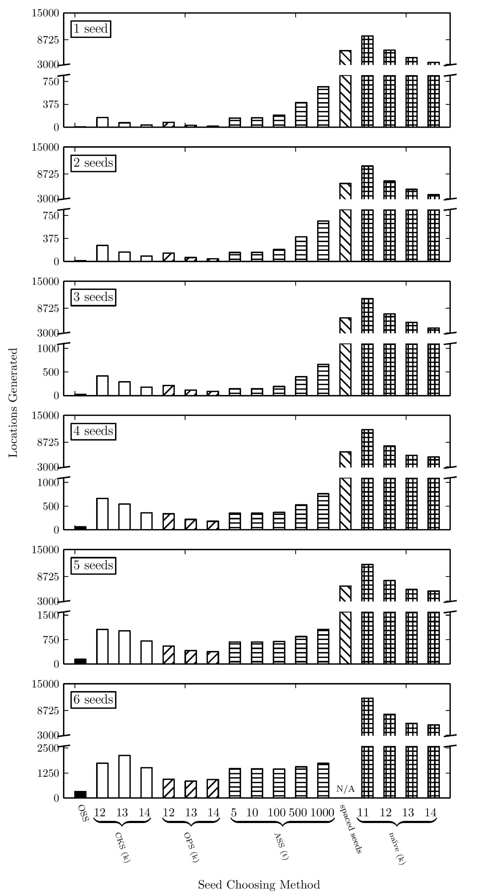

Optimal Seed Solver: Optimizing Seed Selection in Read Mapping
Hongyi Xin¹, Richard Zhu¹, Sunny Nahar, John Emmons¹, Gennady Pekhimenko¹, Carl Kingsford¹, Can Alkan², Onur Mutlu¹
¹ Departments of Computer Science and Electrical and Computer Engineering, Carnegie Mellon University, Pittsburgh, PA, USA
² Dept. of Computer Engineering, Bilkent University, Ankara, Turkey
Problem:
Optimal Seed Solver (OSS)
NGS mappers can be divided into two categories: backtrack based vs. seed-and-extend based
Backtrack based mappers (i.e. bwa, bowtie2) find the best mappings fast but lose high-error mappings
Seed-and-extend based mappers (i.e., mrfast, shrimp, RazerS3) finds all mappings but waste resources on rejecting incorrect mappings
Problem: seed-and-extend mappers select high frequency seeds
Our goal: increase the efficiency of seed-and-extend based mappers by selecting the set of least frequent e+1 seeds with linear complexity
Challenge: large search space. Seeds can start at any position with any length; generate O(L^{e+1}) possibilities
Key idea: use dynamic-programming method to find the optimal seeds of substrings of the read
Find optimal seed positions
Find optimal seed lengths
Key recurrence relationship: reuse the solutions of m seeds to calculate m+1 seeds
OSS consists of two optimizations:
Optimal divider cascading: carrying over information between substrings
Early divider termination: further reducing the search space of each substring
The core dynamic-programming algorithm of OSS (OSS-DP)
1
2
Optimal Divider Cascading (ODC)
Assumption: the frequency of any single seed of the read is already known
Baseline: enumerate all possible seed combinations, O(L^{e+1}) possibilities
OSS: reduce the complexity to O(e*L)
Induction: m seeds → m+1 seeds
Assuming the least frequent m seeds are already known for any substring of the read, R
For any substring, S, it can then be divided into two parts by a divider, P: an m-seed part and an 1-seed part
The least frequent m+1 seeds of S can be found by moving the divider, P, |S| times and select the optimal divider with the minimum total seed frequency
Insight: consecutive optimal seeds of the read must also be the optimal seeds of the substring containing them (Fig 1)
3
4
OSS-DP iterates from 1 to e+1 seeds while in each iteration calculates the optimal solution of all O(e*L²) substrings
Two key observations:
Only substrings that starts at the beginning of R is needed, reduce to O(e*L) total substrings
The first optimal divider, P, of a shorter substring must come first than a longer substring (Fig 2)
Mechanism: Longer substrings are processed first, which helps reduce the search space of shorter substrings
2
1
2-seed part
1-seed part
Fig 2: In OSS, only substrings that starts from the beginning of R is examined. Among all substrings, the first optimal divider, , of a shorter substring comes earlier than a longer substring, therefore, “cascading” the optimal dividers
Fig 1: SA and SB are two combinations that occupies the same amount of letters. The total seed frequency of SA is smaller. In this case, it is easy to prove that the total seed frequency of SA’ will also be smaller than SB’
6
Results
4
OSS is compared against 5 previous seed selection mechanisms:
Cheap K-mer Selection (CKS)
Optimal Pre-fix Selection (OPS)
Adaptive Seeds Finder (ASF)
Spaced Seeds (SS)
Naïve (Fixed length, fixed placement)
Categorization: length vs. placement
CKS: fixed length, flexible placement
OPS: fixed length, flexible placement
ASF: flexible length, fixed placement
SS: fixed length, fixed placement*
Naïve: fixed length, fixed placement
Methodology: 4 million 101-bp reads from 1000 Genome Project (ERR240726)
CKS: 12-14 bp seeds
OPS: 12-14 bp seeds
ASF: T = 5, 10, 100, 500, 1000 (if a read fails to produce enough seeds, ASF will roll back to CKS-12)
SS: pattern = 110100110010101111
Qualitative comparison: (Table 1)
Average case complexity
Number of seed lookups
Quantitative comparison: (Fig 4)
Average frequency per seed
Key results:
OSS achieves linear average case complexity
OSS provides 3x average seed frequency reduction than the second best seed selection algorithm (OPS)
Early Divider Termination (EDT)
5
mrFAST
ODC confines the right bound of the optimal divider of a substring
Goal: introduce a left bound
Key observation: longer substrings have equal or less total seed frequency
Key idea: move the divider, P, from right to left, stop when the frequency increase of the left part outweighs the total frequency of the right part (Fig 3)
Key result: with ODC and EDT, the empirical average number of comparisons to find the optimal divider of a substring is reduced to 5.25
GEM
Hobbes
PatternHunter
3
TTCCCAGCACAGACGCATAGCCTGGTC
191
212
Frequency increase
TTCCCAGCACAGACGCATAGCCTGGTC
233
177
42
TTCCCAGCACAGACGCATAGCCTGGTC
321
102
88
TTCCCAGCACAGACGCATAGCCTGGTC
332
56
11
TTCCCAGCACAGACGCATAGCCTGGTC
522
43
190
Fig 3: EDT in action. When the frequency increase of the left part outweighs the optimal 1-seed frequency of the right part, STOP.
Conclusion and future work
7
Conclusion:
OSS finds the least frequent e+1 non-overlapping seeds of a read
OSS achieves linear average case complexity, O(e*L)
OSS requires a large number of seed lookups ( O(L²) )
There is still room to improve the seed selection heuristics: the second best seed selection mechanism, OPS, provides 3x more frequent seeds
Future work:
Develop better seed selection heuristics that approximates the optimal seeds with much fewer seed lookups and simpler algorithms
Develop a fast seed lookup implementation that accommodates OSS
Acknowledgement and availability
8
This study is supported by two NIH grants (HG006004 to C. Alkan and O. Mutlu; HG007104 to C. Kingsford) and a Marie Curie Career Integration Grant (PCIG-2011-303772) to C. Alkan
The full manuscript of this work is available at:
Safari tech report: http://www.ece.cmu.edu/~safari/tr.html
arXiv.org: http://arxiv.org/abs/1506.08235
The code is publically available at:
https://github.com/CMU-SAFARI/optimal-seed-solver
Table 1: Provides the qualitative comparison between OSS, ASF, CKS, OPS, SS and naïve. Note that OSS achieves linear average case complexity. In this table, x is the number of seeds while L is the length of read
F
*Spaced seeds use special patterns to balance out frequencies among seeds

