Slide 1

PocketTrend: Timely Identification and Delivery of Trending Search Content to Mobile Users
Gennady Pekhimenko,
Dimitrios Lymberopoulos,
Oriana Riva, Karin Strauss,
Doug Burger

Slide 2



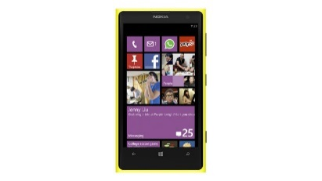









Pocket Cloudlets [ASPLOS’11]

Slide 3
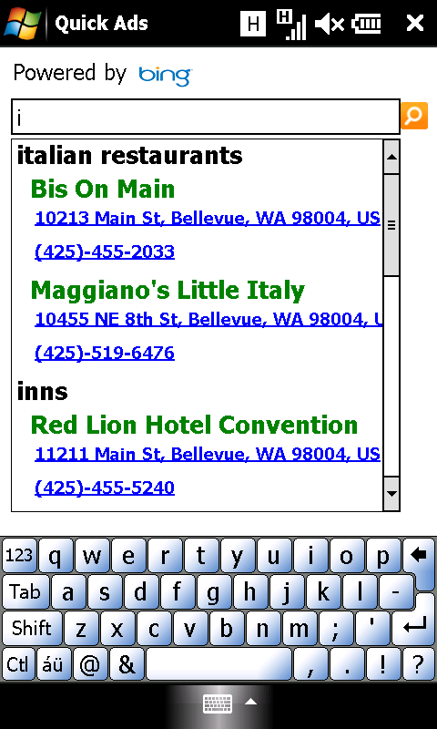
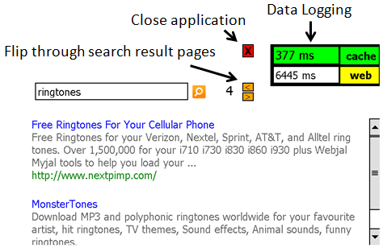
PocketSearch
Local Search
Web Search
Stability of the search results
Small subset of queries covers most of the searches,
e.g., 55% hit rate with 2500 search queries (1MB in space)
Repetitive queries from the same user

Slide 4
PocketSearch Limitations
USA Presidential Elections

Slide 5
Motivation for PocketTrend
User perspective
Improve real-time user experience by delivering “trending” queries/content ahead of time
Longer battery life by decreasing the number of radio activations
Data center perspective
Avoid worst-case scenarios with higher than normal peaks
Potential energy savings by servicing fewer queries

Slide 6
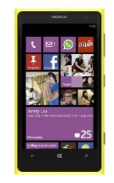




Data Analysis
Data-driven analysis:
Search queries from Bing users
1 million unique users in US
2 months of the data analyzed
Information available:
User ID (encrypted and hashed)
Search query
Full URLs visited (“clicks”)
Timestamp
Geographical location

Slide 7
What to Push?
Very few URLs cover most of the clicks

Slide 8
When to Push? Pole Election in Rome
Small window for update - push immediately

Slide 9
When to Push? US Presidential Elections
Larger window for update –
less aggressive pushes

Slide 10
Whom to Push? Pairs of Events
Same users are interested in multiple trends

Slide 11
Whom to Push? (2)
Higher user volume means higher chances for an interest in a trending event

Slide 12
PocketTrend: Analysis Summary
Several hours window to start pushing the content
Target push receivers based on user search volume
Small subset of queries/URLs covers most of the accesses

Slide 13
Outline
Motivation & Background
PocketTrend: Data Analysis
PocketTrend: Implementation
Evaluation
Conclusion
Future Work

Slide 14
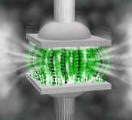
PocketTrend: Key Idea
What to push?
Query Cache Formation
When to push?
Trend Detection
boston+bomb
boston+marathon
…
boston+explosion
Whom to push?
Data Compression
How to push?
Delta Encoding

Slide 15
Trend Detection
Step #1 out of 5
Trend Identification
Trending Event Detection:
Finding Trending Keywords
Keyword:
Boston
Facebook
explosion
cnn
….
Curr. hour:
150
4000
100
1100
….
Ref. hour:
80
3900
1
800
….
explosion
boston
cnn
trending words

Slide 16
Trend Detection
Step #2 out of 5
Trend Identification
Trending Event Detection:
Forming and Merging Trends
explosion + marathon
explosion
boston
cnn
cnn + fox + news
trending words
trends merge

Slide 17
Trend Detection
Step #3 out of 5
Trend Identification
Trending Content Identification:
Forward Pass
Query URLs Clicked
boston url1, url2,… url1…
bomb+boston url1, url2,… url2…
… … …
Trending queries and URLs
Search
logs
explosion
boston
cnn
Forward Pass
trending words

Slide 18
Trend Detection
Step #4 out of 5
Trend Identification
Trending Content Identification:
Backward Pass
Trending queries and URLs
Trending queries and URLs
Query Clicked
“bomb in boston” url1, … “explosion at marathon” url1, …
… …
Backward Pass

Slide 19
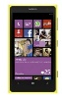


Trend Detection
Step #5 out of 5
Trend Identification
Trending Content Identification:
Identify & Compress Cache Content
Trending queries and URLs
Trending Search Content

Slide 20
Trend Detection Example
12:19pm
14:00pm
12:09pm
11:49am
12:11pm
13:00pm
“marathon”
Cache V.1 formed
Cache V.2 formed
Time (PDT)
“explosion”
“boston”
Initial trend detected
Trending words:
marathon, boston, explosion, news, fox, bomb, cnn
Boston Marathon Bombing

Slide 21
Typical Trends
Trend Name | Duration | Trending Words # | Trending Word List
USA Presidential Elections | 60+ hours | 5-53 | vote, election, polls, results, presidential …
Boston Marathon Bombing | 120+ hours | 7-18 | boston, marathon, bomb, explosion …
Pope Election | 10+ hours | 2-8 | pope, elected, francis, new, cardinal, jorge …
Lil Wayne Hospitalization | 30+ hours | 3-4 | lil, wayne, hospitalization
Father’s Day | 10+ hours | 3-4 | fathers, happy, father’s, day
Gandolfini Death | 20+ hours | 3 | Gandolfini, james, death
4th July | 20+ hours | 3 | 4th , july, fireworks
San Francisco Plane Crash | 10+ hours | 3 | Crash, plane, francisco

Slide 22
Trend Development over Time
+ mit, watertown
+ jfk, explosions, library
+ fbi, suspect
+ bombing, Boston
Boston Marathon Bombing

Slide 23
Different Update Strategies
Passive updates: update a user that comes with any query with the whole cache
Pros: simple to implement and energy efficient (no additional radio activations)
Cons: potential increase in bandwidth and may be to slow to update some users in time
Active updates: send a cache to specific users, e.g., based on the overall user search volume
Pros: have the highest hit rate
Cons: energy inefficient (additional radio activations)

Slide 24
Methodology
In-house infrastructure to replay the sequence of search queries
Mobile volume up to 100k queries per hour
Cache version is updated every hour
It is possible to do it more frequently in practice and this should lead to a better cache hit ratio

Slide 25
Results: Presidential Elections
Passive updates strategy is effective

Slide 26
Results: Boston Marathon

Slide 27
Effectiveness Analysis
Passive updates quality is usually better than active

Slide 28
Cache Effectiveness
How many users benefit from the trending cache?
Depends on how long the event lasts
For Boston Marathon Bombing it was ~19.5% users
For Presidential Elections - ~10.7% users
Passive update strategy (UpdatesOnly) is better in terms of relative %
Active update strategy (5K) is better in the absolute numbers

Slide 29
Cache Size Sensitivity

Slide 30
Conclusions
PocketTrend – a new system to effectively cache the dynamically evolving trends
both the search queries and dynamic web-content
provides benefits to both the mobile users and data centers
Most of the benefits are possible with minimal overhead
small storage for caches
minimal energy and bandwidth overheads

Slide 31
PocketTrend: Timely Identification and Delivery of Trending Search Content to Mobile Users
Gennady Pekhimenko,
Karin Strauss,
Dimitrios Lymberopoulos,
Oriana Riva, Doug Burger

Slide 32
PocketTrend: Key Idea
Trending Words
Trend Detection
boston+bomb
boston+marathon
Word Grouping
…
boston+explosion
“Strong”
Matching
Backward Pass

Slide 33
PocketTrend: Architecture
When to push?
Trend Detection
boston+bomb
Query Cache Formation
Whom to push?
boston+marathon
…
boston+explosion
What to push?
How about content?
Data Compression
Delta Encoding

Slide 34
Trend Detection
Step #1. Detecting the key words that exceed the usual number of appearances in searches
Relative frequency over the same hour in the reference day ( ≥ 5x)
Absolute counters (≥ 100 queries) to be statistically significant
Step #2. Group together the words that are frequently searched together
≥ 20% of the searches that include one word, also have a second word in the same search query
For example, “marathon” and “explosion” – 93%
Step #3. If there are multiple trends that have a word in the intersection -> merge them
For example, “news”, “cnn”, “fox” is first detected as a separate trend, but later joined with the rest of the boston marathon bombing

Slide 35
Trend Detection - 2
Step #4. Evaluate the overall importance of the resulting set of words (based on the number of “strongly” matching queries -> forward pass)
Should be ≥ 1000 of matching queries per hour
Should be ≥ 0.5% of matching queries over all queries per hour
Step #5. For all “strongly” matching queries find all resulting clicks, and then perform backward pass to find all queries that lead to these clicks
Step #6. Form a corresponding cache for the trend

Slide 36
Outline
Motivation & Background
PocketTrend: Data Analysis
PocketTrend: Implementation
Evaluation
Conclusion
Future Work

Slide 37
Trend Development over Time - 2
USA Presidential Elections

Slide 38
Cache Size Sensitivity

Slide 39
How about Web Content?
USA Presidential Elections
Users tend to use the trending cache within first 10 hours, hence PocketSearch is not going to be effective for Web content.

Slide 40
Comparison with PocketSearch
PocketTrend can help in the cases when we have active trend.
With and without PocketSearch.

Slide 41
Comparison with PocketSearch (2)
Boston Marathon Bombing

Slide 42
Overhead Analysis
Passive updates strategy is more efficient

Slide 43
PocketTrend
When to push?
Whom to push?
What to push?
How about content?
Trending Words
Trend Detection
boston+bomb
Query Cache Formation
boston+marathon
Word Grouping
…
boston+explosion
“Strong”
Matching
Backward Pass
Data Compression
Delta Encoding

Slide 44
Boston Marathon Bombing Example
Event happened (11:49am PDT)
The words: boston, marathon, bombing are detected to be “trending” within 20 minutes
In parallel, several other key words became more trending than usual, e.g., cnn, fox, new
At the end of the hour (~1pm): the trend was detected with the words:
marathon, boston, explosion, news, fox, bomb, cnn

Slide 45
Prior Work on Trend Detection
Mostly data center driven
System aspects are not covered
PocketSearch
Notes:
Let me now present the motivation behind cache compression idea. The key reason why cache compression works is the significant redundancy in both on-chip and in-memory data. Here I show 4 consecutive 4-bytes words from the memory footprint of one of the real applications. These 4 words can easily be a part of some cache line as well.

Slide 46
Comparison to Prior Work
End-to-end system/evaluation

Slide 47
PocketTrend: Key Ideas
Detect the current trend based on the “unusual” word frequencies, e.g., boston+marathon+bombing
Collect the top search queries and web sites clicks that belong to the trend and cache them
Deliver the cache to the mobile phone users (either actively or lazily, + compression and diffing or delta encoding)
Perform periodic updates with the new cache version (if needed)

Slide 48
Effect of Compression
Search queries – up to 5x with XPRESS9 level 12
Web-links – up to 4.5x with XPRESS9 level 12

Slide 49
Future Work
Explore web-content opportunities
Delta-encoding and diffing of the web-pages
Compression opportunities for similar web-pages
Comparison with desktop traffic
Searching for more trending events over longer periods of time

