Slide 1
Variational Autoencoders
Presentation by Yuri Burda
CS2523, University of Toronto

Slide 2
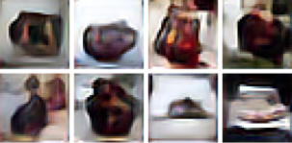
Tasks with uncertainty in outputs
Image generation
The decadent chocolate dessert is on the table.
A red school bus parked in the parking lot
A stop sign is flying in blue skies.
Mansimov, Parisotto, Ba, Salakhutdinov (2015)
Speech generation, summary generation, frame prediction in videos, video generation etc.

Slide 3
Tasks with uncertainty in outputs
Generate random digits
taken from Kingma, Rezende, Mohamed, Welling (2014)

Slide 4
Directed Graphical Models
Latent variables modeling hidden causes
The mean and covariance depend on the latent variables through a neural network
A Gaussian for every configuration of latent variables; a kind of infinite mixture of Gaussians
Input data

Slide 5
Learning
Want to maximize , or, equivalently,
inference

Slide 6
Approximate inference
Performing inference for every x from scratch is slow
Idea: use approximate inference network that generalizes from one example to another
Try with Q that is easy to sample from, for instance
with mean and covariance depending on x through neural networks

Slide 7
Variational Lower Bound
Trades off data log-likelihood and KL divergence from the approximate posterior Q(h|x) to the posterior P(h|x)
tractable
Easier to optimize than

Slide 8
Reparametrization Trick
How to estimate ?
Assume
A way to sample from :
with
Then

Slide 9
Variational Autoencoder
Optimize
with gradient of estimated as
Kingma, Welling (2014)
Rezende, Mohamed, Daan (2014)

Slide 10
Noteable results
Maaløe, C. Sønderby, S. Sønderby, Winther (2015) – 0.96% error on MNIST with 100 labeled examples
Classification performance
Semi-supervised model
0.96% error rate
10 examples/class
Feedforward model
≈ 0.94% error rate
6000 examples/class

Slide 11
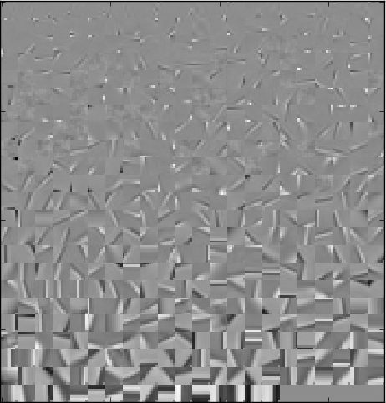
Noteable results
Learns reasonable filters on image patches, digits, etc

Slide 12
Noteable results
Interpretable latent space: Kingma, Rezende, Mohamed, Welling (2014)
Kulkarni, Whitney, Kohli, Tenenbaum (2015)

Slide 13
Variational Autoencoders
Thank You!
Presentation by Yuri Burda
CS2523, University of Toronto

