Slide 1
Depth and Surface Normal Estimation from a Single Image
Mian Wei
^{University of Toronto}
Notes:
Hi Good morning, today I will talking about depth and surface normal estimation from a single image. And before I go into the details of the papers, I want to talk about

Slide 2
Indirect-Invariant What is the problem?
Notes:
What the problem is.

Slide 3
Indirect-Invariant Given one image
Notes:
So suppose you’re given a single image

Slide 4
Notes:
Such as this bed.

Slide 5
Indirect-Invariant Estimate the following:
Notes:
You would like to be able to estimate the following

Slide 6
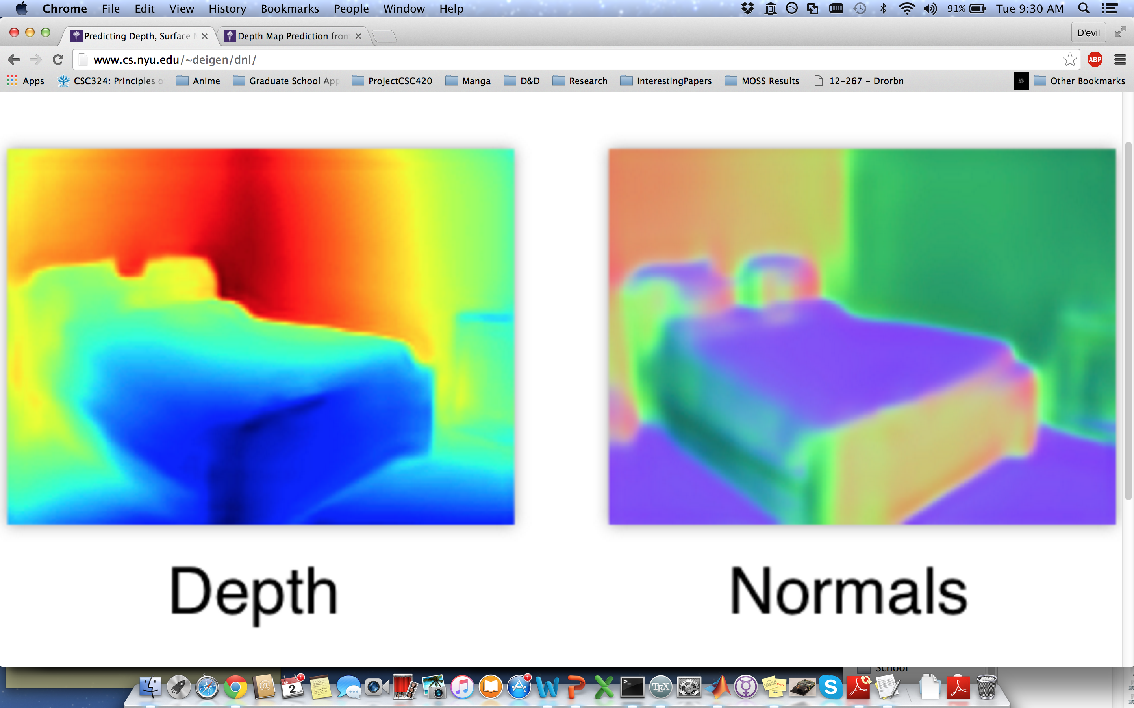
Notes:
The depth of the object

Slide 7
Notes:
As well as the surface normals of the object.

Slide 8
Indirect-Invariant Why is this hard?
Notes:
And really, we want to first understand why this problem is hard. Because in research, we aren’t really interested in problems that look trivial to solve, at the very least, those problems aren’t interesting. We want to look at a problem and see how much information we can toss out the window and still be able to solve the problem.

Slide 9
Indirect-Invariant Multiple ambiguities
Notes:
So in images, there’s multiple ambiguities that can arise which cannot be resolved without having more information about scene.

Slide 10
Indirect-Invariant Scale ambiguity
Notes:
One obvious ambiguity is the scale ambiguity.

Slide 11
Notes:
If I capture an image of an object from a certain distance,

Slide 12
Notes:
I can move that object closer and shrink it so that it maps to the same image plane as the original object and I would still yield the same image.

Slide 13
Indirect-Invariant Bas-relief ambiguity
Notes:
However, there is another less well-known ambiguity called the bas-relief ambiguity. Instead of telling you what the bas-relief ambiguity is,

Slide 14
Indirect-Invariant Let’s play a game
Notes:
I figure a game would better illustrate my point.

Slide 15
Indirect-Invariant Spot the Difference
Notes:
So in this case, we’ll play spot the difference which is a game I’m sure most of you are familiar with.

Slide 16
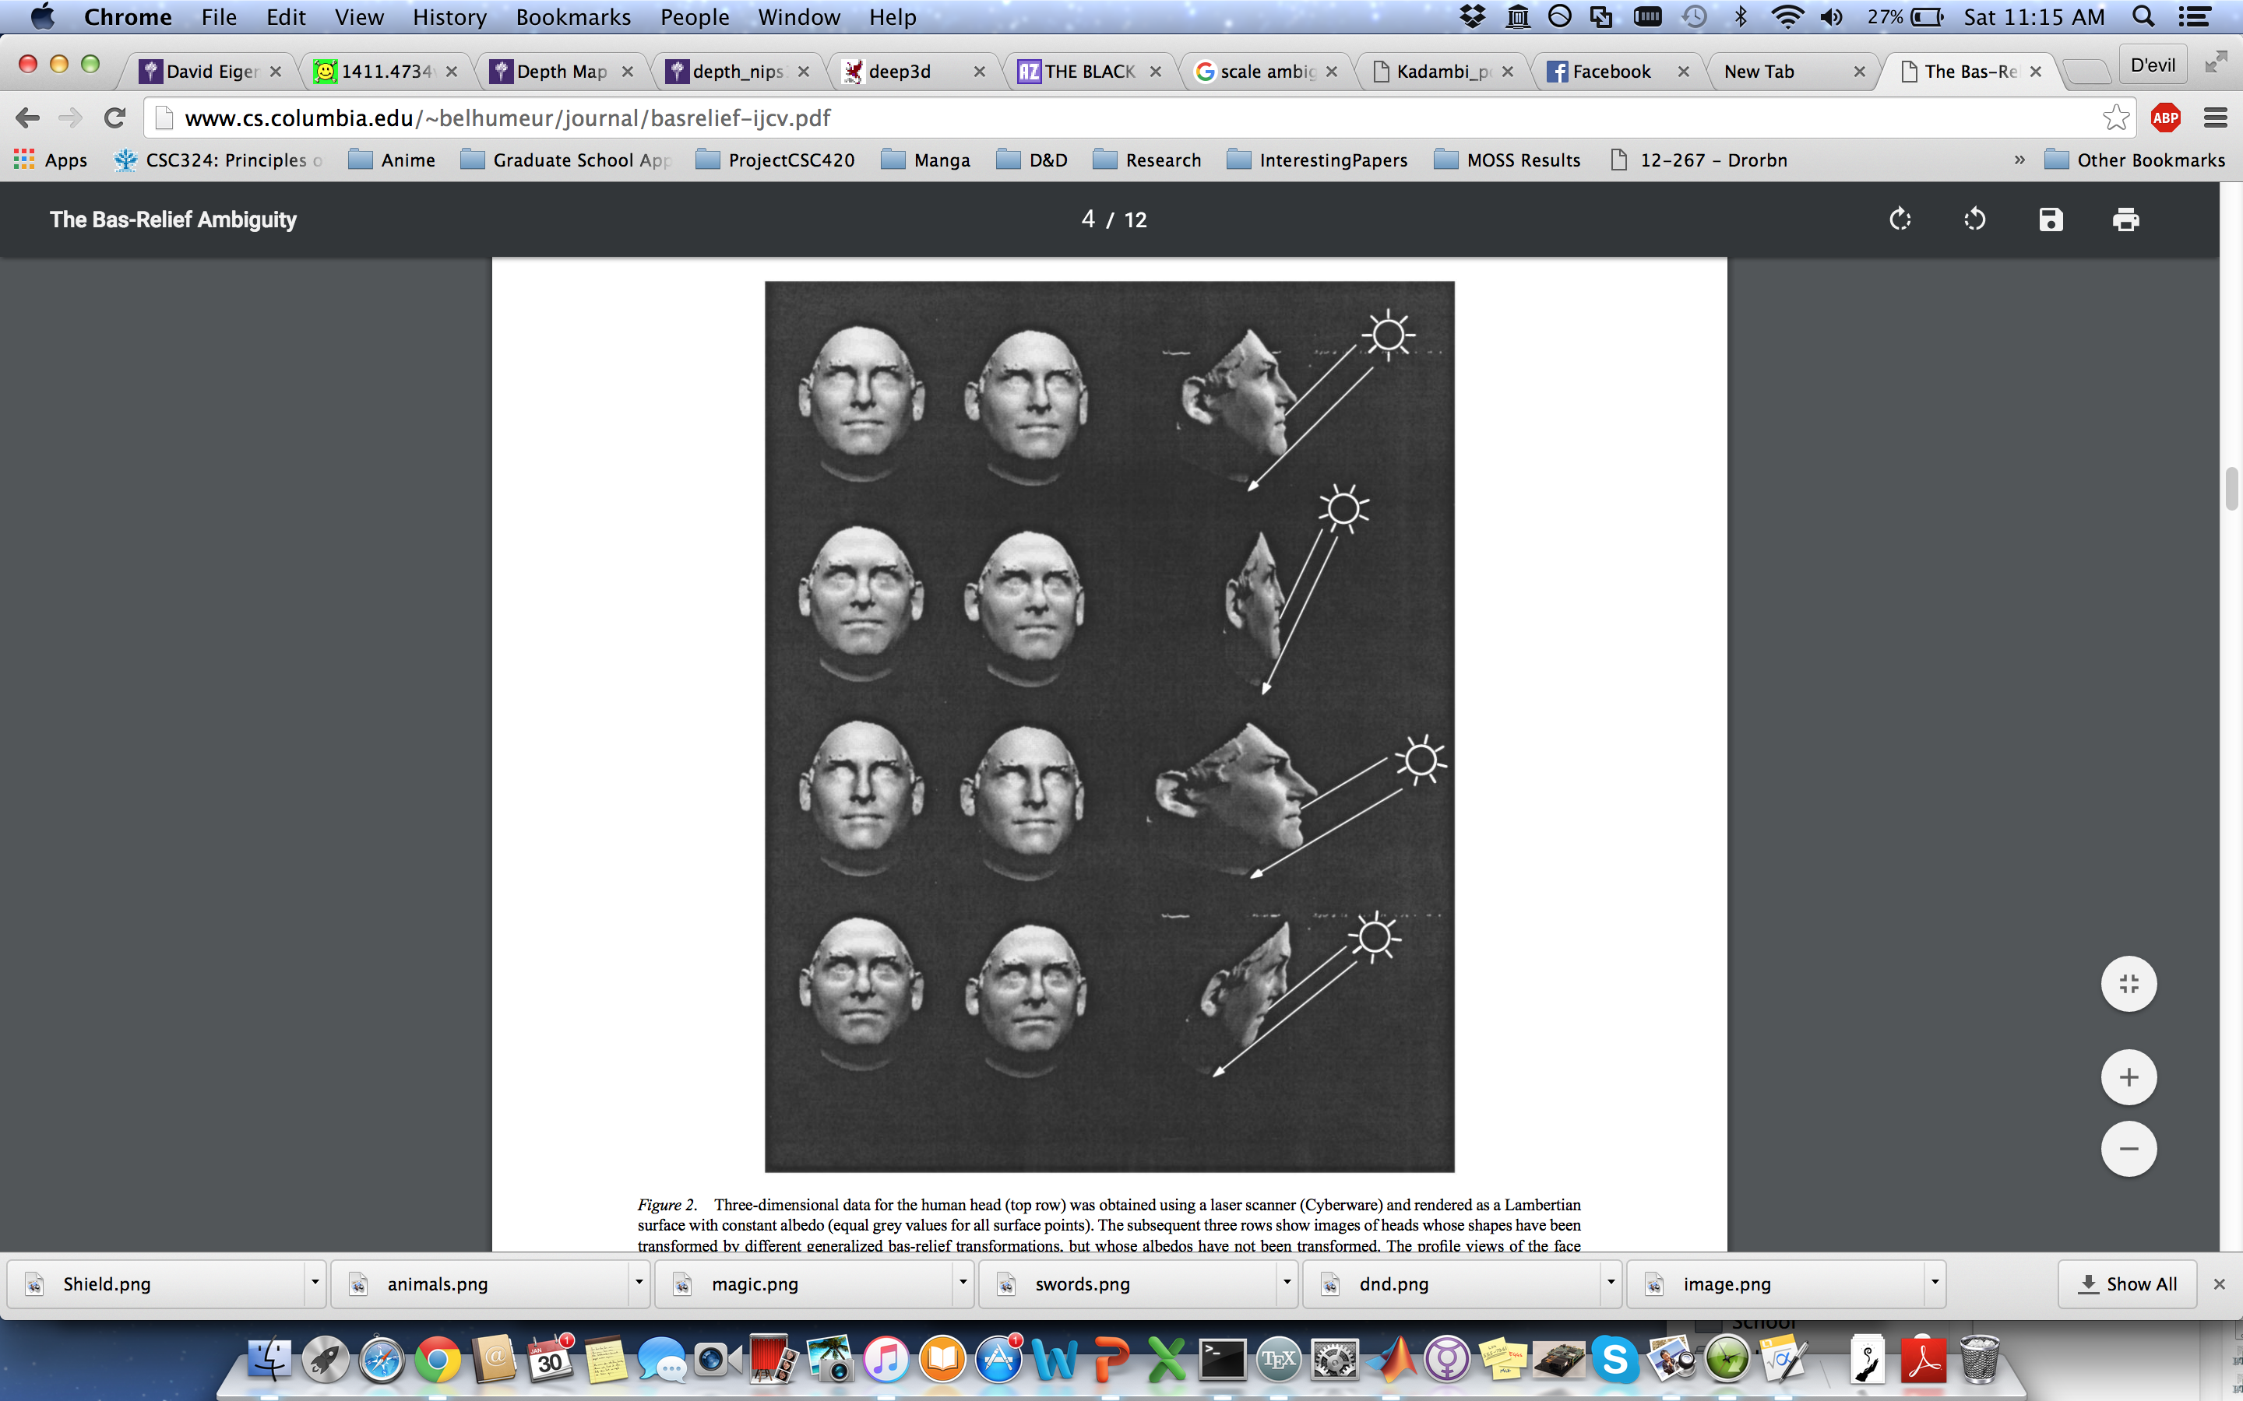
Notes:
So here are 4 images of a head.

Slide 17
Notes:
The top left image is the original image. And there may or may not have been modifications done to the shape of the other heads. So some of the heads may be shallower or deeper in depth than the original image. Show of hands how many think some of them are deeper? Some of them are shallower?

Slide 18
Indirect-Invariant All the same
Notes:
Actually they’re all the same images, but I just wanted to test you guys to see if people could perceive depth accurately. Presumably, if you can’t tell the difference, then a neural network also shouldn’t be able to.

Slide 19
Notes:
How about now? So the original image is again in the top left corner. I’ll give you guys a few seconds to look over the heads. How many people think the top right head is shallower? How many people think the bottom left head is shallower? How many people think the bottom right head is shallower? How many people can’t tell?

Slide 20
Notes:
So here is the ground truth. So the heads in the bottom rows are flattened. And this is really to illustrate my point that if you don’t know anything else about the scene, it’s really hard to determine depth. So the reason the heads do have slight variations is really the results of human error, I think. Mathematically this should be sound. What I mean by this is that

Slide 21
Indirect-Invariant Family of transformation
Notes:
There exists a family of transformations

Slide 22
Indirect-Invariant Generalized Bas-Relief
Notes:
Dubbed “The generalized bas-relief” transformations

Slide 23
Indirect-Invariant Change shape and illumination
Notes:
Which change the shape of an object as well as illumination of the scene in such a way

Slide 24
Indirect-Invariant Yield same image
Notes:
That from the perspective of the camera, nothing looks changed. Because of these ambiguities, depth and surface normal estimation from a single image becomes very difficult.

Slide 25
Indirect-Invariant Existing works
Notes:
So now I will talk about some existing works.

Slide 26
Indirect-Invariant Multi-view Stereo
Notes:
In multi-view stereo,

Slide 27
Notes:
We take an image from one view

Slide 28
Notes:
Then we take a second image from a different view and using corresponding points between the images, we can triangulate the depth of the points.

Slide 29
Indirect-Invariant Photometric Stereo
Notes:
Photometric stereo is a technique that does not require any correspondence matching.

Slide 30
Indirect-Invariant Collimated Light Sources
Notes:
You use collimated light sources

Slide 31
Indirect-Invariant Light rays parallel
Notes:
This just means that light rays coming from the light source are parallel and have minimal spreading

Slide 32
Notes:
Essentially you take images under different illumination conditions. COLLIMATED SO LIGHT RAYS ARE PARALLEL

Slide 33
Notes:
In this case the position of the light sources

Slide 34
Notes:
You use at least 3 light sources to take 3 images and use lighting cues in order to estimate the surface normals

Slide 35
Indirect-Invariant Shape from Focus
Notes:
There is another technique called shape from focus.

Slide 36
Notes:
You start off knowing the focus plane, so the depth at which the camera is focused

Slide 37
Notes:
Now we’ll look into the optics of the camera so I show the lens of the camera as well as the image plane

Slide 38
Notes:
The lens of the camera

Slide 39
Notes:
As well as the image plane of the camera so this is the plane on which the camera sensors lie.

Slide 40
Notes:
You start off knowing the focus plane, so the depth at which the camera is focused. And here we’ll consider a point in 3D space.

Slide 41
Notes:
That is currently in focus, which is shown by the light rays converging at the image plane.

Slide 42
Notes:
And on the right I’ll show the region in the image plane where in the light rays project to. Here you can see the area of effect that depth has on the radius of blur

Slide 43
Notes:
Supposing that we discretize the image plane, since we have finitely many sensors on the camera, we see here that all the rays project to a disk contained in a single pixel. So this point like I said before is in focus.

Slide 44
Notes:
So notice how the light coming from my “point” is being received by more and more camera sensors.

Slide 45
Notes:
As I start moving the object closer to the camera. This is because the light rays have to follow the thin lens law, so the image plane at which the object is focused becomes farther away from the lens as the object moves closer.

Slide 46
Notes:
This would also hold true as you move the object back. And so the size of this blur, is related to the displacement from the focus plane.

Slide 47
Notes:
And if we look at the camera sensors now, we’ll see that the light coming from the point in 3D space is received by 9 pixels rather than 1 pixel. So depth effectively affects the amount of blur occurring in the image.

Slide 48
Indirect-Invariant Light Fall-off Stereo
Notes:
Another less-known technique is called Light Fall-off stereo.

Slide 49
Notes:
Essentially you start off with a set up as follows: A conventional camera, and a directional light source so the light illuminates the scene from one direction instead of a cone of directions. SO COLLIMATED

Slide 50
Notes:
Then you move the light source back in the direction of your light source. Essentially the relationship between pixel intensity and distance from the light source is quadratic so if the light source moves away from every point equally, you can use the change in pixel intensity to extrapolate the depth of the pixel.

Slide 51
Indirect-Invariant Specialized Hardware
Notes:
The previous methods I showed can be done using conventional cameras and light sources. You can also do get depth information using specialized hardware.

Slide 52
Indirect-Invariant Laser Scanner
Notes:
You can use a laser scanner to obtain the 3D model of an object.

Slide 53
Indirect-Invariant Active Illumination
Notes:
You can also replace a camera in stereo with a projector and do something called active illumination where you control the lighting in a scene to do stereo.

Slide 54
Indirect-Invariant Time of Flight
Notes:
The last technique that I’ll mention is time of flight which times the light travelling from the light source to the camera to get depth.

Slide 55
Indirect-Invariant Estimating Depth
Notes:
So now I’ll start with the papers. The first paper talks about estimating depth using a multi-scale deep network.

Slide 56
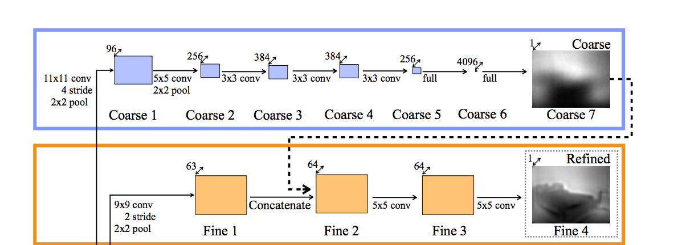
Notes:
So here is the architecture of the network. Notice that the top network is input the bottom network.

Slide 57
Indirect-Invariant Train 2 networks
Notes:
So the idea here is to train two different network.

Slide 58
Indirect-Invariant Global coarse-scale network
Notes:
The first network will be a global coarse-scale network.

Slide 59
Indirect-Invariant Local fine-scale network
Notes:
The second network will be a more local fine-scale network.

Slide 60
Indirect-Invariant Global coarse-scale network
Notes:
So the global coarse-scale network will

Slide 61
Indirect-Invariant Learns a coarse depth map
Notes:
Learn a coarse depth map of the scene.

Slide 62
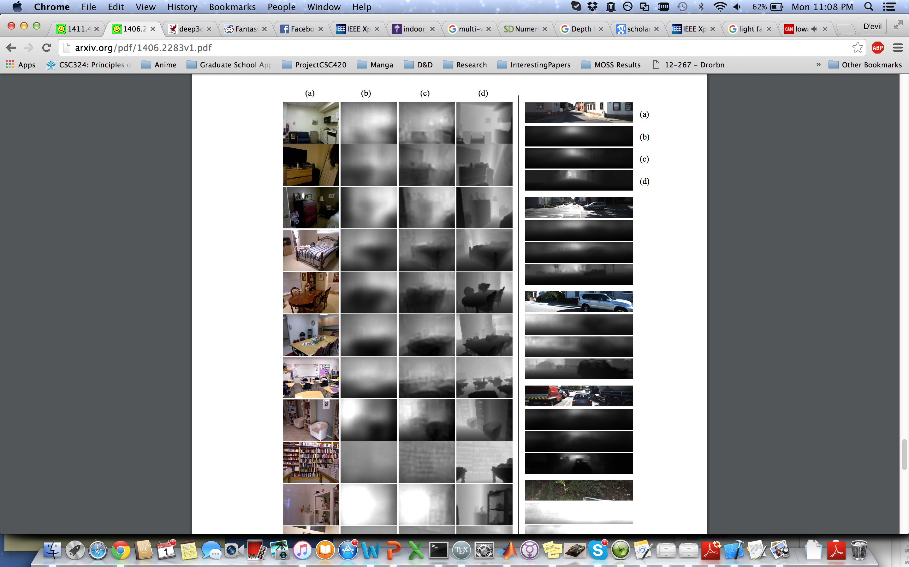
Notes:
For example, here is an image of a kitchen?

Slide 63
Notes:
And this is the coarse depth map estimated by the network.

Slide 64
Notes:
As you can see, the areas within the vicinity of the fridge, sink and chair are closer to the camera than the wall which we expect.

Slide 65
Indirect-Invariant Used as input to local network
Notes:
The output of the coarse network is also used as input to the local network.

Slide 66
Indirect-Invariant Intuition:
Notes:
The intuition here is that since the global

Slide 67
Indirect-Invariant Coarse info learnt already
Notes:
Coarse information has already been learnt by the coarse the network, the local scale network

Slide 68
Indirect-Invariant Focus on learning finer info
Notes:
Can focus on learning the finer depth information of the scene

Slide 69
Notes:
So here is the finer depth map of the scene I showed before.

Slide 70
Notes:
In comparison to the coarse depth map, we can clearly make out the chair and countertop better.

Slide 71
Indirect-Invariant Scale ambiguity
Notes:
In this paper, they do address the scale ambiguity

Slide 72
Indirect-Invariant Scale invariant error function
Notes:
By introducing a scale-invariant error function.

Slide 73
Notes:
Essentially it looks like this, and in some ways this is really just the log of relative depth. Since we deal with relative depth here, scale does not matter. Here y* is the ground truth depth and y is the estimated depth.

Slide 74
Notes:
So if we do more math, we end up showing here that scaling the depths do not affect the error scores.

Slide 75
Indirect-Invariant Loss Function
Notes:
The Loss function they use to train the network

Slide 76
Indirect-Invariant Scale invariant
Notes:
Is also scale invariant and draws inspiration from the error function.

Slide 77
Notes:
Essentially if you expanded the square in the error function, you get something similar to this loss function.

Slide 78
Indirect-Invariant 2 Datasets
Notes:
In order to evaluate their method, they use 2 datasets.

Slide 79
Indirect-Invariant NYUDepthV2
Notes:
The first data set is NYUDepthV2.

Slide 80
Indirect-Invariant Indoor Rooms
Notes:
This data set consists of 1400 images and is typically biased towards indoor rooms.

Slide 81
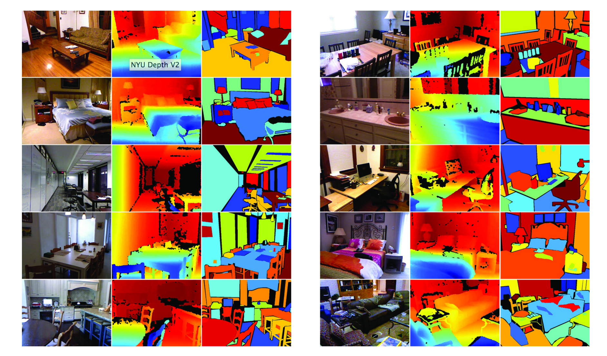
Notes:
The data set provides ground truth depth as well as semantic labels of the images.

Slide 82
Indirect-Invariant KITTI
Notes:
Kitti is the second data set they use and it consists of

Slide 83
Indirect-Invariant Outdoor images taken on a car
Notes:
Outdoor images and videos taken atop a car.

Slide 84
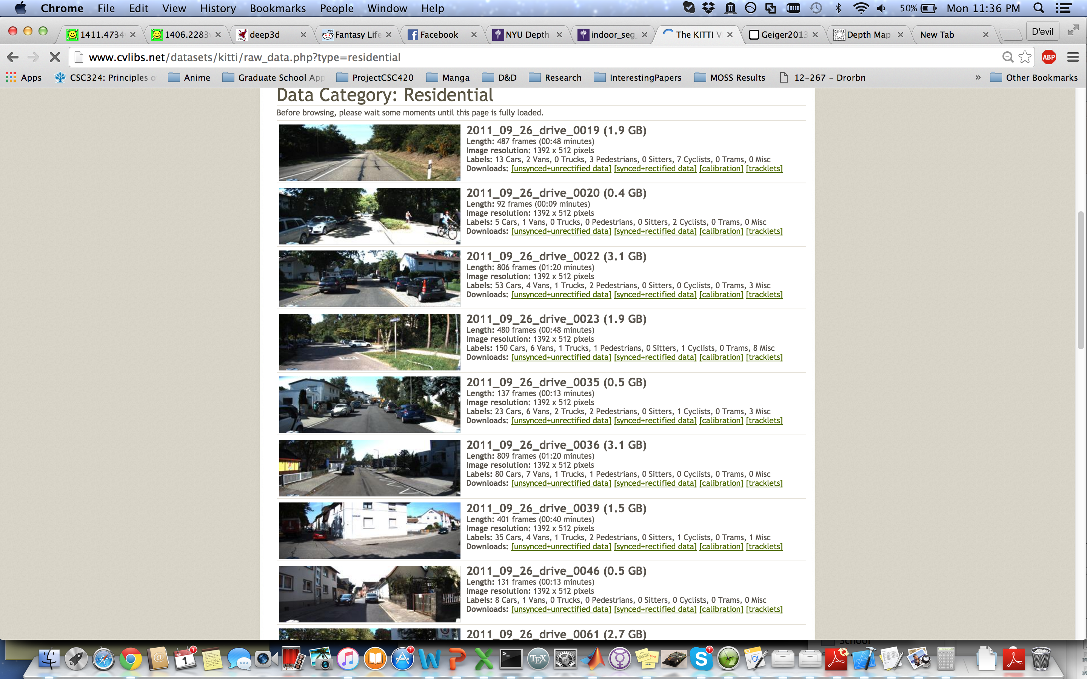
Notes:
Here are some sample images from the kitti dataset.

Slide 85
Indirect-Invariant How do you get ground truth?
Notes:
Given these datasets, Sanja figured it would interesting to talk a little bit about how people go about getting the ground truth for these data sets.

Slide 86
Indirect-Invariant NYUDepthV2
Notes:
The images taken by NYUDepthV2

Slide 87
Indirect-Invariant Kinect
Notes:
Are done with the first version of the kinect

Slide 88
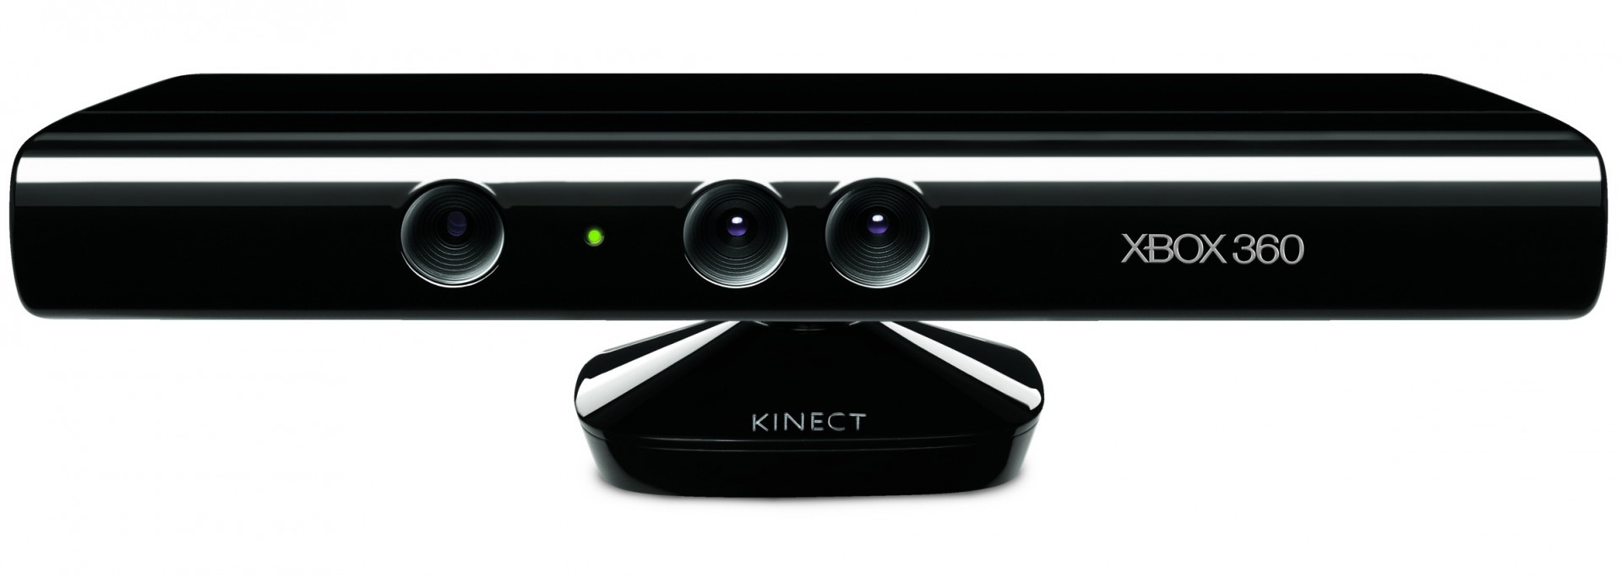
Notes:
Which looks like this. Does everyone know how the Kinect 1 works? Or would people like me to explain it in some detail?

Slide 89
Indirect-Invariant KITTI
Notes:
The kitti data set is taken

Slide 90
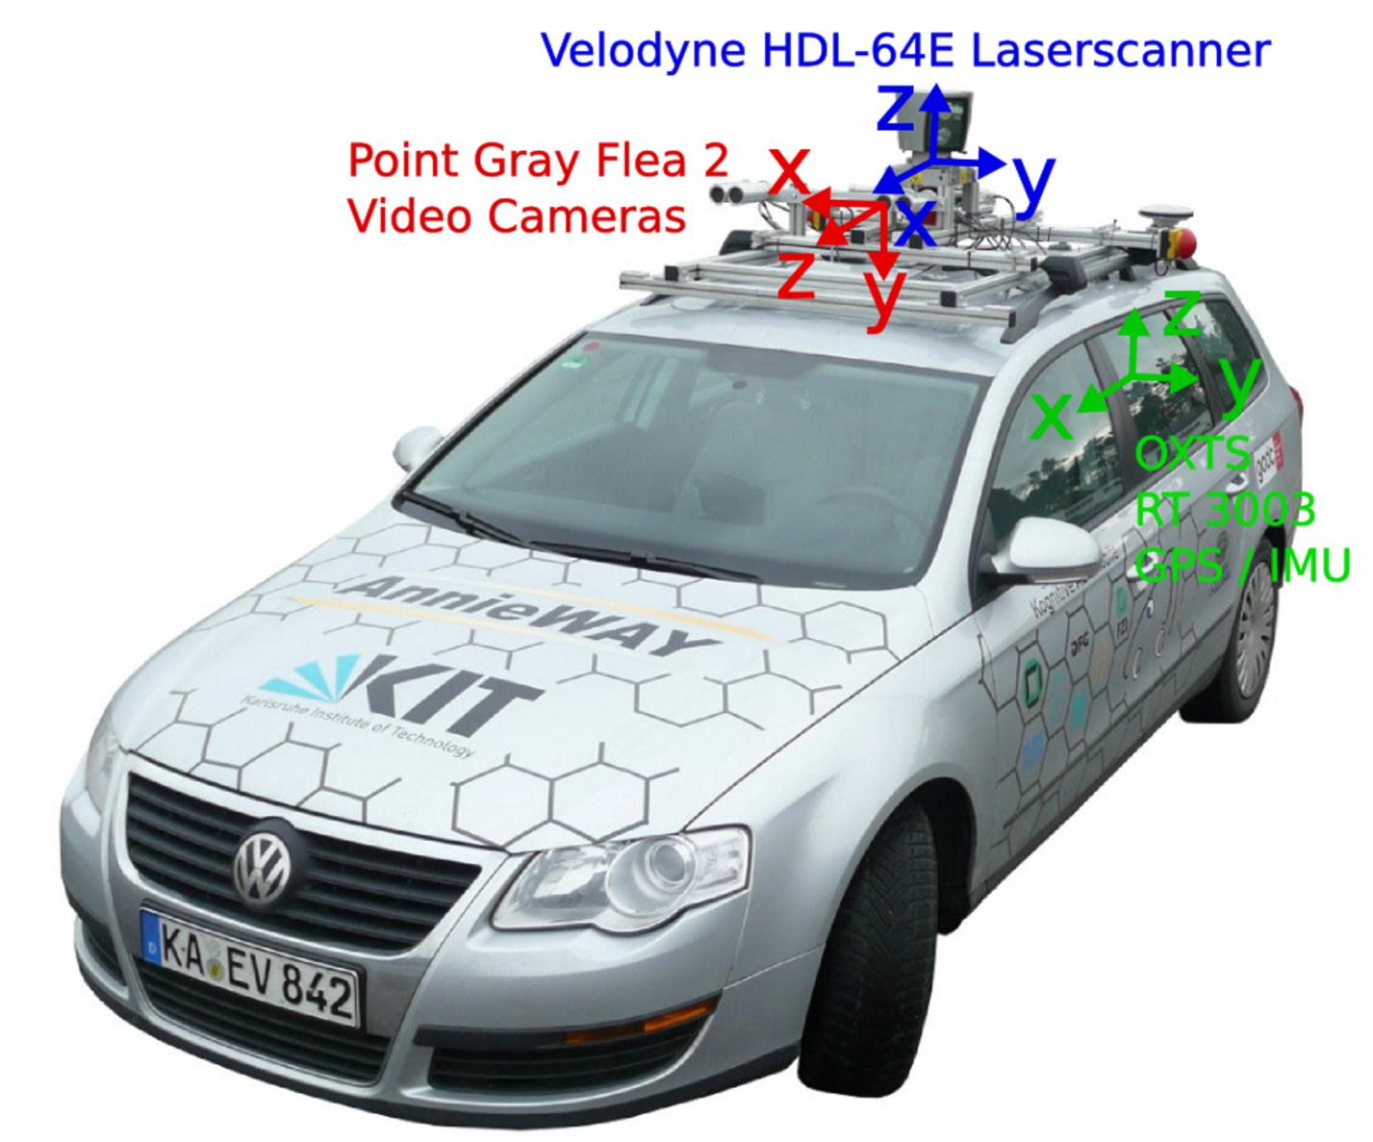
Notes:
Using a stereo pair and laser scanner mounted on top of the car.

Slide 91
Indirect-Invariant Time of Flight
Notes:
The laser scanner uses time of flight

Slide 92
Indirect-Invariant Times how long light travels
Notes:
Which like I said before, times how long light travels from

Slide 93
Indirect-Invariant From light source to camera
Notes:
The light source to the camera. Since the speed of light is constant, the time taken is proportional to the distance of the object.

Slide 94
Indirect-Invariant Results
Notes:
So now I’ll show some of the results of the first paper.

Slide 95
Notes:
Here are some of the same outputs from the NYU data set. Notice how the coarse network and the local networks in some sense achieve their goal of capturing respectively, coarse and fine depth features. The column on the far right is ground truth. The result is not super amazing, but you can make out some of the shapes, like the bed in the top row or the table in the third row.

Slide 96
Notes:
Here is the output of the network on a sample data set in KITTI, it does not seem to work as well. The fine-scale network does not seem to capture the finer details, though this could just be because the scene does not have much fine detail to begin with.

Slide 97
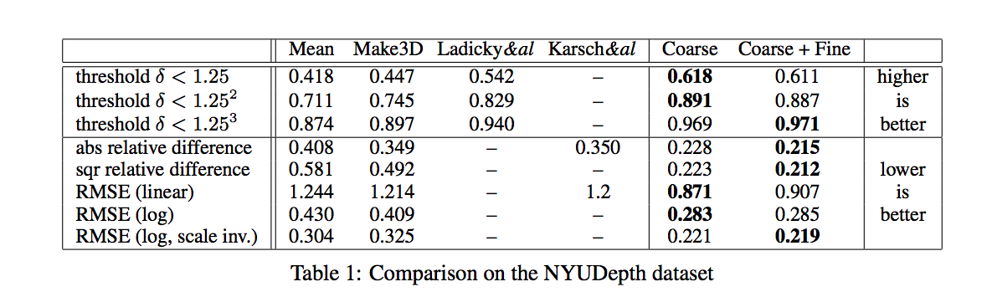
Notes:
Here they benchmark the result of their algorithm against Make3D which is the state of the art and returning the mean depth of the training data set as your output. So if you look at the metrics, you’ll notice that the old state of art is hardly better than just outputting the mean depth of the data set. The proposed technique performs about 20-30% better on the metrics used to measure performance here.

Slide 98
Indirect-Invariant Estimating Surface Normals
Notes:
How I will talk about the second paper which deals more with estimating surface normals than depth.

Slide 99
Indirect-Invariant Similar to Eigen
Notes:
So it’s very similar to the first paper, in some sense as it incorporates networks at different scale to learn coarse/fine information.

Slide 100
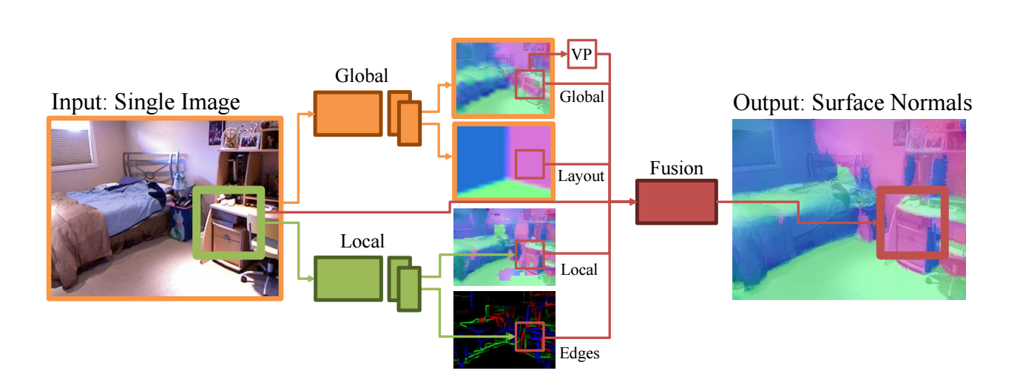
Notes:
So here’s the architecture of the network they use.

Slide 101
Indirect-Invariant Trains 3 networks
Notes:
They train 3 networks here.

Slide 102
Indirect-Invariant Global coarse-scale network
Notes:
A global coarse-scale network.

Slide 103
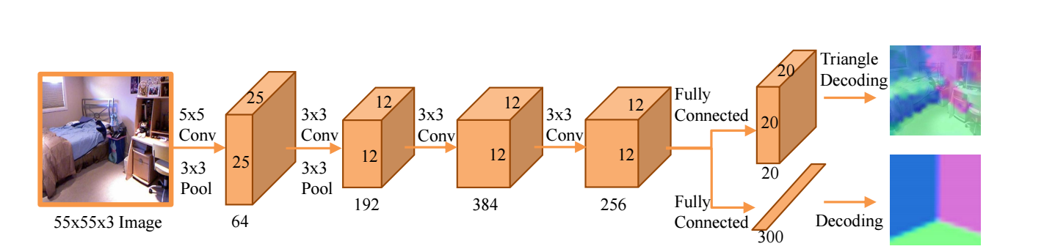
Notes:
Which look like this . In addition to estimating a coarse surface normal map,

Slide 104
Indirect-Invariant Trains for room layout as well
Notes:
they also try estimate the room layout. By including information about room layout into the picture, they’re hoping this will give additional information to the network for estimating the final results.

Slide 105
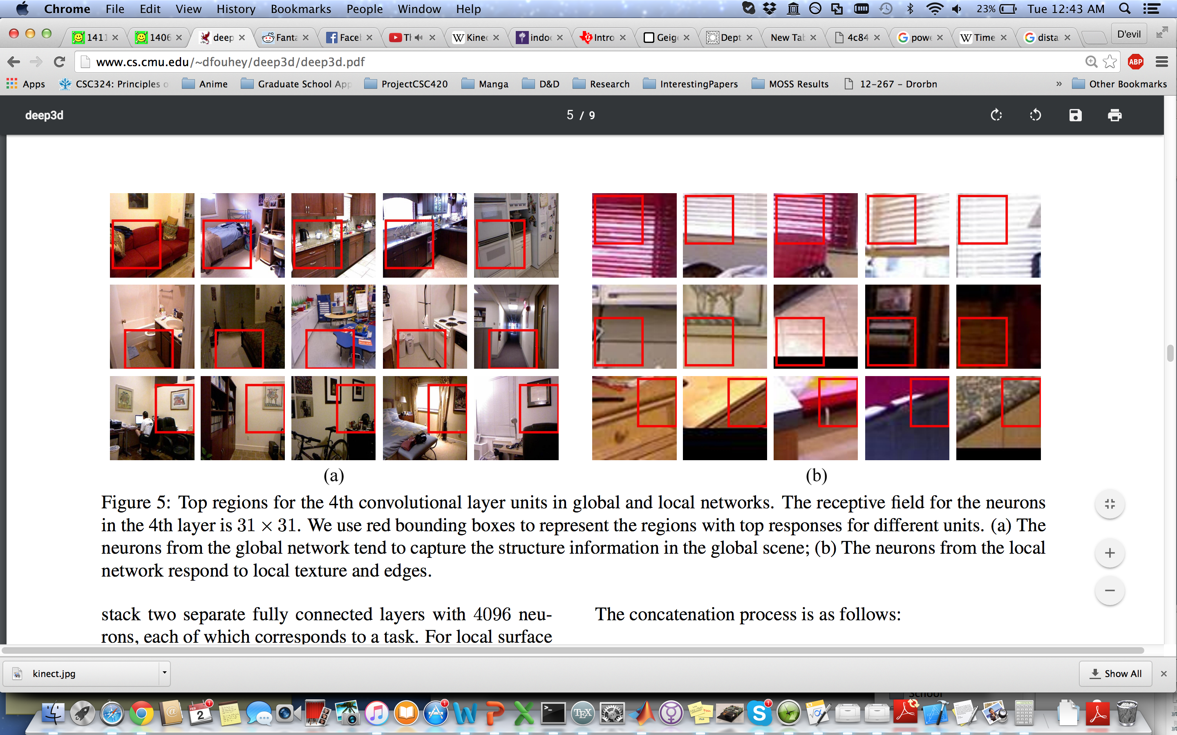
Notes:
And here are some example patches that the neurons fires off on. So in some sense, the patches shown are lacking in fine detail and is useful instead of figuring the overall shape of the room.

Slide 106
Indirect-Invariant Local fine-scale network
Notes:
They also train a local fine-scale network like the previous paper.

Slide 107
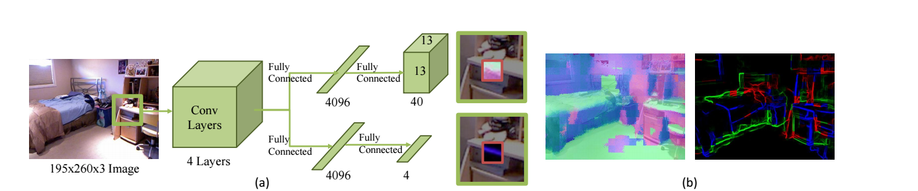
Notes:
So the network looks like this.

Slide 108
Indirect-Invariant Trains for edge labels as well
Notes:
In additional to estimating fine depth maps, they also decide to train their network to predict edge labels in an image.

Slide 109
Indirect-Invariant Convex, concave, occlusion, N/A
Notes:
An label is labeled convex, concave depending on the orientation of the intersecting planes, an occlusion or not an edge.

Slide 110
Notes:
Here are some example patches for which the neurons fired. You can see that in every patch, the neurons respond to edges and local textures.

Slide 111
Indirect-Invariant Difference: Global and Local trained separately
Notes:
One difference here between the first paper and the second paper is that the global and local networks are trained separately.

Slide 112
Indirect-Invariant Fusion Network
Notes:
There is a final network, that they call the fusion network that takes as input

Slide 113
Indirect-Invariant Combines both networks
Notes:
all the output of the global and local network as well as the vanishing point-aligned coarse output. So they estimate where the vanishing point in the image is and they modify the coarse surface normal estimates to be consistent with the estimated vanishing point.

Slide 114
Indirect-Invariant How to represent normals
Notes:
So now they try to tackle the problem of how to best represent normals since surface normals lie in continuous space.

Slide 115
Indirect-Invariant Normals lie in continuous space
Notes:
So now they try to tackle the problem of how to best represent normals since surface normals lie in continuous space.

Slide 116
Indirect-Invariant Regression as Classification
Notes:
They decide to turn the regression problem in a classification problem.

Slide 117
Indirect-Invariant Surface normal triangular coding
Notes:
By doing something called surface normal triangular coding which is effectively, one way of discretizing the output space of surface normals.

Slide 118
Notes:
So surface normals are unit vectors and therefore must lie on the surface of a sphere.

Slide 119
Indirect-Invariant Codebook with k-means
Notes:
They then learn a codebook of common surface normals that appear by using k-means

Slide 120
Notes:
So you end up having some sample points on the sphere.

Slide 121
Indirect-Invariant Delaunay Triangulation cover
Notes:
You find the delaunay triangulation cover, which basically allows you to cover the surface of the sphere with triangles.

Slide 122
Notes:
So your output space looks something like this now. This isn’t exacly the delaunay cover since I drew it by hand, but the point is that you can always find a triangular cover of the sphere using the code book.

Slide 123
Indirect-Invariant Triangles as classes
Notes:
Then they treat each triangle as a class.

Slide 124
Indirect-Invariant Represent Surface Normals
Notes:
Then they estimate surface normals

Slide 125
Indirect-Invariant Weighted sum of triangle corners
Notes:
To be the weighted sum of the triangle corners since each corner of the triangle is a word in the codebook and then triangle the surface normal lies in is the triangle with the highest probability score.

Slide 126
Indirect-Invariant Loss Function
Notes:
The loss function they used

Slide 127
Notes:
Is just the cross entropy.

Slide 128
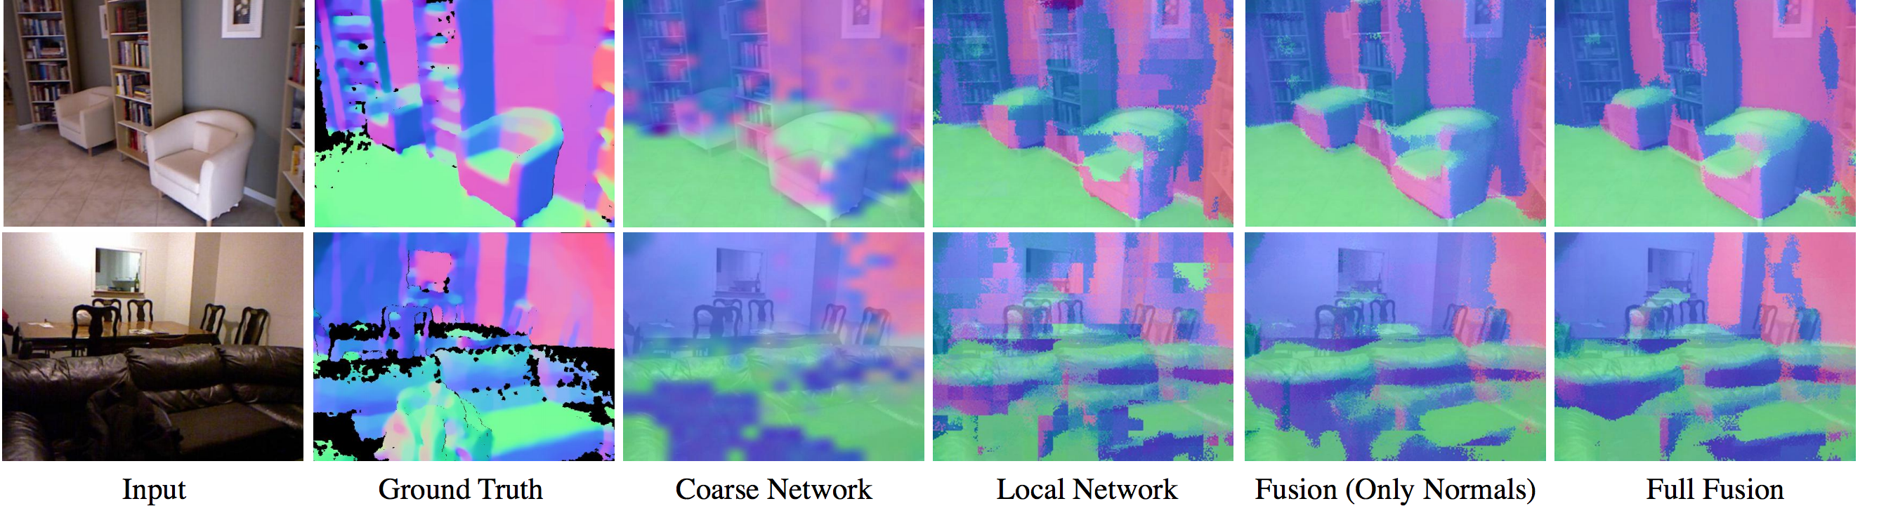
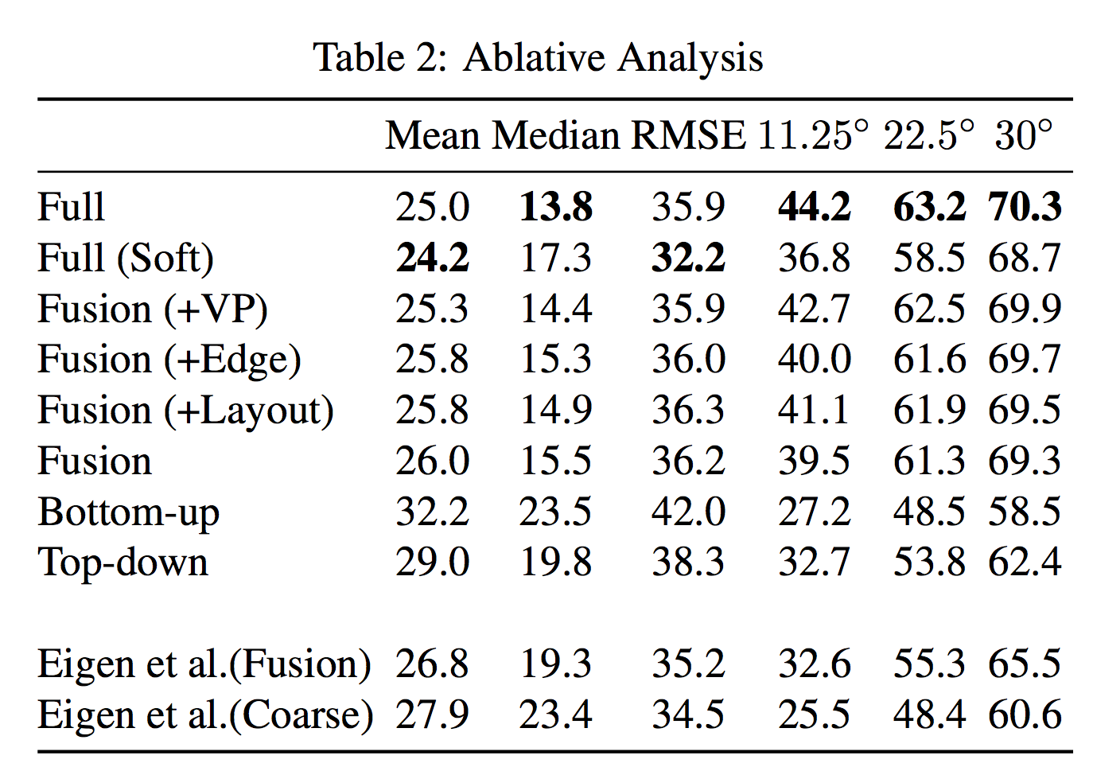
Notes:
Here is some of the results of the network. So you can see that in the coarse network, the chair in the top row requires detail which the fine network provides.

Slide 129
Notes:
Here is some of the results of the network. So you can see that in the coarse network, the chair in the top row requires detail which the fine network provides. I also show the ablative analysis which justifies the outputs that they use in their architecture. It looks like they get around 5-10% improvement from estimating more than just the surface normals.

Slide 130
Indirect-Invariant Thoughts
Notes:
So I’ll share some of my thoughts about the papers I presented about here.

Slide 131
Indirect-Invariant Do not address bas-relief
Notes:
So one thing I noticed is that they never address the bas-relief ambiguity. And I think it would be important to mention this in passing or at least be aware of this. One could make the argument that may be the ambiguity resolves itself, because the networks have ground truth so somewhere along the way they learn to resolve the bas-relief, but this argument could also extend to scale ambiguity which begs the question why they try to account for scale ambiguity. If you account for any ambiguity, then logically you have to account for all the ambiguities that can arise.

Slide 132
Indirect-Invariant Incorporate Computer Graphics
Notes:
Another point of contention is I feel like it would be fruitful to incorporate computer graphics into the models.

Slide 133
Indirect-Invariant Inverse problem
Notes:
Mostly because computer graphics deals a lot with the inverse problem.

Slide 134
Indirect-Invariant Given surface normals
Notes:
Which is given a surface normal, and lighting conditionsl

Slide 135
Indirect-Invariant How should the scene look?
Notes:
How should the scene look

Slide 136
Indirect-Invariant What is the correct image?
Notes:
As well as what is the correct image

Slide 137
Indirect-Invariant Incorporate image formation model
Notes:
Furthermore, we have to understand that images don’t just appear out of thin air. There is physics behind everything that happens in a scene and how it appears to the camera. So this physics should be exploited in order to get better surface normal estimations. So they should incorporate how surface normals and depth are mathematically related to their appearance in a scene by looking at image formation model.

Slide 138
Indirect-Invariant Why depth from single image
Notes:
And if we have time, I would like some people to give me some ideas about why depth from single image is useful. Because from my perspective, any useful application of estimating depth can be replaced with a stereo system or using video to get depth estimates.

