Slide 1
Handout # 16: Software-Defined Networking
CSC 458/2209 – Computer Networks
Professor Yashar Ganjali
Department of Computer Science
University of Toronto
yganjali@cs.toronto.edu
http://www.cs.toronto.edu/~yganjali

Slide 2
Announcements
Programming Assignment 2
To be completed individually.
Due: Friday, Nov. 29th at 5pm
No tutorials this week

Slide 3
Announcements
Final Exam
Time: Tue. December 10th, 2019; 14:00-16:00
Location:
A-KE: GB304
KI-OM: MS2170
OU-ZZ: ???

Slide 4
The Story So Far
Layering
Link layer
Media, framing, error detection/correction, switches, hubs, …
Network layer
Addressing (CIDR, subnet), routing and forwarding, DNS, BGP, …
Transport layer
TCP, UDP, flow control, congestion control, queue management, …
Misc: Queueing Mechanisms, Middleboxes
Next: Software-defined networking

Slide 5
Innovation – Computers vs. Networks
How difficult is it to create/modify a computer application?
How difficult is it to create/modify a network feature?
What is the difference?
What are the tools available for each?

Slide 6
Innovation in Applications
Application
Application
Application
OS
Computer
Computer
OS abstracts hardware substrate
→ Innovation in applications

Slide 7
Innovation in OS and Applications
Application
Application
Application
Application
Windows
(OS)
Windows
(OS)
Linux
Mac
OS
or
or
x86
(Computer)
x86
(Computer)
Simple, common, stable, hardware substrate below
+ Programmability
+ Competition
→ Innovation in OS and applications

Slide 8
Innovation in Infrastructure
App
App
App
Application
Application
Windows
(OS)
Linux
Mac
OS
Windows
(OS)
Linux
Mac
OS
Windows
(OS)
Linux
Mac
OS
Windows
(OS)
Linux
Mac
OS
or
or
Virtualization
x86
(Computer)
x86
(Computer)
Simple, common, stable, hardware substrate below
+ Programmability + Strong isolation model
+ Competition above
→ Innovation in infrastructure

Slide 9
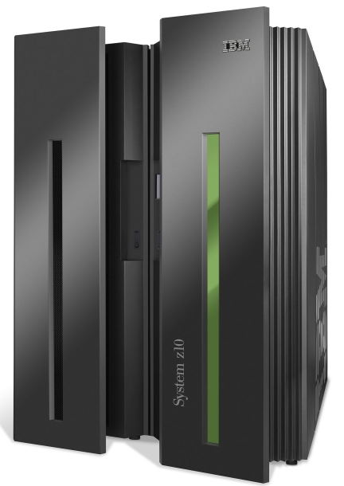
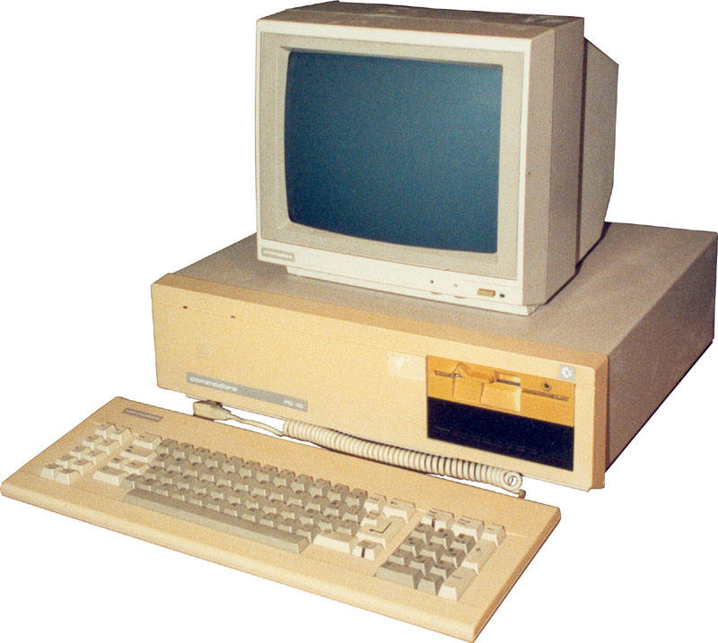
App
App
App
App
App
App
App
App
App
App
App
Specialized
Applications
Open Interface
Windows
(OS)
Linux
Mac
OS
Specialized
Operating
System
or
or
Open Interface
Specialized
Hardware
Microprocessor
Vertically integrated
Closed, proprietary
Slow innovation
Small industry
Horizontal
Open interfaces
Rapid innovation
Huge industry
Notes:
The mainframe industry in the 1980s was vertical and closed: it consisted of specialized hardware, operating system and applications --- all from the same company.
A revolution happened when open interfaces started to appear. The industry became horizontal. Innovation exploded.

Slide 10
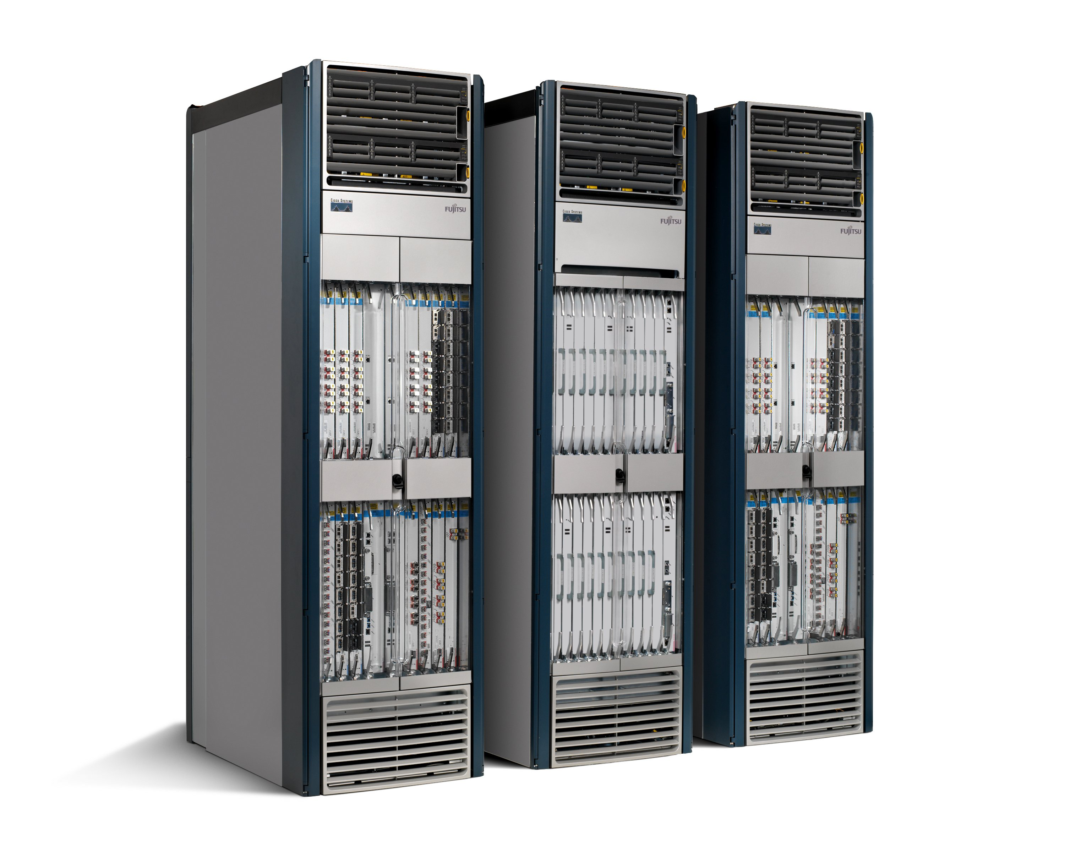
We Have Lost Our Way
Routing, management, mobility management, access control, VPNs, …
Feature
Feature
Million of lines of source code
6,000 RFCs
OS
Custom Hardware
Billions of gates
Bloated
Power Hungry
Vertically integrated, complex, closed, proprietary
Networking industry with “mainframe” mind-set

Slide 11
Reality is Even Worse
App
App
App
App
App
Operating
System
App
Operating System
Specialized Packet Forwarding Hardware
Specialized Packet Forwarding Hardware
Lack of competition means glacial innovation
Closed architecture means blurry, closed interfaces

Slide 12
App
App
App
App
App
App
App
App
App
App
App
Specialized
Features
Open Interface
Control
Plane
Control
Plane
Control
Plane
or
or
Specialized
Control
Plane
Open Interface
Specialized
Hardware
Merchant
Switching Chips
Vertically integrated
Closed, proprietary
Slow innovation
Horizontal
Open interfaces
Rapid innovation

Slide 13
What we need …

Slide 14
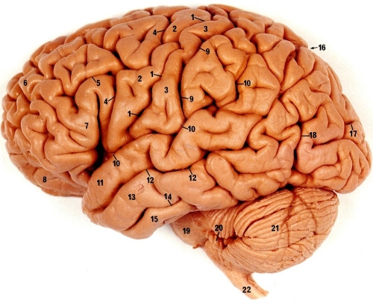
1) Separate Intelligence from Datapath
Operators, users, 3rd party developers, researchers, …
New function!

Slide 15
2) Cache Decisions
In minimal flow-based datapath
“If header = x, send to port 4”
“If header = y, overwrite header with z, send to ports 5,6”
“If header = ?, send to me”
Flow
Table

Slide 16
How Can We Do This?
Feature
Feature
Network OS
Feature
Feature
OS
Custom Hardware
Feature
Feature
OS
Feature
Feature
Custom Hardware
OS
Feature
Feature
Custom Hardware
OS
Custom Hardware
Feature
Feature
OS
Custom Hardware

Slide 17
Software Defined Network (SDN)
3. Consistent, up-to-date global network view
2. At least one Network OS probably many. Open- and closed-source
Feature
Feature
Network OS
1. Open interface to packet forwarding
Packet
Forwarding
Packet
Forwarding
Packet
Forwarding
Packet
Forwarding
Packet
Forwarding

Slide 18
Consequences
More innovation in network services
Owners, operators, 3rd party developers, researchers can improve the network
E.g. energy management, data center management, policy routing, access control, denial of service, mobility
Lower barrier to entry for competition
Healthier market place, new players
Lower cost
Infrastructure
Management

Slide 19
Example: Routing
OSPF
RFC 2328: 245 pages
Distributed System
Builds consistent, up-to-date map of the network: 101 pages
Dijkstra’s Algorithm
Operates on map: 4 pages

Slide 20
Example: Routing
OSPF = Dijkstra
IS-IS
OSPF
IS-IS
Network OS
Distributed System
Distributed
System
Distributed
System
OS
Packet
Forwarding
Custom Hardware
Packet
Forwarding
Packet
Forwarding
Packet
Forwarding

Slide 21
Back to the story …

Slide 22
Software Defined Network (SDN)
Control Program A
Control Program B
Network OS
Packet
Forwarding
Packet
Forwarding
Packet
Forwarding
Packet
Forwarding
Packet
Forwarding

Slide 23
Network OS
Network OS: distributed system that creates a consistent, up-to-date network view
Runs on servers (controllers) in the network
NOX, ONIX, HyperFlow, Kandoo, Floodlight, Trema, Beacon, Maestro, Beehive, OpenDayLight, … + more
Uses forwarding abstraction to:
Get state information from forwarding elements
Give control directives to forwarding elements

Slide 24
Software Defined Network (SDN)
Control Program A
Control Program B
Network OS
Packet
Forwarding
Packet
Forwarding
Packet
Forwarding
Packet
Forwarding
Packet
Forwarding

Slide 25
Control Program
Control program operates on view of network
Input: global network view (graph/database)
Output: configuration of each network device
Control program is not a distributed system
Abstraction hides details of distributed state

Slide 26
Software Defined Network (SDN)
Control Program A
Control Program B
Network OS
Packet
Forwarding
Packet
Forwarding
Packet
Forwarding
Packet
Forwarding
Packet
Forwarding

Slide 27
Forwarding Abstraction
Purpose: Abstract away forwarding hardware
Flexible
Behavior specified by control plane
Built from basic set of forwarding primitives
Minimal
Streamlined for speed and low-power
Control program not vendor-specific
OpenFlow is an example of such an abstraction

Slide 28
Forwarding Substrate
Flow-based
Small number of actions for each flow
Plumbing: Forward to port(s)
Control: Forward to controller
Routing between flow-spaces: Rewrite header
Bandwidth isolation: Min/max rate
External open API to flow-table

Slide 29
What is a flow?
Application flow
All http
Jim’s traffic
All packets to Canada
…
Types of action
Allow/deny flow
Route & re-route flow
Isolate flow
Make flow private
Remove flow

Slide 30
Substrate: “Flowspace”
Ethernet
DA, SA, etc
IP
DA, SA, etc
TCP
DP, SP, etc
Payload
Collection of bits to plumb flows
(of different granularities)
between end points
Header
User-defined flowspace
Payload

Slide 31
OpenFlow
Open standard to run experimental protocols in production networks
API between the forwarding elements and the network OS
Based in Stanford, supported by various companies (Cisco, Juniper, HP, NEC, …)
Used by universities to deploy innovative networking technology

Slide 32
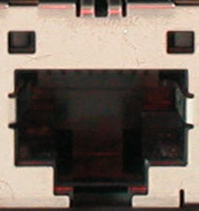
Traditional Switch
Ethernet Switch

Slide 33
Traditional Switch
Control Path
Control Path (Software)
Data Path (Hardware)

Slide 34
OpenFlow Switch
Control Program A
Control Program B
Network OS
OpenFlow Protocol (SSL)
Ethernet Switch
Control Path
OpenFlow
Data Path (Hardware)

Slide 35
OpenFlow Rules
Control Program A
Control Program B
Network OS
“If header = p, send to port 4”
Packet
Forwarding
“If header = q, overwrite header with r, add header s, and send to ports 5,6”
“If header = ?, send to me”
Flow
Table(s)
Packet
Forwarding
Packet
Forwarding

Slide 36
Plumbing Primitives
<Match, Action>
Match arbitrary bits in headers:
Match on any header, or new header
Allows any flow granularity
Action
Forward to port(s), drop, send to controller
Overwrite header with mask, push or pop
Forward at specific bit-rate
Match: 1000x01xx0101001x
Header
Data

Slide 37
OpenFlow Rules – Cont’d
Exploit the flow table in switches, routers, and chipsets
Flow 1.
Rule
(exact & wildcard)
Action
Statistics
Flow 2.
Rule
(exact & wildcard)
Action
Statistics
Flow 3.
Rule
(exact & wildcard)
Action
Statistics
Rule
(exact & wildcard)
Flow N.
Default Action
Statistics
Notes:
37

Slide 38
Flow Table Entry
OpenFlow Protocol Version 1.0
Rule
Action
Stats
Packet + byte counters
Forward packet to port(s)
Encapsulate and forward to controller
Drop packet
Send to normal processing pipeline
Switch
Port
MAC
src
MAC
dst
Eth
type
VLAN
ID
IP
Src
IP
Dst
IP
Prot
TCP
sport
TCP
dport
+ mask what fields to match

Slide 39
Examples
Switching
Switch
Port
MAC
src
MAC
dst
Eth
type
VLAN
ID
IP
Src
IP
Dst
IP
Prot
TCP
sport
TCP
dport
Action
*
*
00:1f:..
*
*
*
*
*
*
*
port6
Flow Switching
Switch
Port
MAC
src
MAC
dst
Eth
type
VLAN
ID
IP
Src
IP
Dst
IP
Prot
TCP
sport
TCP
dport
Action
port3
00:2e..
00:1f..
0800
vlan1
1.2.3.4
5.6.7.8
4
17264
80
port6
Firewall
Switch
Port
MAC
src
MAC
dst
Eth
type
VLAN
ID
IP
Src
IP
Dst
IP
Prot
TCP
sport
TCP
dport
Forward
*
*
*
*
*
*
*
*
*
22
drop

Slide 40
Examples
Routing
Switch
Port
MAC
src
MAC
dst
Eth
type
VLAN
ID
IP
Src
IP
Dst
IP
Prot
TCP
sport
TCP
dport
Action
*
*
*
*
*
*
5.6.7.8
*
*
*
port6
VLAN
Switch
Port
MAC
src
MAC
dst
Eth
type
VLAN
ID
IP
Src
IP
Dst
IP
Prot
TCP
sport
TCP
dport
Action
port6,
port7,port9
*
*
*
*
vlan1
*
*
*
*
*

Slide 41
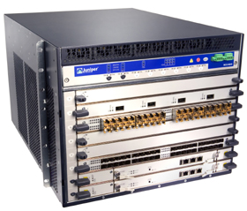
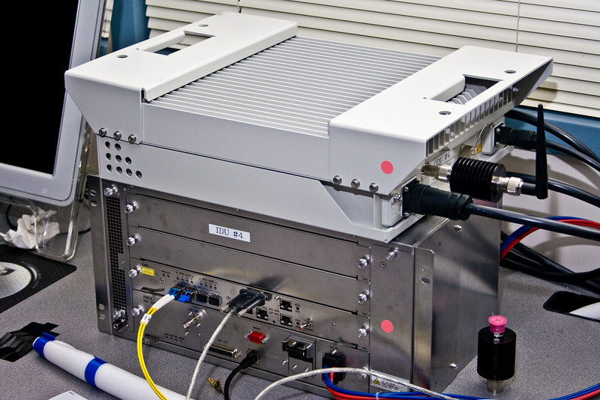
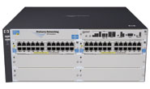
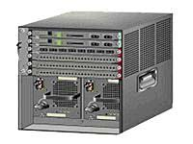
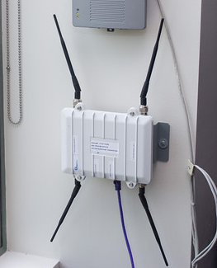
OpenFlow Hardware
Juniper MX-series
NEC IP8800
WiMax (NEC)
HP Procurve 5400
Cisco Catalyst 6k
PC Engines
More ...
Quanta LB4G

Slide 42
OpenFlow Usage Example
Controller
Dedicated OpenFlow Network
Peter’s code
OpenFlow
Switch
PC
Rule
Action
Statistics
OpenFlow
Protocol
OpenFlow
Switch
OpenFlow
Switch
Rule
Action
Statistics
Rule
Action
Statistics
Peter
OpenFlowSwitch.org
Notes:
42

Slide 43
Usage examples
Peter’s code:
Static “VLANs”
His own new routing protocol: unicast, multicast, multipath, load-balancing
Network access control
Home network manager
Mobility manager
Energy manager
Packet processor (in controller)
IPvPeter
Network measurement and visualization
…
Notes:
43

Slide 44
Research/Production VLANS
Controller
Research VLANs
Flow Table
Production VLANs
Normal L2/L3 Processing

Slide 45
Virtualize OpenFlow Switch
Controller A
Researcher A VLANs
Controller B
Flow Table
Researcher B VLANs
Controller C
Flow Table
Researcher C VLANs
Flow Table
Production VLANs
Normal L2/L3 Processing

Slide 46
Virtualizing OpenFlow
B’s
Controller
A’s
Controller
C’s
Controller
OpenFlow
Protocol
OpenFlow
Switch
OpenFlow FlowVisor & Policy Control
OpenFlow
Protocol
OpenFlow
Switch
OpenFlow
Switch

Slide 47
Virtualizing OpenFlow
http
Load-balancer
Broadcast
Multicast
OpenFlow
Protocol
OpenFlow
Switch
OpenFlow
FlowVisor & Policy Control
OpenFlow
Protocol
OpenFlow
Switch
OpenFlow
Switch

Slide 48
Food for Thought
What are the challenges in switching from traditional networks to OpenFlow networks?
What are the opportunities?

