Slide 1
CSC458/2209 PA1 Simple Router
Based on slides by: Antonin & Yinan Liu
Jun Lin Chen
Get the up-to-date version from https://www.cs.toronto.edu/~jlchen/csc458/pa1.pdf
CSC458/2209 - Computer Networks, University of Toronto

Slide 2
Asking Question
Please ask questions on Piazza.
Try not to give away any homework hints.
I will try my best to be responsive.
CSC458/2209 - Computer Networks, University of Toronto
Notes:
Let me know if I am wrong.
I noticed that some of you are having issue with the
You could ”Make Post Private” so only instructors can see
I am sorry, I did not try it in the VM.

Slide 3
Overview
Your are going to write a “simplified” router
Given a static network topology
Given a static routing table
You are responsible for writing the logic to handle incoming Ethernet frames (ICMP, ARP, IP….):
Forward it
Generate ICMP messages
Drop it
And more ...
CSC458/2209 - Computer Networks, University of Toronto

Slide 4
But how to do it???
Where will my routing logic run?
Where will the traffic come from?
How will I test my code?
CSC458/2209 - Computer Networks, University of Toronto
Notes:
The answers are on the next slide.

Slide 5
No hardware router ☺
Network topology emulated with Mininet:
your router connects 2 servers to a client
Your router will handle real traffic
The topology is emulated on CDF machines!
So please test it in our labs
CSC458/2209 - Computer Networks, University of Toronto
Notes:
We will fix all the problem

Slide 6
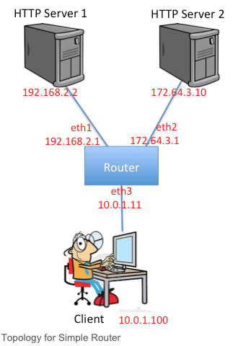
Emulated Topology
CSC458/2209 - Computer Networks, University of Toronto

Slide 7
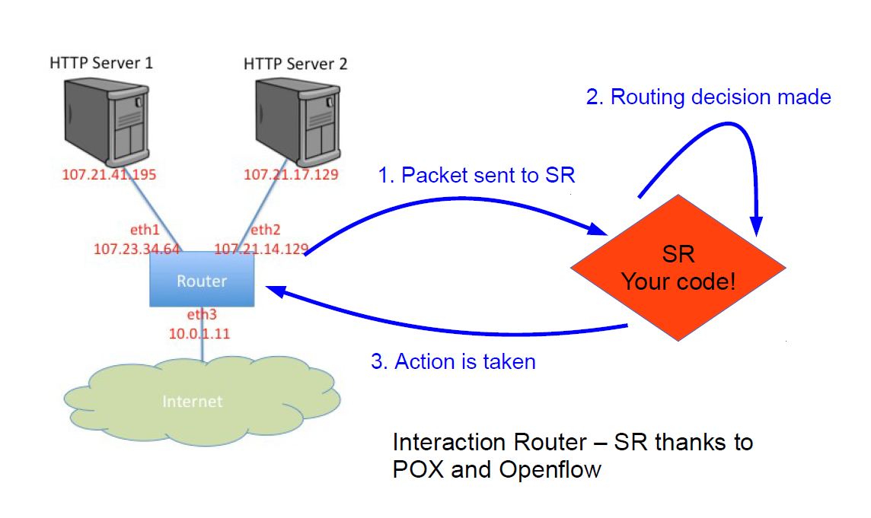
Emulated Topology
CSC458/2209 - Computer Networks, University of Toronto
Notes:
SR: Simple Router
POX:
Some of you having problem for installing

Slide 8
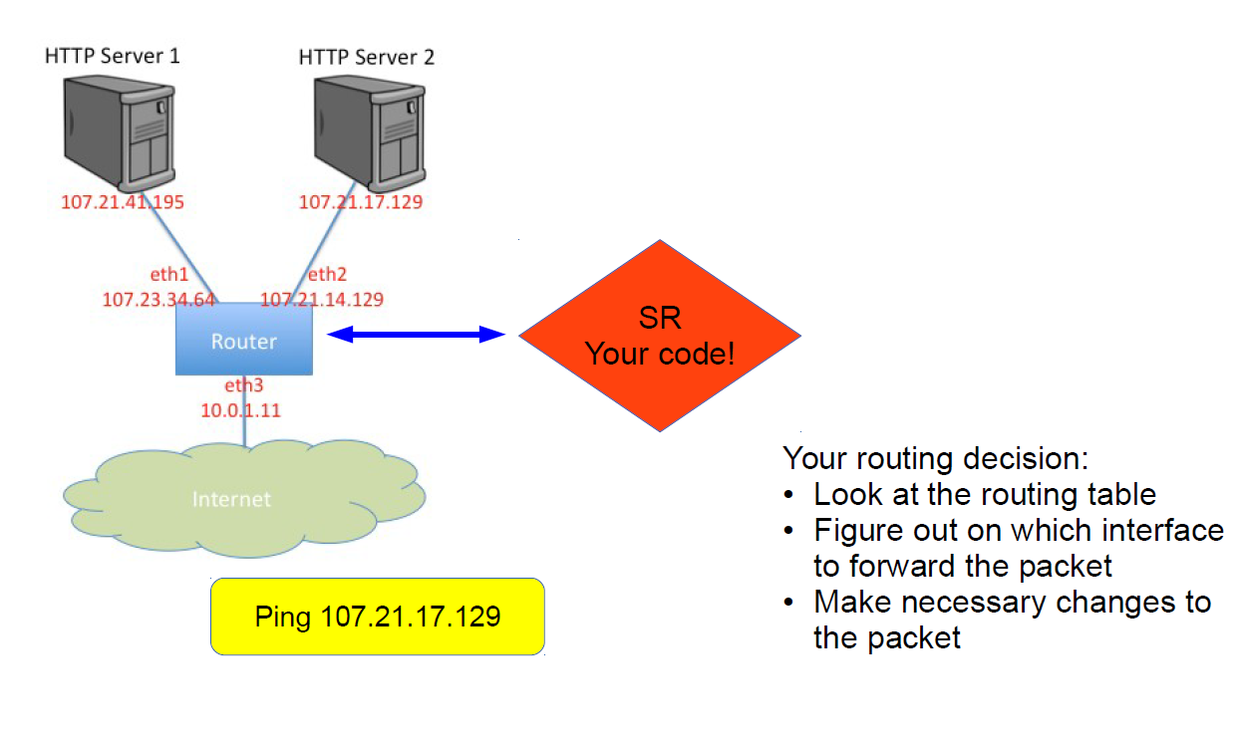
Emulated Topology
CSC458/2209 - Computer Networks, University of Toronto

Slide 9
What your routing logic needs to do?
Route Ethernet frames between the client and the HTTP servers
Handle ARP request and replies
Maintain an ARP cache
Handle traceroutes
Generate TTL Exceeds Message
Handle TCP/UDP packets sent to one of the routers’ interfaces
Generate ICMP Port Unreachable
Respond to ICMP echo requests
See course webpage for full requirements:
http://www.cs.toronto.edu/~yganjali/courses/csc458/page-3/simple-router/
CSC458/2209 - Computer Networks, University of Toronto

Slide 10
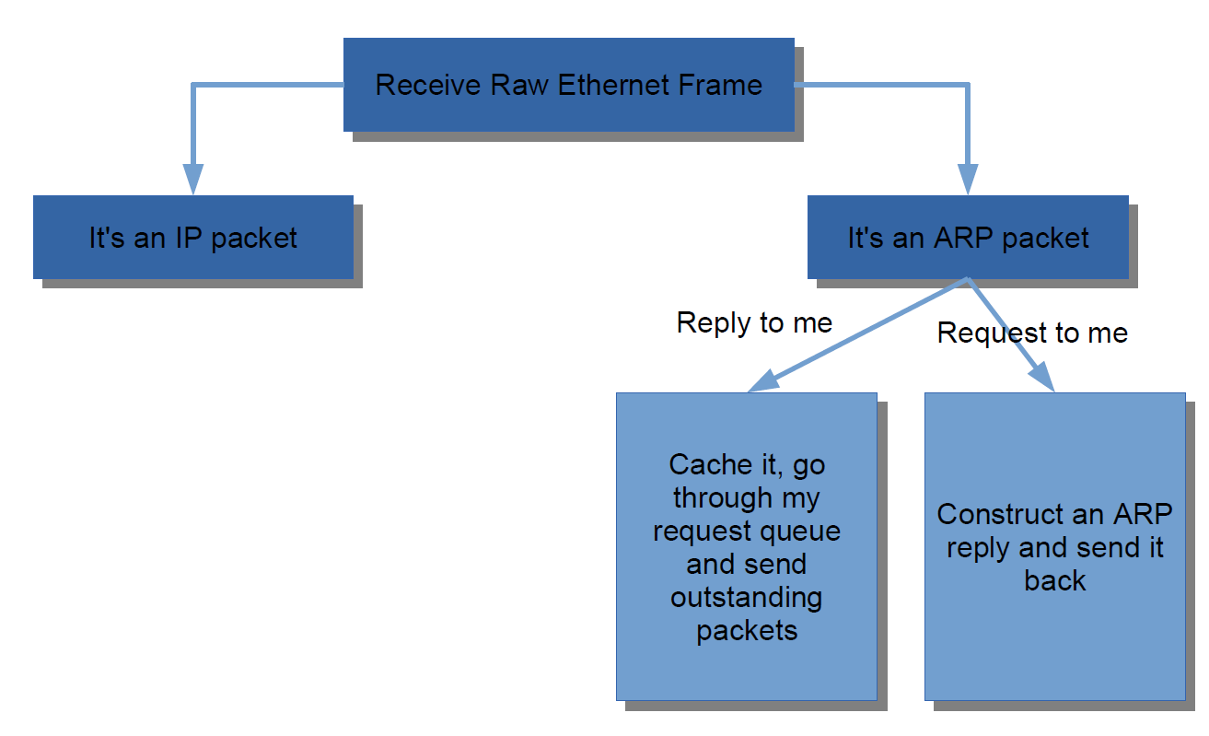
A rough flow chart
CSC458/2209 - Computer Networks, University of Toronto
Notes:
Please be aware there might be some other
There is no port number in ARP packet

Slide 11
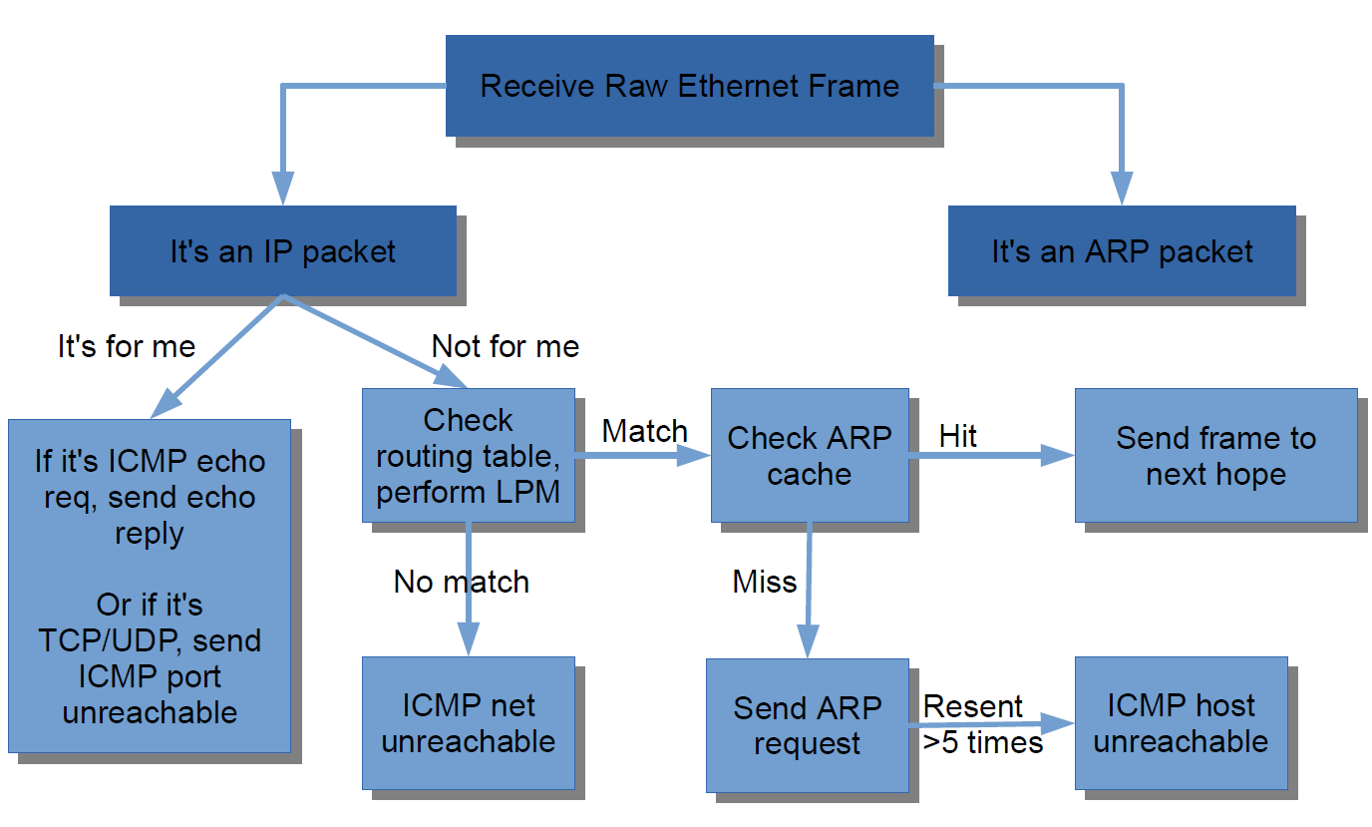
A rough flow chart
CSC458/2209 - Computer Networks, University of Toronto

Slide 12
A rough flow chart
Many things missing from this chart
Checksums, TTLs
Read the instructions carefully
500+ lines of code, so start early
Submission:
8 time per day
Last 7 days before the final submission
The Markus server would give some feedback
Final submission: Oct. 11st at 5pm
CSC458/2209 - Computer Networks, University of Toronto
Notes:
IMPORTANT
The date on the website is WRONG

Slide 13
How to test your code?
Test connectivity with ping from a server or the client
Traceroute will not work well outside of Mininet:
Use Mininet CLI
mininet> server1 traceroute –n server2
HTTP requests with wget, curl, lynx
Don’t forget to test “error” cases!
CSC458/2209 - Computer Networks, University of Toronto
Notes:
Server1 can be h1

Slide 14
Some advice
Be through in your testing
Do not hesitate to change the routing table What about an incorrect routing table?
Be careful when implementing Longest Prefix Match
Don’t get mixed up with endinanness:
Linux is little endian
Network is big endian
Try to put the calls to hton(), ntoh() in a single place
Write good quality code
Do not hardcode constants, avoid code duplication Coding Guidelines https://web.stanford.edu/class/cs244a/CS244aCodingGuidelines.html
CSC458/2209 - Computer Networks, University of Toronto

Slide 15
Things that may be useful
Mininet console, which supports:
tcpdump, ping, traceroute
(apt-get install traceroute on instance)
Debug functions in sr_utils.c
print_hdrs()
print_addr_ip_int()
GDB/Valgrind
Tutorials Point: http://www.tutorialspoint.com/unix_sockets/index.htm
Pizza
CSC458/2209 - Computer Networks, University of Toronto

Slide 16
Start reading!
http://www.cs.toronto.edu/~yganjali/courses/csc458/page-3/simple-router/
CSC458/2209 - Computer Networks, University of Toronto

