Slide 1
Handout # 7:
Data Plane and Packet Forwarding
CSC 2229 – Software-Defined Networking
Professor Yashar Ganjali
Department of Computer Science
University of Toronto
yganjali@cs.toronto.edu
http://www.cs.toronto.edu/~yganjali
TexPoint fonts used in EMF.
Read the TexPoint manual before you delete this box.:

Slide 2
Announcements
In class presentations
  Starting next week
  Papers will be sent by email, today
  If you don’t hear from me, please contact me ASAP.
Final project
  Feedback on projects today

Slide 3
Data Plane Functionalities
So far we have focused on control plane
  It distinguishes SDN from traditional networks
  Source of many (perceived) challenges …
  … and opportunities
What about the data plane?
  Which features should be provided in the data plane?
What defines the boundary between control and data planes?

Slide 4
OpenFlow and Data Plane
Historically, OpenFlow defined data plane’s role as forwarding.
  Other functions are left to middleboxes and edge nodes in this model.
Question. Why only forwarding?
  Other data path functionalities exist in today’s routers/switches too.
  What distinguishes forwarding from other functions?

Slide 5
Adding New Functionalities
Consider a new functionality we want to implement in a software-defined network.
Where is the best place to add that function?
  Controller?
  Switches?
  Middleboxes?
  Endhosts?
?
?
?
?

Slide 6
Adding New Functionalities
What metrics/criteria do we have to decide where new functionalities should be implemented?
Example: Elephant flow detection
  Data plane: change forwarding elements (DevoFlow)
  Control plane: push functionality close to the path (Kandoo)
What does the development process look like?
  Changing ASIC expensive and time-consuming
  Changing software fast

Slide 7
Alternative View
Decouple based on development cycle
  Fast: mostly software
  Slow: mostly hardware
Development process
  Start in software
  As function matures, move towards hardware
Not a new idea
  Model has been used for a long-time in industry.

Slide 8
Android/Linux
3/4 new smartphones
2/3 servers
2/3 websites
2/3 mainframes
99% supercomputers
IBM, Compaq, Dell run Linux
Google incorporated
1st MSDC with
switch chip + Linux
# Virtual Ethernet ports
> # Physical ports
Linux v1
v2
1st WAN with
Switch chip + Linux
dNOSS
NEC
+
HP
OVN
ONAP
OCP
Server
OCP
Switch
OCP
Wedge
Stratum
SONiC
HP
Open
Switch
P4
Runtime
OVS
ONIE
ONL
ODL
ONOS
Rise of Merchant Switch Chips
FBOSS
OpenNFV
CORD
1994
1996
1998
2008
2010
2011
2012
2013
2015
2016
2017/8

Slide 9
Changing the control plane
I can tailor my network to meet my needs ...
Quickly deploy new protocols.
Monitor precisely what my forwarding plane is doing.
Fold expensive middlebox functions into the network, for free.
Try out beautiful new ideas. Tailor my network to meet my needs.
Differentiate. Now I own my intellectual property.
Notes:
With software-defined network controllers, it seems like we should be able to do all of these, but that’s not true!
There is a caveat here!

Slide 10
But wait a minute…

Slide 11
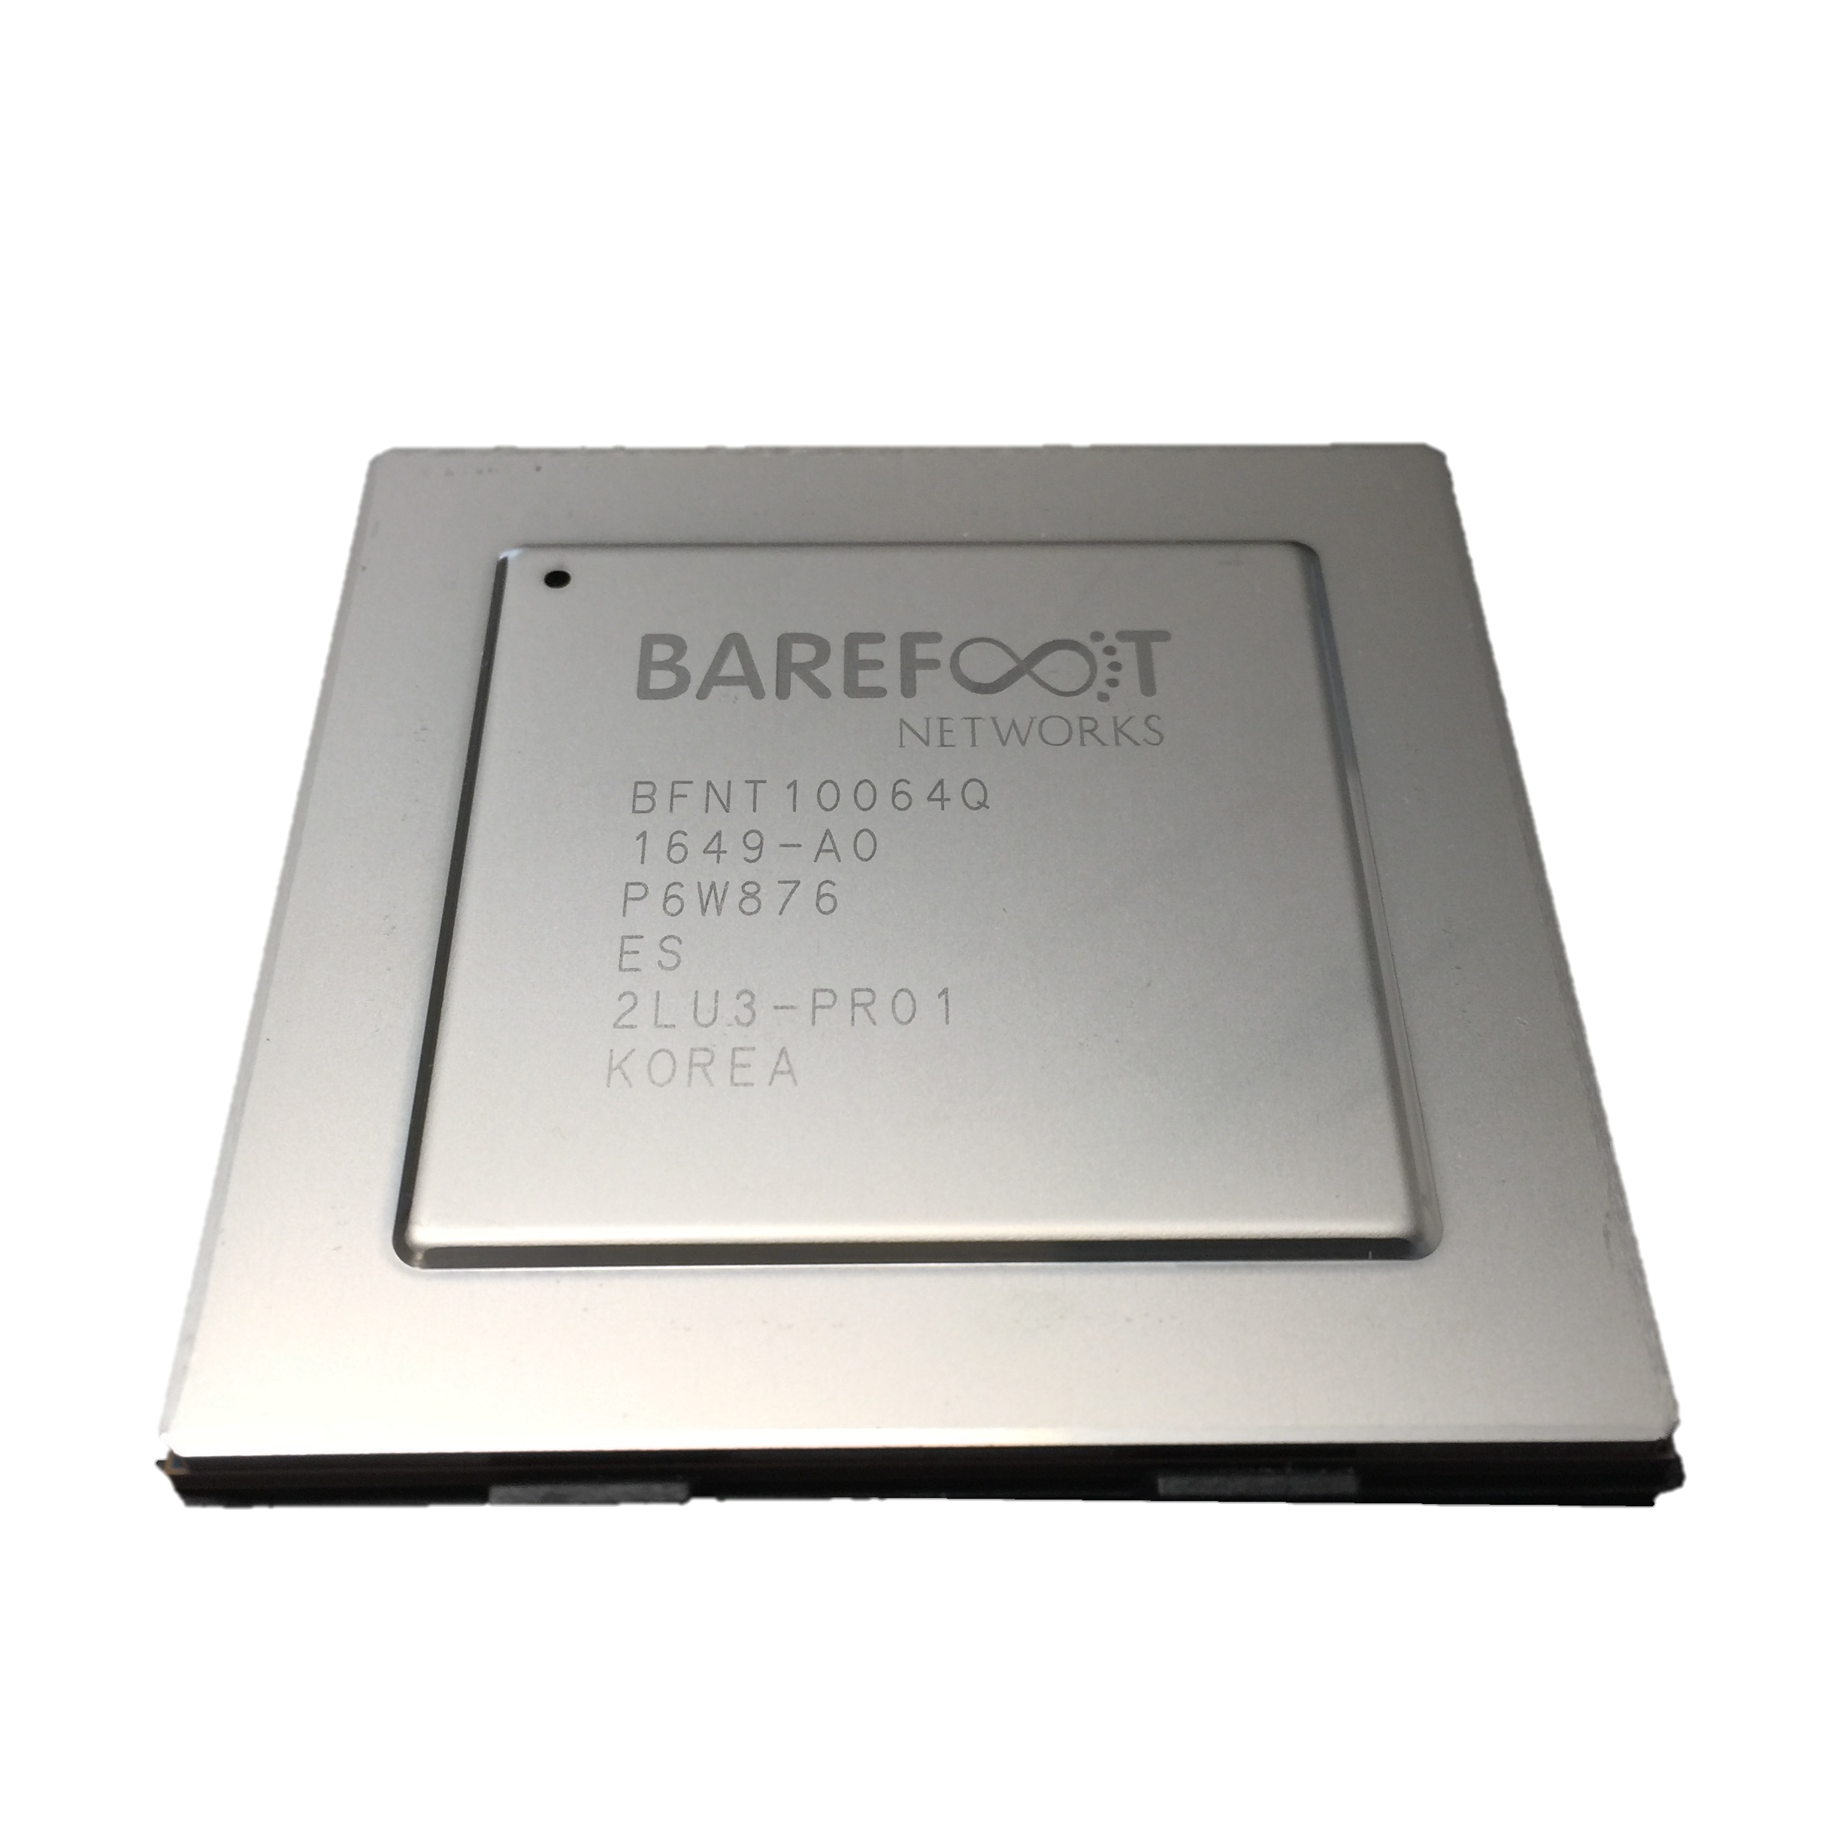
OSPF
BGP
New
etc.
Switch OS
Driver
Notes:
Traditionally:
The chip doing the switching is built out of a fixed pipeline that processes different parts of the header.
Fixed function to keep it low cost and efficient
Example:
VXLAN was introduced in 2010.
- To separate tenants
2 pages description of the protocol
The software part can be implemented in a few days.
It took Cisco and VMWare 4.5 years to add the new entry in the pipeline
Not a complex application: the most profitable, and simple application took 4.5 years to

Slide 12

Feature
Feature
Software
Team
Network Owner
Network Equipment Vendor
Weeks
Feature
Years
ASIC
Team
Years

Slide 13
When you need a new feature…
Equipment vendor can’t just send you a software upgrade
New forwarding features take years to develop
By then, you’ve figured out a kludge to work around it
Your network gets more complicated, more brittle
Eventually, when the upgrade is available, it either
  No longer solves your problem, or
  You need a fork-lift upgrade, at huge expense.

Slide 14

Network systems are built “bottoms-up”
Switch OS
Driver
“This is how I process packets …”
Fixed-function switch

Slide 15
“Programmable switches are 10-100x slower than fixed-function switches”
Conventional wisdom in networking
Notes:
Why people use bottom-up rather than top-down?

Slide 16
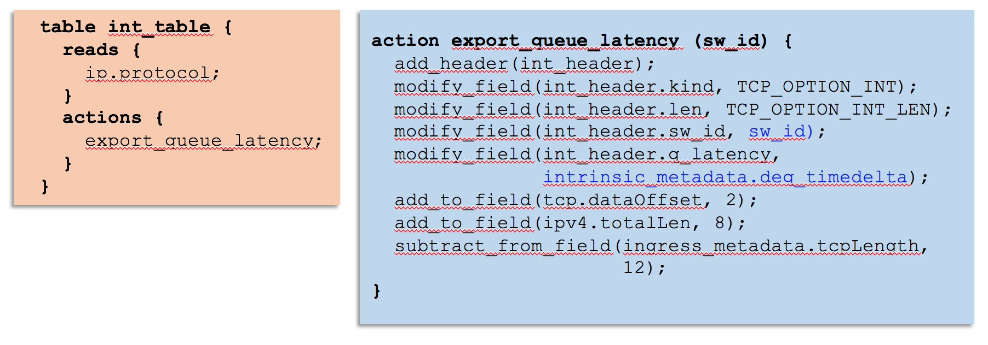
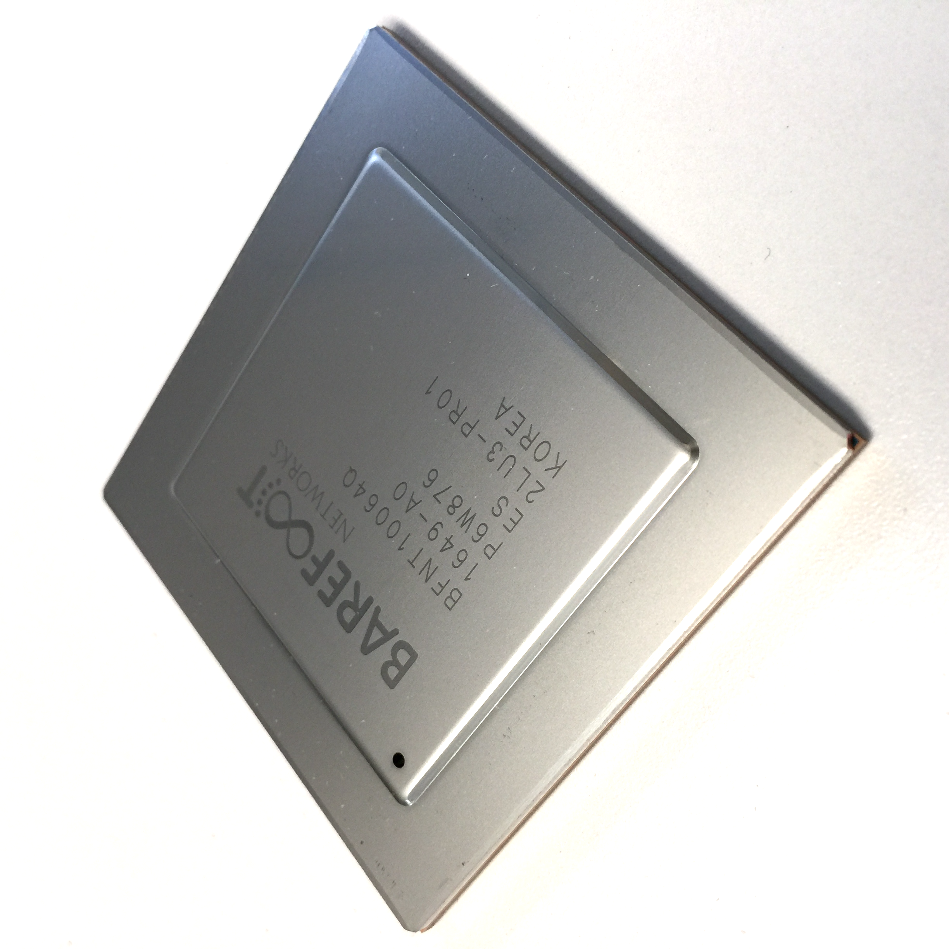
Network systems are starting to be programmed “top-down”
“This is precisely how you must process packets”
Switch OS
Driver
Programmable Switch

Slide 17
Why are programmable forwarding planes happening now?

Slide 18
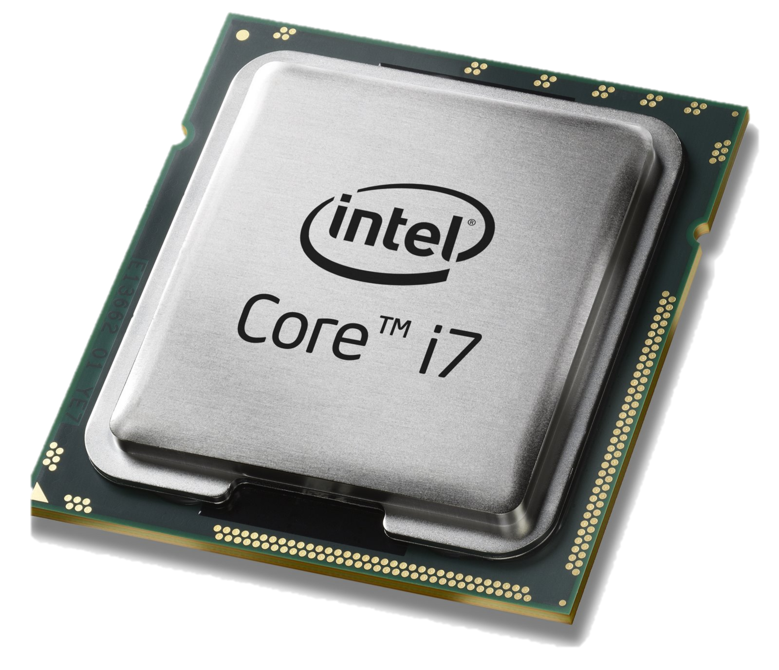
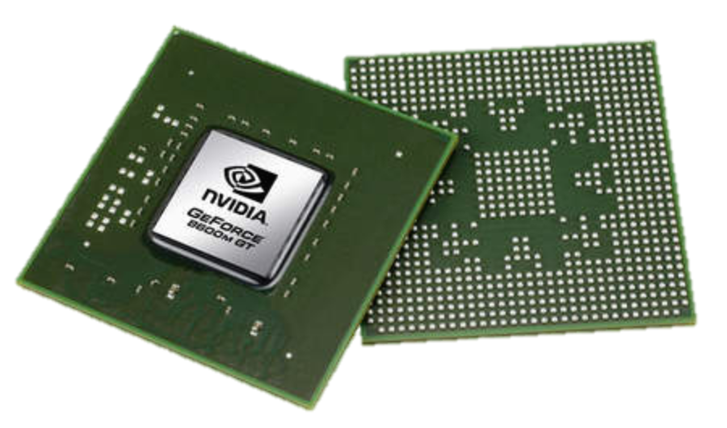
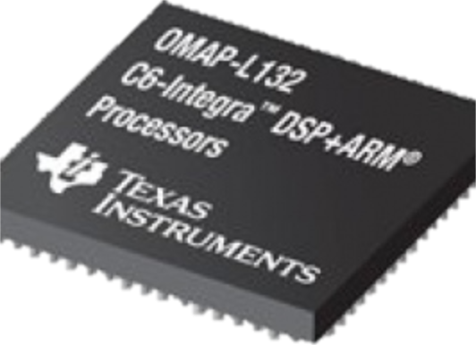
Domain Specific Processors
Signal
Processing
Machine
Learning
Computers
Graphics
Networking
Java
OpenCL
Matlab
TensorFlow
>>>
Language
Compiler
Compiler
Compiler
Compiler
Compiler
?
?
CPU
GPU
DSP
TPU

Slide 19
Domain Specific Processors
Signal
Processing
Machine
Learning
Computers
Graphics
Networking
Java
OpenCL
Matlab
TensorFlow
>>>
P4
Compiler
Compiler
Compiler
Compiler
Compiler
?
CPU
GPU
DSP
TPU
PISA

Slide 20
PISA: Protocol Independent Switch Architecture
Match+Action
Stage
Memory
ALU
Programmable
Parser
Programmable Match-Action Pipeline

Slide 21
PISA: Protocol Independent Switch Architecture

Slide 22
Example P4 Program
Parser Program
Header and Data Declarations
Tables and Control Flow
parser parse_ethernet {
extract(ethernet);
return switch(ethernet.ethertype) {
0x8100 : parse_vlan_tag;
0x0800 : parse_ipv4;
0x8847 : parse_mpls;
default: ingress;
}
header_type ethernet_t { … }
header_type l2_metadata_t { … }
header ethernet_t ethernet;
header vlan_tag_t vlan_tag[2];
metadata l2_metadata_t l2_meta;
table port_table { … }
control ingress {
apply(port_table);
if (l2_meta.vlan_tags == 0) {
process_assign_vlan();
}
}
Memory
ALU
Programmable
Parser
Programmable Match-Action Pipeline

Slide 23
Barefoot Tofino 6.5Tb/s Switch
December 2016
Same power.
Same cost.
The world’s fastest switch in production.
Forwarding defined in software (P4).
Programs always run at line-rate.

Slide 24
How programmability is being used
Reducing complexity
1
Notes:
Removed unneeded functionality

Slide 25
Reducing complexity
switch.p4
Switch OS
Driver
IPv4 and IPv6 routing
- Unicast Routing
- Routed Ports & SVI
- VRF
- Unicast RPF
- Strict and Loose
- Multicast
- PIM-SM/DM & PIM-Bidir
Ethernet switching
- VLAN Flooding
- MAC Learning & Aging
- STP state
- VLAN Translation
Load balancing
- LAG
- ECMP & WCMP
- Resilient Hashing
- Flowlet Switching
Fast Failover
– LAG & ECMP
Tunneling
- IPv4 and IPv6 Routing & Switching
- IP-in-IP (6in4, 4in4)
- VXLAN, NVGRE, GENEVE & GRE
- Segment Routing, ILA
MPLS
- LER and LSR
- IPv4/v6 routing (L3VPN)
- L2 switching (EoMPLS, VPLS)
- MPLS over UDP/GRE
ACL
- MAC ACL, IPv4/v6 ACL, RACL
- QoS ACL, System ACL, PBR
- Port Range lookups in ACLs
QOS
- QoS Classification & marking
- Drop profiles/WRED
- RoCE v2 & FCoE
- CoPP (Control plane policing)
NAT and L4 Load Balancing
Security Features
- Storm Control, IP Source Guard
Monitoring & Telemetry
Ingress Mirroring and Egress Mirroring
Negative Mirroring
Sflow
INT
Counters
Route Table Entry Counters
VLAN/Bridge Domain Counters
Port/Interface Counters
Protocol Offload
- BFD, OAM
Multi-chip Fabric Support
- Forwarding, QOS
Compiler
Programmable Switch
Notes:
A group of people implemented all these in p4.
Many people will comment most of these out. Then compile, and no need to worry about them.

Slide 26
Reducing complexity
My switch.p4
Switch OS
Driver
Compiler
Programmable Switch

Slide 27
How programmability is being used
Adding new features
2

Slide 28
Protocol complexity 20 years ago
Ethernet
ethtype
ethtype
IPv4
IPX

Slide 29
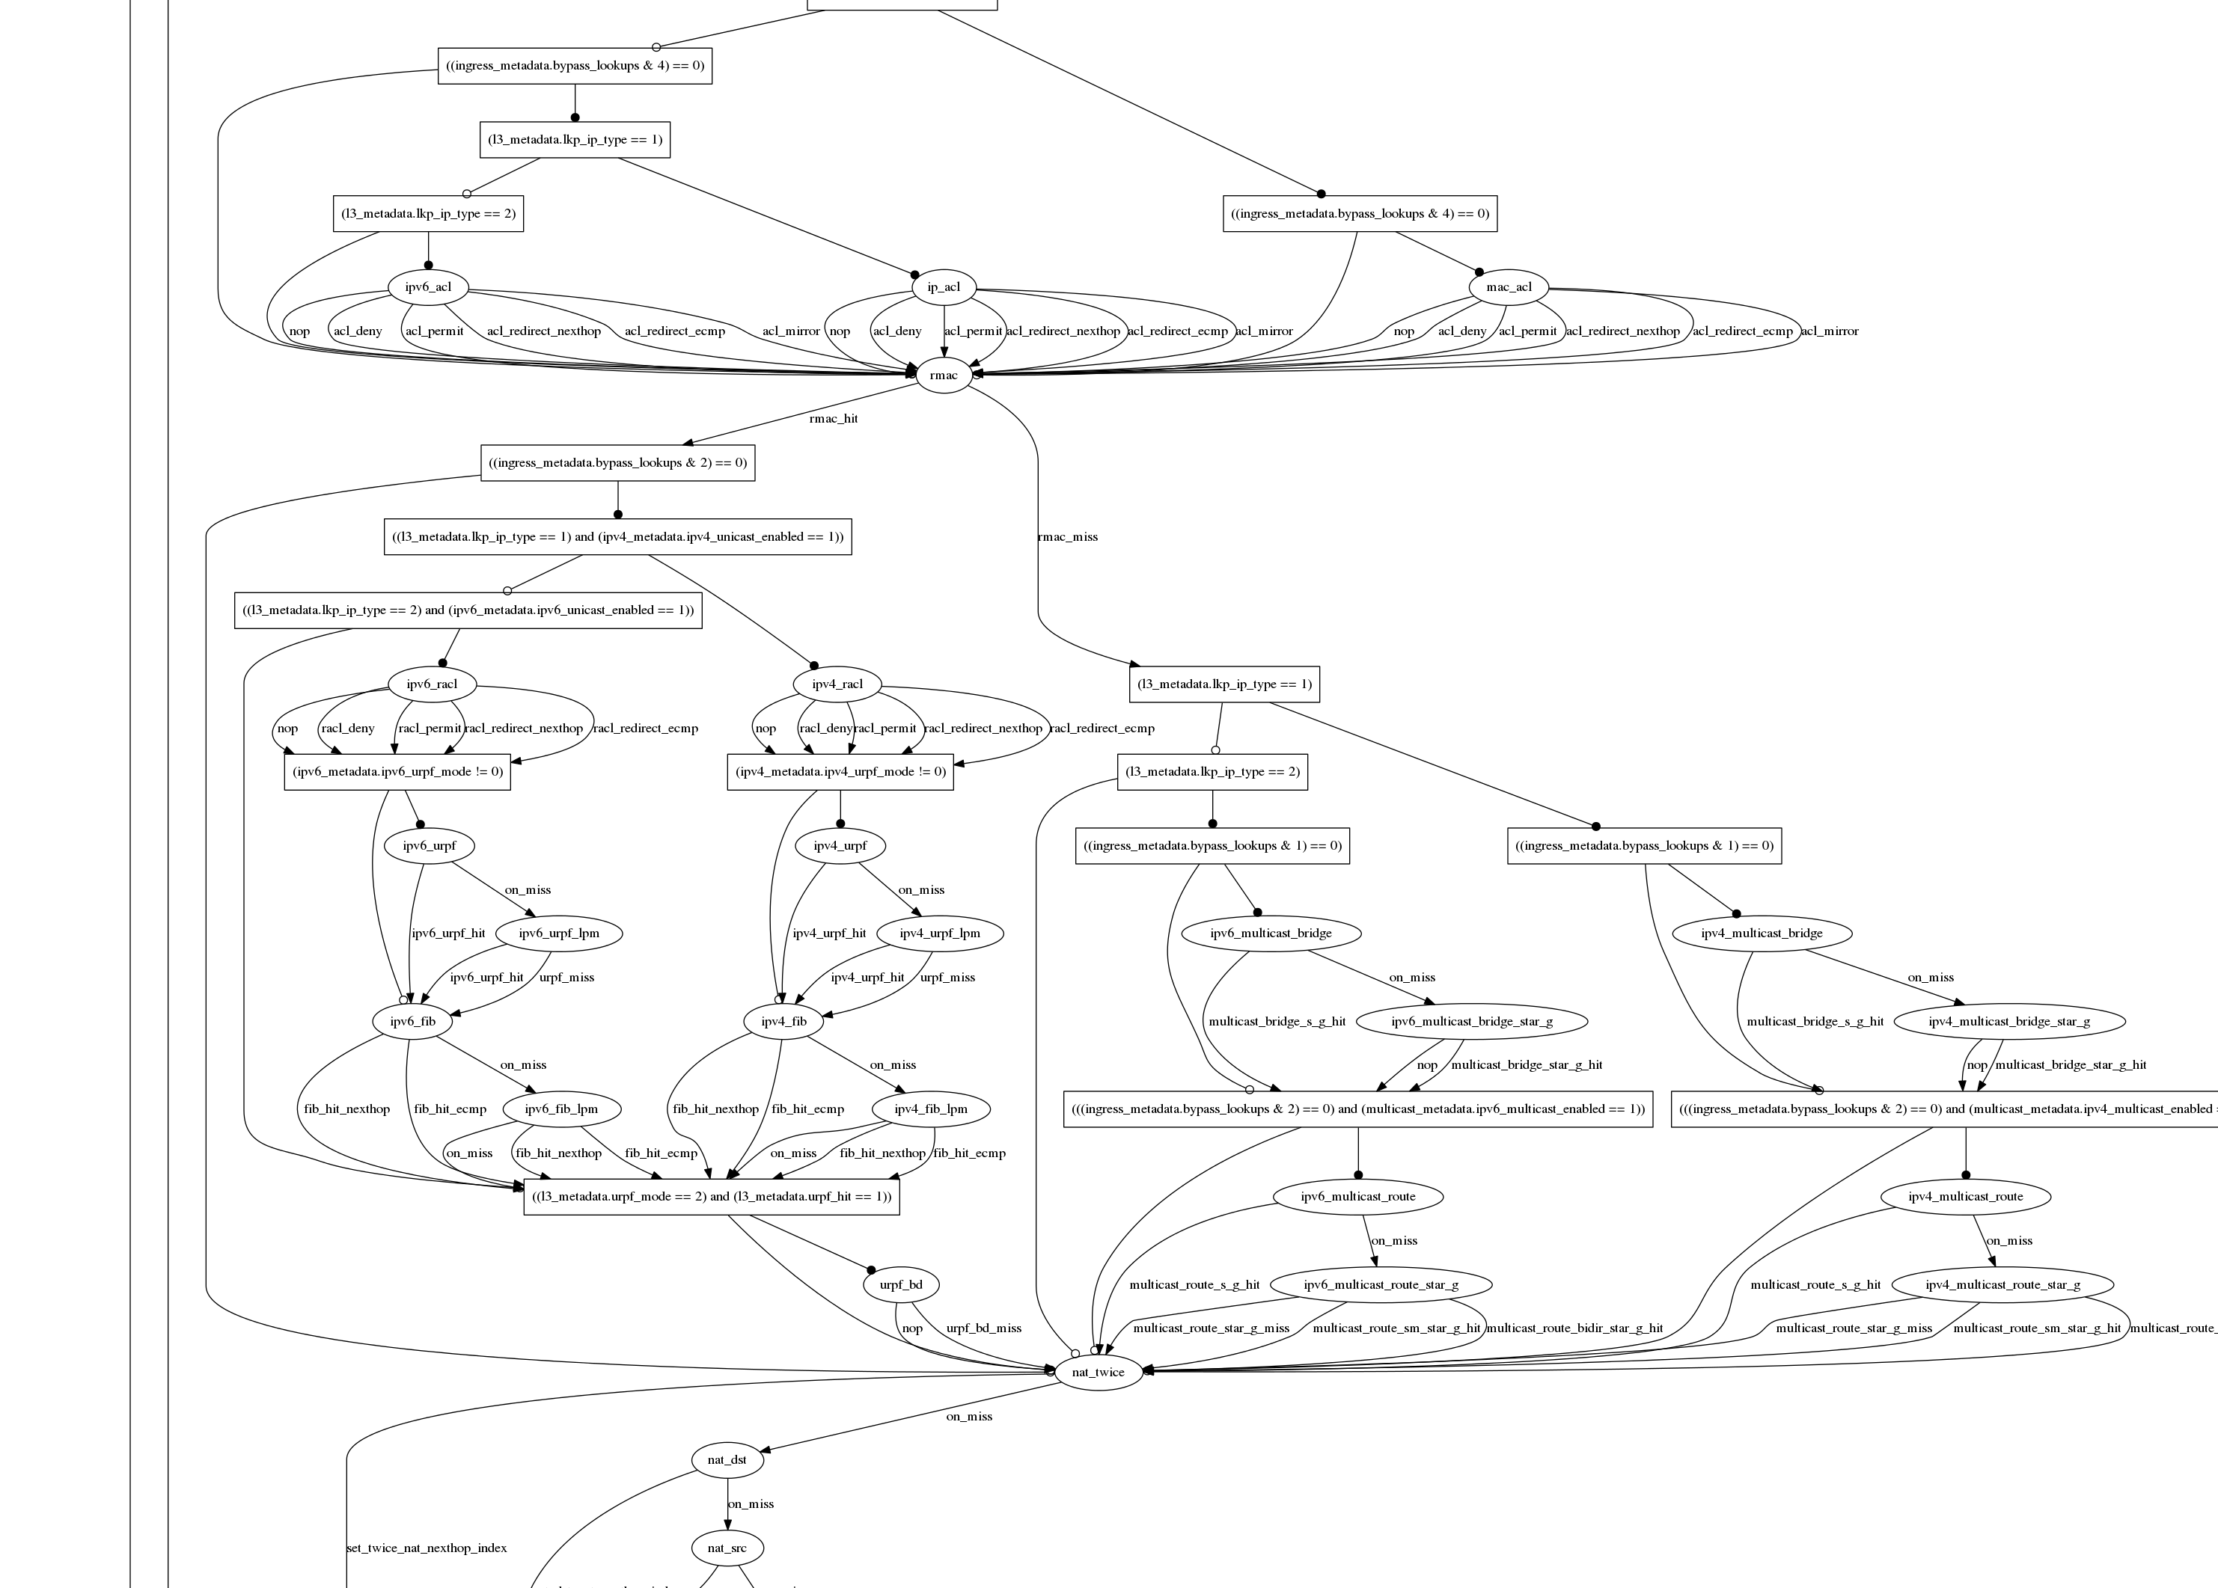
Datacenter switch today
Switch.p4

Slide 30
Adding features: Some examples so far
New encapsulations and tunnels
New ways to tag packets for special treatment
New approaches to routing: e.g. source routing in MSDCs
New approaches to congestion control
New ways to process packets: e.g. processing ticker-symbols

Slide 31
New applications: Some examples so far
Layer-4 Load Balancer¹
  Replace 100 servers or 10 dedicated boxes with one programmable switch
  Track and maintain mapping for 5-10 million http flows
Fast stateless firewall
  Add/delete and track 100s of thousands of new connections per second
Cache for Key-value store²
  Memcache in-network cache for 100 servers
  1-2 billion operations per second
[1] “SilkRoad: Making Stateful Layer-4 Load Balancing Fast and Cheap Using Switching ASICs.” Rui Miao et al. Sigcomm 2017.
[2] “NetCache: Balancing Key-Value Stores with Fast In-Network Caching”, Xin Jin et al. SOSP 2017

Slide 32
How programmability is being used
Network telemetry
3

Slide 33
“I visited Switch 1 @780ns,
Switch 9 @1.3µs, Switch 12 @2.4µs”
1
“Which path did my packet take?”
# | Rule
1
2
3
…
75 | 192.168.0/24
…
“In Switch 1, I followed rules 75 and 250. In Switch 9, I followed rules 3 and 80. ”
2
“Which rules did my packet follow?”

Slide 34
3
“How long did my packet queue at each switch?”
“Delay: 100ns, 200ns, 19740ns”
Queue
4
“Who did my packet share the queue with?”
Time

Slide 35
3
“How long did my packet queue at each switch?”
“Delay: 100ns, 200ns, 19740ns”
Aggressor flow!
Queue
4
“Who did my packet share the queue with?”
Time

Slide 36
We’d like the network to answer these questions
“Which path did my packet take?”
“Which rules did my packet follow?”
“How long did it queue at each switch?”
“Who did it share the queues with?”
A PISA device programmed using P4 can answer all four questions at line rate, for the first time. Without generating additional packets.

Slide 37
INT: Inband Network Telemetry
Add: SwitchID, Arrival Time,
Queue Delay, Matched Rules, …
Original Packet
Log, Analyze
Replay
Visualize

Slide 38
/* INT: add switch id */
action int_set_header_0() {
add_header(int_switch_id_header);
modify_field(int_switch_id_header.switch_id,
global_config_metadata.switch_id);
}
/* INT: add ingress timestamp */
action int_set_header_1() {
add_header(int_ingress_tstamp_header);
modify_field(int_ingress_tstamp_header.ingress_tstamp, i2e_metadata.ingress_tstamp);
}
/* INT: add egress timestamp */
action int_set_header_2() {
add_header(int_egress_tstamp_header);
modify_field(int_egress_tstamp_header.egress_tstamp,
eg_intr_md_from_parser_aux.egress_global_tstamp);
}
P4 code snippet: Insert switch ID, ingress and egress timestamp
Log, Analyze
Replay
Visualize

Slide 39
How programmability is being used
1
Reducing complexity
Adding new features
Network telemetry
2
3

Slide 40
In summary…
SDN is about who is in charge!
  Network owners and operators took charge of how their networks are controlled.
  They also decide how packets are processed.
Chip technology: Programmable forwarding now has the same power, performance and cost as fixed function.
New ideas: Beautiful new ideas now owned by the programmer, not the chip designer.

Slide 41
Back to Packet Forwarding in Data Plane …

Slide 42
Back to Data Plane Packet Forwarding
Most important functionality of the data plane: packet forwarding
Packet forwarding
  Receive packet on ingress lines
  Transfer to the appropriate egress line
  Transmit the packet

Slide 43
Output-Queued Switching
Data
1
1
Hdr
Header Processing
Queue
Packet
Lookup
IP Address
Update
Header
Address
Table
Buffer
Memory
Data
2
2
N times line rate
Hdr
Header Processing
Queue
Packet
Lookup
IP Address
Update
Header
Address
Table
Buffer
Memory
N times line rate
Data
Hdr
Header Processing
N
N
Queue
Packet
Lookup
IP Address
Update
Header
Address
Table
Buffer
Memory
43

Slide 44
Properties of OQ Switches
Require speedup of N
  Crossbar fabric N times faster than the line rate
Work conserving
  If there is a packet for a specific output port, link will not stay idle
Ideal in theory
  Achieves 100% throughput
  Very hard to build in practice

Slide 45
Input-Queued Switching
Data
Hdr
Header Processing
Lookup
IP Address
Update
Header
Queue
Packet
1
1
Address
Table
Buffer
Memory
Data
Hdr
Data
Hdr
Header Processing
Data
Queue
Packet
2
2
Hdr
Lookup
IP Address
Update
Header
Address
Table
Buffer
Memory
Scheduler
Data
Hdr
Header Processing
Lookup
IP Address
Update
Header
Queue
Packet
N
N
Address
Table
Buffer
Memory
Data
Hdr

Slide 46
Properties of Input-Queued Switches
Need for a scheduler
  Choose which input port to connect to which output port during each time slot
No speedup necessary
  But sometimes helpful to ensure 100% throughput
Throughput might be limited due to poor scheduling

Slide 47
Head-of-Line Blocking
Blocked!
Blocked!
Blocked!
The switch is NOT work-conserving!

Slide 50
VOQs: How Packets Move
VOQs
Scheduler

Slide 51
HoL Blocking vs. OQ Switch
IQ switch with HoL blocking
OQ switch
Delay
0%
20%
40%
60%
80%
100%
Load

Slide 52
Scheduling in Input-Queued Switches
Input: the scheduler can use …
  Average rate
  Queue sizes
  Packet delays
Output: which ingress port to connect to which egress port
  A matching between input and output ports
Goal: achieve 100% throughput

Slide 53
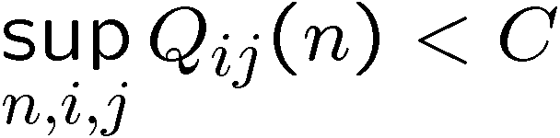
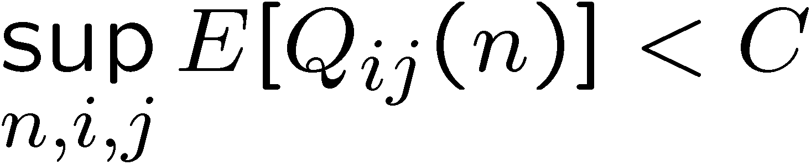
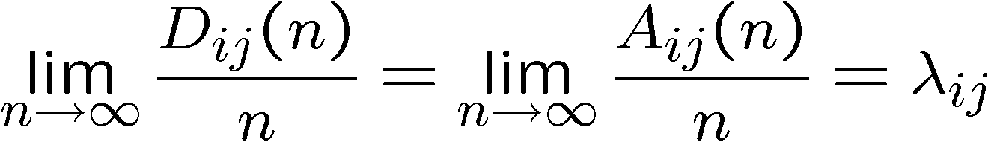
Common Definitions of 100% throughput
Work-conserving
For all n,i,j, Q_{ij}(n) < C,
i.e.,
For all n,i,j, E[Q_{ij}(n)] < C
i.e.,
Departure rate = arrival rate,
i.e.,
weaker
Usually we focus on this definition.
Notes:
Other definitions?
Why “100% throughput”?

Slide 54
Scheduling in Input-Queued Switches
Uniform traffic
  Uniform cyclic
  Random permutation
  Wait-until-full
Non-uniform traffic, known traffic matrix
  Birkhoff-von-Neumann
Unknown traffic matrix
  Maximum Size Matching
  Maximum Weight Matching

Slide 55
100% Throughput for Uniform Traffic
Nearly all algorithms in literature can give 100% throughput when traffic is uniform
For example:
  Uniform cyclic.
  Random permutation.
  Wait-until-full [simulations].
  Maximum size matching (MSM) [simulations].
  Maximal size matching (e.g. WFA, PIM, iSLIP) [simulations].

Slide 56
Uniform Cyclic Scheduling
A
1
A
1
A
1
B
2
B
2
B
2
C
3
C
3
C
3
D
4
D
4
D
4
Each (i, j) pair is served every N time slots: Geom/D/1
λ=ρ/N < 1/N
1/N
Stable for ρ < 1

Slide 57
Wait Until Full
We don’t have to do much at all to achieve 100% throughput when arrivals are Bernoulli IID uniform.
Simulation suggests that the following algorithm leads to 100% throughput.
Wait-until-full:
  If any VOQ is empty, do nothing (i.e. serve no queues).
  If no VOQ is empty, pick a random permutation.

Slide 58
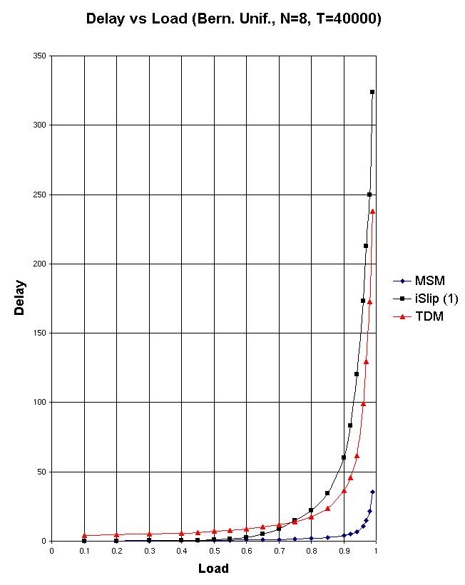
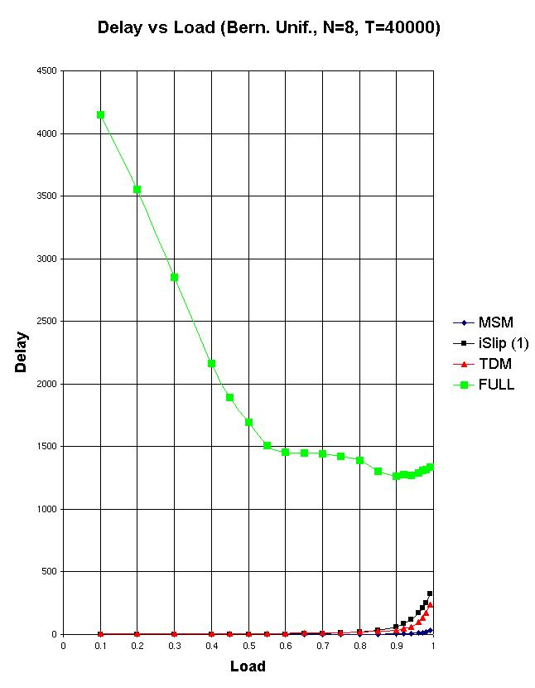
Simple Algorithms with 100% Throughput
Wait
until
full
Uniform Cyclic
Maximal
Matching
Algorithm
(iSLIP)
MSM

Slide 59
Outline
Uniform traffic
  Uniform cyclic
  Random permutation
  Wait-until-full
Non-uniform traffic, known traffic matrix
  Birkhoff-von-Neumann
Unknown traffic matrix
  Maximum Size Matching
  Maximum Weight Matching

Slide 60
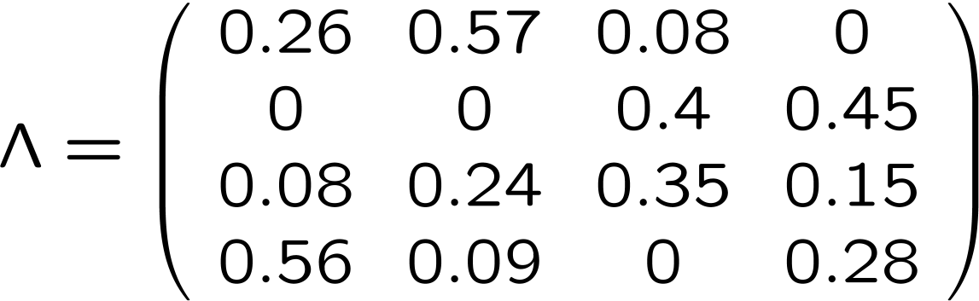
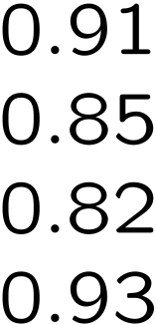
Non-Uniform Traffic
Assume the traffic matrix is:
Λ is admissible (rates < 1) and non-uniform

Slide 61
Uniform Schedule?
Uniform schedule cannot work
Each VOQ serviced at rate μ = 1/N = ¼
Arrival rate > departure rate ⇒ switch unstable!
Need to adapt schedule to traffic matrix.

Slide 62
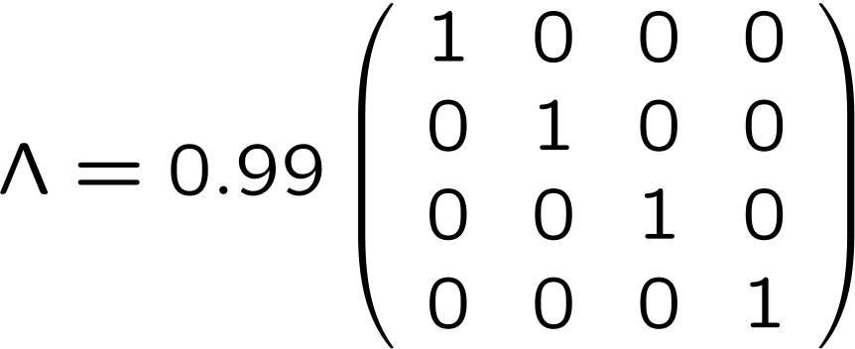
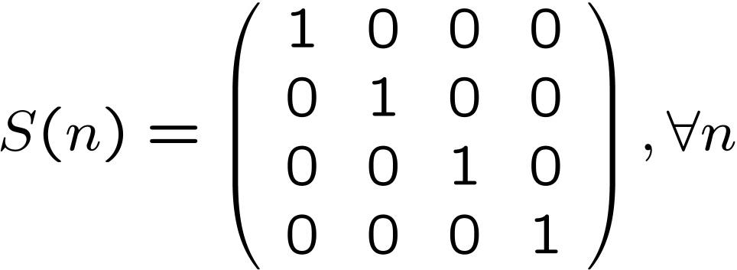
Example 1 – Scheduling (Trivial)
Assume we know the traffic matrix, it is admissible, and it follows a permutation:
Then we can simply choose:

Slide 63
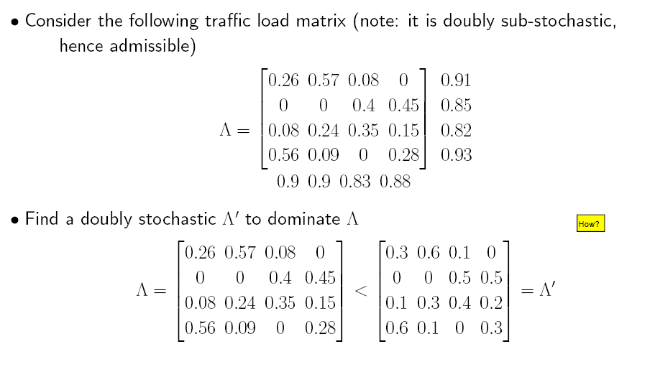
Example 2 - BvN
Consider the following traffic matrix:
Step 1) Increase entries so rows/cols each add up to 1.

Slide 64
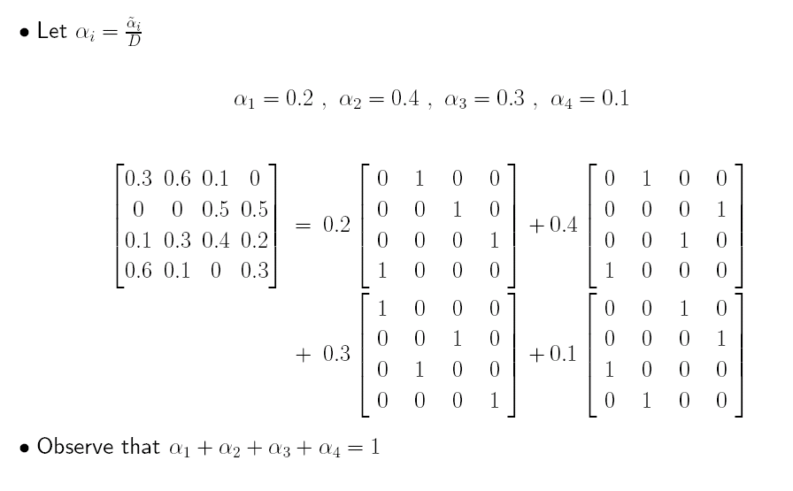
BvN Example – Cont’d
Step 2) Find permutation matrices and weights so that …
Schedule these permutation matrices based on the weights.
For details, please see the references.

Slide 65
Unknown Traffic Matrix
We want to maximize throughput
Traffic matrix unknown ⇒ cannot use BvN
Idea: maximize instantaneous throughput
  In other words: transfer as many packets as possible at each time-slot
Maximum Size Matching (MSM) algorithm

Slide 66
Maximum Size Matching (MSM)
MSM maximizes instantaneous throughput
MSM algorithm: among all maximum size matches, pick a random one
Q₁₁(n)>0
Maximum
Size Match
Q_{N1}(n)>0
Request Graph
Bipartite Match

Slide 67
Question
Is the intuition right?
  Answer: NO!
There is a counter-example for which, in a given VOQ (i,j), λ_{ij} < μ_{ij} but MSM does not provide 100% throughput.

Slide 68
Counter-example
Consider the following non-uniform traffic pattern, with Bernoulli IID arrivals:
Consider the case when Q₂₁, Q₃₂ both have arrivals, w. p. (1/2 - δ)².
In this case, input 1 is served w. p. at most 2/3.
Overall, the service rate for input 1, μ₁ is at most
2/3.[(1/2-δ)²] + 1.[1-(1/2- δ)²]
i.e. μ₁ ≤ 1 – 1/3.(1/2- δ)² .
Switch unstable for δ ≤ 0.0358
Three possible
matches, S(n):

Slide 69
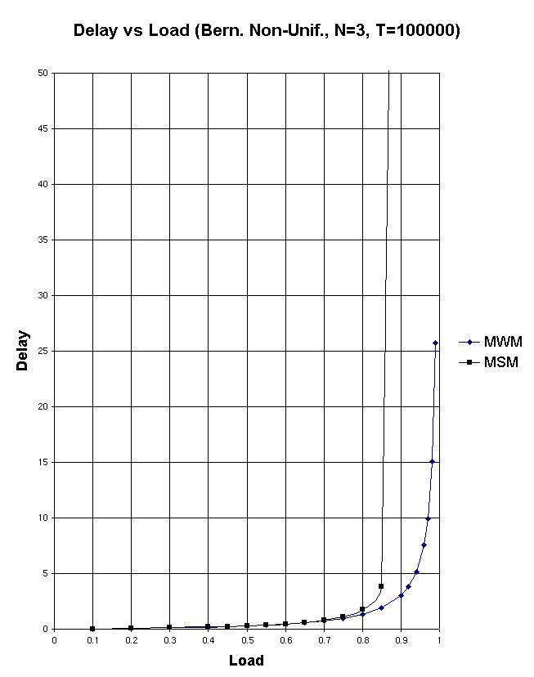
Simulation of Simple 3x3 Example

Slide 70
Outline
Uniform traffic
  Uniform cyclic
  Random permutation
  Wait-until-full
Non-uniform traffic, known traffic matrix
  Birkhoff-von-Neumann
Unknown traffic matrix
  Maximum Size Matching
  Maximum Weight Matching

Slide 71
Scheduling in Input-Queued Switches
Problem. Maximum size matching
  Maximizes instantaneous throughput.
  Does not take into account VOQ backlogs.
Solution. Give higher priority to VOQs which have more packets.
S*(n)
Q₁₁(n)
A₁(n)
A₁₁(n)
D₁(n)
1
1
A_{1N}(n)
A_{N}(n)
A_{N1}(n)
D_{N}(n)
A_{NN}(n)
N
N
Q_{NN}(n)

Slide 72
Maximum Weight Matching (MWM)
Assign weights to the edges of the request graph.
Find the matching with maximum weight.
Q₁₁(n)>0
W₁₁
Assign
Weights
Q_{N1}(n)>0
W_{N1}
Request Graph
Weighted Request Graph

Slide 73
MWM Scheduling
Create the request graph.
Find the associated link weights.
Find the matching with maximum weight.
  How?
Transfer packets from the ingress lines to egress lines based on the matching.
Question. How often do we need to calculate MWM?

Slide 74
Weights
Longest Queue First (LQF)
  Weight associated with each link is the length of the corresponding VOQ.
  MWM here, tends to give priority to long queues.
  Does not necessarily serve the longest queue.
Oldest Cell First (OCF)
  Weight of each link is the waiting time of the HoL packet in the corresponding queue.

Slide 75
Recap
Uniform traffic
  Uniform cyclic
  Random permutation
  Wait-until-full
Non-uniform traffic, known traffic matrix
  Birkhoff-von-Neumann
Unknown traffic matrix
  Maximum Size Matching
  Maximum Weight Matching

Slide 76
Summary of MWM Scheduling
MWM – LQF scheduling provides 100% throughput.
  It can starve some of the packets.
MWM – OCF scheduling gives 100% throughput.
  No starvation.
Question. Are these fast enough to implement in real switches?

Slide 77
Complexity of Maximum Matchings
Maximum Size Matchings:
  Typical complexity O(N^{2.5})
Maximum Weight Matchings:
  Typical complexity O(N³)
In general:
  Hard to implement in hardware
  Slooooow
Can we find a faster algorithm?

Slide 78
Maximal Matching
A maximal matching is a matching in which each edge is added one at a time, and is not later removed from the matching.
No augmenting paths allowed (they remove edges added earlier)
Consequence: no input and output are left unnecessarily idle.

Slide 79
Example of Maximal Matching
A
1
A
1
A
1
B
2
B
2
B
2
C
3
C
3
C
3
D
4
D
4
D
4
E
5
E
5
E
5
F
6
F
6
F
6
Maximal
Size Matching
Maximum
Size Matching

Slide 80
Properties of Maximal Matchings
In general, maximal matching is much simpler to implement, and has a much faster running time.
A maximal size matching is at least half the size of a maximum size matching. (Why?)
We’ll study the following algorithms:
  Greedy LQF
  WFA
  PIM
  iSLIP

Slide 81
Greedy LQF
Greedy LQF (Greedy Longest Queue First) is defined as follows:
  Pick the VOQ with the most number of packets (if there are ties, pick at random among the VOQs that are tied). Say it is VOQ(i₁,j₁).
  Then, among all free VOQs, pick again the VOQ with the most number of packets (say VOQ(i₂,j₂), with i₂ ≠ i₁, j₂ ≠ j₁).
  Continue likewise until the algorithm converges.
Greedy LQF is also called iLQF (iterative LQF) and Greedy Maximal Weight Matching.

Slide 82
Properties of Greedy LQF
The algorithm converges in at most N iterations. (Why?)
Greedy LQF results in a maximal size matching. (Why?)
Greedy LQF produces a matching that has at least half the size and half the weight of a maximum weight matching. (Why?)

Slide 83
Wave Front Arbiter (WFA) [Tamir and Chi, 1993]
Requests
Match
1
1
1
1
2
2
2
2
3
3
3
3
4
4
4
4

Slide 84
Wave Front Arbiter
Requests
Match

Slide 85
Wave Front Arbiter – Implementation
Simple combinational
logic blocks
1,1
1,2
1,3
1,4
2,1
2,2
2,3
2,4
3,1
3,2
3,3
3,4
4,1
4,2
4,3
4,4

Slide 86
Wave Front Arbiter – Wrapped WFA (WWFA)
N steps instead of
2N-1
Requests
Match

Slide 87
Properties of Wave Front Arbiters
Feed-forward (i.e. non-iterative) design lends itself to pipelining.
Always finds maximal match.
Usually requires mechanism to prevent Q₁₁ from getting preferential service.
In principle, can be distributed over multiple chips.

Slide 88
Parallel Iterative Matching [Anderson et al., 1993]
uar selection
uar selection
Iteration:
1
1
1
1
1
1
#1
2
2
2
2
2
2
3
3
3
3
3
3
4
4
4
4
4
4
Φ1: Requests
Φ2: Grant
Φ3: Accept/Match
1
1
1
1
1
1
2
2
2
2
2
2
#2
3
3
3
3
3
3
4
4
4
4
4
4

Slide 89
PIM Properties
Guaranteed to find a maximal match in at most N iterations. (Why?)
In each phase, each input and output arbiter can make decisions independently.
In general, will converge to a maximal match in < N iterations.
How many iterations should we run?

Slide 90
Parallel Iterative Matching – Convergence Time
Number of iterations to converge:
Anderson et al., “High-Speed Switch Scheduling for Local Area Networks,” 1993.

Slide 91
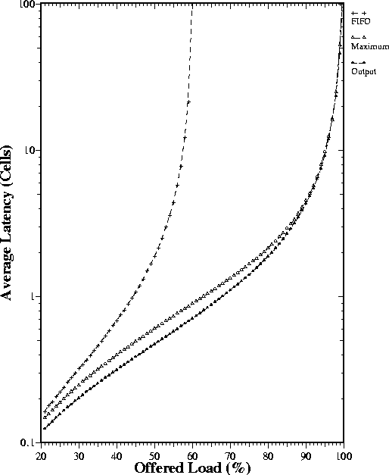
Parallel Iterative Matching

Slide 92
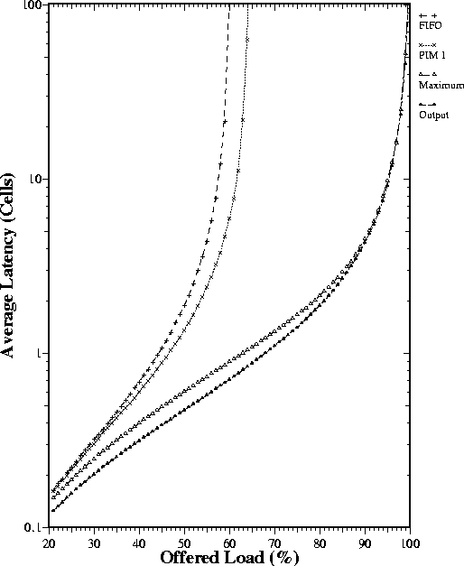
Parallel Iterative Matching
PIM with a single iteration

Slide 93
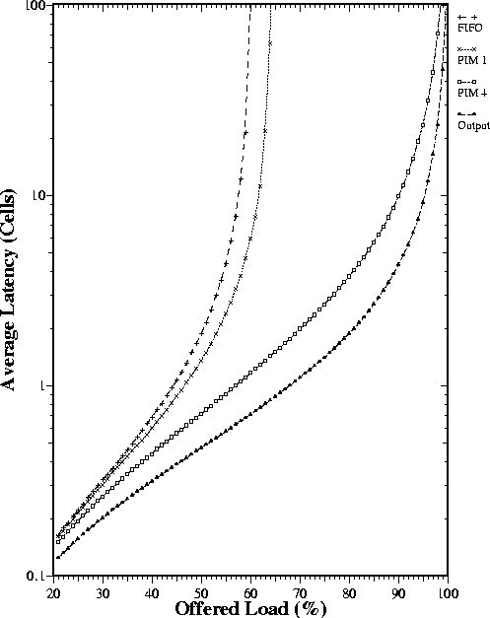
Parallel Iterative Matching
PIM with 4 iterations

Slide 94
iSLIP [McKeown et al., 1993]
1
4
2
1
1
1
1
1
1
3
2
2
2
2
2
2
#1
3
3
3
3
3
3
4
4
4
4
4
4
Φ1: Requests
Φ2: Grant
Φ3: Accept/Match
1
1
1
1
1
1
2
2
2
2
2
2
#2
3
3
3
3
3
3
4
4
4
4
4
4

Slide 95
iSLIP Operation
Grant phase: Each output selects the requesting input at the pointer, or the next input in round-robin order. It only updates its pointer if the grant is accepted.
Accept phase: Each input selects the granting output at the pointer, or the next output in round-robin order.
Consequence: Under high load, grant pointers tend to move to unique values.

Slide 96
iSLIP Properties
Random under low load
TDM under high load
Lowest priority to MRU (most recently used)
1 iteration: fair to outputs
Converges in at most N iterations. (On average, simulations suggest < log2N)
Implementation: N priority encoders
100% throughput for uniform i.i.d. traffic.
But…some pathological patterns can lead to low throughput.

Slide 97
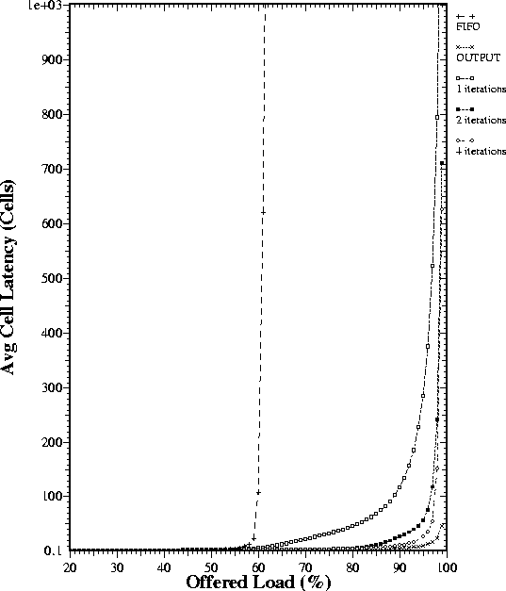
iSLIP

Slide 98
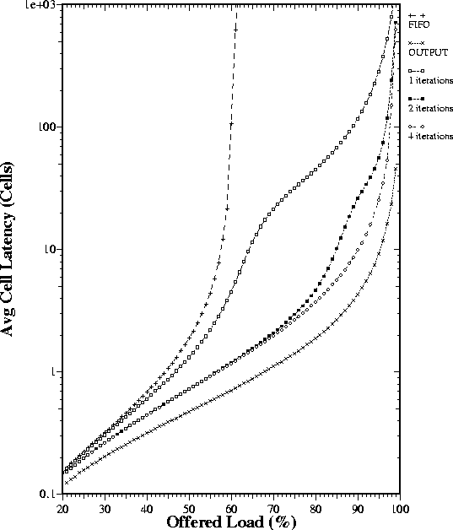
iSLIP

Slide 99
iSLIP Implementation
Programmable
Priority Encoder
State
N
1
1
log₂N
Decision
Grant
Accept
2
2
N
Grant
Accept
log₂N
N
N
N
Grant
Accept
log₂N

Slide 100
Maximal Matches
Maximal matching algorithms are widely used in industry (especially algorithms based on WFA and iSLIP).
PIM and iSLIP are rarely run to completion (i.e. they are sub-maximal).
A maximal match with a speedup of 2 is stable for non-uniform traffic.

Slide 101
References
“Achieving 100% Throughput in an Input-queued Switch (Extended Version)”. Nick McKeown, Adisak Mekkittikul, Venkat Anantharam and Jean Walrand. IEEE Transactions on Communications, Vol.47, No.8, August 1999.
“A Practical Scheduling Algorithm to Achieve 100% Throughput in Input-Queued Switches.”. Adisak Mekkittikul and Nick McKeown. IEEE Infocom 98, Vol 2, pp. 792-799, April 1998, San Francisco.

Slide 102
References
A. Schrijver, “Combinatorial Optimization - Polyhedra and Efficiency”, Springer-Verlag, 2003.
T. Anderson, S. Owicki, J. Saxe, and C. Thacker, “High-Speed Switch Scheduling for Local-Area Networks,” ACM Transactions on Computer Systems, II (4):319-352, November 1993.
Y. Tamir and H.-C. Chi, “Symmetric Crossbar Arbiters for VLSI Communication Switches,” IEEE Transactions on Parallel and Distributed Systems, 4(j):13-27, 1993.
N. McKeown, “The iSLIP Scheduling Algorithm for Input-Queued Switches,” IEEE/ACM Transactions on Networking, 7(2):188-201, April 1999.

