Slide 1
Handout # 24:
Data Center Networks &
Networks for Machine Learning
Professor Yashar Ganjali
Department of Computer Science
University of Toronto
ganjali7@cs.toronto.edu
http://www.cs.toronto.edu/~yganjali

Slide 2
Announcements
Programming Assignment 2: Simple Router
  Due Friday March 28th at 5pm.
This week’s tutorial:
  Programming Assignment 2 Q&A
Next week:
  Sample final exam review
  Sample final and solutions posted on class website
Final Exam
  Time: April 26th, 2pm – 4pm
  Location: MS 3153
    Please double check before the exam

Slide 3
The Story So Far
Layering
  Link layer
  Network layer
  Transport layer
Queueing Mechanisms, Middleboxes,
Software-Defined Networking
Today: Data Center Networks & Networks for Machine Learning

Slide 4
Machine Learning and Computer Networks
Machine Learning (ML):
  Significant growth in the recent years
  Lots of attention and impact
How does it affect computer networking?
  Networks for ML: can traditional networks handle ML requirements?
    Our focus is on data center networks here.
  ML for Networks: how can ML be used to enhance computer networks?
    Networks in general.

Slide 5
Machine Learning and Computer Networks
Machine Learning (ML):
  Significant growth in the recent years
  Lots of attention and impact
How does it affect computer networking?
  Networks for ML: can traditional networks handle ML requirements?
    Our focus is on data center networks here.
  ML for Networks: how can ML be used to enhance computer networks?
    Networks in general.

Slide 6
Today’s Lecture
Data Center Networking
  Design Decision
  Topology
  Transport
Networks for ML
ML for Networks

Slide 7
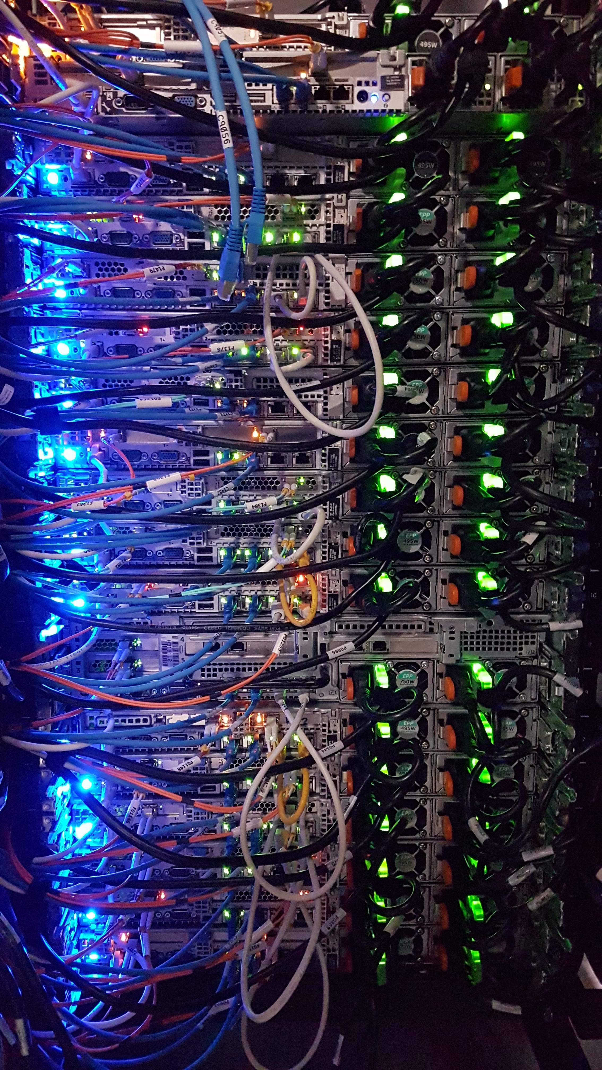
Data Center Network (DCN)
A network of computing and storage resources
  Proximity of components (within the data center) facilitates communication, i.e., high-performance
  Can lead to reduced cost and overheads
    Major cost upfront but less cost in long run.
Functions
  Data Storage and Management
    Security, efficiency, reliability
  Application Hosting
    End-users and business applications, cloud computing and SaaS models
  Data Processing
    Large volumes of data for analytics and processing, big data and AI workloads
  And more …

Slide 8
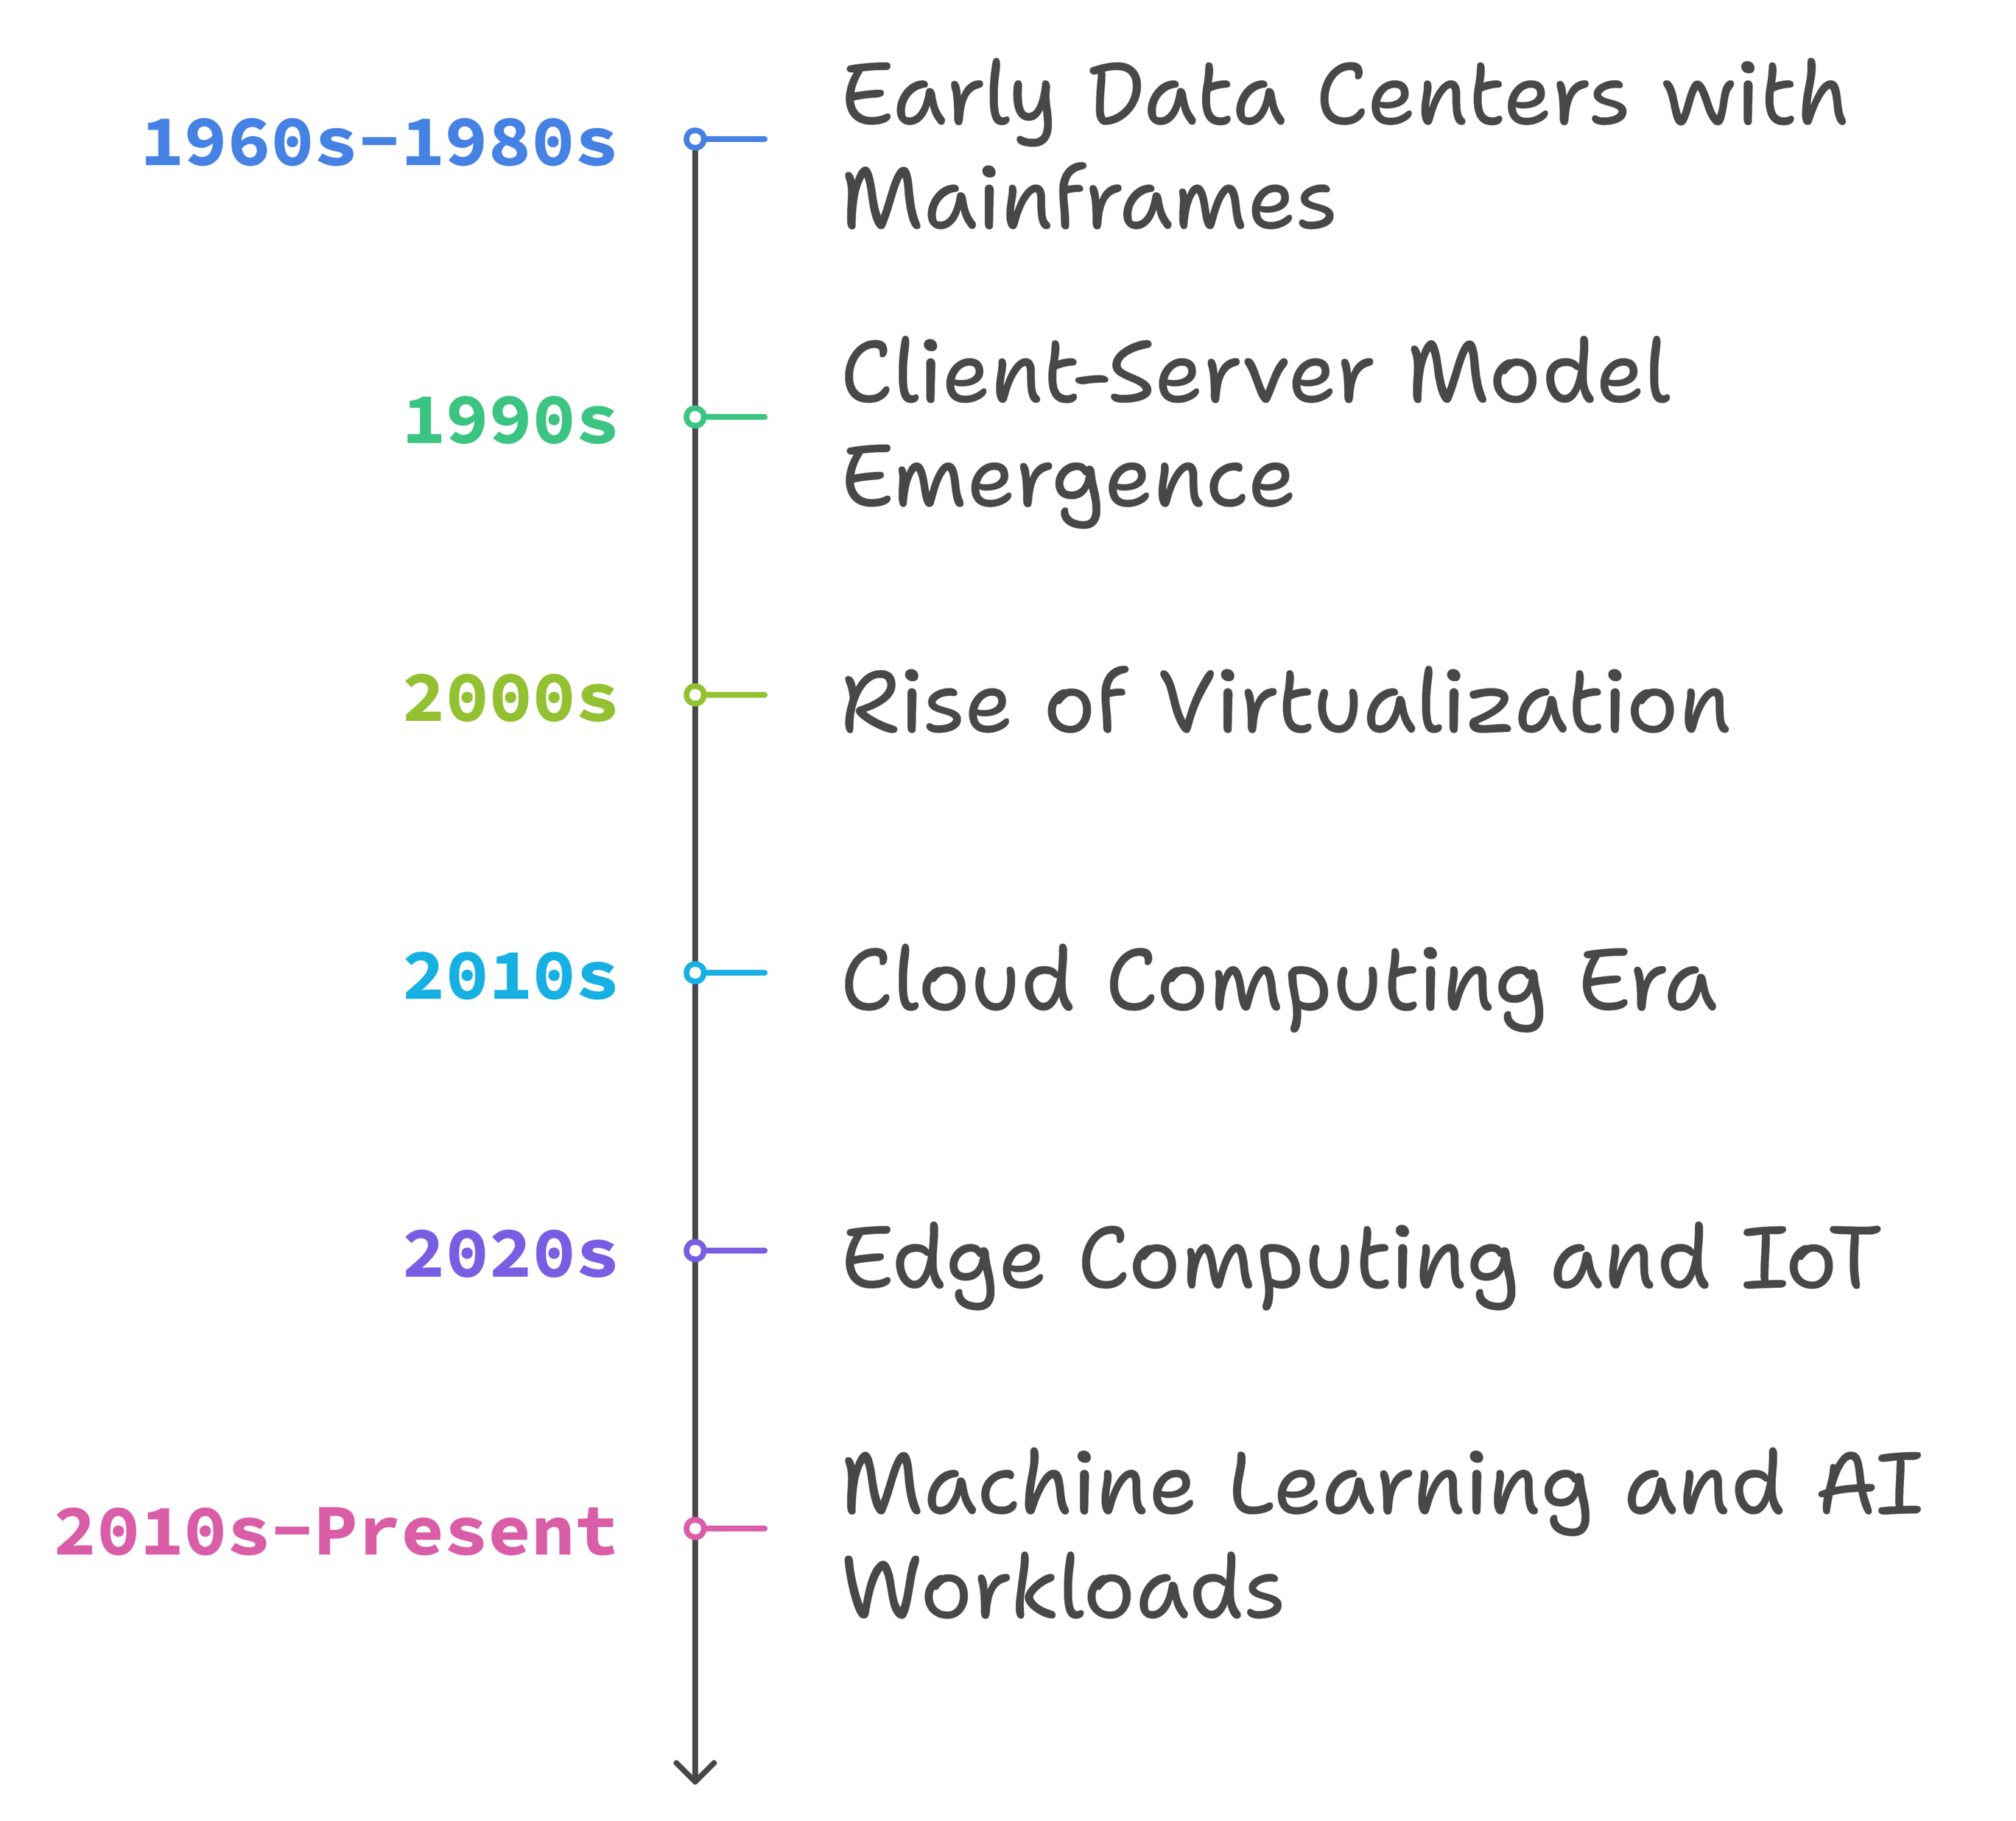
Evolution of DCN
Early Data Centers (1960s-1980s)
  Mainframes
  Centralized computing: limited networking
  Point-to-point and proprietary connections
Client-Server Model (1990s)
  Distributed computing
  Ethernet, TCP/IP
Rise of Virtualization (2000s)
  Virtual machines
  Efficiency and scalability
  VLANs, network segmentation
Cloud Computing Era (2010s)
  Cloud services
  SDN: Scalability and automation
Edge Computing and IoT (2020s)
  Demand for low-latency, distributed network architectures
  Micro data centers closer to data sources
Machine Learning and AI (2010s-Present)
  Exascale high-performance computing
  Network as the bottleneck: stringent performance requirements

Slide 9
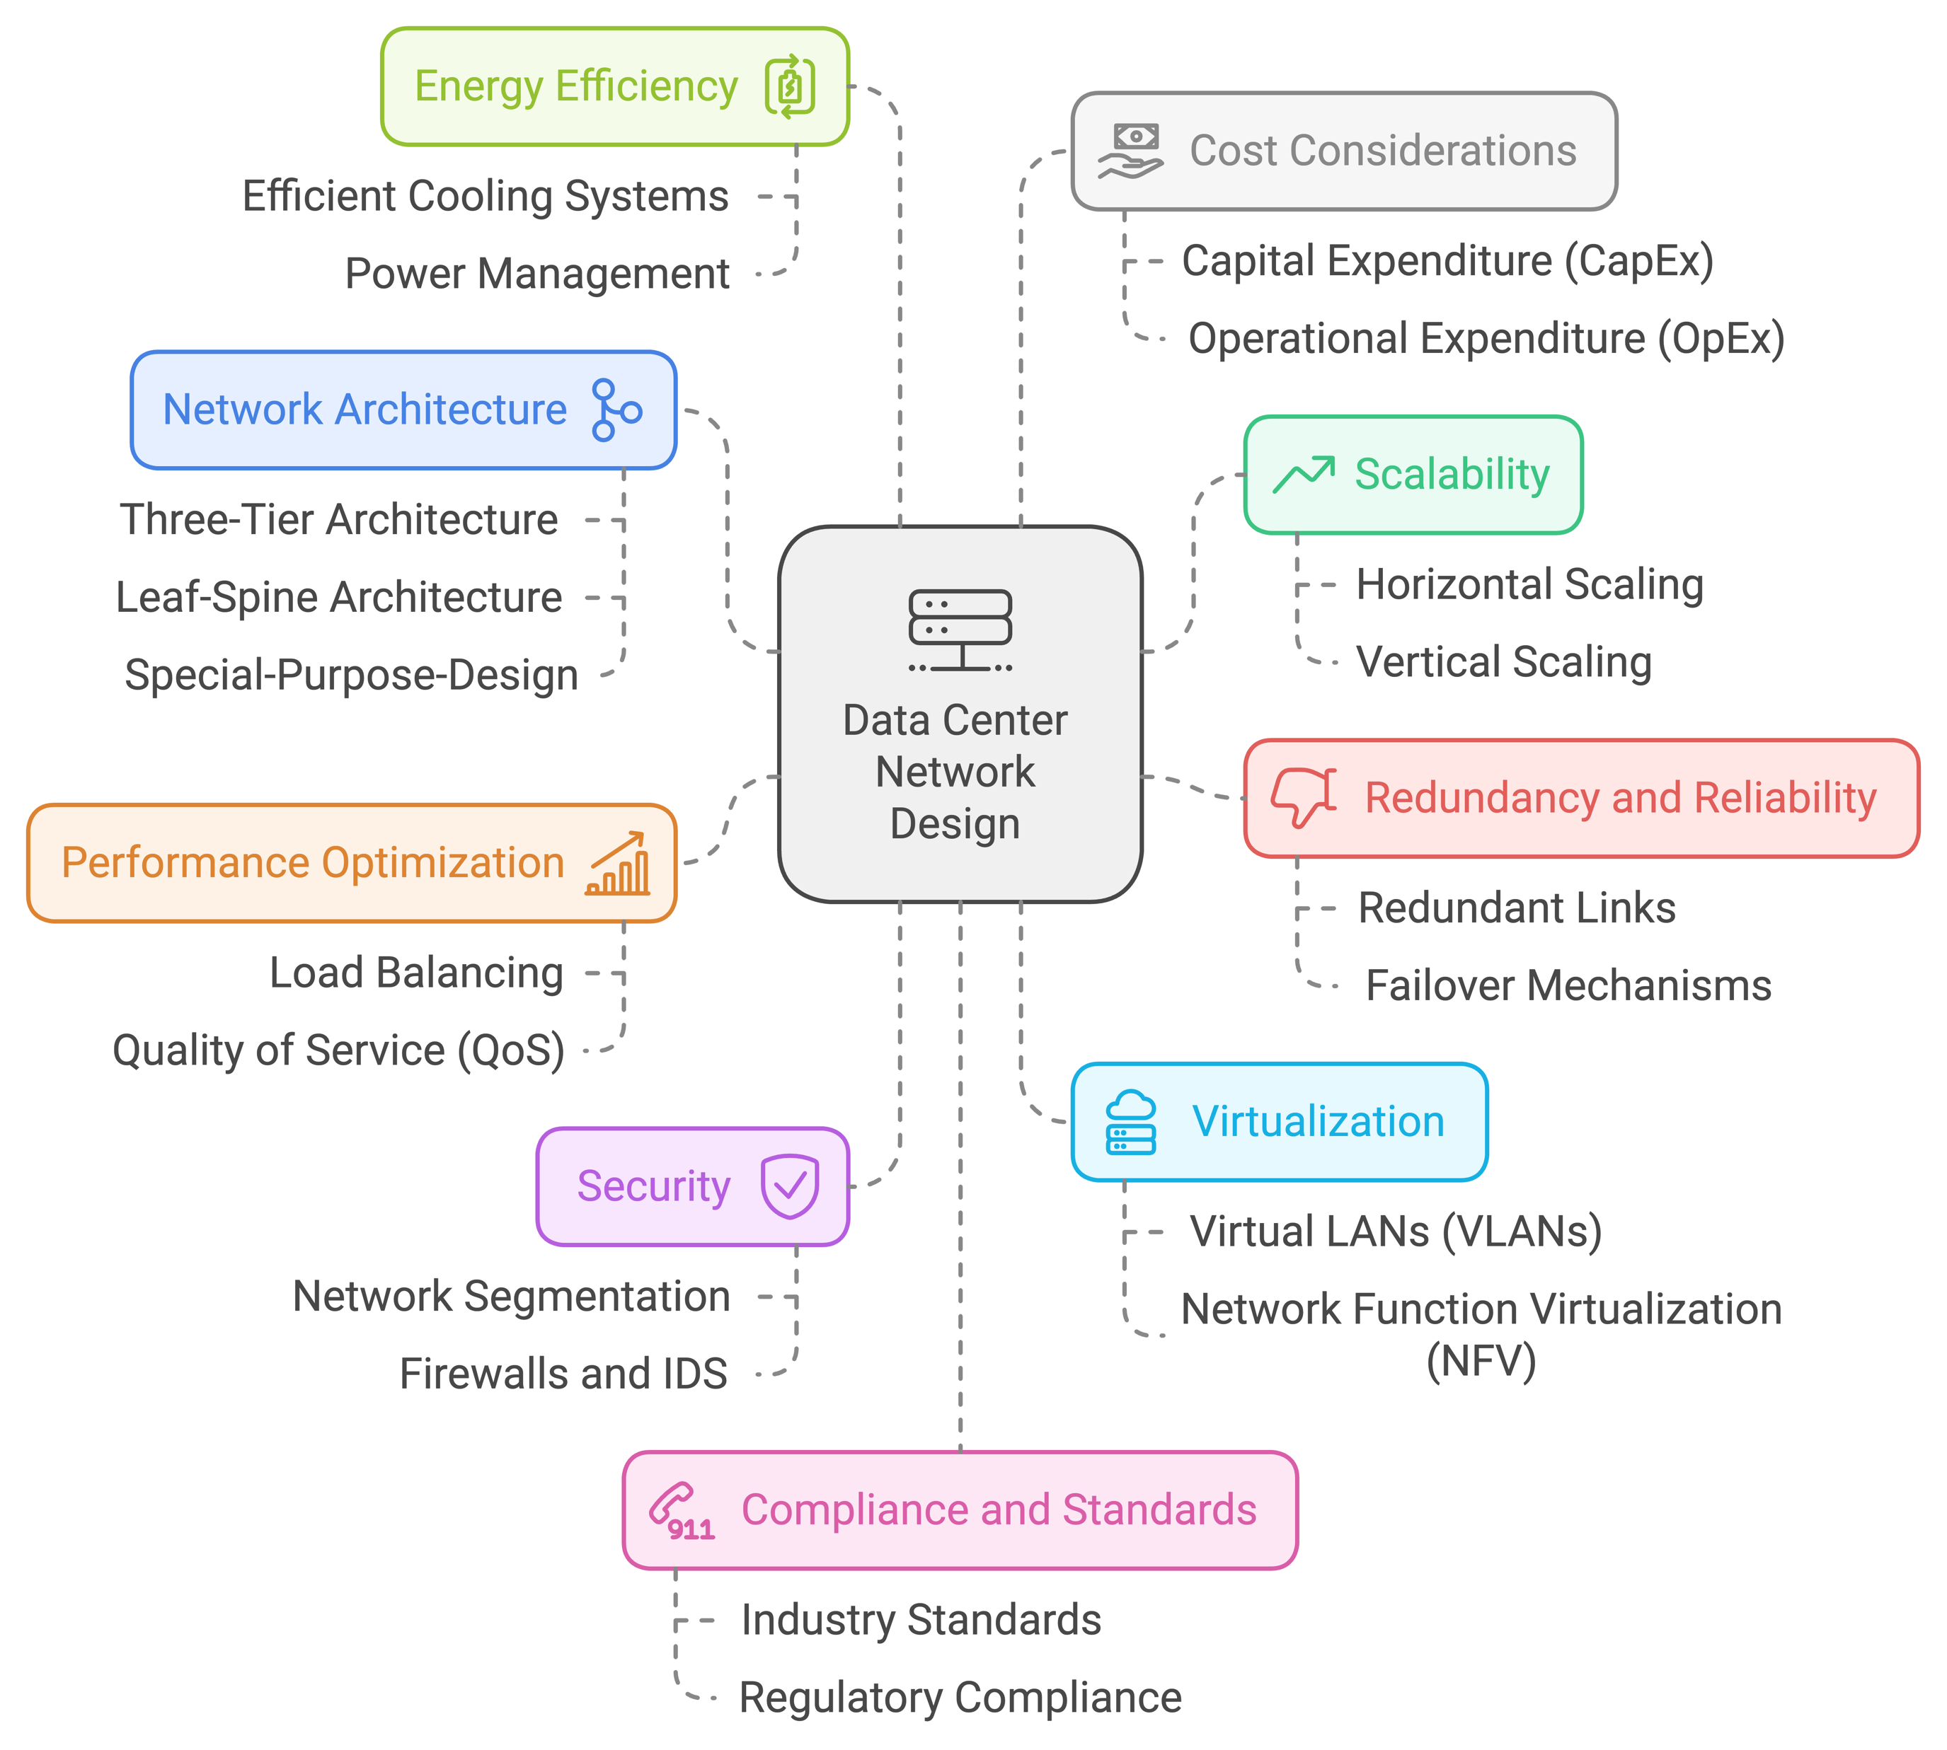
DCN Design Dimensions

Slide 10
Three-Tier Architecture
Hierarchical tree network topology
Commonly used in traditional DCNs
Three layers:
Core:
  Layer 3 (network layer)
  Fully connected high-speed mesh of multiple routers
  Connect to the external networks
Aggregation:
  Layer 3 and 2 (network and link layers)
  Connect to core with few high-speed links (e.g., 100 Gb/s links), to access with many low-speed links (e.g., 10Gb/s) → simplify cabling
  Middleboxes sit here (firewall, load balancer, …)
Access: layer 2 (link)
  Connect to each server in the rack (e.g., through one or two 10Gb/s links)
  VLANs used to limit broadcast
Modular design
Easy to expand

Slide 11
Traffic Direction in 3-Tier Architecture
Within a rack
Between racks
Between racks
To/from Internet
Switching and Routing:
Communication within a rack or within the same aggregation switch happens at link layer (switching).
Traffic going through core (between aggregation switches and to/from external networks/Internet) happens at network layer (routing).
Different flows might have different RTTs (even within DCN)
Total Link Capacities at Each Layer Might Be:
Equal to lower layers, or
Less (over-subscription)
Reason:
  Cost-saving: less bandwidth → lower cost
  Locality: most communication within the same rack, or within the same cluster.

Slide 12
Fat-Tree Architecture
Properties of Fat-Tree Architecture:
Scalable: easily expandable
Low latency, high throughput
Cost-effective
  Commodity hardware
  Lower operational costs
Reliability and Improved Performance:
Edge and aggregation switches are grouped into “pods”.
  Multiple-paths (choice of aggregation and core)
  Automatic failover
Leads to better load balance, redundancy, and thus
  Reliability and high availability, and
  Improved performance

Slide 13
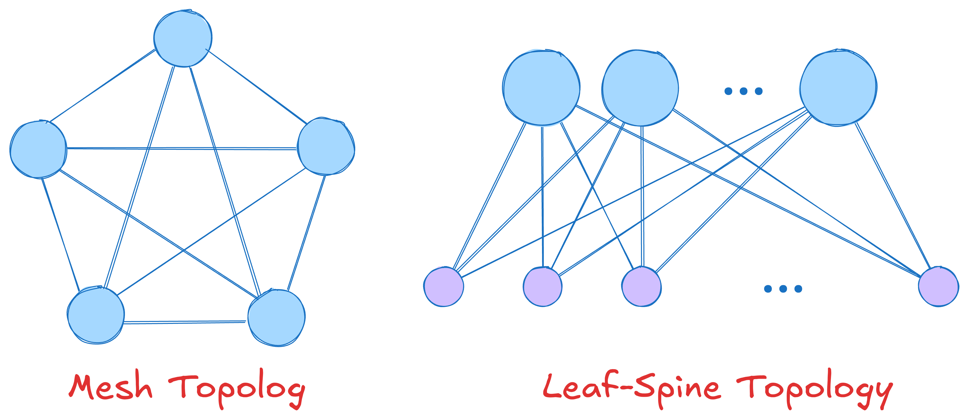
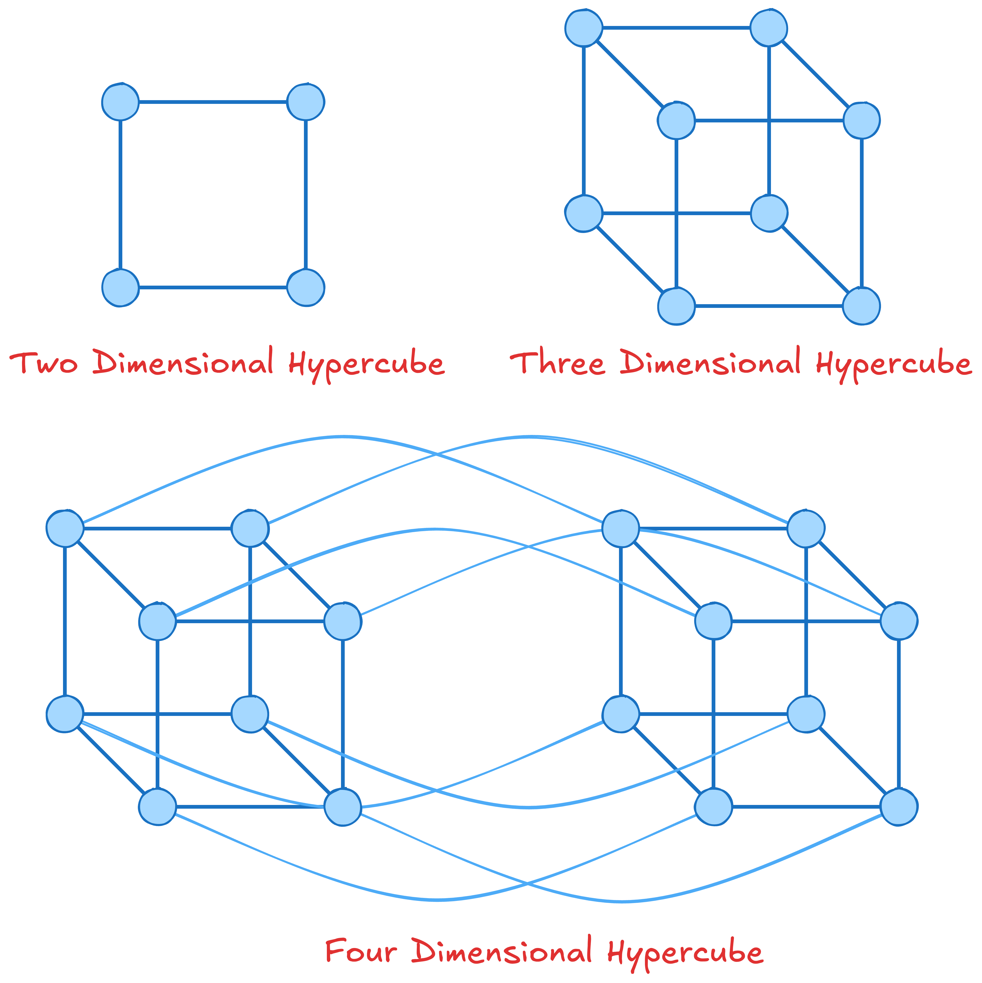
Other DCN Architectures/Topologies
Mesh: every node is connected to every other node
  Direct communication, costly, but high performance
Leaf-Spine topology: two-tier structure, servers and storage node connect directly to leaf switches
  Switched environment, VLANs to limit broadcasts
Hyper-cube: multi-dimensional cube structure
  Used in high-performance computing and ML solutions
Hybrid: combine two or more topologies
  Tailored to specific requirements of DCNs
And many more …
Question: what are the properties of each of these topologies?
  End-to-end latency?
  Simplicity?
  Scalability?
  …

Slide 14
Transport in Data Center Networks
Data center network properties:
  Extremely short RTTs
  Extremely high bandwidth links
  Extremely large transfer
  Single authority (typically)
Leads to new challenges and opportunities
  Can you think of any challenges for providing good transport solutions?
  How about opportunities?

Slide 15
ECN + DCTCP
Easier to ensure ECN is enabled on all devices in DCN
  Single authority
DCTCP
  A variant of TCP
  Uses ECN as congestion signal Use → reduced packet loss
How does DCTCP work?
  Congestion measured based on fraction of packets marked with ECN (called ⍺).
    ⍺ is the moving average of the observed fractions (like estimatedRTT)
  Adjust congestion window based on the extent of congestion: cwnd ⃪ cwnd x (1- ⍺/2)
    Instead of halving the window in case of congestion.
DCTCP Properties:
  More responsive and less aggressive to network conditions compared to traditional TCP
  Keeps queue lengths shorter (as reacts faster) → low latency

Slide 16
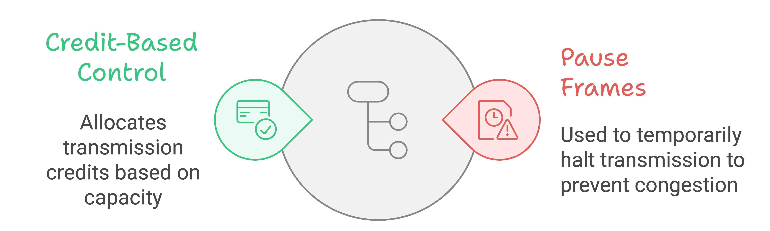
Link Layer Flow Control
Flow control mechanism used to create lossless networks.
  Not to be confused with flow control in transport layer which is end-to-end.
  Setup: two nodes (end-hosts or switches) connected via a link.
    Both have buffer (transmitter queue and receive buffer).
  Goal: ensure the receiver can handle the traffic injected on the link → no packet loss
Two prominent techniques:
  Credit-based
  Pause-based

Slide 17
Credit-Based Link-Level Flow Control
Receiver provides credits to the sender when it has room
  Credit unit: bytes or packets
Credit allocation:
  At the beginning certain (fixed) credit is allocated.
    Question: how much credit should be allocated initially?
  Transmitter uses credit when transmitting.
    Pauses if there is no more credit available.
  Receiver replenishes transmitter credits as receiver buffer becomes available.
Note: we also can have credit-based congestion control. This is not what we are covering here. The concepts are similar, but at different layers.

Slide 18
Pause-based Link-Level Flow Control
pause threshold
Transmitter does not need permission to start.
Receiver signals the transmitter when it is running out of buffer space.
  When buffer occupancy goes above a fixed pause-threshold.
  Pause-frame sent to transmitter
  Transmitter halts transmission
Once the receiver buffer has sufficient space …
  Receiver sends a resume frame to the transmitter
  The transmitter can resume sending.

Slide 19
Priority-based Flow Control (PFC)
Allows multiple priority-queues.
Pause individual queues not all traffic
  Allows other priority queues to continue transmitting even if a single queue is paused.
Improves impact of pause on non-congested traffic to some extent
Still, we might pause non-congested flows
  Why?
  Is there an easy way to solve this problem?
Known issues: head-of-line blocking (deadlock), PFC storm

Slide 20
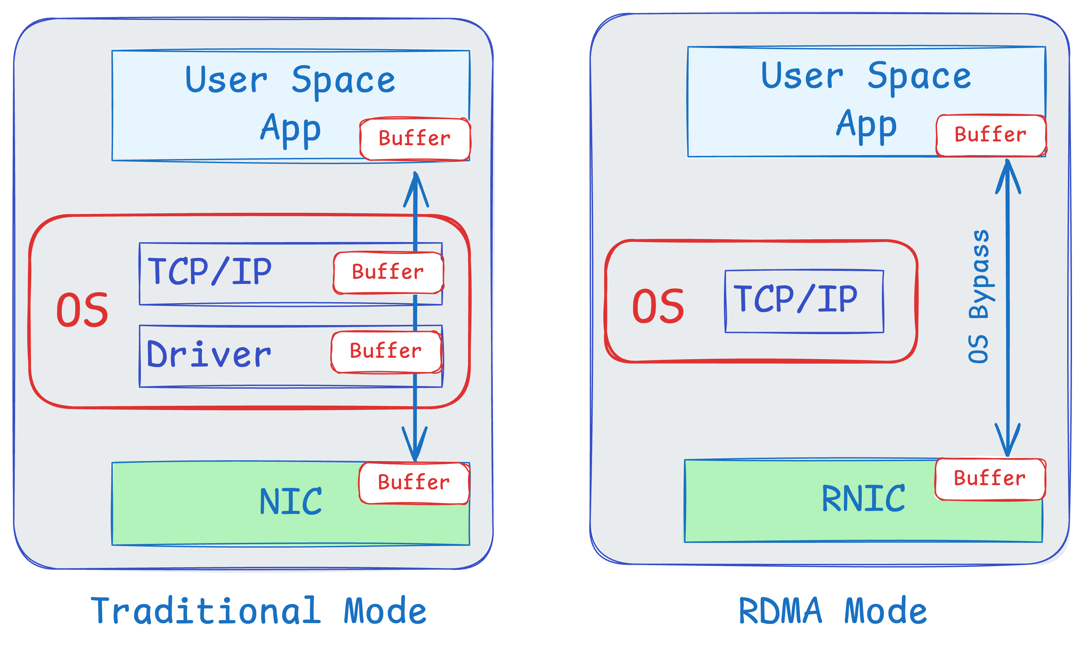
Remote Direct Memory Access
Directly write to remote server’s memory
  Both sides register memory regions to give RDMA direct access permission and mapping
  Need trust/cooperation between two ends
RDMA-capable NIC (RNIC) handles data transfer entirely in hardware
  No need to involve CPU for transfer
Queue Pairs (QPs): a send queue and a receive queue.
  Supports various operations like send, receive, read, and write.

Slide 21
Benefits of RDMA
Low Latency
  Minimizes delays by avoiding CPU intervention.
  Ideal for applications requiring real-time data processing.
High Throughput
  Enables faster data transfer rates.
  Suitable for high-performance computing and large data sets.
Reduced CPU Load
  Frees up CPU resources for other tasks.
  Improves overall system efficiency.
Zero-copy data transfer.
  Eliminate (or minimize data copies)
Applications: High-Performance Computing (HPC), Storage, …

Slide 22
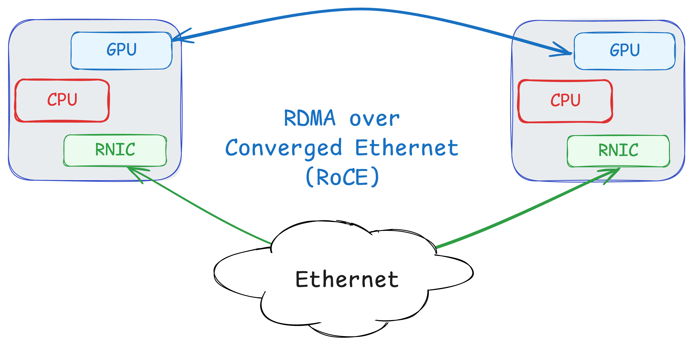
From Proprietary to Commodity
Original technology InfiniBand
  Touching physical layer, link layer, and transport layer in the stack.
  Small number of vendors
Later RDMA enabled over Ethernet
  RoCE: RDMA over Converged Ethernet
  With and without PFC support (RoCE v1 vs. v2)
And even in WAN
  iWARP (Internet Wide-Area RDMA Protocol)
  Implemented over TCP/IP, no need for lossless network
  Significant challenges here, especially over long distances

Slide 23
Networks for Machine Learning
Data Center Networks have evolved significantly
  To accommodate demands for modern applications.
  Example: many novel congestion control algorithms in recent years:
    Swift, timely, HPCC, DCQCN, …
    Enablers: more accurate information from network (exact queue occupancy), assumptions about start rate (start at line rate), etc.
Machine learning applications have grown significantly as well.
  Used more in various domains, solving a wide range of problems.
  At the same time, ML applications have higher demands from the underlying network
Question: are existing DCN solutions enough?
  I.e., can they provide the high-performance connectivity needed for ML applications?

Slide 24
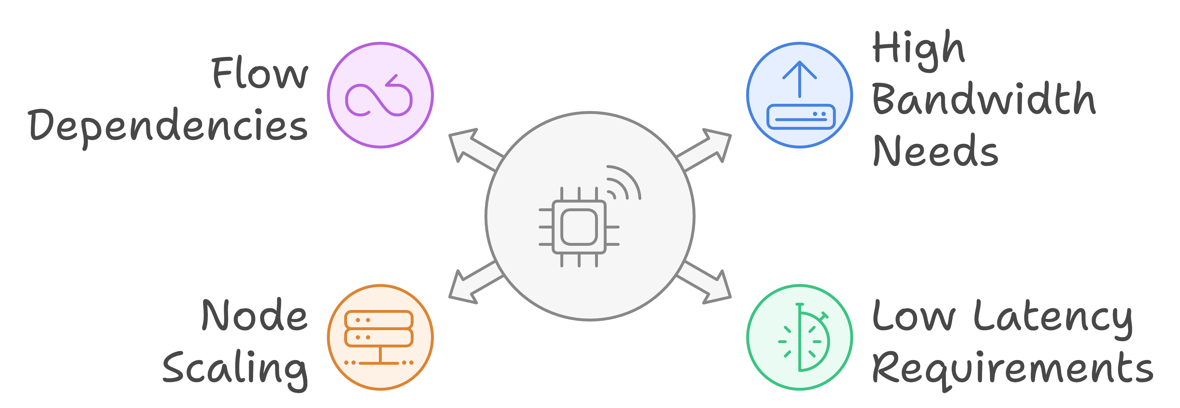
Challenges: ML Workloads
ML workloads can be extremely large:
  E.g., Training of Large-Language Models (LLMs)
Need various forms of parallelism
  Data parallelism
  Model parallelism
  Hybrid
ML workloads have extremely high requirements from the network:
  High bandwidth
  Low latency
  Low jitter (variations in delay)
Goal: Keep expensive GPUs busy

Slide 25
Challenges: End of Moore’s Law
Moore’s Law: the number of transistors on a microchip will double approximately every two years.
  For years, Moore’s law meant we could easily grow compute power according to growth in demand.
End of Moore’s Law: recently, we have hit a wall and cannot continue growing compute per node as predicted by the Moore’s Law.
  However, the demand keeps growing …
  For ML even faster than what Moore’s law could handle.
We need to add more nodes to scale to the demands of ML means.
  More nodes → more communication → increased need for network.
All of this leads to significant pressure on the network (throughput, latency, reliability, …)

Slide 26
Challenges: Flow Dependencies
Handling many independent flows in a network makes many network problems easy (easier) to solve
  Random arrivals, each flow has a small share of bandwidth
  Why?
In ML, we have few flows
  Having few flows means each flow can have a large fraction of link bandwidth
    ⇒ Any interaction between flows can lead to significant performance degradation
In ML flows have direct/indirect dependencies
  Dependence between compute and communication
    ⇒ flows directly or indirectly depend on each other
    ⇒ Performance degradation in one flow can impact the performance of the entire job
Providing high-performance connectivity for ML workloads is extremely challenging.
  Due to scale, high-performance requirements (bandwidth, latency, …), larger flows, dependencies, …
Example: load balancing in ML
  Even two flows sharing a path can significantly reduce the overall performance.

Slide 27
What Makes ML Different: Opportunities
ML workloads are more more predictable
  Repeating patterns of communication
  Collective Communications: scatter, gather, all-reduce, …
Knowing communication patterns ⇒ opportunities for …
  Building specialized hardware
    E.g., topology that matches the flow requirements
      Today’s most successful ML networking solutions
  Build network solutions that adapt based on application requirements
    Application-aware scheduling
    Reconfigurable topology
    Adaptive routing, …
Even without prediction, access to “Collective Communication Libraries” can provide significant opportunities.
  Examples to come.

Slide 28
Network Topology
DCN topology: fat-tree, leaf-spine, …
  Static and uniform
  Needs to work with a wide range of workloads
    Tuned for average workload
Distributed ML application have high demand which is not necessarily uniform
  More demand for certain paths
Two options to deal with extra traffic
  Add extra capacity and over-provision; or
  Use existing capacity better:
    Measurement studies show there is extra capacity available, it just needs to be used effectively
How can we adapt the topology to match demand?
  Customized the topology for specific classes of traffic
    Special-purpose design
    Can be optimal, but very expensive
    What happens if new communication patterns emerge?
  Dynamically rearrange the topology
    How?

Slide 29
Reconfigurable DCN Topology
Needs to adapt topology to workload
  Even more important when you share the infrastructure:
    Cloud-based ML training, or various ML jobs sharing the network
Optical Circuit Switching:
  Reconfigure input/output connectivity of switch ports
  Avoids electronic-optic-electronic conversion
  Various technologies:
    MEMS-based Switching: mechanically rearrange mirrors to change connectivity of ports
    Arrayed Wave Guide (AWG) Switching: change wavelength to connect to different output ports
Benefit: shifting capacity to where it is needed on demand
Challenge: reconfiguration might take some time
  Not ideal for typical packet switching scenarios
What if we know the demand and it is fairly stable?
  Google’s Jupiter: estimate demand matrix, adapt topology using a fast control plane
ML Workloads are predictable ⇒ opportunity to change the switch connectivity to meet demand in real time
RDCN performance improvements:
  High bandwidth (1.6-4x increased in available bandwidth), 70-80% lower power, micro to nano-second scale delay

Slide 30
Adapting Other Network Functions
Topology is only one dimension
What about: routing, prioritization, scheduling, …?
How can we optimize network behavior based on application requirements?

Slide 31
Application-Aware Networking
To optimize network behavior, we need to provide information about application requirements.
  Application-Aware Networking
  Today’s networks lack this information
Main Question: how can we provide information from applications to the network?
Naïve approach:
  Create new interfaces between network and applications.
  Allow application developers provide more information about the requirements
    E.g., I need 10Gb/s bandwidth for 2 seconds.
This is not very practical
  Putting the burden on application developer
  She/he might not even know the requirements
Alternative: create tools/mechanisms to automatically generate signals that can help network adjust itself based on application requirements, or state.

Slide 32
Example: Incast Problem
Consider a simple multi-get request from a distributed storage.
  Get some content from several servers
The request can trigger large number of flows.
  Quickly fill up the buffer at switch → lots of packet drops
  This is called the incast problem
  Very challenging problem in DCNs
Network does not know when incast will happen
  Cannot react in a timely manner.
  Over-provisioning seams to be the only viable solution.
Applications, however, have information that can be used to predict incast.
  E.g., multi-get request can be seen as a hint.

Slide 33
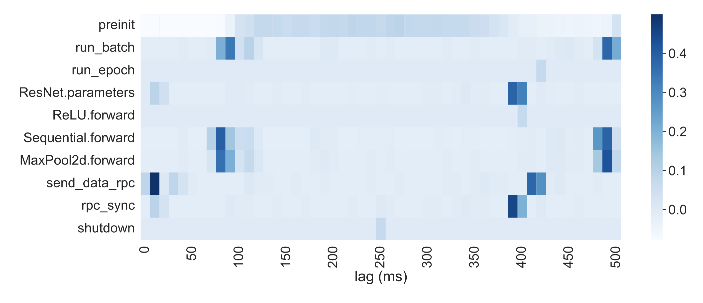
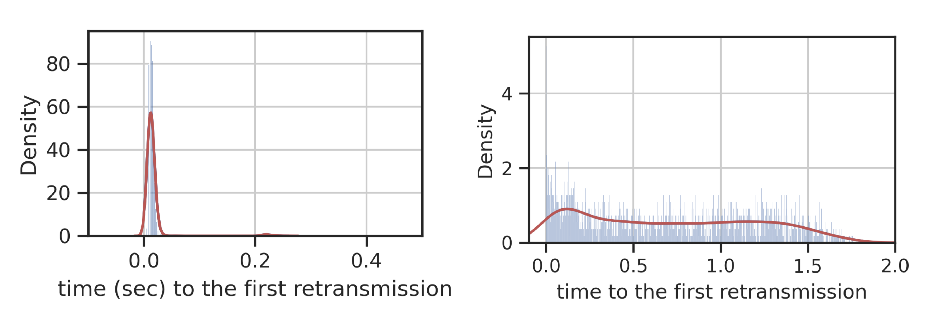
Networks and Applications*
Imagine, we have a system that observes network events
  E.g., incast in switches
Also, it can observe certain events in applications
  E.g., when each function is called
We correlate these events find out triggers on the end-host side for network events
  I.e., which application events lead to network problems
  E.g., each incast event in the network is preceded by a multi-get request 1 RTT before
Correlation between selected function calls and micro-bursts for a distributed ML application.
Probability of Incast in Future
* Mortazavi, S.H., Munir, A., Bahnasy, M.M., Dong, H., Wang, S. and Ganjali, Y. 2022. EarlyBird: automating application signalling for network application integration in datacenters. Proceedings of the ACM SIGCOMM Workshop on Network-Application Integration (New York, NY, USA, Aug. 2022), 40–45.
Incast Probability with SmartTag

Slide 34
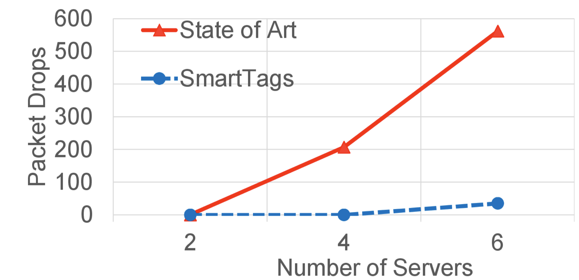
SmartTags*
We can use this information to generate messages on the end-host to notify the network of future network events.
  We call these SmartTags.
We can use SmartTags to change the behavior of the network
  Example. To alleviate incase we can reroute traffic, delay certain flows, …
Can lead to significant improvements in network behavior.
  Improvements that are not possible in today’s networks.
Can be very effective for ML applications.
  Automatically predict flow arrivals to change topology, reroute traffic, adjust flow priorities, etc.
  Many more opportunities …
SmartTags are indicators of future events:
opportunity to prepare network.
Packet Drops with and without SmartTags
* Munir, A., Mortazavi, S.H., Bahnasy, M.M., Baniamerian, A., Wang, S., Guan, S. and Ganjali, Y. 2022. SmartTags: bridging applications and network for proactive performance management. Proceedings of the ACM SIGCOMM Workshop on Network-Application Integration (New York, NY, USA, Aug. 2022), 46–52.

Slide 35
Network Aware Applications
Application-Aware Networking:
  Adapt network based on application requirements, signals, …
Given tighter integration of applications and network why not use network information to help applications?
  Adapt application to network state.
Example: scheduling ML jobs based on network state
  Each application is aware of its own requirements at best.
    But not network state (e.g., available bandwidth): application must estimate network state by probing
  Network can provide information about its state
    Help application-level scheduling
    As well as state of other applications

Slide 36
Cassini: Network-Aware Job Scheduling*
CASSINI is a network-aware job scheduler for ML clusters
  Goal: schedule ML jobs based on network state and other jobs in the system to ensure smooth operation
Step 1. Profile individual jobs
  Identify communication patterns
  Why can we do this here?
Step 2. Convert to a geometric abstraction that represents the network demand
  Perimeter of the circle: job's iteration time
  Arcs of the circle: job’s up and down phases.
Question. How can we use this geometric abstraction to find good job schedules?
  Rotating the circle is equivalent to shifting the job in time.
Data Parallelism Communication Patterns
Similar, but more complex, patterns for other type of parallelism
* Rajasekaran, S., Ghobadi, M. and Akella, A. 2024. CASSINI: Network-Aware Job Scheduling in Machine Learning Clusters. (2024), 1403–1420.

Slide 37
Cassini: Network-Aware Job Scheduling
CASSINI is a network-aware job scheduler for ML clusters
  Goal: schedule ML jobs based on network state and other jobs in the system to ensure smooth operation
Step 1. Profile individual jobs
  Identify communication patterns
  Why can we do this here?
Step 2. Convert to a geometric abstraction that represents the network demand
  Perimeter of the circle: job's iteration time
  Arcs of the circle: job’s up and down phases.
Question. How can we use this geometric abstraction to find good job schedules?
  Rotating the circle is equivalent to shifting the job in time.
Data Parallelism Communication Patterns
Convert to a new
geometric abstraction
How much should
we rotate each circle?

Slide 38
Cassini: Network-Aware Job Scheduling
?
Step 3. For each link in the network:
  Overlays the circles of jobs going through the link and rotates them
  Find a configuration that minimizes the total bandwidth demand
  This gives us a set of relative shifts in time
Step 4. Extend link-level compatibility to cluster level
  Start with job 1, set time to 0.
  For each job that shares a bottleneck, use the method above to find the required shift in time.
If there is no loop the output would be a job schedule
  I.e., when each job should start
Question 1: what if jobs have different iteration periods?
Question 2: can we have a loop in the graph above?

Slide 39
ML for Networks
So far, we have focus on how to enhance networks to meet the stringent requirements of ML applications.
Given the advances in ML, a natural question is: how can we use ML to enhance computer networks?
Any suggestions?

Slide 40
ML for Networks Examples - Part 1
Traffic Prediction and Forecasting:
  We saw how knowing the pattern of traffic in ML workloads can help us make the network better.
  How about using ML to predict network traffic patterns
    To optimize resource allocation, …
  We can use time-series models (e.g., ARIMA, LSTMs, etc.).
    Analyze historical traffic data to anticipate congestion.
Congestion Control:
  We have seen some examples of how congestion control can be enhanced for certain environments (DCN, wireless, …) and workloads
  We can use ML to dynamically adjust flow rates
    Minimize packet loss, delay, …
    Also, use ML-based prediction of queue lengths or latency
  Train reinforcement learning (RL) models for real-time congestion-mitigation
  Examples: Orca, PCC-Vivace, …
* Abbasloo, S., Yen, C.-Y. and Chao, H.J. 2020. Classic Meets Modern: a Pragmatic Learning-Based Congestion Control for the Internet. Proceedings of the Annual conference of the ACM Special Interest Group on Data Communication on the applications, technologies, architectures, and protocols for computer communication (Virtual Event USA, Jul. 2020), 632–647.
** Mo Dong, Tong Meng, Doron Zarchy, Engin Arslan, Yossi Gilad, Brighten Godfrey, and Michael Schapira. 2018. PCC -Vivace: Online-Learning Congestion Control. In 15th USENIX Symposium on Networked Systems Design and Implementation (NSDI’18). 343–356.

Slide 41
ML for Networks Examples – Part 2
Network Routing and Load Balancing:
  Typically, rely on static routes
    Shortest path based on fixed costs and randomized load balancing
  If information about link loads are available, we can use reinforcement learning for adaptive path selection.
    Distribute load evenly across servers in data centers.
  E.g., apply graph neural networks (GNNs) to analyze network topologies, and find optimal routers.
Network Configuration Automation:
  Configuring switch/routers a tedious task, typically done manually
  We can use ML to automate switch/router configurations.
    Use natural language processing (NLP) to translate operator requirements to device configuration.
    Train models on historical configuration logs to predict optimal settings.
  Avoid misconfigurations (that can lead to outages) and optimize network performance.

Slide 42
ML for Networks Examples – Part 3
Network Management and Troubleshooting:
  Automatic configuration is done when the network is setup.
    We can also think of more dynamic scenarios.
  How can we manage the network?
    Ensure optimized behavior
  We have talked about SDN control applications.
    Routing, access control, load balancing, …
  A management layer above can help make high-level decisions on resource allocations, adapting control applications, etc.
    Ideally, use natural language to describe the intent of network operators, called intent-based networking
  ML can provide the tools needed to convert operator intent to rules, and policies
    Push to the network through SDN control and management plane.
    Also, optimize behavior based on operator intent.
  ML can also provide mechanisms for automated interaction with customers
    E.g., troubleshooting customer systems in real-time.

