Slide 1
Handout # 20:
Queueing Mechanisms; Middleboxes
Professor Yashar Ganjali
Department of Computer Science
University of Toronto
ganjali7@cs.toronto.edu
http://www.cs.toronto.edu/~yganjali

Slide 2
Announcements
Problem Set 2
  Posted on class website.
  Submit electronically as ps2.pdf.
  Due: Friday March 21 at 5pm.
Programming Assignment 2: Simple Router
  Due Friday March 28 at 5pm.
This week’s tutorial:
  Problem Set 2 Overview

Slide 3
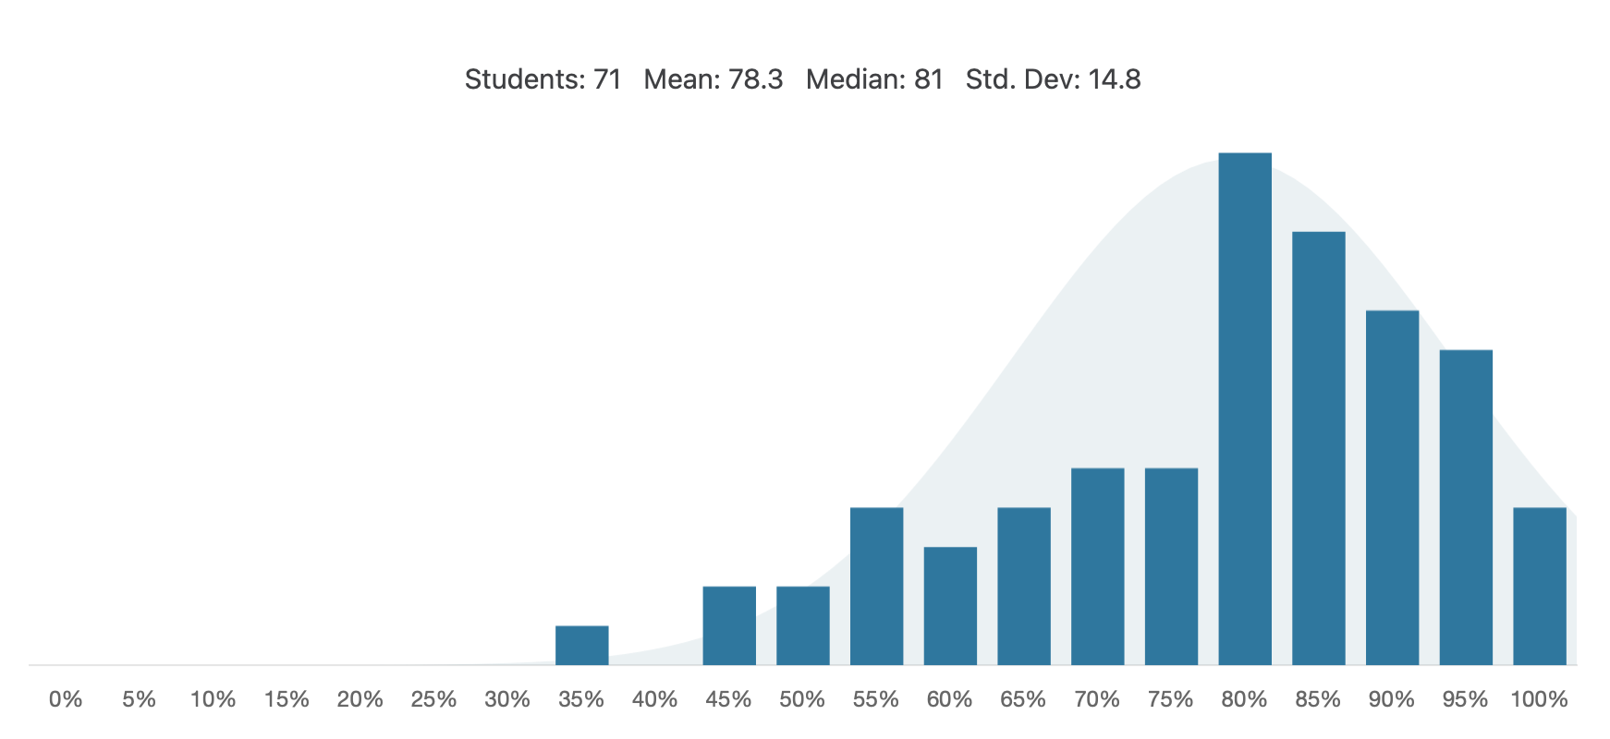
Midterm Results
SEC0101
  Mean: 78.3
  Median: 81
EC5101
  Coming soon.
Very strong results. Great job!

Slide 4
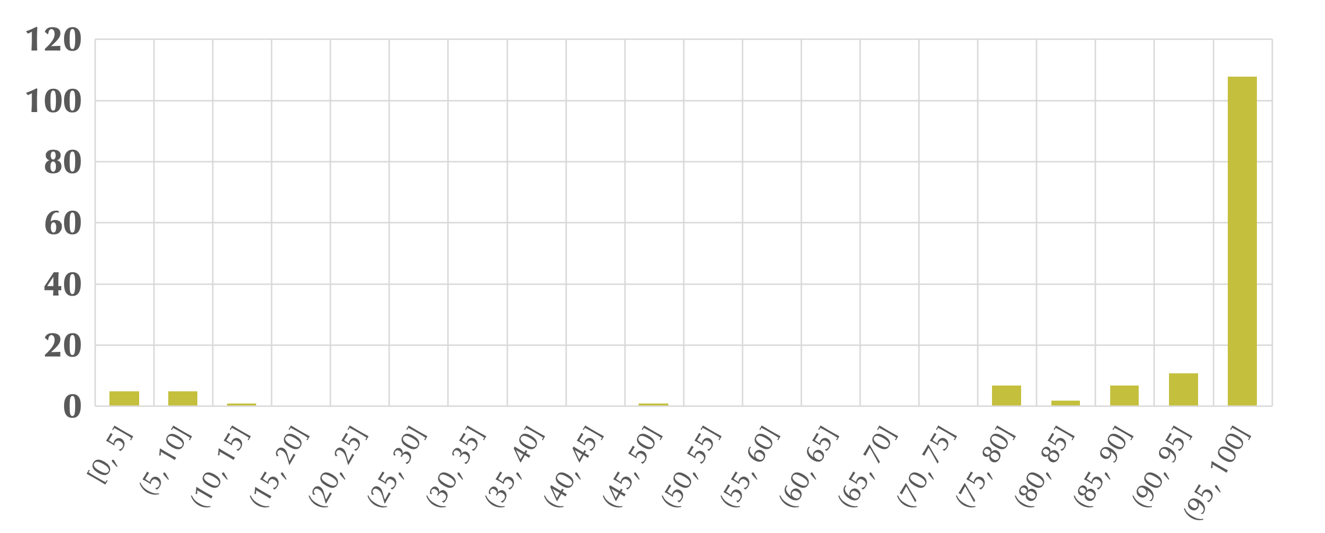
Programming Assignment 1
Mean: 90.53%
Median: 100
Amazing! Great job!

Slide 5
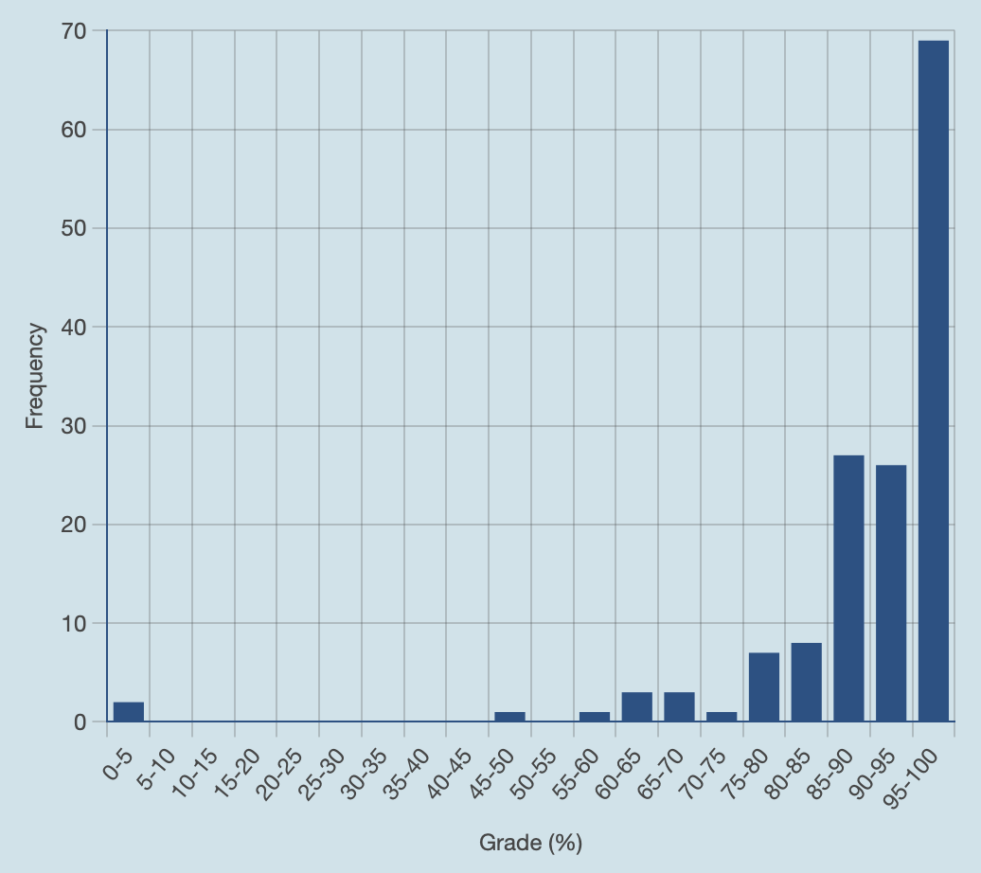
Problem Set 1
Mean: 90.63%
Median: 93.33%
Excellent job!

Slide 6
The Story ...
Network layers
  Link layer
    Framing, switches, hubs, bridges, error detection, correction, ...
  Network layer
    Addressing, routing, autonomous systems, BGP, ...
  Transport layer
    Flow control, congestion control, ...
Ready or applications
  ... almost!

Slide 7
Today
Queuing Mechanisms
  Random Early Detection (RED)
  Explicit Congestion Notification (ECN)
Middleboxes
  Network Address Translation
  Firewalls
  Web Proxies

Slide 8
End-to-end Principle
Design principle for the Internet that says you should keep functionalities at the end-hosts
  Application specific functions
Example: congestion control in the Internet
Power at the end-hosts
  Pros: flexible, easy to change and innovate, ...
  Cons: trust at the hands of least trusted component, not necessarily optimal, high overhead, ...

Slide 9
Bursty Loss From Drop-Tail Queuing
TCP depends on packet loss
  Packet loss is the indication of congestion
  In fact, TCP drives the network into packet loss
  … by continuing to increase the sending rate
Drop-tail queuing leads to bursty loss
  When a link becomes congested…
  … many arriving packets encounter a full queue
  And, as a result, many flows divide sending rate in half
  … and, many individual flows lose multiple packets

Slide 10
Slow Feedback from Drop Tail
Feedback comes when buffer is completely full
  … even though the buffer has been filling for a while
Plus, the filling buffer is increasing RTT
  … and the variance in the RTT
Might be better to give early feedback
  Get one or two flows to slow down, not all of them
  Get these flows to slow down before it is too late

Slide 11
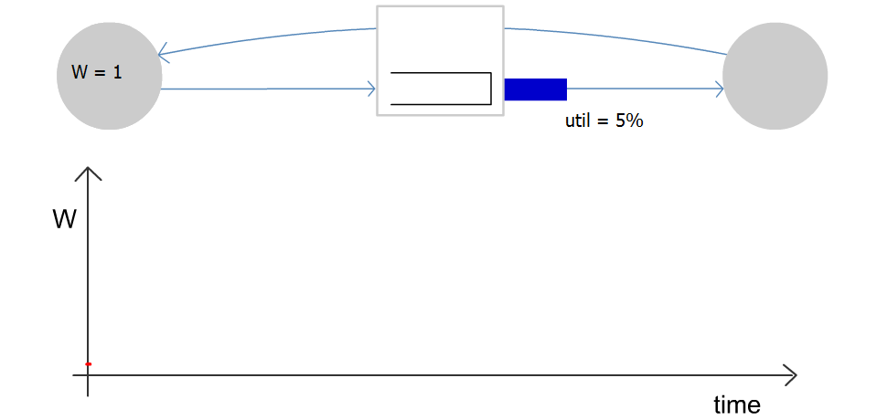
Congestion Window Evolution
Rule for adjusting W
  If an ACK is received: W ← W+1/W
  If a packet is lost: W ← W/2
Only W packets
may be outstanding

Slide 12
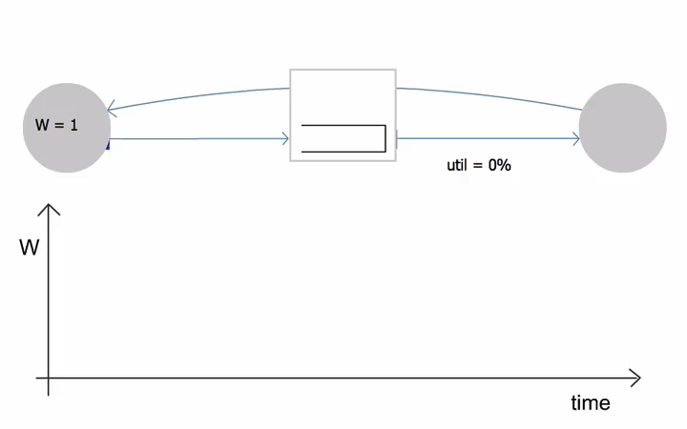
Congestion Window Evolution

Slide 13
Random Early Detection (RED)
Basic idea of RED
  Router notices that the queue is getting backlogged
  … and randomly drops packets to signal congestion
Packet drop probability
  Drop probability increases as queue length increases
  If buffer is below some level, don’t drop anything
  … otherwise, set drop probability as function of queue
Probability
Average Queue Length

Slide 14
RED Drop Probabilities
D(t)
A(t)
1
maxP
AvgLen
minTh
maxTh
Need to cap by 1

Slide 15
RED Average Queue Length
Drop probability is increased as the average queue length increases.
(Geometric) moving average of the queue length is used so as to detect long term congestion, yet allow short term bursts to arrive.

Slide 16
Properties of RED
Drops packets before queue is full
  In the hope of reducing the rates of some flows
Drops packet in proportion to each flow’s rate
  High-rate flows have more packets
  … and, hence, a higher chance of being selected
Drops are spaced out in time
  Which should help desynchronize the TCP senders
Tolerant of burstiness in the traffic
  By basing the decisions on average queue length

Slide 17
Problems With RED
Hard to get the tunable parameters just right
  How early to start dropping packets?
  What slope for the increase in drop probability?
  What time scale for averaging the queue length?
Sometimes RED helps but sometimes not
  If the parameters aren’t set right, RED doesn’t help
  And it is hard to know how to set the parameters
RED is implemented in practice
  But, often not used due to the challenges of tuning right
Many variations
  With cute names like “Blue” and “FRED”… ☺

Slide 18
Synchronization of Sources
RTT
A
B
C
D
Source A

Slide 19
Synchronization of Sources
RTT
A
B
C
D
Aggregate Flow
f(RTT)
Avg

Slide 20
Desynchronized Sources
RTT
A
B
C
D
Source A

Slide 21
Desynchronized Sources
RTT
A
B
C
D
Aggregate Flow
Avg

Slide 22
Explicit Congestion Notification
Early dropping of packets
  Good: gives early feedback
  Bad: must drop the packet to give the feedback
Explicit Congestion Notification
  Router marks the packet with an ECN bit
  … and sending host interprets as a sign of congestion
Surmounting the challenges
  Must be supported by the end hosts and the routers
  Requires two bits in the IP header (one for the ECN mark, and one to indicate the ECN capability)
  Solution: borrow two of the Type-Of-Service bits in the IPv4 packet header

Slide 23
Detour: OpenTCP
Network can impact congestion control by using AQM schemes.
Finding the optimal value by probing
  Costly, and not very efficient
What if the network could help?
  Two extremes: end-to-end vs. centralized
How about a solution in the middle?
  Network guides the flows without creating dependency.

Slide 24
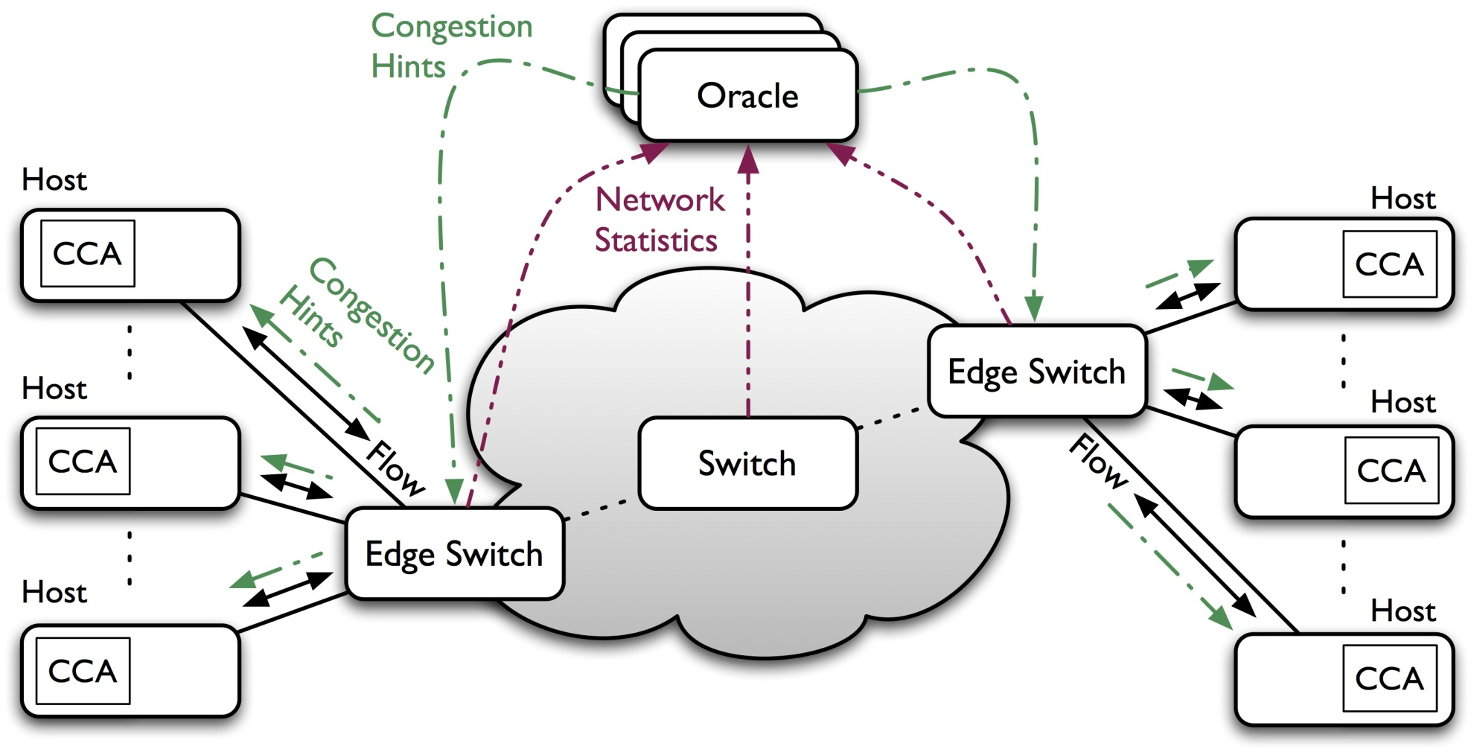
Detour:
OpenTCP in Software-Defined Networks

Slide 25
Conclusions
Congestion is inevitable
  Internet does not reserve resources in advance
  TCP actively tries to push the envelope
Congestion can be handled
  Additive increase, multiplicative decrease
  Slow start, and slow-start restart
Active Queue Management can help
  Random Early Detection (RED)
  Explicit Congestion Notification (ECN)

Slide 26
Today
Queuing Mechanisms
  Random Early Detection (RED)
  Explicit Congestion Notification (ECN)
Middleboxes
  Network Address Translation
  Firewalls
  Web Proxies

Slide 27
Network-Layer Principles
Globally unique identifiers
  Each node has a unique, fixed IP address
  … reachable from everyone and everywhere
Simple packet forwarding
  Network nodes simply forward packets
  … rather than modifying or filtering them
source
destination
IP network

Slide 28
Internet Reality
Host mobility
  Changes in IP addresses as hosts move
IP address depletion
  Dynamic assignment of IP addresses
  Use of private addresses
Security concerns
  Discarding suspicious or unwanted packets
  Detecting suspicious traffic
Performance concerns
  Controlling how link bandwidth is allocated
  Storing popular Web content near the clients

Slide 29
Middleboxes
Middleboxes are intermediaries
  Interposed in-between the communicating hosts
  Often without knowledge of one or both parties
Examples
  Network address translators
  Firewalls
  Traffic shapers
  Intrusion detection systems
  Transparent Web proxy caches

Slide 30
Two Views of Middleboxes
An abomination
  Violation of layering
  Cause confusion in reasoning about the network
  Responsible for many subtle bugs
A necessity
  Solving real and pressing problems
  Needs that are not likely to go away

Slide 31
Today
Queuing Mechanisms
  Random Early Detection (RED)
  Explicit Congestion Notification (ECN)
Middleboxes
  Network Address Translation
  Firewalls
  Web Proxies

Slide 32
History of NATs
IP address space depletion
  Clear in early 90s that 2³² addresses not enough
  Work began on a successor to IPv4
In the meantime, …
  Share addresses among numerous devices
  … without requiring changes to existing hosts
Meant to provide temporary relief
  Intended as a short-term remedy
  Now, NAT are very widely deployed
  … much more so than IPv6

Slide 33
Active Component in the Data Path
outside
NAT
inside

Slide 34
IP Header Translators
Local network addresses not globally unique
  E.g., private IP addresses (in 10.0.0.0/8)
NAT box rewrites the IP addresses
  Make the “inside” look like a single IP address
  … and change header checksums accordingly
Outbound traffic: from inside to outside
  Rewrite the source IP address
Inbound traffic: from outside to inside
  Rewrite the destination IP address

Slide 35
Using a Single Source Address
138.76.29.7
10.0.0.1
outside
NAT
inside
10.0.0.2

Slide 36
What if Both Hosts Contact Same Site?
Suppose hosts contact the same destination
  E.g., both hosts open a socket with local port 3345 to destination 128.119.40.186 on port 80
NAT gives packets same source address
  All packets have source address 138.76.29.7
Problems
  Can destination differentiate between senders?
  Can return traffic get back to the correct hosts?

Slide 37
Port-Translating NAT
Map outgoing packets
  Replace source address with NAT address
  Replace source port number with a new port number
  Remote hosts respond using (NAT address, new port #)
Maintain a translation table
  Store map of (source address, port #) to (NAT address, new port #)
Map incoming packets
  Consult the translation table
  Map the destination address and port number
  Local host receives the incoming packet

Slide 38
Network Address Translation Example
NAT translation table
WAN side addr LAN side addr
1: host 10.0.0.1
sends datagram to
128.119.40.186, 80
2: NAT router
changes datagram
source addr from
10.0.0.1, 3345 to
138.76.29.7, 5001,
updates table
138.76.29.7, 5001 10.0.0.1, 3345
…… ……
S: 10.0.0.1, 3345
D: 128.119.40.186, 80
10.0.0.1
1
2
S: 138.76.29.7, 5001
D: 128.119.40.186, 80
10.0.0.4
10.0.0.2
138.76.29.7
S: 128.119.40.186, 80
D: 10.0.0.1, 3345
4
S: 128.119.40.186, 80
D: 138.76.29.7, 5001
3
4: NAT router
changes datagram
dest addr from
138.76.29.7, 5001 to 10.0.0.1, 3345
10.0.0.3
3: Reply arrives
dest. address:
138.76.29.7, 5001

Slide 39
Maintaining the Mapping Table
Create an entry upon seeing a packet
  Packet with new (source addr, source port) pair
Eventually, need to delete the map entry
  But when to remove the binding?
If no packets arrive within a time window
  … then delete the mapping to free up the port #s
Yet another example of “soft state”
  I.e., removing state if not refreshed for a while

Slide 40
Objections Against NAT
Port #s are meant for addressing processes
  Yet, NAT uses them to identify end hosts
  Makes it hard to run a server behind a NAT
138.76.29.7
Requests to 138.76.29.7 on port 80
10.0.0.1
NAT
10.0.0.2
Which host should get the request???

Slide 41
Objections Against NAT
Difficult to support peer-to-peer applications
  P2P needs a host to act as a server
  … difficult if both hosts are behind NATs
Routers are not supposed to look at port #s
  Network layer should care only about IP header
  … and not be looking at the port numbers at all
NAT violates the end-to-end argument
  Network nodes should not modify the packets
IPv6 is a cleaner solution
  Better to migrate than to limp along with a hack

Slide 42
Where is NAT Implemented?
Home router (e.g., Linksys box)
  Integrates router, DHCP server, NAT, etc.
  Use single IP address from the service provider
  … and have a bunch of hosts hiding behind it
Campus or corporate network
  NAT at the connection to the Internet
  Share a collection of public IP addresses
  Avoid complexity of renumbering end hosts and local routers when changing service providers

Slide 43
Today
Queuing Mechanisms
  Random Early Detection (RED)
  Explicit Congestion Notification (ECN)
Middleboxes
  Network Address Translation
  Firewalls
  Web Proxies

Slide 44
Firewalls
Isolates organization’s internal net from larger Internet, allowing some packets to pass, blocking others.
administered
network
public
Internet
firewall

Slide 45
Internet Attacks: Denial of Service
Denial-of-service attacks
  Outsider overwhelms the host with unsolicited traffic
  … with the goal of preventing any useful work
Example
  Bad guys take over a large collection of hosts
  … and program these hosts to send traffic to your host
  Leading to excessive traffic
Motivations for denial-of-service attacks
  Malice (e.g., just to be mean)
  Revenge (e.g. for some past perceived injustice)
  Greed (e.g., blackmailing)

Slide 46
Internet Attacks: Break-Ins
Breaking in to a host
  Outsider exploits a vulnerability in the end host
  … with the goal of changing the behavior of the host
Example
  Bad guys know a Web server has a buffer-overflow vulnerability
  … and, say, send an HTTP request with a long URL
  Allowing them to break in
Motivations for break-ins
  Take over the machine to launch other attacks
  Steal information stored on the machine
  Modify/replace the content the site normally returns

Slide 47
Packet Filtering
Should arriving packet be allowed in? Departing packet let out?
Internal network connected to Internet via firewall
Firewall filters packet-by-packet, based on:
  Source IP address, destination IP address
  TCP/UDP source and destination port numbers
  ICMP message type
  TCP SYN and ACK bits

Slide 48
Packet Filtering Examples
Block all packets with IP protocol field = 17 and with either source or dest port = 23.
  All incoming and outgoing UDP flows blocked
  All ssh connections are blocked
Block inbound TCP packets with SYN but no ACK
  Prevents external clients from making TCP connections with internal clients
  But allows internal clients to connect to outside
Block all packets with TCP port of Fortnight

Slide 49
Firewall Configuration
Firewall applies a set of rules to each packet
  To decide whether to permit or deny the packet
Each rule is a test on the packet
  Comparing IP and TCP/UDP header fields
  … and deciding whether to permit or deny
Order matters
  Once the packet matches a rule, the decision is done

Slide 50
Firewall Configuration Example
Alice runs a network in 222.22.0.0/16
  Wants to let Bob’s school access certain hosts
    Bob is on 111.11.0.0/16
    Alice’s special hosts on 222.22.22.0/24
  Alice doesn’t trust Trudy, inside Bob’s network
    Trudy is on 111.11.11.0/24
  Alice doesn’t want any other traffic from Internet
Rules
  #1: Don’t let Trudy machines in
    Deny (src = 111.11.11.0/24, dst = 222.22.0.0/16)
  #2: Let rest of Bob’s network in to special dests
    Permit (src=111.11.0.0/16, dst = 222.22.22.0/24)
  #3: Block the rest of the world
    Deny (src = 0.0.0.0/0, dst = 0.0.0.0/0)

Slide 51
A Variation: Traffic Management
Permit vs. deny is too binary a decision
  Maybe better to classify the traffic based on rules
  … and then handle the classes of traffic differently
Traffic shaping (rate limiting)
  Limit the amount of bandwidth for certain traffic
  E.g., rate limit on Web or P2P traffic
Separate queues
  Use rules to group related packets
  And then do round-robin scheduling across the groups
  E.g., separate queue for each internal IP address

Slide 52
Firewall Implementation Challenges
Per-packet handling
  Must inspect every packet
  Challenging on very high-speed links
Complex filtering rules
  May have large # of rules
  May have very complicated rules
Location of firewalls
  Complex firewalls near the edge, at low speed
  Simpler firewalls in the core, at higher speed

Slide 53
Clever Users Subvert Firewalls
Example: filtering dorm access to a server
  Firewall rule based on IP addresses of dorms
  … and the server IP address and port number
  Problem: users may log in to another machine
    E.g., connect from the dorms to another host
    … and then onward to the blocked server
Example: filtering P2P based on port #s
  Firewall rule based on TCP/UDP port numbers
    E.g., allow only port 80 (e.g., Web) traffic
  Problem: software using non-traditional ports
    E.g., write P2P client to use port 80 instead

Slide 54
Application Gateways
Filter packets on application data
  Not just on IP and TCP/UDP headers
Example: restricting ssh usage
  Don’t allow any external clients to ssh inside
  Only allow certain internal users to ssh outside
Solution: ssh gateway
  Force all ssh traffic to go through a gateway
  I.e. filter ssh traffic that doesn’t originate from the IP address of the gateway
At the gateway…
  Require user to login and provide password
  Apply policy to decide whether they can proceed

Slide 55
ssh Gateway Example
gateway-to-remote
host ssh session
host-to-gateway
ssh session
firewall
Application
gateway

Slide 56
Motivation for Gateways
Enable more detailed policies
  E.g., login id and password at ssh gateway
Avoid rogue machines sending traffic
  E.g., e-mail “server” running on user machines
  … probably a sign of a spammer
Enable a central place to perform logging
  E.g., forcing all Web accesses through a gateway
  … to log the IP addresses and URLs
Improve performance through caching
  E.g., forcing all Web accesses through a gateway
  … to enable caching of the popular content

Slide 57
Today
Queuing Mechanisms
  Random Early Detection (RED)
  Explicit Congestion Notification (ECN)
Middleboxes
  Network Address Translation
  Firewalls
  Web Proxies

Slide 58
Web Clients and Servers
Web is a client-server protocol
  Client sends a request
  Server sends a response
Proxies play both roles
  A server to the client
  A client to the server
www.google.com
Proxy
www.cnn.com

Slide 59
Proxy Caching
Client #1 requests http://www.foo.com/fun.jpg
  Client sends “GET fun.jpg” to the proxy
  Proxy sends “GET fun.jpg” to the server
  Server sends response to the proxy
  Proxy stores the response, and forwards to client
Client #2 requests http://www.foo.com/fun.jpg
  Client sends “GET fun.jpg” to the proxy
  Proxy sends response to the client from the cache
Benefits
  Faster response time to the clients
  Lower load on the Web server
  Reduced bandwidth consumption inside the network

Slide 60
Getting Requests to the Proxy
Explicit configuration
  Browser configured to use a proxy
  Directs all requests through the proxy
  Problem: requires user action
Transparent proxy (or “interception proxy”)
  Proxy lies in path from the client to the servers
  Proxy intercepts packets en route to the server
  … and interposes itself in the data transfer
  Benefit: does not require user action

Slide 61
Challenges of Transparent Proxies
Must ensure all packets pass by the proxy
  By placing it at the only access point to the Internet
  E.g., at the border router of a campus or company
Overhead of reconstructing the requests
  Must intercept the packets as they fly by
  … and reconstruct into the ordered by stream
May be viewed as a violation of user privacy
  The user does not know the proxy lies in the path
  Proxy may be keeping logs of the user’s requests

Slide 62
Other Functions of Web Proxies
Anonymization
  Server sees requests coming from the proxy address
  … rather than the individual user IP addresses
Transcoding
  Converting data from one form to another
  E.g., reducing the size of images for cell-phone browsers
Prefetching
  Requesting content before the user asks for it
Filtering
  Blocking access to sites, based on URL or content

Slide 63
Conclusions
Middleboxes address important problems
  Using fewer IP addresses
  Blocking unwanted traffic
  Making fair use of network resources
  Improving Web performance
Middleboxes cause problems of their own
  No longer globally unique IP addresses
  No longer can assume network simply delivers packets

