Slide 1
Handout # 12:
Transport Protocols
Professor Yashar Ganjali
Department of Computer Science
University of Toronto
ganjali7@cs.toronto.edu
http://www.cs.toronto.edu/~yganjali

Slide 2
Announcements
Programming Assignment 1
  Due Friday February 14th at 5pm.
  Submission instructions on course web page.
Problem Set 1
  Solutions will be posted on Friday
This week’s tutorial:
  Programming Assignment 1 Q&A
Reading for this week:
  Chapter 5 of the textbook

Slide 3
Announcements – Cont’d
Midterm exam
  L0101: Monday February 24th
  L0201: Tuesday February 25th
  In class: same room and time as the lecture
  For undergraduate and graduate students
Sample midterm and solutions on class web page.
Everything covered up to the end of today’s lecture
  Emphasis on the slides, problem set, and sample midterm provided.
  Textbook: up to Chapter 5

Slide 4
Role of Transport Layer
Link layer
  Transfer bit frames between neighboring nodes
  E.g., Ethernet
Network layer
  Logical communication between nodes
  Hides details of the link technology
  E.g., IP
Transport layer
  Communication between processes (e.g., socket)
  Relies on network layer and serves the application layer
  E.g., TCP and UDP
Application layer
  Communication for specific applications
  E.g., HyperText Transfer Protocol (HTTP), File Transfer Protocol (FTP), Network News Transfer Protocol (NNTP)

Slide 5
Today’s Lecture
Principles underlying transport-layer services
  (De)multiplexing
  Detecting corruption
  Reliable delivery
  Flow control
Transport-layer protocols in the Internet
  User Datagram Protocol (UDP)
  Transmission Control Protocol (TCP)

Slide 6
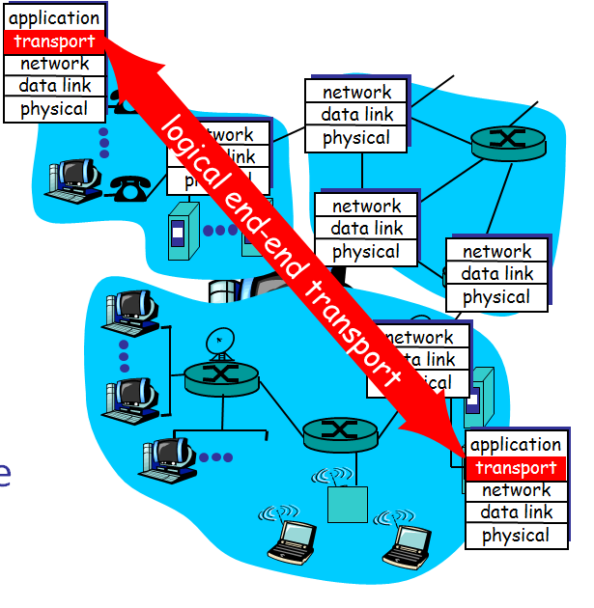
Transport Protocols
Provide logical communication between application processes running on different hosts
Run on end hosts
  Sender: breaks application messages into segments,
  and passes to network layer
  Receiver: reassembles segments into messages, passes to application layer
Multiple transport protocol available to applications
  Internet: TCP and UDP

Slide 7
Internet Transport Protocols
Datagram messaging service (UDP)
  No-frills extension of “best-effort” IP
Reliable, in-order delivery (TCP)
  Connection set-up
  Discarding of corrupted packets
  Retransmission of lost packets
  Flow control
  Congestion control (next lecture)
Other services not available
  Delay guarantees
  Bandwidth guarantees
Do not overload the receiver
Do not overload the network

Slide 8
Multiplexing and Demultiplexing
Host receives IP datagrams
  Each datagram has source and destination IP address,
  Each datagram carries one transport-layer segment
  Each segment has source and destination port number
Host uses IP addresses and port numbers to direct the segment to appropriate socket
32 bits
source port #
dest port #
other header fields
application
data
(message)
TCP/UDP segment format

Slide 9
Unreliable Message Delivery Service
Lightweight communication between processes
  Avoid overhead and delays of ordered, reliable delivery
  Send messages to and receive them from a socket
User Datagram Protocol (UDP)
  IP plus port numbers to support (de)multiplexing
  Optional error checking on the packet contents
SRC port
DST port
checksum
length
DATA

Slide 10
Why Would Anyone Use UDP?
Finer control over what data is sent and when
  As soon as an application process writes into the socket
  … UDP will package the data and send the packet
No delay for connection establishment
  UDP just blasts away without any formal preliminaries
  … which avoids introducing any unnecessary delays
No connection state
  No allocation of buffers, parameters, sequence #s, etc.
  … making it easier to handle many active clients at once
Small packet header overhead
  UDP header is only eight-bytes long

Slide 11

Popular Applications That Use UDP
Multimedia streaming
  Retransmitting lost/corrupted packets is not worthwhile
  By the time the packet is retransmitted, it’s too late
  E.g., telephone calls, video conferencing, gaming
Simple query protocols like Domain Name System
  Overhead of connection establishment is overkill
  Easier to have application retransmit if needed
“Address for www.cnn.com?”
“12.3.4.15”

Slide 12
Transmission Control Protocol (TCP)
Connection oriented
  Explicit set-up and tear-down of TCP session
Stream-of-bytes service
  Sends and receives a stream of bytes, not messages
Reliable, in-order delivery
  Checksums to detect corrupted data
  Acknowledgments & retransmissions for reliable delivery
  Sequence numbers to detect losses and reorder data
Flow control
  Prevent overflow of the receiver’s buffer space
Congestion control
  Adapt to network congestion for the greater good

Slide 13
An Analogy: Talking on a Cell Phone
Alice and Bob on their cell phones
  Both Alice and Bob are talking
What if Bob couldn’t understand Alice?
  Bob asks Alice to repeat what she said
What if Bob hasn’t heard Alice for a while?
  Is Alice just being quiet?
  Or, have Bob and Alice lost reception?
  How long should Bob just keep on talking?
  Maybe Alice should periodically say “uh huh”
  … or Bob should ask “Can you hear me now?” ☺

Slide 14
Some Take-Aways from the Example
Acknowledgments from receiver
  Positive: “okay” or “ACK”
  Negative: “please repeat that” or “NACK”
Timeout by the sender (“stop and wait”)
  Don’t wait indefinitely without receiving some response
  … whether a positive or a negative acknowledgment
Retransmission by the sender
  After receiving a “NACK” from the receiver
  After receiving no feedback from the receiver

Slide 15
Challenges of Reliable Data Transfer
Over a perfectly reliable channel
  All of the data arrives in order, just as it was sent
  Simple: sender sends data, and receiver receives data
Over a channel with bit errors
  All of the data arrives in order, but some bits corrupted
  Receiver detects errors and says “please repeat that”
  Sender retransmits the data that were corrupted
Over a lossy channel with bit errors
  Some data are missing, and some bits are corrupted
  Receiver detects errors but cannot always detect loss
  Sender must wait for acknowledgment (“ACK” or “OK”)
  … and retransmit data after some time if no ACK arrives

Slide 16
TCP Support for Reliable Delivery
Checksum
  Used to detect corrupted data at the receiver
  …leading the receiver to drop the packet
Sequence numbers
  Used to detect missing data
  ... and for putting the data back in order
Retransmission
  Sender retransmits lost or corrupted data
  Timeout based on estimates of round-trip time
  Fast retransmit algorithm for rapid retransmission

Slide 17
TCP Segments

Slide 18
TCP “Stream of Bytes” Service
Host A
Byte 0
Byte 1
Byte 2
Byte 3
Byte 80
Host B
Byte 0
Byte 1
Byte 2
Byte 3
Byte 80

Slide 19
…Emulated Using TCP “Segments”
Host A
Byte 0
Byte 1
Byte 2
Byte 3
Byte 80
Segment sent when:
Segment full (Max Segment Size),
Not full, but times out, or
“Pushed” by application.
TCP Data
TCP Data
Host B
Byte 0
Byte 1
Byte 2
Byte 3
Byte 80

Slide 20
TCP Segment
IP Data
TCP Data (segment)
TCP Hdr
IP Hdr
IP packet
  No bigger than Maximum Transmission Unit (MTU)
  E.g., up to 1500 bytes on an Ethernet
TCP packet
  IP packet with a TCP header and data inside
  TCP header is typically 20 bytes long
TCP segment
  No more than Maximum Segment Size (MSS) bytes
  E.g., up to 1460 consecutive bytes from the stream

Slide 21
Sequence Numbers
Host A
ISN (initial sequence number)
Sequence number = 1st byte
TCP
HDR
TCP Data
ACK sequence number = next expected byte
TCP Data
TCP
HDR
Host B

Slide 22
Initial Sequence Number (ISN)
Sequence number for the very first byte
  E.g., Why not a de facto ISN of 0?
Practical issue
  IP addresses and port #s uniquely identify a connection
  Eventually, though, these port #s do get used again
  … and there is a chance an old packet is still in flight
  … and might be associated with the new connection
So, TCP requires changing the ISN over time
  Set from a 32-bit clock that ticks every 4 microseconds
  … which only wraps around once every 4.55 hours!
But, this means the hosts need to exchange ISNs

Slide 23
TCP Three-Way Handshake

Slide 24
Establishing a TCP Connection
A
B
SYN
SYN ACK
Each host tells its ISN to the other host.
ACK
Data
Data
Three-way handshake to establish connection
  Host A sends a SYN (open) to the host B
  Host B returns a SYN acknowledgment (SYN ACK)
  Host A sends an ACK to acknowledge the SYN ACK

Slide 25
TCP Header
Source port
Destination port
Sequence number
Flags:
SYN
FIN
RST
PSH
URG
ACK
Acknowledgment
HdrLen
0
Flags
Advertised window
Checksum
Urgent pointer
Options (variable)
Data

Slide 26
Step 1: A’s Initial SYN Packet
A’s port
B’s port
A’s Initial Sequence Number
Flags:
SYN
FIN
RST
PSH
URG
ACK
Acknowledgment
20
Flags
Advertised window
0
Checksum
Urgent pointer
Options (variable)
A tells B it wants to open a connection…

Slide 27
Step 2: B’s SYN-ACK Packet
B’s port
A’s port
B’s Initial Sequence Number
Flags:
SYN
FIN
RST
PSH
URG
ACK
A’s ISN plus 1
20
Flags
Advertised window
0
Checksum
Urgent pointer
Options (variable)
B tells A it accepts, and is ready to hear the next byte…
… upon receiving this packet, A can start sending data

Slide 28
Step 3: A’s ACK of the SYN-ACK
A’s port
B’s port
Sequence number
Flags:
SYN
FIN
RST
PSH
URG
ACK
B’s ISN plus 1
20
Flags
Advertised window
0
Checksum
Urgent pointer
Options (variable)
A tells B it is okay to start sending
… upon receiving this packet, B can start sending data

Slide 29
What if the SYN Packet Gets Lost?
Suppose the SYN packet gets lost
  Packet is lost inside the network, or
  Server rejects the packet (e.g., listen queue is full)
Eventually, no SYN-ACK arrives
  Sender sets a timer and wait for the SYN-ACK
  … and retransmits the SYN if needed
How should the TCP sender set the timer?
  Sender has no idea how far away the receiver is
  Hard to guess a reasonable length of time to wait
  Some TCPs use a default of 3 or 6 seconds

Slide 30
SYN Loss and Web Downloads
User clicks on a hypertext link
  Browser creates a socket and does a “connect”
  The “connect” triggers the OS to transmit a SYN
If the SYN is lost…
  The 3-6 seconds of delay may be very long
  The user may get impatient
  … and click the hyperlink again, or click “reload”
User triggers an “abort” of the “connect”
  Browser creates a new socket and does a “connect”
  Essentially, forces a faster send of a new SYN packet!
  Sometimes very effective, and the page comes fast

Slide 31
TCP Retransmissions

Slide 32
Automatic Repeat reQuest (ARQ)
Automatic Repeat reQuest
  Receiver sends acknowledgment (ACK) when it receives packet
  Sender waits for ACK and timeouts if it does not arrive within some time period
Simplest ARQ protocol
  Stop and wait
  Send a packet, stop and wait until ACK arrives
Sender
Receiver
Packet
Timeout
ACK
Time

Slide 33
Reasons for Retransmission
Packet
Packet
Packet
Timeout
Timeout
ACK
Timeout
ACK
Packet
Packet
Packet
ACK
Timeout
Timeout
Timeout
ACK
ACK
ACK lost
DUPLICATE
PACKET
Early timeout
DUPLICATE
PACKETS
Packet lost
Notes:
Application may get duplicates in the case of early timeouts

Slide 34
How Long Should Sender Wait?
Sender sets a timeout to wait for an ACK
  Too short: wasted retransmissions
  Too long: excessive delays when packet lost
TCP sets timeout as a function of the RTT
  Expect ACK to arrive after an RTT
  … plus a fudge factor to account for queuing
But, how does the sender know the RTT?
  Can estimate the RTT by watching the ACKs
  Smooth estimate: keep a running average of the RTT
    EstimatedRTT = a * EstimatedRTT + (1 –a ) * SampleRTT
  Compute timeout: TimeOut = 2 * EstimatedRTT

Slide 35
Example RTT Estimation

Slide 36
A Flaw in This Approach
An ACK doesn’t really acknowledge a transmission
  Rather, it acknowledges receipt of the data
Consider a retransmission of a lost packet
  If you assume the ACK goes with the 1st transmission
  … the SampleRTT comes out way too large
Consider a duplicate packet
  If you assume the ACK goes with the 2nd transmission
  … the Sample RTT comes out way too small
Simple solution in the Karn/Partridge algorithm
  Only collect samples for segments sent one single time

Slide 37
TCP Sliding Window

Slide 38
Motivation for Sliding Window
Stop-and-wait is inefficient
  Only one TCP segment is “in flight” at a time
  Especially bad when delay-bandwidth product is high
Numerical example
  1.5 Mbps link with a 45 msec round-trip time (RTT)
    Delay-bandwidth product is 67.5 Kbits (or 8 KBytes)
  But, sender can send at most one packet per RTT
    Assuming a segment size of 1 KB (8 Kbits)
    … leads to 8 Kbits/segment / 45 msec/segment ➔ 182 Kbps
    That’s just one-eighth of the 1.5 Mbps link capacity

Slide 39
Sliding Window
Allow a larger amount of data “in flight”
  Allow sender to get ahead of the receiver
  … though not too far ahead
Sending process
Receiving process
TCP
TCP
Last byte written
Last byte read
Next byte expected
Last byte ACKed
Last byte received
Last byte sent

Slide 40
Receiver Buffering
Window size
  Amount that can be sent without acknowledgment
  Receiver needs to be able to store this amount of data
Receiver advertises the window to the sender
  Tells the sender the amount of free space left
  … and the sender agrees not to exceed this amount
Window Size
Data ACK’d
Outstanding
Un-ack’d data
Data OK
to send
Data not OK
to send yet

Slide 41
TCP Header for Receiver Buffering
Source port
Destination port
Sequence number
Flags:
SYN
FIN
RST
PSH
URG
ACK
Acknowledgment
HdrLen
0
Flags
Advertised window
Checksum
Urgent pointer
Options (variable)
Data

Slide 42
Fast Retransmission

Slide 43
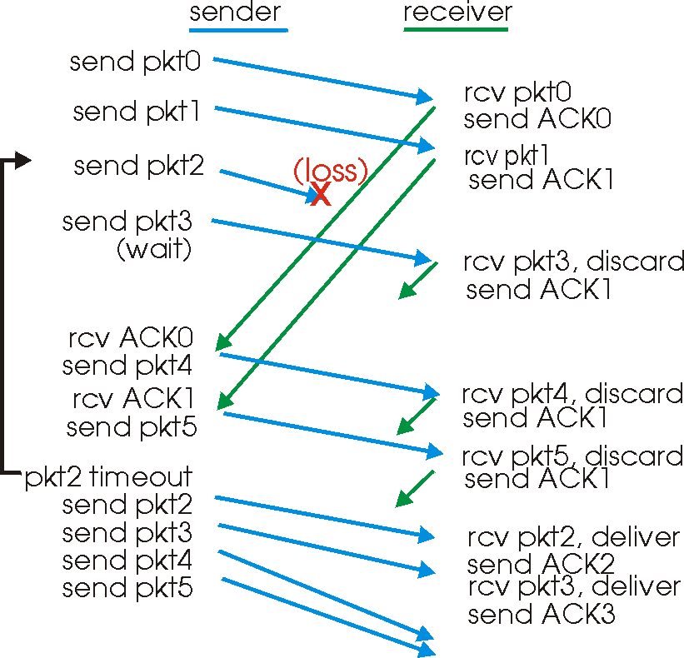
Timeout is Inefficient
Timeout-based retransmission
  Sender transmits a packet and waits until timer expires
  … and then retransmits from the lost packet onward

Slide 44
Fast Retransmission
Better solution possible under sliding window
  Although packet n might have been lost
  … packets n+1, n+2, and so on might get through
Idea: have the receiver send ACK packets
  ACK says that receiver is still awaiting nth packet
    And repeated ACKs suggest later packets have arrived
  Sender can view the “duplicate ACKs” as an early hint
    … that the nth packet must have been lost
    … and perform the retransmission early
Fast retransmission
  Sender retransmits data after the triple duplicate ACK

Slide 45
Effectiveness of Fast Retransmit
When does Fast Retransmit work best?
  Long data transfers
    High likelihood of many packets in flight
  High window size
    High likelihood of many packets in flight
  Low burstiness in packet losses
    Higher likelihood that later packets arrive successfully
Implications for Web traffic
  Most Web transfers are short (e.g., 10 packets)
    Short HTML files or small images
  So, often there aren’t many packets in flight
  … making fast retransmit less likely to “kick in”
  Forcing users to like “reload” more often… ☺

Slide 46
Tearing Down the Connection

Slide 47
Tearing Down the Connection
B
ACK
SYN
SYN ACK
Data
ACK
FIN
FIN ACK
FIN
ACK
A
time
Closing the connection
  Finish (FIN) to close and receive remaining bytes
  And other host sends a FIN ACK to acknowledge
  Reset (RST) to close and not receive remaining bytes

Slide 48
Sending/Receiving the FIN Packet
Sending a FIN: close()
  Process is done sending data via the socket
  Process invokes “close()” to close the socket
  Once TCP has sent all of the outstanding bytes…
  … then TCP sends a FIN
Receiving a FIN: EOF
  Process is reading data from the socket
  Eventually, the attempt to read returns an EOF

Slide 49
Conclusions
Transport protocols
  Multiplexing and demultiplexing
  Sequence numbers
  Window-based flow control
  Timer-based retransmission
  Checksum-based error detection
Next lecture (after reading week and midterm)
  Congestion control

