Slide 1
CSC458 Computer Networks
Problem Set #1 Tutorial
Hossein Bijanrostami
Winter 2025

Slide 2
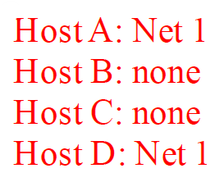

Slide 3
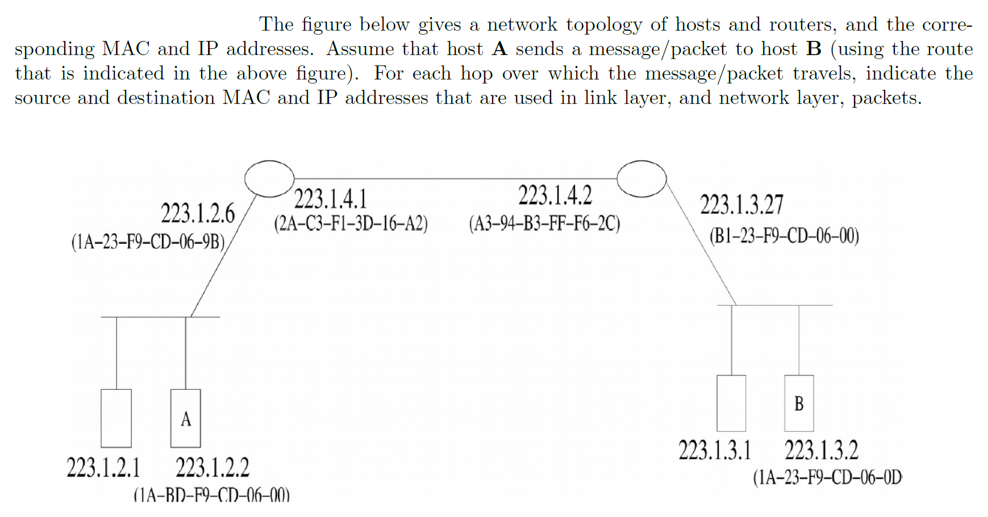

Slide 4
