Slide 1
Handout # 9:
The Internet Protocol,
Routing and Forwarding
Professor Yashar Ganjali
Department of Computer Science
University of Toronto
ganjali7@cs.toronto.edu
http://www.cs.toronto.edu/~yganjali

Slide 2
Announcements
Problem Set 1 out today (January 27th)
  5 Problems (15 parts)
  Due: Friday, Feb. 7th at 5pm.
  Submit electronically on MarkUS.
    File name: ps1.pdf
This week’s tutorial:
  Problem Set 1 review and sample problems
Programming assignment 1
  Due Friday February 14th at 5pm.
  Don’t leave to the last minute.

Slide 3
Announcements – Cont’d
Reading for this week:
  Chapter 3 of the textbook
  Next week: Chapter 4
Midterm exam
  L0101: Monday February 24th
  L0201: Tuesday February 25th
  In class: same room and time as the lecture
  For undergraduate and graduate students
  Covers everything up to the end of Lecture 6 (Transport Protocol)

Slide 4
The Story
So far …
  Layers, and protocols
  Link layer
  Interconnecting LANs
    Hubs, switches, and bridges
  The Internet Protocol
    IP datagram, fragmentation
    Naming and addressing
    CIDR, DNS
This time
  Routing and forwarding
Application
Presentation
Session
Transport
Network
Data Link
Physical

Slide 5
The IP Datagram -- Recap
bits 0
8
16
32
vers
HLen
TOS
Total Length
Offset within original packet
ID
Flags
FRAG Offset
Hop count
TTL
Protocol
checksum
SRC IP Address
<=64 KBytes
DST IP Address
(OPTIONS)
(PAD)

Slide 6
Fragmentation
Problem: A router may receive a packet larger than the maximum transmission unit (MTU) of the outgoing link.
Source
Destination
A
B
Ethernet
MTU=1500 bytes
MTU=1500 bytes
MTU<1500 bytes
R1
R2
Solution: R1 fragments the IP datagram into multiple, self-contained datagrams.
Data
HDR (ID=x)
Offset=0
More Frag=1
Offset>0
More Frag=0
Data
HDR (ID=x)
Data
HDR (ID=x)
Data
HDR (ID=x)

Slide 7
Fragmentation
Fragments are re-assembled by the destination host; not by intermediate routers.
To avoid fragmentation, hosts commonly use path MTU discovery to find the smallest MTU along the path.
Path MTU discovery involves sending various size datagrams until they do not require fragmentation along the path.
Most links use MTU>=1500bytes today.
Try:
traceroute –F www.uwaterloo.ca 1500 and
traceroute –F www.uwaterloo.ca 1501
(DF=1 set in IP header; routers send “ICMP” error message, which is shown as “!F”).
Bonus: Can you find a destination for which the path MTU < 1500 bytes?

Slide 8
Switches vs. Routers
We talked about switches (Link Layer).
  In network layer, we use “routers” to forward packets.
Advantages of switches over routers:
  Plug-and-play
  Fast filtering and forwarding of frames
  No pronunciation ambiguity (e.g., “rooter” vs. “rowter”)! ☺
Disadvantages of switches over routers
  Topology is restricted to a spanning tree
  Large networks require large ARP tables
  Broadcast storms can cause the network to collapse

Slide 9
Packet Routing and Forwarding
Forwarding IP datagrams
  Class-based vs. CIDR
Routing Techniques
  Naïve: Flooding
  Distance vector: Distributed Bellman Ford Algorithm
  Link state: Dijkstra’s Shortest Path First-based Algorithm

Slide 10
Hop-by-Hop Packet Forwarding
Each router has a forwarding table
  Maps destination addresses…
  … to outgoing interfaces
Upon receiving a packet
  Inspect the destination IP address in the header
  Index into the table
  Determine the outgoing interface
  Forward the packet out that interface
Then, the next router in the path repeats
  And the packet travels along the path to the destination

Slide 11
Inside a Router
Link 1, ingress
Choose
Egress
Link 1, egress
Link 2, ingress
Choose
Egress
Link 2, egress
Link 3, ingress
Choose
Egress
Link 3, egress
Link 4, ingress
Choose
Egress
Link 4, egress

Slide 12
Inside a Router
Forwarding
Table
Link 1, ingress
Forwarding
Decision
Link 1, egress
Link 2, ingress
Choose
Egress
Link 2, egress
Link 3, ingress
Choose
Egress
Link 3, egress
Link 4, ingress
Choose
Egress
Link 4, egress

Slide 13
Forwarding in an IP Router
Lookup packet DA in forwarding table.
  If known, forward to correct port.
  If unknown, drop packet.
Decrement TTL, update header Checksum.
Forward packet to outgoing interface.
Transmit packet onto link.
Question:
How is the address looked up in a real router?

Slide 14
Separate Table Entries Per Address
If a router had a forwarding entry per IP address
  Match destination address of incoming packet
  … to the forwarding-table entry
  … to determine the outgoing interface
1.2.3.4
5.6.7.8
2.4.6.8
1.2.3.5
5.6.7.9
2.4.6.9
host
host
...
host
host
host
...
host
LAN 1
LAN 2
router
router
router
WAN
WAN
1.2.3.4
1.2.3.5
Forwarding Table

Slide 15
Separate Entry Class-based Address
If the router had an entry per class-based prefix
  Mixture of Class A, B, and C addresses
  Depends on the first couple of bits of the destination
Identify the mask automatically from the address
  First bit of 0: class A address (/8)
  First two bits of 10: class B address (/16)
  First three bits of 110: class C address (/24)
Then, look in the forwarding table for the match
  E.g., 192.2.3.4 maps to 192.2.3.0/24
  Then, look up the entry for 192.2.3.0/24
  … to identify the outgoing interface

Slide 16
Example – Class-based Addressing
IP Address Space
Class A
Class B
Class C
D
Class A
Routing Table:
212.17.9.4
Class B
Exact
Match
Class C
212.17.9.0
Port 4
212.17.9.0
Exact Match: There are many well-known ways to find an exact match in a table.

Slide 17
CIDR Makes Packet Forwarding Harder
There’s no such thing as a free lunch
  CIDR allows efficient use of the limited address space
  But, CIDR makes packet forwarding much harder
Forwarding table may have many matches
  E.g., table entries for 201.10.0.0/21 and 201.10.6.0/23
  The IP address 201.10.6.17 would match both!
201.10.0.0/21
Provider 1
Provider 2
201.10.0.0/22
201.10.4.0/24
201.10.5.0/24
201.10.6.0/23

Slide 18
Longest Prefix Match Forwarding
Forwarding tables in IP routers
  Maps each IP prefix to next-hop link(s)
Destination-based forwarding
  Packet has a destination address
  Router identifies longest-matching prefix
  Cute algorithmic problem: very fast lookups

Slide 19
Classless Inter-Domain Routing (CIDR) – Addressing
128.9.19/24
128.9.25/24
128.9.16/20
128.9.176/20
128.9/16
0
2³²-1
128.9.16.14
Most specific route = “longest matching prefix”

Slide 20
How a Router Forwards Datagrams
128.17.20.1
e.g. 128.9.16.14 => Port 2
R2
Prefix
Next-hop
Port
65/8
128.17.16.1
3
R1
R3
1
128.9/16
128.17.14.1
2
2
3
128.9.16/20
128.17.14.1
2
128.9.19/24
128.17.10.1
7
128.9.25/24
128.17.14.1
2
R4
128.9.176/20
128.17.20.1
1
142.12/19
128.17.16.1
3
128.17.16.1
Forwarding Table

Slide 21
Simplest Algorithm is Too Slow
Scan the forwarding table one entry at a time
  See if the destination matches the entry
  If so, check the size of the mask for the prefix
  Keep track of the entry with longest-matching prefix
Overhead is linear in size of the forwarding table
  Today, that means 400,000-500,000 entries!
  And, the router may have just a few nanoseconds
  … before the next packet is arriving
Need greater efficiency to keep up with line rate
  Better algorithms
  Hardware implementations

Slide 22
Lookup Performance Required
Line Rate | PktSize = 40B | PktSize = 240B
155 Mb/s | 480 Kp/s | 80 Kp/s
2.5 Gb/s | 7.81 Mp/s | 1.3 Mp/s
10 Gb/s | 31.25 Mp/s | 5.21 Mp/s
100 Gb/s | 312.5 Mp/s | 52.1 Mp/s
b/s: bits per second p/s: packets per second

Slide 23
Fast Lookups
The are algorithms that are faster than linear scan
  Proportional to number of bits in the address
We can use special hardware
  Content Addressable Memories (CAMs)
  Allows look-ups on a key rather than flat address
Huge innovations in the mid-to-late 1990s
  After CIDR was introduced (in 1994)
  … and longest-prefix match was a major bottleneck

Slide 24
Where do Forwarding Tables Come From?
Routers have forwarding tables
  Map prefix to outgoing link(s)
Entries can be statically configured
  E.g., “map 12.34.158.0/24 to Port 1”
But, this doesn’t adapt
  To failures
  To new equipment
  To the need to balance load
  …
That is where other technologies come in…
  Routing protocols, DHCP, and ARP

Slide 25
Packet Routing and Forwarding
Forwarding IP datagrams
  Class-based vs. CIDR
Routing Techniques
  Naïve: Flooding
  Distance vector: Distributed Bellman Ford Algorithm
  Link state: Dijkstra’s Shortest Path First-based Algorithm
Routing is a very complex subject and has many aspects.
Here, we will concentrate on the basics.

Slide 26
The Problem
“A”
“B”
R₂
R₁
R₄
How does R₁ choose a next-hop on the path towards host B?
R₃

Slide 27
What is Routing?
A famous quotation from RFC 791
  “A name indicates what we seek.
  An address indicates where it is.
  A route indicates how we get there.”
  -- Jon Postel

Slide 28
Forwarding vs. Routing
Forwarding: data plane
  Directing a data packet to an outgoing link
  Individual router using a forwarding table
Routing: control plane
  Computing paths the packets will follow
  Routers talking amongst themselves
  Individual router creating a forwarding table

Slide 29
Why Does Routing Matter?
End-to-end performance
  Quality of the path affects user performance
  Propagation delay, throughput, and packet loss
Use of network resources
  Balance of the traffic over the routers and links
  Avoiding congestion by directing traffic to lightly-loaded links
Transient disruptions during changes
  Failures, maintenance, and load balancing
  Limiting packet loss and delay during changes

Slide 30
Example Network
Objective: Determine the route from A to B that minimizes the path cost.
Examples of link cost:
Distance, data rate, price, congestion/delay, …
A
R₁
1
R₂
1
R₄
4
R₆
2
2
3
2
R₇
3
R₅
2
R₃
4
R₈
B

Slide 31
Example Network
In this simple case, solution is clear from inspection
A
R₁
1
R₂
1
R₄
4
R₆
2
2
3
2
R₇
3
R₅
2
R₃
4
R₈
B

Slide 32
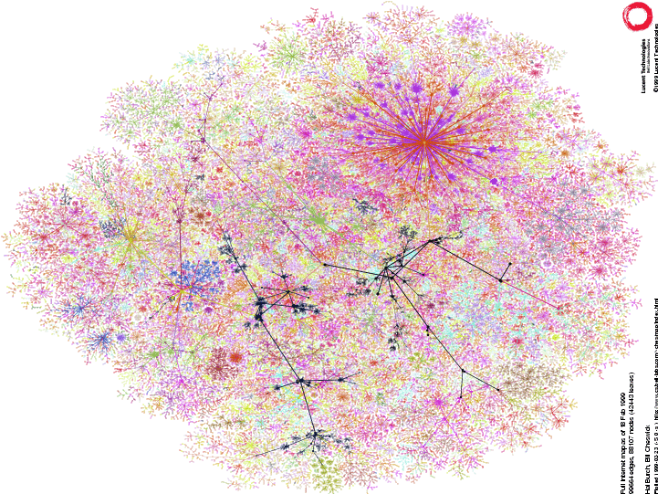
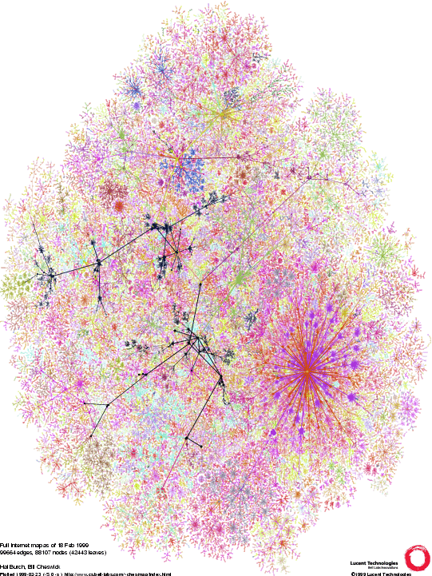
What about this Network...!?
Learn more at
http://www.lumeta.com

Slide 33
Technique 1: Naïve Approach
Flood! -- Routers forward packets to all ports
except the ingress port.
R₁
Advantages:
  Simple
  Every destination in the network is reachable.
Disadvantages:
  Some routers receive a packet multiple times.
  Packets can go round in loops forever.
  Inefficient.

Slide 34
Lowest Cost Routes
Objective: Find the lowest cost route from each of
(R₁, …, R₇) to R₈.
R₁
1
R₂
1
R₄
4
R₆
2
2
3
2
R₇
3
R₅
2
R₃
4
R₈

Slide 35
A Spanning Tree
R₁
1
1
4
R₂
R₄
R₆
3
2
2
R₇
2
R₅
2
3
R₃
4
R₈
The solution is a spanning tree with R8 as the root of the tree.
Tree: There are no loops.
Spanning: All nodes included.
We’ll see two algorithms that build spanning trees automatically:
  The distributed Bellman-Ford algorithm
  Dijkstra’s shortest path first algorithm

Slide 36
Technique 2: Distance Vector
Distributed Bellman-Ford Algorithm
Define distances at each node x
  d_{x}(y) = cost of least-cost path from x to y
Update distances based on neighbors
  d_{x}(y) = min {c(x,v) + d_{v}(y)} over all neighbors v
v
2
y
3
1
1
x
4
u
z
2
1
5
t
d_{u}(z) = min{c(u,v) + d_{v}(z),
c(u,w) + d_{w}(z)}
w
4
3
s

Slide 37
Distance Vector Algorithm
c(x,v) = cost for direct link from x to v
  Node x maintains costs of direct links c(x,v)
D_{x}(y) = estimate of least cost from x to y
  Node x maintains distance vector D_{x} = [D_{x}(y): y є N ]
Node x maintains its neighbors’ distance vectors
  For each neighbor v, x maintains D_{v} = [D_{v}(y): y є N ]
Each node v periodically sends D_{v} to its neighbors
  And neighbors update their own distance vectors
  D_{x}(y) ← min_{v}{c(x,v) + D_{v}(y)} for each node y ∊ N
Over time, the distance vector D_{x} converges

Slide 38
Distance Vector Algorithm
Iterative, asynchronous: each local iteration caused by:
  Local link cost change
  Distance vector update message from neighbor
Distributed:
  Each node notifies neighbors only when its DV changes
  Neighbors then notify their neighbors if necessary
Each node:
wait for (change in local link cost or message from neighbor)
recompute estimates
if DV to any destination has changed, notify neighbors

Slide 39
Distance Vector Example: Step 1
Optimum 1-hop paths
Table for A
Dst | Cst | Hop
A | 0 | A
B | 4 | B
C | ∞ | –
D | ∞ | –
E | 2 | E
F | 6 | F
Table for B
Dst | Cst | Hop
A | 4 | A
B | 0 | B
C | ∞ | –
D | 3 | D
E | ∞ | –
F | 1 | F
E
C
3
1
F
1
2
6
1
3
D
A
4
B
Table for C
Dst | Cst | Hop
A | ∞ | –
B | ∞ | –
C | 0 | C
D | 1 | D
E | ∞ | –
F | 1 | F
Table for D
Dst | Cst | Hop
A | ∞ | –
B | 3 | B
C | 1 | C
D | 0 | D
E | ∞ | –
F | ∞ | –
Table for E
Dst | Cst | Hop
A | 2 | A
B | ∞ | –
C | ∞ | –
D | ∞ | –
E | 0 | E
F | 3 | F
Table for F
Dst | Cst | Hop
A | 6 | A
B | 1 | B
C | 1 | C
D | ∞ | –
E | 3 | E
F | 0 | F

Slide 40
Distance Vector Example: Step 2
Optimum 2-hop paths
Table for A
Dst | Cst | Hop
A | 0 | A
B | 4 | B
C | 7 | F
D | 7 | B
E | 2 | E
F | 5 | E
Table for B
Dst | Cst | Hop
A | 4 | A
B | 0 | B
C | 2 | F
D | 3 | D
E | 4 | F
F | 1 | F
E
C
3
1
F
1
2
6
1
3
D
A
4
B
Table for C
Dst | Cst | Hop
A | 7 | F
B | 2 | F
C | 0 | C
D | 1 | D
E | 4 | F
F | 1 | F
Table for D
Dst | Cst | Hop
A | 7 | B
B | 3 | B
C | 1 | C
D | 0 | D
E | ∞ | –
F | 2 | C
Table for E
Dst | Cst | Hop
A | 2 | A
B | 4 | F
C | 4 | F
D | ∞ | –
E | 0 | E
F | 3 | F
Table for F
Dst | Cst | Hop
A | 5 | B
B | 1 | B
C | 1 | C
D | 2 | C
E | 3 | E
F | 0 | F

Slide 41
Distance Vector Example: Step 3
Optimum 3-hop paths
Table for A
Dst | Cst | Hop
A | 0 | A
B | 4 | B
C | 6 | E
D | 7 | B
E | 2 | E
F | 5 | E
Table for B
Dst | Cst | Hop
A | 4 | A
B | 0 | B
C | 2 | F
D | 3 | D
E | 4 | F
F | 1 | F
E
C
3
1
F
1
2
6
1
3
D
A
4
B
Table for C
Dst | Cst | Hop
A | 6 | F
B | 2 | F
C | 0 | C
D | 1 | D
E | 4 | F
F | 1 | F
Table for D
Dst | Cst | Hop
A | 7 | B
B | 3 | B
C | 1 | C
D | 0 | D
E | 5 | C
F | 2 | C
Table for E
Dst | Cst | Hop
A | 2 | A
B | 4 | F
C | 4 | F
D | 5 | F
E | 0 | E
F | 3 | F
Table for F
Dst | Cst | Hop
A | 5 | B
B | 1 | B
C | 1 | C
D | 2 | C
E | 3 | E
F | 0 | F

Slide 42
Bellman-Ford Algorithm
Questions:
  How long can the algorithm take to run?
  How do we know that the algorithm always converges?
  What happens when link costs change, or when routers/links fail?
Topology changes make life hard for the Bellman-Ford algorithm…

Slide 43
A Problem with Bellman-Ford
Bad news travels slowly
R₁
1
R₂
1
R₃
1
R₄
Consider the calculation of distances to R₄:
Time
R₁
R₂
R₃
0
3,R₂
2,R₃
1, R₄
R₃ R₄ fails
1
3,R₂
2,R₃
3,R₂
2
3,R₂
4,R₃
3,R₂
3
5,R₂
4,R₃
5,R₂
…
…
…
…
“Counting to infinity”

Slide 44
Counting to Infinity Problem – Solutions
Set infinity = “some small integer” (e.g. 16). Stop when count = 16.
Split Horizon: Because R₂ received lowest cost path from R₃, it does not advertise cost to R₃
Split-horizon with poison reverse: R₂ advertises infinity to R₃
There are many problems with (and fixes for) the Bellman-Ford algorithm.

Slide 45
Technique 3: Link State
Dijkstra’s Shortest Path First Algorithm
Routers send out update messages whenever the state of an incident link changes.
  Called “Link State Updates”
Based on all link state updates received each router calculates lowest cost path to all others, starting from itself.
  Use Dijkstra’s single-source shortest path algorithm
  Assume all updates are consistent
At each step of the algorithm, router adds the next shortest (i.e. lowest-cost) path to the tree.
Finds spanning tree rooted at the router.

Slide 46
Dijsktra’s Algorithm
1 Initialization:
2 S = {u}
3 for all nodes v
4 if v adjacent to u {
5 D(v) = c(u,v)
6 else D(v) = ∞
7
8 Loop
9 find w not in S with the smallest D(w)
10 add w to S
11 update D(v) for all v adjacent to w and not in S:
12 D(v) = min{D(v), D(w) + c(w,v)}
13 until all nodes in S

Slide 47
Dijkstra’s Algorithm Example
Find Routes for the Red (Leftmost) Node
2
2
3
1
3
1
1
1
4
4
2
1
2
1
5
5
4
3
4
3
2
2
3
1
3
1
1
1
4
4
2
1
2
1
5
5
4
3
4
3

Slide 48
Dijkstra’s Algorithm Example
2
2
3
1
3
1
1
1
4
4
2
1
2
1
5
5
4
3
4
3
2
2
3
1
3
1
1
1
4
4
2
1
2
1
5
5
4
3
4
3

Slide 49
Shortest-Path Tree
Shortest-path tree from u
Forwarding table at u
v
2
y
link
3
1
1
x
4
v
(u,v)
u
z
2
1
w
(u,w)
5
t
x
(u,w)
w
4
3
y
(u,v)
s
z
(u,v)
s
(u,w)
t
(u,w)

Slide 50
Reliable Flooding of LSP
The Link State Packet:
  The ID of the router that created the LSP
  List of directly connected neighbors, and cost
  Sequence number
  TTL
Reliable Flooding
  Resend LSP over all links other than incident link, if the sequence number is newer. Otherwise drop it.
Link State Detection:
  Link layer failure
  Loss of “hello” packets

Slide 51
Comparison of LS and DV algorithms
Message complexity
LS: with n nodes, E links, O(nE) messages sent
DV: exchange between neighbors only
  Convergence time varies
Speed of Convergence
LS: O(n²) algorithm requires O(nE) messages
DV: convergence time varies
  May be routing loops
  Count-to-infinity problem
Robustness: what happens if router malfunctions?
LS:
  Node can advertise incorrect link cost
  Each node computes only its own table
DV:
  DV node can advertise incorrect path cost
  Each node’s table used by others (error propagates)

