Slide 1
CSC458 PA1
Packaging IP in Ethernet
Ehsan Etesami
ehsan.etesami@utoronto.ca
Thanks to Farid Zandi and Parsa Pazhooheshy
Winter 2025
Department of Computer Science
University of Toronto

Slide 2
Introduction
IP address can be changed
When data is sent over a network, it uses the
IP address to find the correct destination.
IP Address: 10.0.0.1
MAC Address: 00:1B:44:11:3A:B7
unique to every network card or interface
Within the local network, it needs the MAC address to actually deliver the data to the right device.

Slide 3
Introduction
Assumption: We have the IP packet and the IP address of the next hop.
IP Layer
IP Data
IP Header
Dest IP: 10.0.0.1
Should reside in the same physical network
Sender
Link Layer
Ethernet Data
Ethernet Header
Dest MAC address:
00:1B:44:11:3A:DD
ARP Table
It only caches each record for a limited time (30 seconds); Computers can move between networks!
IP Address | MAC Address | TTL
10.0.0.1 | 00:1B:44:11:3A:DD | 30000
ARP: Address Resolution Protocol

Slide 4
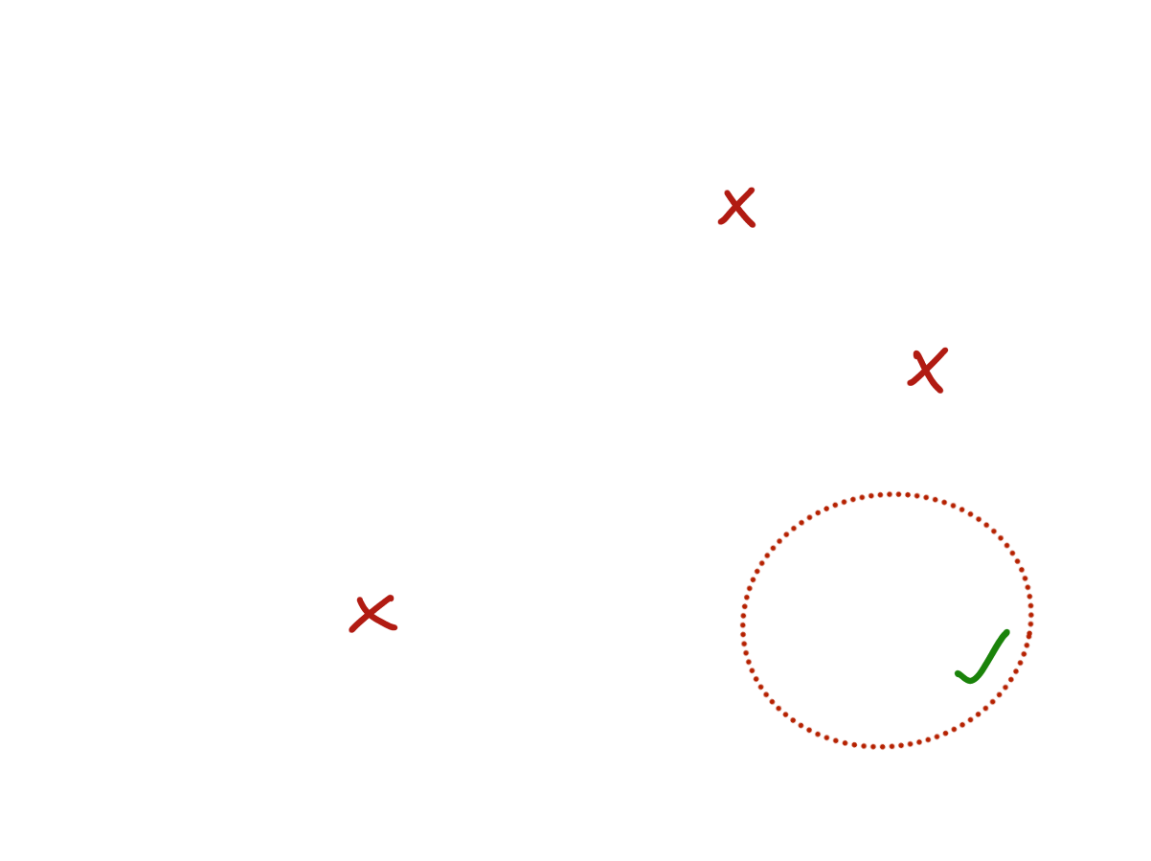
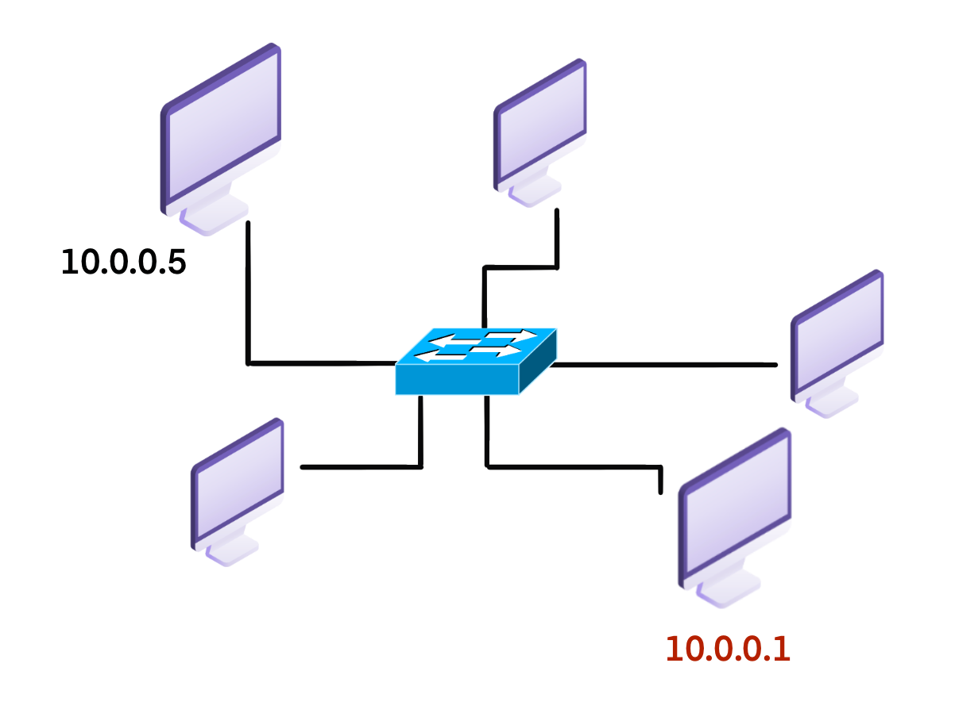
Introduction
What is the corresponding MAC address of the destination IP address?
00:1B:44:11:3A:AA
ARP Table at 10.0.0.5
IP Address | MAC Address | TTL
10.0.0.1
No response after 5 seconds? Assume the next hop is not active anymore.
00:1B:44:11:3A:DD
ARP Table at 10.0.0.1
Who has 10.0.0.1? Tell 10.0.0.5?
IP Address | MAC Address | TTL
10.0.0.5 | 00:1B:44:11:3A:AA | 30000
This is a broadcast message, the dst MAC address is FF:FF:FF:FF:FF:FF

Slide 5
Introduction
What is the corresponding MAC address of the destination IP address?
00:1B:44:11:3A:AA
ARP Table at 10.0.0.5
IP Address | MAC Address | TTL
10.0.0.1 | 00:1B:44:11:3A:DD
No response after 5 seconds? Assume the next hop is not active anymore.
00:1B:44:11:3A:DD
ARP Table at 10.0.0.1
Who has 10.0.0.1? Tell 10.0.0.5?
IP Address | MAC Address | TTL
10.0.0.5 | 00:1B:44:11:3A:AA | 30000
10.0.0.1 is at 00:1B:44:11:3A:DD

Slide 6
PA1: Deliverables
class NetworkInterface {
private:
EthernetAddress ethernet_address_;
Address ip_address_;
Public:
NetworkInterface(
const EthernetAddress& ethernet_address,
const Address& ip_address);
std::optional<EthernetFrame> maybe_send();
void send_datagram(
const InternetDatagram& dgram,
const Address& next_hop);
std::optional<InternetDatagram> recv_frame(
const EthernetFrame& frame);
void tick(size_t ms_since_last_tick);
};
network_interface.hh
network_interface.cpp
pa1.md

Slide 7
Functions to Complete
void NetworkInterface::send_datagram( const InternetDatagram& dgram, const Address& next_hop)
IP Data
IP Header
Dest IP: 10.0.0.1
Destination IP
10.0.0.1
Ethernet Data
Ethernet Header
Dest MAC address:
?
Destination Mac is Known?
Yes
No
Create Ethernet Frame, Send it
Broadcast an ARP request, Queue IP datagram
Note: Don’t flood the network with ARP requests:
If you have sent an ARP request for the same IP address in the last 5 seconds, you should NOT send a new ARP request.

Slide 8
Functions to Complete
optional<InternetDatagram> NetworkInterface::recv_frame( const EthernetFrame& frame)
Destined for this host or Broadcast?
IP Data
IP Header
Dest IP: 10.0.0.1
Yes
??
Is it’s type ARP?
Is it’s type
IPv4?
Ethernet Data
Ethernet Header
Type
Dst MAC address
Is it ARP Request? Or Reply?
Parse ip datagram
Each time an ARP reply/request is received for an existing ARP entry you need to update entry's data including the TTL field.

Slide 9
Functions to Complete
optional<EthernetFrame> NetworkInterface::maybe_send()
Whenever the physical layer of the network is ready to send out a packet, it will call this function to check if there is any packet ready to be sent.
void NetworkInterface::tick(const size_t ms_since_last_tick)
This is the callback function that informs you about the passage of time. You need to check:
Expire any entry in ARP cache table that was learnt more than 30 seconds ago.
Remove the pending ARP reply wait for any next hop IP that was sent more than 5 seconds ago.

Slide 10
PA1: Understanding the Tick Function
To simulate the passage of time, we will call the tick function with a given value of X milliseconds.
This means that X milliseconds have passed since the last time the tick function was called.
Inside the function, you should check the Time-To-Live (TTL) of all entries and ensure that none of them have expired.

Slide 11
PA1: Notes
You can modify both network_interface.cc and network_interface.hh files.
You will only submit these two files along with writeups/pa1.md
We will use the MarkUs submission system.
We will
Check your submission with automated tests (90%)
50% is dedicated to public tests
40% is dedicated to private tests
Read your source code and asses its coding style (5%)
Check completeness of the pa1.md (5%)

Slide 12
PA1: Environment Setup
On Intel/AMD computers:
Use a VM image in VirtualBox
On ARM MacBooks and Macs:
Install the UTM virtual machine software
Use the provided ARM64 GNU/Linux virtual machine image
Using your own GNU/Linux installation
Require C++20 compiler (GCC 13 or later, clang 16 or later)
Ubuntu 23.04+
https://stanford.edu/class/cs144/vm_howto/

Slide 13
PA1: Walkthrough: Environment Setup
Download the VM image
Connect to your VM
Clone the repository
Use VSCode to connect to your VM through SSH
Let’s put it into practice.

Slide 14
PA1: Writeups
The "Credit/Thank" Section:
Acknowledge anyone who assisted you in completing the assignment.
The "Collaborate" Section:
Any kind of equal collaboration. We just want to make sure we understand the nature of any potential collaboration.
The "Program Structure and Design" Section:
Explain the key design decisions you made to help reviewers understand your code. Start with a high-level overview of your approach, highlighting the most important choices. This section is not a substitute for inline comments but should be read before the reviewer examines your code in detail.

