Slide 1
Handout # 3:
Link Layer, Error Detection/Correction
Professor Yashar Ganjali
Department of Computer Science
University of Toronto
ganjali7@cs.toronto.edu
http://www.cs.toronto.edu/~yganjali

Slide 2
Announcements
Programming Assignment 1 (PA1)
  Will be posted on January 20th (next week).
  To be completed individually.
  Due: Feb. 14th at 5PM.
  Please note there will be a problem set in the middle of PA1.
Tutorials
  This week: socket programming.
  Next week: review of PA1.
Links posted on class web page (along with PA1)
  Socket programming
  Coding guidelines
  Some useful resources
Use Piazza if you have any questions.

Slide 3
Announcements – Cont’d
Reading for this week:
  Chapter 2 of the textbook
  Last week: Chapter 1
Next week: Chapter 3

Slide 4
Last Time …
Protocols, layering and reference models
Application
FTP
Application
Presentation
ASCII/Binary
Transport
Session
TCP
Transport
Network
Network
IP
Link
Link
Ethernet
Physical
The 7-layer OSI Model
The 4-layer Internet model

Slide 5
Outline
Part 1. Physical/link layer
  Different types of media
  Encoding bits with signals
  Framing
  Model of a link
Part 2. Error detection and correction
  Hamming distance
  Parity, checksums, …

Slide 6

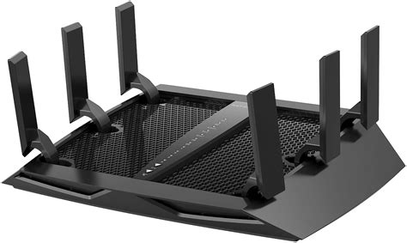
Part 1 – Physical/Link Layer
Focus:
How do we send a message across a wire?
The physical / link layers:
  Different kinds of media
  Encoding bits, messages
  Model of a link
Application
Presentation
Session
Transport
Network
Data Link
Physical
0
1
1
0
0
1
1
1

Slide 7

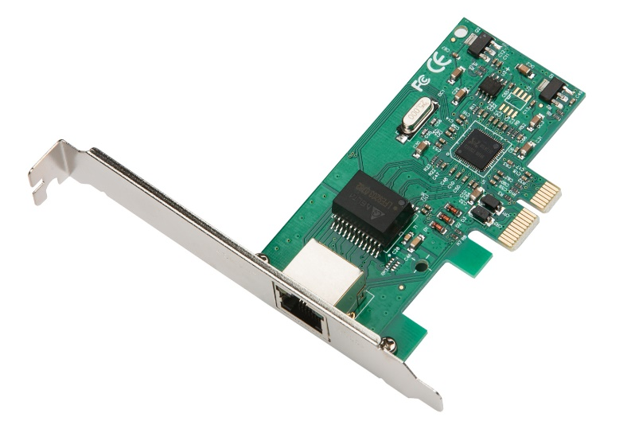
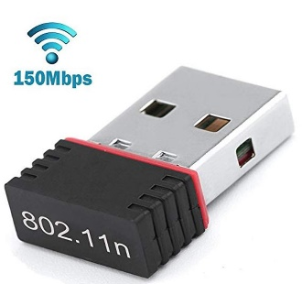

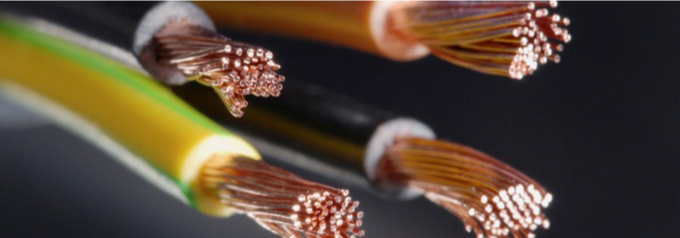
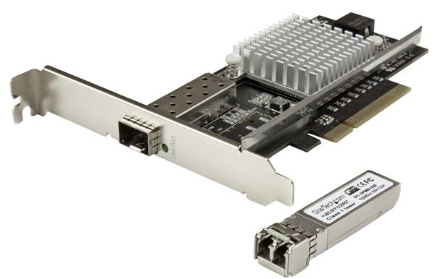
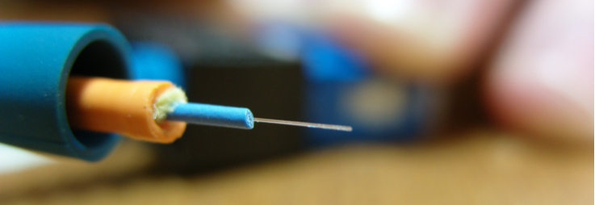
Network Link
A Communication Medium
and
A Network Adapter
Or a NIC (Network Interface Card)

Slide 8

1. Different Types of Media
Wire
  Mostly copper wires, e.g., CAT6 Ethernet Cables
    Different number of wires
    Operation frequencies (16MHz to 2GHz)
  Shielding (insulating the wire)
  Distance: 10s of meters to kilometers
  10Mbps to 100Gbps
Fiber
  Multi-mode, e.g., 100Mbps, 2KM
  Single-mode, e.g., 10 Gbps for 80km
Wireless
  Wireless LANs, e.g., WiFi (family of protocols based on IEEE 802.11 standards),
  Bluetooth, Microwave, satellite, cell phones, …
Notes:
UTP: Unshielded Twisted Pair
IRDA: InfraRed Data Association

Slide 9
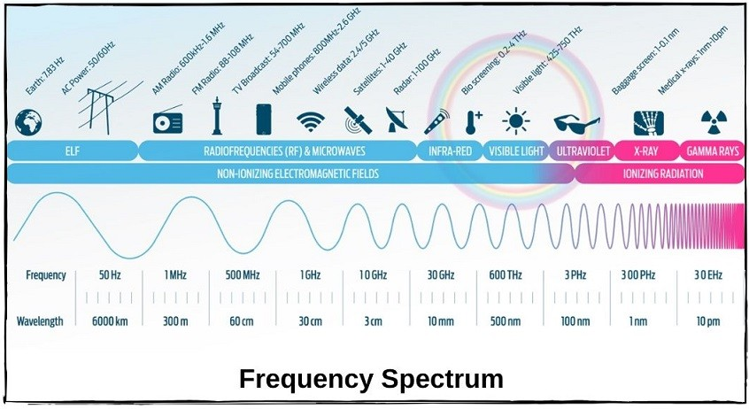
Range of Electromagnetic Waves
*https://ipcisco.com/lesson/wlan-frequency-bands/
Notes:
L -> low
M -> Medium
H -> High
V -> Very
U -> Ultra
S -> Super
E -> Extremely !

Slide 10
Physical Layer
a bit
adapter
adapter
Encoding
Transmission
Reception
Decoding
1
0
Encoding/Decoding:
  Generate analog waveform (e.g., voltage) from digital data at transmitter and sample to recover at receiver
We send/recover symbols that are mapped to bits
  There are different ways of mapping bits to signals
    E.g. NRZ, NRZI, MANCHESTER, 4B/5B

Slide 11
3. Framing
Sending bits on links is good!
But we need to send messages not bits.
  Complete link layer messages are called frames.
packet
Data link layer protocol
packet
frame
frame
frame
adapter
adapter
Sending node
Receiving node
Sending side
  Encapsulates packet in a frame
  Adds error checking bits, flow control, etc.
Receiving side
  Looks for errors, flow control, etc.
  Extracts datagram and passes to receiving node

Slide 12
Framing
Main challenge:
  When a receiver gets a sequence of bits, how should she know where the start and the end of a message/frame is?
Common solution: Sentinels
  Look for special control codes that mark start and end of frames
    What if this control code appears in the main message?
    How do you print a quotation mark in c?!
  And “stuff” this control code within the data region
  Example:
    Sender always inserts a 0 after five 1s in the frame content
    Receiver always removes a 0 appearing after five 1s
01111110
Frame Content
01111111

Slide 13
How do we identify link adapters?

Slide 14
Medium Access Control (MAC) Address
Any adaptor is “built” with a Unique MAC address
  Flat name space of 48 bits (e.g., 00-15-C5-49-04-A9 in HEX)
  Works like a Social Insurance Number you get when you are born.
Hierarchical Allocation
  Blocks: assigned to vendors (e.g., Dell) by the IEEE
    First 24 bits (e.g., 00-15-C5-**-**-**)
  Adapter: assigned by the vendor from its block
    Last 24 bits
Broadcast address (i.e., FF-FF-FF-FF-FF-FF)
  Send the frame to all adapters
Checkout your MAC address(es):
Linux, Mac: ifconfig
Windows: ipconfig \all | findstr “Physical”

Slide 15


Bootstrapping …
How do you get an IP address?
Static: set the IP address manually (number got from your service provider); or
Dynamic Host Configuration Protocol (DHCP)
  Broadcast “I need an IP address, please!”
  Response “You can have IP address 192.168.1.22”
Where am I?!
192.168.1.22
6C-A1-00-4E-CC-66
1A-F2-CC-76-09-AD
192.168.1.22
192.168.1.1
DHCP Server
6C-A1-00-4E-DD-76
192.168.1.21

Slide 16
Discovering the Receiver …
ARP Table
Address Resolution Protocol (ARP)
Broadcast “who has IP address 192.168.1.21 ?”
Response “6C-A1-00-4E-DD-76 has 192.168.1.21 !”
IP | MAC
192.168.1.1 | 1A-F2-CC-76-09-AD
192.168.1.21 | 6C-A1-00-4E-DD-76
I have an IP packet for 192.168.1.21
But I don’t know her MAC address : (
How did we get this?!
6C-A1-00-4E-CC-66
1A-F2-CC-76-09-AD
192.168.1.22
192.168.1.1
6C-A1-00-4E-DD-76
192.168.1.21

Slide 17
4. Model of a Link
Rate R Mbps
Message
M bits
Delay D seconds
Abstract model is typically all we will need
  What goes in comes out altered by the model
Other parameters that are important:
  The kind and frequency of errors
  Whether the media is broadcast or not

Slide 18
Message Latency
How long does it take to send a message?
Two terms:
  Propagation delay = distance / speed of light in media
    How quickly a message travels over the wire
  Transmission delay = message (bits) / rate (bps)
    How quickly you can inject the message onto the wire
Later we will see queuing delay …
Message M
Delay D, Rate R

Slide 19
Relationships
Latency = Propagation + Transmit + Queue
Propagation Delay = Distance/SpeedOfLight
Transmit Time = MessageSize/Bandwidth

Slide 20
One-way Latency
Dialup with a modem:
  D = 10ms, R = 56Kbps, M = 1000 bytes
  Latency = 10ms + (1000 x 8)/(56 x 1000) sec = 153ms!
Cross-country with T3 (45Mbps) line:
  D = 50ms, R = 45Mbps, M = 1000 bytes
  Latency = 50ms + (1000 x 8) / (45 x 1000000) sec = 50ms!
Either a slow link or long wire makes for large latency

Slide 21

Latency and RTT
Latency is typically the one way delay over a link
  Arrival Time - Departure Time
The round trip time (RTT) is twice the one way delay
  Measure of how long to signal and get a response
Departure
Time
Arrival
Time
RTT
+

Slide 22
Throughput
Measure of system’s ability to “pump out” data
  NOT the same as bandwidth
Throughput = Transfer Size / Transfer Time
  Eg, “I transferred 1000 bytes in 1 second on a 100Mb/s link”
    BW?
    Throughput?
Transfer Time = SUM OF
  Time to get started shipping the bits
  Time to ship the bits
  Time to get stopped shipping the bits

Slide 23
Messages Occupy “Space” On the Wire
Consider a 1b/s network.
  How much space does 1 byte take?
Suppose latency is 16 seconds.
  How many bits can the network “store”
  This is the BANDWIDTH-DELAY Product
  Measure of “data in flight.”
  1b/s * 16s = 16b
Tells us how much data can be sent before a receiver sees any of it.
  Twice B.D.P. tells us how much data we could send before hearing back from the receiver something related to the first bit sent.
  Implications?

Slide 24
A More Realistic Example
BDP = 50ms * 100Mbps = 5Mb = 625KB
101100…11…0010101010101010101

Slide 25
Packet Switching
A
B
R2
Source
R1
R3
Destination
R4
Host A
TRANSP1
“Store-and-Forward” at each Router
R1
TRANSP2
PROP1
TRANSP3
R2
PROP2
TRANSP4
R3
Host B
PROP3
PROP4

Slide 26
Packet Switching
Why not send the entire message in one packet?
  M is the message size
  m is the packet size (M divided by number of packets)
  K is the number of packets in the message.
Breaking message into packets allows parallel transmission across all links, reducing end to end latency. It also prevents a link from being “hogged” for a long time by one message.

Slide 27
Packet Switching – Queueing Delay
Because the egress link is not necessarily free when a packet arrives, it may be queued in a buffer. If the network is busy, packets might have to wait a long time.
Host A
TRANSP1
Q2
R1
TRANSP2
PROP1
TRANSP3
R2
PROP2
How can we determine the queueing delay?
R3
TRANSP4
PROP3
Host B
PROP4

Slide 28
Increasing Link Bandwidth
Typical approaches
  Increase number of wires (fibers, etc.)
  Increase bits per second
Example:
  NVLink 1.0:
    20 GB/s on each link in each direction
    8 lanes (links)
    Total: 160 GB/s capacity
  NVLink 4.0:
    25 GB/s in each direction
    18 links
    Total: 1.8 TB/s
This is a simplified model. The reality is a bit more complicated, but we’ll get to it later.

Slide 29
Part 1: Key Concepts
We typically model links in terms of bandwidth and delay, from which we can calculate message latency.
Different media have different properties that affect their performance as links.
We need to encode bits into signals so that we can recover them at the other end of the channel.
Framing allows complete messages to be recovered at the far end of the link.

Slide 30
Outline
Part 1. Physical/link layer
  Different types of media
  Encoding bits with signals
  Framing
  Model of a link
Part 2. Error detection and correction
  Hamming distance
  Parity, checksums, CRC, …

Slide 31
Part 2 – Error Detection and Correction
Focus: How do we detect and correct messages that are garbled during transmission?
The responsibility for doing this cuts across the different layers
Application
Presentation
Session
Transport
Network
Data Link
Physical

Slide 32
Errors and Redundancy
Noise can flip some of the bits we receive
  We must be able to detect when this occurs!
  Why?
  Who needs to detect it? (links, routers, OSs, or apps?)
Basic approach: add redundant data
  Error detection codes allow errors to be recognized
  Error correction codes allow errors to be repaired too

Slide 33
Motivating Example
A simple error detection scheme:
  Just send two copies. Differences imply errors.
Question: Can we do any better?
  With less overhead
  Catch more kinds of errors
Answer: Yes – stronger protection with fewer bits
  But we can’t catch all inadvertent errors, nor malicious ones
We will look at basic block codes
  K bits in, N bits out is a (N, K) code
  Simple, memoryless mapping

Slide 34
Detection vs. Correction
Two strategies to correct errors:
  Detect and retransmit, or Automatic Repeat reQuest. (ARQ)
  Error correcting codes, or Forward Error Correction (FEC)
Satellites, real-time media tend to use error correction
Retransmissions typically at higher levels (Network+)
Question: Which should we choose?

Slide 35
Detect or Correct?
Advantages of Error Detection
  Requires smaller number of bits → low overhead.
  Requires less/simpler processing.
Advantages of Error Correction
  Reduces number of retransmissions.
Most data networks today use error detection, not error correction.

Slide 36
Retransmissions vs. FEC
The better option depends on the kind of errors and the cost of recovery
Example: Message with 1000 bits, Prob(bit error) 0.001
  Case 1: random errors
  Case 2: bursts of 1000 errors
  Case 3: real-time application (teleconference)

Slide 37
Encoding to Detect Errors
We use codes to help us detect errors.
The set of possible messages is mapped by a function onto the set of codes.
We pick the mapping function so that it is easy to detect errors among the resulting codes.
Example: Consider the function that duplicates each bit in the message. E.g. the message 1011001 would be mapped to the code 11001111000011, and then transmitted by the sender. The receiver knows that bits always come in pairs. If the two bits in a pair are different, it declares that there was a bit error.
Of course, this code is quite inefficient…

Slide 38
The Hamming Distance
Errors must not turn one valid codeword into another valid codeword, or we cannot detect/correct them.
Hamming distance of a code is the smallest number of bit differences that turn any one codeword into another
  e.g, code 000 for 0, 111 for 1, Hamming distance is 3
For code with distance d+1:
  d errors can be detected, e.g, 001, 010, 110, 101, 011
For code with distance 2d+1:
  d errors can be corrected, e.g., 001 → 000

Slide 39
Hamming Distance
Number of bits that differ between two codes
e.g. 1 0 0 1 0 1 0 1
1 0 1 1 1 0 0 1
0 0 1 0 1 1 0 0
In our example code (replicated bits), all codes have at least two bits different from every other code. Therefore, it has a Hamming distance of 2.
HD=3

Slide 40
Hamming Distance
Set of codes
4
3
d₂₃
HD = min (d_{ij} )
1
2
To reliably detect a d-bit error: HD ≥ d+1
To reliably correct a d-bit error: HD ≥ 2d+1

Slide 41
Parity
Start with n bits and add another so that the total number of 1s is even (even parity)
  e.g. 0110010 → 01100101
  Easy to compute as XOR of all input bits
Will detect an odd number of bit errors
  But not an even number
Does not correct any errors

Slide 42
2D Parity
Add parity row/column to array of bits
Detects all 1, 2, 3 bit errors, and many errors with >3 bits.
Corrects all 1 bit errors
0101001 1
1101001 0
1011110 1
0001110 1
0110100 1
1011111 0
1111011 0

Slide 43
Checksums
Used in Internet protocols (IP, ICMP, TCP, UDP)
Basic Idea: Add up the data and send it along with sum
Algorithm:
  checksum is the 1s complement of the 1s complement sum of the data interpreted 16 bits at a time (for 16-bit TCP/UDP checksum)
1s complement: flip all bits to make number negative
1s complement sum: if there is a carry from the most significant bit (MSB), wrap it around and add it back to the least significant bit (LSB).

Slide 44
1s Complement Sum Examples
Example 1
  Number 1: 0110
  Number 2: 0101
No carry in this case, so no wrapping is needed.
The sum is 1011.
The 1s complement sum is 0100.
Example 2
  Number 1: 1110
  Number 2: 0101
The result is 5 bits (10011). The carry (1) is added to the least significant 4 bits:
The final sum is 0100.
The 1s complement sum is 1011.
1110
+ 0101
--------
10011
0110
+ 0101
--------
1011
0011
+ 1
--------
0100

Slide 45
CRCs (Cyclic Redundancy Check)
Stronger protection than checksums
  Used widely in practice, e.g., Ethernet CRC-32
  Implemented in hardware (XORs and shifts)
Mathematics more involved …
  Optional: see textbook if you are interested

Slide 46
Part 2: Key Concepts
Redundant bits are added to messages to protect against transmission errors.
Two recovery strategies are retransmissions (ARQ) and error correcting codes (FEC)
The Hamming distance tells us how much error can safely be tolerated.

