Slide 1
Handout # 2:
Course Logistics and Introduction
Professor Yashar Ganjali
Department of Computer Science
University of Toronto
ganjali7@cs.toronto.edu
http://www.cs.toronto.edu/~yganjali

Slide 2
Today
Outline
  What this course is about
Logistics
  Course structure, assignments, evaluation
  What is expected from you
  What you can expect from this course
Review
  Simple example – mail vs. FTP
Foundations and basic concepts

Slide 3
What is This Course About?
Undergrad course; can be taken by grads
Computer networks
  Basics: layers, naming, and addressing, network (socket) programming, routing, congestion control, …
  Advanced networking: peer-to-peer, routers and switch architectures, software-defined networking, datacenter networking, networks for ML, …
Theory vs. Practice
  CSC 457: focus on foundation, principles, and theory
  CSC 458: focus on networking systems and programming

Slide 4
Logistics – Prerequisites, Readings
Prerequisites
  Algorithms
  Basic probability theory
  Strong background in C programming and Unix environment
Note: CSC 457 is not a prerequisite.
Readings
  Will be posted on course schedule web page
  Read before class

Slide 5
Logistics – Textbooks
Textbook
  Computer Networks: A Systems Approach (6th Edition), Peterson, Davie, 2021.
You can get a print copy of this book. Alternatively, you can find an online version here:
  https://book.systemsapproach.org/
Recommended book
  UNIX Network Programming, Volume I: The Sockets Networking API, W. Richard Stevens, Bill Fenner, and Andrew M. Rudoff, 3rd edition, 2003

Slide 6
Logistics – Sections
This course is offered in two sections
  L0101: Mon. 9-11 AM, MP 137, Prof. Yashar Ganjali
  L0201: Tue. 3-5 PM, ES B142, Prof. Peter Marbach
Both sections are completely full.
  Please only attend the class to which you have been assigned.
Content/assignments are the same. Midterm exam is different.

Slide 7
Logistics – Hours, Web, Announcements
Office hours
  Section L0101:
    Time: Mon. 11 AM – Noon, Fri. 11 AM – Noon, or by appointment
    Location: BA5238
  Section L0201:
    Time: Tue. 5 PM – 6 PM, or by appointment
    Location: BA5224
Course web page
  http://www.cs.toronto.edu/~yganjali/teaching/csc458-winter-2025/
Please check the class web page, and the bulletin board regularly for announcements.

Slide 8
Logistics – Teaching Assistants
Hossein Bijanrostami
Ehsan Etesami
Parsa Pazhooheshy (Head TA)
Sajad Shirali-Shareza
Farid Zandi Shafagh
Please check class web site for email addresses, and assignments for which each TA is responsible.

Slide 9
Logistics – TA hours, Tutorials
Tutorials and discussion session
  L0101: Wed. 10-11 AM, BA 1220
  L0201: Thu. 3-4 PM, ES B 149
First tutorial:
  Next week

Slide 10
Logistics – Mailing List, Bulletin Board
Bulletin board
  We will use Piazza for announcements and Q&A
    https://piazza.com/utoronto.ca/winter2025/csc458csc2209
    Sign up link on class web site
  Post any questions related to the course.
  Check previous posts before asking a question.
  We guarantee to respond within 48 hours.
Class mailing list
  Based on e-mail address you have defined on ACORN.
  The TAs and I will use this list for announcements only.
  Do not send e-mails to this list!

Slide 11
Logistics – Grading
Grading for undergraduate AND graduate students
  Assignments: 50%
    Two problem sets: 20%
    Two programming: 30%
  Midterm exam: 20% - In class
    L0101: Feb. 24
    L0201: Feb. 25
  Final exam: 30% - TBA
Please note that grading is the same for graduate and undergraduate students.

Slide 12
Logistics - Deadlines
Assignment deadlines
  One free late submission of 24 hours
    Use on assignment of your choice
    E-mail TAs before the deadline
  10% deduction for each day late
    Up to 20%
    Assignment not accepted after two days

Slide 13
Logistics – Programming Assignments
Implementing a simple network stack
To be completed individually.
You can submit your assignment during a seven- day period before the deadline
  Your last submission before the deadline will be marked
Marking:
  Public tests: 50% of the mark
  Private tests: 40%
  Style and documentation: 10%

Slide 14
Logistics – Academic Integrity
All submissions must present original, independent work.
We take academic offenses very seriously.
Please read
  Handout # 1 (course information sheet)
  “Guideline for avoiding plagiarism”
  http://www.cs.toronto.edu/~fpitt/documents/plagiarism.html
  “Advice about academic offenses”
  http://www.cs.toronto.edu/~clarke/acoffences/
Use of AI tools: OK to use for general questions, not specific ones related to assignments.
    Please see Handout #1 for more information.

Slide 15
Logistics - Accessibility
Accessibility Needs
  The University of Toronto is committed to accessibility. If you require accommodations or have any accessibility concerns, please visit accessibility services as soon as possible.
  https://studentlife.utoronto.ca/department/accessibility-services/

Slide 16
Acknowledgements
Special thanks to:
  Prof. Nick McKeown from Stanford University
  Prof. Jennifer Rexford from Princeton University
  Prof. David Wetherall from University of Washington
  Prof. Nick Feamster from University of Chicago
  Dr. Soheil Abbasloo from Microsoft Research

Slide 17
Quick Survey
Have you taken another networking course before?
Are you familiar with
  Socket programming?
  Ethernet, framing, encoding, error detection/correction?
  UDP, TCP and congestion control?
  DNS, SNMP, BGP?
  Voice and video over IP?
  Network security?
  Software-defined networking?
  Control plane vs. data path?
  Datacenter networks?
  Networks for machine learning?

Slide 18
Questions?
What else do you want to know
about this course?

Slide 19
Announcement
First tutorial
  Next week
Covers socket programming

Slide 20
Let’s Begin
An introduction to the mail system
An introduction to the Internet

Slide 21
An Introduction to the Mail System
U of T
Stanford
Yashar
Nick
Admin
Admin

Slide 22
Characteristics of the Mail System
Each envelope is individually routed.
No time guarantee for delivery.
No guarantee of delivery in sequence.
No guarantee of delivery at all!
  Things get lost
  How can we acknowledge delivery?
  Retransmission
    How to determine when to retransmit? Timeout?
    Need local copies of contents of each envelope.
    How long to keep each copy.
    What if an acknowledgement is lost?

Slide 23
An Introduction to the Mail System
U of T
Stanford
Application Layer
Yashar
Nick
Transport Layer
Admin
Admin
Network Layer
Link Layer

Slide 24
An Introduction to the Internet
cs.toronto.edu
leland.stanford.edu
Application Layer
Yashar
Nick
Transport Layer
O.S.
O.S.
Data
Header
Data
Header
Datagram
Network Layer
Link Layer

Slide 25
Characteristics of the Internet
Each packet is individually routed.
No time guarantee for delivery.
No guarantee of delivery in sequence.
No guarantee of delivery at all!
  Things get lost
  Acknowledgements
  Retransmission
    How to determine when to retransmit? Timeout?
    Need local copies of contents of each packet.
    How long to keep each copy?
    What if an acknowledgement is lost?

Slide 26
Characteristics of the Internet – Cont’d
No guarantee of integrity of data.
Packets can be fragmented.
Packets may be duplicated.

Slide 27
Layering in the Internet
Transport Layer
  Provides reliable, in-sequence delivery of data from end-to-end on behalf of application.
Network Layer
  Provides “best-effort”, but unreliable, delivery of datagrams.
Link Layer
  Carries data over (usually) point-to-point links between hosts and routers; or between routers and routers.

Slide 28
An Introduction to the Mail System
U of T
Stanford
Application Layer
Yashar
Nick
Transport Layer
Admin
Admin
Network Layer
Link Layer

Slide 29
Some Questions About the Mail System
How many sorting offices are needed and where should they be located?
How much sorting capacity is needed?
  Should we allocate for Mother’s Day?
How can we guarantee timely delivery?
  What prevents delay guarantees?
  Or delay variation guarantees?
How can we build an infra-structure for overnight deliveries?
  What are the challenges for extremely tight deadlines?
How do we protect against fraudulent mail deliverers, or fraudulent senders?

Slide 30
Outline – Foundations & Basic Concepts
A detailed FTP example
Layering
Packet switching and circuit switching

Slide 31
Example: File Transfer over the Internet
Using TCP/IP and Ethernet
1
App
20
App
“A” U of T
“B” Stanford
OS
OS
2
3
4
19
18
17
Ethernet
Ethernet
5
14
R1
6
15
R5
8
11
7
16
9
R2
R3
12
10
13
R4

Slide 32
In the Sending Host
1. Application-Programming Interface (API)
  Application requests TCP connection with “B”
2. Transmission Control Protocol (TCP)
  Creates TCP “Connection setup” packet
  TCP requests IP packet to be sent to “B”
TCP Packet
TCP
Data
TCP
Header
Type = Connection Setup
Empty

Slide 33
In the Sending Host – Cont’d
3. Internet Protocol (IP)
  Creates IP packet with correct addresses.
  IP requests packet to be sent to router.
TCP Packet
TCP
Data
TCP
Header
Encapsulation
Destination Address: IP “B”
Source Address: IP “A”
Protocol = TCP
IP
Data
IP
Header
IP Packet

Slide 34
In the Sending Host – Cont’d
4. Link (“MAC” or Ethernet) Protocol
  Creates MAC frame with Frame Check Sequence (FCS).
  Wait for Access to the line.
  MAC requests PHY to send each bit of the frame.
IP Packet
IP Data
IP
Header
Encapsulation
Destination Address: MAC “R1”
Source Address: MAC “A”
Protocol = IP
Ethernet
FCS
Ethernet Data
Ethernet
Header
Ethernet Packet

Slide 35
In Router R1
5. Link (“MAC” or Ethernet) Protocol
  Accept MAC frame, check address and Frame Check Sequence (FCS).
  Pass data to IP Protocol.
IP Packet
IP Data
IP
Header
Decapsulation
Destination Address: MAC “R1”
Source Address: MAC “A”
Protocol = IP
Ethernet
FCS
Ethernet Data
Ethernet
Header
Ethernet Packet

Slide 36
In Router R1
6. Internet Protocol (IP)
  Use IP destination address to decide where to send packet next (“next-hop routing”).
  Request Link Protocol to transmit packet.
Destination Address: IP “B”
Source Address: IP “A”
Protocol = TCP
IP
Data
IP
Header
IP Packet

Slide 37
In Router R1
7. Link (“MAC” or Ethernet) Protocol
  Creates MAC frame with Frame Check Sequence (FCS).
  Wait for Access to the line.
  MAC requests PHY to send each bit of the frame.
IP Packet
IP Data
IP
Header
Encapsulation
Destination Address: MAC “R2”
Source Address: MAC “R1”
Protocol = IP
Ethernet
FCS
Ethernet Data
Ethernet
Header
Ethernet Packet

Slide 38
In Router R5
16. Link (“MAC” or Ethernet) Protocol
  Creates MAC frame with Frame Check Sequence (FCS).
  Wait for Access to the line.
  MAC requests PHY to send each bit of the frame.
IP Packet
IP Data
IP
Header
Encapsulation
Destination Address: MAC “B”
Source Address: MAC “R5”
Protocol = IP
Ethernet
FCS
Ethernet Data
Ethernet
Header
Ethernet Packet

Slide 39
In the Receiving Host
17. Link (“MAC” or Ethernet) Protocol
  Accept MAC frame, check address and Frame Check Sequence (FCS).
  Pass data to IP Protocol.
IP Packet
IP Data
IP
Header
Decapsulation
Destination Address: MAC “B”
Source Address: MAC “R5”
Protocol = IP
Ethernet
FCS
Ethernet Data
Ethernet
Header
Ethernet Packet

Slide 40
In the Receiving Host - Cont’d
18. Internet Protocol (IP)
  Verify IP address.
  Extract/decapsulate TCP packet from IP packet.
  Pass TCP packet to TCP Protocol.
TCP Packet
TCP
Data
TCP
Header
Decapsulation
Destination Address: IP “B”
Source Address: IP “A”
Protocol = TCP
IP
Data
IP
Header
IP Packet

Slide 41
In the Receiving Host - Cont’d
19. Transmission Control Protocol (TCP)
  Accepts TCP “Connection setup” packet
  Establishes connection by sending “Ack”.
20. Application-Programming Interface (API)
  Application receives request for TCP connection with “A”.
TCP Packet
TCP
Data
TCP
Header
Type = Connection Setup
Empty

Slide 42
Outline – Foundations & Basic Concepts
A detailed FTP example
Layering
Packet switching and circuit switching

Slide 43
Layering – The OSI Model
layer-to-layer communication
Application
Application
7
7
Presentation
Presentation
6
6
Session
Session
5
5
Peer-layer communication
Transport
Transport
4
Router
Router
4
Network
Network
Network
Network
3
3
Link
Link
Link
Link
2
2
Physical
Physical
Physical
Physical
1
1

Slide 44
Layering – Our File Transfer Example
Application
FTP
Application
Presentation
ASCII/Binary
Transport
Session
TCP
Transport
Network
Network
IP
Link
Link
Ethernet
Physical
The 7-layer OSI Model
The 4-layer Internet model

Slide 45
Outline – Foundations & Basic Concepts
A detailed FTP example
Layering
Packet switching and circuit switching

Slide 46
Circuit Switching
A
B
Source
Destination
It’s the method used by the telephone network.
A call has three phases:
  Establish circuit from end-to-end (“dialing”),
  Communicate,
  Close circuit (“tear down”).
Originally, a circuit was an end-to-end physical wire.
Nowadays, a circuit is like a virtual private wire: each call has its own private, guaranteed data rate from end-to-end.

Slide 47
Circuit Switching – Telephone Network
Each phone call is allocated 64kb/s. So, a 10Gb/s trunk line can carry about 156,000 calls.
Destination
“Callee”
Source
“Caller”
Trunk
Exchange
Central
Office
“C.O.”
Central
Office
“C.O.”

Slide 48
Packet Switching
A
B
R2
Source
Destination
R1
R3
R4
It’s the method used by the Internet.
Each packet is individually routed packet-by-packet, using the router’s local routing table.
The routers maintain no per-flow state.
Different packets may take different paths.
Several packets may arrive for the same output link at the same time. Therefore, a packet switch has buffers.

Slide 49
Packet Switching – Simple Router Model
“4”
Link 1, ingress
Choose
Egress
Link 1, egress
Link 2
Link 2, ingress
Choose
Egress
Link 2, egress
R1
“4”
Link 1
Link 3
Link 3, ingress
Choose
Egress
Link 3, egress
Link 4
Link 4, ingress
Choose
Egress
Link 4, egress

Slide 50
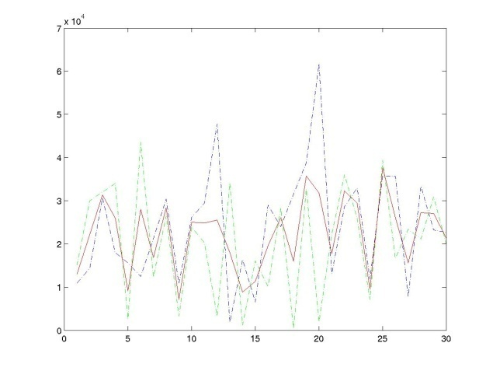
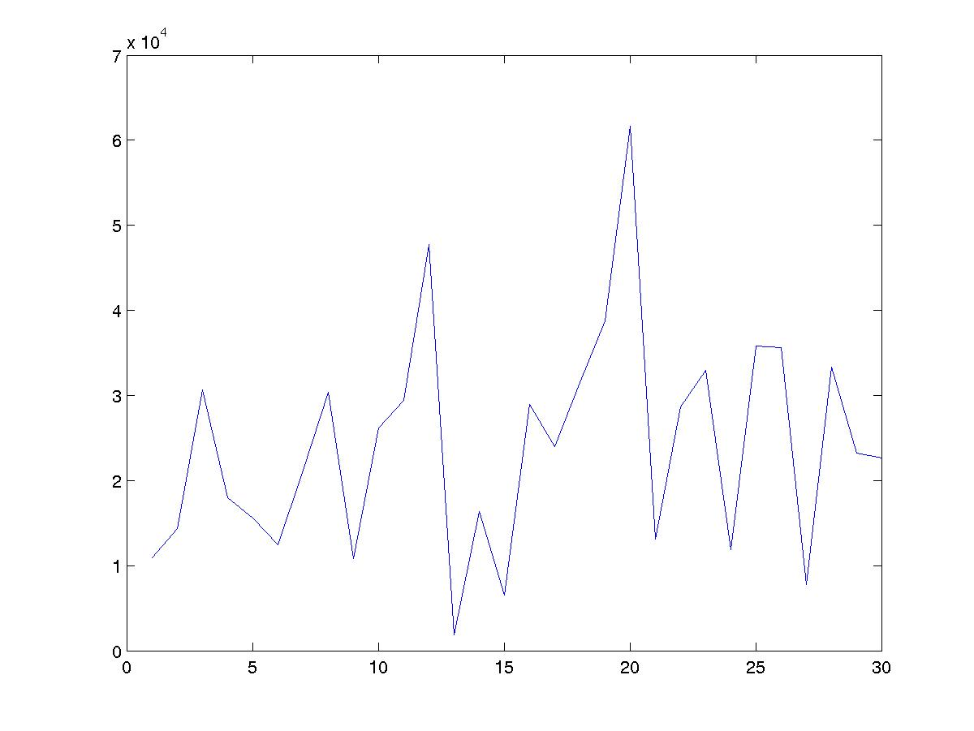
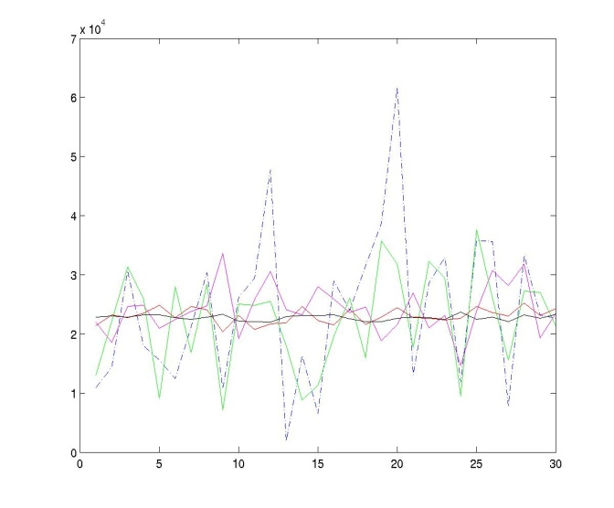
Statistical Multiplexing – Basic Idea
One flow
rate
rate
Average rate
Two flows
time
rate
time
Network traffic is bursty.
i.e. the rate changes frequently.
Peaks from independent flows generally occur at different times.
Conclusion: The more flows we have,
the smoother the traffic.
Many flows
Average rates of:
1, 2, 10, 100, 1000 flows.
time

Slide 51
Packet Switching – Statistical Multiplexing
Packets for one output
Queue Length
X(t)
Dropped packets
Dropped packets
1
Data
Hdr
R
X(t)
R
B
2
Data
Hdr
Link rate, R
R
Packet buffer
N
Data
Hdr
Time
Because the buffer absorbs temporary bursts, the egress link need not operate at rate N.R.
But the buffer has finite size, B, so losses will occur.

Slide 52
Statistical Multiplexing
Rate
A
C
A
C
time
B
Rate
C
B
C
time
Notes:
Statistical multiplexing
Important if traffic is bursty
Less expensive
Contention requires buffering
Variable delay => no QoS guarantees

Slide 53
Statistical Multiplexing Gain
A+B
Rate
2C
R < 2C
A
R
B
time
Statistical multiplexing gain = 2C/R
Other definitions of SMG: The ratio of rates that give rise to a particular queue occupancy, or particular loss probability.
Notes:
Statistical multiplexing
Important if traffic is bursty
Less expensive
Contention requires buffering
Variable delay => no QoS guarantees

Slide 54
Why Packet Switching in the Internet?
Efficient use of expensive links:
  The links are assumed to be expensive and scarce.
  Packet switching allows many, bursty flows to share the same link efficiently.
  “Circuit switching is rarely used for data networks, ... because of very inefficient use of the links” - Gallager
Resilience to failure of links & routers:
  “For high reliability, ... [the Internet] was to be a datagram subnet, so if some lines and [routers] were destroyed, messages could be ... rerouted” - Tanenbaum
Notes:
Breaking message into packets allows parallel transmission across all links, reducing network latency.
In summary the benefits that of packet switched networks can be summarized as follows:
They use the bandwidth efficiently, meaning that a trunk link uses less resources than the sum of its tributaries, as they multiplex and conserve bandwidth
They have little state in the intermediate nodes
They are robust, some claim that they were designed to withstand a nuclear attack
They do not have a central authority from whom we need permission to run experiments

Slide 55
Final Comments, Discussion
Is layering the best approach?
  Simplifies design
  Yet, limited and inflexible
Best effort service
  Made the rapid growth of the Internet possible
  Makes providing any guarantees very difficult
Packet switching
  Enables statistical multiplexing
  We need extremely fast routers
Routing
  How does a router know which output port to send the packet to?

