Slide 1
Handout # 13:
Internet Topology and Routing
Professor Yashar Ganjali
Department of Computer Science
University of Toronto
ganjali7@cs.toronto.edu
http://www.cs.toronto.edu/~yganjali

Slide 2
Announcements
Problem Set 1
  Due today
  Submit electronically on MarkUS.
    File name: ps1.pdf
  0% but make sure you complete the assignment.
Programming assignment 1
  Due Friday October 17th at 5pm.
  Don’t leave to the last minute.
TA office hours
  Extra help for each assignment
  Please check class website for time/location information

Slide 3
Announcements – Cont’d
This week’s tutorial:
  Problem Set 1 Q&A
Next week’s tutorial:
  Programming assignment 1 Q&A
Reading for this week:
  Chapter 4 of the textbook
  Next week: Chapter 5

Slide 4
Announcements – Cont’d
Quiz #1:
  Next week, in-class
  Roughly based on PS1
Midterm exam
  Tuesday, October 21st
  In class: same room and time as the lecture
  For undergraduate and graduate students

Slide 5
Outline
Internet’s Topology
  Internet’s two-tiered topology
  AS-level topology
  Router-level topology
Routing in the Internet
  Hierarchy and Autonomous Systems
  Interior Routing Protocols: RIP, OSPF
  Exterior Routing Protocol: BGP

Slide 6
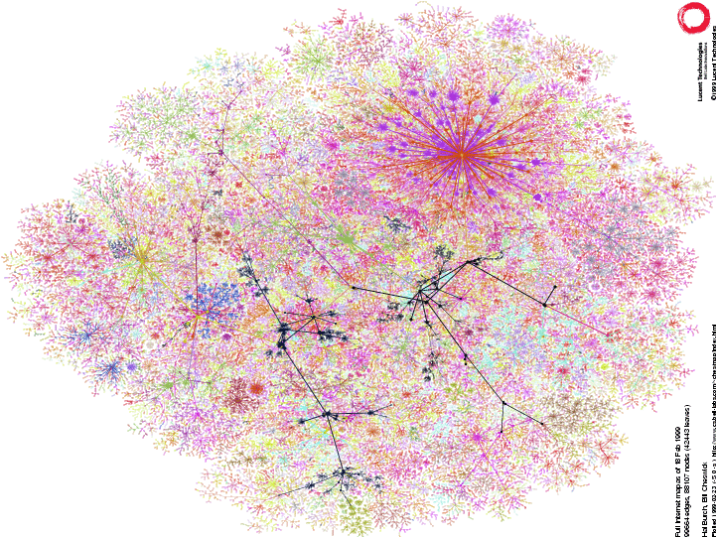
Internet Routing Architecture
Divided into Autonomous Systems
  Distinct regions of administrative control
  Routers/links managed by a single “institution”
  Service provider, company, university, …
Hierarchy of Autonomous Systems
  Large, tier-1 provider with a nationwide backbone
  Medium-sized regional provider with smaller backbone
  Small network run by a single company or university
Interaction between Autonomous Systems
  Internal topology is not shared between AS’s
  … but, neighboring AS’s interact to coordinate routing

Slide 7
AS Topology
Node: Autonomous System
Edge: Two AS’s that connect to each other
4
3
5
2
7
6
1

Slide 8
What is an Edge, Really?
Edge in the AS graph
  At least one connection between two AS’s
  Some destinations reached from one AS via the other
AS 1
AS 1
Exchange Point
AS 2
AS 3
AS 2

Slide 9
Identifying Autonomous Systems
AS Numbers are 32 bit values (used to be 16)
Currently estimated to be over 90,000 in use.
Level 3: 1
MIT: 3
Harvard: 11
Yale: 29
U of T: 239
AT&T: 7018, 6341, 5074, …
Rogers: 812
Bell: 577
…

Slide 10
Interdomain Paths
Path: 6, 5, 4, 3, 2, 1
4
3
5
2
7
6
1
Client
Web server
6

Slide 11
Business Relationships
Neighboring AS’s have business contracts
  How much traffic to carry
  Which destinations to reach
  How much money to pay
Common business relationships
  Customer-provider
    E.g., Princeton is a customer of AT&T
    E.g., MIT is a customer of Level 3
  Peer-peer
    E.g., Princeton is a peer of Patriot Media
    E.g., AT&T is a peer of Sprint

Slide 12
Customer-Provider Relationship
Customer needs to be reachable from everyone
  Provider tells all neighbors how to reach the customer
Customer does not want to provide transit service
  Customer does not let its providers route through it
Traffic to the customer
Traffic from the customer
d
provider
advertisements
provider
traffic
customer
d
customer

Slide 13
Peer-Peer Relationship
Peers exchange traffic between customers
  AS exports only customer routes to a peer
  AS exports a peer’s routes only to its customers
  Often the relationship is settlement-free (i.e., no $$$)
Traffic to/from the peer and its customers
advertisements
peer
peer
traffic
d

Slide 14
Princeton Example
Internet: customer of AT&T and USLEC
Research universities/labs: customer of Internet2
Local residences: peer with Patriot Media
Local non-profits: provider for several non-profits
AT&T
USLEC
Internet2
peer
Patriot

Slide 15
AS Structure: Tier-1 Providers
Tier-1 provider
  Has no upstream provider of its own
  Typically has a national or international backbone
  UUNET, Sprint, AT&T, Level 3, …
Top of the Internet hierarchy of 20-30 AS’s
  Full peer-peer connections between tier-1 providers

Slide 16
AS Structure: Other AS’s
Tier-2 providers
  Provide transit service to downstream customers
  … but, need at least one provider of their own
  Typically have national or regional scope
  E.g., Minnesota Regional Network
  Includes a few thousand of the AS’s
Stub AS’s
  Do not provide transit service to others
  Connect to one or more upstream providers
  Includes vast majority (e.g., 85-90%) of the AS’s

Slide 17
Characteristics of the AS Graph
AS graph structure
  High variability in node degree (“power law”)
  A few very highly-connected AS’s
  Many AS’s have only a few connections
1
All AS’s have 1 or more neighbors
0.1
CCDF
0.01
Very few have degree >= 100
0.001
AS degree
1
10
100
1000

Slide 18
Characteristics of AS Paths
AS path may be longer than shortest AS path
Router path may be longer than shortest path
2 AS hops,
8 router hops
s
d
3 AS hops, 7 router hops

Slide 19
Backbone Networks
Backbone networks
  Multiple Points-of-Presence (PoPs)
  Lots of communication between PoPs
  Accommodate traffic demands and limit delay

Slide 20
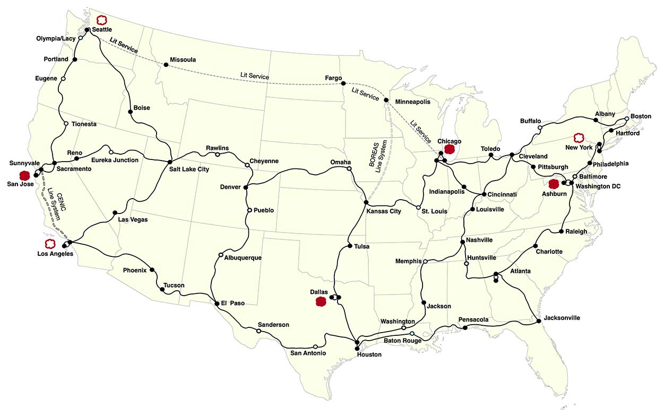
Example: Internet2 Backbone
Physical Topology Map of Internet 2, October 2021, http://www.internet2.edu

Slide 21
Points-of-Presence (PoPs)
Inter-PoP links
  Long distances
  High bandwidth
Intra-PoP links
  Short cables between racks or floors
  Aggregated bandwidth
Links to other networks
  Wide range of media and bandwidth
Inter-PoP
Intra-PoP
Other networks

Slide 22
Where to Locate Nodes and Links
Placing Points-of-Presence (PoPs)
  Large population of potential customers
  Other providers or exchange points
  Cost and availability of real-estate
  Mostly in major metropolitan areas
Placing links between PoPs
  Already fiber in the ground
  Needed to limit propagation delay
  Needed to handle the traffic load

Slide 23
Customer Connecting to a Provider
Provider
Provider
1 access link
2 access links
Provider
Provider
2 access routers
2 access PoPs

Slide 24
Multi-Homing: Two or More Providers
Motivations for multi-homing
  Extra reliability, survive single ISP failure
  Financial leverage through competition
  Gaming the 95th-percentile billing model
  Better performance by selecting better path
Provider 1
Provider 2

Slide 25
Inferring the AS-Level Topology
Collect AS paths from many vantage points
  Learn a large number of AS paths
  Extract the nodes and the edges from the path
Example: AS path “1 7018 88” implies
  Nodes: 1, 7018, and 88
  Edges: (1, 7018) and (7018, 88)
Ways to collect AS paths from many places
  Mapping traceroute data to the AS level
    Map using whois
    Example: try whois –h utoronto.ca
  Measurements of the interdomain routing protocol

Slide 26
Map Traceroute Hops to AS’s
Traceroute output: (hop number, IP)
1 169.229.62.1
2 169.229.59.225
3 128.32.255.169
4 128.32.0.249
5 128.32.0.66
6 209.247.159.109
7 *
8 64.159.1.46
9 209.247.9.170
10 66.185.138.33
11 *
12 66.185.136.17
13 64.236.16.52
AS25
AS25
AS25
AS25
AS11423
AS3356
AS3356
AS3356
AS3356
AS1668
AS1668
AS1668
AS5662
Berkeley
Calren
Level3
AOL
CNN
Notes:
Define what data path is: forwarding path for the traffic
To identify routing anomalies, understand how traffic is affected by routing dynamics
W: Good to recap “data path” and “ BGP path”. I still don’t know what is a BGP path.

Slide 27
Challenges of Inter-AS Mapping
Mapping traceroute hops to AS’s is hard
  Need an accurate registry of IP address ownership
  Whois data are notoriously out of date
Collecting diverse interdomain data is hard
  Public repositories like RouteViews and RIPE-RIS
  Covers hundreds to thousands of vantage points
  Especially hard to see peer-peer edges
AT&T
Sprint
???
Harvard
B-school
Harvard
d2
d1

Slide 28
Inferring AS Relationships
Key idea
  The business relationships determine the routing policies
  The routing policies determine the paths that are chosen
  So, look at the chosen paths and infer the policies
Example: AS path “1 7018 88” implies
  AS 7018 allows AS 1 to reach AS 88
  AT&T allows Level 3 to reach Princeton
  Each “triple” tells something about transit service
Collect and analyze AS path data
  Identify which AS’s can transit through the other
  … and which other AS’s they are able to reach this way

Slide 29
Paths You Should Never See (“Invalid”)
Customer-provider
Peer-peer
two peer edges
transit through
a customer

Slide 30
Challenges of Relationship Inference
Incomplete measurement data
  Hard to get a complete view of the AS graph
  Especially hard to see peer-peer edges low in hierarchy
Real relationships are sometime more complex
  Peer in one part of the world, customer in another
  Other kinds of relationships (e.g., backup)
  Special relationships for certain destination prefixes
Still, inference work has proven very useful
  Qualitative view of Internet topology and relationships

Slide 31
Outline
Internet’s Topology
  Internet’s two-tiered topology
  AS-level topology
  Router-level topology
Routing in the Internet
  Hierarchy and Autonomous Systems
  Interior Routing Protocols: RIP, OSPF
  Exterior Routing Protocol: BGP

Slide 32
Routing Story So Far …
Techniques
  Flooding
  Distributed Bellman Ford Algorithm
  Dijkstra’s Shortest Path First Algorithm
Question 1. Can we apply these to the Internet as a whole?
Question 2. If not, what can we do?

Slide 33
Routing in the Internet
The Internet uses hierarchical routing.
Within an AS, the administrator chooses an Interior Gateway Protocol (IGP)
  Examples of IGPs: RIP (rfc 1058), OSPF (rfc 1247, ISIS (rfc 1142).
Between AS’s, the Internet uses an Exterior Gateway Protocol
  AS’s today use the Border Gateway Protocol, BGP-4 (rfc 1771)

Slide 34
Routing in the Internet
AS ‘A’
AS ‘B’
AS ‘C’
BGP
BGP
Interior Gateway
Protocol
Interior Gateway
Protocol
Interior Gateway
Protocol
Transit AS
e.g. backbone service provider
Stub AS
Stub AS

Slide 35
Interior Routing Protocols
RIP
  Uses distance vector (distributed Bellman-Ford algorithm).
  Updates sent every 30 seconds.
  No authentication.
  Originally in BSD UNIX.
  Widely used for many years; not used much anymore.
OSPF
  Link-state updates sent (using flooding) as and when required.
  Every router runs Dijkstra’s algorithm.
  Authenticated updates.
  Autonomous system may be partitioned into “areas”.
  Widely used.

Slide 36
Interdomain Routing
AS-level topology
  Destinations are IP prefixes (e.g., 12.0.0.0/8)
  Nodes are Autonomous Systems (AS’s)
  Links are connections & business relationships
4
3
5
2
7
6
1
Web server
Client

Slide 37
Challenges for Interdomain Routing
Scale
  Prefixes: 800,000-1,000,000, and growing
  AS’s: 90,000 visible ones, and growing
  AS paths and routers: at least in the millions…
Privacy
  AS’s don’t want to divulge internal topologies
  … or their business relationships with neighbors
Policy
  No Internet-wide notion of a link cost metric
  Need control over where you send traffic
  … and who can send traffic through you

Slide 38
Link-State Routing is Problematic
Topology information is flooded
  High bandwidth and storage overhead
  Forces nodes to divulge sensitive information
Entire path computed locally per node
  High processing overhead in a large network
Minimizes some notion of total distance
  Works only if policy is shared and uniform
Typically used only inside an AS
  E.g., OSPF and IS-IS

Slide 39
Distance Vector is on the Right Track
Advantages
  Hides details of the network topology
  Nodes determine only “next hop” toward the dest
Disadvantages
  Minimizes some notion of total distance, which is difficult in an interdomain setting
  Slow convergence due to the counting-to-infinity problem (“bad news travels slowly”)
Idea: extend the notion of a distance vector

Slide 40
Path-Vector Routing
Extension of distance-vector routing
  Support flexible routing policies
  Avoid count-to-infinity problem
Key idea: advertise the entire path
  Distance vector: send distance metric per dest d
  Path vector: send the entire path for each dest d
“d: path (2,1)”
“d: path (1)”
3
2
1
1
data traffic
data traffic
d

Slide 41
Faster Loop Detection
Node can easily detect a loop
  Look for its own node identifier in the path
  E.g., node 1 sees itself in the path “3, 2, 1”
Node can simply discard paths with loops
  E.g., node 1 simply discards the advertisement
“d: path (2,1)”
“d: path (1)”
3
2
1
“d: path (3,2,1)”

Slide 42
Border Gateway Protocol (BGP-4)
BGP is a path-vector routing protocol.
BGP advertises complete paths (a list of AS’s).
  Also called AS_PATH (this is the path vector)
  Example of path advertisement: “The network 171.64/16 can be reached via the path {AS1, AS5, AS13}”.
Paths with loops are detected locally and ignored.
Local policies pick the preferred path among options.
When a link/router fails, the path is “withdrawn”.

Slide 43
BGP Operations
Establish session on
TCP port 179
AS1
BGP session
Exchange all
active routes
AS2
While connection
is ALIVE exchange
route UPDATE messages
Exchange incremental
updates

Slide 44
Incremental Protocol
A node learns multiple paths to destination
  Stores all of the routes in a routing table
  Applies policy to select a single active route
  … and may advertise the route to its neighbors
Incremental updates
  Announcement
    Upon selecting a new active route, add node id to path
    … and (optionally) advertise to each neighbor
  Withdrawal
    If the active route is no longer available
    … send a withdrawal message to the neighbors

Slide 45
BGP Messages
Open : Establish a BGP session.
Keep Alive : Handshake at regular intervals.
Notification : Shuts down a peering session.
Update : Announcing new routes or withdrawing previously announced routes.
Attributes include: Next hop, AS Path, local preference, Multi-exit discriminator, …
  Used to select among multiple options for paths
BGP announcement = prefix + path attributes

Slide 46
BGP Route
Destination prefix (e.g,. 128.112.0.0/16)
Route attributes, including
  AS path (e.g., “7018 88”)
  Next-hop IP address (e.g., 12.127.0.121)
192.0.2.1
12.127.0.121
AS 7018
AT&T
AS 88
AS 12654
Princeton
RIPE NCC
RIS project
128.112.0.0/16
AS path = 88
Next Hop = 192.0.2.1
128.112.0.0/16
AS path = 7018 88
Next Hop = 12.127.0.121

Slide 47
BGP Path Selection
Simplest case
  Shortest AS path
  Arbitrary tie break
Example
  Three-hop AS path preferred over a four-hop AS path
  AS 12654 prefers path through Global Crossing
But, BGP is not limited to shortest-path routing
  Policy-based routing
AS 1129
Global Access
135.207.0.0/16
AS Path = 1129 1755 1239 7018 6341
AS 12654
RIPE NCC
RIS project
135.207.0.0/16
AS Path = 3549 7018 6341
AS 3549
Global Crossing

Slide 48
AS_PATH Attribute
AS 1129
135.207.0.0/16
AS Path = 1755 1239 7018 6341
Global Access
AS 1755
135.207.0.0/16
AS Path = 1239 7018 6341
135.207.0.0/16
AS Path = 1129 1755 1239 7018 6341
Ebone
AS 12654
AS 1239
135.207.0.0/16
AS Path = 7018 6341
Pick shorter
AS path
RIPE NCC
RIS project
Sprint
AS 7018
135.207.0.0/16
AS Path = 3549 7018 6341
135.207.0.0/16
AS Path = 6341
AT&T
AS 6341
AS 3549
135.207.0.0/16
AS Path = 7018 6341
AT&T Research
Global Crossing
135.207.0.0/16
Prefix Originated

Slide 49
Flexible Policies
Each node can apply local policies
  Path selection: Which path to use?
  Path export: Which paths to advertise?
Examples
  Node 2 may prefer the path “2, 3, 1” over “2, 1”
  Node 1 may not let node 3 hear the path “1, 2”
1
2
3

Slide 50
So Many Choices…
peer
peer
provider
customer
AS 4
Frank’s
Internet Barn
AS 3
AS 2
Which route should
Frank pick to 13.13.0.0./16?
AS 1
13.13.0.0/16

Slide 51
Frank’s Choices…
Route learned from customer preferred over
route learned from peer, preferred over
route learned from provider
peer
peer
AS 4
provider
customer
local pref = 80
AS 3
local pref = 90
local pref = 100
Set appropriate “local pref”
to reflect preferences:
Higher Local preference values
are preferred
AS 2
AS 1
13.13.0.0/16

Slide 52
BGP Route Selection Summary
Enforce relationships
E.g. prefer customer routes
over peer routes
Highest Local Preference
Shortest ASPATH
Lowest MED
i-BGP < e-BGP
traffic engineering
Lowest IGP cost
to BGP egress
Lowest router ID
Throw up hands and
break ties

Slide 53
BGP Policy: Applying Policy to Routes
Import policy
  Filter unwanted routes from neighbor
    E.g. prefix that your customer doesn’t own
  Manipulate attributes to influence path selection
    E.g., assign local preference to favored routes
Export policy
  Filter routes you don’t want to tell your neighbor
    E.g., don’t tell a peer a route learned from other peer
  Manipulate attributes to control what they see
    E.g., make a path look artificially longer than it is

Slide 54
BGP Policy: Influencing Decisions
Open ended programming.
Constrained only by vendor configuration language
Receive
BGP
Updates
Apply Policy =
filter routes &
tweak attributes
Based on
Attribute
Values
Best
Routes
Apply Policy =
filter routes &
tweak attributes
Transmit
BGP
Updates
Apply Import
Policies
Best Route
Selection
Best Route
Table
Apply Export
Policies
Install forwarding
Entries for best
Routes.
IP Forwarding Table

Slide 55
Import Policy: Local Preference
Favor one path over another
  Override the influence of AS path length
  Apply local policies to prefer a path
Example: prefer customer over peer
Local-pref = 90
AT&T
Sprint
Local-pref = 100
Tier-2
Tier-3
Yale

Slide 56
Import Policy: Filtering
Discard some route announcements
  Detect configuration mistakes and attacks
Examples on session to a customer
  Discard route if prefix not owned by the customer
  Discard route that contains other large ISP in AS path
AT&T
USLEC
Princeton
128.112.0.0/16

Slide 57
Export Policy: Filtering
Discard some route announcements
  Limit propagation of routing information
Examples
  Don’t announce routes from one peer to another
  Don’t announce routes for network-management hosts
UUNET
AT&T
Sprint
network operator
128.112.0.0/16
Princeton

Slide 58
Export Policy: Attribute Manipulation
Modify attributes of the active route
  To influence the way other AS’s behave
Example: AS prepending
  Artificially inflate the AS path length seen by others
  To convince some AS’s to send traffic another way
AT&T
Sprint
USLEC
88 88
Princeton
88
128.112.0.0/16

Slide 59
BGP Policy Configuration
Routing policy languages are vendor-specific
  Not part of the BGP protocol specification
  Different languages for Cisco, Juniper, etc.
Still, all languages have some key features
  Policy as a list of clauses
  Each clause matches on route attributes
  … and either discards or modifies the matching routes
Configuration done by human operators
  Implementing the policies of their AS
  Business relationships, traffic engineering, security, …
  http://www.cs.princeton.edu/~jrex/papers/policies.pdf

Slide 60
AS is Not a Single Node
Multiple routers in an AS
  Need to distribute BGP information within the AS
  Internal BGP (iBGP) sessions between routers
AS1
eBGP
iBGP
AS2

Slide 61
Joining BGP and IGP Information
Border Gateway Protocol (BGP)
  Announces reachability to external destinations
  Maps a destination prefix to an egress point
    128.112.0.0/16 reached via 192.0.2.1
Interior Gateway Protocol (IGP)
  Used to compute paths within the AS
  Maps an egress point to an outgoing link
    192.0.2.1 reached via 10.10.10.10
10.10.10.10
192.0.2.1

Slide 62
Joining BGP with IGP Information
128.112.0.0/16
Next Hop = 192.0.2.1
128.112.0.0/16
10.10.10.10
AS 7018
AS 88
192.0.2.1
Forwarding Table
destination
next hop
192.0.2.0/30
10.10.10.10
+
Forwarding Table
destination
next hop
BGP
128.112.0.0/16
10.10.10.10
destination
next hop
192.0.2.0/30
10.10.10.10
128.112.0.0/16
192.0.2.1

Slide 63
Causes of BGP Routing Changes
Topology changes
  Equipment going up or down
  Deployment of new routers or sessions
BGP session failures
  Due to equipment failures, maintenance, etc.
  Or, due to congestion on the physical path
Changes in routing policy
  Reconfiguration of preferences
  Reconfiguration of route filters
Persistent protocol oscillation
  Conflicts between policies in different AS’s

Slide 64
Routing Change: Before and After
0
0
(1,0)
(2,0)
(2,0)
(1,2,0)
1
2
1
2
(3,1,0)
(3,2,0)
3
3

Slide 65
Routing Change: Path Exploration
AS 1
  Delete the route (1,0)
  Switch to next route (1,2,0)
  Send route (1,2,0) to AS 3
AS 3
  Sees (1,2,0) replace (1,0)
  Compares to route (2,0)
  Switches to using AS 2
0
(2,0)
(1,2,0)
1
2
(3,2,0)
3

Slide 66
Routing Change: Path Exploration
Initial situation
  Destination 0 is alive
  All AS’s use direct path
When destination dies
  All AS’s lose direct path
  All switch to longer paths
  Eventually withdrawn
E.g., AS 2
  (2,0) → (2,1,0)
  (2,1,0) → (2,3,0)
  (2,3,0) → (2,1,3,0)
  (2,1,3,0) → null
(2,0)
(2,1,0)
(2,3,0)
(2,1,3,0)
(1,0)
(1,2,0)
(1,3,0)
1
2
0
(3,0)
(3,1,0)
(3,2,0)
3

Slide 67
BGP Session Failure
BGP runs over TCP
  BGP only sends updates when changes occur
  TCP doesn’t detect lost connectivity on its own
Detecting a failure
  Keep-alive: 60 seconds
  Hold timer: 180 seconds
Reacting to a failure
  Discard all routes learned from the neighbor
  Send new updates for any routes that change
AS1
AS2

Slide 68
BGP Converges Slowly, if at All
Path vector avoids count-to-infinity
  But, AS’s still must explore many alternate paths
  … to find the highest-ranked path that is still available
Fortunately, in practice
  Most popular destinations have very stable BGP routes
  And most instability lies in a few unpopular destinations
Still, lower BGP convergence delay is a goal
  Can be tens of seconds to tens of minutes
  High for important interactive applications
  … or even conventional application, like Web browsing

Slide 69
Conclusions
BGP is solving a hard problem
  Routing protocol operating at a global scale
  With tens of thousands of independent networks
  That each have their own policy goals
  And all want fast convergence
Key features of BGP
  Prefix-based path-vector protocol
  Incremental updates (announcements and withdrawals)
  Policies applied at import and export of routes
  Internal BGP to distribute information within an AS
  Interaction with the IGP to compute forwarding tables

