Slide 1
CSC458 PA1
Simple Router
Ehsan Etesami
ehsan.etesami@utoronto.ca
Thanks to David, Parsa and Farid
Fall 2025
Department of Computer Science
University of Toronto

Slide 2
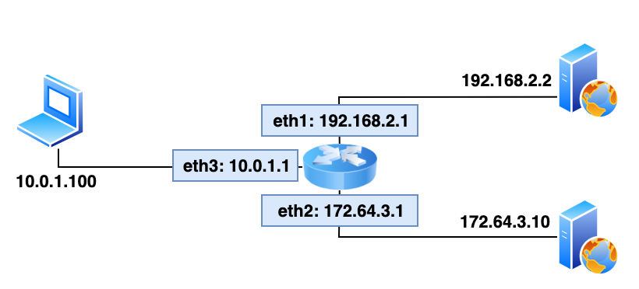
PA1 Objective
You are going to write a “simplified” router
Given a static network topology
Given a static routing table
You are responsible for writing the logic to handle incoming Ethernet frames (ICMP, ARP, IP….):
Forward it
Generate ICMP messages
Drop it
And more ...

Slide 3
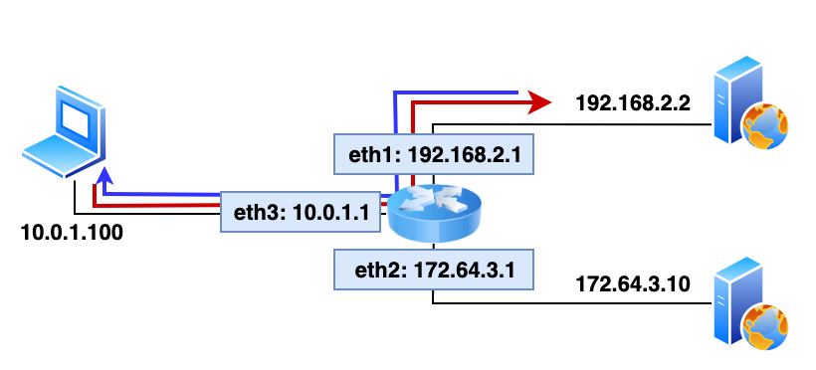
Setup Overview
No hardware router
Network topology emulated with Mininet¹
Your router connects 2 servers to a client
Your router will handle real traffic
Mininet creates the virtual network, hosts, links, etc.
https://mininet.org/

Slide 4
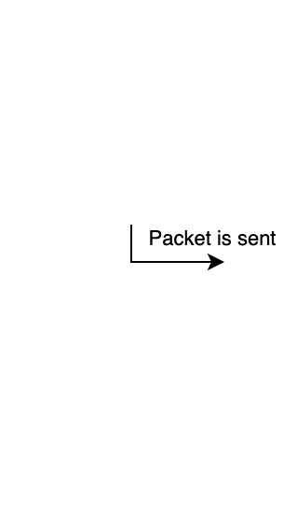

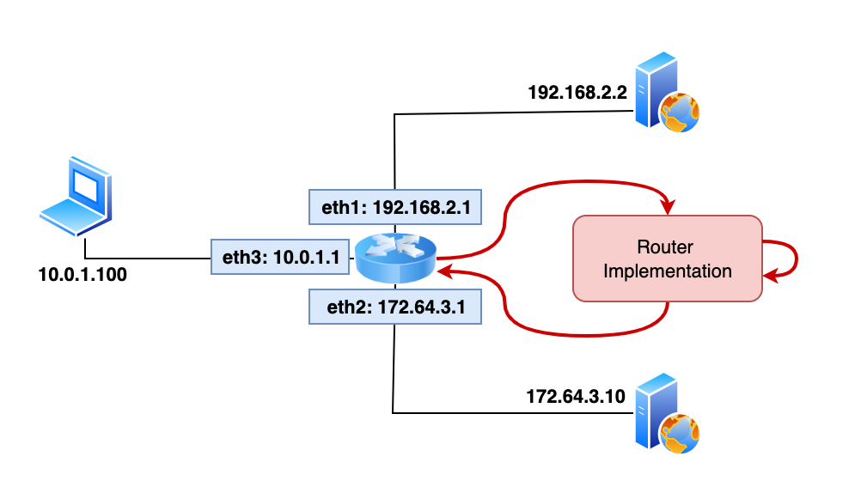
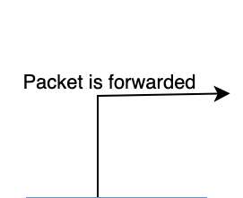
Emulated Topology
Arp
Cache
Routing Decision:
Check routing table
Figure out on which interface to forward the packet
Make necessary changes to packet

Slide 5
What Your Routing Logic Must Do
Receive and parse raw Ethernet frames
Route Ethernet frames between client and servers
Perform IPv4 forwarding (TTL decrement, checksum update, Longest Prefix Match)
Handle ARP requests/replies, maintain ARP cache (15s timeout, retries once/sec up to 5 times)
Queue packets while resolving ARP
Handle TCP/UDP packets sent to router interfaces
Generate ICMP messages:
Echo replies
Destination unreachable
TTL exceeded
↪ See handout for full requirements

Slide 6
Expected User Behavior
Ping any router interface from client
Tracepath/traceroute to and through the router
Ping servers (and traceroute to them)
HTTP download (wget/curl) from app servers
Correct ICMP responses when appropriate (ping to router, port unreachable, etc.)

Slide 7

Introduction to IP & Mac Addresses
IP address can be changed
When data is sent over a network, it uses the
IP address to find the correct destination.
IP Address: 10.0.0.1
MAC Address: 00:1B:44:11:3A:B7
Within the local network, it needs the MAC address to actually deliver the data to the right device.
unique to every network card or interface

Slide 8
Introduction to ARP
ARP: Address Resolution Protocol
A packet is encapsulated as the frame’s payload
Packet
(IP layer)
IP Data
IP Header
Dest IP: 10.0.0.1
Frame
(Link Layer)
Ethernet Data
Ethernet Header
Dest MAC address:
00:1B:44:11:3A:DD
ARP Table
IP Address | MAC Address | TTL
10.0.0.1 | 00:1B:44:11:3A:DD | 15000

Slide 9
Key Protocols to Know
Ethernet: src/dst MACs; forwarding by changing dst MAC to next-hop
IPv4: header lengths, TTL, checksum
ICMP: echo request/reply + error types and codes
ARP: request broadcast, reply unicast; mapping IP ↔ MAC; caching & timeouts

Slide 10
ICMP Messages to Generate
Echo reply (type 0): reply to ping to our interface
Destination net unreachable (type 3, code 0): no route found
Destination host unreachable (type 3, code 1): 5 ARP requests timed out
Port unreachable (type 3, code 3): TCP/UDP to router interface
Time exceeded (type 11, code 0): TTL expired / dropped during forwarding

Slide 11

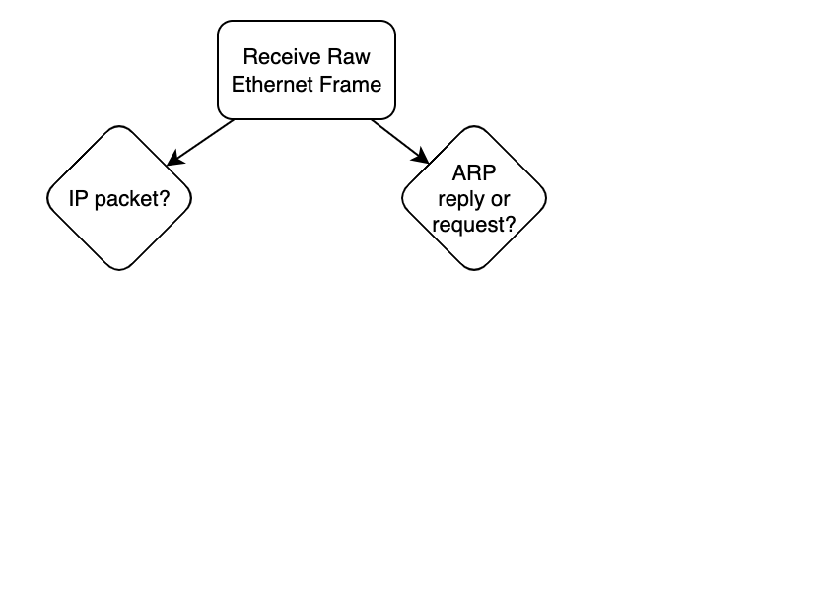
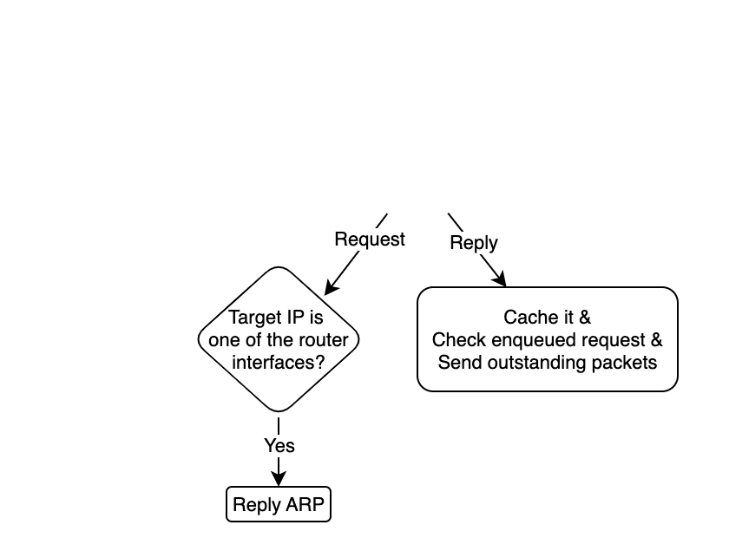
Router Decision Logic
You receive an ARP request/reply
⤷ Use this chart only to help you get started. Read the instructions carefully!

Slide 12
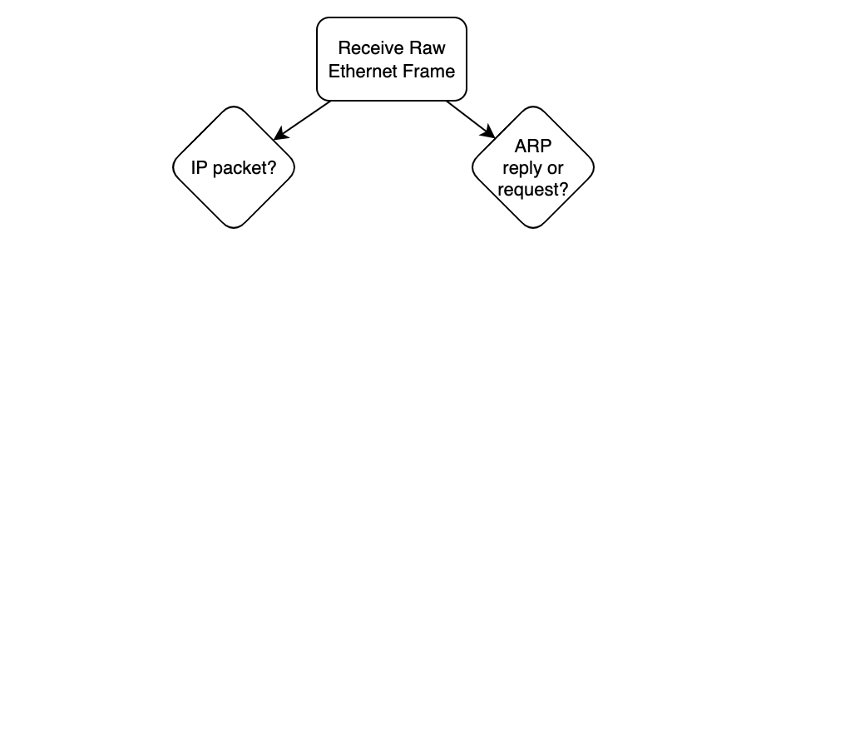
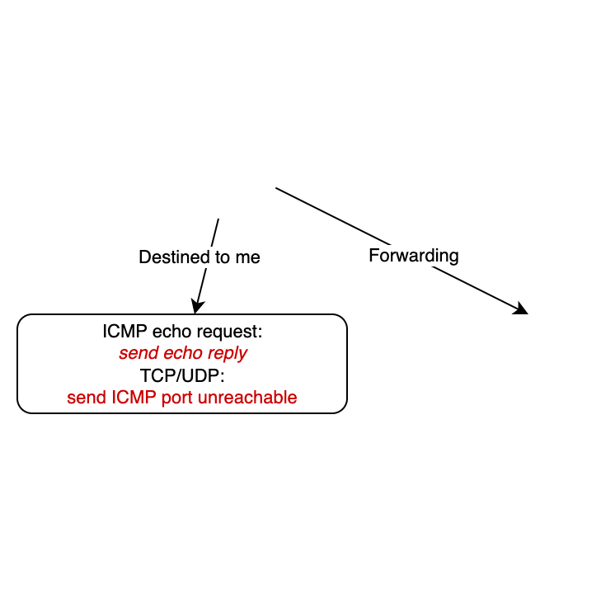
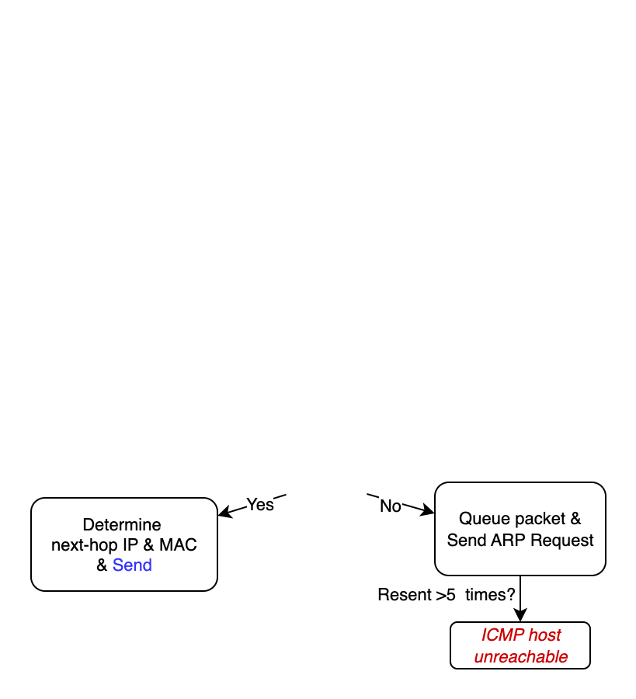
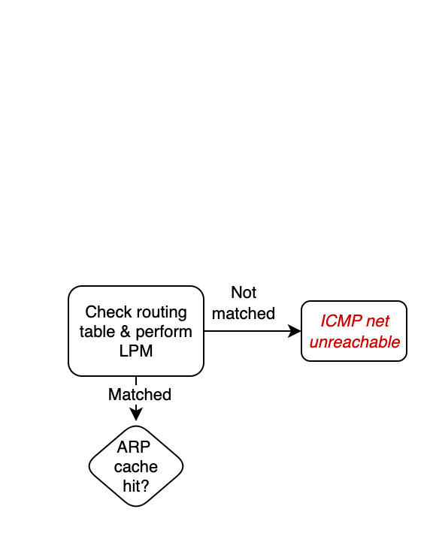
Router Decision Logic
You receive an IP packet
⤷ Many things missing from this chart
Checksums, TTLs
⤷ Read the instructions carefully
⤷ 500+ lines of code, so start early

Slide 13
Files & Code Structure (where to implement)
sr_router.c / sr_router.h — main packet handler: sr_handlepacket()
sr_arpcache.c / sr_arpcache.h — ARP cache, request queue; implement sr_arpcache_sweepreqs()
sr_vns_comm.c — sr_send_packet() used to send raw packets
sr_protocol.h — packet header structs (Ethernet/IP/ICMP/ARP)
sr_if.c / sr_rt.c — helpers for interfaces & routing table (rtable read)
sr_utils.c — provided helpers & printing utilities

Slide 14
Automated Tester
Public tests (50%); core forwarding & ARP behavior:
⇉ ARP reply, ARP expiration, ICMP echo, ICMP forward, TCP forward
Private tests (40%); robustness and hidden corner cases:
⇉ additional hidden cases
Style/documentation (10%): code quality, comments, README

Slide 15
Deliverable & Submission
Package contents of router directory into pa1.tar.gz
Use provided Makefile compress rule: cd router/ ; make compress
Ensure make produces executable file
Submit pa1.tar.gz to Markus
If adding files, extend the tar command in Makefile compress rule

Slide 16
Recommendations and Tips
Change the routing table. What about an incorrect routing table?
Be careful when implementing Longest Prefix Match.
Don’t get mixed up with endianness: Linux is little endian. Network is big endian. Try to put the calls to hton(), ntoh() in a single place
Write good quality code: do not hardcode constants, avoid code duplication
Coding Guidelines:
⇉ https://web.stanford.edu/class/cs244a/CS244aCodingGuidelines.html

Slide 17
Tools and Best Practices
Mininet console, which supports:
⇉ tcpdump, ping, traceroute
Debug functions in sr_utils.c
⇉ print_hdrs()
⇉ print_addr_ip_int()
GDB/Valgrind

Slide 18
PA1: Environment Setup
On Intel/AMD computers:
Use a VM image in VirtualBox
On ARM MacBooks and Macs:
Install the UTM virtual machine software
Use the provided ARM64 GNU/Linux virtual machine image

