Slide 1
Handout # 5:
Interconnecting LANs;
Internet Protocol (IP)
Professor Yashar Ganjali
Department of Computer Science
University of Toronto
ganjali7@cs.toronto.edu
http://www.cs.toronto.edu/~yganjali

Slide 2
Announcements
Programming Assignment 1 out today (Sep. 16th).
  Simple IP router
    Process incoming packets
    Handle ARP
Logistics:
  PA1 Handout: available on class website.
    Also, Mininet Virtual Machine setup guide.
  Due Friday Oct. 17th at 5pm.
  Submit electronically on MarkUS.
    NOTE. Information about submission in PA1 handout.
  To be submitted individually.

Slide 3
Announcements
TA office hours
  Will be posted on class website later this week.
  Please check the time/location.
  Take advantage of these for assignments.
Remember …
  The late submission policy.
    Changed to “two” late submissions allowed.
      One for each assignment.
  Academic integrity guidelines.
  Start early! Start early! Start early! ☺

Slide 4
Announcements – Cont’d
Reading for this week:
  Chapter 3 of the textbook
  Next week: Also, Chapter 3 (catch up if you are behind)
  Note: only sections covered in class are required
    But helpful to go through the rest.
Problem Set 1: next week
  Due on Tue. the week after.
This week’s tutorial: Programming Assignment 1 (PA1) overview.
  Next week: Problem Set 1 sample problems

Slide 5
The Story
So far …
  Layers, and protocols
  Link layer
    Media type, encoding
    Framing, link model
    Error detection, correction
This time
  Interconnecting LANs
    Switches and bridges
  The Internet Protocol
Application
Presentation
Session
Transport
Network
Data Link
Physical

Slide 6
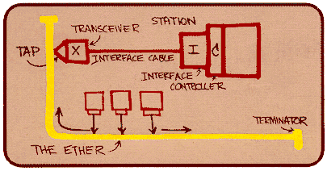
Ethernet
First widely used LAN technology
Dominant wired and wireless LAN technology
  Significant improvements over time …
Kept up with speed race: 10 Mbps – 400 Gbps
  Even 800Gbps and 1.6 Tbps soon
Metcalfe’s
Ethernet
sketch

Slide 7
Ethernet Uses CSMA/CD
Let us assume the link is shared among several nodes
  We call this a collision domain: if two nodes talk at the same time, we will have a collision.
  How can we ensure messages are not mixed up?
Carrier sense: wait for link to be idle
  Channel idle: start transmitting
  Channel busy: wait until idle
Collision detection: listen while transmitting
  No collision: transmission is complete
  Collision: abort transmission, and send jam signal
Random access: exponential back-off
  After collision, wait a random time before trying again
  After the m^{th} collision, choose K randomly from {0, …, 2^{m}-1}
  … and wait for K*512 bit times before trying again

Slide 8
Limitations on Ethernet Length
A
B
Latency d
Latency depends on physical length of link
  Time to propagate a packet from one end to the other
Suppose A sends a packet at time t
  And B sees an idle line at a time just before t+d
  … so B happily starts transmitting a packet
B detects a collision, and sends jamming signal
  But A doesn’t see collision till t+2d

Slide 9
Limitations on Ethernet Length
A
B
Latency d
A needs to wait for time 2d to detect collision
  So, A should keep transmitting during this period
  … and keep an eye out for a possible collision
Imposes restrictions on Ethernet
  Maximum length of the wire: 2500 meters
  Minimum length of the packet: 512 bits (64 bytes)

Slide 10
Ethernet Frame Structure
Addresses: source and destination MAC addresses
  Use ifconfig to get your machine’s MAC address:
    E.g., 36:45:74:cd:4b:00
  Adaptor passes frame to network-level protocol
    If destination address matches the adaptor
    Or the destination address is the broadcast address
  Otherwise, adapter discards frame
Type: indicates the higher layer protocol
  Usually IP
  But also, Novell IPX, AppleTalk, … in early days
CRC: cyclic redundancy check
  Checked at receiver
  If error is detected, the frame is simply dropped
Preamble
Dest.
Address
Source
Address
Data
CRC
Type

Slide 11
Unreliable, Connectionless Service
Connectionless
  No handshaking between sending and receiving adapter.
Unreliable
  Receiving adapter doesn’t send ACKs or NACKs
  Packets passed to network layer can have gaps
  Gaps will be filled if application is using TCP
  Otherwise, the application will see the gaps

Slide 12
Link Layer: Switches vs. Bridges
Bridge
Switch
Connects two or more LANs at the link layer
  Extracts destination address from the frame
  Looks up the destination in a table
  Forwards the frame to the appropriate LAN segment
Each segment is its own collision domain
Connects individual computers
  Essentially the same as a bridge
  … though typically used to connect hosts and switches
  … not LANs
Like bridges, support concurrent communication
  A can talk to C, while B talks to D
B
host
host
host
host
host
host
A
C
Bridge
switch
host
host
host
host
host
host
D

Slide 13
Switches: Dedicated Access and Full Duplex
Dedicated access
  Host has direct connection to the switch
  … rather than a shared LAN connection
Full duplex
  Each connection can send in both directions
  Host sending to switch, and host receiving from switch
Completely avoids collisions
  Each connection is a bidirectional point-to-point link
  No need for carrier sense, collision detection, and so on

Slide 14
Bridges: Traffic Isolation
Bridges break the network into separate collision domains (called LAN segments)
Filter packets
  Frame only forwarded to the necessary segments
  Segments become separate collision domains
Collision Domain
host
host
host
host
host
host
Collision Domain
Bridge
Collision Domain
Collision Domain
host
host
host
host
host
host

Slide 15
Motivation For Cut-Through Switching
Buffering a frame takes time
  Suppose L is the length of the frame
  And R is the transmission rate of the links
  Then, receiving the frame takes L/R time units
Buffering delay can be a high fraction of total delay
  Propagation delay is small over short distances
  Making buffering delay a large fraction of total
  Analogy: large group walking through NYC
A
B
switches

Slide 16
Cut-Through Switching
Start transmitting as soon as possible
  Inspect the frame header and do the look-up
  If outgoing link is idle, start forwarding the frame
Overlapping transmissions
  Transmit the head of the packet via the outgoing link
  … while still receiving the tail via the incoming link
  Analogy: different folks crossing different intersections
A
B
switches

Slide 17
Motivation For Self Learning
Switches forward frames selectively
  Forward frames only on segments that need them
Switch table
  Maps destination MAC address to outgoing interface
  Goal: construct the switch table automatically
B
A
C
switch
D

Slide 18
Self Learning: Building the Table
When a frame arrives
  Inspect the source MAC address
  Associate the address with the incoming interface
  Store the mapping in the switch table
  Use a time-to-live field to eventually forget the mapping
B
Switch learns how to reach A.
A
C
D

Slide 19
Self Learning: Handling Misses
When frame arrives with unfamiliar destination
  Forward the frame out of all the interfaces
  … except for the one where the frame arrived
  Hopefully, this case won’t happen very often
When in doubt, shout!
B
A
C
D

Slide 20
Switch Filtering/Forwarding
When switch receives a frame:
index switch table using MAC dest address
if entry found for destination
then {
if dest on segment from which frame arrived
then drop the frame
else forward the frame on interface indicated
}
else flood
forward on all but the interface
on which the frame arrived

Slide 21
Flooding Can Lead to Loops
Switches sometimes need to broadcast frames
  Upon receiving a frame with an unfamiliar destination
  Upon receiving a frame sent to the broadcast address
Broadcasting is implemented by flooding
  Transmitting frame out every interface
  … except the one where the frame arrived
Flooding can lead to forwarding loops
  E.g., if the network contains a cycle of switches
  Either accidentally, or by design for higher reliability

Slide 22
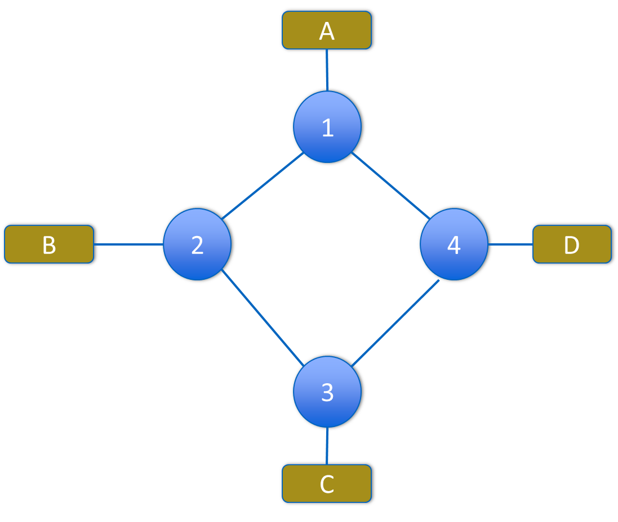
Flooding Can Lead to Loops
Example: A wants to broadcast a message
  A sends packet to 1
  1 Floods to 2 and 4
  2 Floods to B and 3
  4 Floods to D and 3
  3 Floods packet from 2 to C and 4
  3 Floods packet from 4 to C and 2
  4 Floods packet from 3 to D and 1
  2 Floods packet from 3 to B and 1
  1 Floods packet from 2 to A and 4
  1 Floods packet from 4 to B and 2
  …
I want to Broadcast a message
OMG
what have I done??

Slide 23
Dealing with Loops
Enters Radia Perlman
“we have designed an algorithm that allows the extended network to consist of an arbitrary topology. The algorithm computes a subset of the topology that connects all LANs yet is loop-free (a spanning tree).”
Perlman, Radia. "An Algorithm for Distributed Computation of a Spanning Tree in an Extended LAN“, ACM SIGCOMM 1985

Slide 24
Avoiding Loops
Ensure the topology has no loops
  Avoid using some of the links when flooding to avoid forming a loop
Build spanning tree
  A sub-graph that covers all vertices but contains no cycles
  Links not in the spanning tree are not used in forwarding frames
Only one path to destinations on spanning trees
  So don't have to worry about loops!
Graph Has Cycles!
Don’t forward on these links
Graph Has
No Cycles!

Slide 25
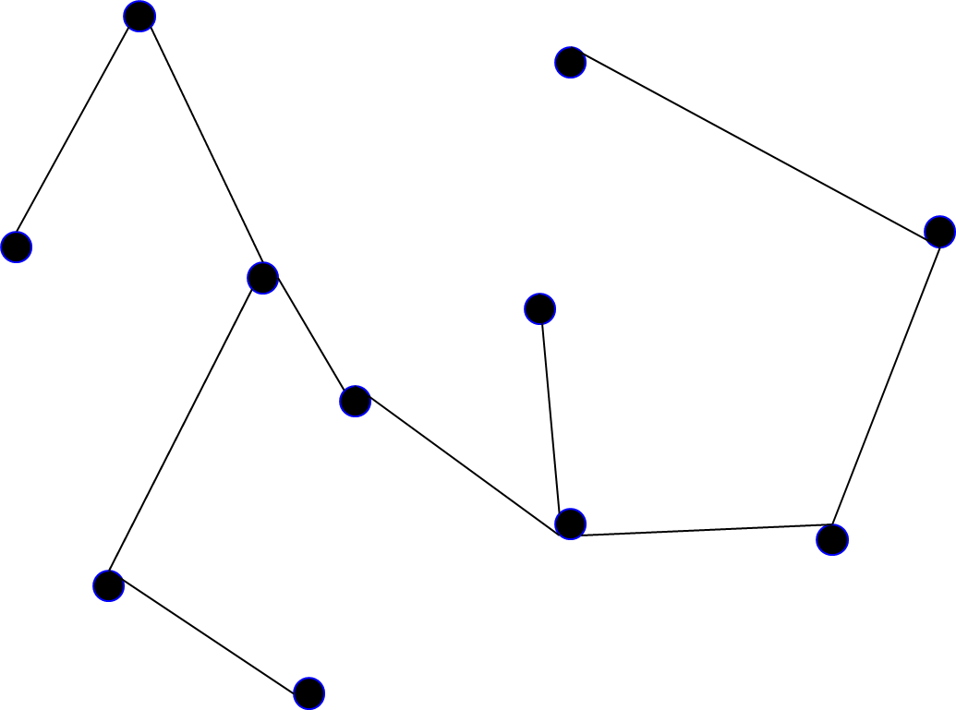
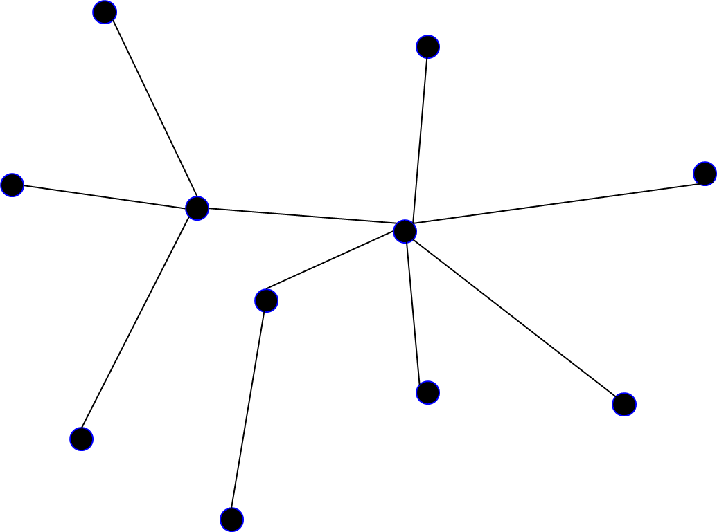
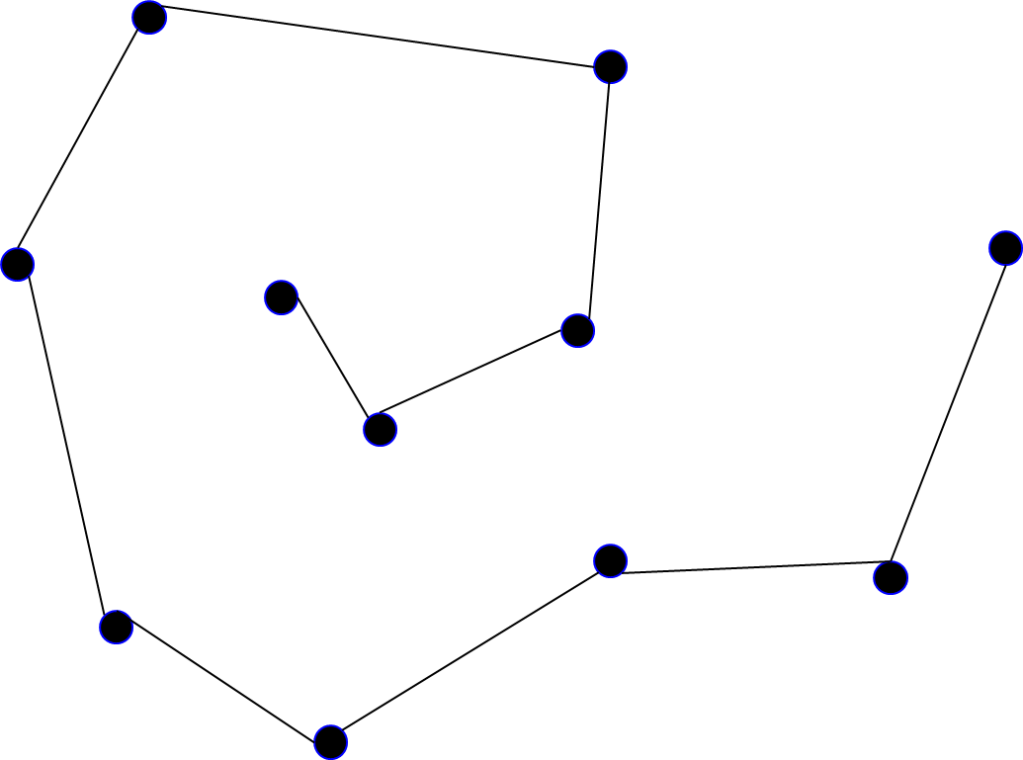
Multiple Spanning Trees
Spanning Tree: A subgraph that includes all vertices but contains no cycles
We can have multiple spanning trees
A spanning Tree
Yet another spanning Tree
Another spanning Tree

Slide 26
Spanning Tree Protocol (STP)
Protocol by which switches/bridges construct a spanning tree
Nice properties
  Zero configuration (by operators or users)
  Self healing
STP should consider some constraints for backwards compatibility
  No changes to end-hosts
  Maintain plug-n-play aspect

Slide 27
Constructing a Spanning Tree
Need a distributed algorithm
  Switches cooperate to build the spanning tree, and adapt automatically when failures occur
Key ingredients of the algorithm
  Switches need to elect a “root”
  Each switch must identify the interfaces that are on the shortest path from the root
  And exclude interfaces that are not on the shortest path from the tree
root

Slide 28
Algorithm has Two Aspects
Pick a root:
  Destination to which the shortest paths go
  Pick the one with the smallest identifier (MAC name/address)
Compute the shortest paths to the root
  No shortest path can have a cycle
  Only keep the links on the shortest path
  Break ties in some way
    So that we only keep one shortest path from each node
STP does both with a single algorithm

Slide 29
Perlman Describes Her Algorithm
Algorhyme, by Radia Perlman:
I think that I shall never see
A graph more lovely than a tree.
A tree whose crucial property
Is loop-free connectivity.
A tree that must be sure to span
So packet can reach every LAN.
First the root must be selected.
By ID it is elected.
Least cost paths from root are traced.
In the tree, these paths are placed.
A mesh is made by folks like me,
Then bridges find a spanning tree.

Slide 30
Constructing a Spanning Tree
Messages (Y, d, X)
  Proposing Y as the root
  From node X
  And advertising a distance d between X and Y
Switches elect the node with smallest identifier as root
  Y in messages
Each switch determines if a link is on its shortest path to the root
  If not, excludes it from the tree

Slide 31
Steps in Spanning Tree Algorithm
Initially, each switch proposes itself as the root
  Example: switch X announces (X, 0, X)
Switches update their view of the root and their distance to the root
  At each switch Z, whenever a message (Y, d, X) is received from X
    If Y’s id < current root:
      set root = Y;
      set shortest-distance-to-root = d + 1
    If Y’s id = current root and shortest-distance-to-root > d + 1:
      set shortest-distance-to-root = d + 1
If root changed or shortest-distance-to-root changed:
  Send all neighbors message (Y, shortest-distance-to-root, Z)
Repeat until no more change
  Identify interfaces not on a shortest path to the root
  … and exclude them from the spanning tree

Slide 32
Breaking Ties
When there are multiple shortest paths to the root:
  Choose the path via neighbor switch with the smallest identifier
One could use any tie-breaking system
  This is just an easy one to remember and implement

Slide 33
STP Example
Let’s run STP on this example
  We assume all links have “distance” 1
  Easy to generalize
1
3
5
2
6
4
7

Slide 34
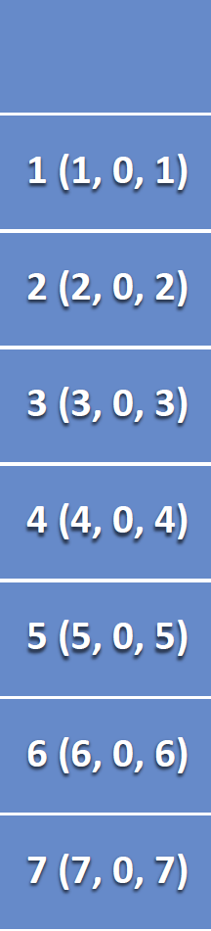
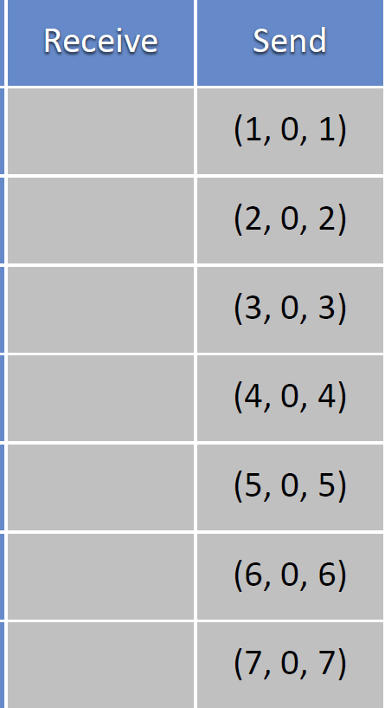
STP Example, Round 1
Current
view
1
3
5
2
6
4
7

Slide 35
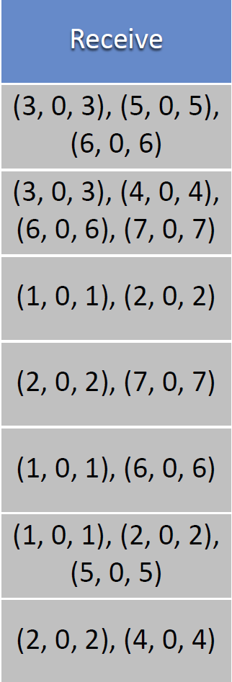
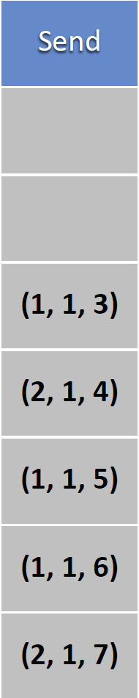
STP Example, Round 2
Current
view
1
3
5
2
6
4
7

Slide 36
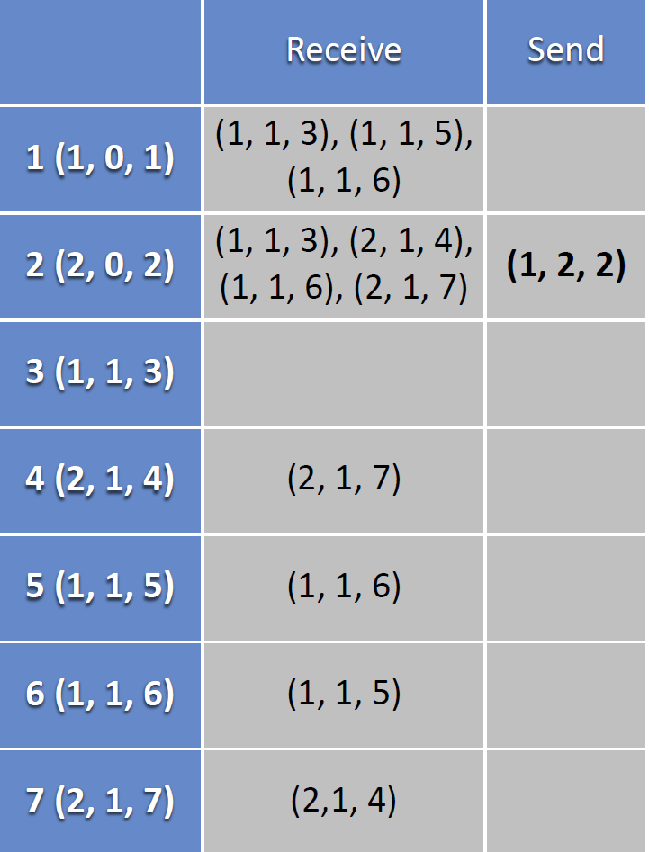
STP Example, Round 3
Current
view
1
3
5
2
6
4
7

Slide 37
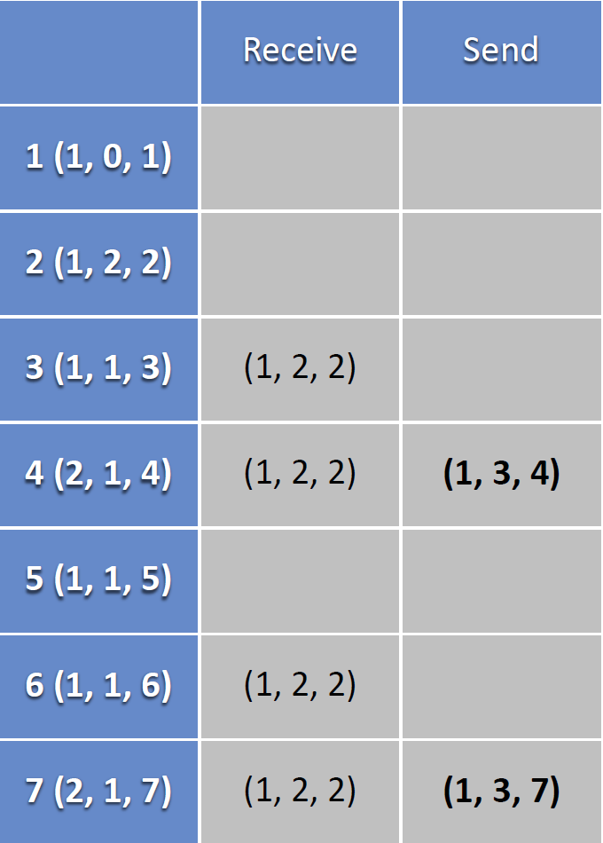
STP Example, Round 4
Current
view
1
3
5
2
6
4
7

Slide 38
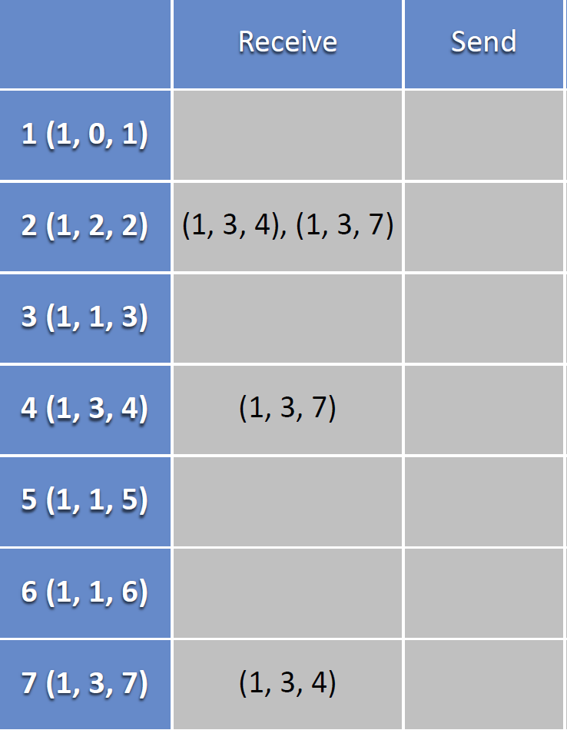
STP Example, Round 5
Current
view
1
3
5
2
6
4
7

Slide 39
After Round 5: We have our Spanning Tree
1
3
5
2
6
4
7

Slide 40
Robust Spanning Tree Algorithm
Algorithm must react to failures
  Failure of the root node: need to elect a new root, with the next lowest identifier
  Failure of other switches and links: Need to recompute the spanning tree
Root switch continues sending messages
  Periodically reannouncing itself as the root
  Other switches continue forwarding messages
Detecting failures through timeout (soft state)
  Switch waits to hear from others
  Eventually times out and claims to be the root
See textbook for details and other examples.

Slide 41
Strengths and Weaknesses
Strengths:
  Plug-n-Play: zero-configuration
  Simple
  Cheap
Weaknesses:
  Wasted bandwidth
  Delay in reestablishing spanning tree
  Slow to react to host movement (need timeout)
  Poor predictability: depending on location of root and traffic pattern

Slide 42
Part II – The Internet Protocol (IP)
IP: The Internet Protocol
  Service characteristics
  The IP Datagram format
  IP addresses
  Classless Inter-Domain Routing (CIDR)
  An aside: Turning names into addresses (DNS)

Slide 43
The Internet Protocol (IP)
Protocol Stack
App
Transport
TCP / UDP
Data
Hdr
TCP Segment
Network
IP
Data
Hdr
IP Datagram
Link

Slide 44
The Internet Protocol (IP)
Characteristics of IP
  CONNECTIONLESS: mis-sequencing
  UNRELIABLE: may drop packets…
  BEST EFFORT: … but only if necessary
  DATAGRAM: individually routed
Source
D
H
Destination
A
B
R2
D
H
R1
R3
Architecture
Links
Topology
R4
Transparent

Slide 45
The IP Datagram
bits 0
8
16
32
vers
HLen
TOS
Total Length
Offset within original packet
ID
Flags
FRAG Offset
Hop count
TTL
Protocol
checksum
SRC IP Address
<=64 KBytes
DST IP Address
(OPTIONS)
(PAD)

Slide 46
IP Addresses
IP (Version 4) addresses are 32 bits long
  Usually represented in a dotted decimal notation
    1.2.3.4 (each 8 bits are represented as a decimal number)
Every interface has a unique IP address:
  A computer might have two or more IP addresses
  A router has many IP addresses
IP addresses are assigned statically or dynamically (e.g., DHCP)
IP (Version 6) addresses are 128 bits long

Slide 47
Are Hosts on the Same Network?
Assume we want to send a packet from 1.2.3.4 (A) to 1.2.10.2 (B).
Two possibilities:
  If A and B are on the same network:
    No need to route, A can directly send the packet over link layer to B
  If A and B are NOT on the same network:
    A must send the packet to a router that can forward it towards B.
Question.
How can we tell if A and B are on the same network?

Slide 48
Are Hosts on the Same Network?
Each IP address is divided into two parts:
  Network ID
  Host ID
E.g., in 1.2.3.4, we can have
  Net-ID: 1, Host-ID: 2.3.4
  Net-ID: 1.2, Host-ID: 3.4
  …
Net ID
Host-ID
8 bits
24 bits
Net ID: 1
Host-ID: 2.3.4
16 bits
16 bits
Net ID: 1.2
Host-ID: 3.4
Question.
How can we tell the boundary between Net-ID and Host-ID?

Slide 49
IP Addressing
We In early days of the Internet
  We had predefined classes (Class-based Addressing)
  E.g., Class A had 8 bits of network ID, 24 bits of host ID
    How to identify?
      Class A addresses always started with 0.
Very rigid and inflexible
  We had 128 Class A network (each with 2²⁴ hosts)
Classless Inter-Domain Routing (CIDR) was introduced to provide more flexibility
  No rigid classes
  Identify Net-ID and Host-ID using a network mask

Slide 50
Network Mask (NetMask)
A NetMask is a 32-bit number used to divide an IP address into Net-ID and Host-ID
  A netmask consists of a sequence of 1s (representing the network part) followed by 0s (representing the host part).
The netmask is typically shown as a dotted decimal notation
  255.255.255.0, meaning the first 24 bits are the Net-ID and remaining are Host-ID
Can also be represented by a “prefix + length”, e.g. 128.100.3.0/24, or just 128.100.3/24.
Example:
yganjali@apps0.cs.toronto.edu > ifconfig eth0
Link encap:Ethernet HWaddr 00:15:17:1C:85:30
inet addr:128.100.3.40 Bcast:128.100.3.255 Mask:ffffff00
UP BROADCAST RUNNING MULTICAST MTU:1500 Metric:1

Slide 51
Subnetting and Supernetting
Using flexible Net-ID vs. Host-ID gives flexibility in networks.
Subnetting: break your network into smaller networks:
  E.g., UofT can break its address (1/8) to multiple subnets: one subnet for DCS, another for ECE, …
  1/8 → 1.0/10 + 1.64/10 + 1.128/10 + 1.192/10
Supernetting: combine networks into bigger ones:
  E.g., DCS can combine the IP addresses of Systems Lab and Graphics Lab departments into one larger network
  1.2.128/17 + 1.2.0/17 → 1.2/16
8 bits
24 bits
Net ID
Host-ID
Sub Net ID (10 bits)
22 bits
Orig. Net ID
00
Host-ID
Sub Net ID (10 bits)
22 bits
Orig. Net ID
01
Host-ID
Sub Net ID (10 bits)
22 bits
Orig. Net ID
10
Host-ID
Sub Net ID (10 bits)
22 bits
Orig. Net ID
11
Host-ID
Subnetting and supernetting allow hiding details of internal networks from the rest of the world. → simplify the network

Slide 52
Detour: Map Computer Names to IP addresses
The Domain Naming System (DNS)
Names are hierarchical and belong to a domain:
  e.g. apps0.cs.utoronto.ca
  Common domain names: .com, .edu, .io, .org, .net, .ca (other country-specific domain,).
  Top-level names are assigned by the Internet Corporation for Assigned Names and Numbers (ICANN).
  A unique name is assigned to each organization.
DNS Client-Server Model
  DNS maintains a hierarchical, distributed database of names.
  Servers are arranged in a hierarchy.
  Each domain has a “root” server.
  An application needing an IP address is a DNS client.

Slide 53
Mapping Computer Names to IP addresses
The Domain Naming System (DNS)
A DNS Query
  Client asks local server.
  If local server does not have address, it asks the root server of the requested domain.
  Addresses are cached in case they are requested again.
.stanford.edu
“What is the IP address of
www.eecs.berkeley.edu?”
e.g. gethostbyname()
.edu
Client
application
.berkeley.edu
.eecs.berkeley.edu
Example: On CDF machines, try “host www.eecs.berkeley.edu”

Slide 54
An Aside – Error Reporting (ICMP) and traceroute
On DCS servers try: traceroute www.google.com
1 router.cs.toronto.edu (128.100.3.254) 0.372 ms 0.369 ms 0.367 ms
2 10.9.128.5 (10.9.128.5) 0.411 ms 0.508 ms 0.507 ms
3 10.9.128.13 (10.9.128.13) 0.624 ms 0.637 ms 0.731 ms
4 10.96.4.25 (10.96.4.25) 0.852 ms 0.843 ms 10.96.7.33 (10.96.7.33) 0.684 ms
5 10.96.7.30 (10.96.7.30) 0.536 ms 10.96.4.30 (10.96.4.30) 0.521 ms 0.637 ms
6 10.16.128.10 (10.16.128.10) 0.919 ms 10.17.128.10 (10.17.128.10) 1.078 ms 0.977 ms
7 google.ip4.torontointernetxchange.net (206.108.34.6) 1.175 ms ut-hub-utoronto2-if-internet.gtanet.ca (205.211.94.133) 2.232 ms 1.830 ms
8 205.211.94.25 (205.211.94.25) 2.330 ms 2.319 ms *
9 google.ip4.torontointernetxchange.net (206.108.34.6) 1.463 ms 192.178.98.189 (192.178.98.189) 1.464 ms 1.163 ms
10 172.253.69.115 (172.253.69.115) 1.164 ms 172.253.69.113 (172.253.69.113) 1.153 ms 192.178.98.45 (192.178.98.45) 2.134 ms
11 172.253.69.113 (172.253.69.113) 1.418 ms 172.253.69.115 (172.253.69.115) 1.088 ms yyz10s17-in-f4.1e100.net (142.251.33.164) 1.179 ms

Slide 55
An Aside – Error Reporting (ICMP) and traceroute
Internet Control Message Protocol
  Used by a router/end-host to report some types of error:
    E.g. Destination Unreachable: packet can’t be forwarded to/towards its destination.
    E.g. Time Exceeded: TTL reached zero, or fragment didn’t arrive in time. traceroute uses this error to its advantage.
  An ICMP message is an IP datagram, and is sent back to the source of the packet that caused the error.

Slide 56
Summary
Shuttling data from one link to another
  Bits, frames, packets, …
  Repeaters/hubs, bridges/switches, routers, …
Key ideas in switches
  Cut-through switching
  Self learning of the switch table
  Spanning trees
Internet Protocol
  Addresses, subnets, CIDR
  DNS, Traceroute, ICMP

