Slide 1
Tutorial on Socket Programming and More
Parsa Pazhooheshy
CSC 458- Fall 2025

Slide 2
Outline
This tutorial is a gentle introduction to some different concepts that you will see through the course.
You will learn more about these concepts throughout the course. This tutorial is supposed to be just a starting point.

Slide 3
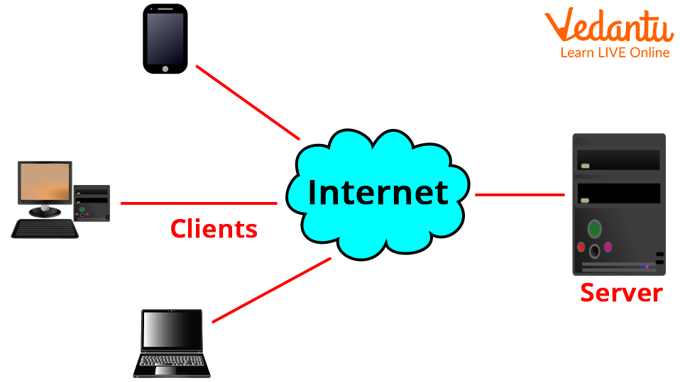
Internet as a Black Box
Definition
The Internet is a vast, globally interconnected network that enables communication between devices (clients and servers) using standardized protocols.
Facilitates seamless data exchange between clients and servers over a publicly accessible infrastructure.

Slide 4
Internet as a Black Box
Characteristics
Scalability & Decentralization: No single entity owns or controls the entire Internet; it is built on a distributed and scalable architecture.
Packet-Switched Communication: Data is transmitted in small packets over multiple paths, improving efficiency and reliability.

Slide 5
Internet still as a Black-Box!
Devices
Clients: Devices (computers, smartphones, IoT devices) that request and consume data or services.
Servers: Systems that provide resources, data, and services (e.g., web servers, cloud storage).

Slide 6
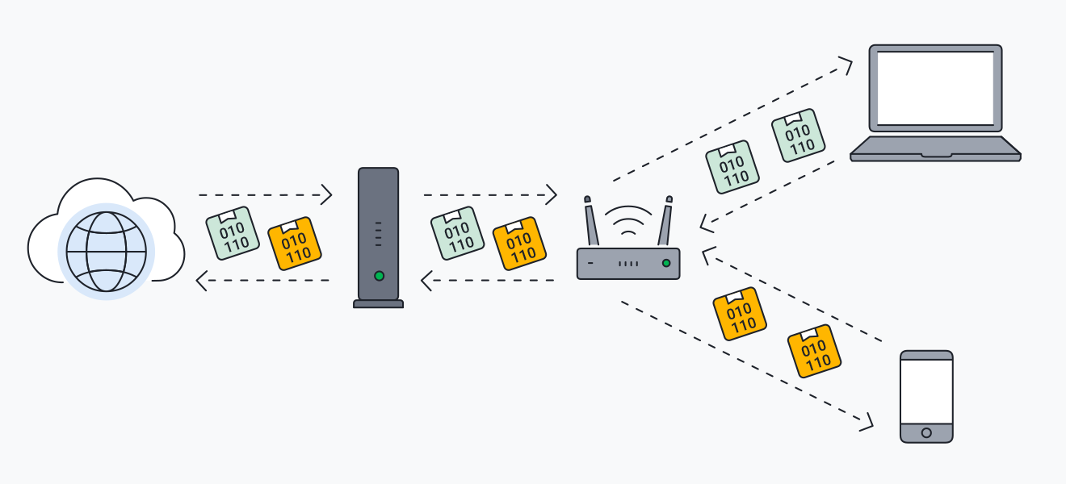
Internet not as a Black-Box any more!
Devices
Routers & Switches: Direct network traffic and ensure data packets reach their destination efficiently.

Slide 7
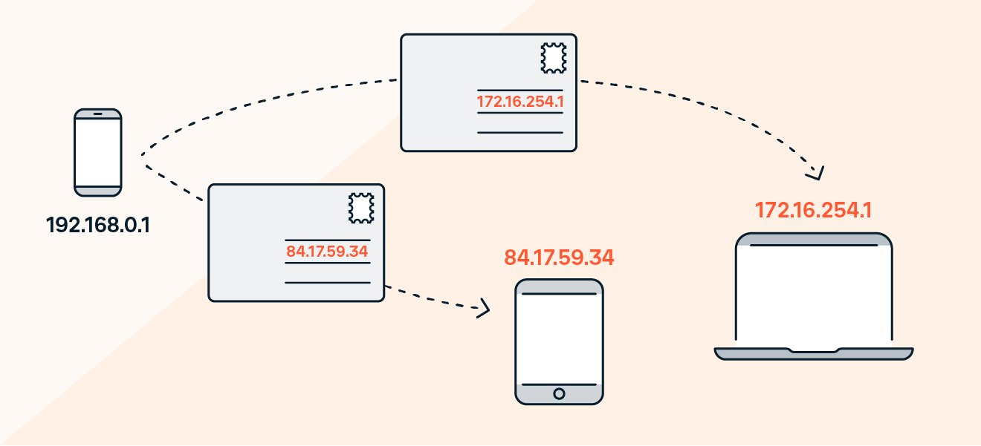
IP Address: The Internet’s Addressing System
A unique numerical identifier assigned to each device on a network.
Used for device identification and communication across the Internet.
Similar to a home address but for digital devices.

Slide 8
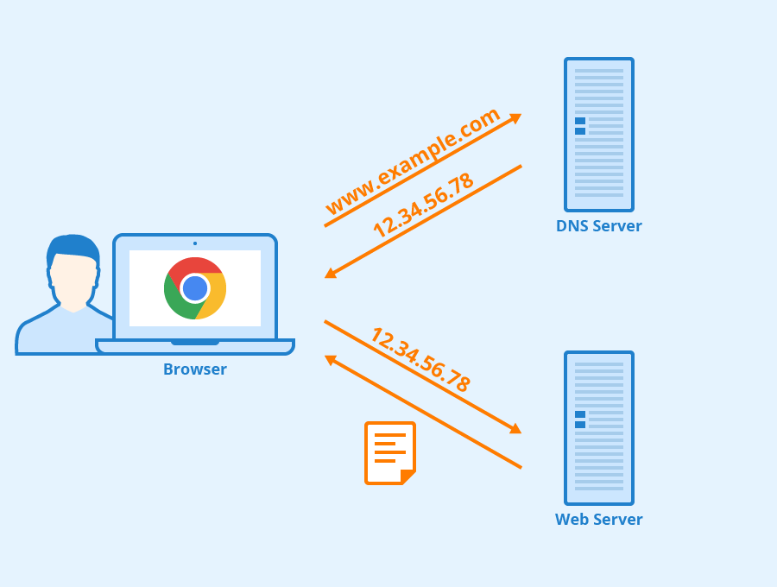
Internet not as a Black-Box any more!
Devices
Domain Name System (DNS):
  When a user types a domain name into a browser, the browser sends a DNS query.
  A DNS server responds to the query by providing the IP address for the domain.
  The browser uses the IP address to communicate with the website's server.

Slide 9
Step by Step Process of a Web Request
You type www.example.com in your browser.
The DNS translates www.example.com to an IP address (e.g., 192.168.1.1).
Your device sends a request to the web server hosting the website.
The server processes the request and sends back the HTML, CSS, and JavaScript needed to display the website.
Your browser renders the website, and you can interact with it.

Slide 10
Recap
What we have covered so far
Internet as a black box
Servers and Clients in the Internet
Routers and Switches
DNS

Slide 11
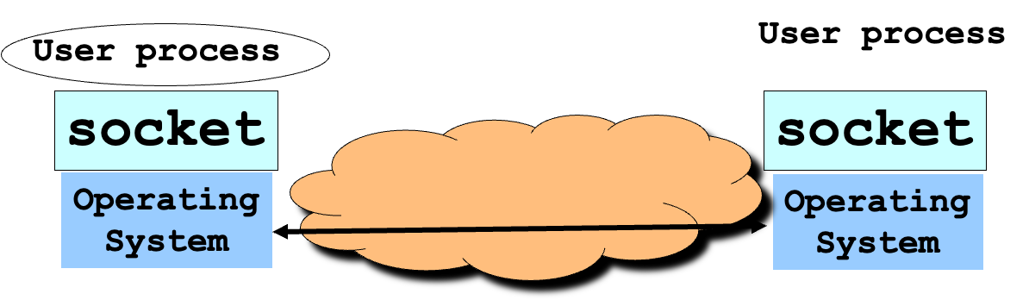
Network Socket
Network sockets are application-level software implementation that enable communication between two processes over a network (which can be Internet or any other network type).
It acts as a bridge between applications and the network stack, allowing processes to send and receive data.
The API for the network protocol stack creates a handle for each socket created by an application, commonly referred to as a socket descriptor.

Slide 12
Function | Purpose
socket() | Creates a new socket.
bind() | Assigns an IP address & port to the socket.
listen() | Sets up a socket to accept connections (server-side).
accept() | Accepts an incoming connection request.
connect() | Establishes a connection to a remote socket.
send()/recv() | Sends or receives data over a socket.
close() | Closes the socket after communication.

Slide 13
Typical Client Program
Prepare to communicate
Create a socket
Determine server address and port number
Initiate the connection to the server
Exchange data with the server
Write data to the socket
Read data from the socket
Do stuff with the data (e.g., render a Web page)
Close the socket

Slide 14
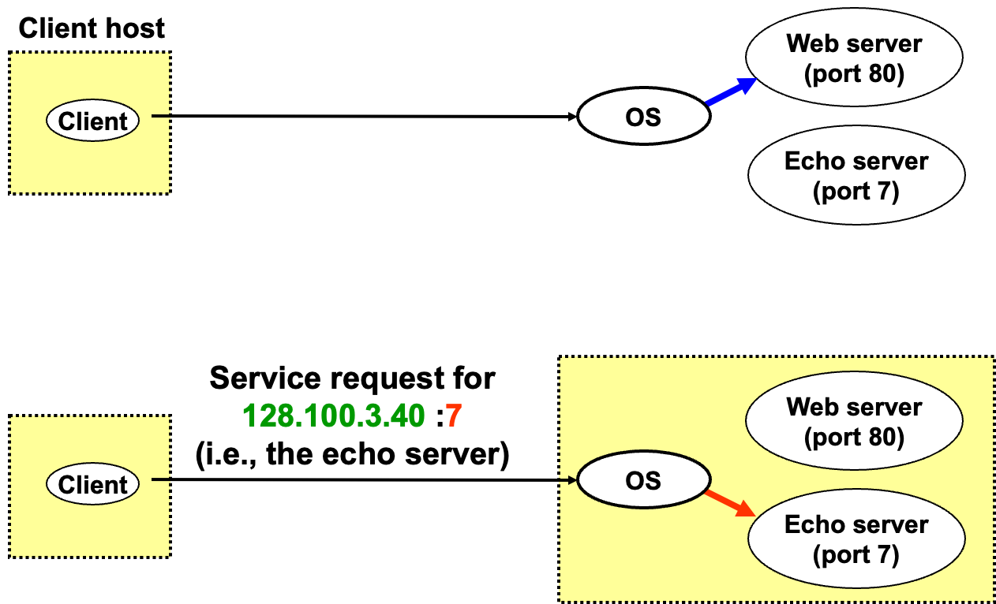
Using Ports to Identify Services

Slide 15
Socket Parameters
A socket connection has 5 general parameters:
  The protocol
    – Example: TCP and UDP
  The local and remote address
    Example: 128.100.3.40
  The local and remote port number
    Some ports are reserved (e.g., 80 for HTTP)
    Root access require to listen on port numbers below 1024

Slide 16
Servers Differ From Clients
Passive open
Prepare to accept connections
… but don’t actually establish one
… until hearing from a client
Hearing from multiple clients
Allow a backlog of waiting clients
... in case several try to start a connection at once
Create a socket for each client
Upon accepting a new client
… create a new socket for the communication

Slide 17
Typical Server Program
Prepare to communicate
Create a socket
Associate local address and port with the socket
Wait to hear from a client (passive open)
Indicate how many clients-in-waiting to permit
Accept an incoming connection from a client
Exchange data with the client over new socket
Receive data from the socket
Send data to the socket
Close the socket
Repeat with the next connection request

