Slide 1
Handout # 4:
Network and Machine Learning
Professor Yashar Ganjali
Department of Computer Science
University of Toronto
ganjali7@cs.toronto.edu
http://www.cs.toronto.edu/~yganjali

Slide 2
Announcements
Final project
  Form your team (2-3 students)
  Start drafting your project proposal
    Due: Friday, Feb. 14
    Please check prior handouts for more information on this.
List of papers for Week 5 posted
  Volunteers for Week 6?
    2% bonus?
Next week:
  Three paper presentations
  Please read before class

Slide 3
Today
Networks and Machine Learning
Data Center Network Transport
Network-Application Integration

Slide 4
Announcements
Need volunteers for paper presentations
  Presentation in three weeks (February 14)
  Bonus for people who volunteer to present first
  Need name + email
    Also, last week’s volunteers
Week after February 14:
  Reading week

Slide 5

In the Beginning …
Main Design Objective: today’s networks were designed to grow rapidly.
Design Decisions: any design choices were side-effects of this objective:
  Best-effort service model
  End-to-end principle
  Simplicity (ease of growth)
  Packet-based design
  Distributed control model
  …
All these design decisions are based on the “rapid growth” objective.

Slide 6
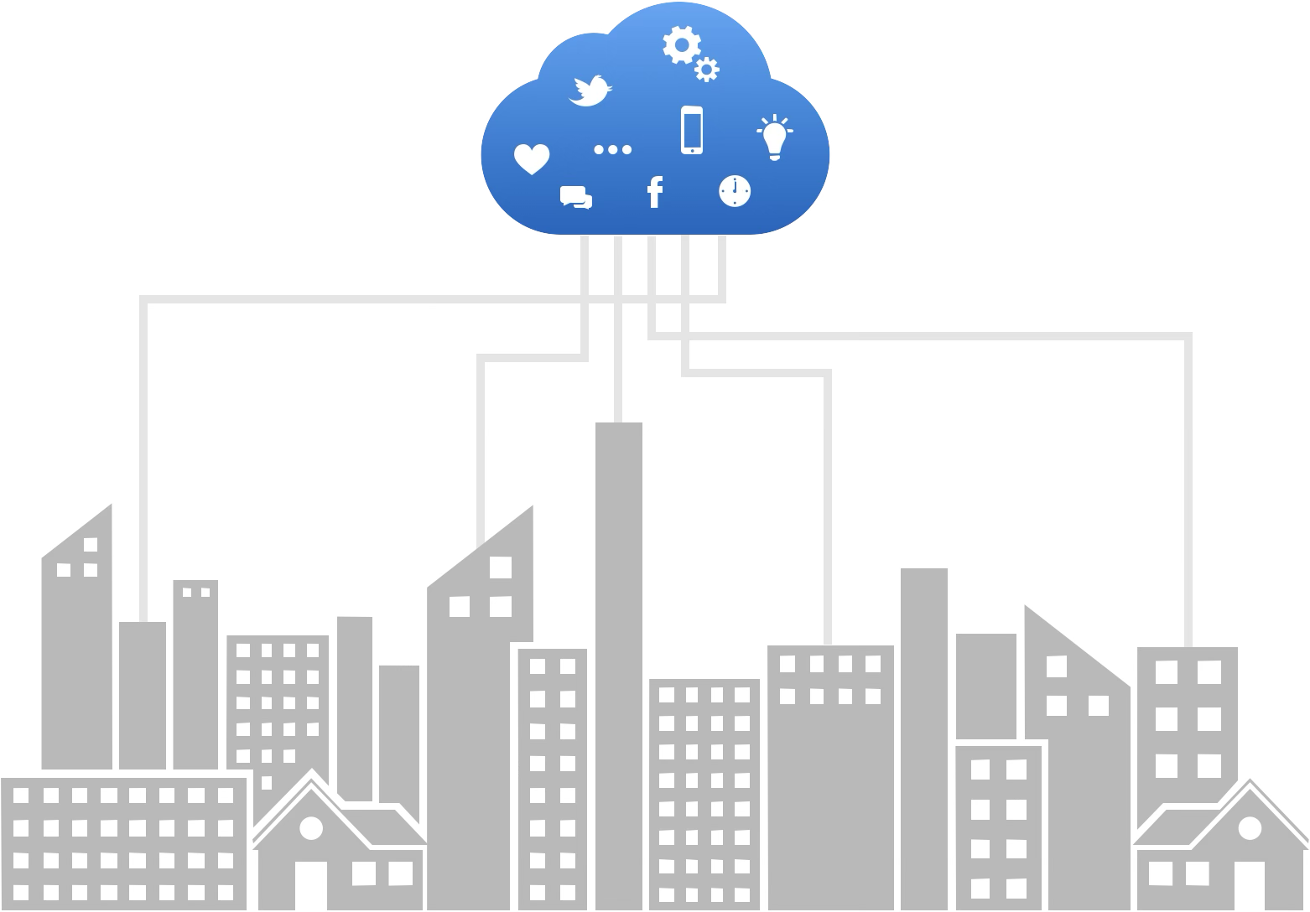
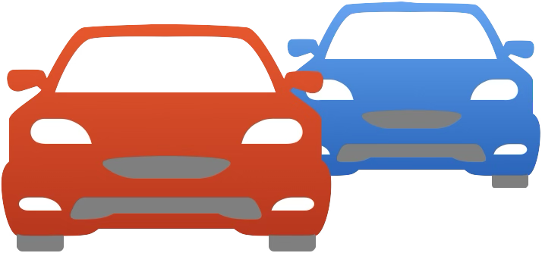
New Needs
Question: Do principles/design of current networks match our current and future needs?
Examples:
  Smart cities, IoT, …
  Self-driving cars
  Remote surgery
  Exascale ML training
Can we rely on today’s networks?
  Delay, bandwidth, availability, reliability, scale, …

Slide 7
The Mismatch
Current and Future Needs
Past Design
Need performance guarantees
  Bandwidth, latency, …
  At scale
Need optimality
  Minimize cost, and energy, …
Need manageability
  Network, individual components, services, …
Need for change
  New services, protocols, …
No performance guarantees
  Best-effort service design
  Scale → performance degradation
Ad hoc optimization solutions
  Not generalizable/automated
No built-in management primitives
  Simplicity, end-to-end design
No plan for change ➜ ossification
  Short-term focus on growth

Slide 8
Networks for Machine Learning
Data Center Networks have evolved significantly
  To accommodate demands for modern applications.
  Example: SDN and programmable switches
  Example: many novel congestion control algorithms in recent years:
    Swift, timely, HPCC, DCQCN, …
    Enablers: more accurate information from network (exact queue occupancy), assumptions about start rate (start at line rate), etc.
Machine learning applications have grown significantly as well.
  Used more in various domains, solving a wide range of problems.
  At the same time, ML applications have higher demands from the underlying network
Question: are existing DCN solutions enough?
  I.e., can they provide the high-performance connectivity needed for ML applications?

Slide 9
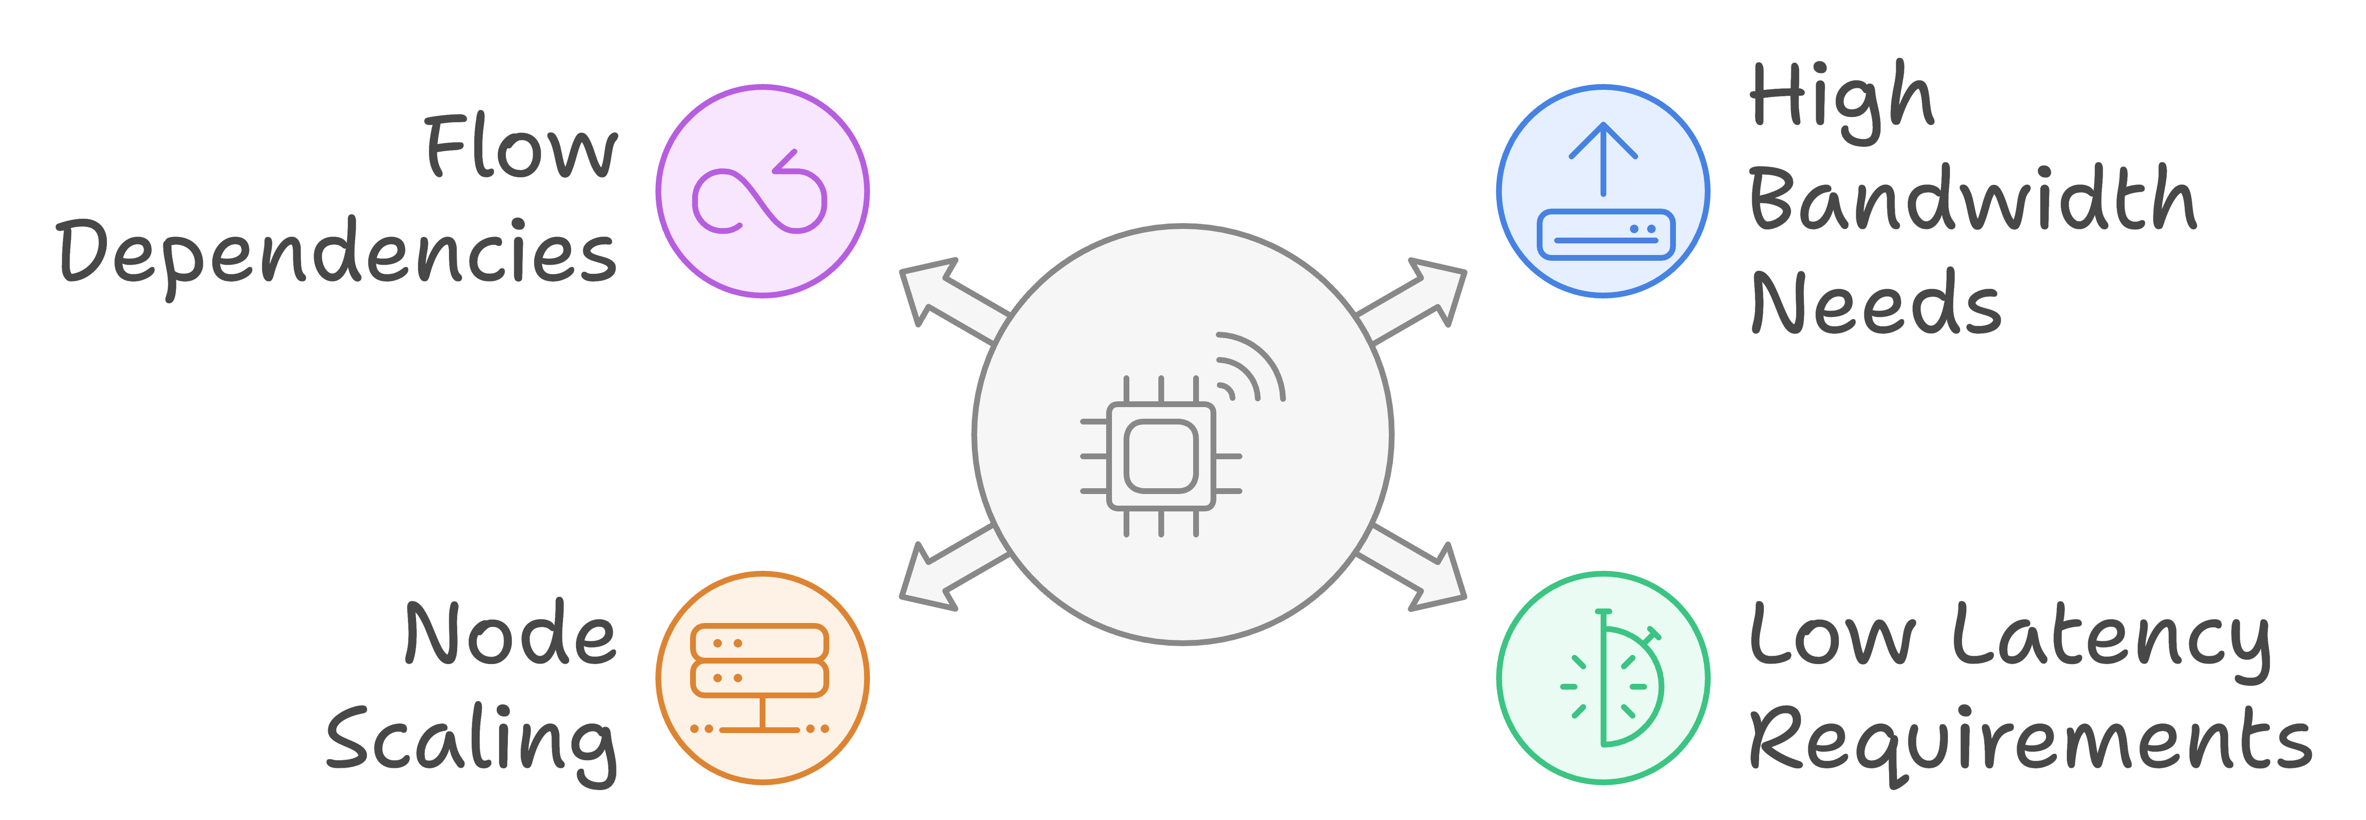
What Makes ML Different: Challenges
ML workloads can be extremely large:
  E.g., Training of Large-Language Models (LLMs)
  Need various forms of parallelism
    Data parallelism
    Model parallelism
    Hybrid
ML workloads have extremely high requirements from the underlying network:
  High bandwidth
  Low latency
  Low jitter (variations in delay)
Moore’s Law: the number of transistors on a microchip will double approximately every two years.
  For years, Moore’s law meant we could easily grow compute power according to growth in demand.
End of Moore’s Law: recently, we have hit a wall and cannot continue growing compute per node as predicted by the Moore’s Law.
  However, the demand keeps growing …
  For ML even faster than what Moore’s law could handle.
We need to add more nodes to scale to the demands of ML means.
All of this leads to significant pressure on the network (throughput, latency, reliability, …)

Slide 10
What Makes ML Different: Challenges
Handling many independent flows in a network makes many network problems easy (easier) to solve
  Random arrivals, each flow has a small share of bandwidth
  Why?
In ML, we have few flows
  Having few flows means each flow can have a large fraction of link bandwidth
    ⇒ Any interaction between flows can lead to significant performance degradation
In ML flows have direct/indirect dependencies
  Dependence between compute and communication
    ⇒ flows directly or indirectly depend on each other
    ⇒ Performance degradation in one flow can impact the performance of the entire job
Providing high-performance connectivity for ML workloads is extremely challenging.
  Due to scale, high-performance requirements (bandwidth, latency, …), larger flows, dependencies, …
Example: load balancing in ML
  Even two flows sharing a path can significantly reduce the overall performance.

Slide 11
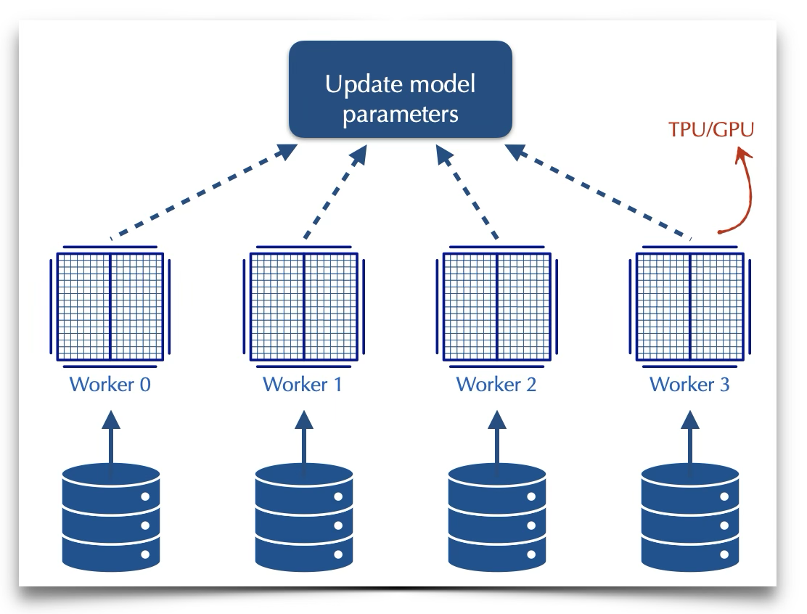
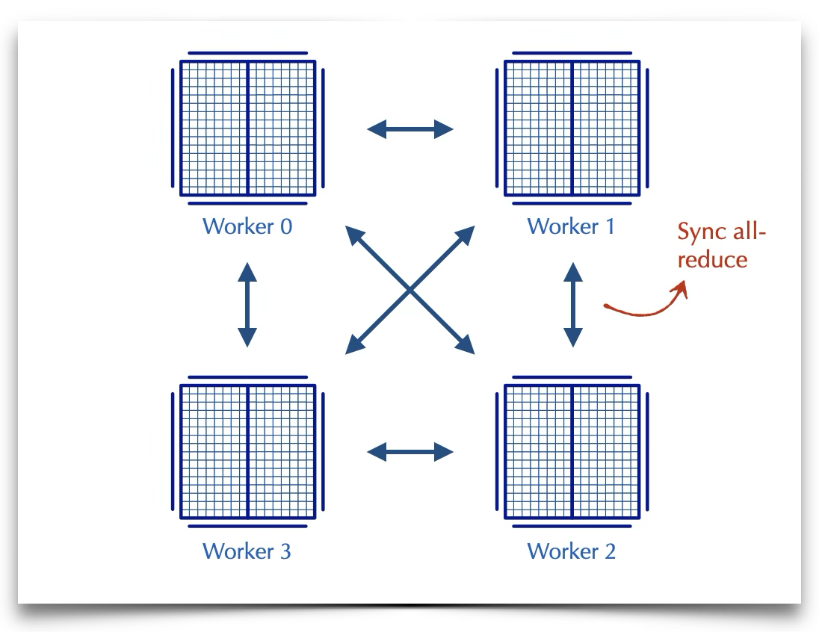
What Makes ML Different: Opportunities
ML workloads are more more predictable
  Repeating patterns of communication
  Collective Communications: scatter, gather, all-reduce, …
Knowing communication patterns ⇒ opportunities for …
  Building specialized hardware
    E.g., topology that matches the flow requirements
      Today’s most successful ML networking solutions
  Build network solutions that adapt based on application requirements
    Application-aware scheduling
    Reconfigurable topology
    Adaptive routing, …
Access to “Collective Communication Libraries” can provide significant opportunities

Slide 12
Network Topology
DCN topology: fat-tree, leaf-spine, …
  Static and uniform
  Needs to work with a wide range of workloads
    Tuned for average workload
Distributed ML application have high demand which is not necessarily uniform
  More demand for certain paths
Two options to deal with extra traffic
  Add extra capacity and over-provision; or
  Use existing capacity better:
    Measurement studies show there is extra capacity available, it just needs to be used effectively

Slide 13
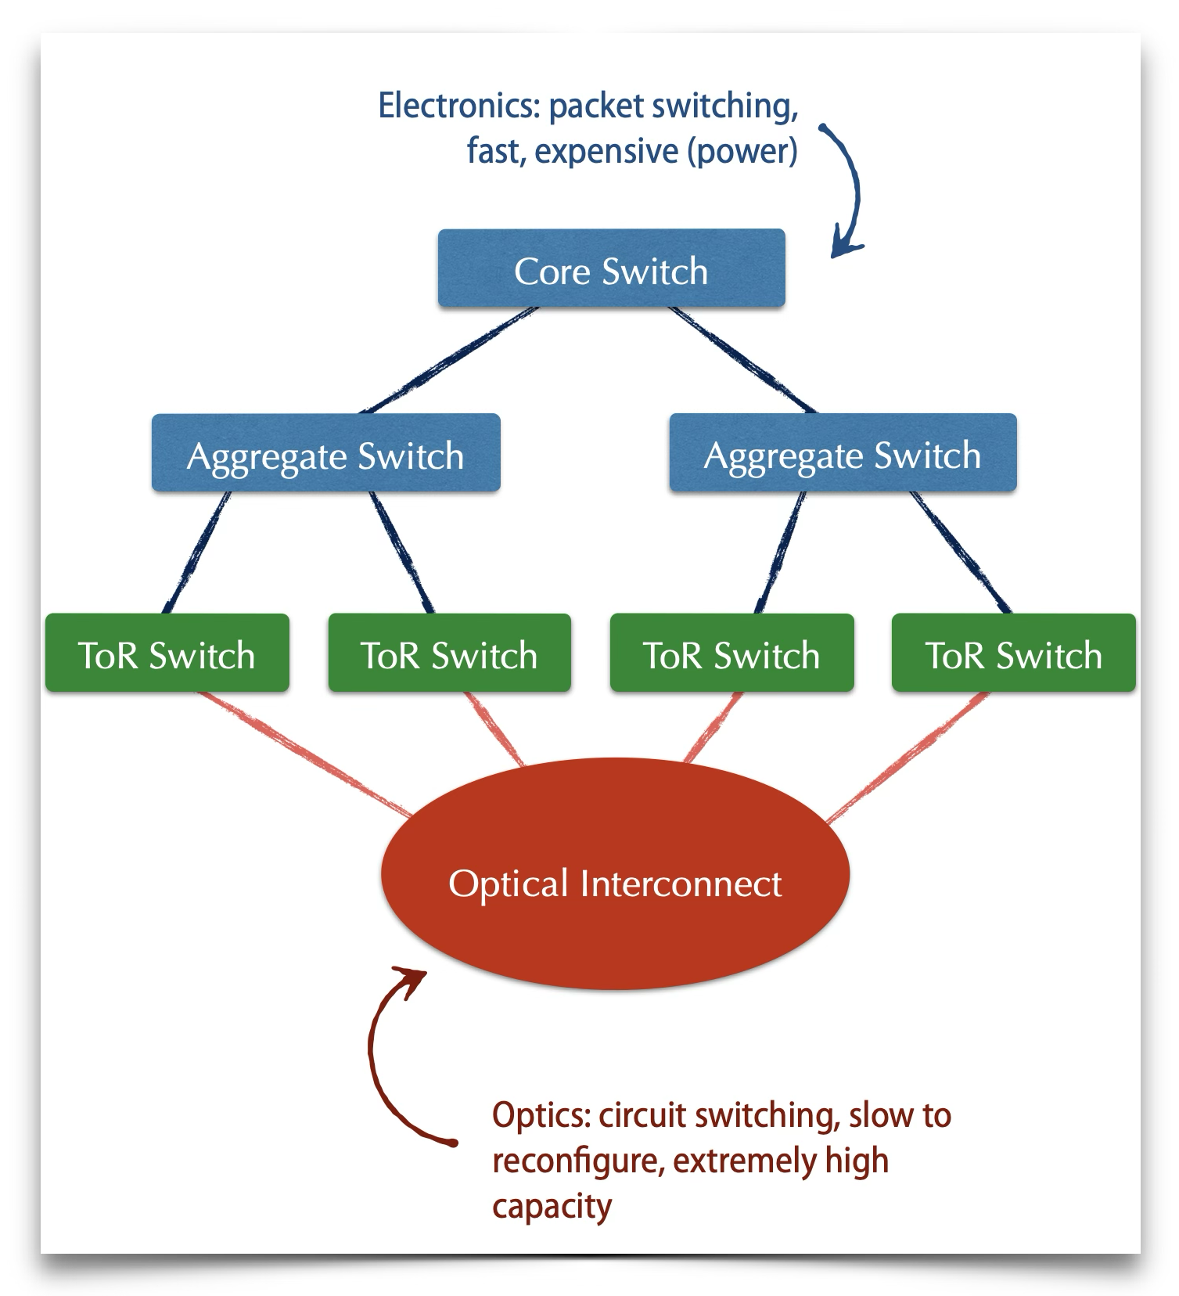
Adapt Network Topology to Demand
Needs to adapt topology to workload
  Even more important when you share the infrastructure
    Cloud-based ML training, or various ML jobs sharing the network
How can we adapt the topology to match demand? Two paradigms:
  Customized the topology for specific classes of traffic
    Special-purpose design
    Can be optimal, but very expensive
    What happens if new communication patterns emerge?
  Dynamically rearrange the topology
    How?

Slide 14
Reconfigurable DCN Topology
Optical Circuit Switching:
  Reconfigure input/output connectivity of switch ports
  Avoids electronic-optic-electronic conversion
  Various technologies:
    MEMS-based Switching: mechanically rearrange mirrors to change connectivity of ports
    Arrayed Wave Guide (AWG) Switching: change wavelength to connect to different output ports
Benefit: shifting capacity to where it is needed on demand
Challenge: reconfiguration might take some time
  Not ideal for typical packet switching scenarios
What if we know the demand and it is fairly stable?
  Google’s Jupiter: estimate demand matrix, adapt topology using a fast control plane
ML Workloads are predictable ⇒ opportunity to change the switch connectivity to meet demand in real time
RDCN performance improvements:
  High bandwidth (1.6-4x increased in available bandwidth), 70-80% lower power, micro to nano-second scale delay

Slide 15
Some Examples
Optical interconnect for ML
  Nvidia GPU Clusters: DGX-H100 → DGX SuperPOD
  SiP-ML: Hybrid data and model parallelism
  TPUv4: OCS for interconnection
  Communication pattern supported efficiently on the network
  Task partitioning/placement based on degree and network latency

Slide 16
Transport in Data Center Networks

Slide 17
Traditional Congestion Control
TCP implements host-based, feedback-based, window-based congestion control.
TCP sources attempts to determine how much capacity is available
TCP sends packets, then reacts to observable events (loss).

Slide 18
Idea of TCP Congestion Control
Each source determines the available capacity
  … so it knows how many packets to have in transit
Congestion window
  Maximum # of unacknowledged bytes to have in transit
  The congestion-control equivalent of receiver window
  MaxWindow = min{congestion window, receiver window}
  Send at the rate of the slowest component: receiver or network
Adapting the congestion window
  Decrease upon losing a packet: backing off
  Increase upon success: optimistically exploring

Slide 19
Additive Increase, Multiplicative Decrease
How much to increase and decrease?
  Increase linearly, decrease multiplicatively
  A necessary condition for stability of TCP
  Consequences of over-sized window are much worse than having an under-sized window
    Over-sized window: packets dropped and retransmitted
    Under-sized window: somewhat lower throughput
Multiplicative decrease
  On loss of packet, divide congestion window in half
Additive increase
  On success for last window of data, increase linearly

Slide 20
Additive Increase
Src
D
A
D
D
A
A
D
D
D
A
A
A
Dest
Actually, TCP uses bytes, not segments to count:
When ACK is received:

Slide 21
TCP “Sawtooth”
Window
Loss
halved
t

Slide 22
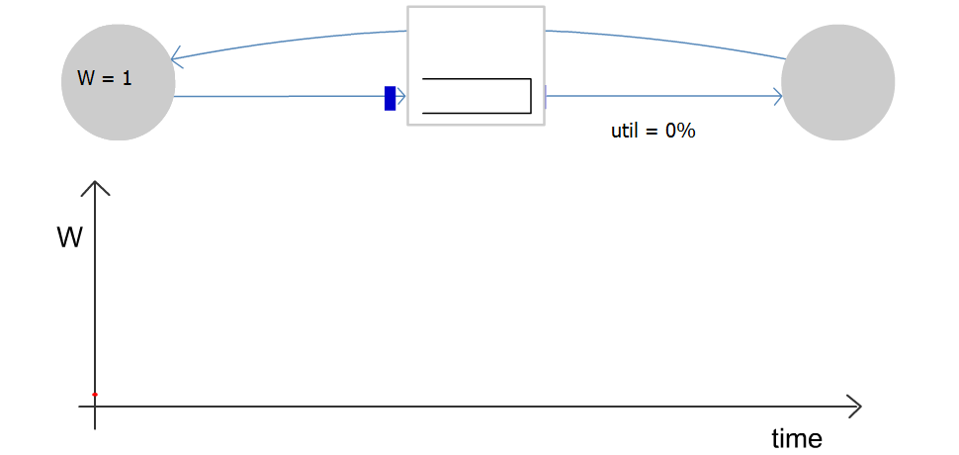
Congestion Window Evolution
Rule for adjusting W
  If an ACK is received: W ← W+1/W
  If a packet is lost: W ← W/2
Only W packets
may be outstanding

Slide 23
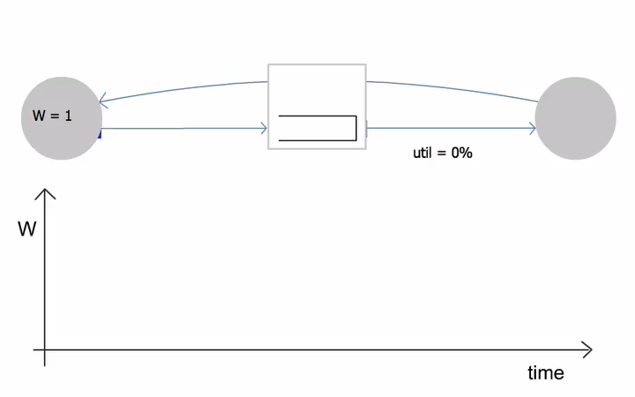
Congestion Window Evolution

Slide 24
Random Early Detection (RED)
Basic idea of RED
  Router notices that the queue is getting backlogged
  … and randomly drops packets to signal congestion
Packet drop probability
  Drop probability increases as queue length increases
  If buffer is below some level, don’t drop anything
  … otherwise, set drop probability as function of queue
Probability
Average Queue Length

Slide 25
RED Drop Probabilities
D(t)
A(t)
1
maxP
AvgLen
minTh
maxTh
Need to cap by 1

Slide 26
RED Average Queue Length
Drop probability is increased as the average queue length increases.
(Geometric) moving average of the queue length is used so as to detect long term congestion, yet allow short term bursts to arrive.

Slide 27
Transport in Data Center Networks
Data center network properties:
  Extremely short RTTs
  Extremely high bandwidth links
  Extremely large transfer
  Single authority (typically)
Leads to new challenges and opportunities
  Can you think of any challenges for providing good transport solutions?
  How about opportunities?

Slide 28
Explicit Congestion Notification
D(t)
A(t)
1
maxP
AvgLen
minTh
maxTh
Explicit Congestion Notification
  Router marks the packet with an ECN bit
  Receiver reflects the ECN bit in the ACK
  … and sending host interprets as a sign of congestion
Sender can use this as congestion signal
  Instead of packet loss

Slide 29
DCTCP
Easier to ensure ECN is enabled on all devices in DCN
  Single authority
Use ECN marks as congestion signal → reduced packet loss
  Congestion measured based on fraction of packets marked with ECN (called ⍺).
  ⍺ is the moving average of the observed fractions (like estimatedRTT)
Adjust congestion window based on the extent of congestion: cwnd ⃪ cwnd x (1- ⍺/2)
  Instead of halving the window in case of congestion.
More responsive and less aggressive to network conditions compared to traditional TCP
Keeps queue lengths shorter (as reacts faster) → low latency

Slide 30
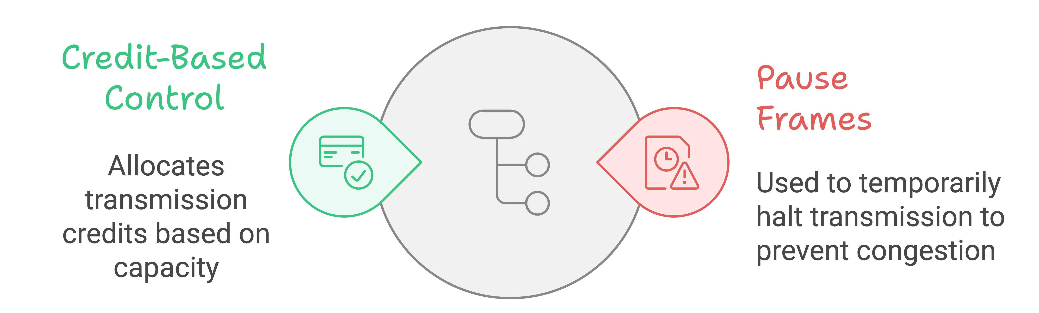
Link Layer Flow Control
Flow control mechanism used to create lossless networks.
  Not to be confused with flow control in transport layer which is end-to-end.
  Setup: two nodes (end-hosts or switches) connected via a link.
    Both have buffer (transmitter queue and receive buffer).
  Goal: ensure the receiver can handle the traffic injected on the link → no packet loss
Two prominent techniques:
  Credit-based
  Pause-based

Slide 31
Credit-Based Link-Level Flow Control
Receiver provides credits to the sender when it has room
  Credit unit: bytes or packets
Credit allocation:
  At the beginning certain (fixed) credit is allocated.
    Question: how much credit should be allocated initially?
  Transmitter uses credit when transmitting.
    Pauses if there is no more credit available.
  Receiver replenishes transmitter credits as receiver buffer becomes available.
Note: we also can have credit-based congestion control. This is not what we are covering here. The concepts are similar, but at different layers.

Slide 32
Pause-based Link-Level Flow Control
pause threshold
Transmitter does not need permission to start.
Receiver signals the transmitter when it is running out of buffer space.
  When buffer occupancy goes above a fixed pause-threshold.
  Pause-frame sent to transmitter
  Transmitter halts transmission
Once the receiver buffer has sufficient space …
  Receiver sends a resume frame to the transmitter
  The transmitter can resume sending.

Slide 33
Priority-based Flow Control (PFC)
Allows multiple priority-queues.
Pause individual queues not all traffic
  Allows other priority queues to continue transmitting even if a single queue is paused.
Improves impact of pause on non-congested traffic to some extent
Still, we might pause non-congested flows
  Why?
  Is there an easy way to solve this problem?
Known issues: head-of-line blocking (deadlock), PFC storm

Slide 34
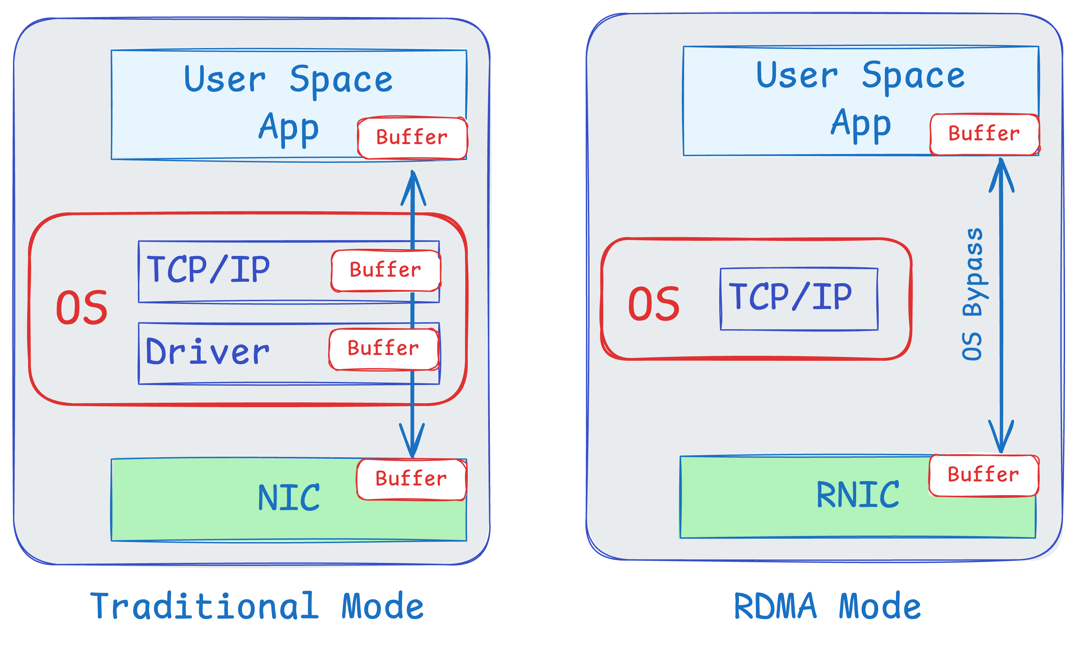
Remote Direct Memory Access
Directly write to remote server’s memory
  Both sides register memory regions to give RDMA direct access permission and mapping
  Need trust/cooperation between two ends
RDMA-capable NIC (RNIC) handles data transfer entirely in hardware
  No need to involve CPU for transfer
Queue Pairs (QPs): a send queue and a receive queue.
  Supports various operations like send, receive, read, and write.

Slide 35
Benefits of RDMA
Low Latency
  Minimizes delays by avoiding CPU intervention.
  Ideal for applications requiring real-time data processing.
High Throughput
  Enables faster data transfer rates.
  Suitable for high-performance computing and large data sets.
Reduced CPU Load
  Frees up CPU resources for other tasks.
  Improves overall system efficiency.
Zero-copy data transfer.
  Eliminate (or minimize data copies)
Applications: High-Performance Computing (HPC), Storage, …

Slide 36
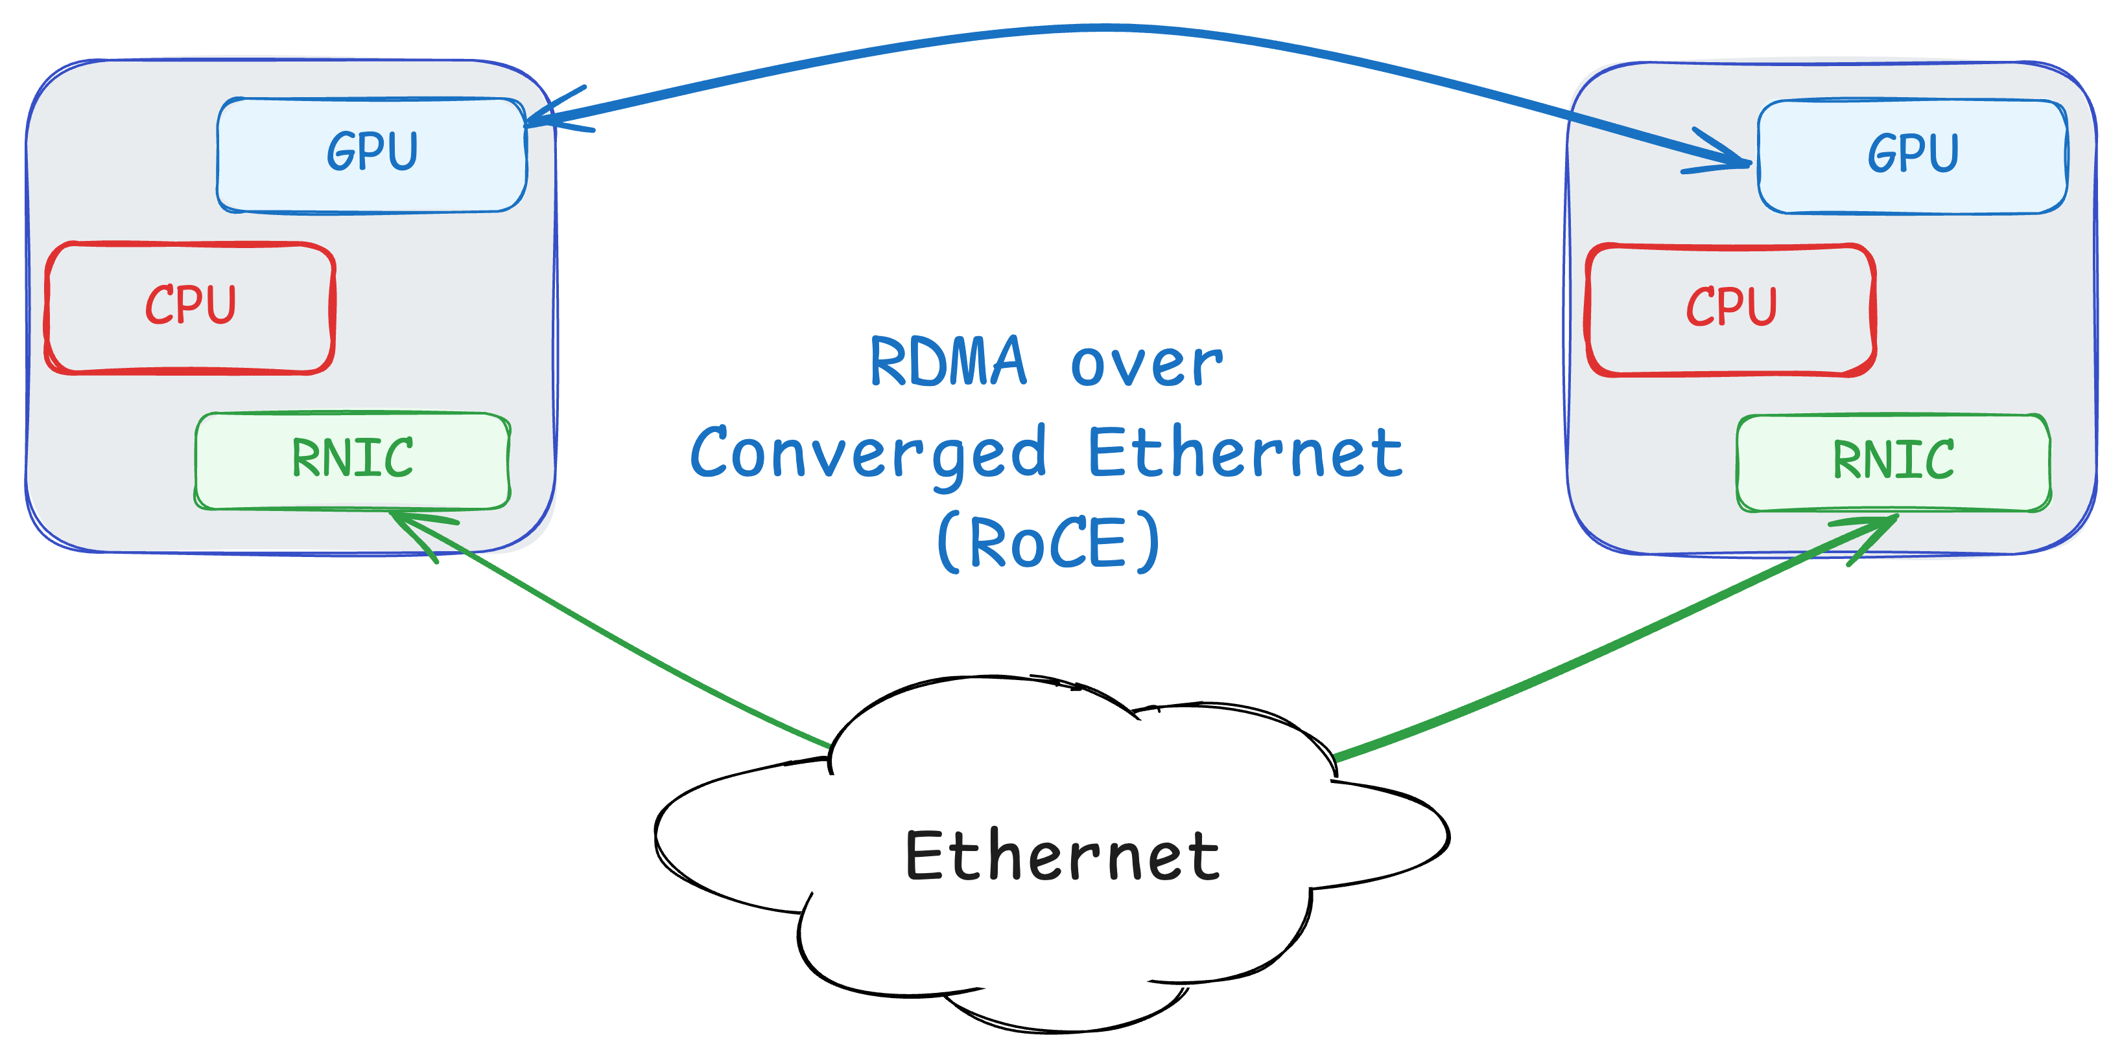
From Proprietary to Commodity
Original technology InfiniBand
  Touching physical layer, link layer, and transport layer in the stack.
  Small number of vendors
Later RDMA enabled over Ethernet
  RoCE: RDMA over Converged Ethernet
  With and without PFC support (RoCE v1 vs. v2)
And even in WAN
  iWARP (Internet Wide-Area RDMA Protocol)
  Implemented over TCP/IP, no need for lossless network
  Significant challenges here, especially over long distances

Slide 37
Detour: OpenTCP
Network can impact congestion control by using AQM schemes.
Finding the optimal value by probing
  Costly, and not very efficient
What if the network could help?
  Two extremes: end-to-end vs. centralized
How about a solution in the middle?
  Network guides the flows without creating dependency.

Slide 38
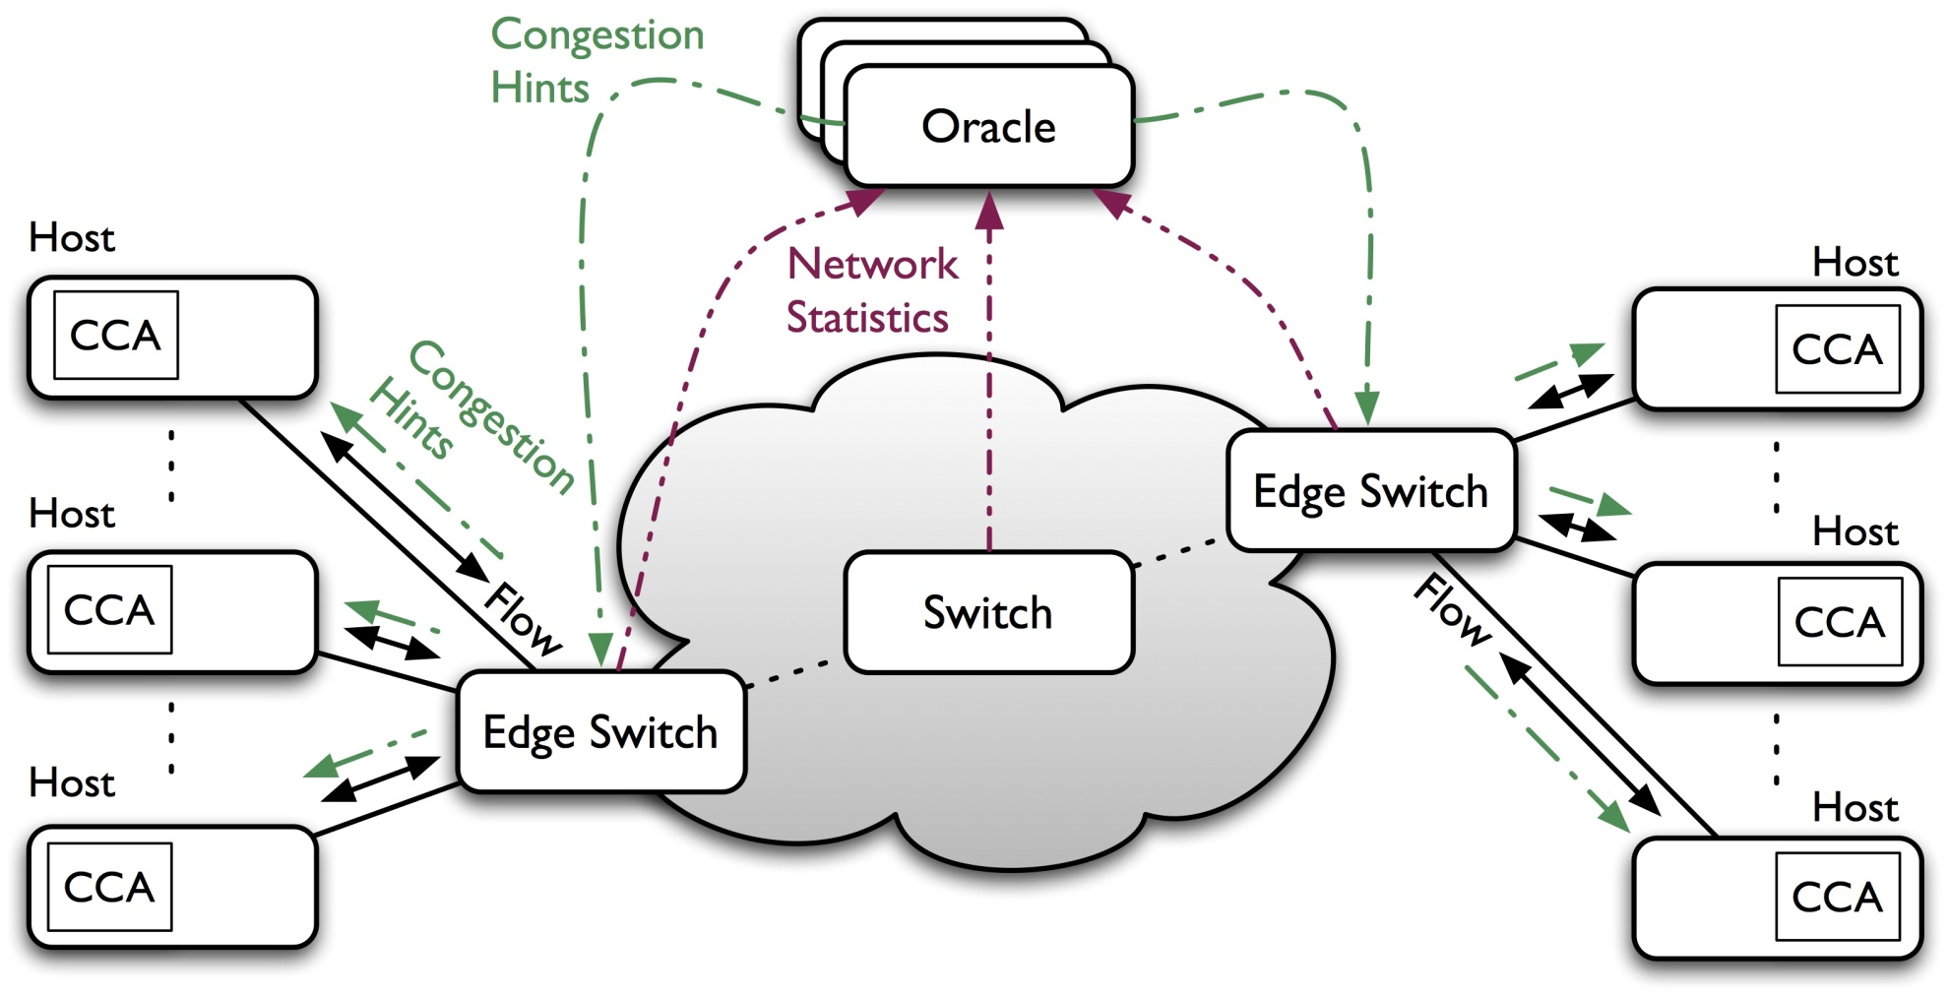
Detour:
OpenTCP in Software-Defined Networks

Slide 39
OpenTCP: Performance Improvements

Slide 40
Adapting Other Network Functions
Topology is only one dimension
What about: routing, prioritization, scheduling, …?
How can we optimize network behavior based on application requirements?

Slide 41
Application-Aware Networking
To optimize network behavior, we need to provide information about application requirements.
  Application-Aware Networking
  Today’s networks lack this information
Main Question: how can we provide information from applications to the network?
Naïve approach:
  Create new interfaces between network and applications.
  Allow application developers provide more information about the requirements
    E.g., I need 10Gb/s bandwidth for 2 seconds.
This is not very practical
  Putting the burden on application developer
  She/he might not even know the requirements
Alternative: create tools/mechanisms to automatically generate signals that can help network adjust itself based on application requirements, or state.

Slide 42
Example: Incast Problem
Consider a simple multi-get request from a distributed storage.
  Get some content from several servers
The request can trigger large number of flows.
  Quickly fill up the buffer at switch → lots of packet drops
  This is called the incast problem
  Very challenging problem in DCNs
Network does not know when incast will happen
  Cannot react in a timely manner.
  Over-provisioning seams to be the only viable solution.
Applications, however, have information that can be used to predict incast.
  E.g., multi-get request can be seen as a hint.

Slide 43
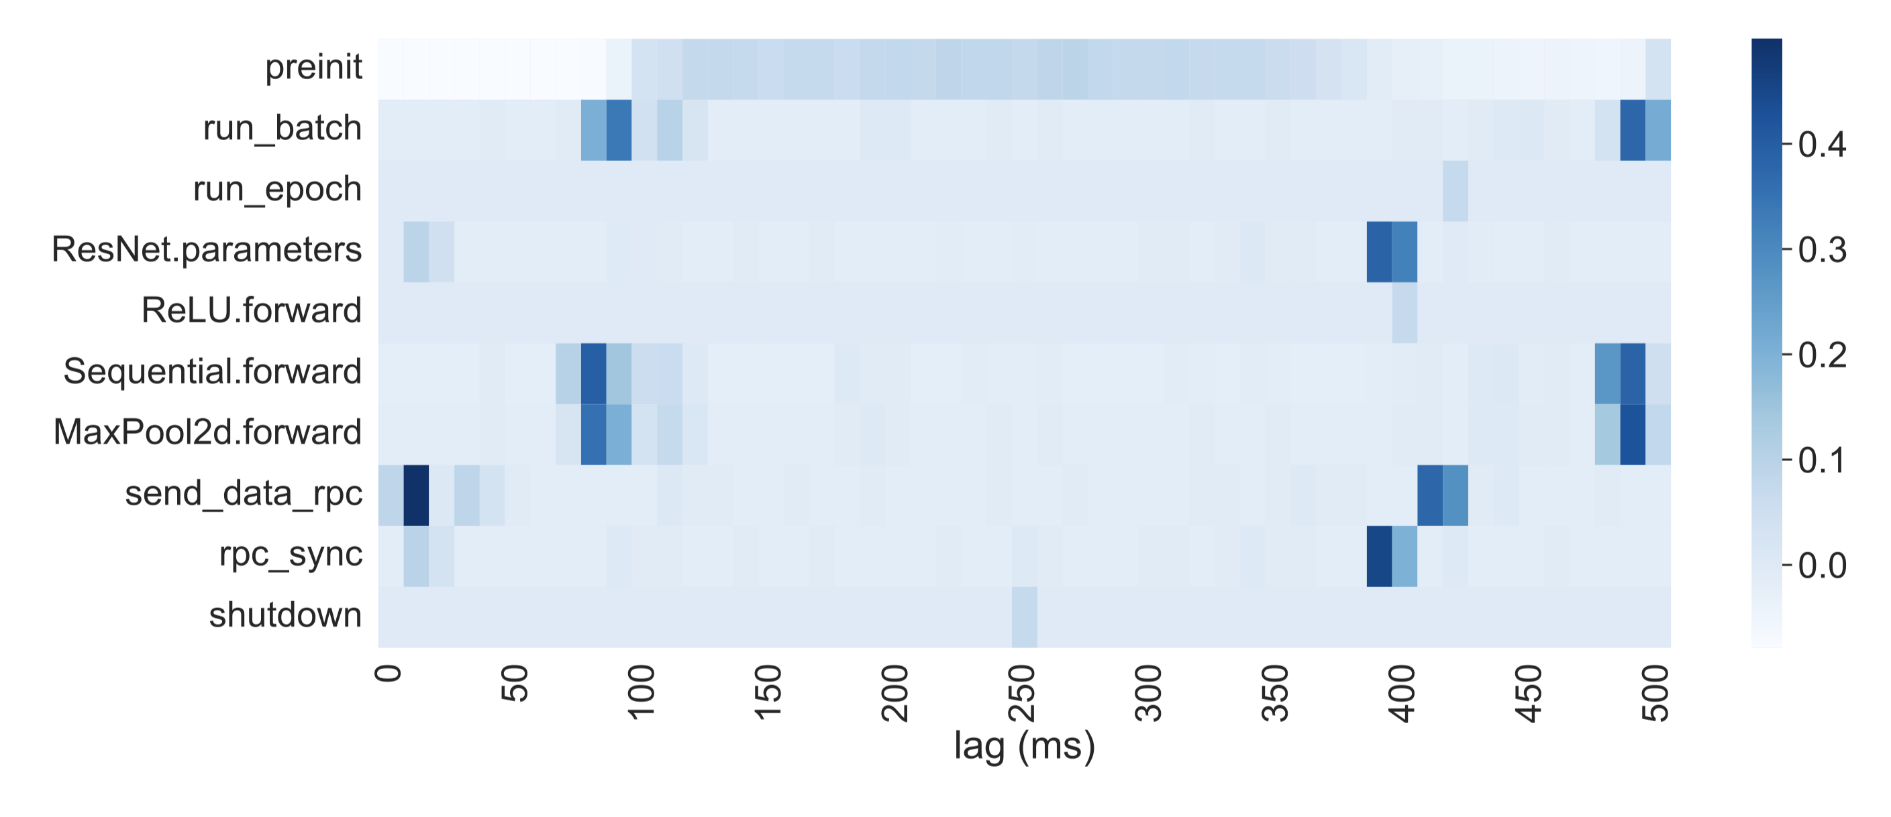
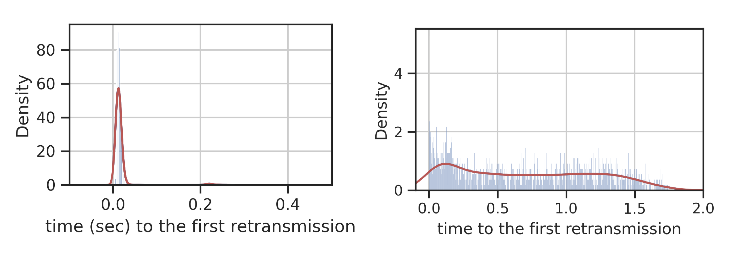
Networks and Applications*
Imagine, we have a system that observes network events, and
  E.g., incast in switches
Also, it can observe certain events in applications
  E.g., when each function is called
We correlate these events find out triggers on the end-host side for network events
  I.e., which application events lead to network problems
  E.g., each incast event in the network is preceded by a multi-get request 1 RTT before
Correlation between selected function calls and micro-bursts for a distributed ML application.
Probability of Incast in Future
* Mortazavi, S.H., Munir, A., Bahnasy, M.M., Dong, H., Wang, S. and Ganjali, Y. 2022. EarlyBird: automating application signalling for network application integration in datacenters. Proceedings of the ACM SIGCOMM Workshop on Network-Application Integration (New York, NY, USA, Aug. 2022), 40–45.
Incast Probability with SmartTag

Slide 44
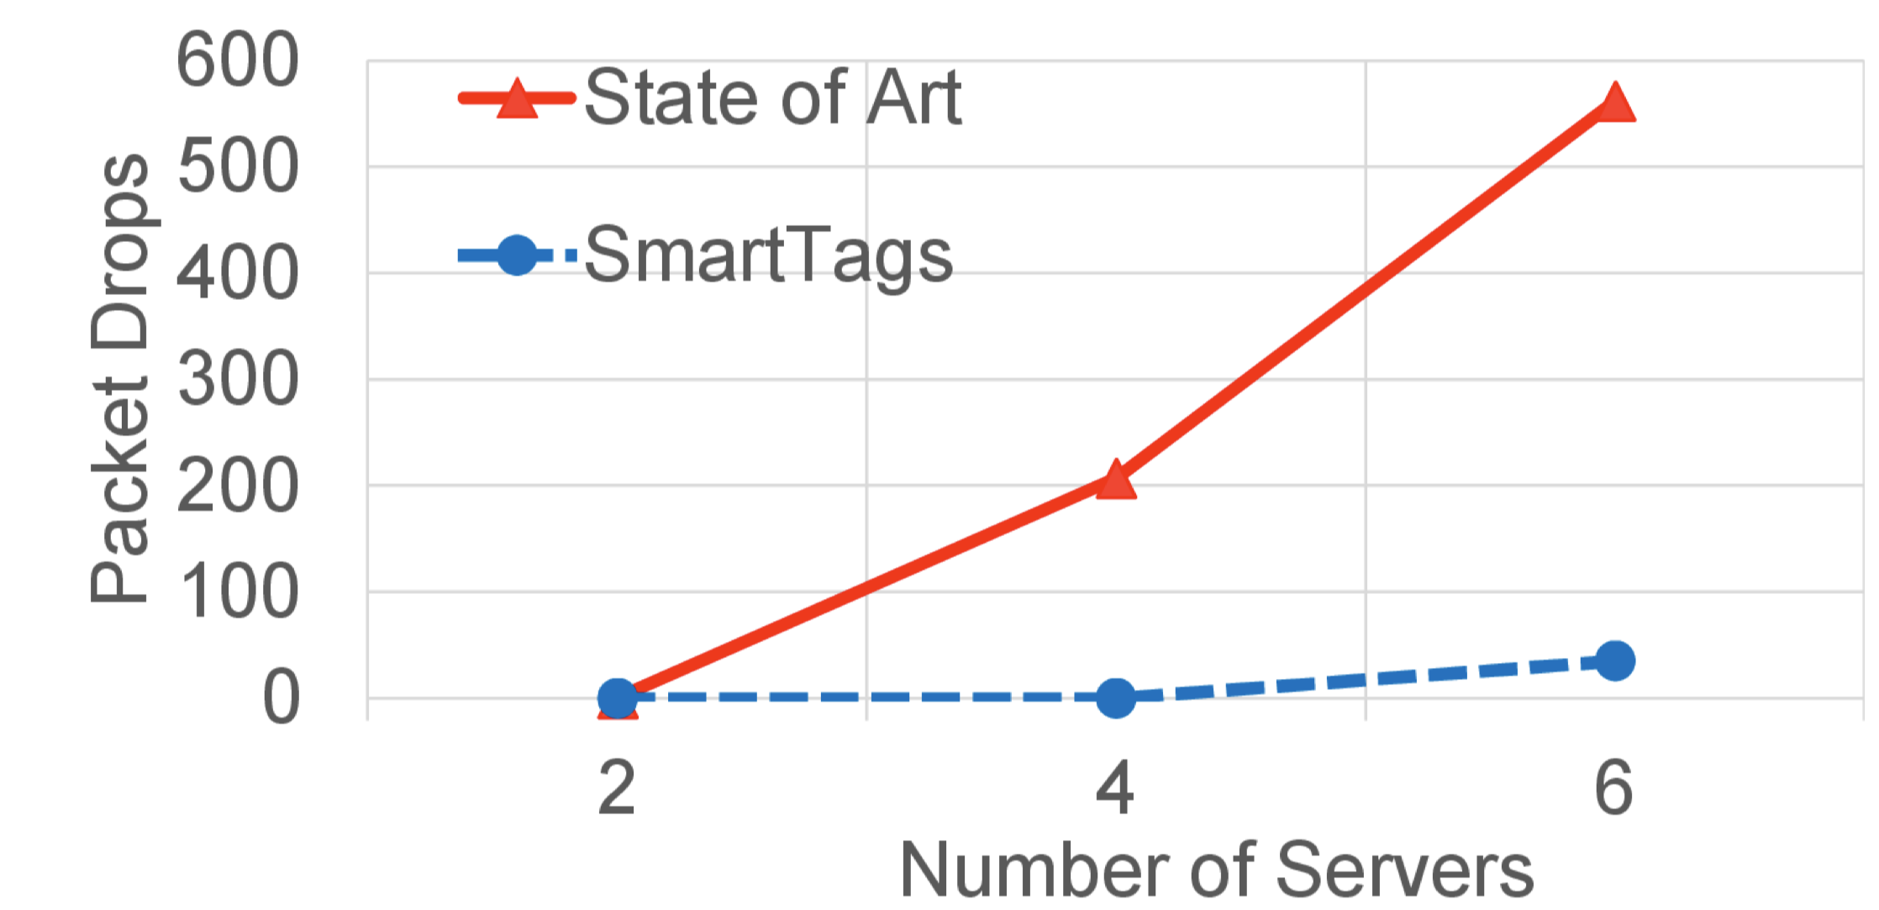
SmartTags*
We can use this information to generate messages on the end-host to notify the network of future network events.
  We call these SmartTags.
We can use SmartTags to change the behavior of the network
  Example. To alleviate incase we can reroute traffic, delay certain flows, …
Can lead to significant improvements in network behavior.
  Improvements that are not possible in today’s networks.
Can be very effective for ML applications.
  Automatically predict flow arrivals to change topology, reroute traffic, adjust flow priorities, etc.
  Many more opportunities …
SmartTags are indicators of future events:
opportunity to prepare network.
Packet Drops with and without SmartTags
* Munir, A., Mortazavi, S.H., Bahnasy, M.M., Baniamerian, A., Wang, S., Guan, S. and Ganjali, Y. 2022. SmartTags: bridging applications and network for proactive performance management. Proceedings of the ACM SIGCOMM Workshop on Network-Application Integration (New York, NY, USA, Aug. 2022), 46–52.

Slide 45
Network Aware Applications
Application-Aware Networking:
  Adapt network based on application requirements, signals, …
Given tighter integration of applications and network why not use network information to help applications?
  Adapt application to network state.
Example: scheduling ML jobs based on network state
  Each application is aware of its own requirements at best.
    But not network state (e.g., available bandwidth): application must estimate network state by probing
  Network can provide information about its state
    Help application-level scheduling
    As well as state of other applications

Slide 46
Cassini: Network-Aware Job Scheduling*
CASSINI is a network-aware job scheduler for ML clusters
  Goal: schedule ML jobs based on network state and other jobs in the system to ensure smooth operation
Step 1. Profile individual jobs
  Identify communication patterns
  Why can we do this here?
Step 2. Convert to a geometric abstraction that represents the network demand
  Perimeter of the circle: job's iteration time
  Arcs of the circle: job’s up and down phases.
Question. How can we use this geometric abstraction to find good job schedules?
  Rotating the circle is equivalent to shifting the job in time.
Data Parallelism Communication Patterns
Similar, but more complex, patterns for other type of parallelism
* Rajasekaran, S., Ghobadi, M. and Akella, A. 2024. CASSINI: Network-Aware Job Scheduling in Machine Learning Clusters. (2024), 1403–1420.

Slide 47
Cassini: Network-Aware Job Scheduling
CASSINI is a network-aware job scheduler for ML clusters
  Goal: schedule ML jobs based on network state and other jobs in the system to ensure smooth operation
Step 1. Profile individual jobs
  Identify communication patterns
  Why can we do this here?
Step 2. Convert to a geometric abstraction that represents the network demand
  Perimeter of the circle: job's iteration time
  Arcs of the circle: job’s up and down phases.
Question. How can we use this geometric abstraction to find good job schedules?
  Rotating the circle is equivalent to shifting the job in time.
Data Parallelism Communication Patterns
Convert to a new
geometric abstraction
How much should
we rotate each circle?

Slide 48
Cassini: Network-Aware Job Scheduling
?
Step 3. For each link in the network:
  Overlays the circles of jobs going through the link and rotates them
  Find a configuration that minimizes the total bandwidth demand
  This gives us a set of relative shifts in time
Step 4. Extend link-level compatibility to cluster level
  Start with job 1, set time to 0.
  For each job that shares a bottleneck, use the method above to find the required shift in time.
If there is no loop the output would be a job schedule
  I.e., when each job should start
Question 1: what if jobs have different iteration periods?
Question 2: can we have a loop in the graph above?

Slide 49
Machine Learning and Computer Networks
Machine Learning (ML) applications are especially more
  Significant growth in the recent years
  Lots of attention and impact
How does it affect computer networking?
  Networks for ML: can traditional networks handle ML requirements?
    Our focus is on data center networks here.
  ML for Networks: how can ML be used to enhance computer networks?
    Networks in general.

Slide 50
ML for Networks
So far, we have focus on how to enhance networks to meet the stringent requirements of ML applications.
Given the advances in ML, a natural question is: how can we use ML to enhance computer networks?
Any suggestions?

Slide 51
ML for Networks
Traffic Prediction and Forecasting
Congestion Control
Network Routing and Load Balancing
Network Configuration Automation
Network Management and Troubleshooting:

Slide 52
ML for Networks Examples - Part 1
Traffic Prediction and Forecasting:
  We saw how knowing the pattern of traffic in ML workloads can help us make the network better.
  How about using ML to predict network traffic patterns
    To optimize resource allocation, …
  We can use time-series models (e.g., ARIMA, LSTMs, etc.).
    Analyze historical traffic data to anticipate congestion.
Congestion Control:
  We have seen some examples of how congestion control can be enhanced for certain environments (DCN, wireless, …) and workloads
  We can use ML to dynamically adjust flow rates
    Minimize packet loss, delay, …
    Also, use ML-based prediction of queue lengths or latency
  Train reinforcement learning (RL) models for real-time congestion-mitigation
  Examples: Orca, PCC-Vivace, …
* Abbasloo, S., Yen, C.-Y. and Chao, H.J. 2020. Classic Meets Modern: a Pragmatic Learning-Based Congestion Control for the Internet. Proceedings of the Annual conference of the ACM Special Interest Group on Data Communication on the applications, technologies, architectures, and protocols for computer communication (Virtual Event USA, Jul. 2020), 632–647.
** Mo Dong, Tong Meng, Doron Zarchy, Engin Arslan, Yossi Gilad, Brighten Godfrey, and Michael Schapira. 2018. PCC -Vivace: Online-Learning Congestion Control. In 15th USENIX Symposium on Networked Systems Design and Implementation (NSDI’18). 343–356.

Slide 53
ML for Networks Examples – Part 2
Network Routing and Load Balancing:
  Typically, rely on static routes
    Shortest path based on fixed costs and randomized load balancing
  If information about link loads are available, we can use reinforcement learning for adaptive path selection.
    Distribute load evenly across servers in data centers.
  E.g., apply graph neural networks (GNNs) to analyze network topologies, and find optimal routers.
Network Configuration Automation:
  Configuring switch/routers a tedious task, typically done manually
  We can use ML to automate switch/router configurations.
    Use natural language processing (NLP) to translate operator requirements to device configuration.
    Train models on historical configuration logs to predict optimal settings.
  Avoid misconfigurations (that can lead to outages) and optimize network performance.

Slide 54
ML for Networks Examples – Part 3
Network Management and Troubleshooting:
  Automatic configuration is done when the network is setup.
    We can also think of more dynamic scenarios.
  How can we manage the network?
    Ensure optimized behavior
  We have talked about SDN control applications.
    Routing, access control, load balancing, …
  A management layer above can help make high-level decisions on resource allocations, adapting control applications, etc.
    Ideally, use natural language to describe the intent of network operators, called intent-based networking
  ML can provide the tools needed to convert operator intent to rules, and policies
    Push to the network through SDN control and management plane.
    Also, optimize behavior based on operator intent.
  ML can also provide mechanisms for automated interaction with customers
    E.g., troubleshooting customer systems in real-time.

Slide 55
Final Comments
Largescale machine learning (training and inference) has led to significant pressure on computer networks.
Major challenges for computer networks
  Latency, throughput, loss, … requirements
Opportunities to enhance networks
  Take advantage of ML workload properties
  Ability to integrate with existing solutions

