Slide 1
Handout # 3:
Data Center Networks,
Data Path vs. Control Programming
Professor Yashar Ganjali
Department of Computer Science
University of Toronto
ganjali7@cs.toronto.edu
http://www.cs.toronto.edu/~yganjali

Slide 2
Announcements
List of papers for Week 4 are posted.
  10% bonus for Week 4 (Jan 31st) volunteers.
  Volunteers for Week 5?
    5% bonus
    Next week 0%
    The week after …. ☺
Each presentation is 20 minutes.
  Followed by 10 minutes of discussion and Q&A.
Please read the papers before each class.

Slide 3
Final Project
List of suggested projects posted on class web site.
  Very brief and high level.
Start choosing your team members
  Use Piazza if needed
Final Project Topic
  Consult with the instructor to choose a problem
    Choose 1-2 problems from the offered list
  Replicate & Improve
    Choose a paper related to the course topic, replicate existing solution, and improve (bonus)
  Survey of existing solutions
    Create new insights by looking at certain problems/solutions from different perspectives
  Apply your background/ideas
    Identify challenges and opportunities in the areas covered in the course to apply your own ideas.
Please discuss your ideas with me before submitting a proposal.

Slide 4
Outline
Data-Center Networks
  Design
  Architecture
Programming Computer Networks
  Software-Defined Networking
  Programmable Switches
Next week:
  DCN Transport
  DCN and ML

Slide 5
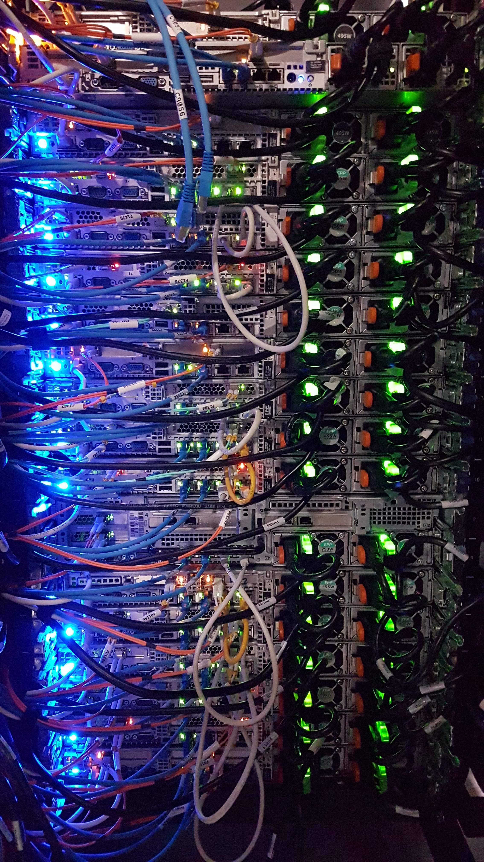
Data Center Network (DCN)
A network of computing and storage resources
  Proximity of components (within the data center) facilitates communication, i.e., high-performance
  Can lead to reduced cost and overheads
    Major cost upfront but less cost in long run.
Functions
  Data Storage and Management:
    Security, efficiency, reliability
  Application Hosting
    End-users and business applications, cloud computing and SaaS models
  Data Processing:
    Large volumes of data for analytics and processing, big data and AI workloads
  And more …

Slide 6
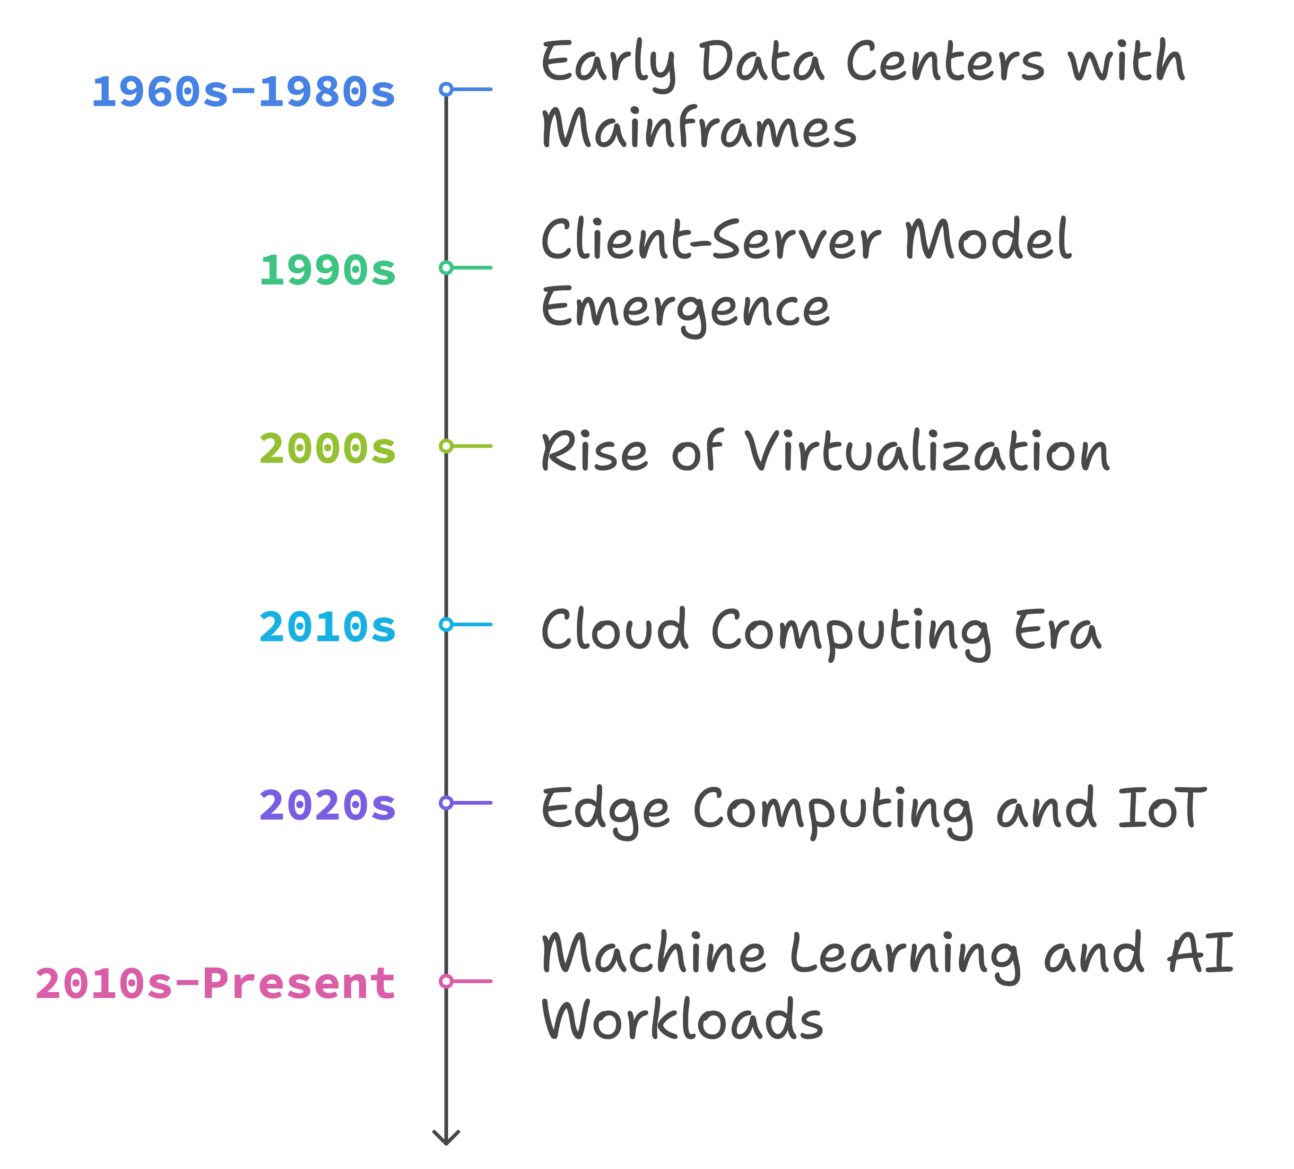
Evolution of DCN
Early Data Centers (1960s-1980s)
  Mainframes
  Centralized computing: limited networking
  Point-to-point and proprietary connections
Client-Server Model (1990s)
  Distributed computing
  Ethernet, TCP/IP
Rise of Virtualization (2000s)
  Virtual machines
  Efficiency and scalability
  VLANs, network segmentation
Cloud Computing Era (2010s)
  Cloud services
  SDN: Scalability and automation
Edge Computing and IoT (2020s)
  Demand for low-latency, distributed network architectures
  Micro data centers closer to data sources
Machine Learning and AI (2010s-Present)
  Exascale high-performance computing
  Network as the bottleneck: stringent performance requirements

Slide 7
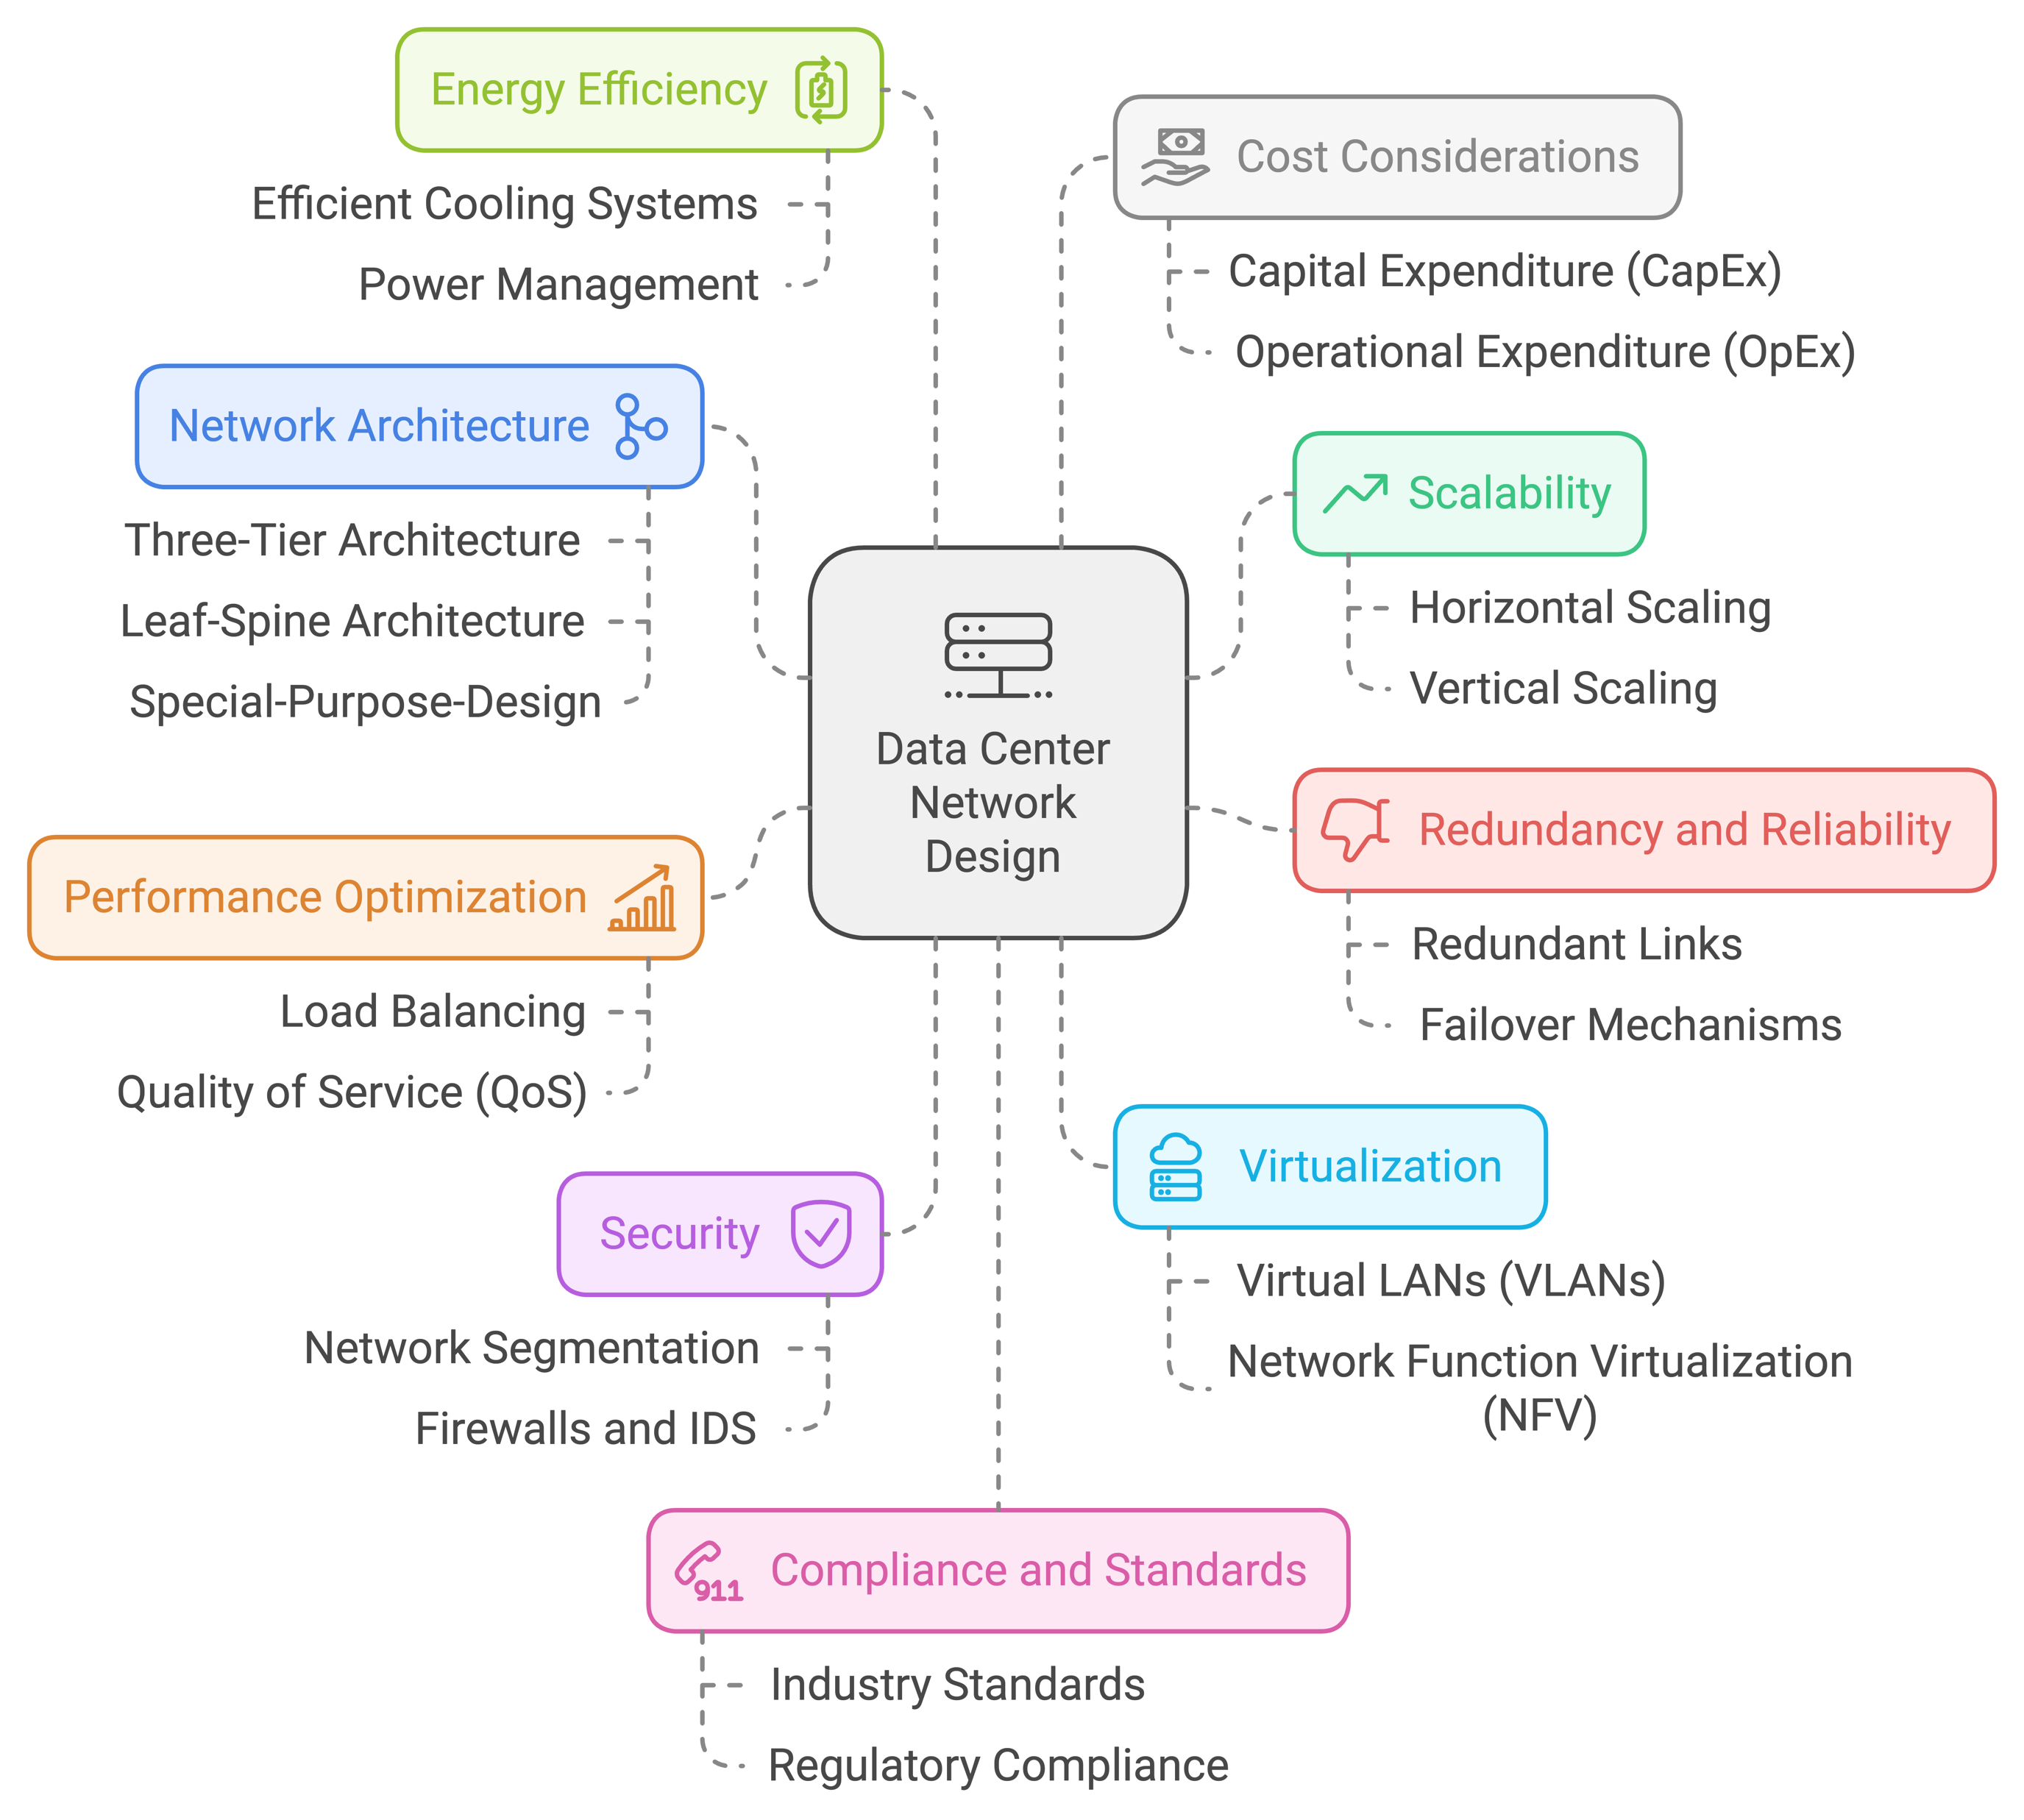
DCN Design Dimensions

Slide 8
Three-Tier Architecture
Hierarchical tree network topology
Commonly used in traditional DCNs
Three layers:
Core:
  Layer 3 (network layer)
  Fully connected high-speed mesh of multiple routers
  Connect to the external networks
Aggregation:
  Layer 3 and 2 (network and link layers)
  Connect to core with few high-speed links (e.g., 100 Gb/s links), to access with many low-speed links (e.g., 10Gb/s) → simplify cabling
  Middleboxes sit here (firewall, load balancer, …)
Access: layer 2 (link)
  Connect to each server in the rack (e.g., through one or two 10Gb/s links)
  VLANs used to limit broadcast
Modular design
Easy to expand

Slide 9
Traffic Direction in 3-Tier Architecture
Within a rack
Between racks
Between racks
To/from Internet
Switching and Routing:
Communication within a rack or within the same aggregation switch happens at link layer (switching).
Traffic going through core (between aggregation switches and to/from external networks/Internet) happens at network layer (routing).
Different flows might have different RTTs (even within DCN)
Total Link Capacities at Each Layer Might Be:
Equal to lower layers, or
Less (over-subscription)
Reason:
  Cost-saving: less bandwidth → lower cost
  Locality: most communication within the same rack, or within the same cluster.

Slide 10
Fat-Tree Architecture
Properties of Fat-Tree Architecture:
Scalable: easily expandable
Low latency, high throughput
Cost-effective
  Commodity hardware
  Lower operational costs
Reliability and Improved Performance:
Edge and aggregation switches are grouped into “pods”.
  Multiple-paths (choice of aggregation and core)
  Automatic failover
Leads to better load balance, redundancy, and thus
  Reliability and high availability, and
  Improved performance

Slide 11
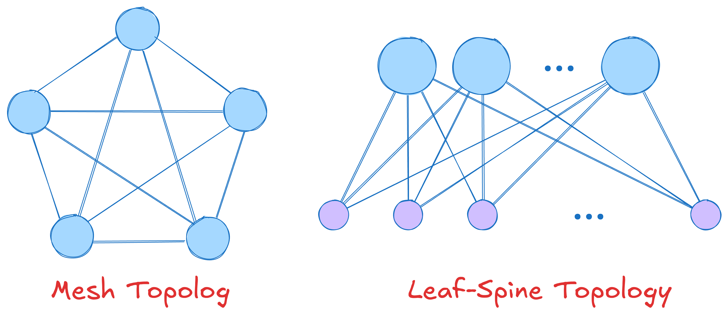
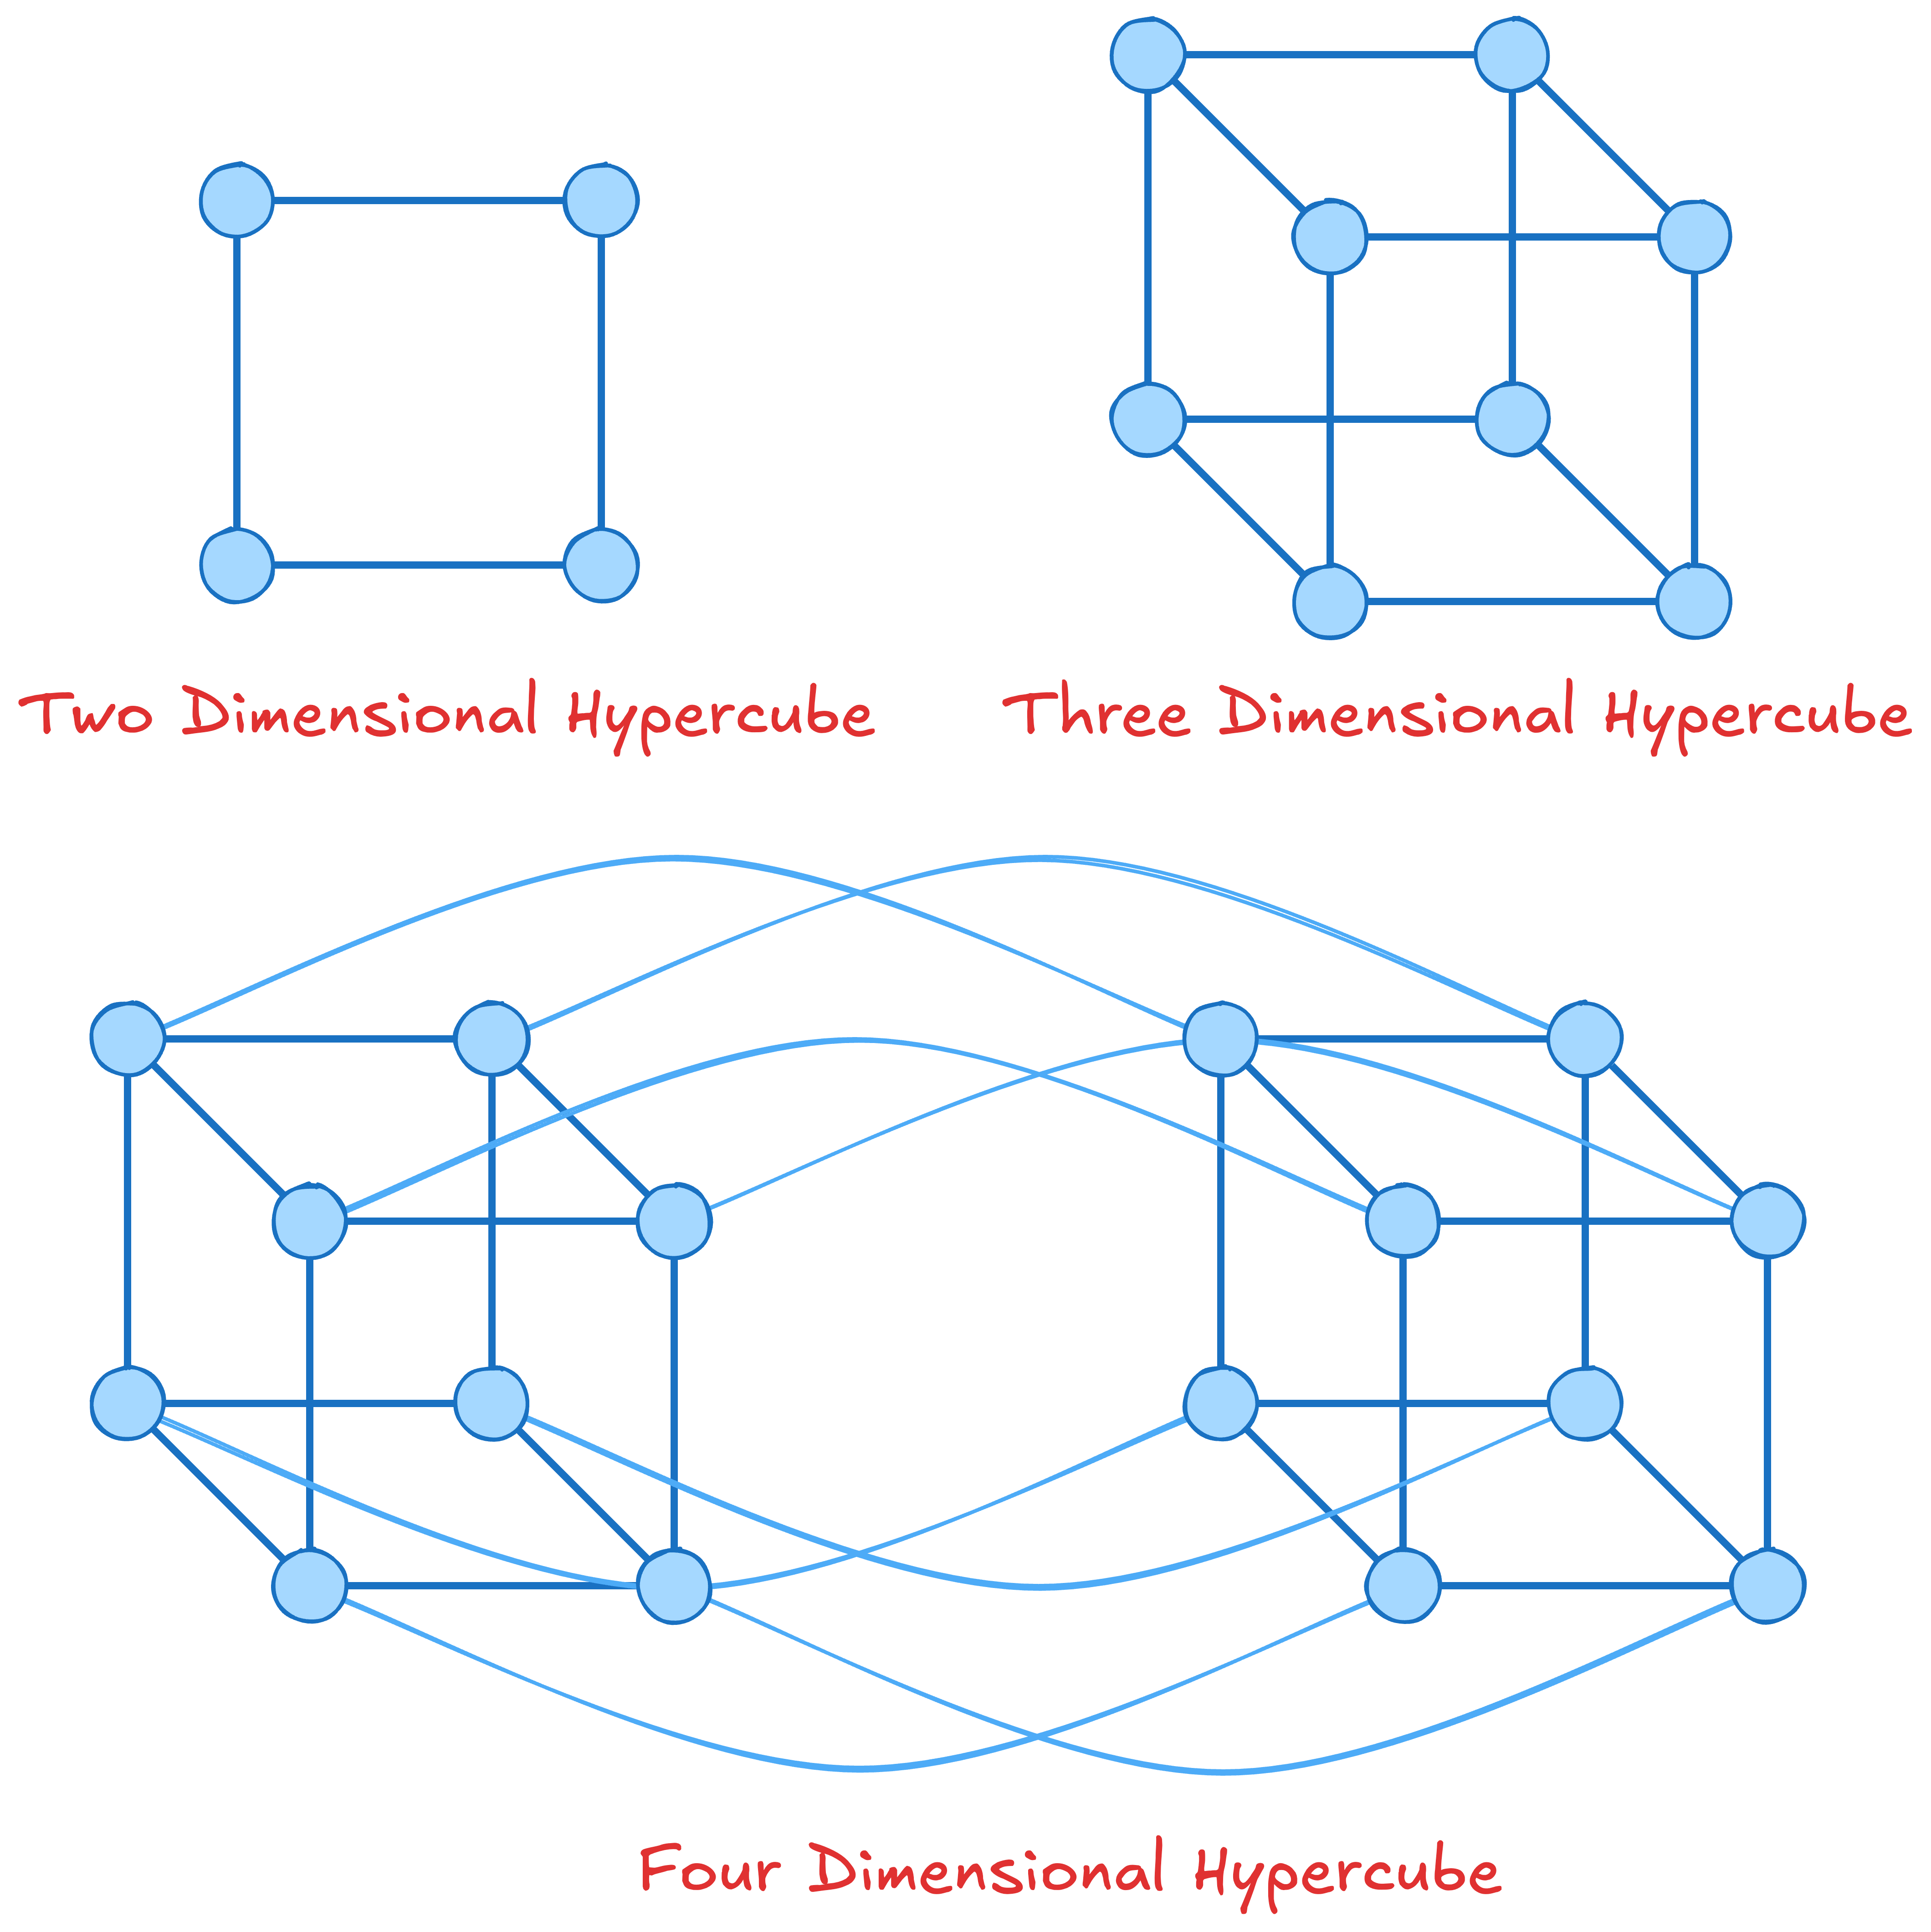
Other DCN Architectures/Topologies
Mesh: every node is connected to every other node
  Direct communication, costly, but high performance
Leaf-Spine topology: two-tier structure, servers and storage node connect directly to leaf switches
  Switched environment, VLANs to limit broadcasts
Hyper-cube: multi-dimensional cube structure
  Used in high-performance computing and ML solutions
ToR (Top-of-Rack) vs. EoR (End-of-Row)
Hybrid: combine two or more topologies
  Tailored to specific requirements of DCNs
And many more …
Question: what are the properties of each of these topologies?
  End-to-end latency?
  Simplicity?
  Scalability?
  …

Slide 12
Programming Data Center Networks
DCN Primary Objective:
  Transfer Packets
Also, provide high performance (bandwidth, latency, loss requirements)
  As well as new functions (e.g., network virtual functions or NFV, …),
Traditionally, forwarding, routing, load balancing, … implemented in a combination of hardware, software running on network devices
  Extremely difficult to change
  New functions take years

Slide 13
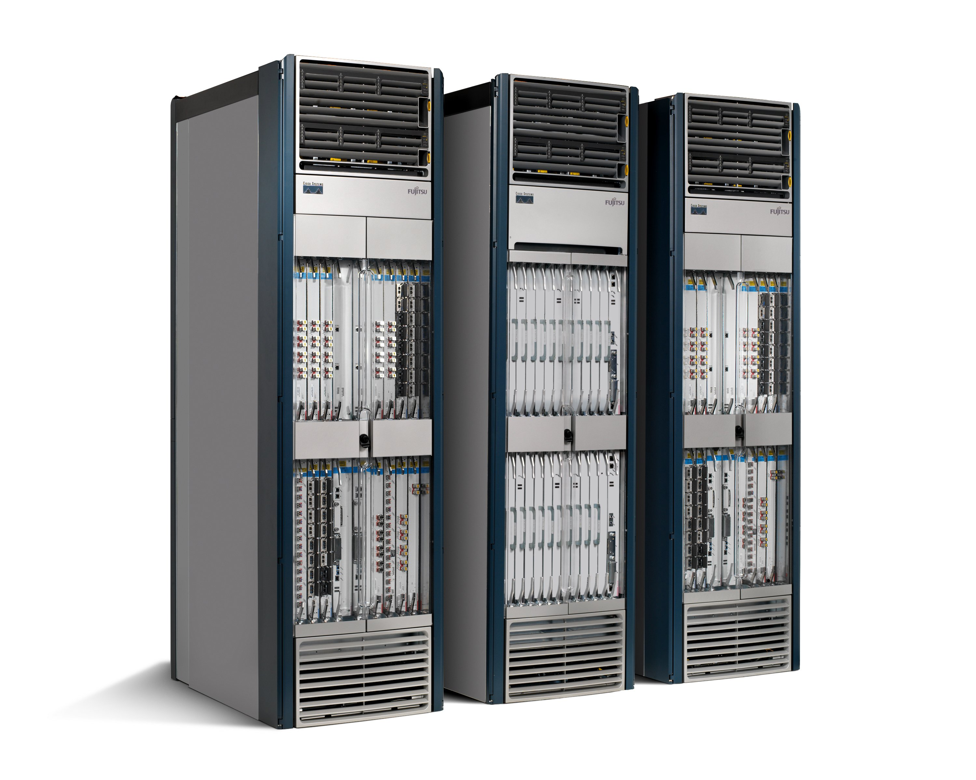
Traditional Networks
Routing, management, mobility management,
access control, VPNs, …
Feature
Feature
Million of lines
of source code
9,000 RFCs
OS
Custom Hardware
Billions of gates
Bloated
Power Hungry
Vertically integrated, complex, closed, proprietary
Networking industry with “mainframe” mind-set

Slide 14
Reality is Even Worse
App
App
App
App
App
Operating
System
App
Operating System
Specialized Packet Forwarding Hardware
Specialized Packet Forwarding Hardware
Lack of competition means glacial innovation
Closed architecture means blurry, closed interfaces

Slide 15
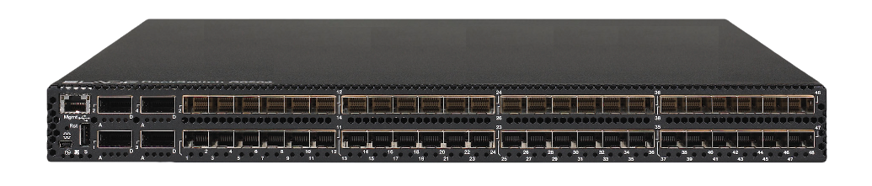
App
App
App
App
App
App
App
App
App
App
App
Specialized
Features
Open Interface
Control
Plane
Control
Plane
Control
Plane
or
or
Specialized
Control
Plane
Open Interface
Specialized
Hardware
Merchant
Switching Chips
Vertically integrated
Closed, proprietary
Slow innovation
Horizontal
Open interfaces
Rapid innovation

Slide 16
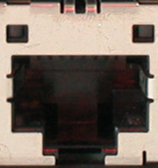
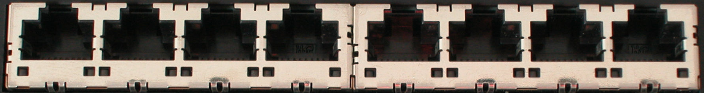
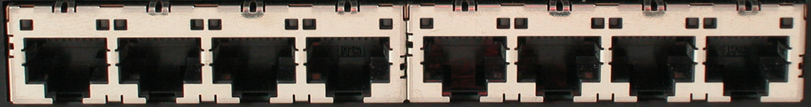
Traditional Switch
Ethernet Switch

Slide 17
Traditional Switch
Control Path
Control Path (Software)
Data Path (Hardware)

Slide 18
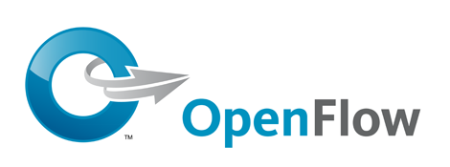
Software Defined Network (SDN)
3. Consistent, up-to-date global network view
2. At least one Network OS
probably many.
Open- and closed-source
Feature
Feature
Network OS
1. Open interface to packet forwarding
Packet
Forwarding
Packet
Forwarding
Packet
Forwarding
Packet
Forwarding
Packet
Forwarding

Slide 19
OpenFlow Switch
Control Program A
Control Program B
Network OS
OpenFlow Protocol (SSL)
Ethernet Switch
Control Path
OpenFlow
Data Path (Hardware)

Slide 20
Consequences
More innovation in network services
  Owners, operators, 3rd party developers, researchers can improve the network
  E.g. energy management, data center management, policy routing, access control, denial of service, mobility
Lower barrier to entry for competition
  Healthier marketplace, new players
Lower cost
  Infrastructure
  Management

Slide 21

Example: New Data Center
Cost
200,000 servers
Fanout of 20 a 10,000 switches
$5k commercial switch a $50M
$1k custom-built switch a $10M
Savings in 10 data centers = $400M
Control
Optimize for features needed
Customize for services & apps
Quickly improve and innovate
SDN can significantly reduce the CapEx and OpEx of data center networks.

Slide 22
Example: Routing
OSPF
  RFC 2328: 245 pages
Distributed System
  Builds consistent, up-to-date map of the network: 101 pages
Dijkstra’s Algorithm
  Operates on map: 4 pages

Slide 23
Example: Routing
OSPF = Dijkstra
IS-IS
OSPF
IS-IS
Network OS
Distributed or Centralized System;
Centralized View
Distributed
System
Distributed
System
OS
Packet
Forwarding
Custom Hardware
Packet
Forwarding
Packet
Forwarding
Packet
Forwarding

Slide 24
Back to the story …

Slide 25
Software Defined Network (SDN)
Control Program A
Control Program B
Network OS
Packet
Forwarding
Packet
Forwarding
Packet
Forwarding
Packet
Forwarding
Packet
Forwarding

Slide 26
Network OS
Network OS: distributed system that creates a consistent, up-to-date network view
  Runs on servers (controllers) in the network
  NOX, ONIX, HyperFlow, Kandoo, Floodlight, Trema, Beacon, Maestro, Beehive, OpenDayLight, ONOS, … + more
Uses forwarding abstraction to:
  Get state information from forwarding elements
  Give control directives to forwarding elements

Slide 27
Software Defined Network (SDN)
Control Program A
Control Program B
Network OS
Packet
Forwarding
Packet
Forwarding
Packet
Forwarding
Packet
Forwarding
Packet
Forwarding

Slide 28
Control Program
Control program operates on view of network
  Input: global network view (graph/database)
  Output: configuration of each network device
Control program is not necessarily a distributed system
  Ideally, the abstraction hides details of distributed state
  Lots of practical challenges though.

Slide 29

OpenFlow
  Started as open standard to run experimental protocols in production networks
    API between the forwarding elements and the network OS
  Started in Stanford, later Open Network Foundation (ONF)
    Various companies (Cisco, Juniper, HP, NEC, …)
Later, many similar (sometimes proprietary) interfaces used by various companies

Slide 30
OpenFlow Rules
Control Program A
Control Program B
Network OS
“If header = p, send to port 4”
Packet
Forwarding
“If header = q, overwrite header with r,
add header s, and send to ports 5,6”
“If header = ?, send to me”
Flow
Table(s)
Packet
Forwarding
Packet
Forwarding

Slide 31
Plumbing Primitives
<Match, Action>
Match arbitrary bits in headers:
  Match on any header, or new header
  Allows any flow granularity
Action
  Forward to port(s), drop, send to controller
  Overwrite header with mask, push or pop
  Forward at specific bit-rate
Match: 1000x01xx0101001x
Header
Data

Slide 32
OpenFlow Rules – Cont’d
Exploit the flow table in switches, routers, and chipsets
Flow 1.
Rule
(exact & wildcard)
Action
Statistics
Flow 2.
Rule
(exact & wildcard)
Action
Statistics
Flow 3.
Rule
(exact & wildcard)
Action
Statistics
Rule
(exact & wildcard)
Flow N.
Default Action
Statistics
Notes:
32

Slide 33
Flow Table Entry
OpenFlow Protocol Version 1.0
Rule
Action
Stats
Packet + byte counters
Forward packet to port(s)
Encapsulate and forward to controller
Drop packet
Send to normal processing pipeline
Switch
Port
MAC
src
MAC
dst
Eth
type
VLAN
ID
IP
Src
IP
Dst
IP
Prot
TCP
sport
TCP
dport
+ mask what fields to match

Slide 34
Examples
Switching
Switch
Port
MAC
src
MAC
dst
Eth
type
VLAN
ID
IP
Src
IP
Dst
IP
Prot
TCP
sport
TCP
dport
Action
*
*
00:1f:..
*
*
*
*
*
*
*
port6
Flow Switching
Switch
Port
MAC
src
MAC
dst
Eth
type
VLAN
ID
IP
Src
IP
Dst
IP
Prot
TCP
sport
TCP
dport
Action
port3
00:2e..
00:1f..
0800
vlan1
1.2.3.4
5.6.7.8
4
17264
80
port6
Firewall
Switch
Port
MAC
src
MAC
dst
Eth
type
VLAN
ID
IP
Src
IP
Dst
IP
Prot
TCP
sport
TCP
dport
Forward
*
*
*
*
*
*
*
*
*
22
drop

Slide 35
Examples
Routing
Switch
Port
MAC
src
MAC
dst
Eth
type
VLAN
ID
IP
Src
IP
Dst
IP
Prot
TCP
sport
TCP
dport
Action
*
*
*
*
*
*
5.6.7.8
*
*
*
port6
VLAN
Switch
Port
MAC
src
MAC
dst
Eth
type
VLAN
ID
IP
Src
IP
Dst
IP
Prot
TCP
sport
TCP
dport
Action
port6,
port7,port9
*
*
*
*
vlan1
*
*
*
*
*

Slide 36
Data Plane Functionalities
So far, we have focused on control plane
  It distinguishes SDN from traditional networks
  Source of many (perceived) challenges …
  … and opportunities
What about the data plane?
  Which features should be provided in the data plane?
What defines the boundary between control and data planes?

Slide 37
OpenFlow and Data Plane
Historically, OpenFlow defined data plane’s role as forwarding.
  Other functions are left to middleboxes and edge nodes in this model.
Question. Why only forwarding?
  Other data path functionalities exist in today’s routers/switches too.
  What distinguishes forwarding from other functions?

Slide 38
Adding New Functionalities
Consider a new functionality we want to implement in a software-defined network.
Where is the best place to add that function?
  Controller?
  Switches?
  Middleboxes?
  Endhosts?
?
?
?
?

Slide 39
Adding New Functionalities
What metrics/criteria do we have to decide where new functionalities should be implemented?
Example: Elephant flow detection
  Data plane: change forwarding elements (e.g., DevoFlow)
  Control plane: push functionality close to the path (e.g., Kandoo)
What does the development process look like?
  Changing ASIC expensive and time-consuming
  Changing software fast

Slide 40
Alternative View
Decouple based on development cycle
  Fast: mostly software
  Slow: mostly hardware
Development process
  Start in software
  As function matures, move towards hardware
Not a new idea
  Model has been used for a long-time in industry.

Slide 41
Changing the Control Plane
I can tailor my network to meet my needs ...
Quickly deploy new protocols.
Monitor precisely what my forwarding plane is doing.
Fold expensive middlebox functions into the network, for free.
Try out beautiful new ideas. Tailor my network to meet my needs.
Differentiate. Now I own my intellectual property.
Notes:
With software-defined network controllers, it seems like we should be able to do all of these, but that’s not true!
There is a caveat here!

Slide 42
But wait a minute…

Slide 43
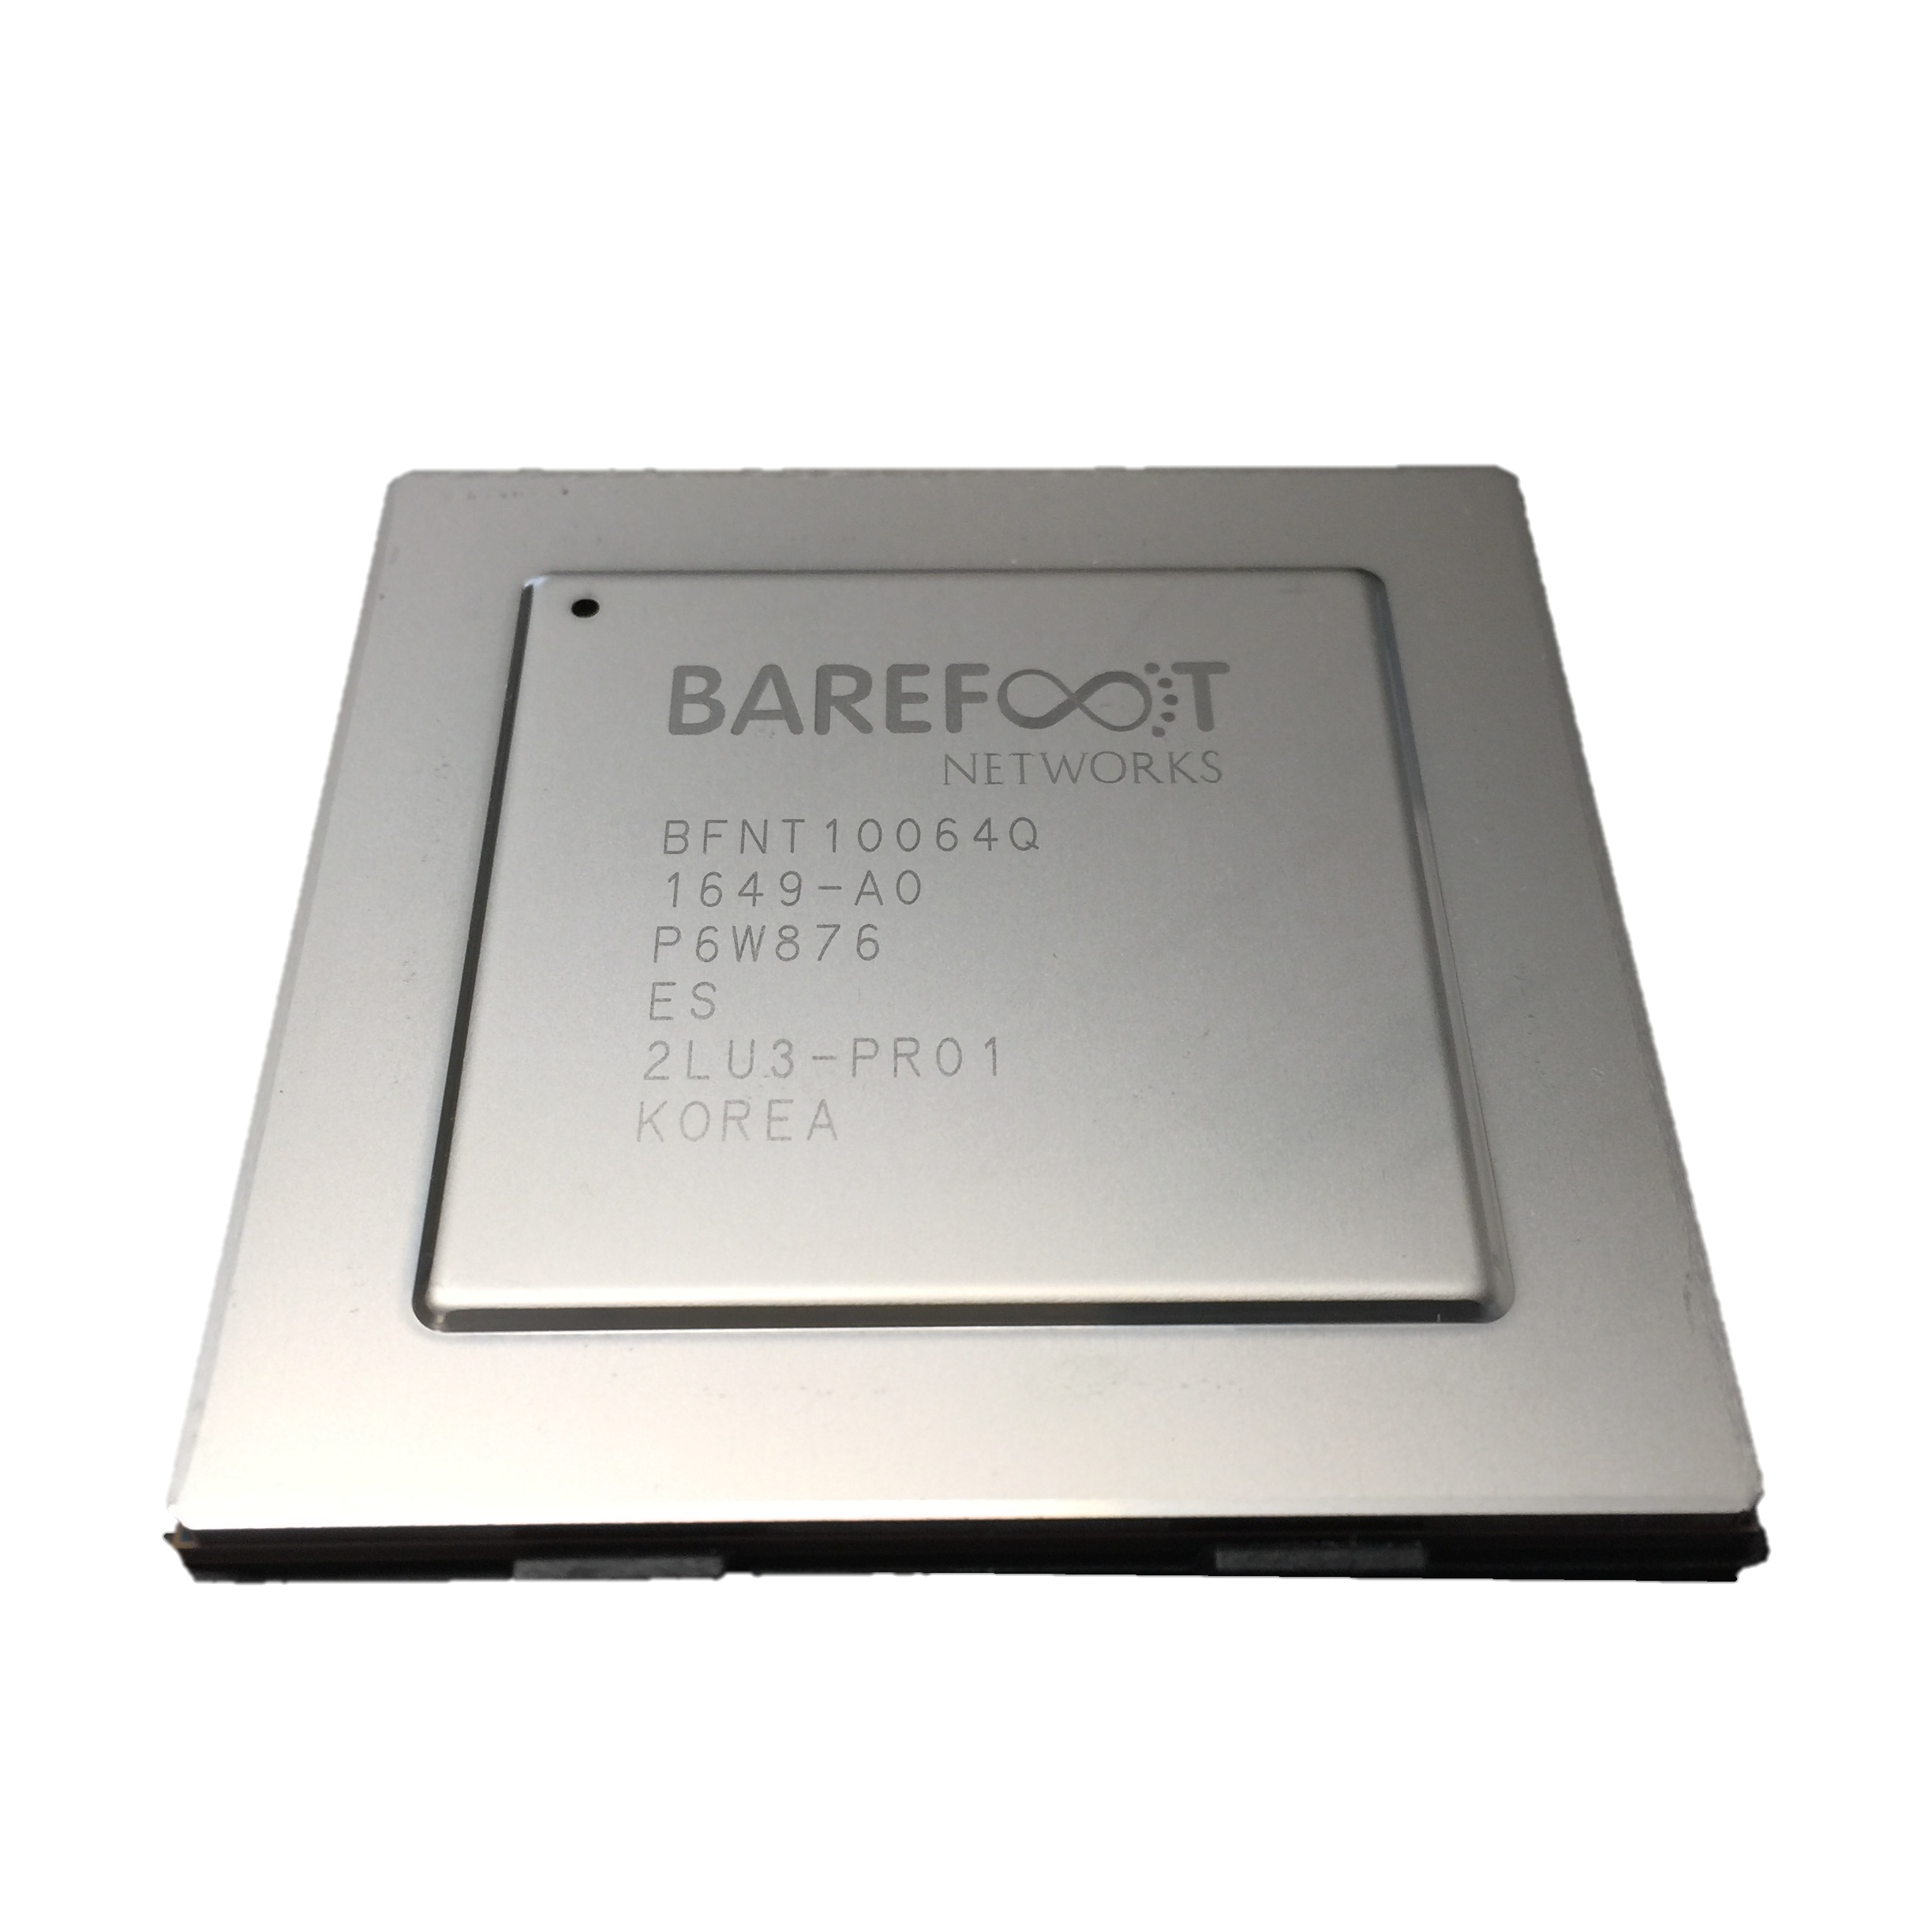
OSPF
BGP
New
etc.
Switch OS
Driver
Notes:
Traditionally:
The chip doing the switching is built out of a fixed pipeline that processes different parts of the header.
Fixed function to keep it low cost and efficient
Example:
VXLAN was introduced in 2010.
- To separate tenants
2 pages description of the protocol
The software part can be implemented in a few days.
It took Cisco and VMWare 4.5 years to add the new entry in the pipeline
Not a complex application: the most profitable, and simple application took 4.5 years to

Slide 44

Feature
Feature
Software
Team
Network Owner
Network Equipment Vendor
Weeks
Feature
Years
ASIC
Team
Years

Slide 45
When you need a new feature…
Equipment vendor can’t just send you a software upgrade
New forwarding features take years to develop
By then, you’ve figured out a kludge to work around it
Your network gets more complicated, more brittle
Eventually, when the upgrade is available, it either
  No longer solves your problem, or
  You need a fork-lift upgrade, at huge expense.

Slide 46

Network Systems Are Built “Bottom-up”
Switch OS
Driver
“This is how I process packets …”
Fixed-function switch

Slide 47
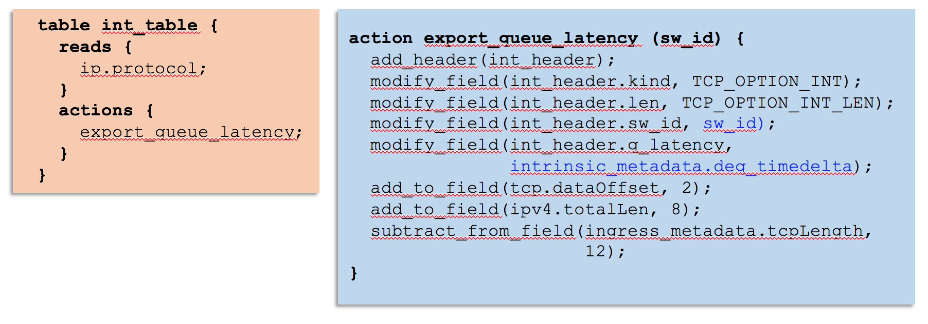
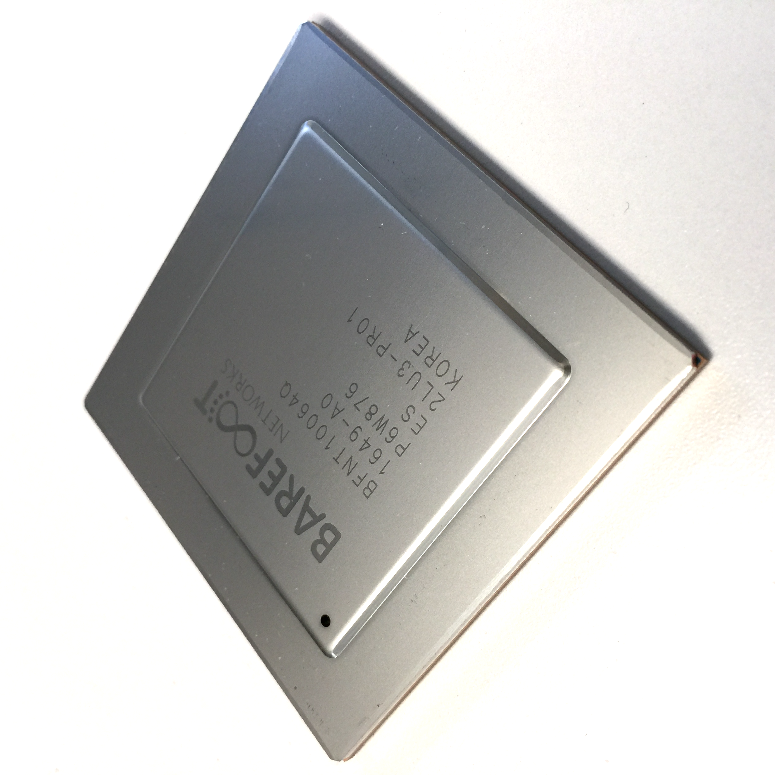
“Top-Down” Network Programming
“This is precisely how you must process packets”
Switch OS
Driver
Programmable Switch

Slide 48
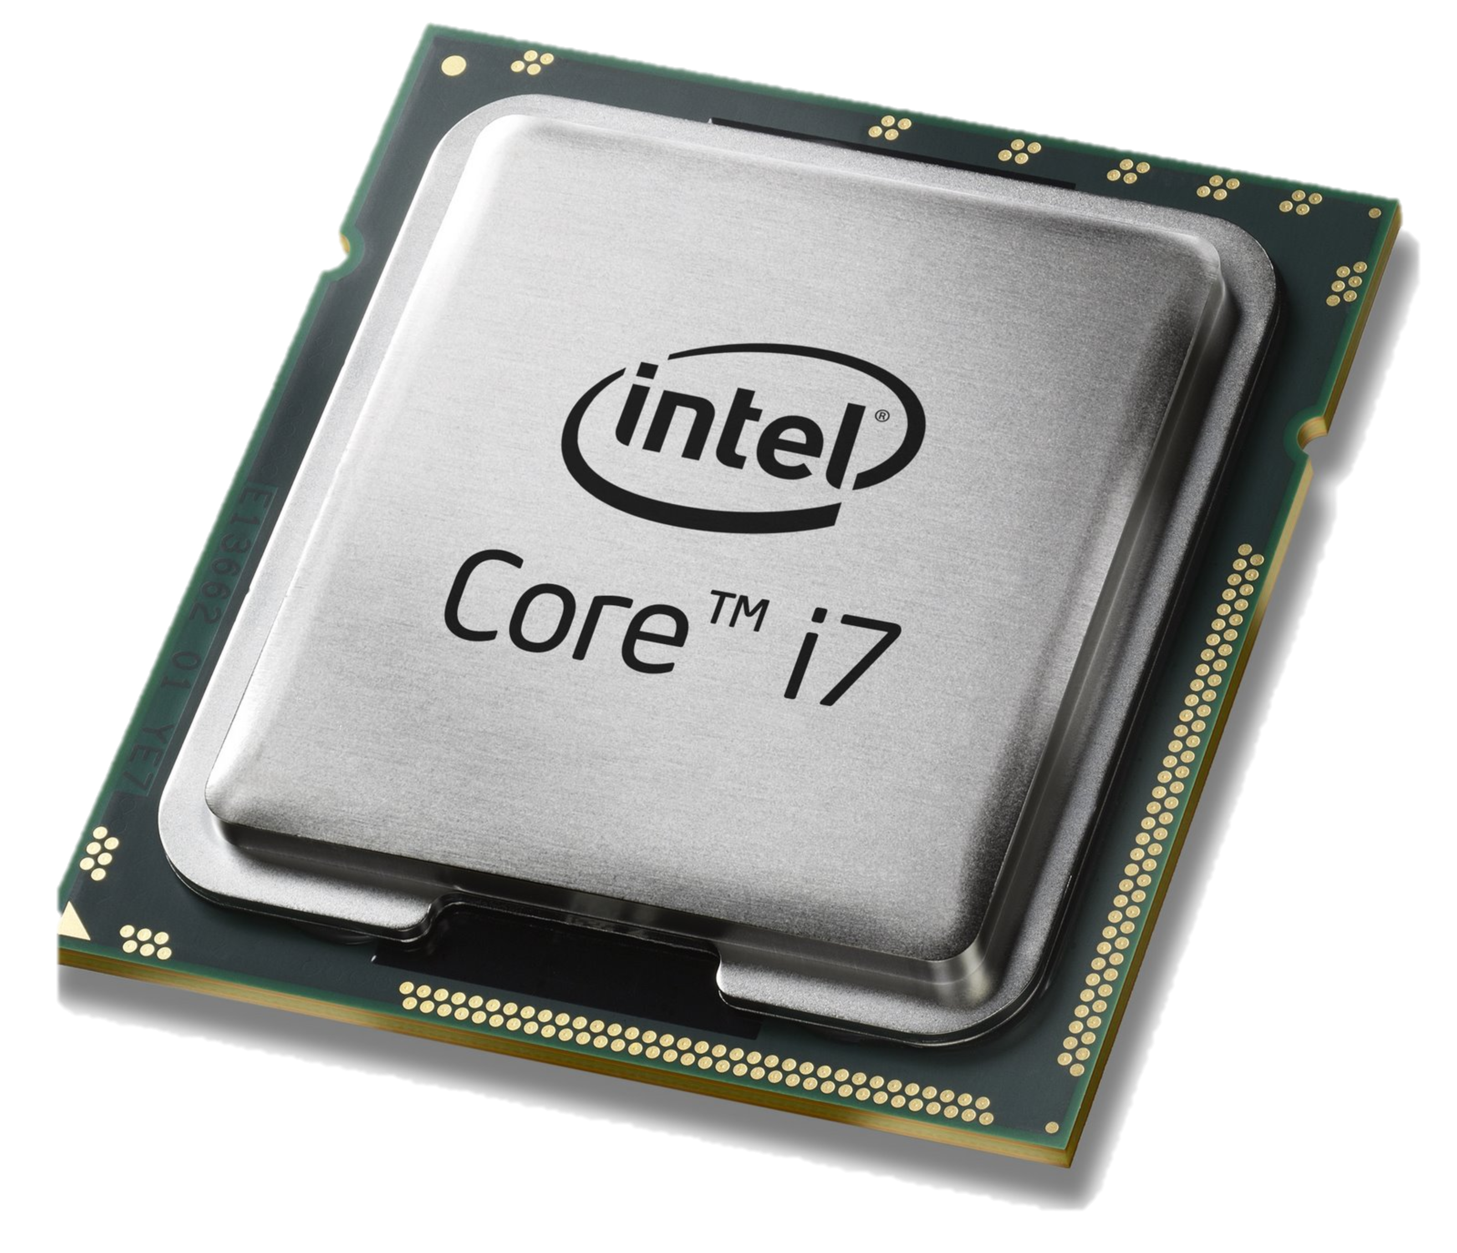
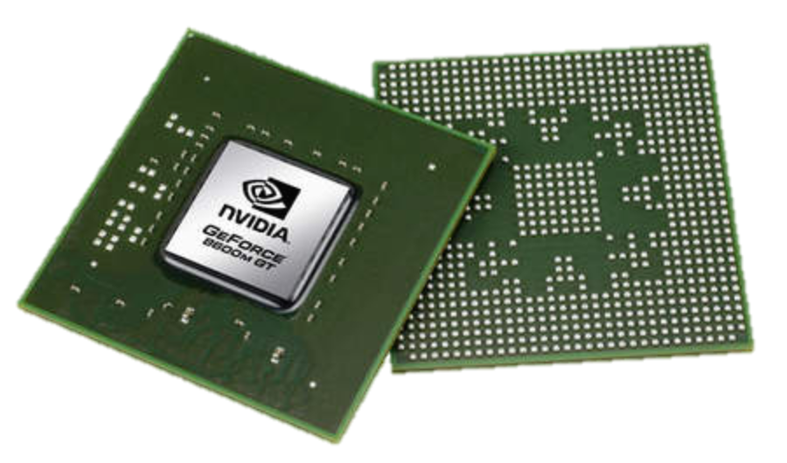
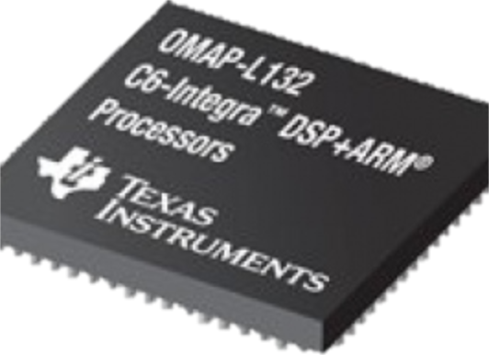
Domain Specific Processors
Signal
Processing
Machine
Learning
Computers
Graphics
Networking
Java
OpenCL
Matlab
TensorFlow
>>>
Language
Compiler
Compiler
Compiler
Compiler
Compiler
?
?
CPU
GPU
DSP
TPU

Slide 49
Domain Specific Processors
Signal
Processing
Machine
Learning
Computers
Graphics
Networking
Java
OpenCL
Matlab
TensorFlow
>>>
P4
Compiler
Compiler
Compiler
Compiler
Compiler
?
CPU
GPU
DSP
TPU
PISA

Slide 50
PISA: Protocol Independent Switch Architecture
Match+Action
Stage
Memory
ALU
Programmable
Parser
Programmable Match-Action Pipeline

Slide 51
PISA: Protocol Independent Switch Architecture

Slide 52
Example P4 Program
Parser Program
Header and Data Declarations
Tables and Control Flow
parser parse_ethernet {
extract(ethernet);
return switch(ethernet.ethertype) {
0x8100 : parse_vlan_tag;
0x0800 : parse_ipv4;
0x8847 : parse_mpls;
default: ingress;
}
header_type ethernet_t { … }
header_type l2_metadata_t { … }
header ethernet_t ethernet;
header vlan_tag_t vlan_tag[2];
metadata l2_metadata_t l2_meta;
table port_table { … }
control ingress {
apply(port_table);
if (l2_meta.vlan_tags == 0) {
process_assign_vlan();
}
}
Memory
ALU
Programmable
Parser
Programmable Match-Action Pipeline

Slide 53
Example: Barefoot Tofino 6.5Tb/s Switch
Same power.
Same cost.
Forwarding defined in software (P4).
Programs always run at line-rate.

Slide 54
Network Programmability: Consequences
Reducing Complexity
1
Notes:
Removed unneeded functionality

Slide 55
Reducing Complexity
switch.p4
Switch OS
Driver
IPv4 and IPv6 routing
- Unicast Routing
- Routed Ports & SVI
- VRF
- Unicast RPF
- Strict and Loose
- Multicast
- PIM-SM/DM & PIM-Bidir
Ethernet switching
- VLAN Flooding
- MAC Learning & Aging
- STP state
- VLAN Translation
Load balancing
- LAG
- ECMP & WCMP
- Resilient Hashing
- Flowlet Switching
Fast Failover
– LAG & ECMP
Tunneling
- IPv4 and IPv6 Routing & Switching
- IP-in-IP (6in4, 4in4)
- VXLAN, NVGRE, GENEVE & GRE
- Segment Routing, ILA
MPLS
- LER and LSR
- IPv4/v6 routing (L3VPN)
- L2 switching (EoMPLS, VPLS)
- MPLS over UDP/GRE
ACL
- MAC ACL, IPv4/v6 ACL, RACL
- QoS ACL, System ACL, PBR
- Port Range lookups in ACLs
QOS
- QoS Classification & marking
- Drop profiles/WRED
- RoCE v2 & FCoE
- CoPP (Control plane policing)
NAT and L4 Load Balancing
Security Features
- Storm Control, IP Source Guard
Monitoring & Telemetry
Ingress Mirroring and Egress Mirroring
Negative Mirroring
Sflow
INT
Counters
Route Table Entry Counters
VLAN/Bridge Domain Counters
Port/Interface Counters
Protocol Offload
- BFD, OAM
Multi-chip Fabric Support
- Forwarding, QOS
Compiler
Programmable Switch
Notes:
A group of people implemented all these in p4.
Many people will comment most of these out. Then compile, and no need to worry about them.

Slide 56
Reducing Complexity
My switch.p4
Switch OS
Driver
Compiler
Programmable Switch

Slide 57
Network Programmability: Consequences
Adding New Features
2

Slide 58
Protocol Complexity 30 Years Ago
Ethernet
ethtype
ethtype
IPv4
IPX

Slide 59
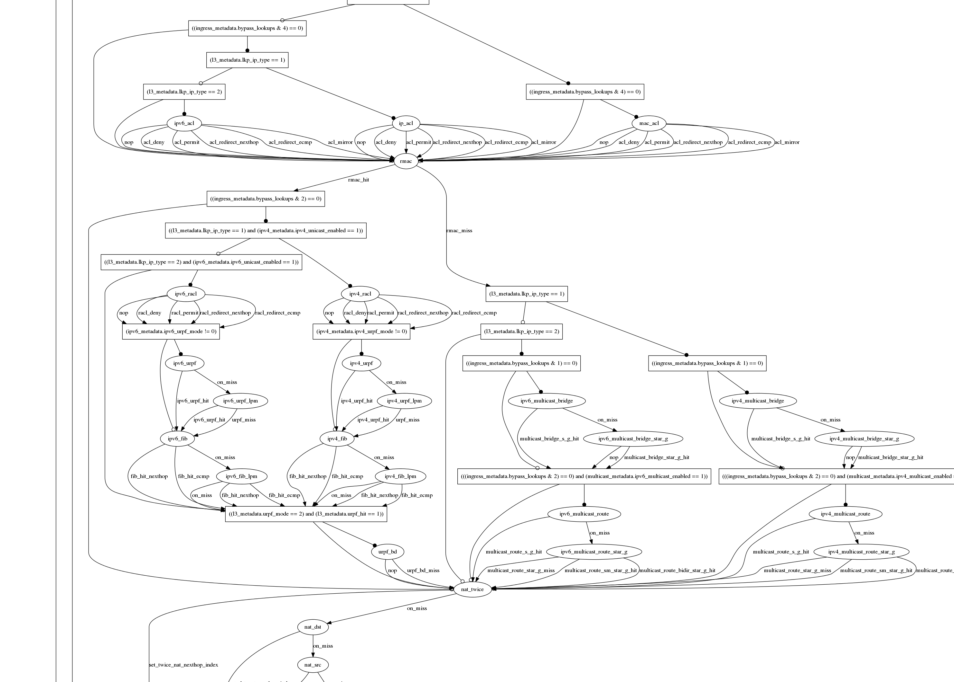
Programmable DCN Switch
Switch.p4

Slide 60
Adding Features: Some Examples
New encapsulations and tunnels
New ways to tag packets for special treatment
New approaches to routing: e.g. source routing in MSDCs
New approaches to congestion control
New ways to process packets: e.g. processing ticker-symbols

Slide 61
New applications: Some Examples
Layer-4 Load Balancer¹
  Replace 100 servers or 10 dedicated boxes with one programmable switch
  Track and maintain mapping for 5-10 million http flows
Fast stateless firewall
  Add/delete and track 100s of thousands of new connections per second
Cache for Key-value store²
  Memcache in-network cache for 100 servers
  1-2 billion operations per second
[1] “SilkRoad: Making Stateful Layer-4 Load Balancing Fast and Cheap Using Switching ASICs.” Rui Miao et al. SIGCOMM 2017.
[2] “NetCache: Balancing Key-Value Stores with Fast In-Network Caching”, Xin Jin et al. SOSP 2017

Slide 62
Network Programmability: Consequences
Network Telemetry
3

Slide 63
“I visited Switch 1 @780ns,
Switch 9 @1.3µs, Switch 12 @2.4µs”
1
“Which path did my packet take?”
# | Rule
1
2
3
…
75 | 192.168.0/24
…
“In Switch 1, I followed rules 75 and 250. In Switch 9, I followed rules 3 and 80. ”
2
“Which rules did my packet follow?”

Slide 64
3
“How long did my packet queue at each switch?”
“Delay: 100ns, 200ns, 19740ns”
Queue
4
“Who did my packet share the queue with?”
Time

Slide 65
3
“How long did my packet queue at each switch?”
“Delay: 100ns, 200ns, 19740ns”
Aggressor flow!
Queue
4
“Who did my packet share the queue with?”
Time

Slide 66
We’d like the network to answer these questions
“Which path did my packet take?”
“Which rules did my packet follow?”
“How long did it queue at each switch?”
“Who did it share the queues with?”
A PISA device programmed using P4 can answer all four questions at line rate, for the first time. Without generating additional packets.

Slide 67
INT: Inband Network Telemetry
Add: SwitchID, Arrival Time,
Queue Delay, Matched Rules, …
Original Packet
Log, Analyze
Replay
Visualize

Slide 68
/* INT: add switch id */
action int_set_header_0() {
add_header(int_switch_id_header);
modify_field(int_switch_id_header.switch_id,
global_config_metadata.switch_id);
}
/* INT: add ingress timestamp */
action int_set_header_1() {
add_header(int_ingress_tstamp_header);
modify_field(int_ingress_tstamp_header.ingress_tstamp, i2e_metadata.ingress_tstamp);
}
/* INT: add egress timestamp */
action int_set_header_2() {
add_header(int_egress_tstamp_header);
modify_field(int_egress_tstamp_header.egress_tstamp,
eg_intr_md_from_parser_aux.egress_global_tstamp);
}
P4 code snippet: Insert switch ID, ingress and egress timestamp
Log, Analyze
Replay
Visualize

Slide 69
Network Programmability: Consequences
1
Reducing Complexity
Adding New Features
Network Telemetry
2
3

Slide 70
Final Comments
Network programmability:
  Significantly powerful, makes change feasible
  Innovation in “control plane” and “data path”
Academia vs. industry
  Programmability allows development and testing of new ideas.
  Has had a major impact in academic research
    Creating proof-of-concept solutions in days/weeks
  Opens doors for innovation and high impact research
  Programmable switches in production: limited use cases
    Programmable core vs. edge: which one do you think is more useful?

