Slide 1
Handout # 2:
Course Logistics and Introduction
Professor Yashar Ganjali
Department of Computer Science
University of Toronto
ganjali7@cs.toronto.edu
http://www.cs.toronto.edu/~yganjali

Slide 2
Today
Outline
  What this course is about
Logistics
  Course structure, evaluation
  What is expected from you
  What you want to know
Introduction
  Packet switching systems
  Data-Center Networks
  Networks and Machine Learning

Slide 3
CSC229: Computer Networks for ML
Graduate level course
  Core challenges of interconnection networks
    Emphasis on machine learning applications
  + new opportunities
Course Structure
  Introductory Lectures: 3 weeks
  Research Papers: 7-8 weeks
  Final Project Presentations: 2 weeks
Theory + Practice
  Switching systems are simple enough for us to prove something about them
  Yet they are complex enough to work in practice

Slide 4
Outline – Part I
Packet switch systems
  Basic architectural components
  Examples
  Evolution of the Internet, and Internet routers
Data Center Networks
  Design Decisions
  Topology
  Transport
Network Programming
  Software-Defined Networking
  Programmable Switches
Network-Application Integration

Slide 5
Outline – Part II
Networks for Machine Learning: Challenges and Opportunities
  Hyperscale data center networking
  Switch and controller design
  Reliability, monitoring, and fault tolerance
  Network optimization
  High-performance transport in data centers,
    Congestion control,
    Flow control,
    Flow scheduling, and prioritization
  Network-Application Integration, reconfigurable data center networks
Machine learning for computer networks
  Traffic prediction & forecasting
  Congestion control
  Routing and load balancing
  Automation
  Management and troubleshooting

Slide 6
Logistics
Class time: Friday 9 AM – 11 AM
  Location: AB114
Office hours: Friday 11 AM - 12 PM, Monday 11 AM – 12 PM, or by appointment
  Location: BA 5238
Course web page
  http://www.cs.toronto.edu/~yganjali/teaching/csc2229-winter-2025/
  Please check regularly for announcements.
Teaching Assistant
  Farid Zandi - faridzandi@cs.toronto.edu

Slide 7
Mailing List, Bulletin Board
Bulletin board
  We will use Piazza for announcements and Q&A
    https://piazza.com/utoronto.ca/winter2025/csc2229
    Sign up link on class web site
  Post any questions related to the course here.
  Check previous posts before asking a question.
Class mailing list
  Based on e-mail address you have defined on ACORN.
  The TA and I will use this list for announcements only.
  Do not send e-mails to this list!

Slide 8
Prerequisites & Papers
Prerequisites
  Any introductory course on networking (e.g., CSC458/2209)
  Algorithms, probability theory, etc.
Papers
  Will be listed on class web page
  Please read suggested papers BEFORE the class

Slide 9
Grading & Deadlines
Grading
  Paper presentations: 20%
  Final project: 70%
    Proposal: 5% - 1-2 pages – Due: Feb. 14
    Intermediate report: 10% - 3-4 pages – Due: Mar. 14
    Presentation: 20% - 25 minutes – Last two weeks of classes
    Final report: 35% - 6-8 pages – Due: Apr 8.
  Active participation in class and discussions: 10%
Deadlines
  Free late submission: two days
    Use on your proposal, intermediate report, or final report.
    Notify the TA before the deadline.
  10% deduction for each day of delay, up to 2 days.

Slide 10
Paper Presentations
We will read and discuss papers from the top-tier conferences in the area.
Each student will present one paper throughout the semester
  + final project presentation which is in groups
All students are expected to read the paper beforehand.
The presentation will be followed by discussion (all of us).

Slide 11
Final Projects
Final Project
  Groups of 2-3 students
Final Project Topic
  Consult with the instructor to choose a problem
    Choose 1-2 problems from the offered list
  Replicate & Improve
    Choose a paper related to the course topic, replicate existing solution, and improve (bonus)
  Survey of existing solutions
    Create new insights by looking at certain problems/solutions from different perspectives
  Apply your background/ideas
    Identify challenges and opportunities in the areas covered in the course to apply your own ideas.
Please discuss your ideas with me before submitting a proposal.

Slide 12
Academic Integrity
All submissions must present original, independent work.
We take academic offenses very seriously.
Please read
  Handout # 1 (course information sheet)
  “Guideline for avoiding plagiarism”
  http://www.cs.toronto.edu/~fpitt/documents/plagiarism.html
  “Advice about academic offenses”
  http://www.cs.toronto.edu/~clarke/acoffences/
Use of AI tools: OK to use for learning. Cannot be submitted as your original work.
    Please see Handout #1 for more information.
    Need to clearly state what/how you have used it.

Slide 13
Accessibility
Accessibility Needs
  The University of Toronto is committed to accessibility. If you require accommodations or have any accessibility concerns, please visit http://studentlife.utoronto.ca/accessibility as soon as possible.

Slide 14
Acknowledgements
Special thanks to:
  Prof. Nick McKeown, Stanford University
  Prof. Balaji Prabhakar, Stanford University
  Prof. Jennifer Rexford, Princeton University
  Prof. Nick Feamster, University of Chicago

Slide 15
Questions?
What else do you like to know
about this course?

Slide 16
Before We Start …
Need volunteers for paper presentations
  Presentation in three weeks (Jan 31)
  Bonus for people who volunteer to present first

Slide 17
Introduction
Background
  What is a router?
  Basic router architecture
Basic packet processing in routers
  IP address lookup
  Packet buffering
  Switching
Data Center Networking
  Design Dimensions
  Topology
  Transport
Machine Learning and Computer Networks

Slide 18
What is Routing?
R3
R1
A
R4
D
B
E
D
R2
C
Destination
Next Hop
R5
F
D
R3
E
R3
F
R5

Slide 19
What is Routing?
R3
R1
A
R4
D
1
4
16
32
Ver
HLen
T.Service
Total Packet Length
B
Fragment ID
Flags
Fragment Offset
E
D
20 bytes
TTL
Protocol
Header Checksum
R2
C
Source Address
Destination
Next Hop
R5
Destination Address
F
D
R3
Options (if any)
E
R3
Data
F
R5

Slide 20
What is Routing?
R3
R1
A
R4
D
B
E
R2
C
R5
F

Slide 21
Basic Architectural Components of a Router
Routing
Protocols
Routing
Table
Control Plane
Data-path
per-packet
processing
Forwarding
Table
Switching
More advanced functionalities are added to this basic design. We will talk about those later.

Slide 22
Packet Switching – Simple Router Model
“4”
Link 1, ingress
Choose
Egress
Link 1, egress
Link 2
Link 2, ingress
Choose
Egress
Link 2, egress
R1
“4”
Link 1
Link 3
Link 3, ingress
Choose
Egress
Link 3, egress
Link 4
Link 4, ingress
Choose
Egress
Link 4, egress

Slide 23
Routing vs. Switching
Routing: network layer based on IP address
Switching: link layer based on MAC address
Application
Data Transfer
Application
Presentation
ASCII/Binary
Transport
Session
TCP
Transport
Network
Network
IP
Link
Link
Ethernet
Physical
The 7-layer OSI Model
The 4-layer Internet model

Slide 24
Layering – The OSI Model
layer-to-layer communication
Application
Application
7
7
Presentation
Presentation
6
6
Session
Session
5
5
Transport
Peer-layer communication
Transport
4
Router
Router
4
Network
Network
Network
Network
3
3
Link
Link
Link
Link
2
2
Physical
Physical
Physical
Physical
1
1

Slide 25
Introduction
Background
  What is a router?
  Basic router architecture
Basic packet processing in routers
  IP address lookup
  Packet buffering
  Switching
Data Center Networking
  Design Dimensions
  Topology
  Transport
Machine Learning and Computer Networks

Slide 26
Per-packet Processing in an IP Router
1. Accept packet arriving on an incoming link.
2. Lookup packet destination address in the forwarding table, to identify outgoing port(s).
3. Manipulate packet header: e.g., decrement TTL, update header checksum.
4. Send packet to the outgoing port(s).
5. Buffer packet in the queue.
6. Transmit packet onto outgoing link.

Slide 27
Generic Router Architecture
Header Processing
Data
Hdr
Lookup
IP Address
Update
Header
Queue
Packet
Data
Hdr
IP Address
Next Hop
Address
Table
Buffer
Memory
~1M prefixes
Off-chip DRAM
~1M packets
Off-chip DRAM

Slide 28
Generic Router Architecture
Data
Hdr
Data
Header Processing
Hdr
Buffer
Manager
Lookup
IP Address
Update
Header
Address
Table
Buffer
Memory
Data
Hdr
Data
Header Processing
Hdr
Buffer
Manager
Lookup
IP Address
Update
Header
Address
Table
Buffer
Memory
Data
Hdr
Data
Hdr
Header Processing
Buffer
Manager
Lookup
IP Address
Update
Header
Address
Table
Buffer
Memory

Slide 29
Why are Fast Routers Difficult to Make?
It’s hard to keep up with Moore’s Law:
  The bottleneck is memory speed.
  Memory speed is not keeping up with Moore’s Law.
Moore’s Law is too slow:
  Routers need to improve faster than Moore’s Law.
The growth in this gap is due to three major challenges …
  Address lookup
  Packet buffering
  Switching

Slide 30
Introduction
Background
  What is a router?
  Basic router architecture
Basic packet processing in routers
  IP address lookup
  Packet buffering
  Switching
Data Center Networking
  Design Dimensions
  Topology
  Transport
Machine Learning and Computer Networks

Slide 31
Generic Router Architecture
Header Processing
Buffer
Manager
Lookup
IP Address
Lookup
IP Address
Update
Header
Address
Table
Buffer
Memory
Address
Table
Header Processing
Buffer
Manager
Lookup
IP Address
Lookup
IP Address
Update
Header
Address
Table
Buffer
Memory
Address
Table
Header Processing
Buffer
Manager
Lookup
IP Address
Lookup
IP Address
Update
Header
Address
Table
Buffer
Memory
Address
Table

Slide 32
IP Address Lookup
Why it’s thought to be hard:
  It’s not an exact match: it’s a longest prefix match.
  The table is large: hundreds of thousands to millions of entries and growing
  The lookup must be fast: about 4-5ns for a 100Gb/s line.

Slide 33
IP Lookups find Longest Prefixes
128.9.172.0/24
128.9.16.0/21
128.9.172.0/21
65.0.0.0/8
142.12.0.0/19
128.9.0.0/16
0
128.9.16.14
2³²-1
Routing lookup: Find the longest matching prefix (aka the most specific route) among all prefixes that match the destination address.

Slide 34
IP Address Lookup
Why it’s thought to be hard:
  It’s not an exact match: it’s a longest prefix match.
  The table is large: hundreds of thousands to millions of entries and growing.
  The lookup must be fast: about 4-5ns for a 100Gb/s line.

Slide 35
Address Tables are Large
Source: http://www.cidr-report.org/

Slide 36
IP Address Lookup
Why it’s thought to be hard:
  It’s not an exact match: it’s a longest prefix match.
  The table is large: hundreds of thousands to millions of entries and growing
  The lookup must be fast: about 4-5ns for a 100Gb/s line.

Slide 37
Lookups Must be Fast
Line rates have been constantly growing over time.
  100Gb/s to 500Gb/s
Packet sizes have not changed
  Max: 1500 bytes (9000 jumbo packets)
  Average: around 250 bytes
  Min: 40 bytes
Time to process each packet around a few nano-seconds

Slide 38
Introduction
Background
  What is a router?
  Basic router architecture
Basic packet processing in routers
  IP address lookup
  Packet buffering
  Switching
Data Center Networking
  Design Dimensions
  Topology
  Transport
Machine Learning and Computer Networks

Slide 39
Generic Router Architecture
Header Processing
Queue
Packet
Buffer
Manager
Lookup
IP Address
Update
Header
Buffer
Memory
Address
Table
Buffer
Memory
Header Processing
Queue
Packet
Buffer
Manager
Lookup
IP Address
Update
Header
Buffer
Memory
Address
Table
Buffer
Memory
Header Processing
Queue
Packet
Buffer
Manager
Lookup
IP Address
Update
Header
Buffer
Memory
Address
Table
Buffer
Memory

Slide 40
Fast Packet Buffers
Example: 40Gb/s packet buffer
Size = RTT*BW = 10Gb; 40 byte packets
Write Rate, R
Buffer
Manager
Read Rate, R
1 packet
every 8 ns
1 packet
every 8 ns
Buffer
Memory
Use SRAM?
+ fast enough random access time, but
- too low density to store 10Gb of data.
Use DRAM?
+ high density means we can store data, but
- too slow (10s of nano sec random access time).
Notes:
How fast?
Get into the motivation – say OC768 line rate buffering is a goal.
- Just mention directly the amount of buffering required.
Why is it not possible today?
Why is it intersting….
Talks abut SRAM/DRAM.

Slide 41
Introduction
Background
  What is a router?
  Basic router architecture
Basic packet processing in routers
  IP address lookup
  Packet buffering
  Switching
Data Center Networking
  Design Dimensions
  Topology
  Transport
Machine Learning and Computer Networks

Slide 42
Generic Router Architecture
Data
1
1
Hdr
Header Processing
Queue
Packet
Lookup
IP Address
Update
Header
Address
Table
Buffer
Memory
Data
2
2
N times line rate
Hdr
Header Processing
Queue
Packet
Lookup
IP Address
Update
Header
Address
Table
Buffer
Memory
N times line rate
Data
Hdr
Header Processing
N
N
Queue
Packet
Lookup
IP Address
Update
Header
Address
Table
Buffer
Memory

Slide 43
Generic Router Architecture
Data
Hdr
Header Processing
Lookup
IP Address
Update
Header
Queue
Packet
1
1
Address
Table
Buffer
Memory
Data
Hdr
Data
Hdr
Header Processing
Data
Queue
Packet
2
2
Hdr
Lookup
IP Address
Update
Header
Address
Table
Buffer
Memory
Scheduler
Data
Hdr
Header Processing
Lookup
IP Address
Update
Header
Queue
Packet
N
N
Address
Table
Buffer
Memory
Data
Hdr

Slide 44
A Router with Output Queues
The best that any queueing system can achieve.

Slide 45
A Router with Input Queues
Head of Line Blocking
The best that any queueing system can achieve.

Slide 46
Head of Line Blocking

Slide 47
Virtual Output Queues

Slide 48
A Router with Virtual Output Queues
The best that any queueing system can achieve.

Slide 49
Generic Router Architecture
Data
1
1
Hdr
Header Processing
Queue
Packet
Lookup
IP Address
Update
Header
Address
Table
Buffer
Memory
Data
2
2
N times line rate
Hdr
Header Processing
Queue
Packet
Lookup
IP Address
Update
Header
Address
Table
Buffer
Memory
N times line rate
Data
Hdr
Header Processing
N
N
Queue
Packet
Lookup
IP Address
Update
Header
Address
Table
Buffer
Memory

Slide 50
Introduction
Background
  What is a router?
  Basic router architecture
Basic packet processing in routers
  IP address lookup
  Packet buffering
  Switching
Data Center Networking
  Design Dimensions
  Topology
  Transport
Machine Learning and Computer Networks

Slide 51
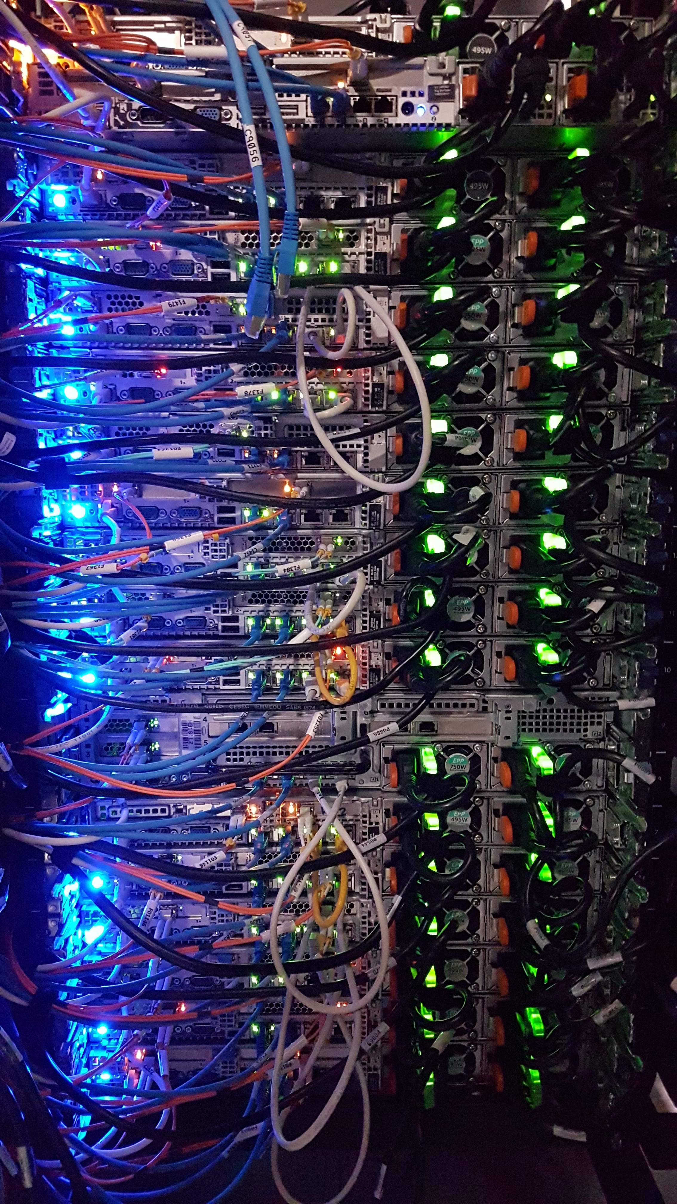
Data Center Network (DCN)
A network of computing and storage resources
  Proximity of components (within the data center) facilitates communication, i.e., high-performance
  Can lead to reduced cost and overheads
    Major cost upfront but less cost in long run.
Functions
  Data Storage and Management:
    Security, efficiency, reliability
  Application Hosting
    End-users and business applications, cloud computing and SaaS models
  Data Processing:
    Large volumes of data for analytics and processing, big data and AI workloads
  And more …

Slide 52
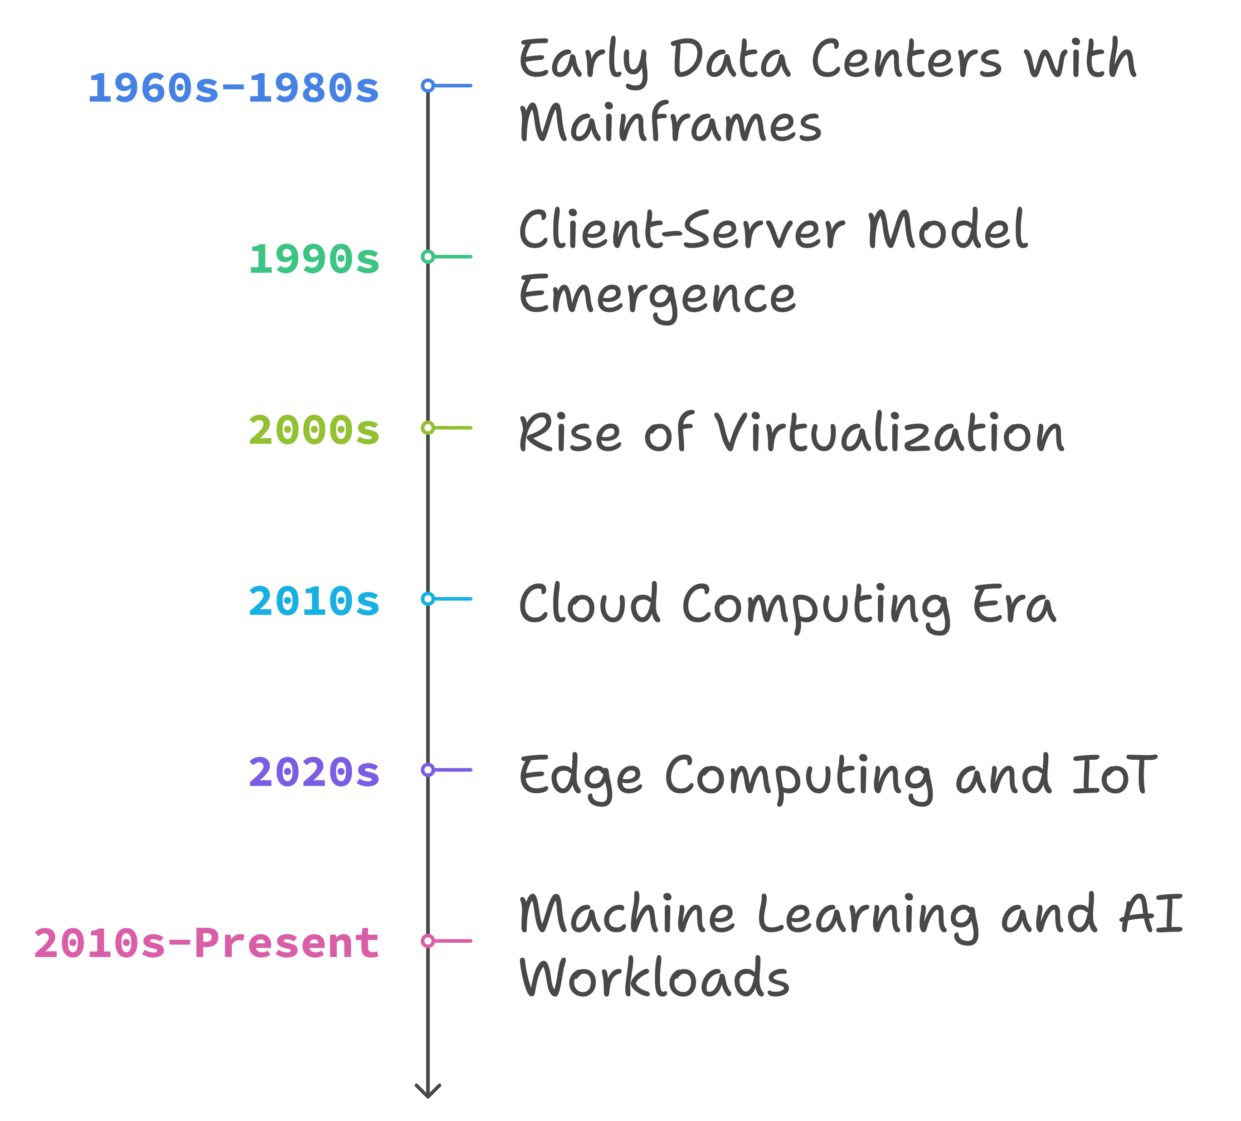
Evolution of DCN
Early Data Centers (1960s-1980s)
  Mainframes
  Centralized computing: limited networking
  Point-to-point and proprietary connections
Client-Server Model (1990s)
  Distributed computing
  Ethernet, TCP/IP
Rise of Virtualization (2000s)
  Virtual machines
  Efficiency and scalability
  VLANs, network segmentation
Cloud Computing Era (2010s)
  Cloud services
  SDN: Scalability and automation
Edge Computing and IoT (2020s)
  Demand for low-latency, distributed network architectures
  Micro data centers closer to data sources
Machine Learning and AI (2010s-Present)
  Exascale high-performance computing
  Network as the bottleneck: stringent performance requirements

Slide 53
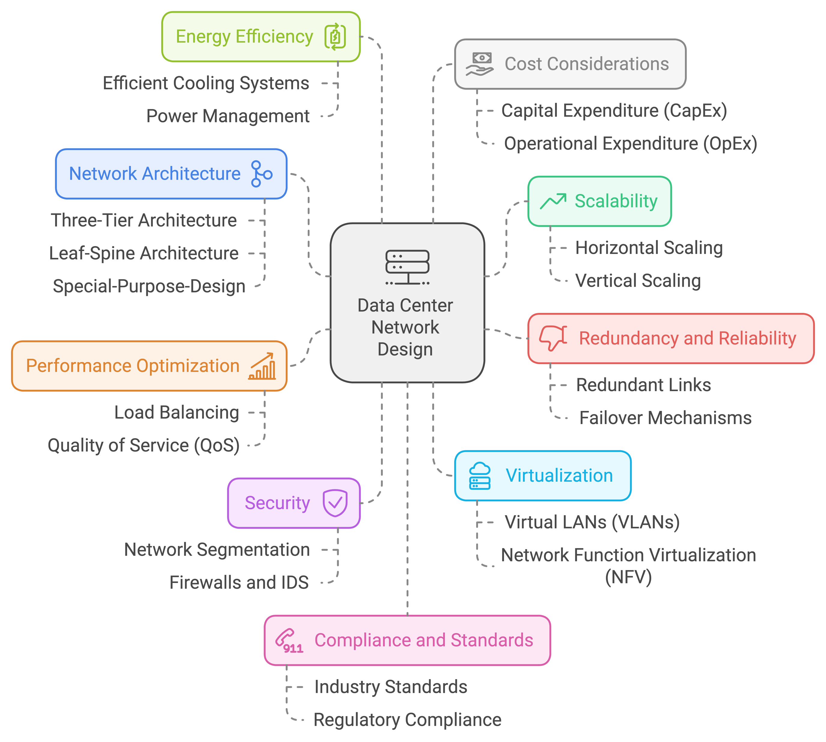
DCN Design Dimensions

Slide 54
Three-Tier Architecture
Hierarchical tree network topology
Commonly used in traditional DCNs
Three layers:
Core:
  Layer 3 (network layer)
  Fully connected high-speed mesh of multiple routers
  Connect to the external networks
Aggregation:
  Layer 3 and 2 (network and link layers)
  Connect to core with few high-speed links (e.g., 100 Gb/s links), to access with many low-speed links (e.g., 10Gb/s) → simplify cabling
  Middleboxes sit here (firewall, load balancer, …)
Access: layer 2 (link)
  Connect to each server in the rack (e.g., through one or two 10Gb/s links)
  VLANs used to limit broadcast
Modular design
Easy to expand

Slide 55
Traffic Direction in 3-Tier Architecture
Within a rack
Between racks
Between racks
To/from Internet
Switching and Routing:
Communication within a rack or within the same aggregation switch happens at link layer (switching).
Traffic going through core (between aggregation switches and to/from external networks/Internet) happens at network layer (routing).
Different flows might have different RTTs (even within DCN)
Total Link Capacities at Each Layer Might Be:
Equal to lower layers, or
Less (over-subscription)
Reason:
  Cost-saving: less bandwidth → lower cost
  Locality: most communication within the same rack, or within the same cluster.

Slide 56
Fat-Tree Architecture
Properties of Fat-Tree Architecture:
Scalable: easily expandable
Low latency, high throughput
Cost-effective
  Commodity hardware
  Lower operational costs
Reliability and Improved Performance:
Edge and aggregation switches are grouped into “pods”.
  Multiple-paths (choice of aggregation and core)
  Automatic failover
Leads to better load balance, redundancy, and thus
  Reliability and high availability, and
  Improved performance

Slide 57
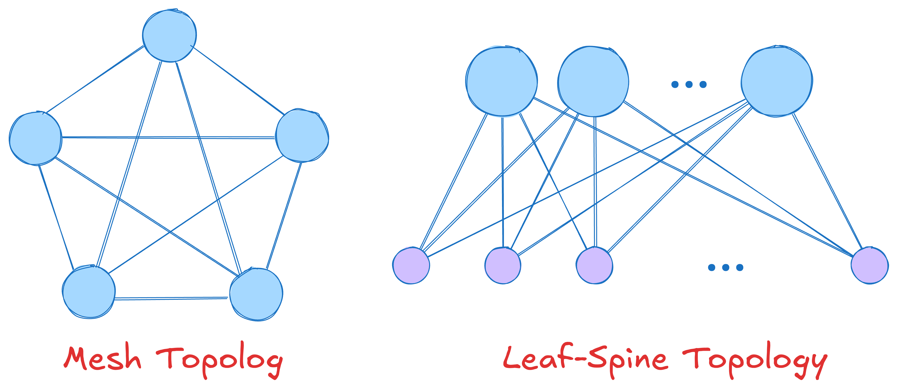
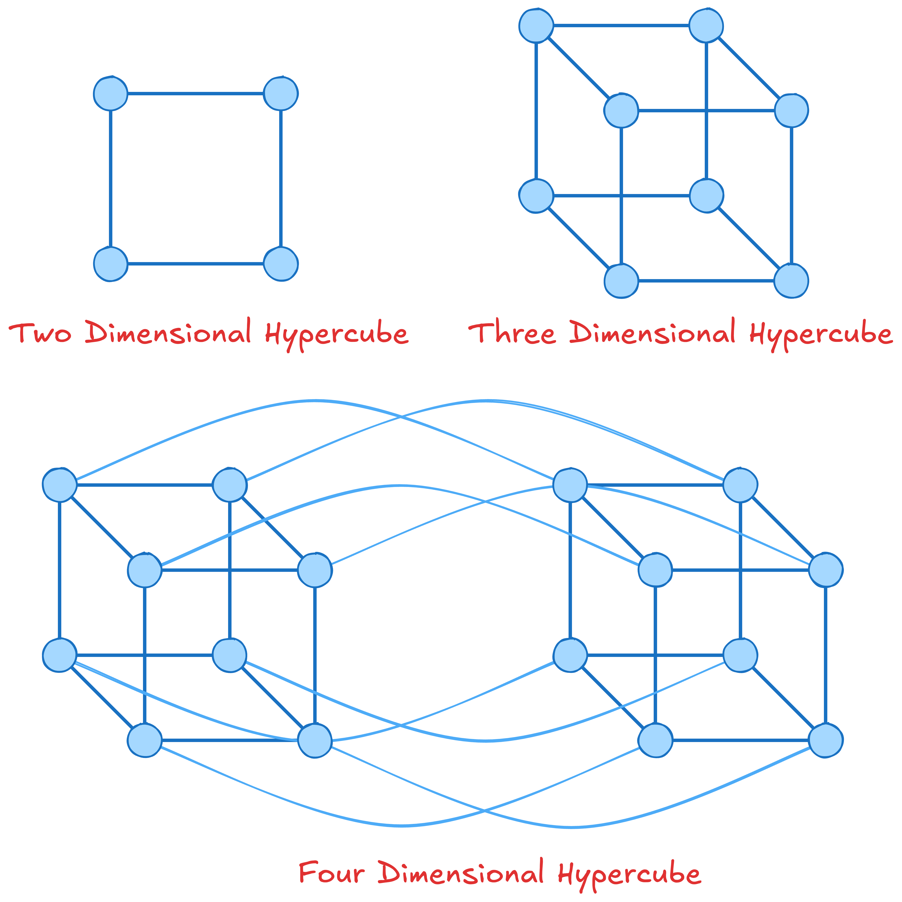
Other DCN Architectures/Topologies
Mesh: every node is connected to every other node
  Direct communication, costly, but high performance
Leaf-Spine topology: two-tier structure, servers and storage node connect directly to leaf switches
  Switched environment, VLANs to limit broadcasts
Hyper-cube: multi-dimensional cube structure
  Used in high-performance computing and ML solutions
Hybrid: combine two or more topologies
  Tailored to specific requirements of DCNs
And many more …
Question: what are the properties of each of these topologies?
  End-to-end latency?
  Simplicity?
  Scalability?
  …

Slide 58
Transport in Data Center Networks
Data center network properties:
  Extremely short RTTs
  Extremely high bandwidth links
  Extremely large transfer
  Single authority (typically)
Leads to new challenges and opportunities
  Can you think of any challenges for providing good transport solutions?
  How about opportunities?

Slide 59
ECN + DCTCP
Easier to ensure ECN is enabled on all devices in DCN
  Single authority
Use ECN marks as congestion signal → reduced packet loss
  Congestion measured based on fraction of packets marked with ECN (called ⍺).
  ⍺ is the moving average of the observed fractions (like estimatedRTT)
Adjust congestion window based on the extent of congestion: cwnd ⃪ cwnd x (1- ⍺/2)
  Instead of halving the window in case of congestion.
More responsive and less aggressive to network conditions compared to traditional TCP
Keeps queue lengths shorter (as reacts faster) → low latency

Slide 60
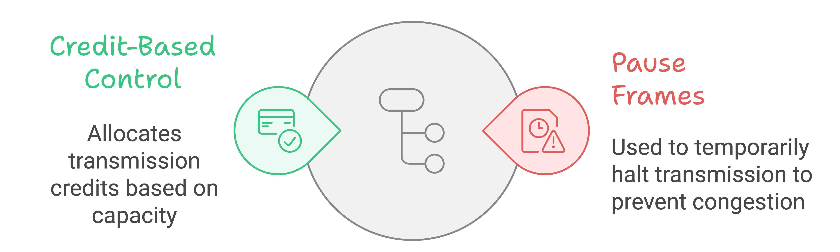
Link Layer Flow Control
Flow control mechanism used to create lossless networks.
  Not to be confused with flow control in transport layer which is end-to-end.
  Setup: two nodes (end-hosts or switches) connected via a link.
    Both have buffer (transmitter queue and receive buffer).
  Goal: ensure the receiver can handle the traffic injected on the link → no packet loss
Two prominent techniques:
  Credit-based
  Pause-based

Slide 61
Credit-Based Link-Level Flow Control
Receiver provides credits to the sender when it has room
  Credit unit: bytes or packets
Credit allocation:
  At the beginning certain (fixed) credit is allocated.
    Question: how much credit should be allocated initially?
  Transmitter uses credit when transmitting.
    Pauses if there is no more credit available.
  Receiver replenishes transmitter credits as receiver buffer becomes available.
Note: we also can have credit-based congestion control. This is not what we are covering here. The concepts are similar, but at different layers.

Slide 62
Pause-based Link-Level Flow Control
pause threshold
Transmitter does not need permission to start.
Receiver signals the transmitter when it is running out of buffer space.
  When buffer occupancy goes above a fixed pause-threshold.
  Pause-frame sent to transmitter
  Transmitter halts transmission
Once the receiver buffer has sufficient space …
  Receiver sends a resume frame to the transmitter
  The transmitter can resume sending.

Slide 63
Priority-based Flow Control (PFC)
Allows multiple priority-queues.
Pause individual queues not all traffic
  Allows other priority queues to continue transmitting even if a single queue is paused.
Improves impact of pause on non-congested traffic to some extent
Still, we might pause non-congested flows
  Why?
  Is there an easy way to solve this problem?
Known issues: head-of-line blocking (deadlock), PFC storm

Slide 64
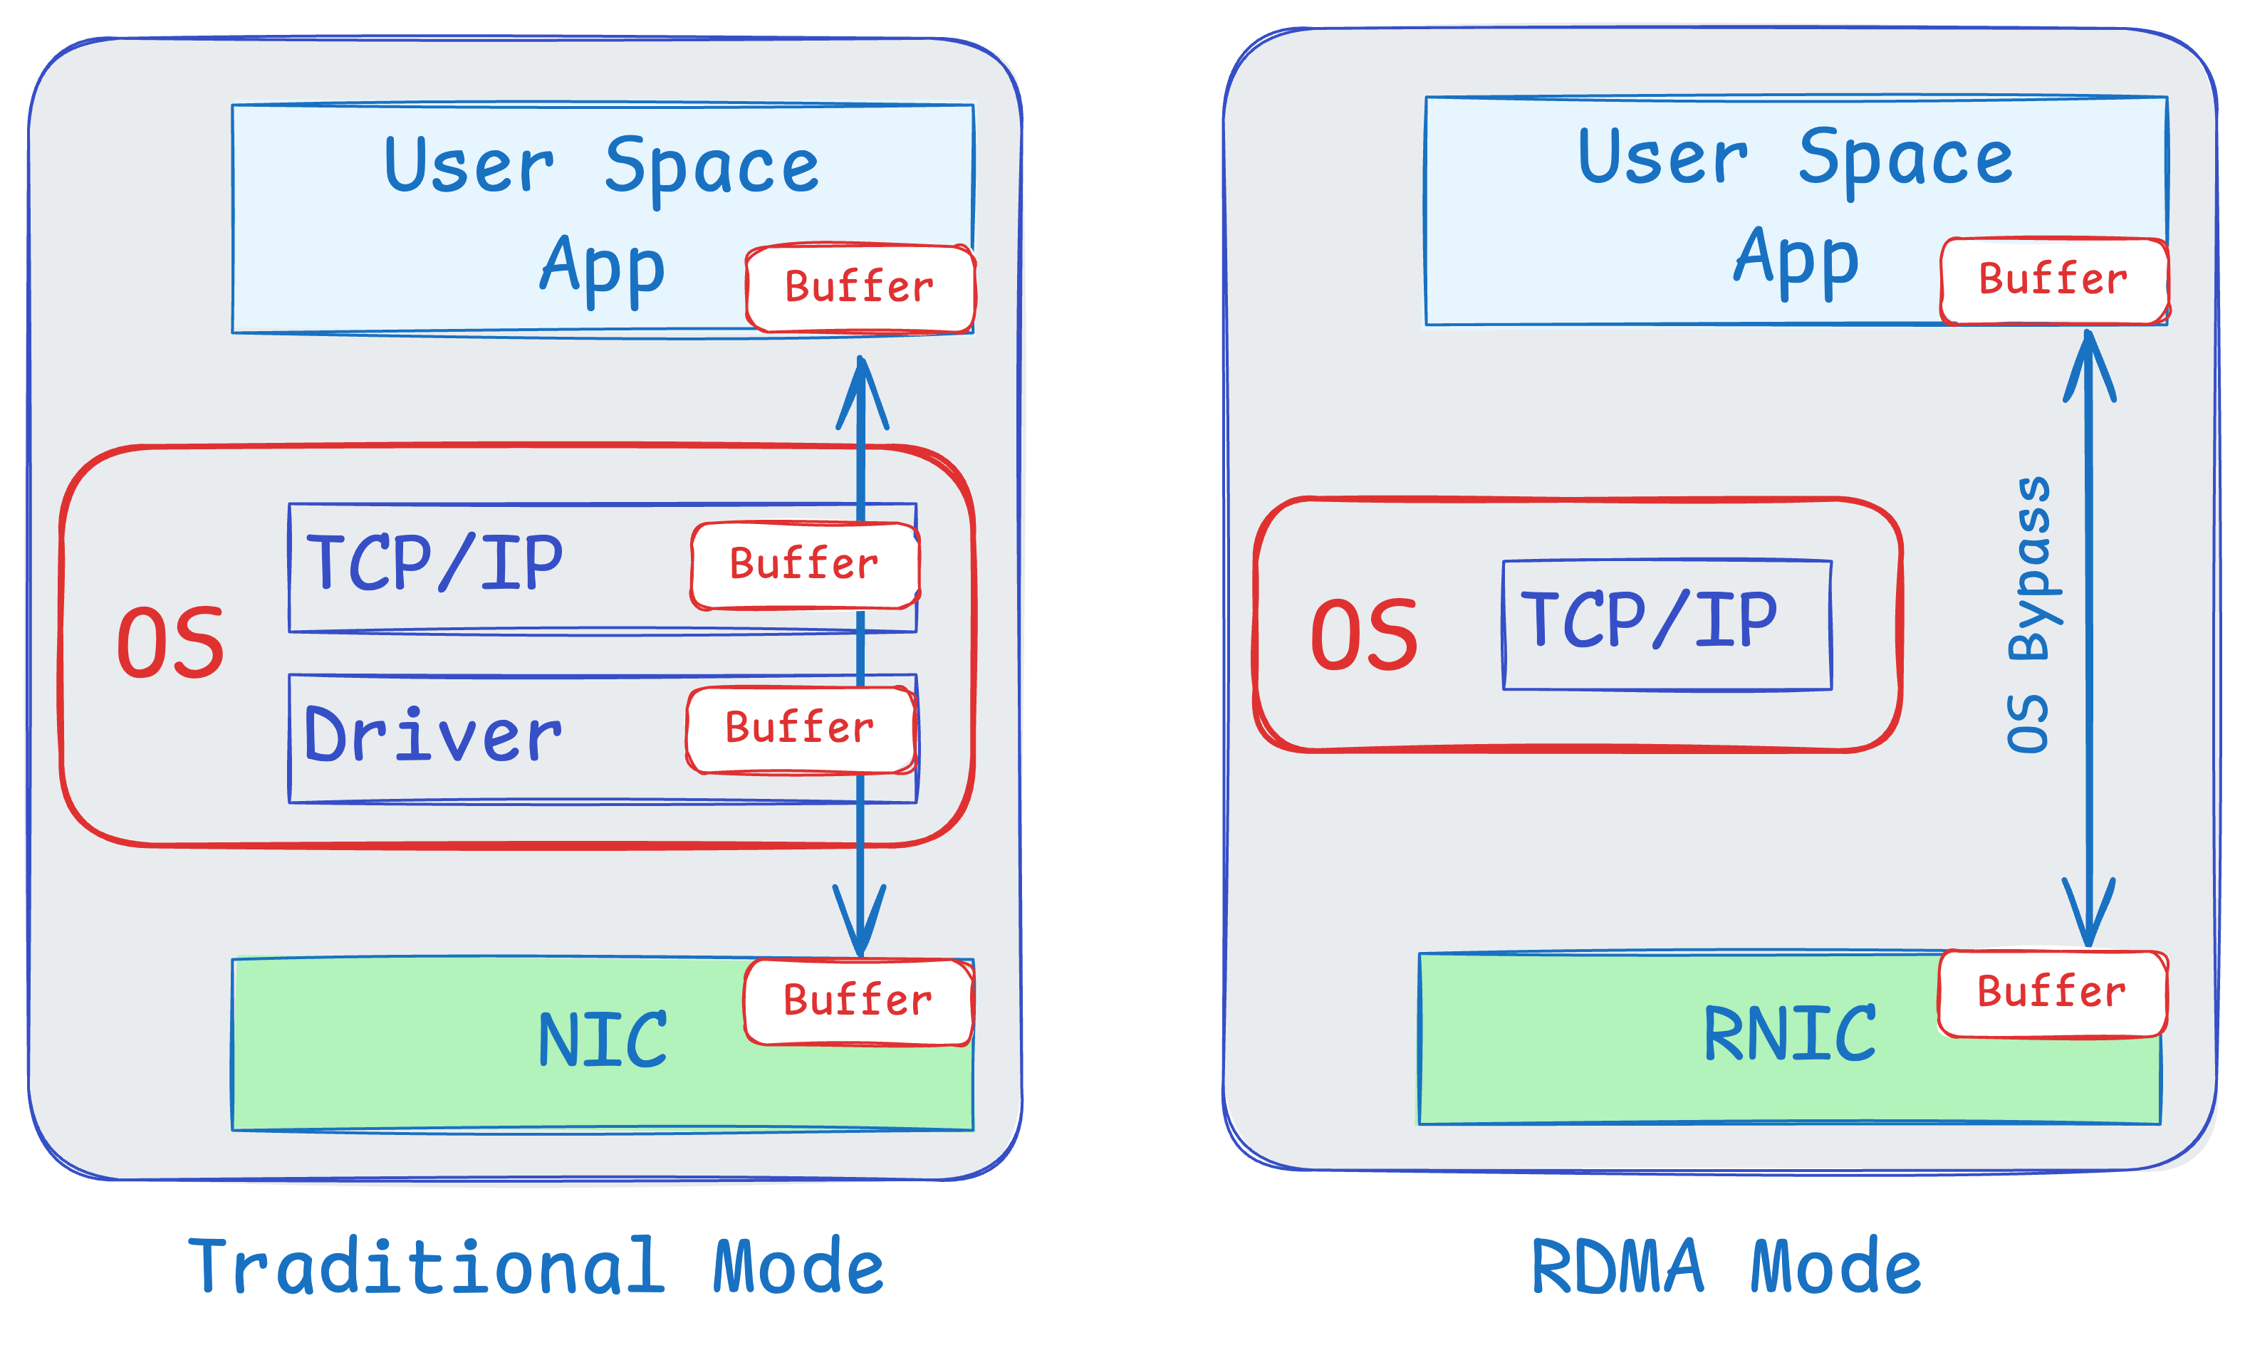
Remote Direct Memory Access
Directly write to remote server’s memory
  Both sides register memory regions to give RDMA direct access permission and mapping
  Need trust/cooperation between two ends
RDMA-capable NIC (RNIC) handles data transfer entirely in hardware
  No need to involve CPU for transfer
Queue Pairs (QPs): a send queue and a receive queue.
  Supports various operations like send, receive, read, and write.

Slide 65
Benefits of RDMA
Low Latency
  Minimizes delays by avoiding CPU intervention.
  Ideal for applications requiring real-time data processing.
High Throughput
  Enables faster data transfer rates.
  Suitable for high-performance computing and large data sets.
Reduced CPU Load
  Frees up CPU resources for other tasks.
  Improves overall system efficiency.
Zero-copy data transfer.
  Eliminate (or minimize data copies)
Applications: High-Performance Computing (HPC), Storage, …

Slide 66
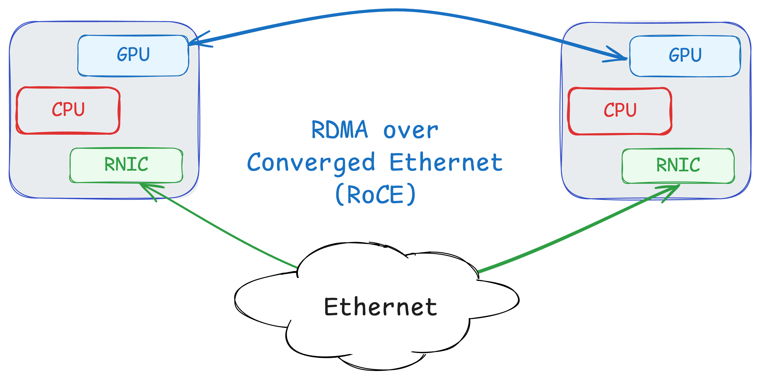
From Proprietary to Commodity
Original technology InfiniBand
  Touching physical layer, link layer, and transport layer in the stack.
  Small number of vendors
Later RDMA enabled over Ethernet
  RoCE: RDMA over Converged Ethernet
  With and without PFC support (RoCE v1 vs. v2)
And even in WAN
  iWARP (Internet Wide-Area RDMA Protocol)
  Implemented over TCP/IP, no need for lossless network
  Significant challenges here, especially over long distances

Slide 67
Introduction
Background
  What is a router?
  Basic router architecture
Basic packet processing in routers
  IP address lookup
  Packet buffering
  Switching
Data Center Networking
  Design Dimensions
  Topology
  Transport
Machine Learning and Computer Networks

Slide 68
Machine Learning and Computer Networks
Machine Learning (ML):
  Significant growth in the recent years
  Lots of attention and impact
How does it affect computer networking?
  Networks for ML: can traditional networks handle ML requirements?
    Our focus is on data center networks here.
  ML for Networks: how can ML be used to enhance computer networks?
    Networks in general.

Slide 69
Networks for Machine Learning
Data Center Networks have evolved significantly
  To accommodate demands for modern applications.
  Example: many novel congestion control algorithms in recent years:
    Swift, timely, HPCC, DCQCN, …
    Enablers: more accurate information from network (exact queue occupancy), assumptions about start rate (start at line rate), etc.
Machine learning applications have grown significantly as well.
  Used more in various domains, solving a wide range of problems.
  At the same time, ML applications have higher demands from the underlying network
Question: are existing DCN solutions enough?
  I.e., can they provide the high-performance connectivity needed for ML applications?

Slide 70
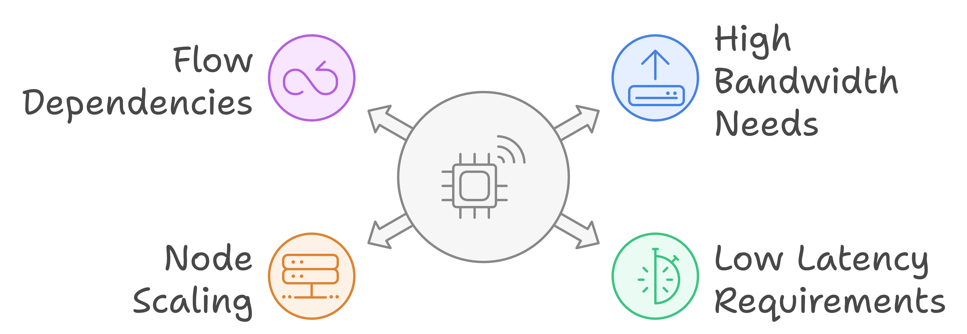
What Makes ML Different: Challenges
ML workloads can be extremely large:
  E.g., Training of Large-Language Models (LLMs)
  Need various forms of parallelism
    Data parallelism
    Model parallelism
    Hybrid
ML workloads have extremely high requirements from the underlying network:
  High bandwidth
  Low latency
  Low jitter (variations in delay)
Moore’s Law: the number of transistors on a microchip will double approximately every two years.
  For years, Moore’s law meant we could easily grow compute power according to growth in demand.
End of Moore’s Law: recently, we have hit a wall and cannot continue growing compute per node as predicted by the Moore’s Law.
  However, the demand keeps growing …
  For ML even faster than what Moore’s law could handle.
We need to add more nodes to scale to the demands of ML means.
All of this leads to significant pressure on the network (throughput, latency, reliability, …)

Slide 71
What Makes ML Different: Challenges
Handling many independent flows in a network makes many network problems easy (easier) to solve
  Random arrivals, each flow has a small share of bandwidth
  Why?
In ML, we have few flows
  Having few flows means each flow can have a large fraction of link bandwidth
    ⇒ Any interaction between flows can lead to significant performance degradation
In ML flows have direct/indirect dependencies
  Dependence between compute and communication
    ⇒ flows directly or indirectly depend on each other
    ⇒ Performance degradation in one flow can impact the performance of the entire job
Providing high-performance connectivity for ML workloads is extremely challenging.
  Due to scale, high-performance requirements (bandwidth, latency, …), larger flows, dependencies, …
Example: load balancing in ML
  Even two flows sharing a path can significantly reduce the overall performance.

Slide 72
What Makes ML Different: Opportunities
ML workloads are more more predictable
  Repeating patterns of communication
  Collective Communications: scatter, gather, all-reduce, …
Knowing communication patterns ⇒ opportunities for …
  Building specialized hardware
    E.g., topology that matches the flow requirements
      Today’s most successful ML networking solutions
  Build network solutions that adapt based on application requirements
    Application-aware scheduling
    Reconfigurable topology
    Adaptive routing, …
Even without prediction, access to “Collective Communication Libraries” can provide significant opportunities.
  Examples to come.

Slide 73
Final Comments
Largescale machine learning (training and inference) has led to significant pressure on computer networks.
Major challenges for computer networks
  Latency, throughput, loss, … requirements
Opportunities to enhance networks
  Take advantage of ML workload properties
  Ability to integrate with existing solutions
We will go through examples of these challenges and opportunities in the rest of this course.

