Slide 1
Communication Complexity of Learning
Matt Lawhon

Slide 2
On the Communication Complexity of Classification Problems
Paper by Daniel Kane, Roi Livni, Shay Moran, Amir Yehudayoff in 2018
They introduce a new communication model, motivated by:
Yao’s model
Distributed Learning
Interesting real would problems

Slide 3
Agenda
Motivating examples
Communication model
Related models/ideas
Fundamental realizability results

Slide 4
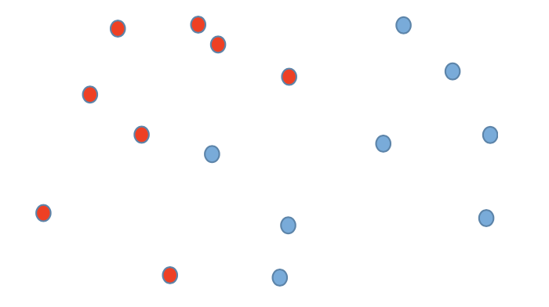
Convex Set Disjointness
Setup: Alice and Bob are each given n points in $ℝ^{d}$.
Problem: Do the convex hulls of their inputs intersect?
Problem with solving this in Yao’s model…
Transmitting bits doesn’t work because they have infinite domains.

Slide 5
Extension to Yao’s Model
Setup: Alice and Bob are each given n points in $ℝ^{d}$ and they want to decide if their sets’ convex hulls intersect.
Extend Yao’s model to allow Alice and Bob to send points in their input or bits as one unit of communication.
Note: What would happen here if they could send points not in their input?
Solve it in 2 bits using an $ℝ^{nd}→ℝ$ bijection.

Slide 6
Convex Set Disjointness Example
Consider $d=1.$ What is the communication complexity?
D
D
D
$CC=3$. Alice communicate 2 endpoints, Bob publishes the output

Slide 7
Convex Set Disjointness Example
Alice and Bob are each given n points in $ℝ^{d} \text{where} d≥2n−1≥$ 1
Solution
It is possible that the union of Alice and Bob’s points are affinely independent.
Which implies that $A∩B=∅ ⟺conv\left(A\right)∩conv\left(B\right)=∅$
$CC=Θ\left(n\right)$ because this is just set disjointness.
Remark
“In this way, Convex Set Disjointness can be seen as a geometric interpolation between Set Disjointness (when d ≥ n − 1), and Greater-Than (when d = 1)” – Shay Moran

Slide 8
Agenda
Motivating examples
Communication model
Related models/ideas
Fundamental realizability results

Slide 9
The Learning Communication Model
Let $X$ be the domain, and $Z=X ×\{−1,1\}$ be the examples domain.
Alice and Bob are given $S_{a}, S_{b}⊂Z$ and can communicate elements of their inputs or bits, for one unit of communication.
Typically learning something about a hypothesis $h:X→\{−1,1\}$ for a given hypothesis class $H$.

Slide 10
Problems we can study
Realizability Decision:
Given $S_{a}, S_{b}$ decide if there exists some $h∈H$ that is consistent with $S_{a}, S_{b}$
Eg. CSD: $S_{a}$ labelled 1, $S_{b}$ labelled 0, $H$ the hypothesis class of half-spaces
Search:
Given $S_{a}, S_{b}$ output a hypothesis that makes no-more (or perhaps $ε$ more) mistakes than the best $h∈H$
If we are confined to output some $h∈H$ as our hypothesis, then we are properly learning
If the best $h∈H$ is consistent with $S_{a}, S_{b}$ then we are learning in the realizable case, as opposed to the agnostic case

Slide 11
Agenda
Motivating examples
Communication model
Related models/ideas
Fundamental realizability results

Slide 12
Distributed Sample Compression Schemes?
A Sample Compression Scheme of size $k<n$ is defined by:
Compressor: $c:{\left(x × y\right)}^{n}→{\left(x × y\right)}^{k}$
Reconstructor: $r:{\left(x × y\right)}^{k}→H$, s.t. $∀\left(x, y\right), r\left(c\left(x,y\right)\right)=y$
This communication model can be viewed as yielding distributed sample compression schemes in the search problem setting.

Slide 13
Distributed Sample Compression Schemes
Introduced by Littlestone and Warmuth who showed that compression implies (PAC) learnability and asked whether learnability implies compression.
There is a strict difference in sample complexity. For half planes:
A trivial SCS of size $d+1$ using the data as support vectors.
A lower bound of $Ω(d\log{(n/d))}$ is known in the two party setting for randomized and/or improper learning (Braverman et al, 2019).
More generally, there are SCS of size only depending on VC-Dimension, but this is not the case for DSCS.

Slide 14
Learning Half-Spaces
Theorem 1. Let $H$ be the class of half-spaces in $ℝ^{d}, d≥2, ε≤3$. Any Protocol that learns $H$ in the realizable case has sample complexity $\tilde{Ω}\left(d−\log\left(ε\right)\right).$
Proof:
First we prove $\tilde{Ω}\left(d\right)$ samples are required.
We know that $ε$-approximate sample compression schemes for any fixed $ε$ (say 1/3), require $\tilde{Ω}\left(d\right)$ samples.
Next we prove $\tilde{Ω}\left(log⁡(1/ε\right))$ samples are required.
Not actually – this proof is 6 pages long.

Slide 15
Agenda
Motivating examples
Communication model
Related models/ideas
Fundamental realizability results

Slide 16
Some Definitions
We define analogous complexity classes of P, NP and coNP.
$H$ is in P if there is an efficient protocol (in terms of sample complexity) for the realizability problem.
$H$ is in NP if there is a poly-log proof that certifies realizability.
$H$ is in coNP if there is a poly-log proof that certifies non-realizability.
VC-Dimension(H)
The size of the largest $S⊂X$ s.t. $∀T⊂S$, $∃h∈H$ s.t. $\{s\left|s∈S∧h\left(s\right)=1\right\}=T$
CoVC-Dimension(H) (aka dual Helly number)
The smallest $k$ s.t. every non-realizable sample has a non-realizable subsample of size at most $k$
Also - separator between proper and improper learning of linear separators (SVMS) with optimal sample complexity (finite = proper) (Bousquet et al, 2020)

Slide 17
CoVC-Dimension
The smallest $k$ s.t. every non-realizable sample has a non-realizable subsample of size at most $k$
Examples:
$H= \{s⊂\left[n\right] :\left|s\right|=1\}, X=[n]$
VC-Dim(H) $= 1$, CoVC-Dim(H) $= n$. (The sample labeled $−1$ everywhere)
$H= \{\left[n\right]→\left\{−1,1\right\} : ∀i≥n/2, h\left(i\right)=1\}$
VC-Dim(H) = n/2, CoVC-Dim(H) = 1. (Every non realizable sample must contain an example $(i, 1)$with $i ≥ n/$2, which is not realizable)

Slide 18
VC-Dim for Half-Spaces
VC-Dimension of Half-Spaces:
$d+1$.
Radon’s Theorem – Any set of $d+2$ points in $ℝ^{d}$ can be partitioned into two sets who’s convex hulls intersect.
CoVC-Dimension of Half-Spaces:
$≤2d+2$
Carathéodory’s Theorem – If $x∈$ $ℝ^{d} lies in the convex hull of a set$ $P, then$ $x$ can be written as the convex combination of at most $d+1$ points in $P$.
Let $S$ be a non-realizable set and denote the positive and negatively labelled points $S_{+}, S_$. The convex hulls of$S_{+}$ and $S_{−}$intersect.
$x$ lies in the convex hull of some $d+1$ points in $S_{−}$ and of some $d+1$ points in $S_{+}$.
The union of these (of size $2d+2$) is non realizable.

Slide 19
Main Result
Theorem 5. The following statements are equivalent for a hypothesis class $H$
$H$ in in P
$H$ is in NP $∩$coNP
$H$ has finite VC-dimension and finite coVC-dimension
There exists a protocol for the realizability problem for $H$ with sample complexity $\tilde{O}\left(dk^{2}log⁡(\left|S\right|)\right)$ for $d=VC\text{−}dim(H)$ and$k=coVC\text{−}dim(H)$
We will prove this by showing $i⇒ii⇒iii⇒iv⇒i$ . Note that showing $iv⇒i⇒ii$is trivial.

Slide 20
$$ii⇒iii$$
$H$ in NP $∩$coNP $⇒H$ has finite VC dimension and coVC dimension
Theorem 6. For every class $H$ with VC dimension $d∈ℕ∪\left\{∞\right\},$
$$N_{H}^{np}\left(n\right)= \tilde{Ω}(\min\left(d, n\right))$$
Proof:
Lemma 4. Let $H$ be a hypothesis class and let $R⊆X$be a subset of size $n$ that is shattered by$H$. There exists two functions $F_{a},F_{b}$that map $n$ bit-strings to labelled examples from $R$ such that for every $x,y∈{\left\{0,1\right\}}^{n}$, $x∩y=∅$ iff the joint sample $S=⟨F_{a}(x);F_{b}(y)⟩$is realizable by $H{\left.​\right|}_{R}$.
Proof: Since $R$ is shattered by $H$, it follows that a sample $S$ with examples from $R$ is realizable by $H$ iff it contains no point with two opposite labels. Now, identify $[n]$with $R$. Set $F_{a}(x)=\{(i,1):x_{i}=1\}$and set $F_{b}$ in the opposite manner: namely, $F_{b}\left(y\right)=\{(i,−1): y_{i}=1\}.$
If $i∈x∩y$then having $\left(i, 1\right)∈F_{a}(x)$and $(i, −1)∈F_{b}(y)$implies that the joint sample $S$ is not realizable. On the other hand, since $R$ is shattered, we have that if $x∩y=∅$, then $S$ is realizable.

Slide 21
$$ii⇒iii$$
$H$ in NP $∩$coNP $⇒H$ has finite VC dimension and coVC dimension
Theorem 6. For every class $H$ with VC dimension $d∈ℕ∪\left\{∞\right\},$
$$N_{H}^{np}\left(n\right)= \tilde{Ω}(\min\left(d, n\right))$$
Proof:
Lemma 4. Let $H$ be a hypothesis class and let $R⊆X$be a subset of size $n$ that is shattered by$H$. There exists two functions $F_{a},F_{b}$that map $n$ bit-strings to labelled examples from $R$ such that for every $x,y∈{\left\{0,1\right\}}^{n}$, $x∩y=∅$ iff the joint sample $S=⟨F_{a}(x);F_{b}(y)⟩$is realizable by $H{\left.​\right|}_{R}$.
Let$R$be a shattered set of size$d$. Since all $x∈$R can be encoded by $O(log(d))$bits, it follows that every NP-proof of sample complexity$T$ for the realizability problem for $H{\left.​\right|}_{R}$implies an NP-proof for DISJ_{d} with bit-complexity $O(T log(d))$ in Yao’s model.

Slide 22
$$ii⇒iii$$
$H$ in NP $∩$coNP $⇒H$ has finite VC dimension and coVC dimension
Theorem 6. For every class $H$ with VC dimension $d∈ℕ∪\left\{∞\right\},$
$$N_{H}^{np}\left(n\right)= \tilde{Ω}(\min\left(d, n\right))$$
Theorem 7. For every class $H$ with coVC dimension $k∈ℕ∪\left\{∞\right\},$
$$N_{H}^{conp}\left(n\right)= \tilde{Θ}(\min\left(k, n\right))$$
Proof of upper bound (lower bound similar to 6):
assume that the coVC dimension is $k < ∞$. If $H$
If $S = ⟨S_{a};S_{b}⟩$is not realizable then it contains a non realizable sample $S$ of size at most coVC-dim$\left(H\right)=k$that serves as a proof that $S$ is not realizable. If $k=∞,$then the whole sample $S$ serves as a proof of size$n$that it is not realizable.

Slide 23
$$iii⇒iv$$
$H$ has finite VC and coVC dimension $⇒H$ has a protocol with bounded sample complexity.
For every class $H$ with VC-dim$\left(H\right)=d$and coVC-dim$\left(H\right)=k$ there exists a protocol for the realizability problem over $H$ with sample complexity $O(dk^{2}logk log|S|).$
Proof idea:
We give a protocol s.t. at iteration $t$ Alice and Bob agree on a hypothesis $h_{t}$ which is$an α$-weak hypothesis for $α=\frac{1}{2}−\frac{1}{5k}$ for Alice’s distribution $p_{t}^{a}$ on $S_{a}$ and Bob’s distribution $p_{t}^{b}$ on $S_{b}.$
This protocol will output “non-realizable” if at any iteration such a protocol doesn’t exist. If it never outputs this after $O(k\log\left|S\right|)$ rounds, it outputs “realizable.”

Slide 24
$$iii⇒iv$$
$H$ has finite VC and coVC dimension $⇒H$ has a protocol with bounded sample complexity.
How many samples are enough at iteration $t$ to achieve the desired $α$?
$ε$-net theorem. Let H be a class of VC dimension $d$ and let $S$ be a realizable sample. For every distribution $p$ over$S$there exists a subsample $S′$′ of$S$of size $O(dlog\left(1/ε\right)/ε)$ s.t.
$$∀h∈H :L_{s^{′}} (h)=0 ⇒L_{p}(h)≤ε.$$
Thus at each iteration a sample of size $O(dk\log\left(k\right))$ suffices.
Further, this also guarantees they can find such subsamples (and that if the sample is not realizable, the protocol will output that).

Slide 25
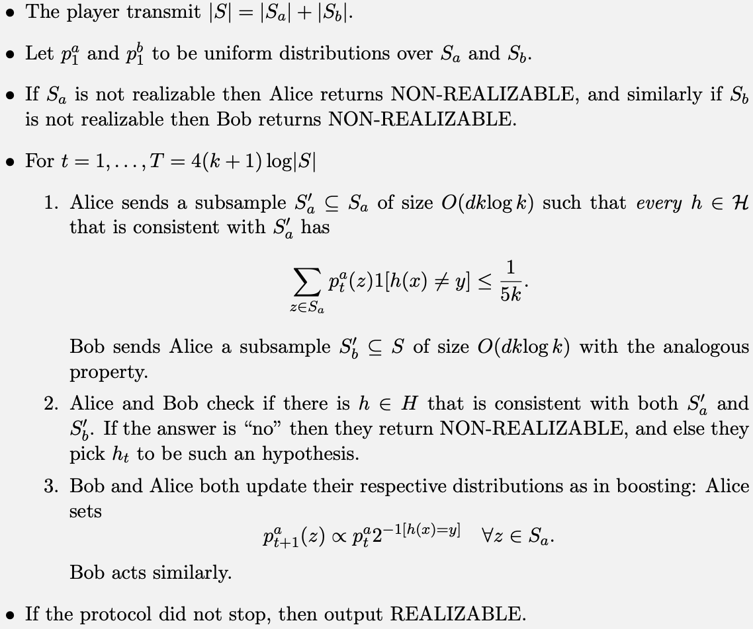

Slide 26
$$iii⇒iv$$
$H$ has finite VC and coVC dimension $⇒H$ has a protocol with bounded sample complexity.
Claim 6.1. Let$H$be a class with coVC dimension $k>0$. For any unrealizable sample $S$ and for any $h_{1},…,h_{T}∈H$, there is $(x,y)∈S$ so
$$\frac{1}{T}\sum_{t=1}^{T}{1[h_{t}\left(x\right)≠y]}≥\frac{1}{k}$$
Proof: Pick some unrealizable subsample $S^{′}of S s.t. \left|S^{′}\right|≤k$. Note that $L_{S^{′}}\left(h\right)≥1/k$

Slide 27
$$iii⇒iv$$
$H$ has finite VC and coVC dimension $⇒H$ has a protocol with bounded sample complexity.
Lemma 2. Set $η$ in Adaboost to be $ln2$. Let $T ≥ 2k log|S|$for k > 0, and have $h_{1}, . . . , h_{T}$denote the weak hypotheses returned by an arbitrary $α$-weak learner with $α=\frac{1}{2}−\frac{1}{5k}$ during the execution of Adaboost. Then, for every $z=(x, y)∈S:$
$$\frac{1}{T}\sum_{t=1}^{T}{1\left[h_{t}\left(x\right)≠y\right]≤\frac{1}{k}}$$

Slide 28
$$iii⇒iv$$
$H$ has finite VC and coVC dimension $⇒H$ has a protocol with bounded sample complexity.
NTS: If the protocol terminates then the sample is realizable.
If $T≥4\left(k+1\right)\log{|S|}$ (by lemma 2)
$$∀\left(x,y\right)∈\left\langle S_{a}, S_{b}\right\rangle :\sum_{t=1}^{T}{1\left[h_{t}\left(x\right)≠y\right]}<\frac{1}{2\left(k+1\right)}$$
Thus, by claim 6.1, the sample is realizable.
Thus we have shown $i⇒ii⇒iii⇒iv⇒i$

Slide 29
Main Result
Theorem 5. The following statements are equivalent for a hypothesis class $H$
$H$ in in P
$H$ is in NP $∩$coNP
$H$ has finite VC dimension and finite coVC dimension
There exists a protocol for the realizability problem for $H$ with sample complexity $\tilde{O}\left(dk^{2}log⁡(\left|S\right|)\right)$ for $d=VC dim(H)$ and$k=coVC dim\left(H\right)$
The sample complexity of the realizability problem$over H$ is either $O(\log{n) or \tilde{Ω}(n)}$.
Convex set disjointness can be decided by $\tilde{O}\left(d^{3}log⁡n)\right)$ points.

Slide 30
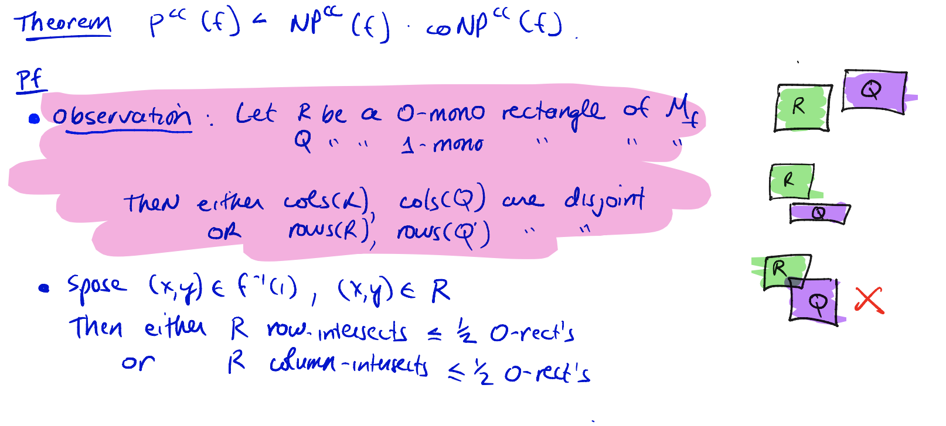
$P=NP∩coNP$ for Realizability Problems
This is analogous to the classic result in standard communication complexity (we went over the algorithmic proof of this)

Slide 31
$P=NP∩coNP$ for Realizability Problems
This result comes about in an entirely different way in coming via a boosting protocol parameterized by VC-Dimension and coVC-Dimension.
Another interesting note:
The standard communication complexity measure is symmetric in the complexities of the non-deterministic protocols $O(N_{0}⋅N_{1})$
The result for realizability problems is not symmetric – the authors speculate this may be because while decision problems are closed under negation, realizability problems are not.

