Slide 1
Attribute-Based Encryption for Circuits
Sergey Gorbunov -- {U of Toronto}
Vinod Vaikuntanathan -- {U of Toronto}
Hoeteck Wee -- {George Washington U}

Slide 2



Public Key Encryption
[Diffie-Hellman 76, Rivest Shamir Adleman 77]
Alice
Bob
$$CT={EncPK(m)}^{}$$
PK
SK
All or nothing access to the data

Slide 3


Public Key Encryption
[Diffie-Hellman 76, Rivest Shamir Adleman 77]
Charlie
SK
Alice
Bob
$$CT1={EncPK(m1)}^{}$$
$$CTq=EncPK(m_{q})$$
SK
John
PK
SK
Modern world
Lots of data!
Lots of users!
SK
Challenge: control who can read which messages

Slide 4

Trivial Solution (establish many key pairs): completely impractical!!
Public Key Encryption
[Diffie-Hellman 76, Rivest Shamir Adleman 77]
Charlie
SK
Alice
Bob
$$CT1={EncPK(m1)}^{}$$
$$CT2=EncPK(m_{2})$$
SK
John
PK
SK
Scenario:
m₁ should be read only by Bob and Charlie
m₂ should be read only by Bob and John
SK

Slide 5




Attribute-Based Encryption
[Sahai-Waters 05]
Public Attribute vector
Alice
Bob
$$CTx={EncPK(x,m)}^{}$$
PK
SK_{P}
Policy
$m$ if P($x$) = 1
User holding SK_{P} & $CTx$ learns
$⊥$ otherwise

Slide 6

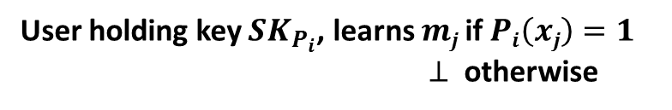




Attribute-Based Encryption
[Sahai-Waters 05]
Charlie
$${SK}_{P_{2}}$$
Alice
Bob
$${CT}_{x_{1}}={EncPK(x1,m1)}^{}$$
${CT}_{x_{q}}= {Enc}_{PK}(x_{q},m_{q})$
SK
John
PK
$${SK}_{P_{1}}$$
$${SK}_{P_{3}}$$
User holding key ${SK}_{P_{i}}$, learns $mj$ if $Pi\left(xj\right)=1$
$⊥$ otherwise

Slide 7

Can we construct Attribute-based Encryption
for all policies (represented by circuits)?
Our Result [G., Vaikuntanathan and Wee] (informal):
There exists an Attribute-based Encryption scheme for
all polynomial-size circuits
-- Assuming hardness of Learning With Errors (LWE) problem

Slide 8
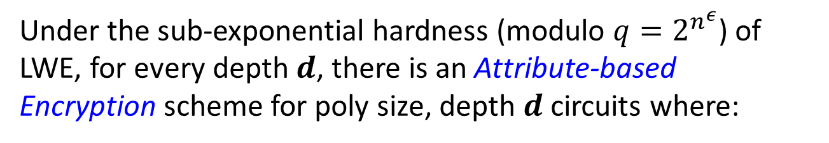
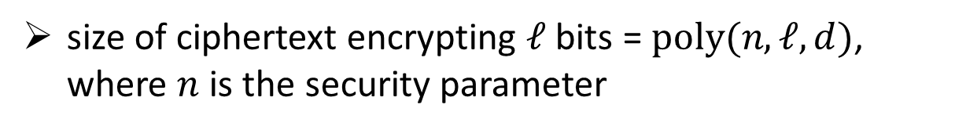
Can we construct Attribute-based Encryption
for all policies (represented by circuits)?
Our Result [G., Vaikuntanathan and Wee] (semi-formal):
Under the sub-exponential hardness (modulo ${q=2}^{n^{ε}}$) of LWE, for every depth $d$, there is an Attribute-based Encryption scheme for poly size, depth $d$ circuits where:
size of ciphertext encrypting $ℓ$ bits = $poly(n,ℓ,d)$, where $n$ is the security parameter

Slide 9
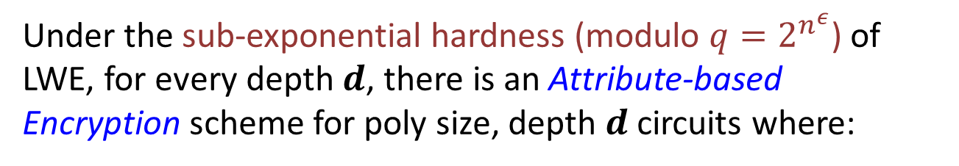

Can we construct Attribute-based Encryption
for all policies (represented by circuits)?
Best algorithm:
$\sim 2^{n^{(1−ε)}}$ time
Our Result [G., Vaikuntanathan and Wee] (semi-formal):
Under the sub-exponential hardness (modulo ${q=2}^{n^{ε}}$) of LWE, for every depth $d$, there is an Attribute-based Encryption scheme for poly size, depth $d$ circuits where:
size of ciphertext encrypting $ℓ$ bits = $poly(n,ℓ,d)$, where $n$ is the security parameter

Slide 10



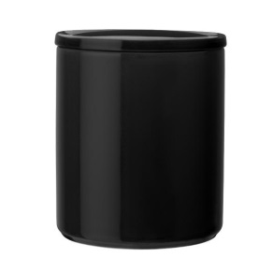
Physical Filters
Penny Coin Filter
Pennies
Other change

Slide 11

Physical Filters
Penny Coin Filter
Bob sees the pennies only…
Pennies
Other change

Slide 12


Computational Filters
(101, m₁)
(000, m₂)
(001, m₃)
OR
AND
Sat Messages
Unsat Messages
m₁

Slide 13
Computational Filters
Enc(101,m₁)
Enc(000, m₂)
Enc(001, m₃)
Bob sees Sat messages only…
OR
AND
Sat Messages
Unsat Messages
m₁
m₁

Slide 14
Analogy: Computational Filters
Decryption algorithms outputs m if and only if P(x) = 1
Circuit for policy P
Attribute Vector x=101
Computational Filter for P
Ciphertext₁₀₁ = Enc_{PK}(101,m)
x₁=1
x₂=0
x₃=1
OR
OR
SK_{P} =
AND
AND
P(101)=1
m

Slide 15
Analogy: Computational Filters
SK_{P} is a computational filter for the policy P! Constructing ABE = reusable computational filters!
Reusable computational filters:
Enc(101,m₁)
OR
SK_{P} =
AND
m₁

Slide 16
Analogy: Computational Filters
SK_{P} is a computational filter for the policy P! Constructing ABE = reusable computational filters!
Reusable computational filters:
Enc(011,m₂)
Enc(101,m₁)
OR
SK_{P} =
AND
m₁,m₂

Slide 17
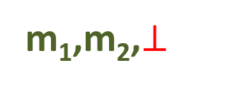
Analogy: Computational Filters
SK_{P} is a computational filter for the policy P! Constructing ABE = reusable computational filters!
Reusable computational filters:
Enc(011,m₂)
Enc(101,m₁)
Enc(001,m₃)
OR
SK_{P} =
AND
m₁,m₂,$⊥$

Slide 18
Constructing One Time Computational Filters
[Yao 86]
Building Blocks
AND filter
OR filter
(indexed by hidden strings
L₁,L₂ and L₃)
(indexed by hidden strings
L₁,L₂ and L₃)
AND-filter
OR-filter
L₁ L₂
L₃
L₁ L₂
L₃
On input L₁ AND L₂, output L₃
On input L₁ OR L₂, output L₃
One time filter for a policy P is a collection of filters for each gate

Slide 19




Constructing One Time Computational Filters
[Yao 86]
Building Blocks
OWF
AND filter
OR filter
$${Enc}_{L_{1}}({Enc}_{L_{2}}(L_{3}))$$
$${Enc}_{L_{1}}\left(L_{3}\right)$$
$${Enc}_{L_{2}}(L_{3})$$
On input $L_{1}$ AND $L_{2}$,
$Decrypt$and output $L_{3}$
On input $L_{1}$ OR $L_{2}$,
$Decrypt$and output $L_{3}$

Slide 20

Constructing One Time Computational Filters
[Yao 86]
One-time ABE
Enc(101,m) = L₁, L₃, L_{out} $⨁$ m
SK_{P} = OR-filter & AND-filter
L₁
L₂
L₃
OR-filter
L₁ L₂
L₄
AND-filter
L₄ L₃
L_{out}

Slide 21

Constructing One Time Computational Filters
[Yao 86]
One-time ABE
Enc(101,m) = L₁, L₃, L_{out} $⨁$ m
SK_{P} = OR-filter & AND-filter
L₁
L₂
L₃
OR-filter
L₁ L₂
L₄
L₄
AND-filter
L₄ L₃
L_{out}

Slide 22

Constructing One Time Computational Filters
[Yao 86]
One-time ABE
Why one time?
Enc(101,m) = L₁, L₃, L_{out} $⨁$ m
Given SK_{P}, Enc(101, m₁), Enc(010, m₂):
the user should not learn m₂,
but he does!!
(the labels/strings are correlated)
SK_{P} = OR-filter & AND-filter
L₁
L₂
L₃
OR-filter
L₁ L₂
L₄
Challenge
L₄
Come up with reusable computational filters where
decrypting Enc(101, m₁) does not help to decrypt Enc(010, m₂)
AND-filter
L₄ L₃
L_{out}
L_{out}

Slide 23
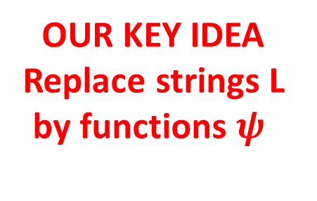
Constructing Reusable Computational Filters
One time
computational filters
OUR KEY IDEA
Replace strings L
by functions $ψ$
Reusable
computational filters
[This Work]
Yao 1986
Gorbunov
Vaikuntanathan
Wee 2013
strings: single-use
functions: many-use

Slide 24
Constructing Reusable Computational Filters
[This Work]
AND filter
(indexed by hidden strings
L₁,L₂ and L₃)
L₁ L₂
AND-filter
L₁ L₂
L₃
On input L₁ AND L₂, output L₃

Slide 25
Constructing Reusable Computational Filters
[This Work]
Reusable AND filter
(indexed by hidden strings
L₁,L₂ and L₃)
L₁ L₂
AND-filter
L₁ L₂
L₃
On input L₁ AND L₂, output L₃

Slide 26

Constructing Reusable Computational Filters
[This Work]
Reusable AND filter
(indexed by public functions $ψ1, ψ2, ψ3$)
L₁ L₂
AND-filter
L₁ L₂
L₃
On input L₁ AND L₂, output L₃

Slide 27
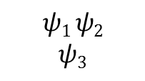
Constructing Reusable Computational Filters
[This Work]
Reusable AND filter
(indexed by public functions $ψ1, ψ2, ψ3$)
L₁ L₂
R-AND-filter
$$ψ1 ψ2$$
$$ψ3$$
On input L₁ AND L₂, output L₃

Slide 28


Constructing Reusable Computational Filters
[This Work]
Reusable AND filter
(indexed by public functions $ψ1, ψ2, ψ3$)
$$ψ1(s)$$
$$ψ2(s)$$
R-AND-filter
$$ψ1 ψ2$$
$$ψ3$$
On input L₁ AND L₂, output L₃

Slide 29

Constructing Reusable Computational Filters
[This Work]
Reusable AND filter
(indexed by public functions $ψ1, ψ2, ψ3$)
$$ψ1(s)$$
$$ψ2(s)$$
R-AND-filter
$$ψ1 ψ2$$
$$ψ3$$
On input $ψ1(s)$ AND $ψ2(s)$,
output $ψ3(s)$

Slide 30





Constructing Reusable Computational Filters
[This Work]
Reusable AND filter
(indexed by public functions $ψ1, ψ2, ψ3$)
$$ψ1(s′)$$
$$ψ2(s′)$$
$$ψ1(s)$$
$$ψ2(s)$$
R-AND-filter
$$ψ1 ψ2$$
$$ψ3$$
On input $ψ1(s′)$ AND $ψ2(s′)$,
output $ψ3(s′)$

Slide 31

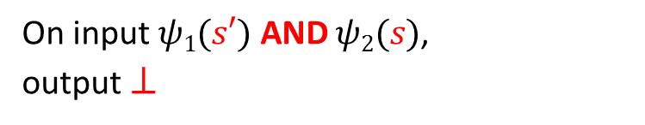
Constructing Reusable Computational Filters
[This Work]
Reusable AND filter
(indexed by public functions $ψ1, ψ2, ψ3$)
$$ψ1(s′)$$
$$ψ2(s′)$$
$$ψ1(s)$$
$$ψ2(s)$$
R-AND-filter
$$ψ1 ψ2$$
$$ψ3$$
On input $ψ1(s′)$ AND $ψ2(s)$,
output $⊥$

Slide 32

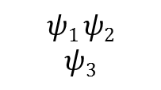



Constructing Reusable Computational Filters
[This Work]
Reusable AND filter
Reusable OR filter
(indexed by public functions $ψ1, ψ2, ψ3$)
(indexed by public functions$ψ1, ψ2, ψ3$)
$$ψ1(s′)$$
$$ψ2(s′)$$
$$ψ1(s)$$
$$ψ2(s)$$
$$ψ1(s)$$
$$ψ2(s)$$
R-AND-filter
R-OR-filter
$$ψ1 ψ2$$
$$ψ3$$
$$ψ1 ψ2$$
$$ψ3$$
On input $ψ1(s′)$ AND $ψ2(s)$,
output $⊥$
On input $ψ1(s)$ OR $ψ2(s)$,
output $ψ3(s)$

Slide 33





Constructing Reusable Computational Filters
[This Work]
Reusable AND filter
Reusable OR filter
(indexed by public functions $ψ1, ψ2, ψ3$)
(indexed by public functions$ψ1, ψ2, ψ3$)
$$ψ1(s′)$$
$$ψ2(s′)$$
$$ψ1(s′)$$
$$ψ2(s′)$$
$$ψ1(s)$$
$$ψ2(s)$$
$$ψ1(s)$$
$$ψ2(s)$$
R-AND-filter
R-OR-filter
$$ψ1 ψ2$$
$$ψ3$$
$$ψ1 ψ2$$
$$ψ3$$
On input $ψ1(s′)$ AND $ψ2(s)$,
output $⊥$
On input $ψ1(s′)$ OR $ψ2(s′)$,
output $ψ3(s′)$

Slide 34



Constructing Reusable Computational Filters
[This Work]
Reusable AND filter
Reusable OR filter
(indexed by public functions $ψ1, ψ2, ψ3$)
(indexed by public functions$ψ1, ψ2, ψ3$)
$$ψ1(s′)$$
$$ψ2(s′)$$
$$ψ1(s′)$$
$$ψ2(s′)$$
$$ψ1(s)$$
$$ψ2(s)$$
$$ψ1(s)$$
$$ψ2(s)$$
R-AND-filter
R-OR-filter
$$ψ1 ψ2$$
$$ψ3$$
$$ψ1 ψ2$$
$$ψ3$$
On input $ψ1(s′)$ AND $ψ2(s)$,
output $⊥$
On input $ψ1(s)$ OR $ψ2(s′)$,
output $ψ3(s)$, $ψ3(s′)$
Reusable filter for a policy P is a collection of reusable filters for each gate

Slide 35
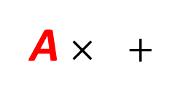
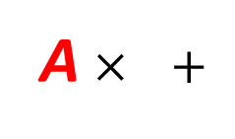
Constructing Reusable Computational Filters
Given a matrix A,
a₁₁
a₂₁
…
a_{m1}
…
a_{1n}
a_{2n}
…
a_{mn}
s₁
s₂
…
s_{n}
s₁
s₂
…
s_{n}
Easy!
Find
…
A
s
[Gauss 1810]
LWE assumption: Add “low-weight” noise vector e, then given A,
Hard!
A $× +$
s
s
e
Find
[Regev 05]
(Generalization of Learning Parity with Noise [BFKL93])
Turn LWE into a trapdoor function:
Easy!
trapdoor T_{A} &
A $× +$
s
s
e
Find
[Ajtai 99]

Slide 36




Constructing Reusable Computational Filters
Function $ψA\left(s\right)=A^{T}s+e$, where $A∈_{R}{\text{ℤ}}_{q}^{n×m} s∈_{R}{\text{ℤ}}_{q}^{n} e∈_{R}{Gaussian}^{m}$
Reusable AND filter
$$ψ_{A_{1}}\left(s\right)=A1Ts+e1$$
$$ψ_{A_{2}}\left(s\right)=A2Ts+e2$$
R-AND-filter
$ψ_{A_{1}}$ $ψ_{A_{2}} ψ_{A_{3}}$
On input $ψ_{A_{1}}\left(s\right)$ AND $ψ_{A_{2}}\left(s\right)$, output $ψ_{A_{3}}\left(s\right)$
Attempt 1: Publish a trapdoor for $A_{1}$: recover $s$, compute $A3Ts+e3$

Slide 37


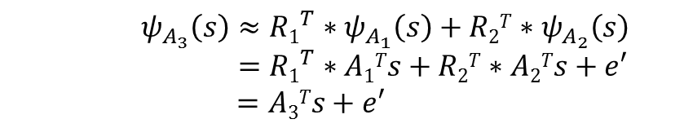
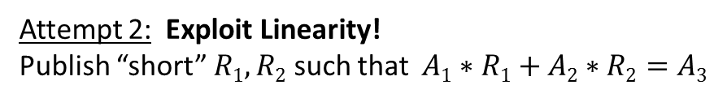
Constructing Reusable Computational Filters
Function $ψA\left(s\right)=A^{T}s+e$, where $A∈_{R}{\text{ℤ}}_{q}^{n×m} s∈_{R}{\text{ℤ}}_{q}^{n} e∈_{R}{Gaussian}^{m}$
Reusable AND filter
$$ψ_{A_{1}}\left(s\right)=A1Ts+e1$$
$$ψ_{A_{2}}\left(s\right)=A2Ts+e2$$
R-AND-filter
$ψ_{A_{1}}$ $ψ_{A_{2}} ψ_{A_{3}}$
$$R1 R2$$
On input $ψ_{A_{1}}\left(s\right)$ AND $ψ_{A_{2}}\left(s\right)$, output $ψ_{A_{3}}\left(s\right)$
Attempt 2: Exploit Linearity!
Publish “short” $R1,R2$ such that $A1∗R1+A2∗R2=A3$
[GPV08, CHKP10]
[ABB10]
${ ψ}_{A_{3}}\left(s\right)≈{R1}^{T}∗ψ_{A_{1}}\left(s\right)+R2T∗ψ_{A_{2}}\left(s\right)$
      $={R1}^{T}∗A1Ts+R2T∗A2Ts+e′$
      $=A3Ts+e′$
Correctness:
Error grows

Slide 38

Constructing Reusable Computational Filters
Function $ψA\left(s\right)=A^{T}s+e$, where $A∈_{R}{\text{ℤ}}_{q}^{n×m} s∈_{R}{\text{ℤ}}_{q}^{n} e∈_{R}{Gaussian}^{m}$
Reusable AND filter
$$ψ_{A_{1}}\left(s\right)=A1Ts+e1$$
$$ψ_{A_{2}}\left(s\right)=A2Ts+e2$$
R-AND-filter
$ψ_{A_{1}}$ $ψ_{A_{2}} ψ_{A_{3}}$
$$R1 R2$$
On input $ψ_{A_{1}}\left(s\right)$ AND $ψ_{A_{2}}\left(s\right)$, output $ψ_{A_{3}}\left(s\right)$
Attempt 2: Exploit Linearity!
Publish “short” $R1,R2$ such that $A1∗R1+A2∗R2=A3$
[GPV08, CHKP10]
[ABB10]
see paper…
Security:
Non-monotone circuits: define reusable NAND filter similarly

Slide 39



1980
1990
Now!
2000
[Yao 86]
[This Work]
LWE function
$$ψA\left(s\right)=A^{T}s+e$$
One time
comp. filters
Reusable
computational filters
Applications
Input Secrecy,
Functional Enc,
Obfuscation…
strings L:
single-use
functions $ψ$:
many-use
$$≈$$
ABE for all circuits

